Slide 1
Keeping compliant during covid-19 May 19, 2020
Scott Gima, RN, MHA, Exec VP & COO
Margaret Scavotto, JD, CHC, President

Slide 2
poll
Where are you working today?
At home
At a health care provider
At a corporate office

Slide 3
poll
Has COVID-19 affected your compliance program?
No – compliance is still progressing as usual
Yes – compliance is completely on hold
Yes – compliance is still progressing but on a slower/delayed timeline
Yes – I have more time to work on compliance now

Slide 4
Adjust expectations

Slide 5
Focus on covid risks

Slide 6
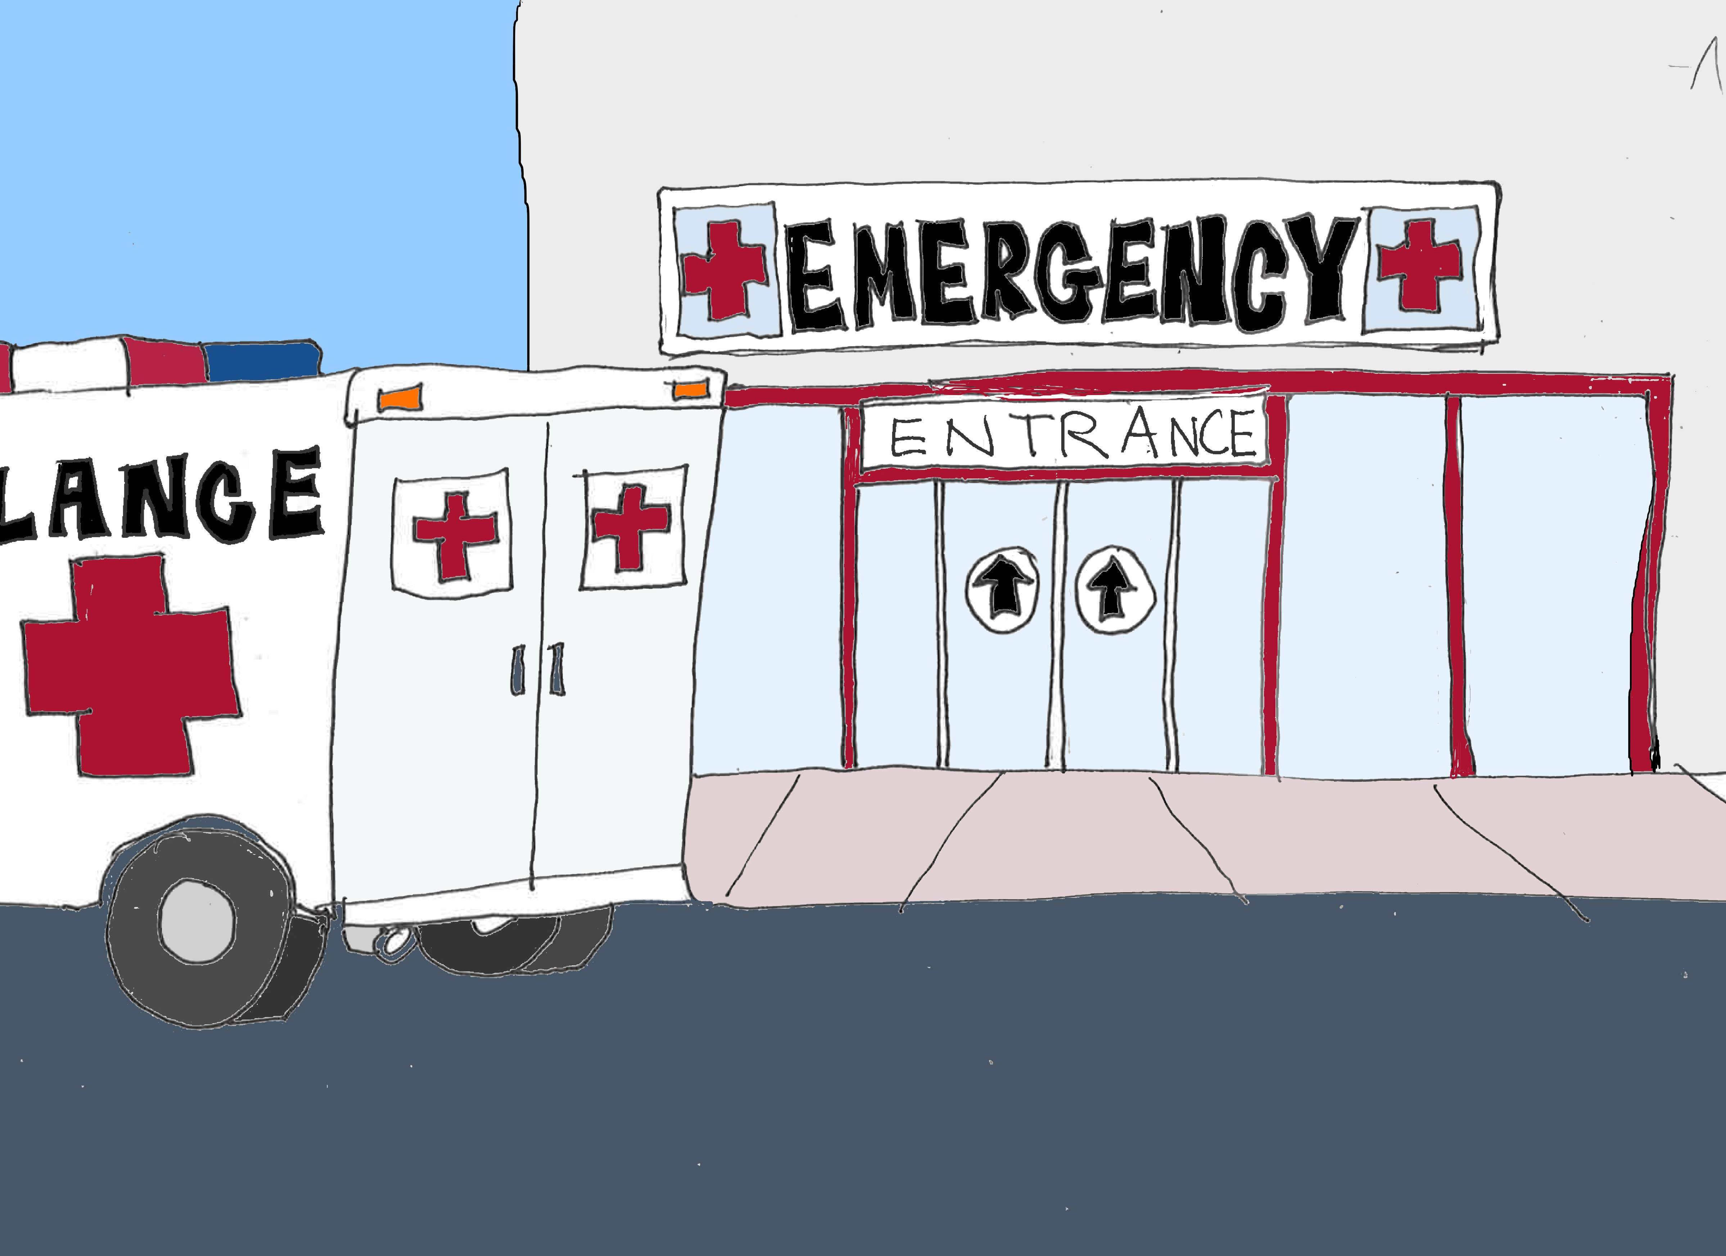
Hospitals: emtala
CMS issued a 1135 waiver https://www.phe.gov/emergency/news/healthactions/section1135/Pages/covid19-13March20.aspx
CMS state survey memo: EMTALA Requirements and Implications Related to COVID-19, March 9 (revised March 30) https://www.cms.gov/files/document/qso-20-15-hospital-cah-emtala-revised.pdf
CMS FAQ for Hospitals and CAHs regarding EMTALA, April 30 https://www.cms.gov/files/document/frequently-asked-questions-and-answers-emtala-part-ii.pdf
Compliance should master this guidance and train anyone who could encounter emergency or testing patients, or receive inquiries from the public or the media.

Slide 7
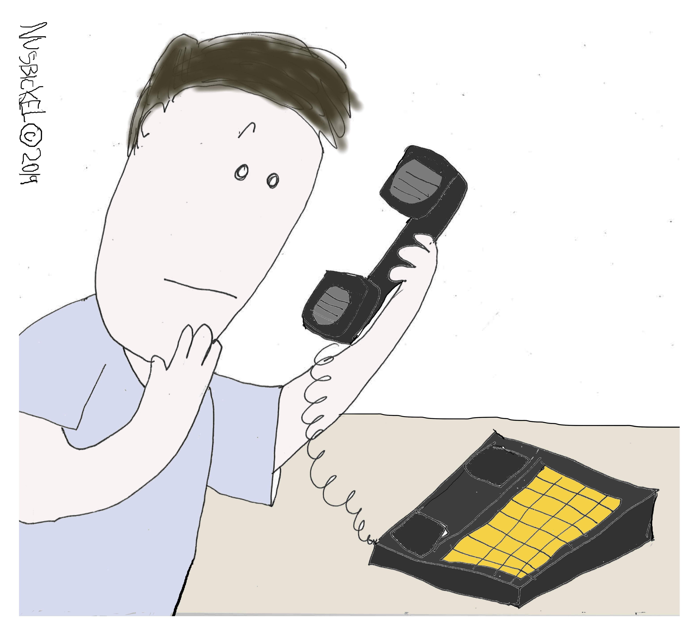
HIPAA privacy
So much guidance!
In February, the OCR issued guidance addressing HIPAA and COVID-19.
The OCR issued a limited waiver of HIPAA sanctions and penalties FOR HOSPITALS. The waiver only applies for 72 hours from the time a hospital implements a disaster protocol.
The OCR issued telehealth guidance/waiver and FAQ.
The OCR issued guidance on communicating with law enforcement, paramedics, other first responders, and public health authorities.

Slide 8
HIPAA privacy
So much guidance!
The OCR issued guidance about disclosure by business associates for public health and health oversight activities.
The OCR announced enforcement discretion for community-based testing sites.
The OCR has issued Spanish versions of its recent Notifications, Guidance, and Bulletins related to COVID-19.
https://www.hhs.gov/hipaa/for-professionals/special-topics/hipaa-covid19/index.html

Slide 9
HIPAA and civil rights
Section 1557 of the Affordable Care Act and Section 504 of the Rehabilitation Act prohibit discrimination on the basis of disability in federal health care programs.
The OCR reminded providers that persons with disabilities “should not be denied medical care on the basis of stereotypes, assessments of quality of life, or judgments about a person’s relative ‘worth’ based on the presence or absence of disabilities.”
“Decisions by covered entities concerning whether an individual is a candidate for treatment should be based on an individualized assessment of the patient on the best available objective medical evidence.”
https://www.hhs.gov/sites/default/files/ocr-bulletin-3-28-20.pdf

Slide 10
Ocr and civil rights
The OCR entered a resolution agreement with the State of Alabama:
Alabama was accused of instituting “ventilator rationing guidelines that allegedly discriminated on the basis of disability and age.” – ventilator services could be denied to individuals with intellectual disabilities such as “profound mental retardation” and “moderate to severe dementia,” as well as age. Alabama agreed to revise its ventilator guidelines.

Slide 11
Ocr and LEP
Title VI of the Civil Rights Act and Section 1557 of the ACA prohibit discrimination in federal healthcare programs on the basis of national origin (including limited English proficiency).
Providers must “take reasonable steps to provide meaningful access to individuals with LEP eligible to be served or likely to be encountered in their health programs and activities”
NOT WAIVED during COVID-19
Examples of “reasonable steps”: written translations of documents; oral assistance from an interpreter (in-person or using remote technology)
https://www.hhs.gov/sites/default/files/lep-bulletin-5-15-2020-english.pdf

Slide 12
Covid-19 and cyber scams
*COVID-19 is an opportunity for hackers – attacks have skyrocketed*
Department of Homeland Security Cybersecurity and Infrastructure Security Agency (CISA) issued a warning about COVID-19 cyber scams
Department of Homeland Security Cybersecurity and Infrastructure Security Agency (CISA) issued an Alert encouraging employers to use VPNs for teleworking employees. https://www.us-cert.gov/ncas/alerts/aa20-073a
The FBI warned of an increase in Business Email Compromise (BEC) attacks related to COVID-19. In particular, these scams target municipalities purchasing personal protective equipment and other supplies.

Slide 13
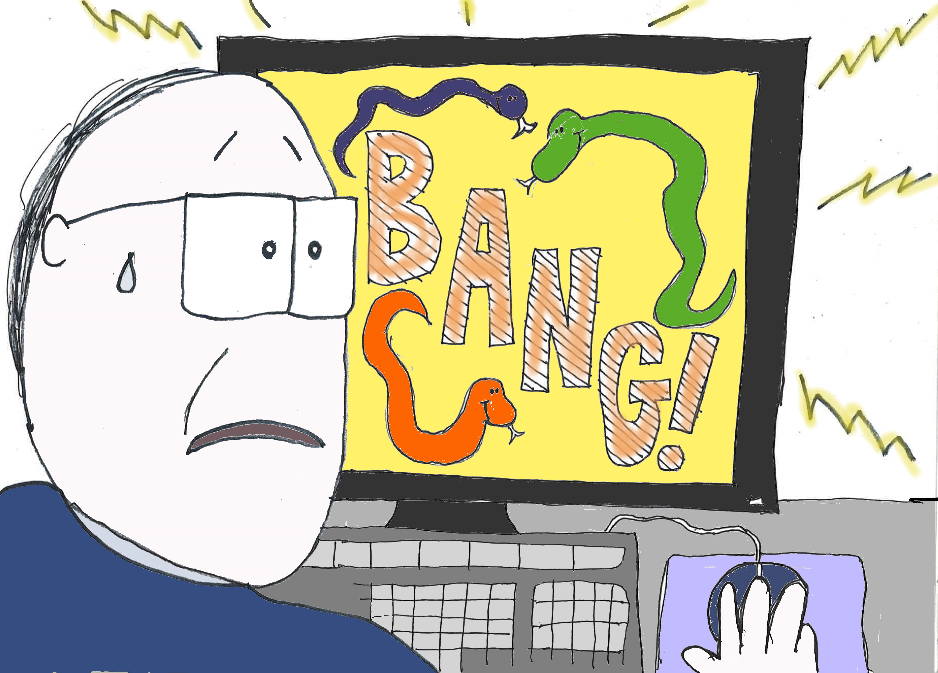
Covid-19 and cyber scams
Other scams & risks:
PPE scams – phony seller wants payment up front
Phishing and malware disguised as COVID-19 updates or offers
Free meals and coupons in response to COVID-19
Emails impersonating the WHO
Emails luring users working from home
Stimulus package scams
Unemployment claims

Slide 14
Covid-19 and Advanced persistent threat groups
CISA Alert AA20-099A. 4/08/20. Chinese APT groups using COVID-19 themed phishing messages or malicious applications disguised as trusted entities for espionage and “hack and leak”
Phishing emails, using coronavirus or COVID-19
Malware attachments in pdf files, word documents or executable file
New domains/websites containing coronavirus or COVID-19 words
Attacks on remote access and teleworking systems
CISA 5/13/20. Attacks on MSPs and Cloud Service Providers

Slide 15
Covid-19 and Advanced persistent threat groups
How to Spot Phishing Emails
Authority – C suite, bank, physician, government agency, World Health Organization
Urgency – limited time to respond or fines, arrest, lost deal.
Emotion – email attempts to make you panic, fearful, hopeful or curious?
Scarcity – limited supply of PPE, act now before supplies are gone
Password Spraying
Use a single common password against many accounts, then a second and so on
Harder to detect
Passwords readily available on the web and darkweb

Slide 16
Web meetings
Hackers have hijacked unsecured online meetings
CISA Alert AA20-099a: https://www.us-cert.gov/ncas/alerts/aa20-099a
Require a meeting password
Or use the waiting room feature that allows the host to control who is admitted to the meeting
Do not share the meeting link or password on publicly available social media sites
Provide the meeting link and password only to participants with a notice not to share
Limit screensharing to “host only”
Remind participants to use the updated version of the meeting apps
Telework policies cover online meetings

Slide 17
Telehealth
HIPAA guidance – privacy and security risks
CMS guidance and the 1135 waiver
Compliance has a key role in interpreting the telehealth guidance and developing a program that adheres to CMS guidelines

Slide 18
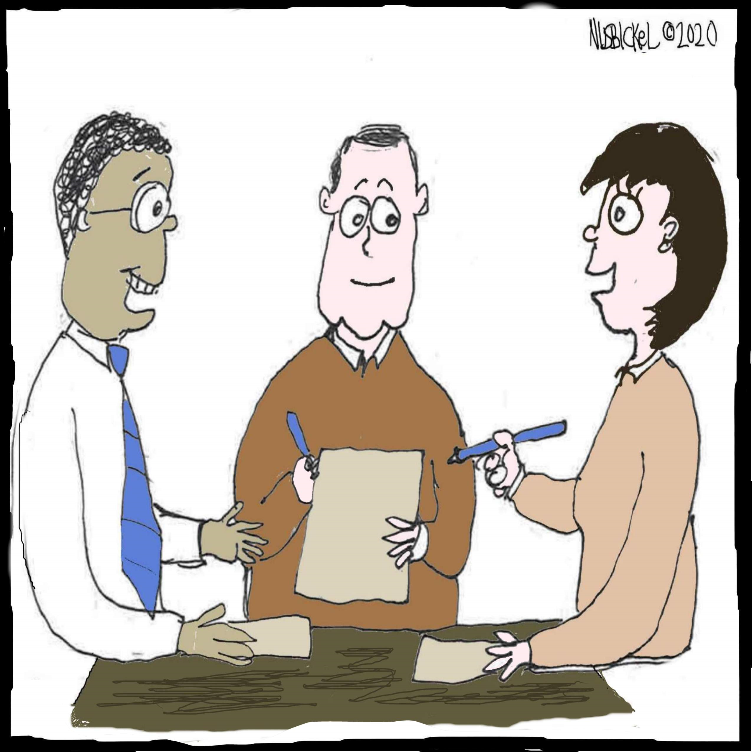
Infection control
Keep COVID-19 Out!
Assume anyone coming in may be infected – patients/visitors/staff
Monitor everyone coming in: keep a log
Reduce visitors or no visitors
Visitor management for limited exceptions
Hand hygiene
Physical or environmental cleaning
PPE
Physical distancing
Dining
Dementia units
Documentation

Slide 19
Infection control
COVID in the Building – Mitigate Spread
Internal contact tracing
Isolation – droplet precautions
Review and update all existing procedures
Resident and employee testing
Baseline
Repeat testing of all baseline negatives
Surveillance testing? Two week intervals?
PPE Use
Cloth masks Procedure masks
Burn rate calculator https://www.cdc.gov/coronavirus/2019-ncov/hcp/ppe-strategy/burn-calculator.html

Slide 20
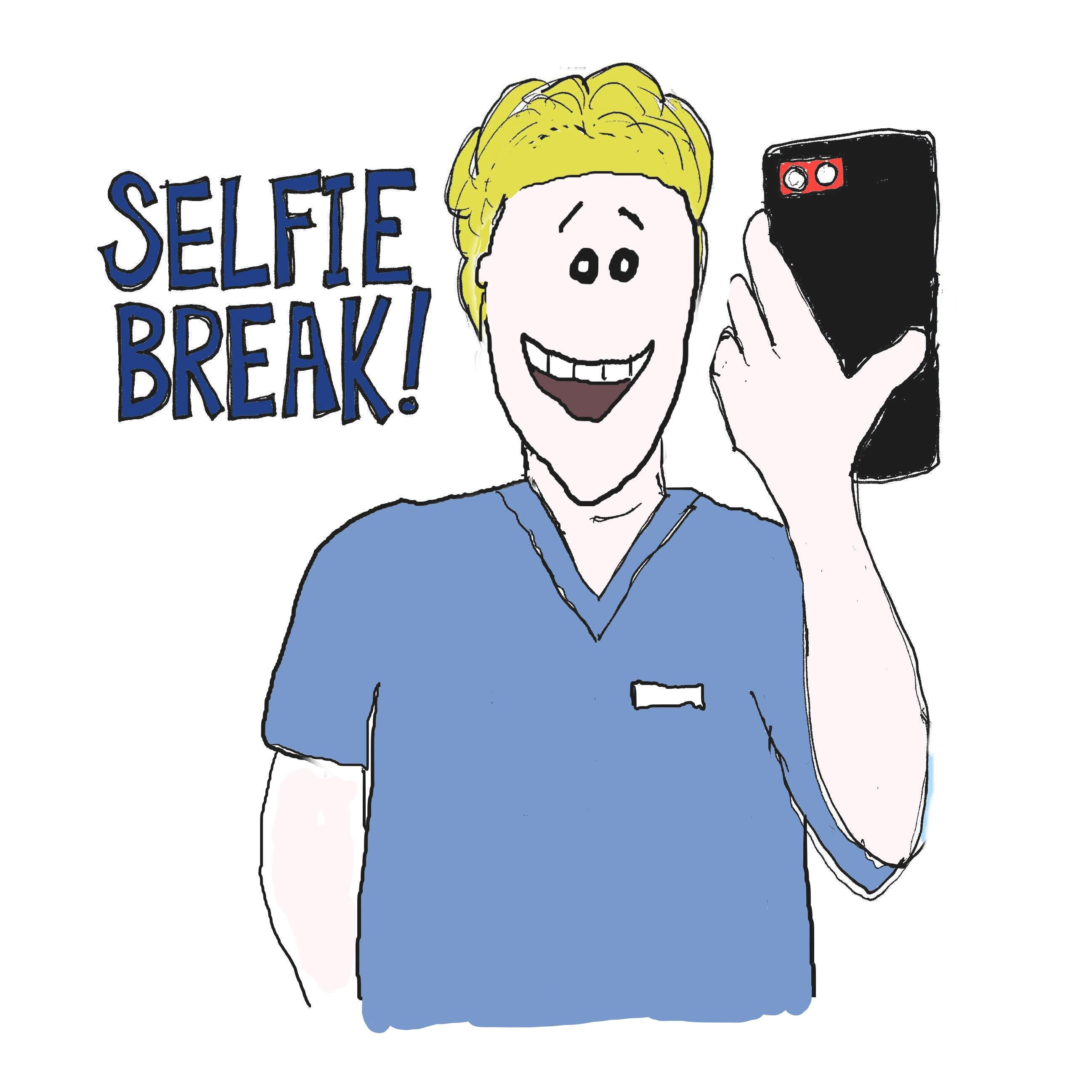
Social media use
Social media is higher risk during a pandemic.
Consider: employees venting; patients contacting you on social media; your organization using social media to keep the public informed and keep people connected.

Slide 21
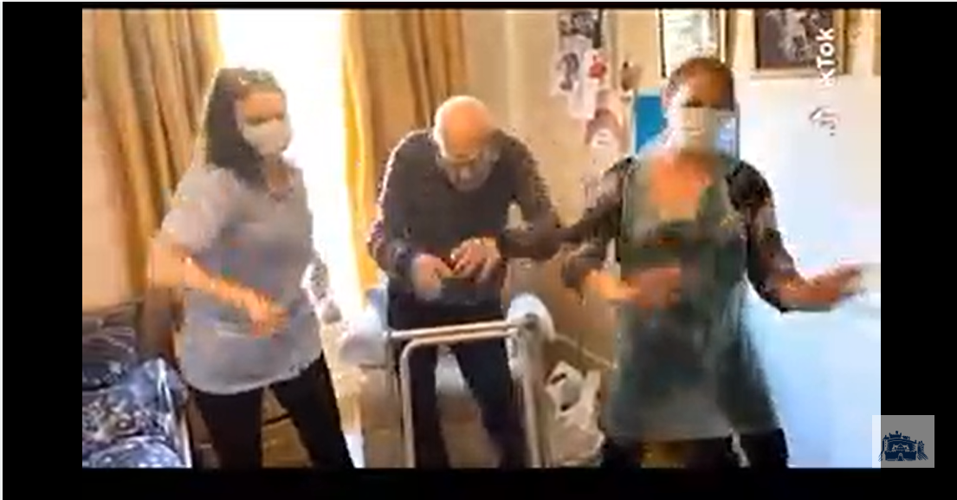
Social media use
https://www.scotsman.com/health/watch-102-year-old-resident-scottish-care-home-shows-tiktok-dance-moves-staff-2546876

Slide 22
Social media use
Do not post patient-specific information to social media without first obtaining a HIPAA authorization. This includes patients in the background.
Implement a social media policy that specifically addresses HIPAA.
Prior to using a new social media application, evaluate the risks with your HIPAA Security Risk Analysis process and mitigate any risks.
Maintain close communications between your HIPAA Privacy and Security Officer, and your marketing or public relations personnel. All marketing and PR communications and programs should be vetted for potential HIPAA risks.
Regularly review your organization’s social media activity to ensure it is HIPAA compliant.
Train staff about appropriate social media uses during COVID-19 – the HIPAA stakes are higher during a pandemic.
Audit your organization’s social media presence.

Slide 23
…but don’t forget “non-covid” risks

Slide 24
Kickbacks and gifts
Many vendors are hurting from the economy – providers should expect a rise in perks and gifts.
Some are offering free food and other benefits to healthcare workers. Gifts and donations should not be tied to current or future Medicare/Medicaid business.
When in doubt, ask legal.

Slide 25
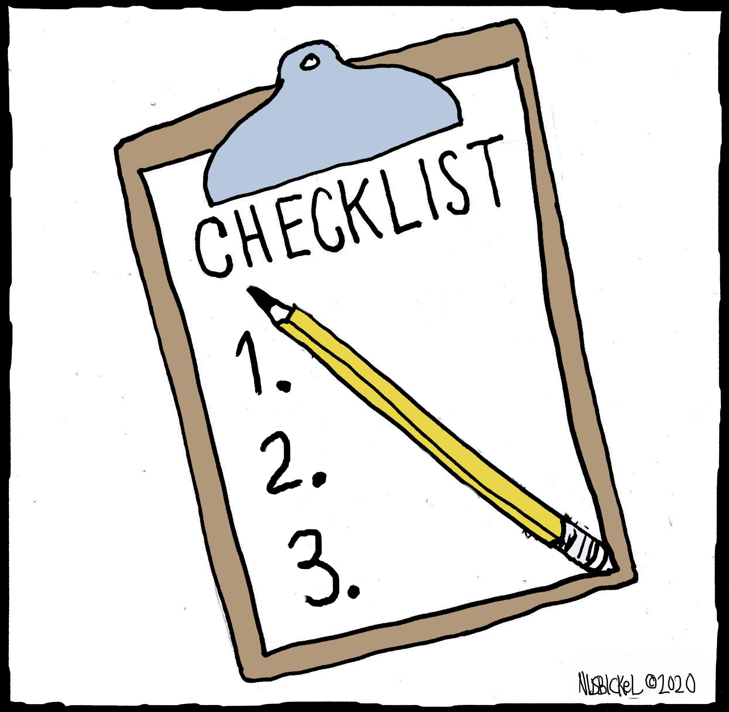
Vendor agreements
Providers are entering new agreements (for PPE, etc.) – in a hurry.
Don’t skip legal review.
Don’t skip vendor vetting.

Slide 26
Screening and credentialing
With employees out with COVID-19, employees not coming in because they don’t want to get COVID-19, and an increase in admissions, providers have to increase staff from other sources.
CMS has relaxed requirements: allowing physicians and other practitioners to practice in additional states without licensure in those states; allowing physicians with expiring privileges to continue practicing; allowing nursing homes to employ nurse aides longer than four months without meeting training and certification requirements
Don’t let up on credentialing, license verification, background checks, and excluded provider screens.
Remember HIPAA training for your “workforce”

Slide 27
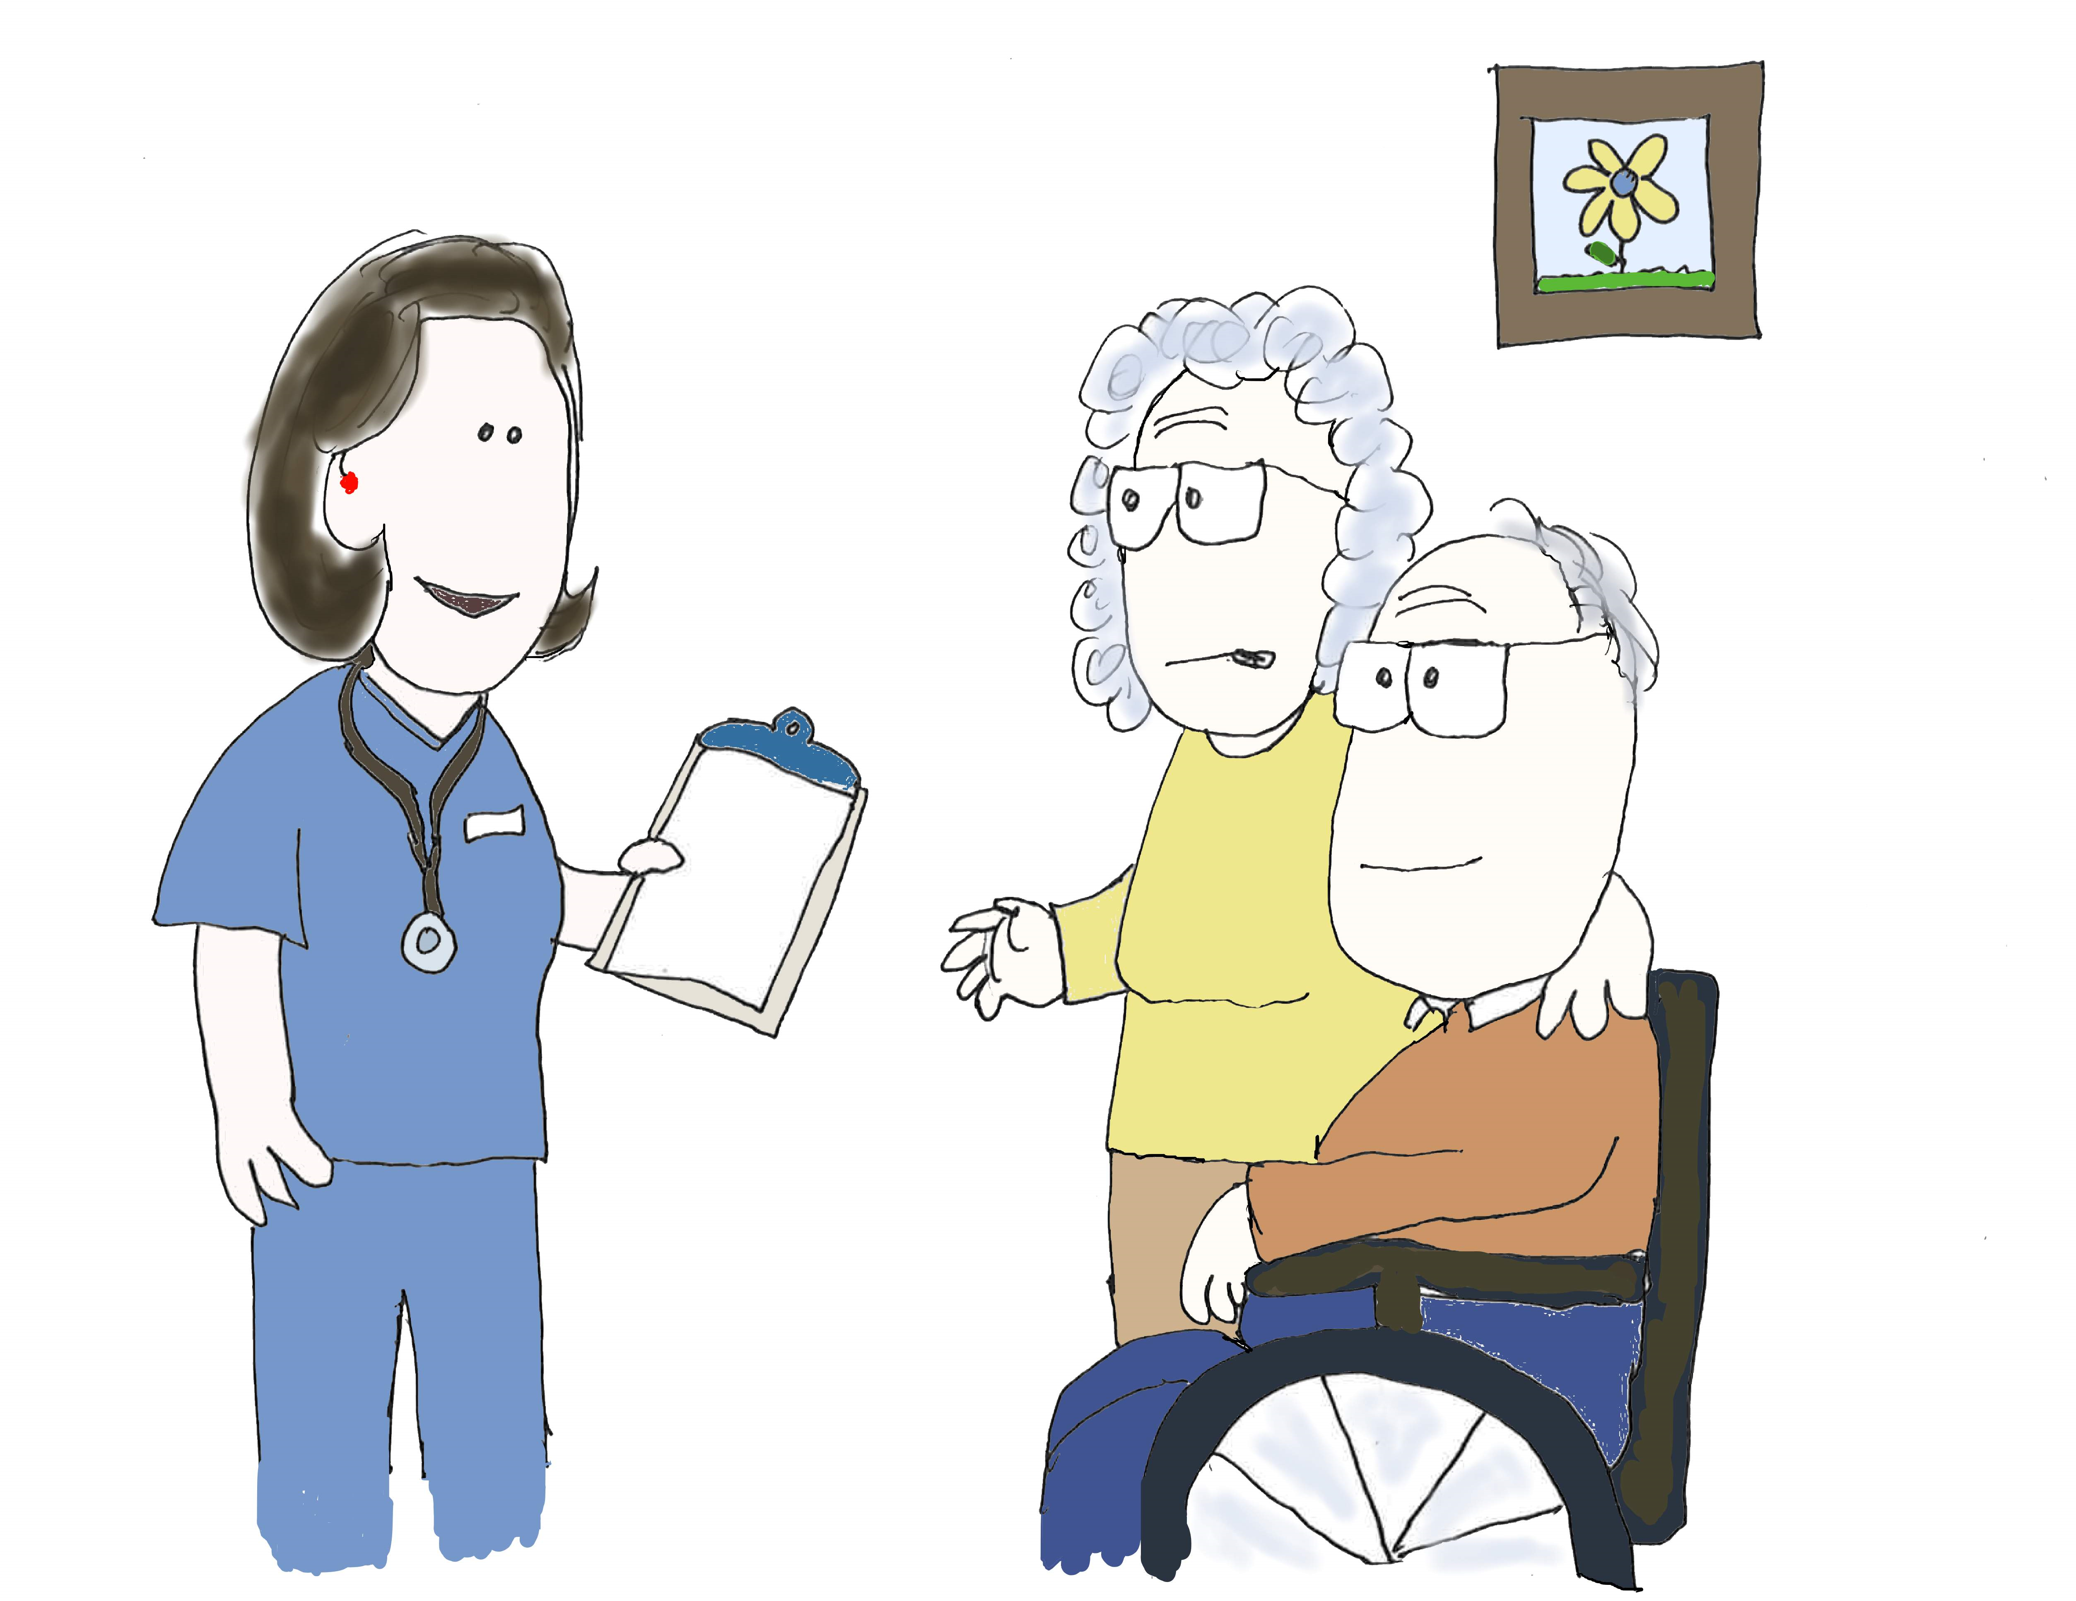
Nursing homes: Resident rights
Residents and families are stretched thin and stressed out.
Employees are stretched thin and stressed out.
Watch for signs of strain that could amount to a resident rights violation – and don’t skip the resident rights training.

Slide 28
Keep your compliance culture strong

Slide 29
Communicate with your board
Your board (and CEO and other leaders) is responsible for your organization’s success during an unprecedented time.
They are more likely to succeed if compliance continues to provide them with essential information about compliance risks and guidance relevant to COVID-19.

Slide 30
Listen. handle reports.
Employees will still have compliance questions and concerns during the pandemic. Be available to answer questions and handle complaints – just as before.
How can the Compliance Department make things easier for employees during the pandemic? What information do they need? How can you help?

Slide 31
Keep up training
Routine training might seem lower priority now – but skipping it is risky.
Consider virtual learning options – and get creative. Do you really need a 60-minute in-service or e-course? Or would your message be effective in four 15-minute videos spread out over a few weeks or months? What would be easier on your staff?

Slide 32
Maintain a positive culture
Me
Do what is right
Actions speak louder than words
Enforce policies uniformly and fairly based on facts
Solve problems – attendance, job performance, poor attitudes
An effective leader is not a dictator
Support managers and staff
Praise publicly, discipline privately
Listen, listen, listen………and by the way, listen
Communication – horizontal and vertical No surprises
Captain Michael Abrashoff “It’s Your Ship”
See the ship through they eyes of the crew
Communicate, communicate, communicate
Create discipline by focusing on purpose – every job is important
Take Command by being respected, trusted, and effective.
Never fail the Washington Post test
Lead by example – is he the problem
Don’t work harder, work smarter

Slide 33
Maintain a positive culture
Patients/residents and staff come first
Nursing homes - introduction or spread of COVID by staff is the biggest risk
Increase the visibility of the management team
Hands on
Accessible
Identify issues and problems and fix them
Transparent communication
Strong leaders make decisions without adequate information
Take action

Slide 34
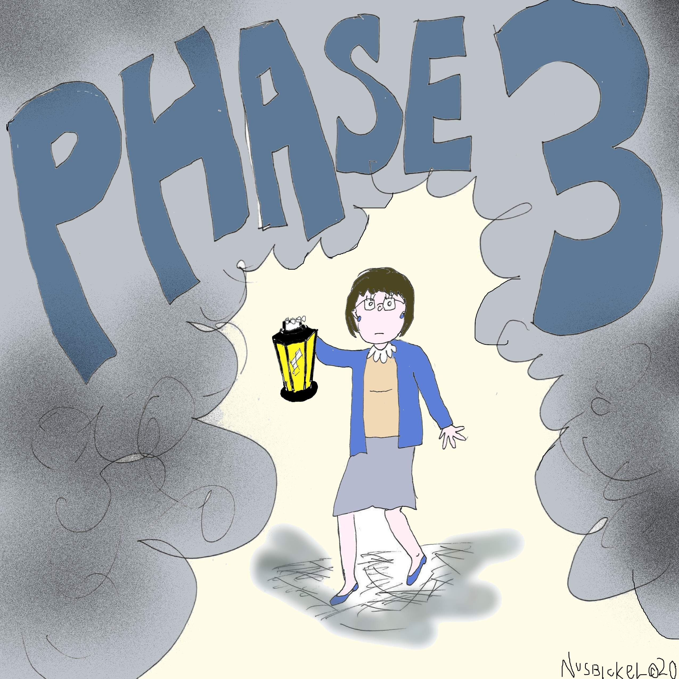
SNFs: phase 3 enforcement is coming
As of November 28, 2019, Compliance & Ethics Programs are required by law for nursing homes.
We are waiting for a Final Rule, and surveyor guidance – but at some point, enforcement will begin.
It can take 6 months to a year to implement an effective compliance program – and conduct the annual review. Move compliance along as much as you can, when you can.

Slide 35
Mpa discounts
All digital download HIPAA Tool Kits are 50% off until June.
Compliance program annual reviews are 25% off until June (call or email Margaret for info)
Our HIPAA & COVID-19 Toolkit is available at the discounted price of $95.
MPA will continue putting out HIPAA announcements, news, and tips on the blog.
MPA has free compliance and HIPAA resources on its Free Resources page.
http://www.Healthcareperformance.com/store
call or email us: 314.394.2222 stg@healthcareperformance.com mcs@healthcareperformance.com

Slide 36
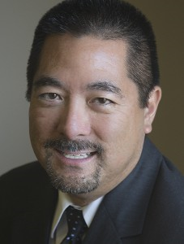
Questions?
Margaret Scavotto, JD, CHC
President
314-394-2222 ext. 24
mcs@healthcareperformance.com
Scott T. Gima, RN, MHA
Exec VP & COO
314.394.2222 ext. 21
stg@healthcareperformance.com
Blog: www.healthcareperformance.com/blog
Store: www.healthcareperformance.com/store
(c) 2020 Management Performance Associates
This presentation does not constitute legal advice

