Slide 1
Phase 3 compliance webinar#5: Training + Covid-19
April 22, 2020
Margaret Scavotto, jd, chc

Slide 2
poll
Where are you working today?
At home
At a nursing home facility
At a corporate office

Slide 3
poll
Has COVID-19 affected your compliance program?
No – compliance is still progressing
Yes – compliance is completely on hold
Yes – compliance is still progressing but on a slower/delayed timeline

Slide 4
MPA discounts
All digital download HIPAA Tool Kits are 50% off until June.
Compliance program annual reviews are 25% off until June (call or email Margaret for info)
Our HIPAA & COVID-19 Toolkit is available at the discounted price of $95.
MPA will continue putting out HIPAA announcements, news, and tips on the blog.
MPA has free compliance and HIPAA resources on its Free Resources page.
Healthcareperformance.com/store
call or email me: 314.394.2222 x 24 mcs@healthcareperformance.com

Slide 5
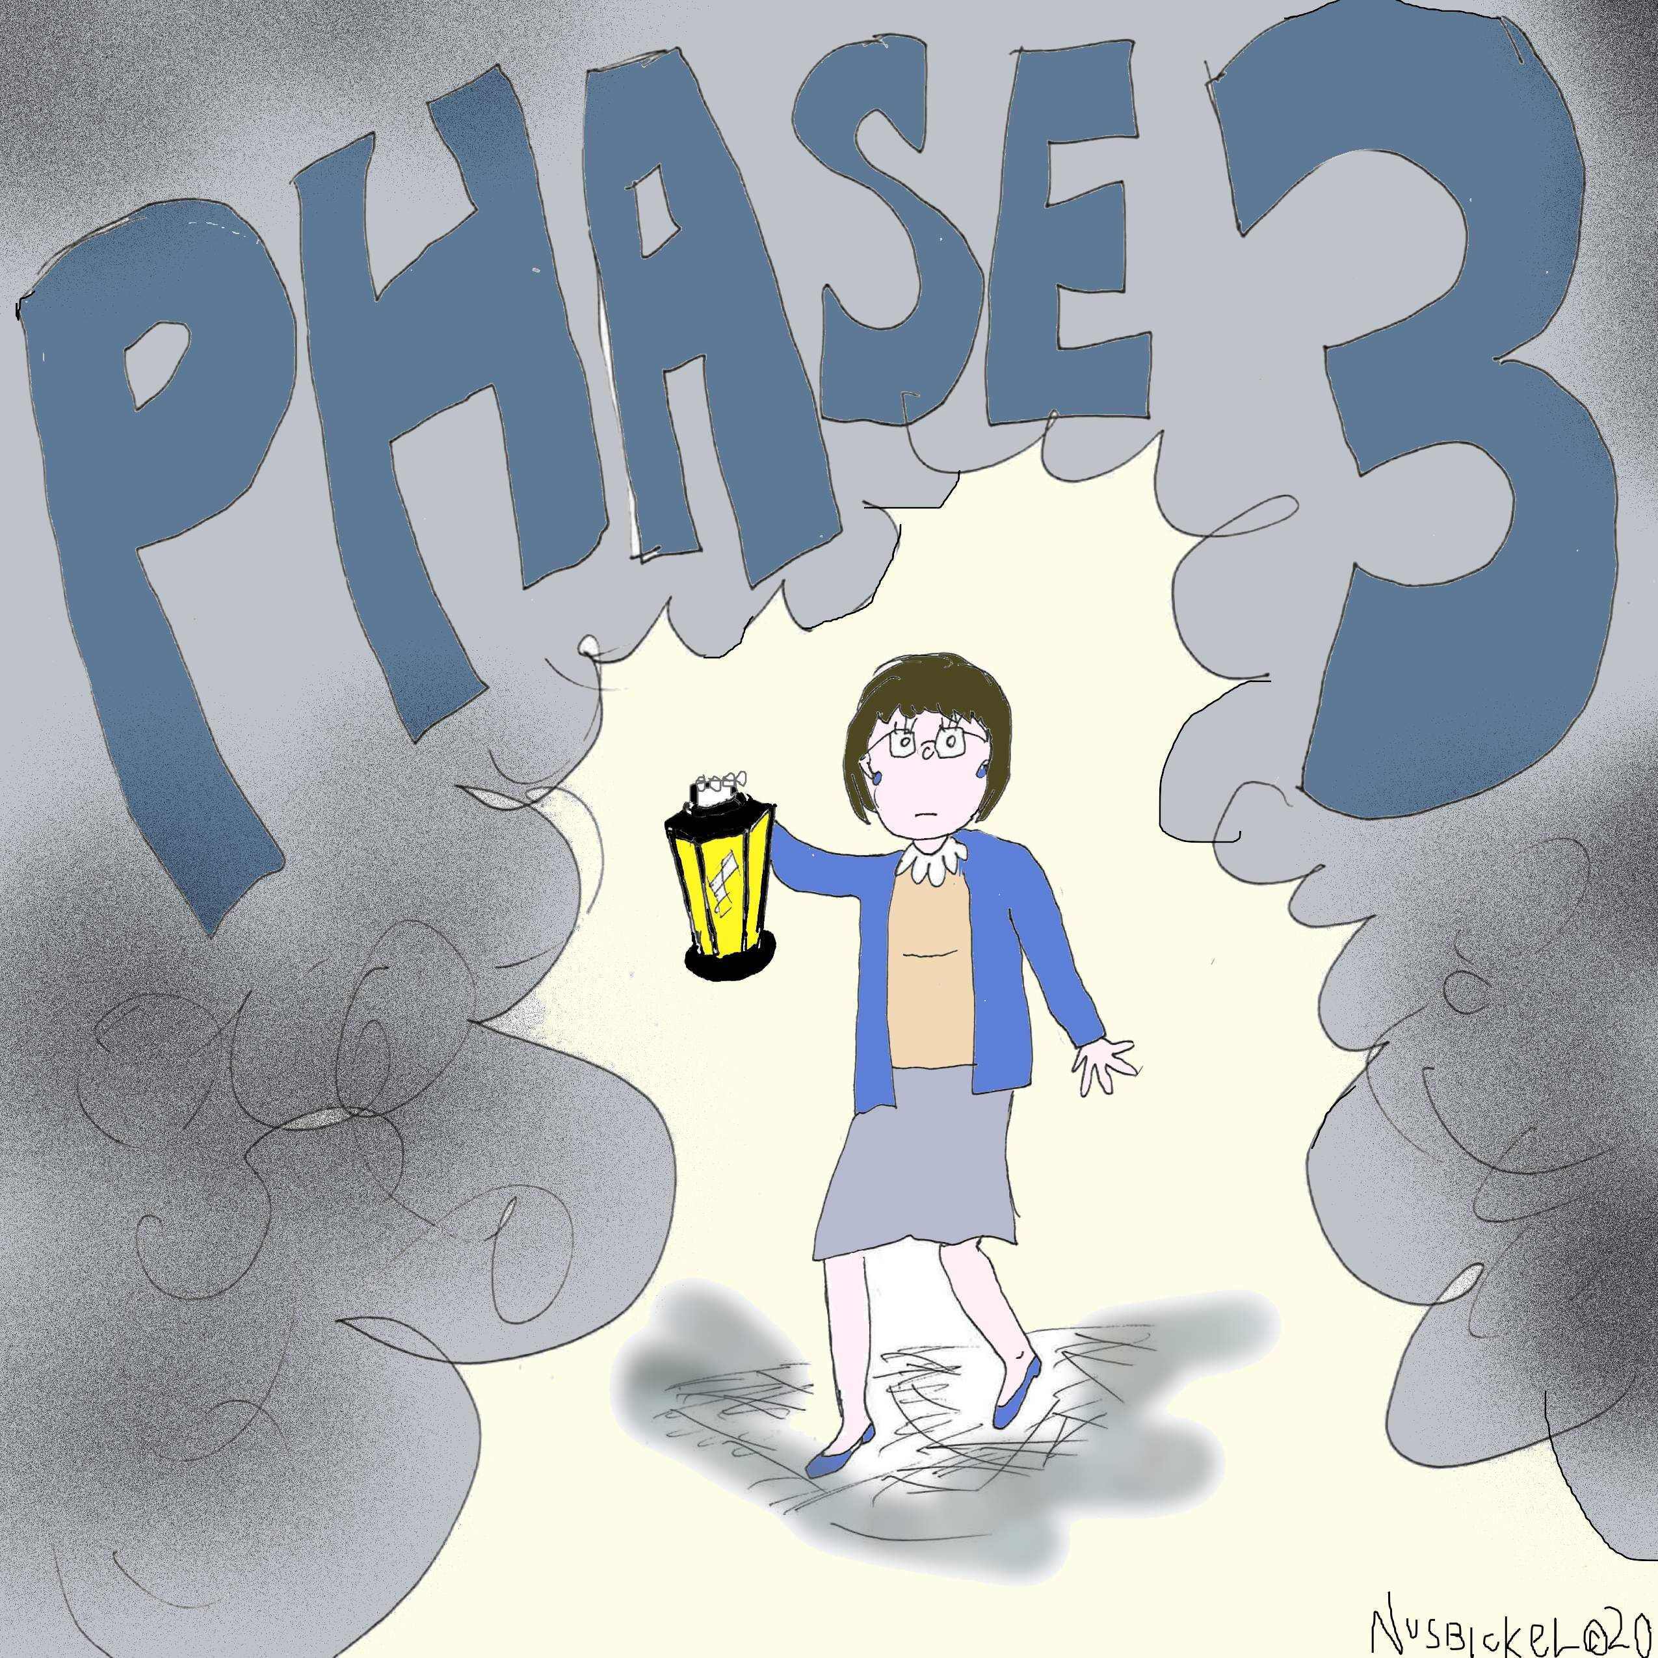
Have changing Phase 3 Compliance requirements left you in a fog?

Slide 6
What’s required now: ACA
ALL nursing homes must have:
Policies and procedures
Screening
Oversight and leadership
Policy communication
Taking steps to achieve compliance: Auditing, reporting, and data
Enforcement and discipline
Corrective action
Annual review
Required as of November 28, 2019!

Slide 7
What’s required now: ACA
Chains of 5+ SNFs must also have:
Mandatory annual compliance training
Compliance officer who reports to the governing body
Compliance liaisons at each facility
Required as of November 28, 2019!

Slide 8
What might change

Slide 9
What might change

Slide 10
Enforcement update
On November 22, 2019, CMS issued a memorandum with an update on the Phase 3 Requirements of Participation. In this memo, CMS advised:
CMS will not release updated Interpretive Guidance and training addressing Phase 3 until the second quarter of 2020.
But... nursing homes are still expected to comply with Phase 3 by November 28, 2019.

Slide 11
Surveys suspended
CMS suspended non-emergency surveys on March 4, 2020
March 20: For three weeks, CMS will ONLY pursue:
Complaint/facility reported incident surveys: IJ. These surveys will include infection control review
Targeted infection control surveys
Self-assessments of infection control (voluntary)
“Beginning today, we will be working with the CDC to focus and identify areas the virus is projected to strike next, and target our inspections accordingly,” – Seema Verma
March 20 guidance: https://www.cms.gov/files/document/qso-20-20-allpdf.pdf

Slide 12
Covid-19 updates

Slide 13
Hipaa & Covid-19 updates
In February, the OCR issued guidance addressing HIPAA and COVID-19.
The OCR issued a limited waiver of HIPAA sanctions and penalties FOR HOSPITALS. The waiver only applies for 72 hours from the time a hospital implements a disaster protocol.
The OCR issued telehealth guidance/waiver and FAQ.
The OCR issued guidance on communicating with law enforcement, paramedics, other first responders, and public health authorities.
The OCR issued guidance about disclosure by business associates for public health and health oversight activities.
The OCR announced enforcement discretion for community-based testing sites.
The OCR has issued Spanish versions of its recent Notifications, Guidance, and Bulletins related to COVID-19.
https://www.hhs.gov/hipaa/for-professionals/special-topics/hipaa-covid19/index.html

Slide 14
Covid-19 and cyber scams
Department of Homeland Security Cybersecurity and Infrastructure Security Agency (CISA) issued a warning about COVID-19 cyber scams
Department of Homeland Security Cybersecurity and Infrastructure Security Agency (CISA) issued an Alert encouraging employers to use VPNs for teleworking employees. https://www.us-cert.gov/ncas/alerts/aa20-073a
The FBI warned of an increase in Business Email Compromise (BEC) attacks related to COVID-19. In particular, these scams target municipalities purchasing personal protective equipment and other supplies.

Slide 15
Ocr and civil rights
Section 1557 of the Affordable Care Act and Section 504 of the Rehabilitation Act prohibit discrimination on the basis of disability in federal health care programs.
The OCR reminded providers that persons with disabilities “should not be denied medical care on the basis of stereotypes, assessments of quality of life, or judgments about a person’s relative ‘worth’ based on the presence or absence of disabilities.”
“Decisions by covered entities concerning whether an individual is a candidate for treatment should be based on an individualized assessment of the patient on the best available objective medical evidence.”
https://www.hhs.gov/sites/default/files/ocr-bulletin-3-28-20.pdf

Slide 16
Ocr enforcement
Pennsylvania: accused of instituting discriminatory Crisis Standards of Care (CSC) guidelines that “unlawfully singled out and authorized the denial of treatment to individuals with disabilities when prioritizing access to critical care and ventilators. The CSC Guidelines listed specific impairments or disabilities that would lead to greater deprioritization. The complaint also alleged that the guidelines did not require an individualized assessment, but instead used “preexisting conditions that are disabilities” to determine a priority score.”
Alabama: accused of instituting “ventilator rationing guidelines that allegedly discriminated on the basis of disability and age.” – ventilator services could be denied to individuals with intellectual disabilities such as “profound mental retardation” and “moderate to severe dementia,” as well as age. Alabama agreed to revise its ventilator guidelines.

Slide 17
Cms guidance – infection control, transfers, TeleheaLth
Transfer Scenarios.
2+ SNFs can transfer/discharge residents for cohorting purposes without additional approval.
Certified LTC facility needs state approval to transfer or discharge to a non-certified location for cohorting.
https://www.cms.gov/files/document/qso-20-25-nh.pdf
Infection control: https://www.cms.gov/files/document/qso-20-14-nh-revised.pdf
https://www.cms.gov/files/document/4220-covid-19-long-term-care-facility-guidance.pdf
Telehealth: https://www.cms.gov/files/document/covid-19-nursing-home-telehealth-toolkit.pdf
CDC: https://www.cdc.gov/coronavirus/2019-ncov/hcp/long-term-care.html

Slide 18
New from cms: nursing homes covid-19 transparency effort
Inform residents, families, and representatives within 12 hours of
Single confirmed COVID-19 infections
3+ residents or staff with new-onset respiratory symptoms occurring within 72 hours
Weekly updates
Report to the CDC’s National Health Safety Network (guidance forthcoming).
Failure to report or timely notify could result in CMS enforcement.
https://www.cms.gov/files/document/qso-20-26-nh.pdf

Slide 19
The oig says…
OIG COVID-19 Fraud Alert
The OIG published a COVID-19 fraud alert warning that “scammers are offering COVID-19 tests to Medicare beneficiaries in exchange for personal details, including Medicare information.” These individuals then use Medicare beneficiary information to commit identity theft and healthcare fraud.
Medicare beneficiaries should be careful of unsolicited phone calls or in-person inquiries about COVID-19 tests, as well as social media solicitations.
https://oig.hhs.gov/coronavirus/fraud-alert-covid19.asp?utm_source=web&utm_medium=web&utm_campaign=covid19-fraud-alert

Slide 20
The oig says…
Health care providers’ primary focus should be patient care. OIG strives to be flexible with providers and consider the burdens at hand.
Health care organizations are encouraged to ask OIG for extensions of OIG deadlines (such as data submissions, or Corporate Integrity Agreement compliance).
Because OIG is teleworking, materials should be submitted to OIG electronically rather than by mail.
https://oig.hhs.gov/coronavirus/letter-grimm-03302020.asp

Slide 21
Covid-19 enforcement updates
Man took kickbacks for COVID-19 tests. In Georgia, a man was arrested and charged with conspiring to violate the Anti-Kickback Statute and conspiring to commit health care fraud. He is accused of soliciting and receiving kickbacks from clinical and diagnostic testing companies. In return, he steered Medicare patients to those companies for genetic tests and, later, COVID-19 tests.
https://www.justice.gov/usao-nj/pr/georgia-man-arrested-orchestrating-scheme-defraud-health-care-benefit-programs-related

Slide 22
Why you should keep up compliance
Compliance plays a vital role in keeping up with and distributing the COVID-19 guidance
Compliance STILL needs to field reports, questions, and complaints
Your employees need support. This is an opportunity for compliance to provide that support and build morale.
When COVID-19 is over (or at least better), your organization will fare much better if a compliance culture has been maintained.

Slide 23
Covid-19 issues to address with training
Incorporate COVID-19 updates into new employee orientation
Train all relevant parties on HIPAA updates and SOCIAL MEDIA
Staff will need training on infection control and PPE.
Anyone using computers needs to be trained on cyberscams. Anyone paying bills needs to be trained on BEC attacks.
Those working from home need to be trained on remote access procedures.

Slide 24
Remote learning
More relevant for organizations with a large number of people working remotely (e.g. chains with corporate offices).
Consider all cancelled meetings – is your Board now meeting virtually? Consider e-learning on compliance.
Also consider e-learning solutions for cancelled training provided by vendors.
Keep information flowing without an in-service: flyers, text alerts, videos/cartoons

Slide 25
Compliance training

Slide 26
Phase 3:
Policy Communication

Slide 27
Phase 3: policy communication
“facility takes steps to effectively communicate the standards, policies, and procedures in the operating organization's compliance and ethics program to the operating organization's entire staff; individuals providing services under a contractual arrangement; and volunteers, consistent with the volunteers' expected roles.”
“Requirements include, but are not limited to, mandatory participation in training as set forth at § 483.95(f) or orientation programs, or disseminating information that explains in a practical manner what is required under the program.”

Slide 28
Oig: policy communication
Policies should be given to employees “who are affected by these policies,” plus physicians, suppliers, agents, and contractors.
Agent: “any individual, including a director, an officer, an employee, or an independent contractor authorized to act on behalf of the organization”
Code of Conduct should go to current employees and new hires – everyone should sign a certification.

Slide 29
Practically speaking: policy communication
Compliance Program and Code: At hire/contract and annually; employees, board, relevant contractors, students, agency staff and volunteers
Compliance risk area policies: Decide by job duties. Distribute at hire/annually and incorporate into your training plan.
Use tip sheets

Slide 30
Phase 3:
Training

Slide 31
Phase 3: chains of 5+: Training
Phase 3 requires:
“A mandatory annual training program on the operating organization's compliance and ethics program that meets the requirements set forth in § 483.95(f).”

Slide 32
Oig: training
The OIG recommends that ALL nursing homes have annual compliance training, regardless of size.
New hires also need compliance training.
Training should address the compliance program, plus risk area training targeted to employees and contractors as relevant
Training can include training programs, and disseminating information
Failure to participate in training should result in disciplinary action; training attendance should be part of annual evaluations

Slide 33
Practically speaking: training
Train employees, board members, and relevant contractors, volunteers and students on compliance at hire and annually.
Provide additional compliance risk area training to employees, contractors, volunteers and students as appropriate.
Example: review the Employee and Contractor Screening Policy with HR. Document that you did this.
Keep the message going with reminders throughout the year, and Compliance Week.

Slide 34
Crunch your numbers: surveys
Questions about the compliance training program
Did annual compliance training tell you what you need to know to do your job?
How could annual compliance training be better?
Questions that evaluate the effectiveness of your training efforts
Do you know how to report non-compliance?
Do you know the name of the Compliance Officer?
Questions to measure training comprehension
Where can I find a copy of the Code of Conduct?
Which of the following are PHI?

Slide 35
training: What you need
Info for your organization on relevant COVID-19 updates
Monthly compliance newsletter or other information for your managers and Board
Annual compliance training for employees, contractors, your board, volunteers, and students
Compliance tip sheets
Compliance Education and Training Policy
Compliance Training Quiz
Employee Compliance Survey
Compliance Week
Materials to keep compliance current: videos, flyers, flashcards, etc.

Slide 36
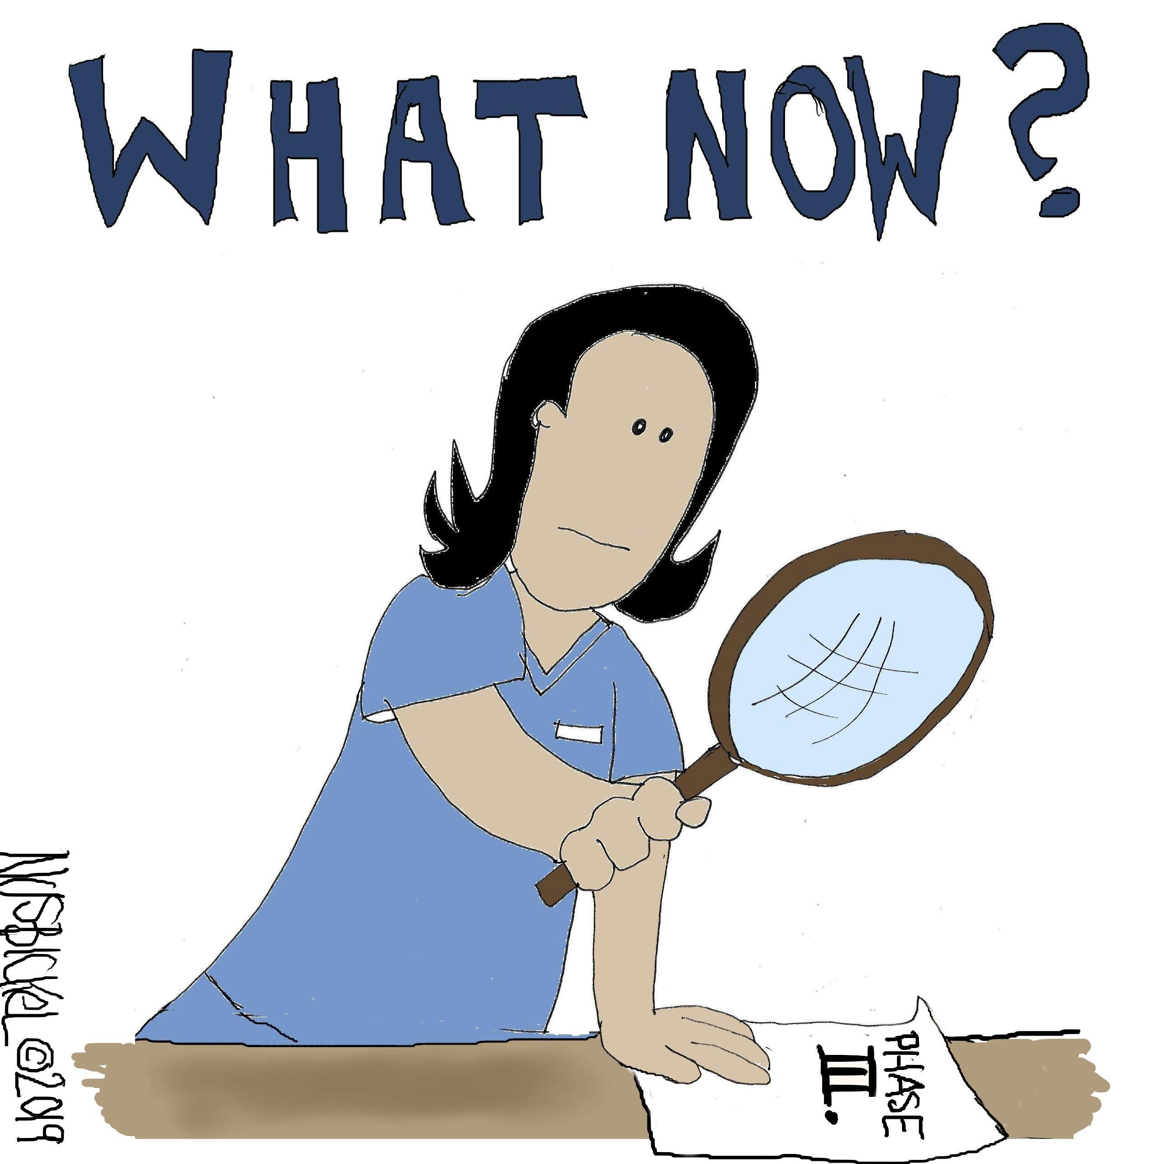

Slide 37
MPA discounts
All digital download HIPAA Tool Kits are 50% off until June.
Compliance program annual reviews are 25% off until June (call or email Margaret for info)
Our HIPAA & COVID-19 Toolkit is available at the discounted price of $95.
MPA will continue putting out HIPAA announcements, news, and tips on the blog.
MPA has free compliance and HIPAA resources on its Free Resources page.
call or email me: 314.394.2222 x 24 mcs@healthcareperformance.com

Slide 38
Coming up…
Responding to the pandemic comes first.
But during COVID-19 – and after this is over – compliance has a vital role to play.
Learn how to triage your role during this time.
Register: https://zoom.us/webinar/register/WN_UPybjXDTQfGAFoCwmsRwXQ

Slide 39
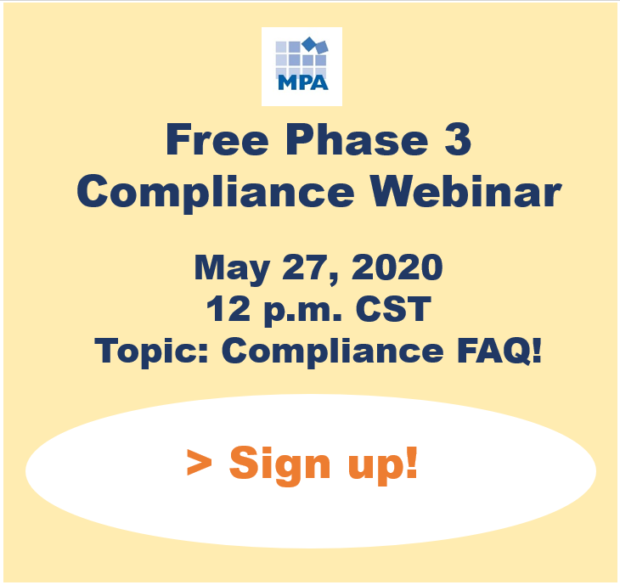
Coming up…
Get your burning compliance questions answered!
Submit questions in advance by emailing Margaret at mcs@healthcareperformance.com, or using this anonymous survey.
Register: https://zoom.us/webinar/register/WN_jeaWvHXUT1KbP4yqPMfI_Q

Slide 40
Margaret Scavotto, JD, CHC
President
314-394-2222 ext. 24
mcs@healthcareperformance.com
Blog: www.healthcareperformance.com/blog
Store: www.healthcareperformance.com/store
Questions?
(c) 2019 Management Performance Associates
This presentation does not constitute legal advice

