Slide 1
Phase 3 compliance webinar#5: social media compliance during a pandemic
May 27, 2020
Margaret Scavotto, jd, chc
Notes:
Staying Social
During a national public health emergency, healthcare providers will have many reasons to use social media. The community will likely turn to social media to learn what your organization is doing in response to COVID-19. Social media can be used to keep the public informed, ward off panic, advise patients and loved ones of new procedures or protocols, and show the public a strong response during the disaster. Social media is also being used to recruit staff, volunteers, and supplies.
The majority of your employees likely use social media – and need to know what they can and cannot post about the pandemic and their, and your, role in COVID-19.
Patients and families might reach out to you on social media messaging apps for information.
All of these social media use bring risks. When protected health information is shared inappropriately, the Privacy Rule can be violated – which means you will be conducting a potential breach investigation. There are also security risks inherent in social media use. And, when the wrong information is shared, it can go viral and make headlines very quickly.
What you can do:
Do not post any patient-specific information to social media without first obtaining a HIPAA authorization.
If you have not already done so, implement a social media policy that specifically addresses HIPAA.
Prior to using a new social media application, evaluate the risks with your HIPAA Security Risk Analysis process and mitigate any risks.
Maintain close communications between your HIPAA Privacy and Security Officer, and your marketing or public relations personnel. All marketing and PR communications and programs should be vetted for potential HIPAA risks.
Regular review your organization’s social media activity to ensure it is HIPAA compliant.
Train, train, train
Help staff understand what is considered a HIPAA violation on social media. Common examples of social media HIPAA violations include:
Posting verbal “gossip” about a patient to unauthorized individuals, even if the name is not disclosed.
Sharing of photographs or videos, or any form of PHI without written authorization from a patient.
A mistaken belief that posts are private or have been deleted when they are still visible to the public.
Posting of any information that could allow an individual to be identified
Sharing of seemingly innocent comments or pictures, such as a workplace lunch which happens to have PHI visible (e.g. visible patient files underneath).
Sharing of photos, videos, or text on social media platforms within a private group
The fact that someone is our patient is PHI
Even if your Facebook settings are private, you could have a breach – Facebook is not encrypted
Use MPA’s HIPAA & Social Media Policy, and MPA’s Monthly Compliance Moments addressing HIPAA and social media.

Slide 2
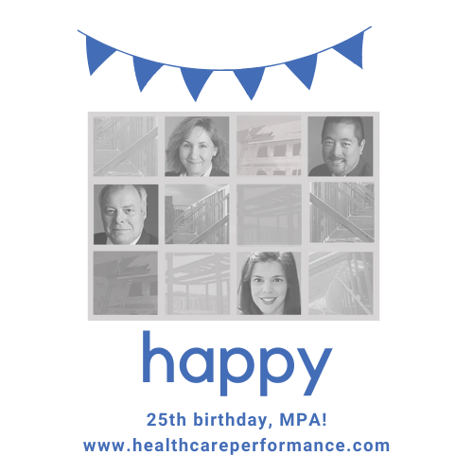

Slide 3
poll
Where are you working today?
At home
At a nursing home facility
At a corporate office

Slide 4
poll
Has COVID-19 affected your compliance program?
No – compliance is still progressing
Yes – compliance is completely on hold
Yes – compliance is still progressing but on a slower/delayed timeline
Yes – I have more time for compliance now

Slide 5
poll
Are you using social media more during the pandemic?
Yes
No
Social media use is the same

Slide 6
MPA discounts
All digital download HIPAA Tool Kits are 50% off until June.
Compliance program annual reviews are 25% off until June (call or email Margaret for info)
Our HIPAA & COVID-19 Toolkit is available at the discounted price of $95.
Now available: HIPAA & Social Media Toolkit with MPA Review
MPA will continue putting out HIPAA announcements, news, and tips on the blog and free compliance and HIPAA resources on its Free Resources page.
Healthcareperformance.com/store
call or email me: 314.394.2222 x 24 mcs@healthcareperformance.com

Slide 7
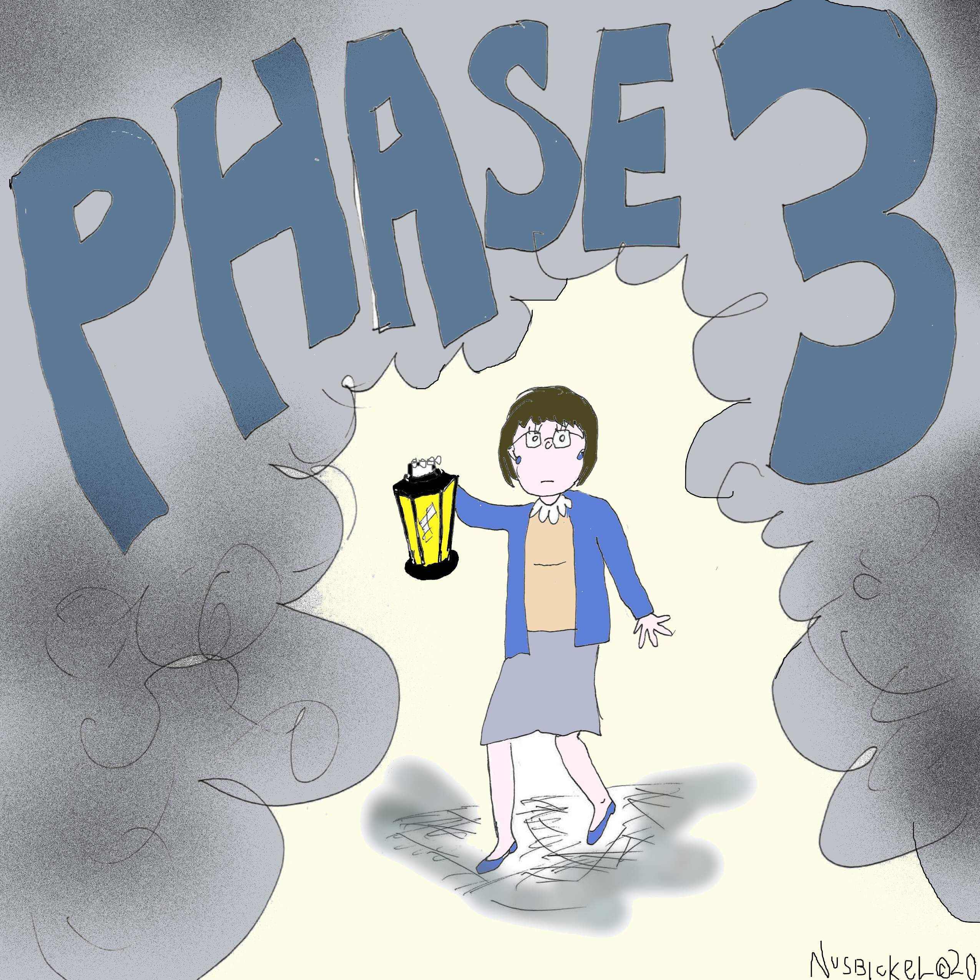
Have changing Phase 3 Compliance requirements left you in a fog?

Slide 8
What’s required now: ACA
ALL nursing homes must have:
Policies and procedures
Screening
Oversight and leadership
Policy communication
Taking steps to achieve compliance: Auditing, reporting, and data
Enforcement and discipline
Corrective action
Annual review
Required as of November 28, 2019!

Slide 9
What’s required now: ACA
Chains of 5+ SNFs must also have:
Mandatory annual compliance training
Compliance officer who reports to the governing body
Compliance liaisons at each facility
Required as of November 28, 2019!

Slide 10
What might change
In July 2019, CMS issued a PROPOSED rule that might change/eliminate some of the Phase 3 requirements.
The proposed rule has not yet been made final.
The OIG recommends EVERYTHING CMS proposes taking out.

Slide 11
Enforcement update
On November 22, 2019, CMS issued a memorandum with an update on the Phase 3 Requirements of Participation. In this memo, CMS advised:
CMS will not release updated Interpretive Guidance and training addressing Phase 3 until the second quarter of 2020.
But... nursing homes are still expected to comply with Phase 3 by November 28, 2019.
CMS has shifted the focus of its surveys due to COVID-19.

Slide 12
Why Hipaa matters

Slide 13
Protected Health Information
HIPAA protects PHI: information that can identify a patient and relates to the patient’s health condition, treatment, and payment for treatment.

Slide 14
Electronic Protected Health Information
ePHI is electronic PHI: PHI received, created, maintained, or transmitted in electronic form.

Slide 15
Ocr enforcement
A dental practice entered a $10,000 settlement with the OCR
A patient left a social media review of the practice
The practice responded – and included the patient’s last name and details of the patient’s health condition
OCR discovered that this happened multiple times – and the practice did not have a HIPAA & social media policy
The practice also didn’t mention social media use in it’s Notice of Privacy Practices
https://www.hhs.gov/about/news/2019/10/02/dental-practice-pays-10000-settle-social-media-disclosures-of-patients-phi.html

Slide 16
Cms 16-33
Pictures or recordings that demean or humiliate nursing home residents are mental abuse.
CMS Survey & Certification Memo 16-33 NH, Protecting Resident Privacy and Prohibiting Mental Abuse Related to Photographs and Audio/Video Recordings by Nursing Home Staff, August 5, 2006, available at
https://www.cms.gov/Medicare/Provider-Enrollment-and-Certification/SurveyCertificationGenInfo/Downloads/Survey-and-Cert-Letter-16-33.pdf

Slide 17
Cms 16-33
CMS surveyors review every nursing home’s policies, to see if they “prohibit staff from taking, keeping and/or distributing photographs and recordings that demean or humiliate a resident(s).” CMS outlines the steps nursing homes must take in order to do well on this survey – and meet expectations for preventing this type of mental abuse:
Implement policies and procedures prohibiting abuse. These policies need to address mental abuse arising from demeaning or humiliating pictures or recordings.
Train staff on mental abuse arising from these pictures or recordings.
Take training one step further and “provide ongoing oversight and supervision of staff in order to assure that these policies are implemented as written.”
Treat these incidents of mental abuse as any other abuse allegation: with investigation and reporting.

Slide 18
Nude photo of patient leads to lawsuit
A Pennsylvania family is suing a nursing home over a photo that circulated social media.
The lawsuit asserts that nursing home employees took a photo of an 83-year old resident with dementia while she was in the shower, and sent it via Snapchat and Facebook Messenger to at least two other employees.
https://www.post-gazette.com/news/crime-courts/2019/06/25/Butler-senior-home-photos-lawsuit-paramount-senior-living-cranberry/stories/201906250146

Slide 19
Yelp!
A patient wrote a review on social media about a dental practice
The practice responded to the review and disclosed the patient’s last name, and details of the patient’s health condition
The dental practice entered a $10,000 settlement with the OCR

Slide 20
Is it a breach?

Slide 21
Facebook fears
A cardiologist posted in a Facebook group for cardiologists about a patient with a rare condition. The cardiologist sought advice from fellow doctors about the best treatment course for this patient. The doctor didn’t give the patient’s name, but mentioned gender, condition, and symptoms.
Is it a breach?

Slide 22
Snapchat snafu
A nursing aide working at a nursing home posted a video of a resident to Snapchat. The video depicted the resident wearing a helmet and seated in a wheelchair requesting a grilled cheese sandwich.
Is it a breach?
http://c-hit.org/2019/12/05/snapchat-post-a-fall-and-a-death-lead-to-nursing-homes-fines/

Slide 23
Covid-19 headlines

Slide 24
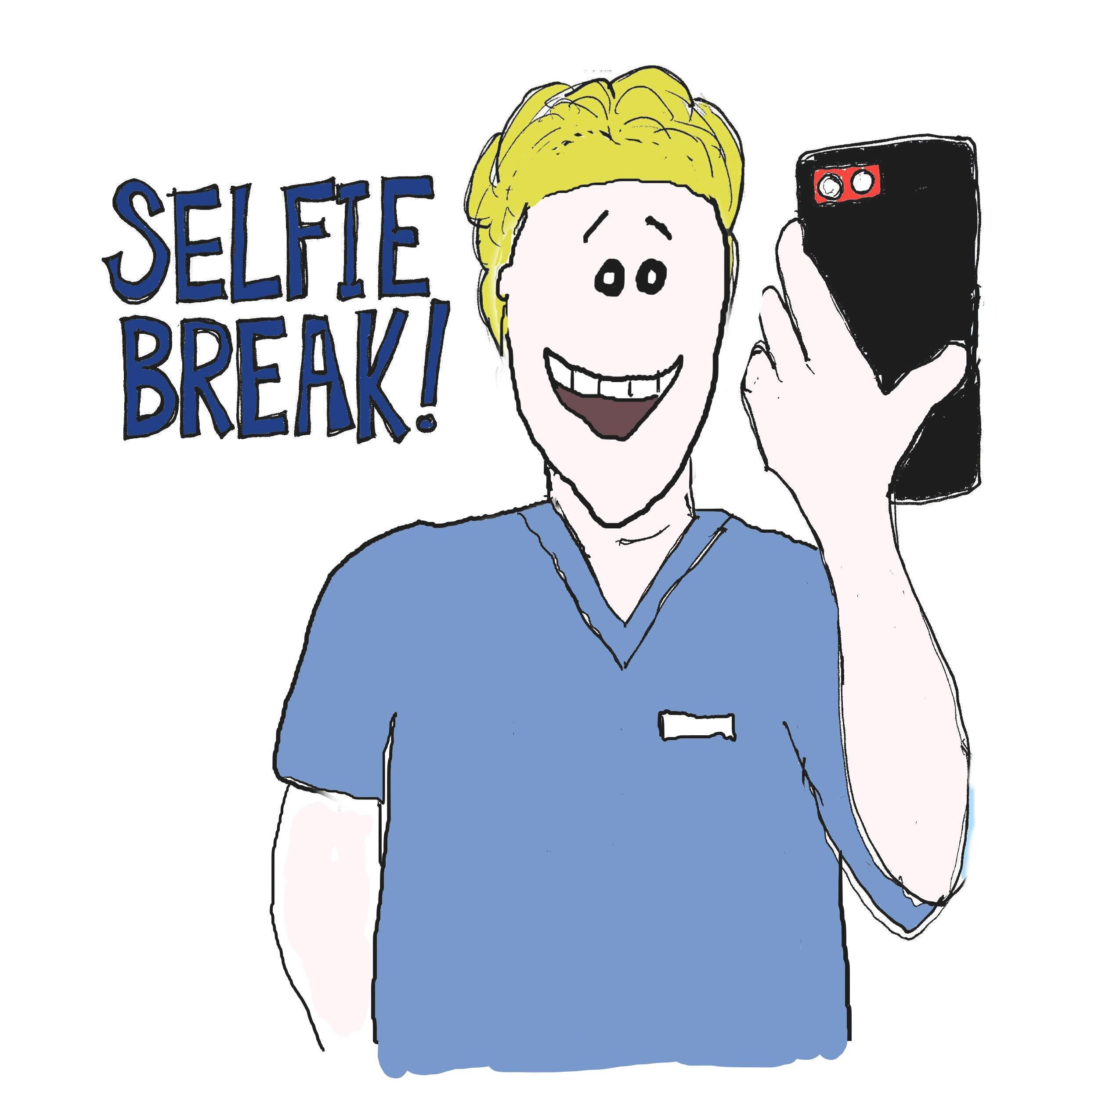
Social media use
Social media is higher risk during a pandemic.
Consider: employees venting; patients contacting you on social media; your organization using social media to keep the public informed and keep people connected.

Slide 25
Social media use by nursing homes

Slide 26
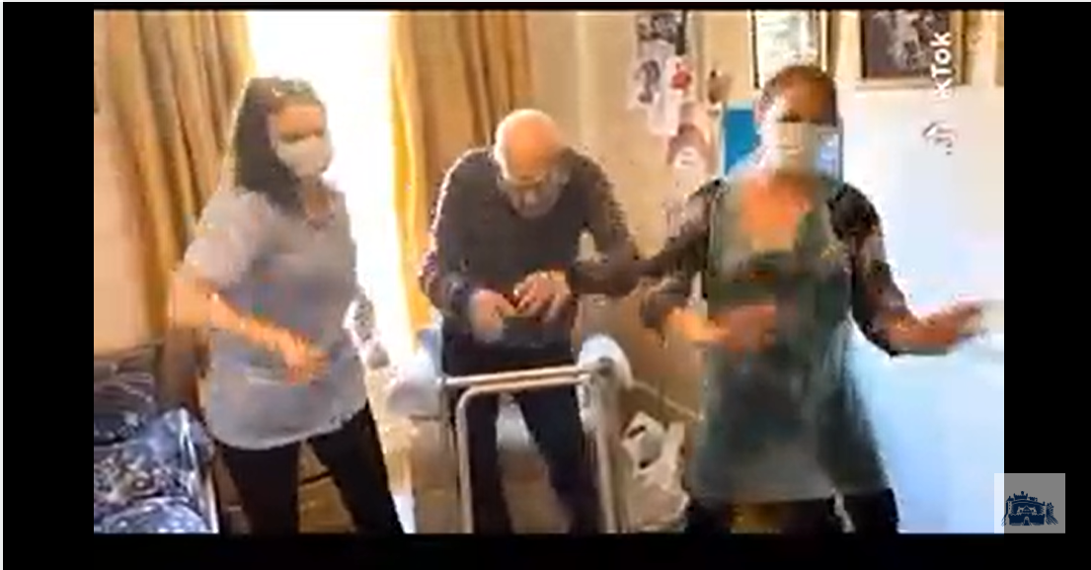
Tiktok twist
https://www.scotsman.com/health/watch-102-year-old-resident-scottish-care-home-shows-tiktok-dance-moves-staff-2546876

Slide 27
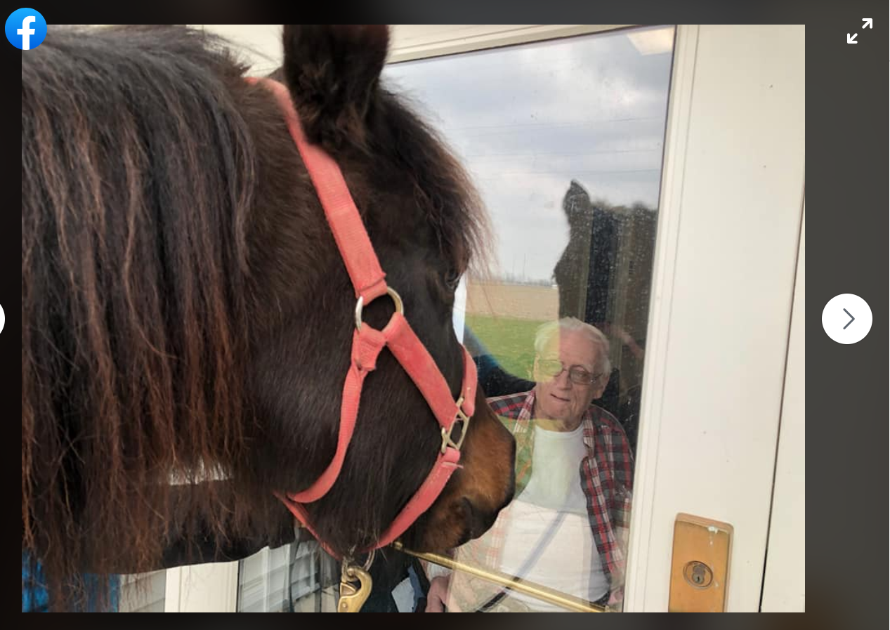
Colt call
a

Slide 28
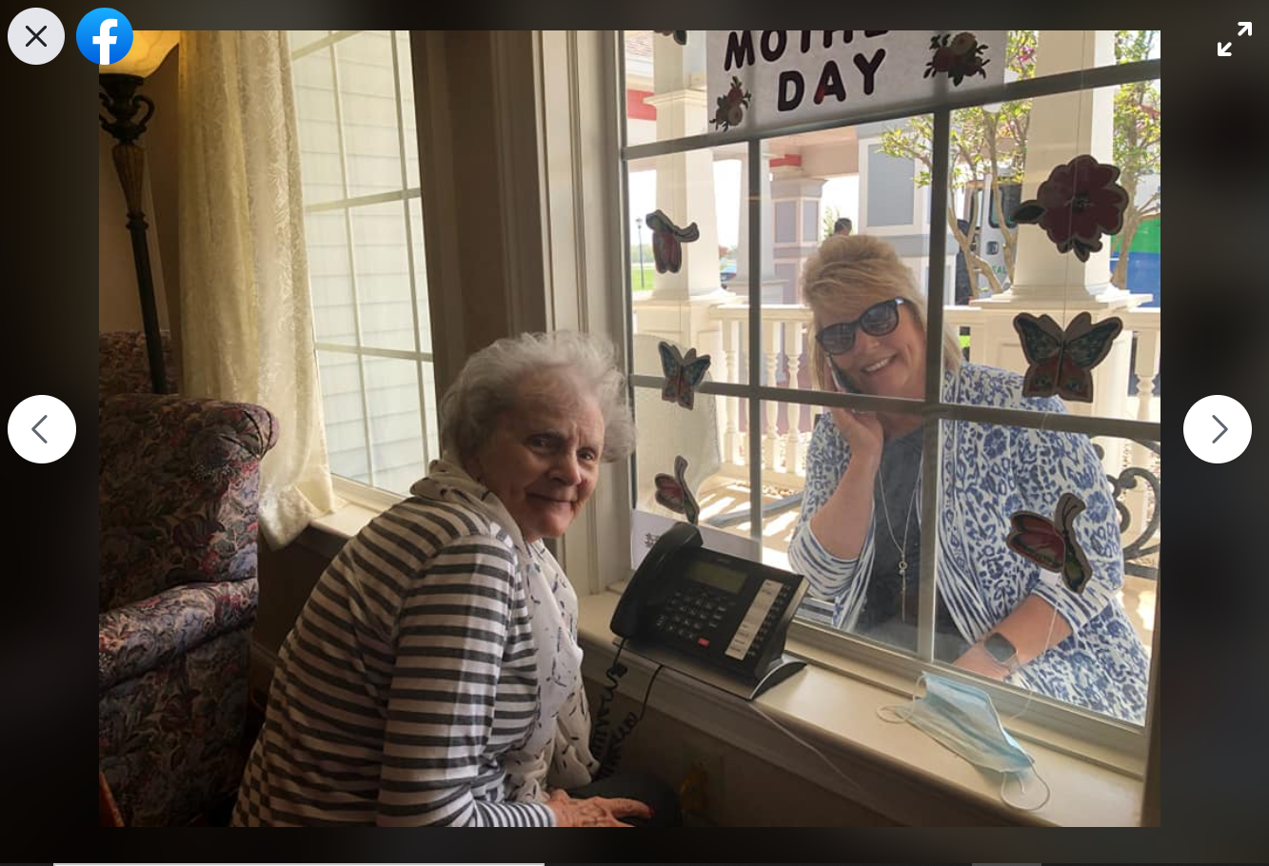
Mother’s day meeting

Slide 29
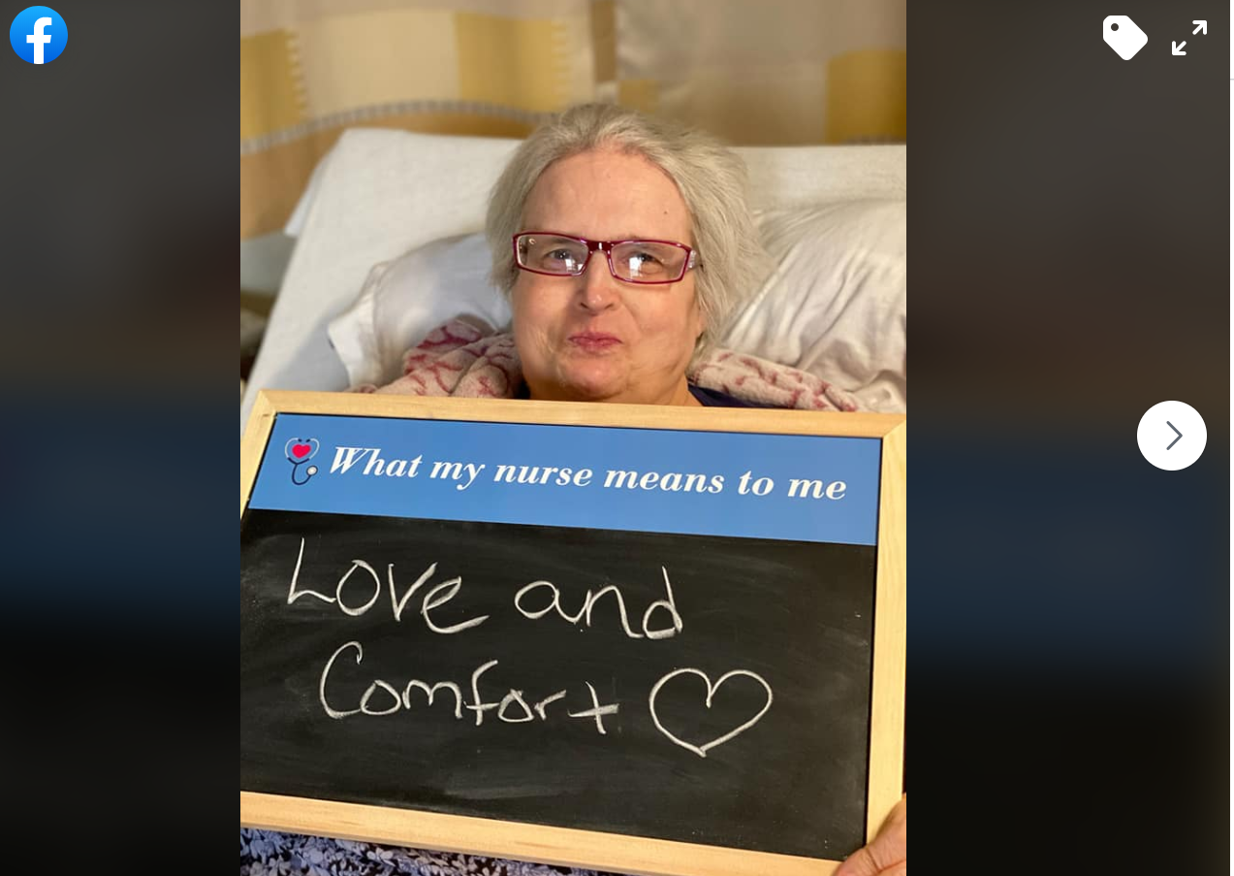
Nurse notes
Notes:
https://www.facebook.com/photo/?fbid=2568965523326715&set=pcb.2568965709993363

Slide 30
Parade!

Slide 31
Dancing dilemma
Notes:
https://www.cincinnati.com/story/news/2020/03/26/coronavirus-kindness-dancing-senior-citizens-football-ups-guy/2915920001/

Slide 32
Other examples
Residents taking cover in the dining room during a tornado watch, while wearing masks
Residents playing bean bag toss
Photos of a resident’s family wishing him happy birthday from outside his window
Facebook page: Made a video of residents thanking healthcare workers caring for them during the pandemic
Notes:
https://www.facebook.com/AngelinaHouseAssistedLiving/
https://www.facebook.com/willowshamburg/videos/vb.355132441336216/226326115386101/?type=2&theater

Slide 33
Social media use by employees

Slide 34
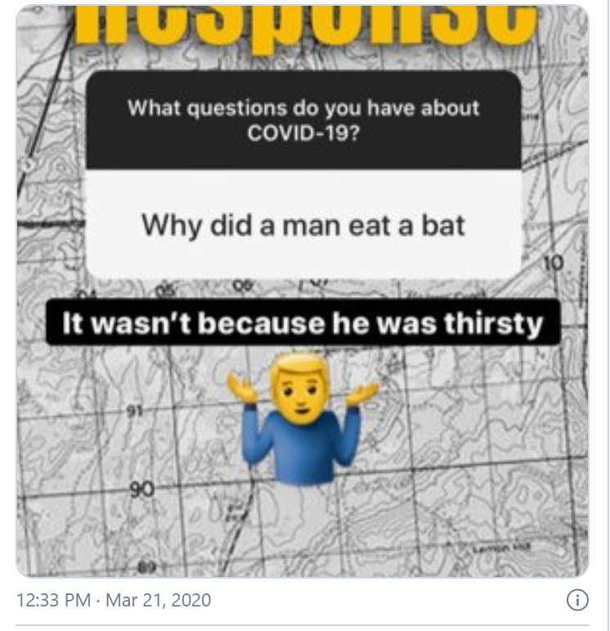
Misinformation mess
Notes:
Source: https://www.cnn.com/2020/03/21/politics/army-coronavirus-social-post/index.html

Slide 35
Ppe predicament
Notes:
Jhonna Porter
https://www.bloomberg.com/news/articles/2020-04-06/doctors-and-nurses-beware-hospitals-are-watching-your-facebook

Slide 36
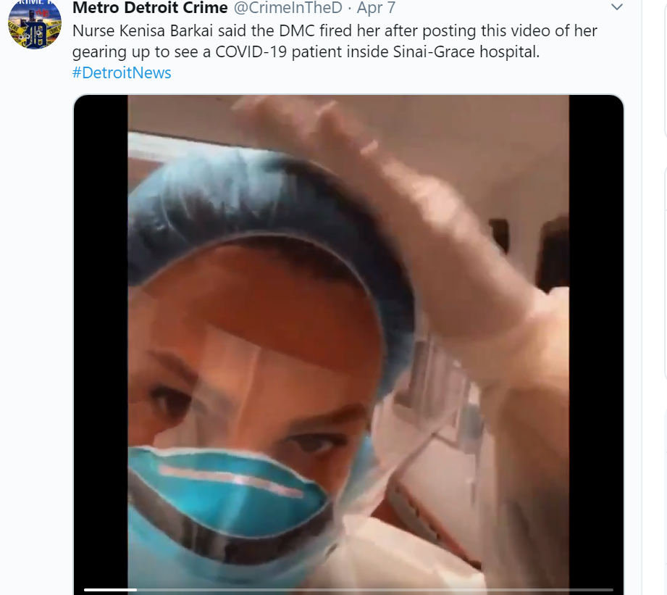
Gear quarrel
Notes:
https://www.clickondetroit.com/news/local/2020/03/29/i-am-nurse-strong-as-hospitals-become-overwhelmed-detroit-nurse-fired-for-posting-video/

Slide 37
Twitter trouble
@MedStarWHC can we please follow @_DCHealth guidelines for eating in common areas?
Notes:
https://www.washingtonpost.com/local/medstar-employee-claims-in-lawsuit-she-was-fired-for-tweeting-about-hospitals-lack-of-coronavirus-safety-precautions/2020/05/19/d7b41d0c-9a19-11ea-89fd-28fb313d1886_story.html

Slide 38
Proceed with caution
THE BEST WAY TO AVOID THESE SITUATIONS IS TO TRAIN PEOPLE ON WHAT NOT TO DO
REMEMBER: if it goes on social media, it could end up in the news.

Slide 39
Social media use
Do not post patient-specific information to social media without first obtaining a HIPAA authorization. This includes patients in the background.
Implement a social media policy that specifically addresses HIPAA.
Prior to using a new social media application, evaluate the risks with your HIPAA Security Risk Analysis process and mitigate any risks.
Maintain close communications between your HIPAA Privacy and Security Officer, and your marketing or public relations personnel. All marketing and PR communications and programs should be vetted for potential HIPAA risks.

Slide 40
Social media use
Regularly review your organization’s social media activity to ensure it is HIPAA compliant.
Train staff about appropriate social media uses during COVID-19 – the HIPAA stakes are higher during a pandemic.
Remind employees all filming requires pre-approval by the facility (before filming and before use)
Audit your organization’s social media presence.

Slide 41
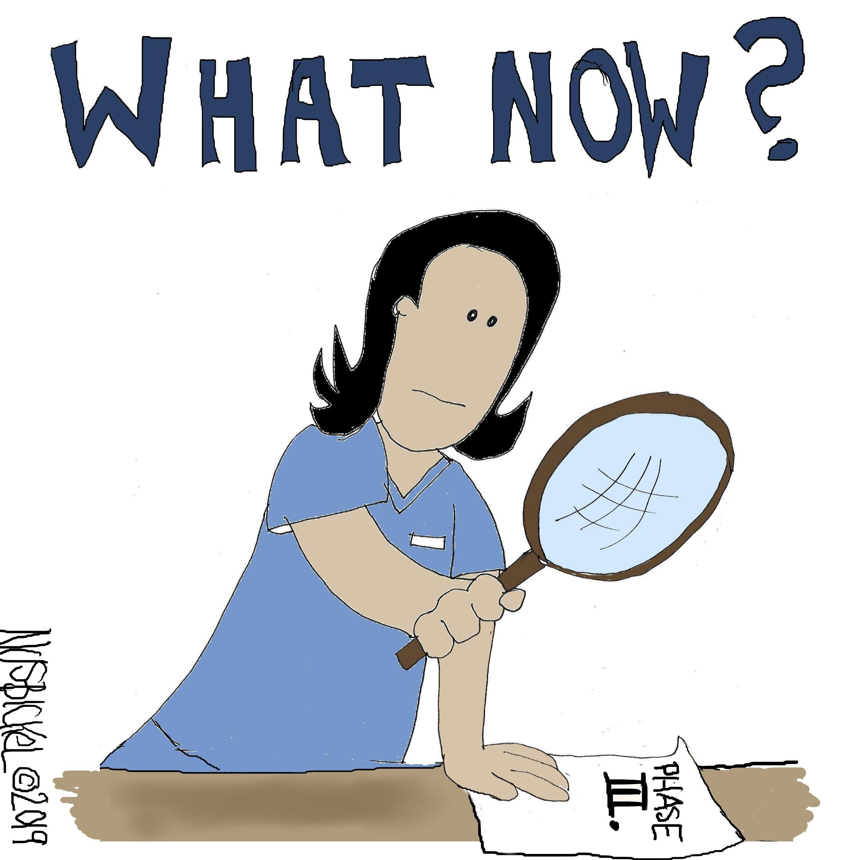

Slide 42
MPA discounts
All digital download HIPAA Tool Kits are 50% off until June.
Compliance program annual reviews are 25% off until June (call or email Margaret for info)
Our HIPAA & COVID-19 Toolkit is available at the discounted price of $95.
Now available: HIPAA & Social Media Toolkit with MPA Review
MPA will continue putting out HIPAA announcements, news, and tips on the blog and free compliance and HIPAA resources on its Free Resources page.
Healthcareperformance.com/store
call or email me: 314.394.2222 x 24 mcs@healthcareperformance.com

Slide 43
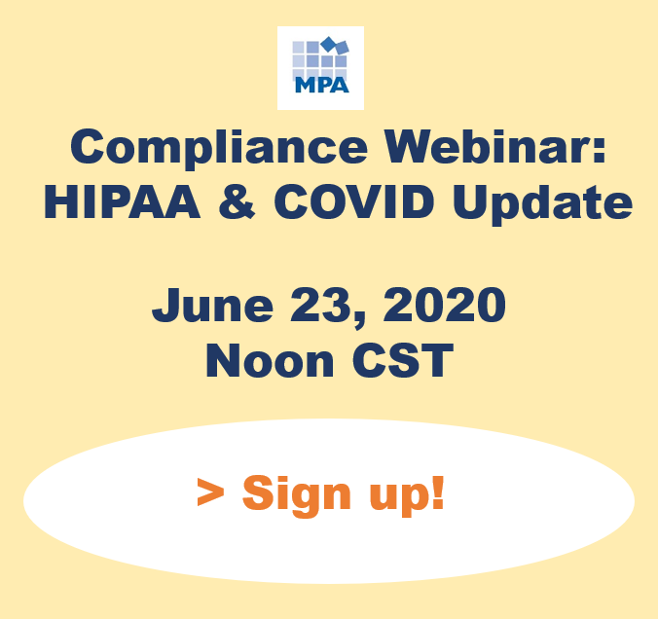
Coming up…
Register: https://us02web.zoom.us/webinar/register/WN_oPEm138gRnad_Wnzn5-5qw

Slide 44
Margaret Scavotto, JD, CHC
President
314-394-2222 ext. 24
mcs@healthcareperformance.com
Blog: www.healthcareperformance.com/blog
Store: www.healthcareperformance.com/store
Questions?
(c) 2019 Management Performance Associates
This presentation does not constitute legal advice

