Slide 1
Product Spotlight
The Office 365 Service Delivery Management Solution
Stuck in blame game?
How to keep users happy when part of your infrastructure is in the Cloud?
GSX isolates Office 365 problems that no one, even Microsoft, can address.
GSX provides the only solution to truly understand, troubleshoot and manage end-user experience across cloud or hybrid Office 365 deployment.
Full Cloud & Hybrid Experience
Test both Cloud & on-premises services
Health of hybrid identities
Network latency impact
Understand your infrastructure’s impact on end-user experience
Put facts to emotions
Perform real Office 365 scenarios;
From each critical location
True & unbiased performance data
True end-user experience data
Manage Office 365 service delivery
Be aware of the issue before your end-user
Troubleshoot faster
Automated service delivery reports
Instant ROI across your entire organization
Get a Free Trial at www.gsx.com I sales@gsx.com
© GSX Solutions
Notes:
GSX’s end-to end monitoring of Office 365 ensures that all features and functionalities are available and working. This has minimized outages, as well as improved the overall user experience and satisfaction with Office 365

Slide 2
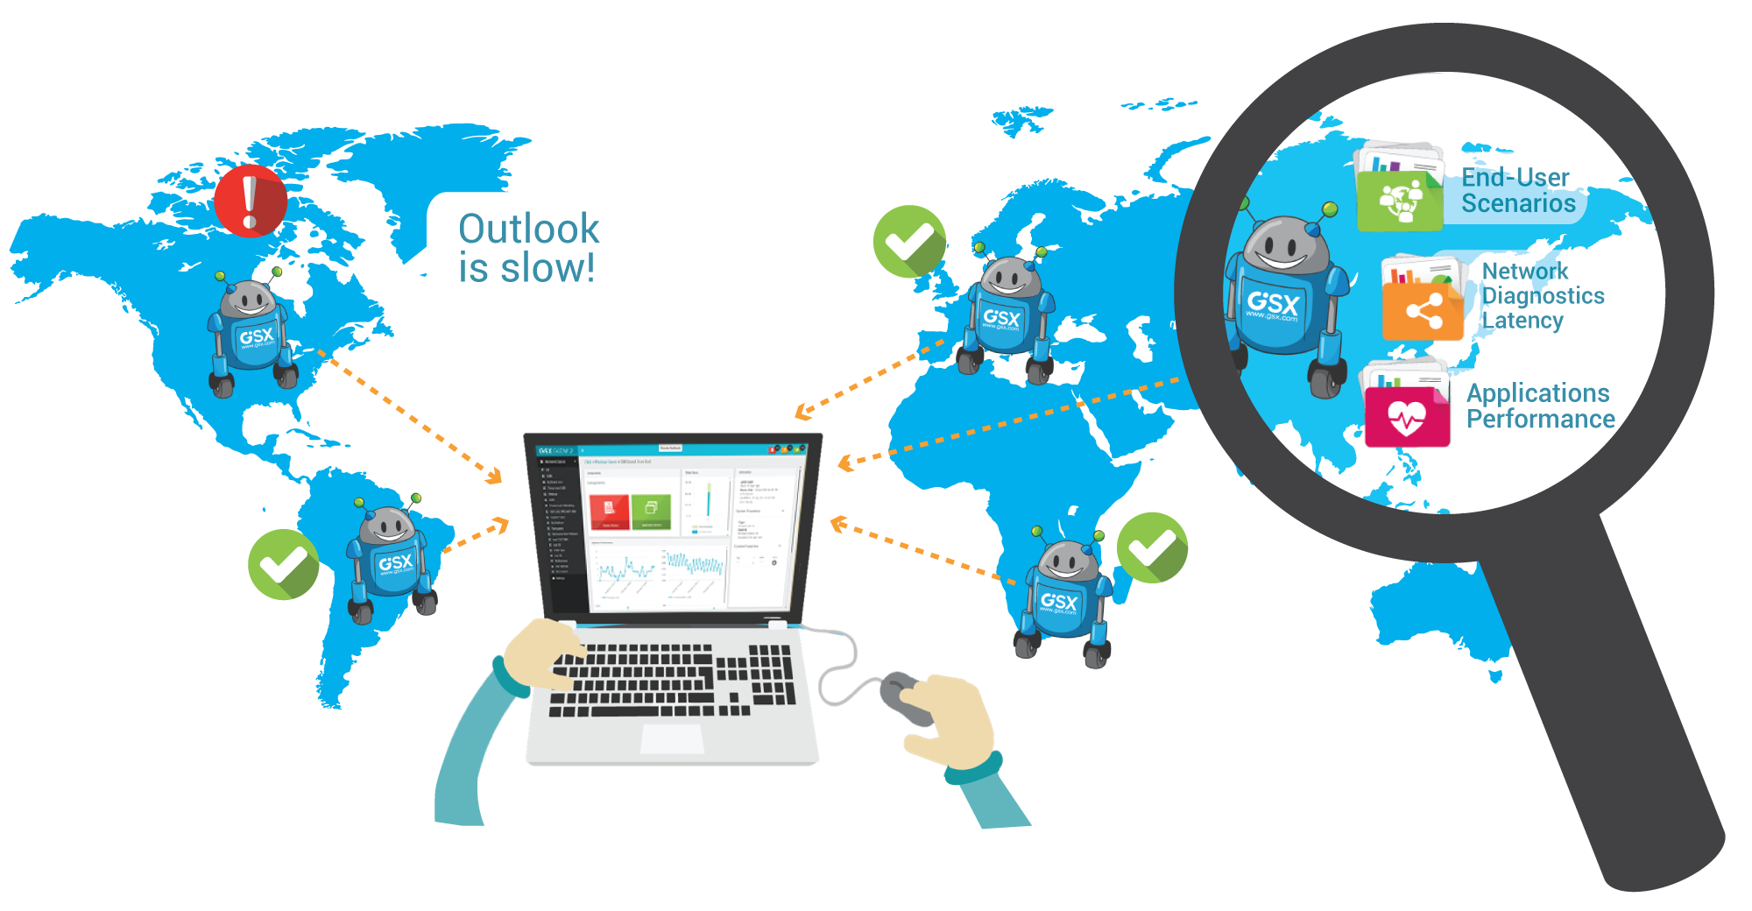
Measuring & Improving Office 365 Service Delivery
Free Office 365 Experience Assessment
Gain actionable insights into your end-user experience!
Request your assessment!
GSX Robot Users predict end-user complaints
Use the service continuously
Alert when and where it matters
GSX Robot Users allow you to troubleshoot faster
Test everything that impacts the end-user experience
Gather needed information on a single pane of glass
30% reduction of end-user complaints & escalation
50% reduction of your mean-time-to-repair
GSX Gizmo enables trust between your users, IT department and Microsoft
Unbiased data, no emotion, 100% facts, less frustration
GSX Gizmo reduces your O365 service management costs.
Get a Free Trial at www.gsx.com I sales@gsx.com
© GSX Solutions

