Slide 1
Charitable Giving Workshop
Developing your Personal Philanthropic Plan
Presented by:
Bridget Handke, CFP® CAP®
Notes:
Welcome to our charitable giving webinar. Today we will talk about how you might determine which charities you might like to give to, creating a charitable budget, and various ways to give that may be better than cash.

Slide 2
Checkbook Giving
Sometimes we give because of requests
Notes:
Historically I have given to my friend’s causes. One of those I give to every year is the Scleroderma Foundation because my colleague Dana participates in a fund raiser each year because the disease affects a child of one of her friends. The fund raiser involves skiing down a mountain numerous times to raise funds and awareness for the foundation. I’m not sure exactly what Scleroderma is. Dana reminds me each year but it doesn’t stick. Nevertheless, I donate to this cause each year because Dana asks. You could be doing something similar. Or maybe giving to your church from your checkbook out of obligation.
A few years ago after I noticed a lot of our clients were very charity minded, I embarked on acquiring a designation called Chartered Advisor in Philanthropy (CAP), which means I completed coursework and tests on a variety of charitable topics. During this coursework, I learned my giving was at the check book giving phase. I gave out of habit and whipped out my check book when I heard a good request. This work shop will explore other was to give that may be more mindful and meaningful.

Slide 3
Develop your Personal Philanthropic Plan
Notes:
Developing a Personal Philanthropic Plan can help you create more impact with your giving and can also give you more joy in seeing the fruits of your efforts and dollars. Getting clear about your goals and intentions will help you on your philanthropic journey. You may want to do this by yourself, with your partner or with your family.

Slide 4
Start with the Personal
Notes:
Start with why: It can help give you better focus so your giving is more fulfilling. You may find yourself more engaged. More connected to your charities. May result in more happiness for you. And the charities you ultimately pick will benefit from your intentional giving.

Slide 5
Define your Values
Acceptance | Fairness | Knowledge
Accountability | Faith | Leadership
Adaptability | Family | Love
Beauty | Freedom | Meaning
Challenge | Fun | Opportunity
Collaboration | Generosity | Peace
Commitment | Global view | Preservation
Communication | Harmony | Relationships
Community | Healing | Respect
Compassion | Honesty | Responsibility
Cooperation | Honor | Service
Courage | Independence | Simplicity
Creativity | Integrity | Spirituality
Dignity | Interdependence | Transformation
Diversity | Innovation | Trust
Equality | Joy | Truth
Excellence | Justice | Wisdom
Notes:
Directing your giving to what you value will help you leverage your dollars to the areas you care about most. While most people have a sense of their values, others haven’t had practice articulating them. You might decide to narrow your charitable giving to your top value. Or perhaps to your top 3 values. This slide shows you a list of common values. Choose which resonate with you or add your own. This values worksheet will be available for download following today’s session.
Lets just play this out a bit. Perhaps you find your top three values are Opportunity, Integrity and Knowledge. Well, there probably aren’t any charities that are titled that way. But you may know what this means to you. One of our clients really appreciated opportunity and wanted to see students of low income have the opportunity to pursue higher education. This would also fit in with knowledge. So if this was you, you might look for a charity that helps students with the opportunity to better themselves through education. And of course, you’d want to find a charity that met your definition of integrity.

Slide 6
Narrow the Field
Notes:
Let’s say you’ve picked your values, but the charities in these areas aren’t jumping out at you.

Slide 7
Issue Areas and Populations
AIDS | Girls
Animals | Healthcare
Anti-Racism | Homelessness & Housing
Art & Art Institutions | Human Rights
Boys | Immigrant & Refugee Rights and Services
Child Abuse | Legal Aid
Children | Literacy
Civil Rights | Medical Reserach
Community Development | Native & Indigenous People’s Rights
Community Gardens | Peace
Conservation | Philanthropy & Volunteerism
Corporate Responsibility | Poverty
Disability Rights | Prison Reform
Disaster Relief | Public Policy
Drug and Alcohol Abuse | Reproductive Rights
Domestic Violence | Science & Technology
Economic Justice | Spiritual Development
Education | Sports & Recreation
Elder Care | Sustainable Development
Environment | Women’s Rights
GLBTQ | Youth Development
Notes:
This is a chart of typical giving areas. It’s not exhaustive. There may be issues areas that pop out at you after you’ve considered your values. From here you might select your top three issues.

Slide 8
Types of Organizations
Empowerment and Leadership Development
Community organizing
Research
Legal Action
Advocacy and Public Policy
Human or Direct Service
Notes:
Once you’ve determined what area you’d like to give to, next decide what kind of organization with in that field is most important to you.
Empowerment and leadership development – developing the voice and the capacity of people directly impacted by an issue to be involved in determining how best to solve an issue. Girls on the Run where mentors teach girls to run a 5k and develop a sense of confidence and accomplishment is an example. Junior League also develops leadership skills.
• Community organizing – bringing large groups of people together to address common issues. Student and neighborhood organizations are an example of this.
• Research – getting the scientific facts to better understand an issue or medical research to understand and/or find a cure. For example the Alzheimer association which researches for Alzheimer's
• Legal action – using the law to protect against or remedy an injustice. The ACLU or Sothern Poverty Law Center are both examples of this type of organization.
• Advocacy and public policy - working to create awareness about an issue and its impact and helping to influence public policy that can alleviate the problem or work toward long-term solutions. MN Center for Environmental Advocacy.
• Human or direct service – providing a service to an individual that addresses their immediate concern; this could be food, shelter, clothing, health care, or other need. Crisis Nursery.

Slide 9
Determine the Breadth of Your Giving
Notes:
Next, determine the breadth of giving you would like to consider. How deeply or broadly would you like to give?
Contributions to a small set of organizations: Choosing just a few organizations (1-3) that match your values and interests is a very effective way to create impact and build a relationship with those few organizations. By concentrating your giving, you might be able to single handedly meet a particular organizational need. Or you may be able to go in with other donors to address a specific project.
Contributions to a broad range of projects and programs: You might choose to give to a wide range of areas or organizations that satisfies your desire to affect many areas. Giving through a foundation where you have the ability to reach a wide range of organizations and their projects and programs, is a very effective way for you to have a broad reach and impact, as your gift is combined with others that have chosen the same option.

Slide 10
Determine your Budget
Notes:
Since we are financial advisors, we couldn’t skip developing your charitable budget. We hope your giving plan fits in with all your other goals and obligations.

Slide 11
How Much to Give?
Tithe
% of Assets
% of Income
What you can afford
Notes:
One question we get a lot is “How much should I give?” At Birchwood Financial Partners, we try to stay away from shoulds and instead offer options for you to choose.
In terms of a financial plan, many people think about saving and spending. When creating a Personal Philanthropic Plan, it may be helpful to include Charitable Giving as part of your overall financial plan.
How much you give is a personal decision and there is no right or wrong answer. As planners we would want to be sure your giving fits in with your other goals and obligations.
The Philanthropic Roundtable reports that giving differs by region. In the midwest, average giving last year 4.3% of adjusted gross income.
Other ways to give are tithing – which generally has meant giving 10% to church.
You could give a % of your assets
A % of your Income
Or simply what you feel you can afford.

Slide 12
Giving Budget Categories
Personal Obligation
Fun or Impulsive
Emotional Connection
Values Driven
Notes:
It may be helpful to organize your criteria into Giving Budget Categories.
I allocate dollars to Dana’s fund raiser under personal obligation. I might even change the name of this category to: Supporting my friends. Other people might decide to keep this category and this might be giving to their church or school.
Fun or Impulsive might be dumping water on your head for ALS and following up with a check. Or maybe running a Tough Mudder that will support wounded warriors.
An emotional connection might a result of following social media stories about hurricanes and giving to the warehouses collecting diapers and emergency supplies.
The Values Driven Category may be the bulk of your dollars and the result of all the work you did to put together your Personal Philanthropic Plan.

Slide 13
Giving Budget Categories
Notes:
I may have decided that my Values Driven category supports giving to education, but I’m not going to stop helping my friend with her fund raiser! Instead, after I determine my charitable dollars, I’m going to further budget out how I’m going to spend those dollars within each category.
I get a lot of requests from friends for their fund raisers. Many for the MS Society since we have family members with MS. Under Personal Obligation, I’ll budget for this and Dana’s fundraiser.
I’ve included a chart in our handouts that may be helpful when planning how to give in each category. This set up was suggested by the Minneapolis Foundation.

Slide 14
Methods of Giving
Beyond Cash
Notes:
Once you’ve figure out which charities you want to give to and how much, the next section will discuss how to give. Beyond just writing a check or paying with a credit card.

Slide 15
A Quick Review of the New Tax Law
Personal exemptions are eliminated
Standard deduction is now $12,000/$24,000
State tax deduction is capped at $10,000
Miscellaneous deductions are eliminated
For more information visit: https://www.irs.gov/credits-deductions/individuals/standard-deduction-at-a-glance
Notes:
Above is a quick review of the most recent federal tax law
Exemptions are eliminated
Standard Deduction is now $12,000/$24,000
State tax deduction is capped at $10,000
Miscellaneous Deductions are eliminated

Slide 16
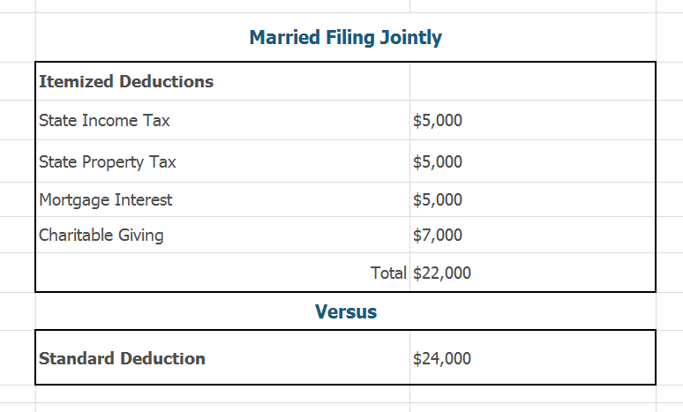
Many will Take the Standard Deduction
Notes:
Here is an example of the itemized deductions a married couple named the Greens have.
In this example, the Greens give $7,000 to charity. Previously, the Greens could use Itemized Deductions as the chart shows on the top. But because of the tax law changes the Greens are only able to use the Standard Deduction as you see on the bottom of the chart. Their charitable contribution will not have the tax reducing impact it would have in the past.

Slide 17
Stack Your Charitable Contributions
Notes:
One alternative is for the Greens to stack their charitable deductions. What this means that in year one, they are going to give 3 years worth of charitable contributions all in one year. Then for the next two years they aren’t going to give anything.
As you can see, they will have $36,000 of itemized deductions in year one, and none in the subsequent years. Since the standard deduction is $24,000, this means that $12,000 of their charitable contributions will have a tax reducing impact for them, as opposed to zero.
So this can be a great strategy for many people. But it might stress your charities as they will have unequal revenue from year to year.

Slide 18
Consider a Donor Advised Fund (DAF)
Irrevocable gift to a public charity that earmarks the funds in your name for future giving.
The gift to the DAF is considered your charitable giving for tax purposes.
You grant from your DAF to your favorite charities in subsequent years. No further tax deduction.
Notes:
The charities uneven income which could affect their operating budget. A work around for this is to give to a Donor Advised Fund. These are public charities and hold funds in your name. You could give your stacked gift of $21,000 and they will put those assets into an account for you. Then over the course of several years you can grant to your favorite charities.
The gift is irrevocable. No changing your mind.
You no longer own the funds.
The gift to the DAF is the charitable gift for income tax purposes.
Then you can go in and gift to your favorite charities in the form of a grant. These grants do not have an income tax impact.
You can use the DAF in a number of ways.
You can stack your gift and give to charities each year to even out their income.
You give to a DAF on a big income year such as a big bonus year and hang onto the funds to give at retirement.

Slide 19
Give Appreciated Assets
You avoid Capital Gains tax.
You receive full value of the gift.
You are limited to giving 30% of your adjusted gross income for tax deduction purposes.
Your charity receives the full value of your gift.
Notes:
One way to improve the tax aspect of your giving is to give appreciated assets such as stocks, bonds and mutual funds instead of cash. So for example, suppose your Uncle gave you a bunch of 3M stock that he had acquired for $20 per share. And Suppose now it’s trading at $200 per share. You could sell some stock to get cash to give a gift. But in doing so you will realize a capital gain and pay capital gains tax on the gain.
And, each time you go to sell the stock, even if it’s two years from now to buy a new car, you will have to pay the capital gains tax.
But instead, you could give the 3M shares themselves. Transfer the securities to your favorite charity’s brokerage account or to your DAF. You get the benefit of giving the full value of the shares. The charity doesn’t pay tax, so when they sell the shares, they still get full use of your gift.
If you give to a DAF, the DAF will convert your gift to their investments and when you grant to your favorite charity the DAF will send a check. Using a DAF for your appreciated stock is a great way to get a potential tax benefit and also help out those small unsophisticated charities that may not be able to handle a gift of securities.

Slide 20
Give out of your Individual Retirement Account (IRA)
You must be 70½.
Can satisfy part of your Required Minimum Distribution (RMD).
You can give up to $100,000 directly from your IRA to charity.
The income never hits your tax return.
Beneficial if you take standard deduction.
Notes:
If you are over the age of 70 ½ and especially if you are taking the standard deduction, it is best to give to charity directly from your Individual Retirement Account. You can give up to $100,000 a year. Whatever you give from your IRA will not hit your tax return.
You’ll still get a 1099 that states you satisfied your Required Minimum Distribution, but with a receipt from the charity and a Qualified Charitable Distribution letter from your custodian you can instruct your tax preparer to subtract the gift from your RMD from your income. You could ask your financial advisor for assistance.

Slide 21
Give Life Insurance
Name a charity as beneficiary.
Give the policy to the charity and also gift the premiums to them each year.
Give them the policy to cash in.
Cash in the policy and gift the cash value.
You should meet with your insurance agent to discuss the details of your policy.
Notes:
Another way to give to charity is to give life insurance.
If you have a life insurance policy that you don’t need for your beneficiaries, you could name the charity as the beneficiary.
Or, you could gift the policy to your charity and they become owners and beneficiaries. The value of the cash value becomes a charitable gift. You could also gift the charity the premium to pay the policy each year and that also is considered a charitable gift which could have a tax reducing impact .
Another thing you can do is just give them the policy. This may work if there are no more premiums to pay. Your potential tax deduction would be the total premiums you’ve paid less any withdrawals.
Or you could simply cash in the policy and give the cash value as a gift. Note that if you cash in a policy and receive more than the premiums you’ve paid then you would owe income tax on that amount.

Slide 22
Life Insurance on Steroids
If you have a Required Minimum Distribution (RMD) you don’t need.
Use the RMD to pay life insurance premiums.
Purchase a policy to leverage the life insurance and give a gift substantially larger than you normally could have.
You should meet with your insurance agent to discuss the details of your policy.
Notes:
Suppose you’d like to give a really substantial gift but just don’t have the resources to leave a big gift to a charity as well as your beneficiaries. Lets say you have an IRA and you simply don’t need the income but you have to take your Required Minimum Distributions anyway. You could take out a life insurance policy and pay the premiums with the RMDS. This could be a way to leverage your RMDs to buy a life insurance policy that has a death benefit much larger than you would normally give. There is no tax benefit to lower your income.

Slide 23
More Complex Gifting
All are irrevocable
Most require the services of a good:
Financial Advisor
Estate Planning Attorney
Tax CPA
Notes:
We have a few more tools that are a bit more complex. They are by no means the only other tools out there. Please make a note, that as with giving to charity in other ways, these tools are irrevocable. Some of them are so complicated that it would be best to work with a team of experts that include your Financial Advisor, an experienced Estate Planning Attorney as well as a CPA.

Slide 24
Retained Life Estate
Give your home to charity now but continue to live in it
Notes:
Lets say your favorite charity is seeking big donors and you would like to help them out. However, your largest asset is your home, and since you are still living you are not done with it yet.
You could give a Retained Life Estate. Essentially what that means is you give your house, but retain the right to live in it while you are alive! Your tax deduction would be only a portion of your home.
As Financial Advisors, we would want to make sure you had adequate other resources. If you needed your home and had to move to assisted living, you would not be able to use the equity of your home toward the cost of your new living. So this strategy would need some analysis.

Slide 25
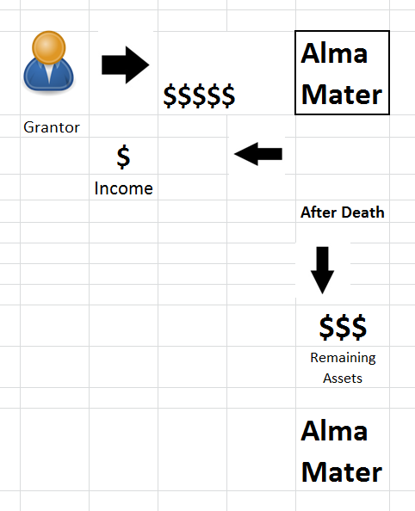
Gift Annuity
Give a charity a large sum and they will give you monthly income for life.
Notes:
A gift annuity is another irrevocable gift that allows you to give now but keep something for yourself. This is normally done with large charities such as Universities.
In this example you give a sum of money to your Alma Mater. Your Alma Mater will give you (or perhaps two of you) a monthly income stream for life or a period of years. At the time of your death, the rest of the cash is then available to the University.
Only a portion of this gift has the potential for a tax deduction.

Slide 26
Charitable Remainder Trust
Notes:
A Charitable Remainder Trust is similar to a gift annuity, but instead of giving assets to a charity, you give them to a trust that you and your attorney have created. You then receive income from the trust.
At the end of your life, the remaining assets then go to charities of your choosing.

Slide 27
Charitable Lead Trust
Notes:
A Charitable Lead Trust is the opposite of the CRT and is sometimes used with very very large estate. It is an estate planning technique for large estate to avoid tax.
You give an asset to the trust. The trust then supplies your favorite charities with an income from that asset for a specified amount of time. After that time is done, the remaining dollars go to your beneficiaries.
If might be used to leave funds to beneficiaries, but you want your beneficiaries to make their own way first before inheriting a large sum. Most of the time however, this technique is used in conjunction with a number of other too.

Slide 28
Conclusion
Figure out what is most important to you.
Develop a budget for giving that is realistic.
Determine your best assets to give.
Receive a tax deduction if possible.
Get help with anything fancy.
Notes:
In conclusion, when it comes to charitable giving, you may find more joy in philanthropy when you consider what is more important to you.
Then develop a budget for yourself and determine how much of your giving will be for requests and obligation, fun, emotional and values driven purposes. After that, work with an advisor to determine what the best assets are to give that will give you the biggest tax break and also will keep your own financial plan humming.
And if you decide to do something more complex, please consult a team of experts so that you don’t end up with any surprises!
Again, you will be receiving handouts from today’s session in your email shortly.

Slide 29
Interested in more help with your Charitable Giving Plan? Email us at Birchwood@BirchwoodFP.com

Slide 30
Investment Advisory services offered through Birchwood Financial Partners, Inc., an SEC Registered Investment Advisor. All written content is for information purposes only. It is not intended to provide any tax or legal advice or provide the basis for any financial decisions. Opinions expressed herein are solely those of Birchwood Financial Partners, Inc., and our editorial staff. Material presented is believed to be from reliable sources; however we make no representations as to its accuracy or completeness. All information and ideas should be discussed in details with your individual advisers or qualified professional before making and final decisions. We are not affiliated with or endorsed by the Social Security Administration or any government agency. The inclusion of any link is not an endorsement of any products or services by Birchwood Financial Partners. All links have been provided as a convenience.

