Slide 1
How PrivacyArmor® provides holistic identity theft protection for employees
Presented by Brian Atz
August 27, 2019

Slide 2
About InfoArmor
The leader in identity protection and proud member of the Allstate Corporation family
12 years
3,000
perfecting identity protection as a benefit
U.S.-based employers depend on us
2.2 million
30%
lives protected
of the Fortune 500 trusts us

Slide 3
What is identity theft?
When someone uses your personal information without permission to open an account or access your financial records — that’s identity theft, and it’s a serious crime.
Every two
seconds
120 hours
on average to resolve
identity theft on your own
An identity is stolen in the U.S.¹

Slide 4
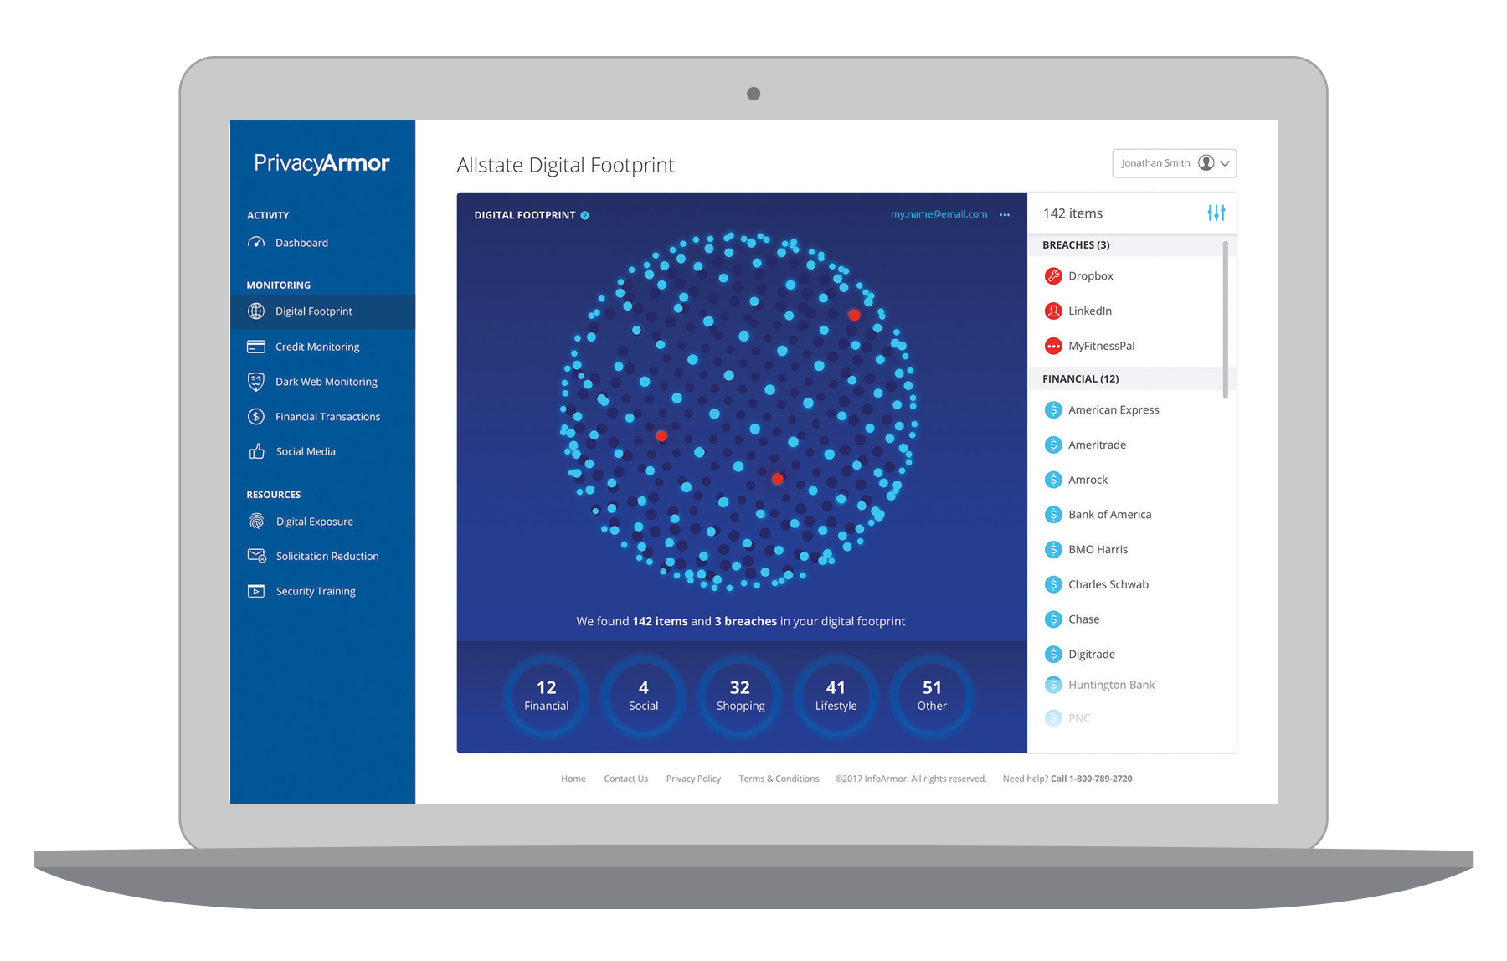
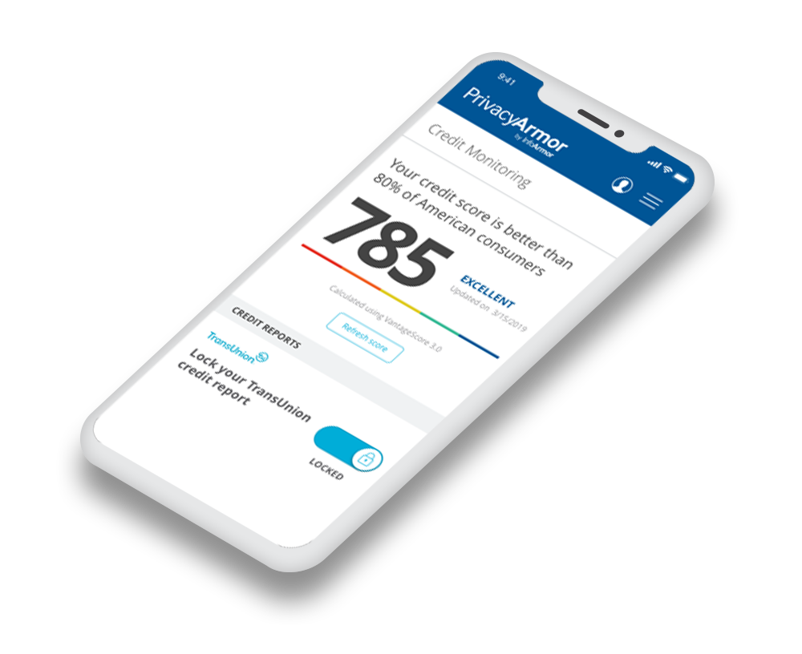
What is PrivacyArmor?
We offer three levels of PrivacyArmor, our proactive identity monitoring service that sends alerts at the first signs of fraud. Our intelligence platform and monitoring capabilities detect, intercept, and restore the misuse of personal information that puts identities and enterprises at risk.
What we monitor:
Social Security numbers
Credit and debit card numbers
Financial accounts
Email addresses
Log-in credentials
IP addresses
✓
✓
✓
✓
✓
✓

Slide 5
Product demo
What we’ll be sharing today:
How to setup a new account
How to add family members
How to setup financial thresholds
How to obtain credit reports
How to lock your credit
How to connect your social accounts
How to add items to dark web monitoring
An overview of notifications and alerts
Our newest feature, the Digital Footprint

Slide 6
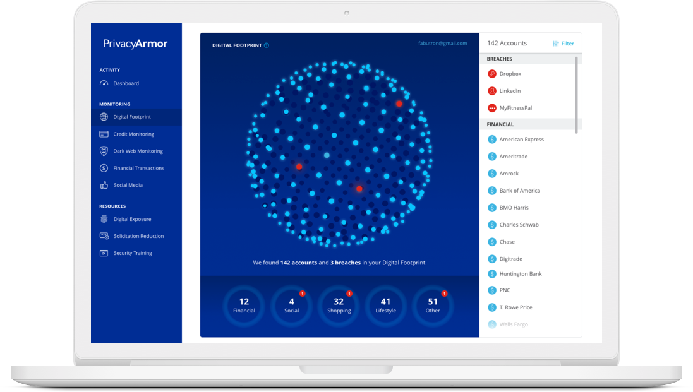
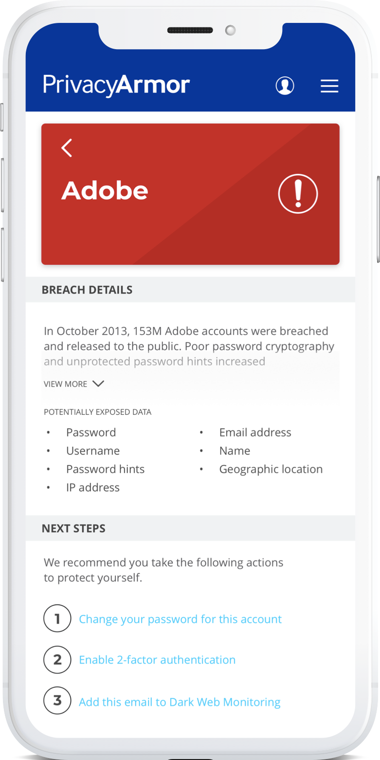
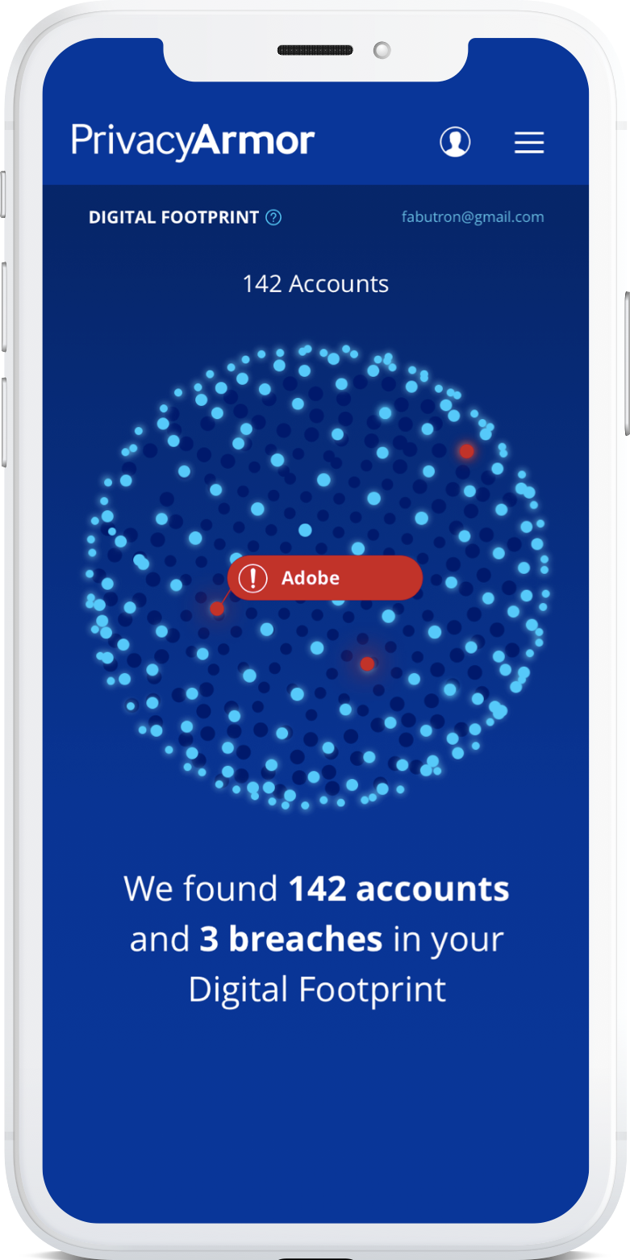
Digital Footprint
A digital footprint is a collection of all the accounts a person has opened, and information they’ve left behind that might expose them. The Digital Footprint offers a simple way for people to see and secure their information, and is our next step in reinventing digital and identity protection.
Personal, meaningful insights and tangible actions help users know, protect, and control their data.
*These images are for illustrative purposes only. Ongoing testing may necessitate design changes.

Slide 7
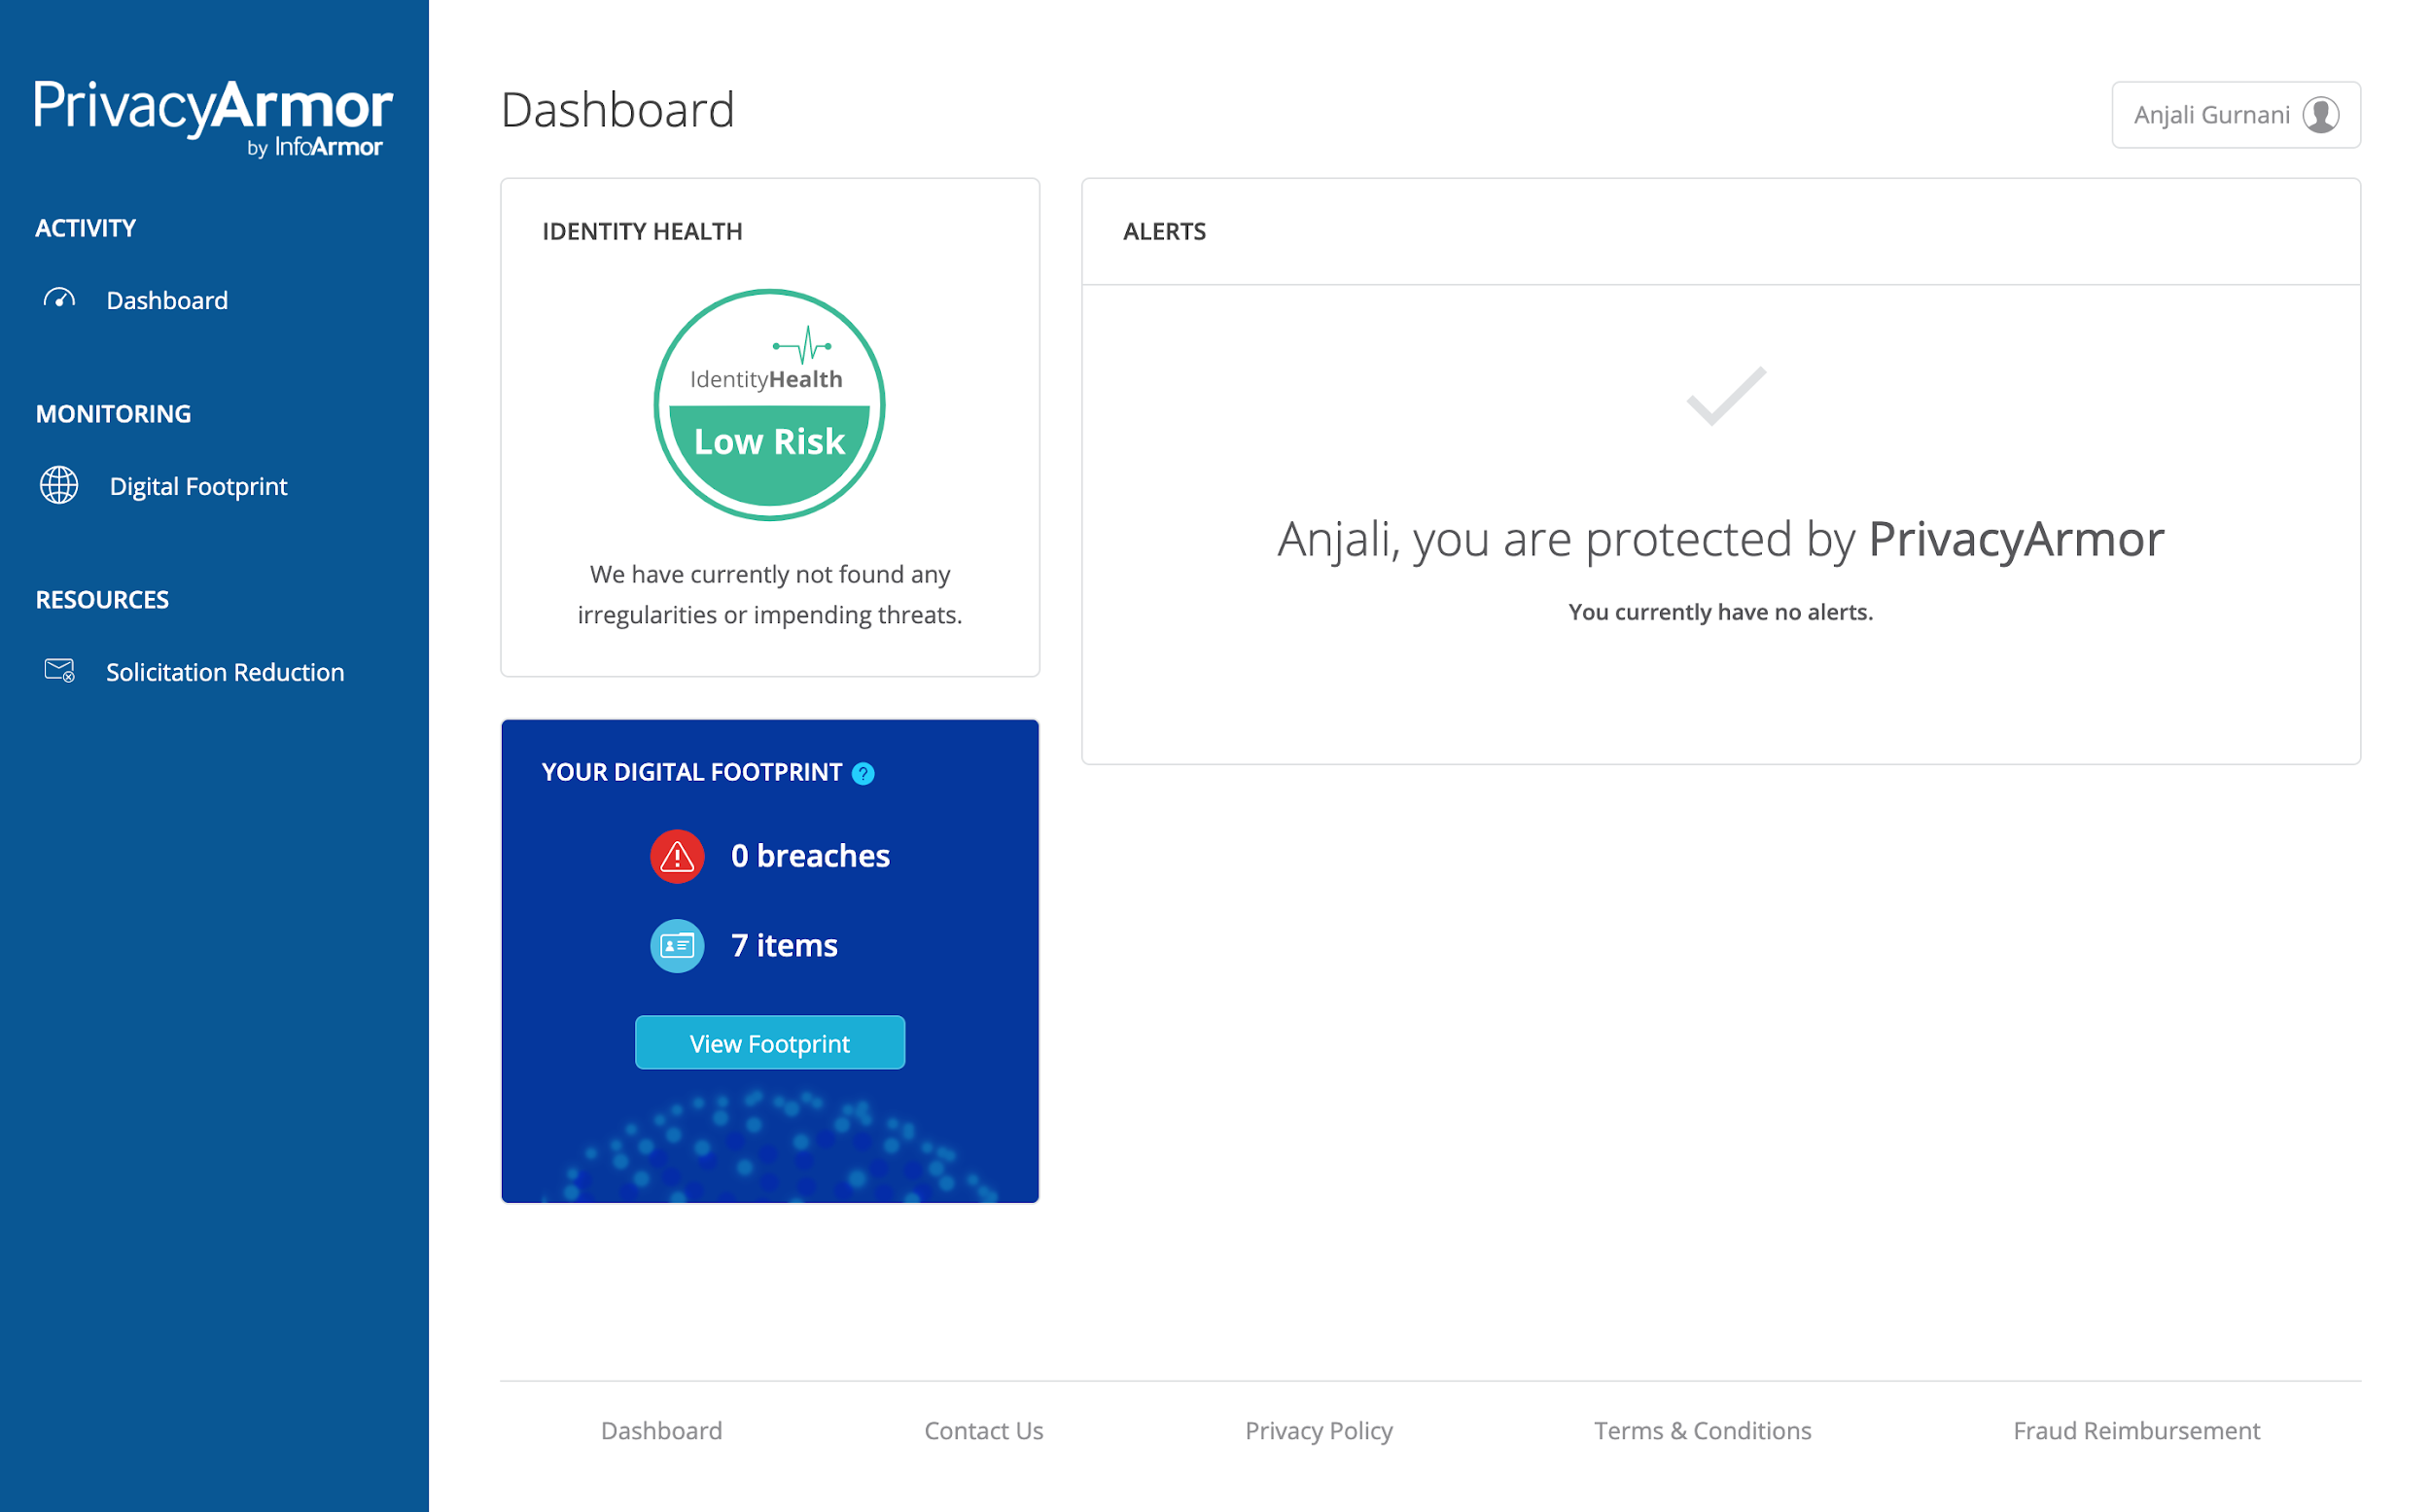
Getting started with the Digital Footprint

Slide 8
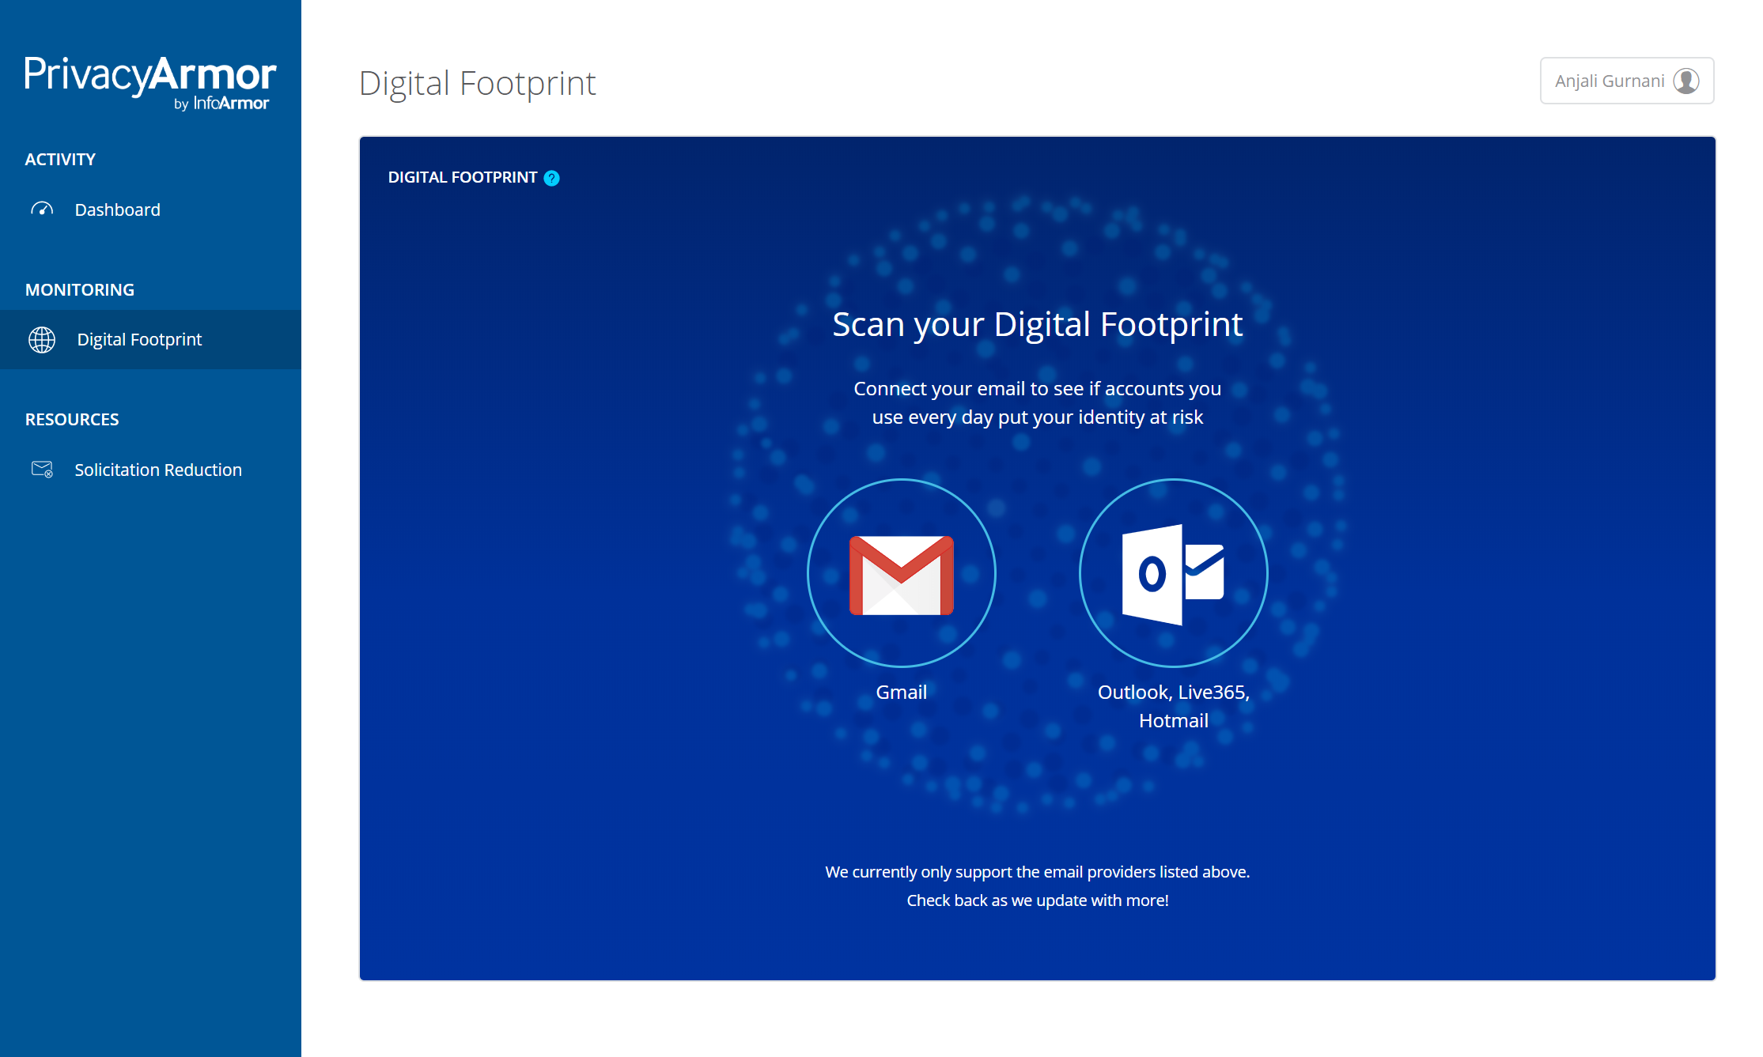
Connecting your Digital Footprint

Slide 9
Interacting with your Digital Footprint

Slide 10
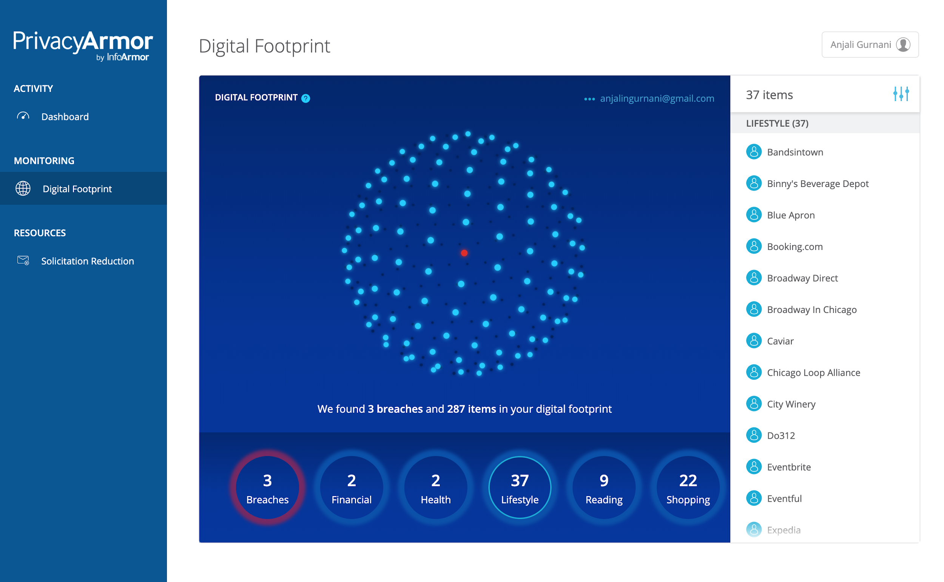
Interacting with your Digital Footprint

Slide 11
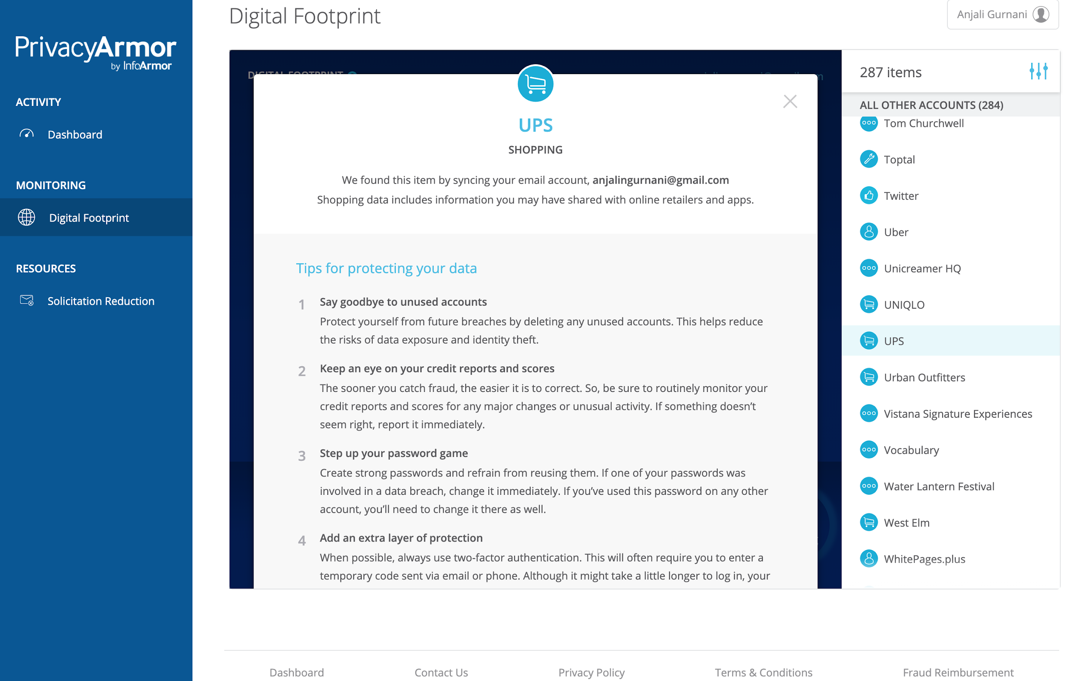
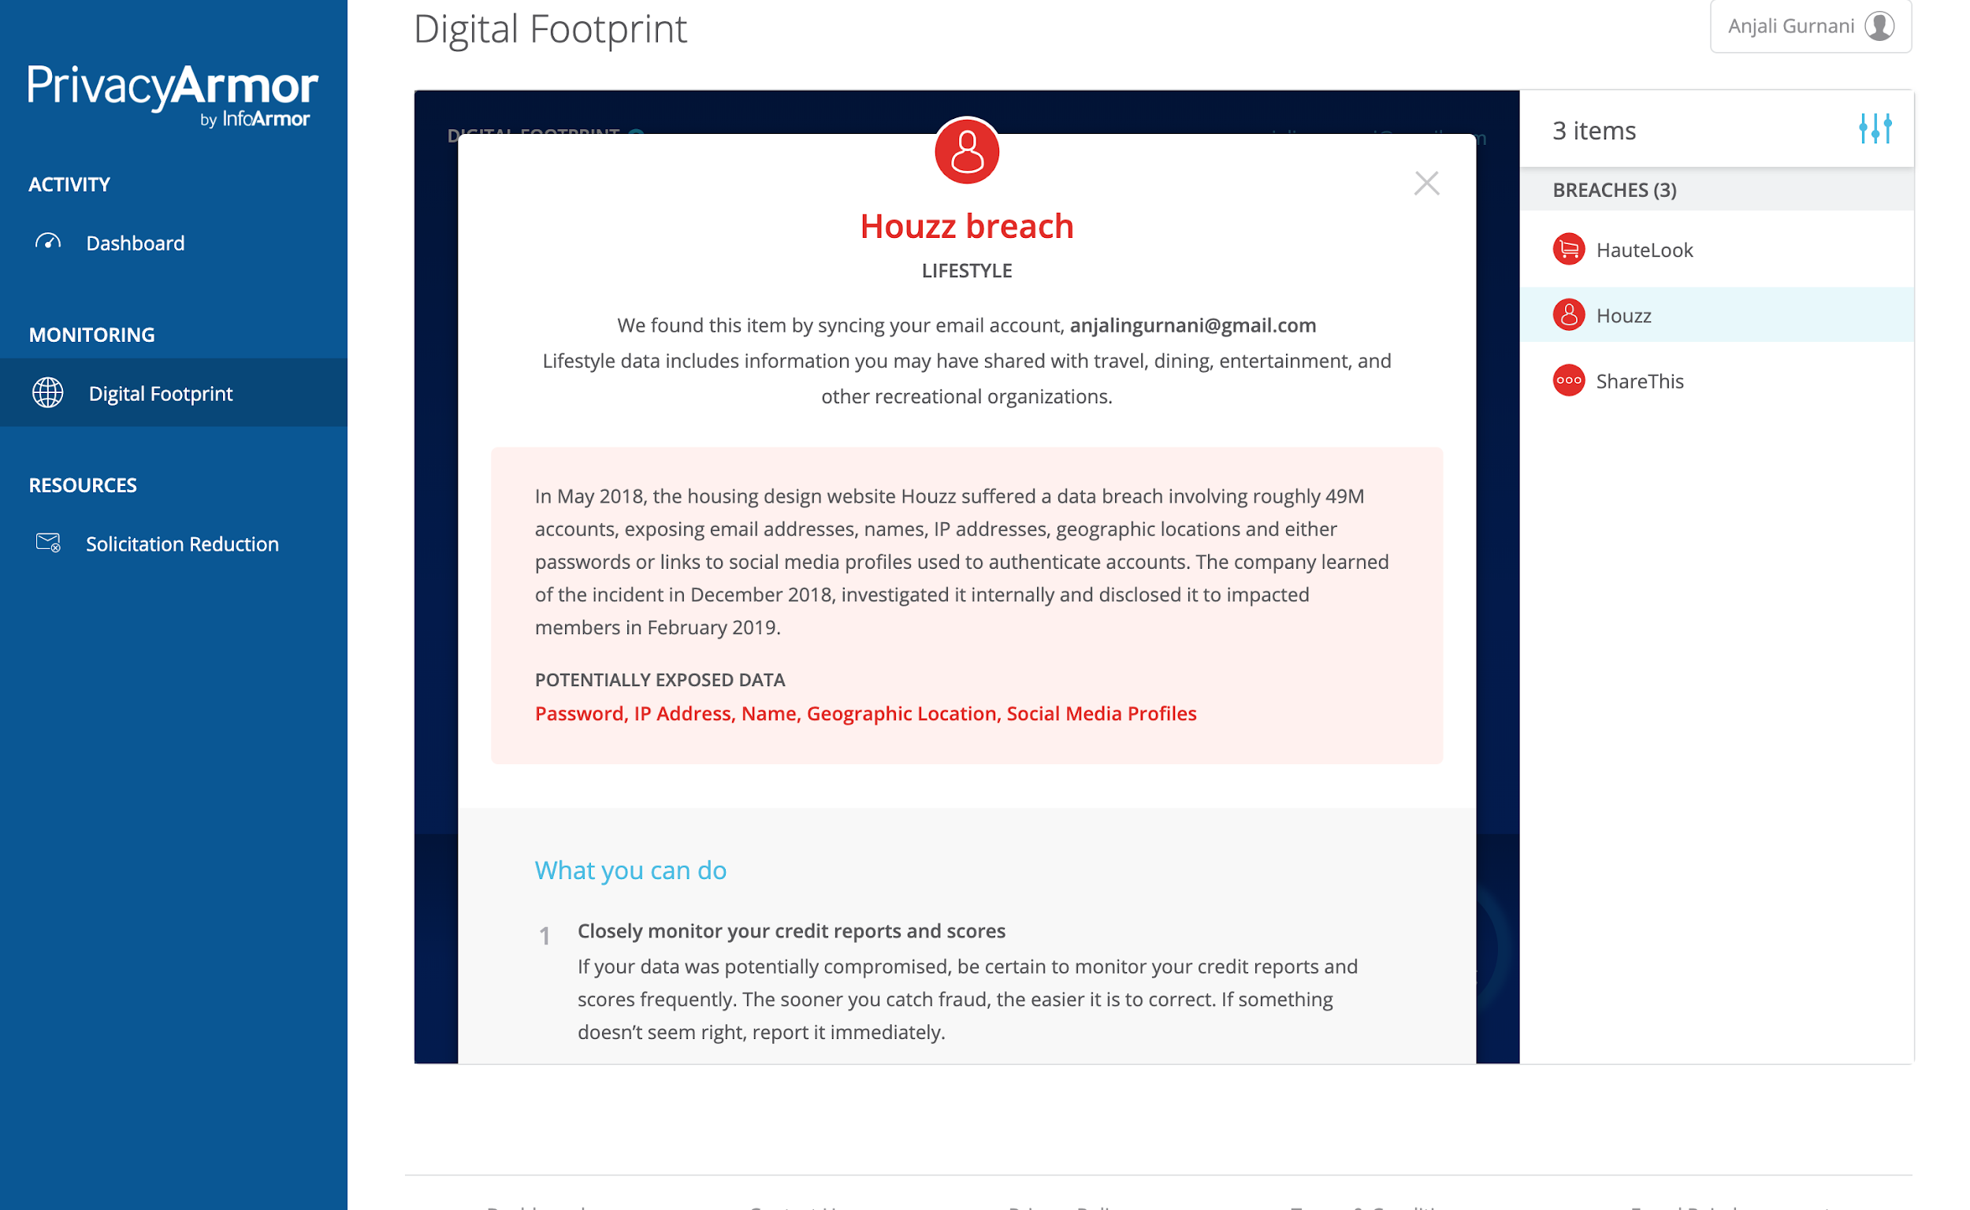
Actionable alerts and proactive recommendations

Slide 12
Coming soon:
Digital Footprint Quiz

Slide 13
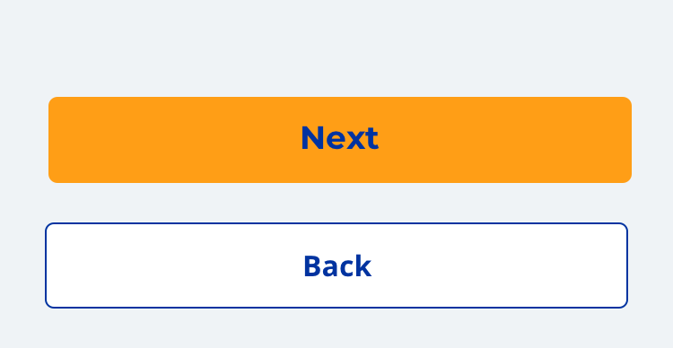
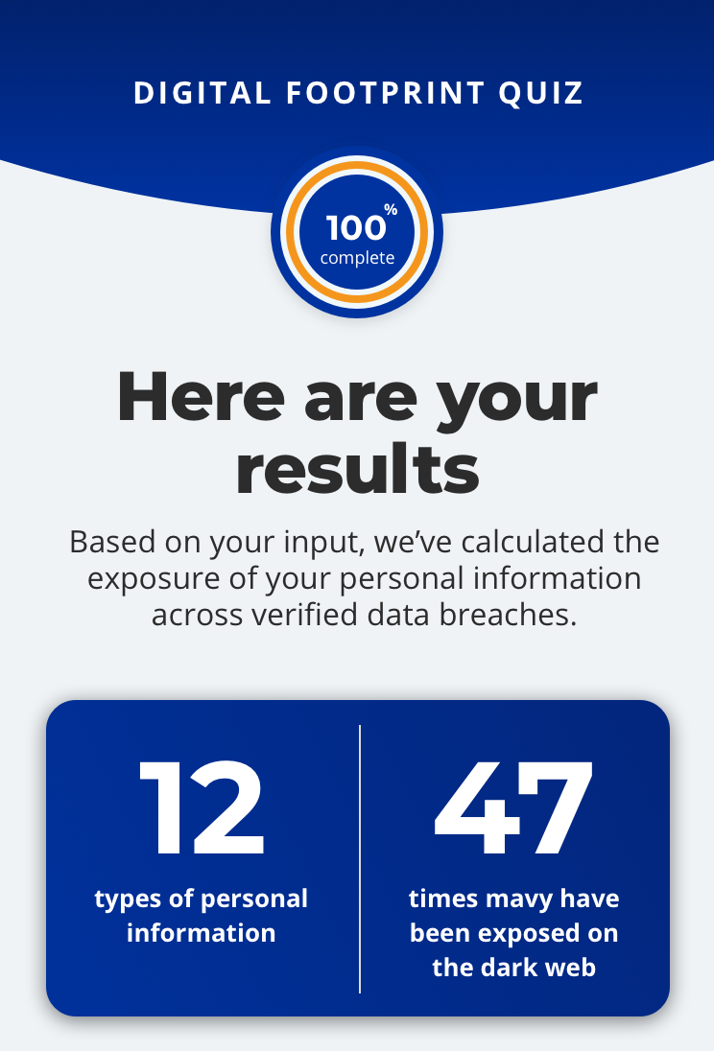
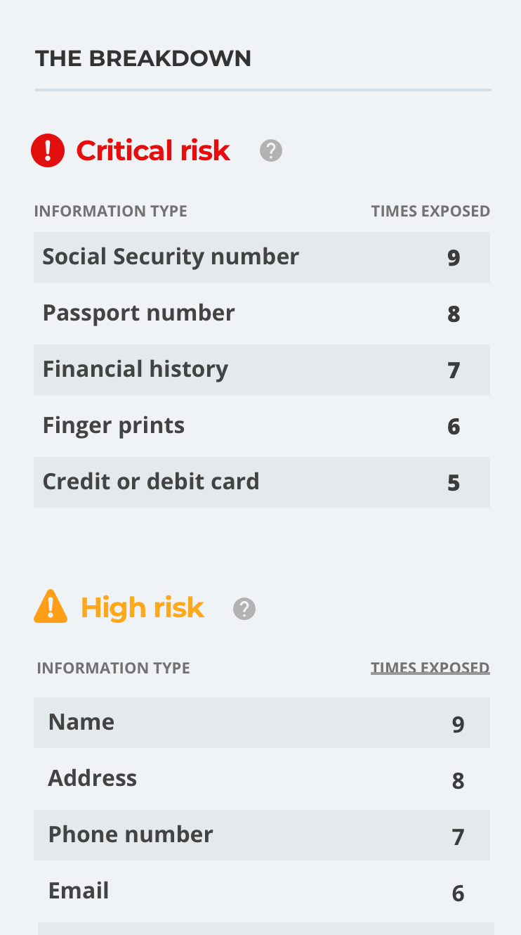
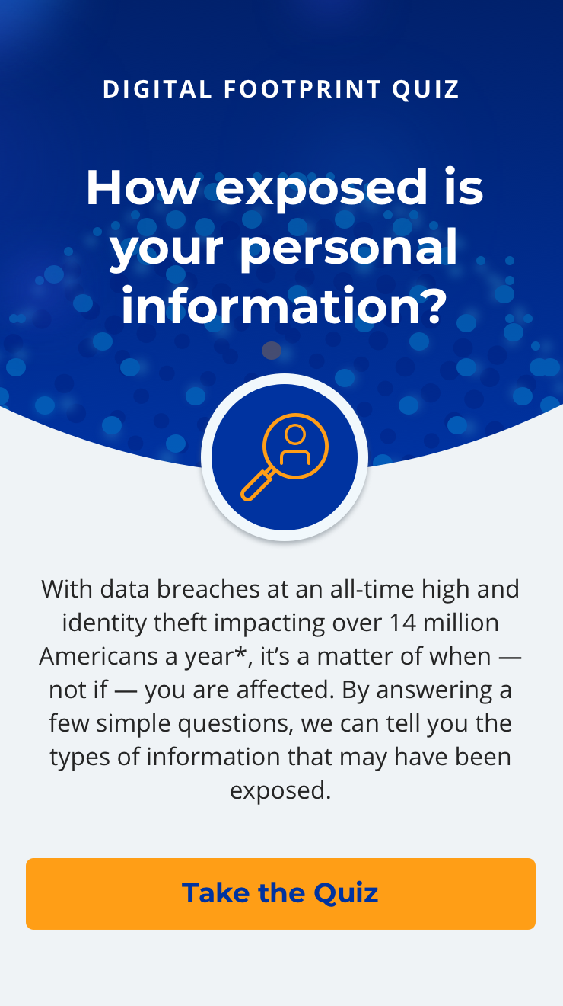
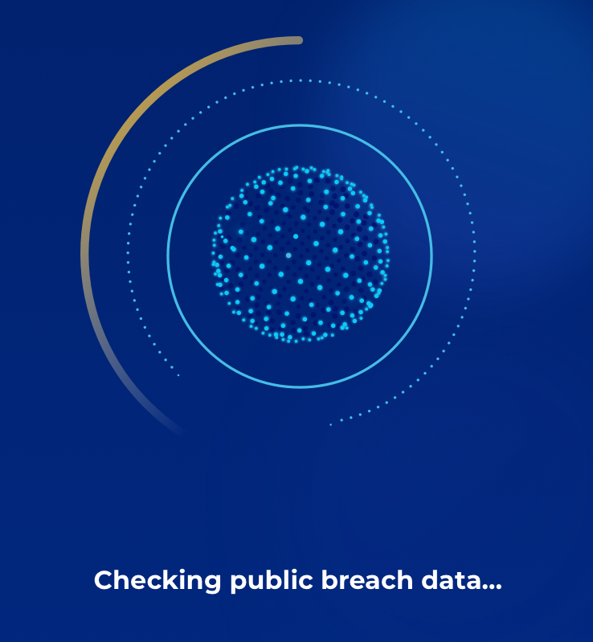
The first step in understanding your Digital Footprint
Pre-Enrollment Quiz

Slide 14
What makes PrivacyArmor better?

Slide 15
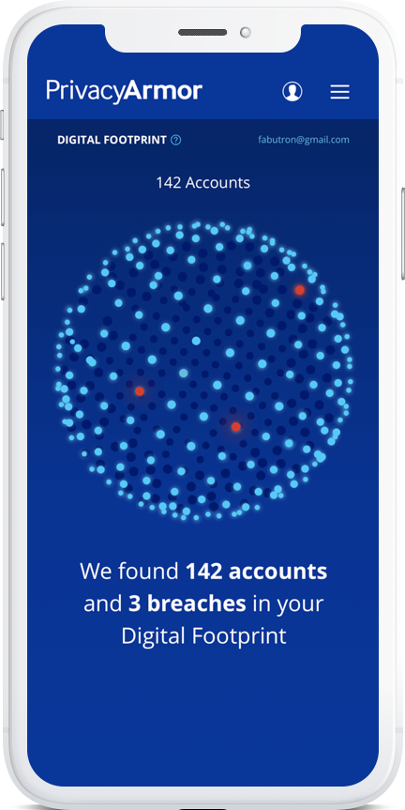
Use copy from slide 17
What makes PrivacyArmor better?
What we’ll be sharing today:
What makes InfoArmor different?
Proprietary tools
We push the industry ahead by using our own intel and making ID protection truly proactive
Unique insights
We have access to dark web and invite-only hacker forums
Multi-faceted monitoring
We pull from multiple information streams to get participants the fullest possible picture of their identity
Proprietary tools
We push the industry ahead by using our own intel and making identity protection truly proactive
Groundbreaking innovation
We were the first to introduce reimbursements for 401(k) and HSA accounts, plus tax fraud advance
Digital Footprint
Shows users what online accounts they have
Detects if personal information has been exposed
Helps stop identity theft before it starts
Unique insights
We have access to dark web and invite-only hacker forums
Groundbreaking innovation
We were the first to introduce 401(k) and HSA reimbursements; tax fraud advances; monitoring for deceased family members, IP address, and social media; auto-on alerts; and high-risk transactions
Multi-faceted monitoring
We pull from multiple information streams to get participants the fullest possible picture of their identity
DIGITAL FOOTPRINT
Shows users what online accounts they have
Detects if personal information has been exposed
Helps stop identity theft before it starts

Slide 16
Elevate your benefits and protect your employees with PrivacyArmor
PrivacyArmor protects your company by investing in your employees
Easy implementation on over 120 platforms
Dedicated, round-the-clock service
Exclusive threat intelligence and tailored alerts
Your data is safe, and never sold
Notes:
Anjali, this is from another PA presentation, but I thought some of this might be useful in this case?

