Slide 1
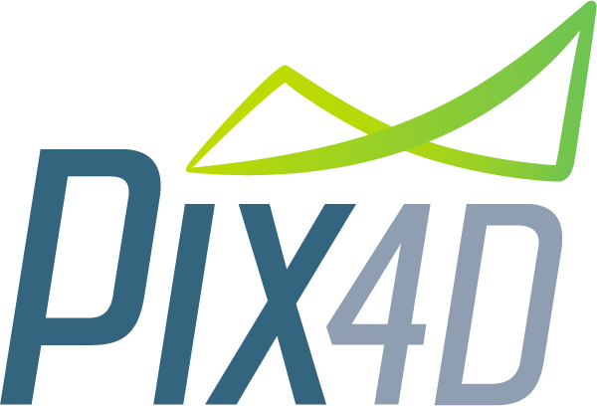
Mining

Slide 2
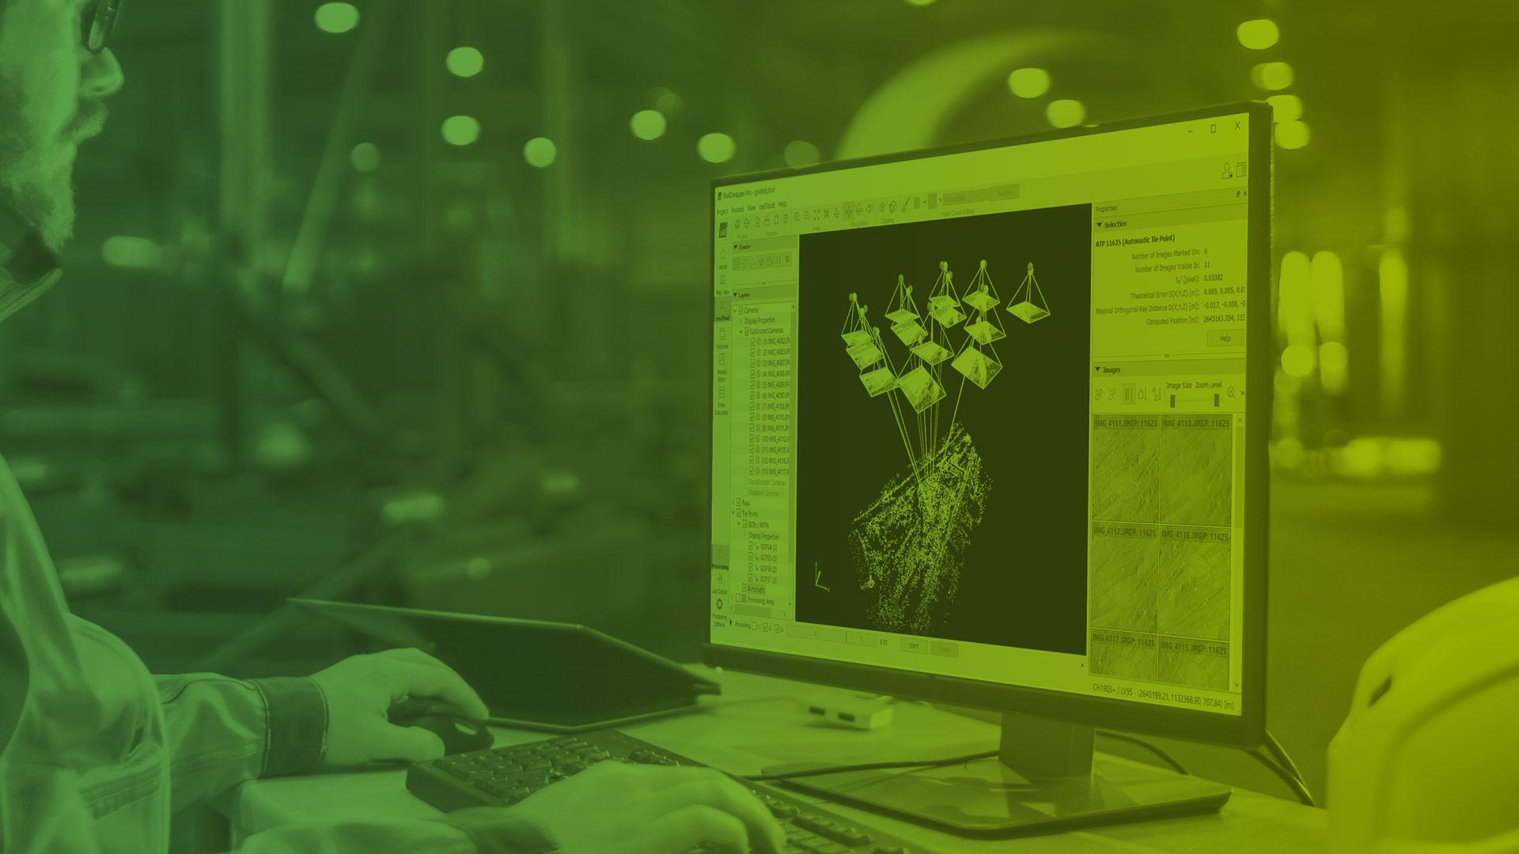
Introduction to Pix4D

Slide 3
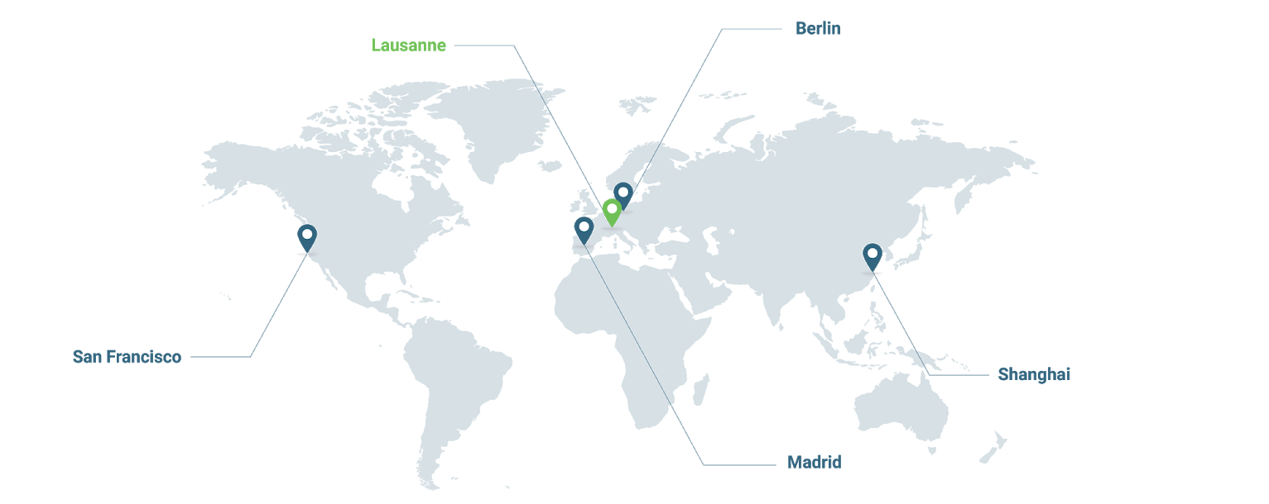





About Pix4D
8000+ active users per month
100’000 acres of reality modeled
200+ countries & territories
SAN FRANCISCO
U.S.A.
LAUSANNE
SWITZERLAND
BERLIN
GERMANY
SHANGHAI
CHINA
MADRID
SPAIN

Slide 4
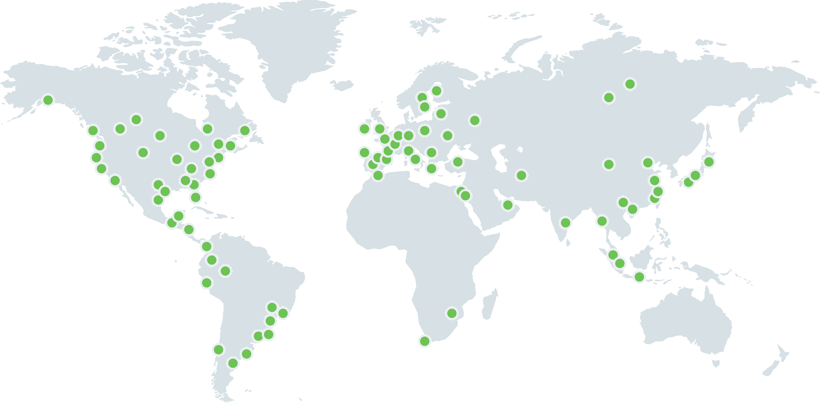
170 Resellers around the world

Slide 5
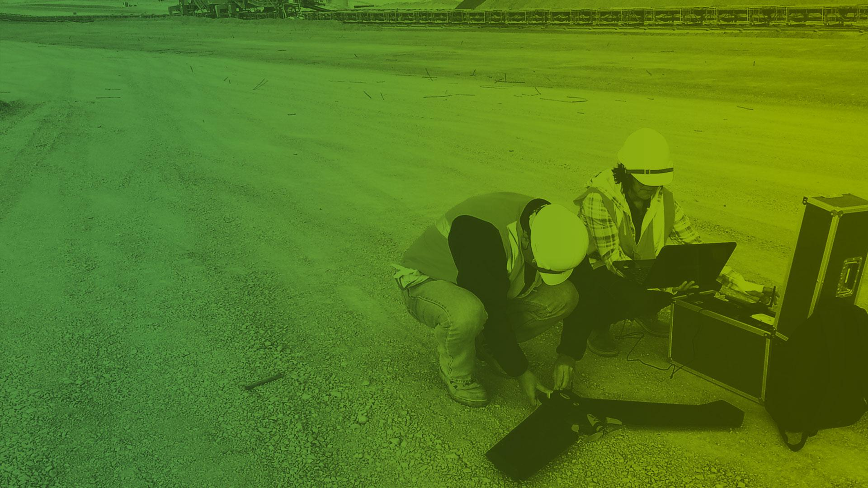
The power of drones and photogrammetry

Slide 6

“44,354,881,622 Cameras in the world by 2022, at minimum”
LDV Capital
Pix4D generates accurate 2D and 3D information purely from images with cutting-edge photogrammetry technology
Notes:
Data source: https://cdn.filestackcontent.com/ZXNI76xKSKqqU7JJuahl
Digital cameras are everywhere--static, moving, flying. On mining sites, over roads, buildings, phones, cars, trains, drones, robots, etc. Cameras are sensors in the Internet of Things (IOT) --complex, powerful & interconnected

Slide 7
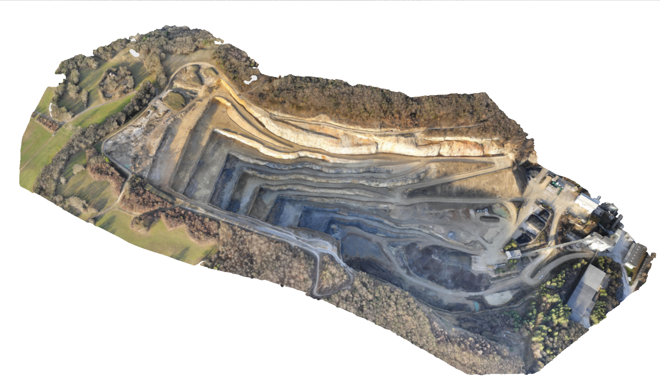
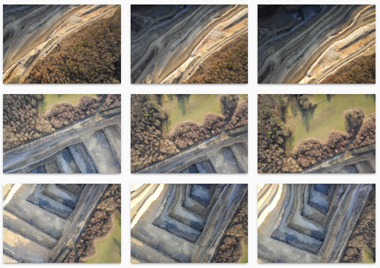
What is it about ?
{ }
Information from images
for better and faster decisions
Notes:
Pix4Dmapper: get accurate 3D or 2D representation of reality:Photogrammetry software for
professional drone mapping
Pix4Dcapture: get the images for photogrammetry: Free app to plan, fly and get optimized images for professional drone mapping

Slide 8

What is photogrammetry ?
“Evolution favours eyes that perceive the world in 3D”
Christoph Strecha
Founder and CEO of Pix4D

Slide 9

Integrated image based solution
Mobile
Data capture & review
Field operations
Flight management
Cloud
Processing & digitization
Annotation & collaboration
Data storage & management
Desktop
Processing & digitization
Quality control over data & projects
Ubiquitous

Slide 10
Behind Pix4D technology
Accurate & robust, images from any sensor, geometrically and radiometrically
A tool for professionals, with innovative instructional approach, and unique tools for quality control
Deep scientific knowledge of photogrammetry and how to mine meaning from images

Slide 11
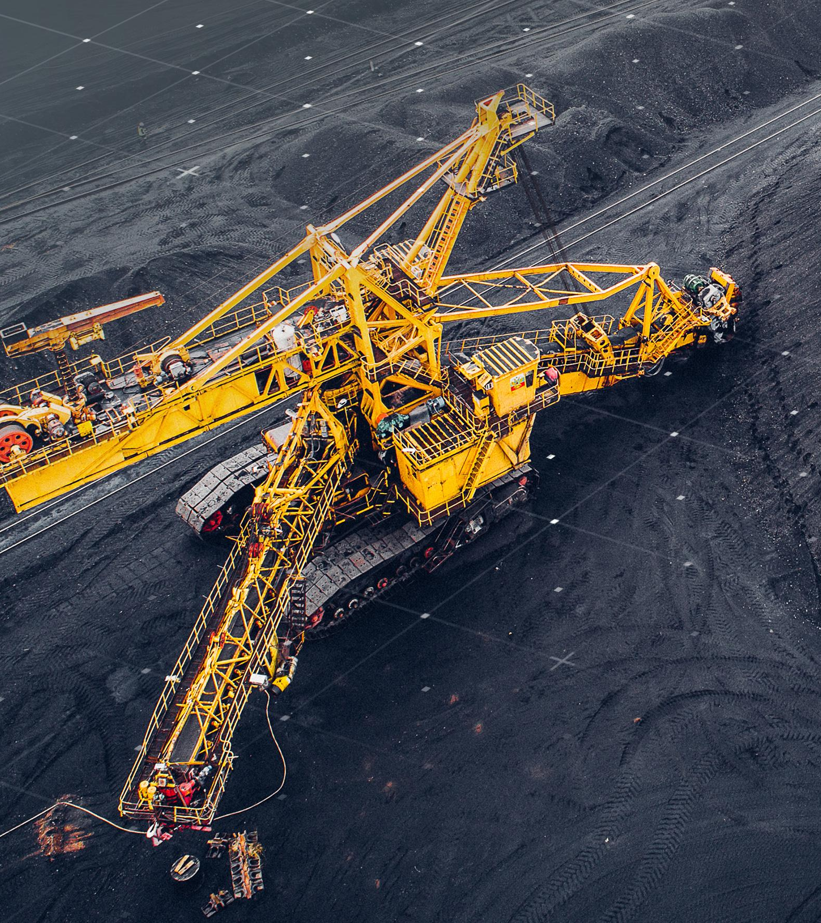
Mining
Operational risk and compliance management
• Aerial surveying & 3D mapping
• Drill & blast planning & topography engineering
• Asset & infrastructure inspections
• Geotechnical inspection & structure characterization
Supply chain management
• Stockpile management
• Production inventory
• Delivery forecasting
Asset lifecycle management
• Base mapping for site designing
• Site surveys during construction
• As built versus as designed comparison
Notes:
Other resources:
http://droneanalyst.com/wp-content/uploads/2017/09/5-Lessons-Dones-in-Mining.pdf
https://pix4d.com/article-digitalist-magazine-using-photogrammetry-transform-mining/
https://pix4d.com/drone-mining-stockpile-volume-pix4dmapper/
https://pix4d.com/toxic-tailing-mapping-for-remediation-in-kyrgyzstan/
https://pix4d.com/supporting-blasting-operations-with-drones/
https://pix4d.com/accurate-volume-estimation-with-non-ideal-flight-plan/

Slide 12
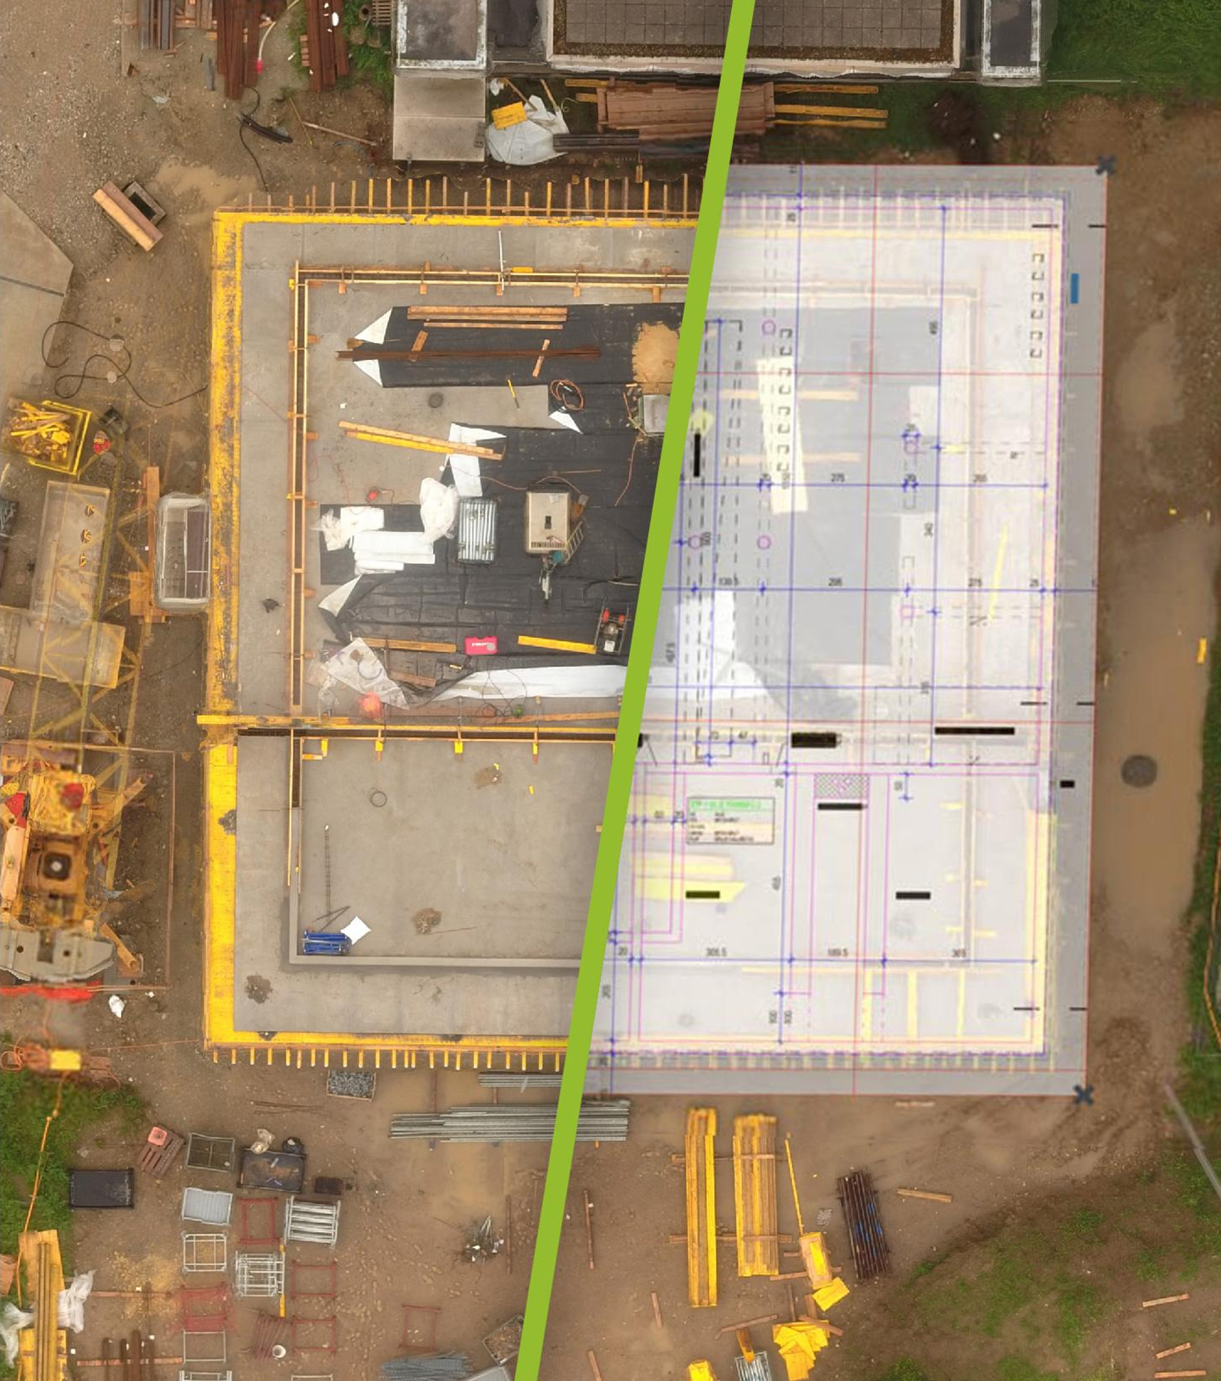
Construction
Earthworks management
• Topographic surveys
• Stockpile measurements & cut/fill
calculations
• Visual records of excavations
As-built monitoring
• Regular visual status reports of the
as-built situation
• Site progress tracking against
BIM project schedule and design
• Online project documentation for
visualisation, measurement, annotation and sharing
Inspection
• Building & infrastructure inspections
• Online results with intuitive viewing/analysis tools
Notes:
Other resources:
http://droneanalyst.com/wp-content/uploads/2017/09/5-Lessons-Dones-in-Mining.pdf
https://pix4d.com/article-digitalist-magazine-using-photogrammetry-transform-mining/
https://pix4d.com/drone-mining-stockpile-volume-pix4dmapper/
https://pix4d.com/toxic-tailing-mapping-for-remediation-in-kyrgyzstan/
https://pix4d.com/supporting-blasting-operations-with-drones/
https://pix4d.com/accurate-volume-estimation-with-non-ideal-flight-plan/

Slide 13
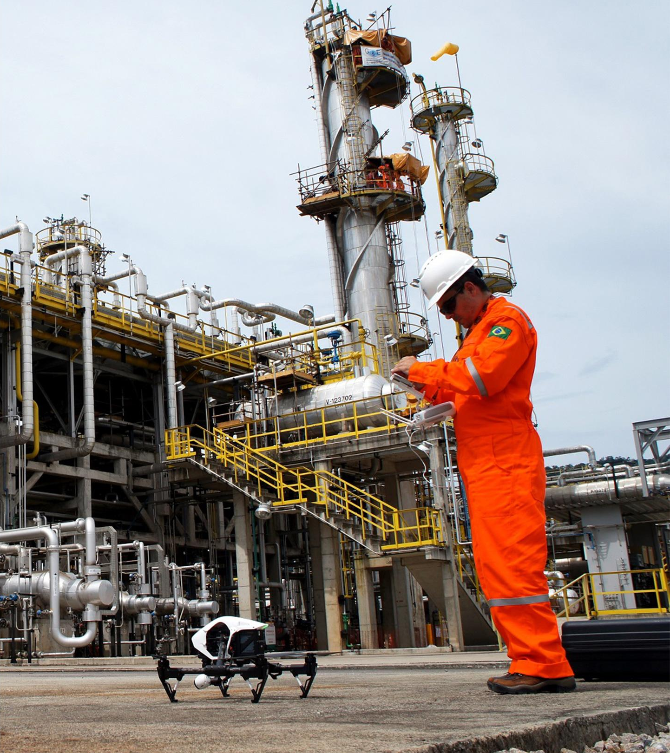
Industrial inspection
Digital database of industrial assets
• All data is visually accessible in
accurate 3D models
• Connect to ERPs and automation software
for integrated workflows
Frequent inspetions of assets
• Roads
• Tunnels
• Turbines • Refineries
• Cell towers
• Dams • Airports
Notes:
Other resources:
http://droneanalyst.com/wp-content/uploads/2017/09/5-Lessons-Dones-in-Mining.pdf
https://pix4d.com/article-digitalist-magazine-using-photogrammetry-transform-mining/
https://pix4d.com/drone-mining-stockpile-volume-pix4dmapper/
https://pix4d.com/toxic-tailing-mapping-for-remediation-in-kyrgyzstan/
https://pix4d.com/supporting-blasting-operations-with-drones/
https://pix4d.com/accurate-volume-estimation-with-non-ideal-flight-plan/

Slide 14
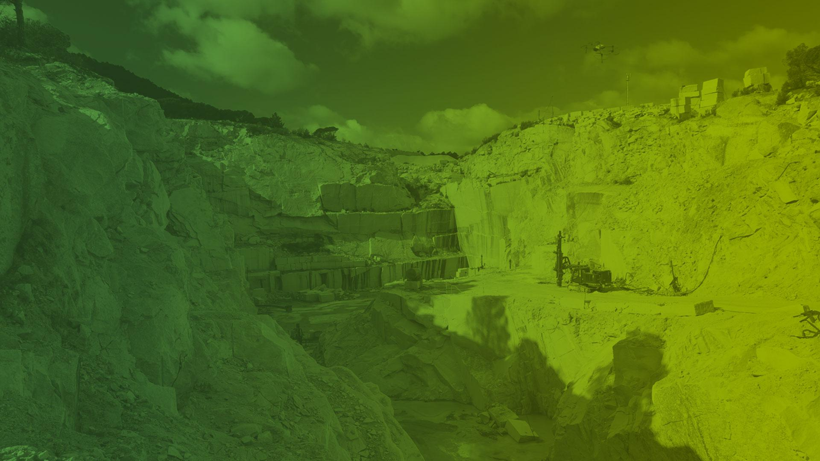
How does drone mapping
create value for mining operations?

Slide 15

Pix4D is trusted by...
Many of the leading mining companies have already embraced Pix4D technology.
Notes:
Decrease operational risk
Improve efficiency
Improve safety

Slide 16
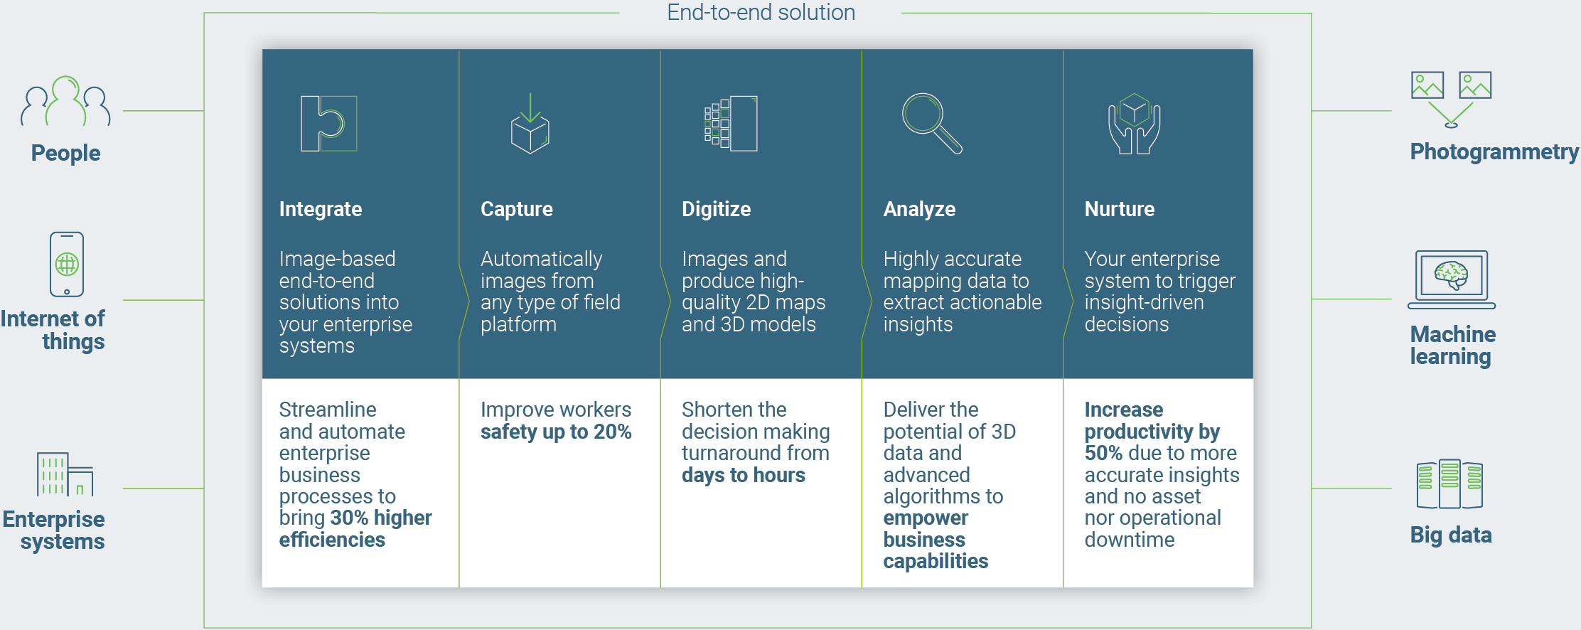
End-to-end solution
Notes:
Produce visual data in a faster, cheaper, more scalable and accurate way
Generate insights from high quality maps, 2D/3D models and aerial view
Significantly reduce environmental health and safety risks
Free up time and resources to invest in core company competencies through task automation and cost reduction

Slide 17

Five common uses of drone imagery in mining
1
2
3
4
5
Transform Field Operations
Traffic Management
Support Infrastructure
Inspection & Planning
Blast Planning
Asset Management
and Surveillance
Monitor Progress
Enable easy data sharing
Produce Accurate and Timely Volumetric Measurements
Environmental Monitoring
Notes:
Sub-bullets under # 1:
Traffic Management
Support Infrastructure Inspection & Planning
Blast Planning
Asset Management and Surveillance

Slide 18
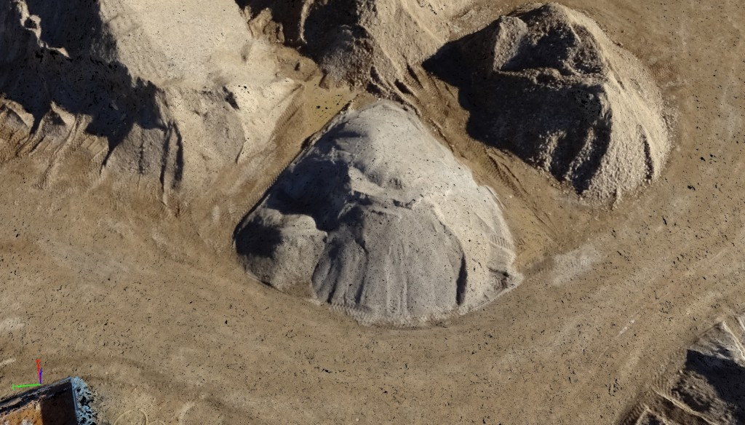
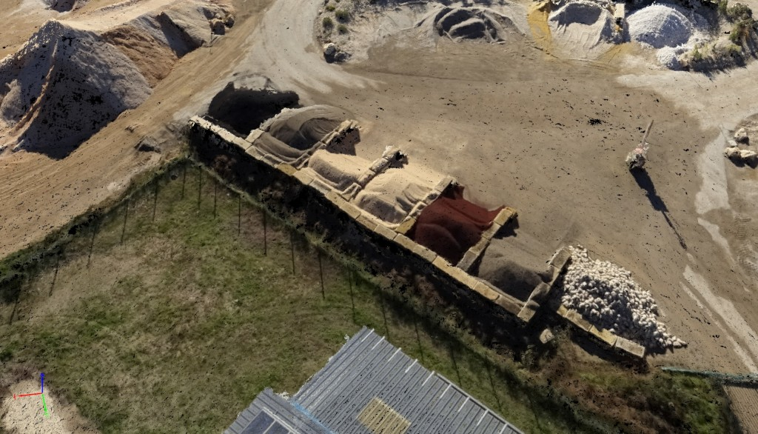
Traffic management
Optimize:
Fuel consumption
Haul roads design
Stockpile locations
Generate updated haul road plans using interactive 3D polyline tool
Notes:
On average, mining companies spend millions of dollars on fuel. Timely drone data can help operators improve surface operations, optimize fuel consumption, traffic route, haul roads design, stockpile locations and more. Planners can quickly calculate on-site road grades and generate updated haul road plans using interactive 3D polyline tool. Live feed of aerial view enables dispatch in real time to re-route trucks to less trafficked locations.

Slide 19
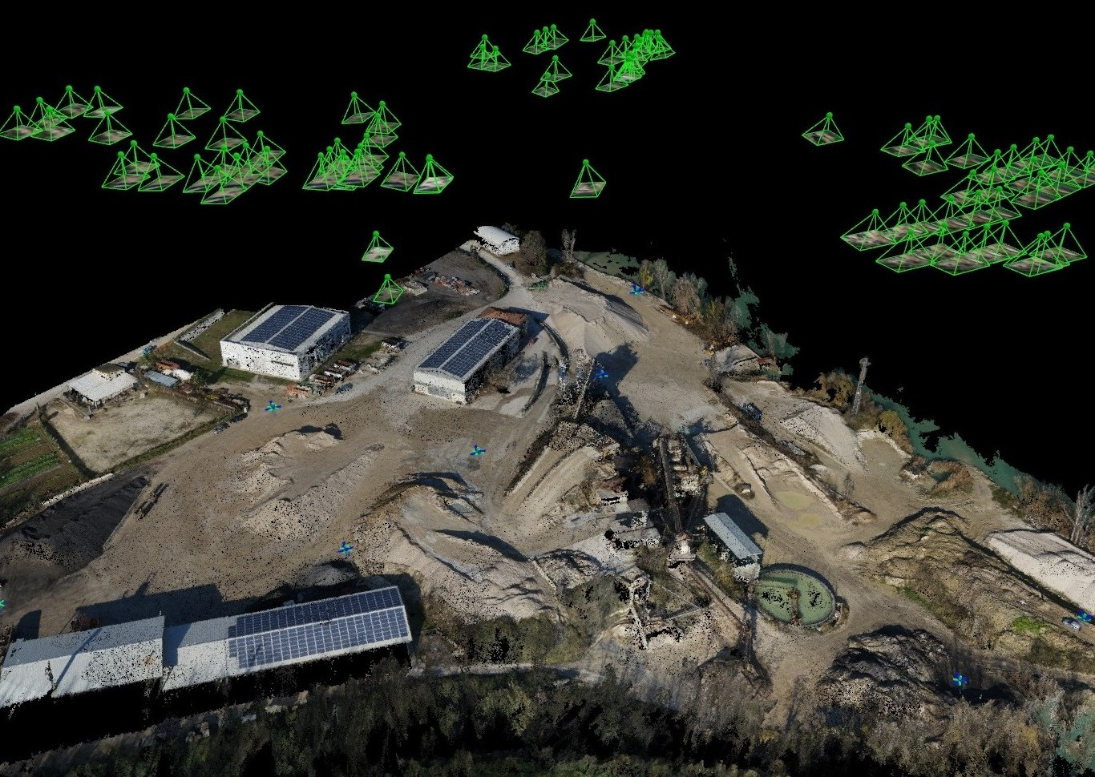
Support infrastructure inspection & planning
Aerial data. Close to real time tracking. Access hard to reach areas
Notes:
Aerial visual data can be useful to support infrastructure maintenance. Fix-wing drones are capable of covering vast tracts of land between mines, ports and railways to inspect powerlines and other utility facilities. In addition, drone imagery can provide access to hard to reach areas for maintenance inspections. Site managers can create a georeferenced image database for safe and efficient post-flight inspection. Locate defects in 3D from images, visualize structural details from multiple angles, model thermal behavior of plants, and export orthophotos from any plane.

Slide 20
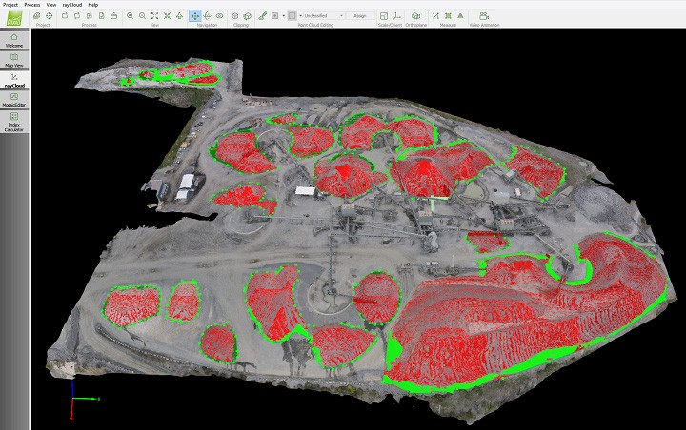
Blast planning and monitoring
Lower cost. Safer work conditions. Higher accuracy
Notes:
Blasting operations affect all other associated subsystems, such as loading, transport, crushing, and milling operations. Misfire investigation, toxic fumes produced by detonating explosives in surface mining and construction operations, poses additional potential hazards to workers and the public. Image processing, generating required point clouds, 3D models, and orthomosaics for the entire area of the blasting operations, takes only a short time, with a post-clearance 3D model generated to complete the cycle. Blast-hole monitoring would not only improve results in productivity, safety, and environmental impact, but integrating this data into an ERP would also allow for managing and tracking the consumption of explosives or other consumables. It could also increase accuracy of the bills of material (BOMs) used in production orders or help verify third-party invoices for drilling and blasting. This process saves time, money, and resources, and includes measuring stockpile volumes and excavated material and locating boreholes for blast sites.
Visual data from drones can digitalize crucial pit and quarry for blast planning. Surveyors and mine planners can evaluate existing site topographic conditions with automatically generated digital surface models from high resolution drone imagery. The results and the spatial information of the scene are useful for post-analysis, engineering applications of potential post-accident comparisons, and records management.
Lower cost
Safer worker conditions
Higher accuracy

Slide 21
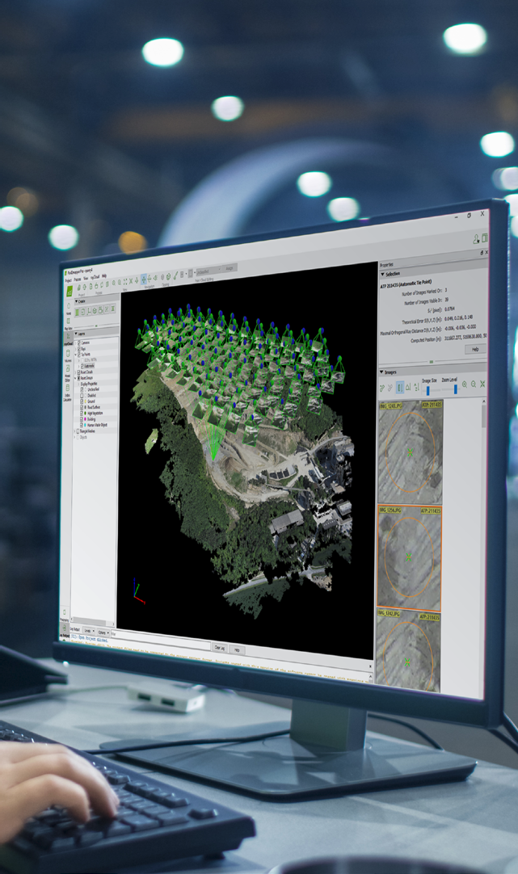
Enable easy data sharing
Data products can be:
Shared at anytime and anywhere
Used in other software
Annotated and commented
Empower on-site supervisors and management team with real time data
Notes:
Visual data captured by drones can be shared and accessed by anyone, anytime, and anywhere. All stakeholders can annotate, comment and share to enable cross-team cooperation at scale for planning, accounting, staffing, monitoring and maintenance. It allows on-site supervisors to be empowered with real time data analytics and management team to have access to data at all time. Pix4D’s Enterprise Solution, Pix4Dengine, can be easily integrated into existing software and workflow.

Slide 22
Produce accurate and timely volumetric measurements
Problem:
Accurate volume measurement and inventory management are two of the biggest challenges in the mining industry
Advantages:
Flexibility to collect data quickly
Faster and more efficient operations
Drones are about half the cost compare to traditional ground-based volumetrics
Benefits:
Higher profitability from more accurate volume measurements
Improved safety and reduced risk on jobsites
Notes:
Mine sites planning is critical to ensure the feasibility of a project before committing resources or hiring subcontractors. Obtaining accurate data in a timely manner is difficult when site conditions are constantly changing. Mining companies are constrained by infrequent and less accurate methods of measuring earthwork quantities. Traditional methods of measuring stockpiles with in-house equipment or third-party surveys often produce limited data, incur additional costs, and lead to inaccurate measurements. Additionally, information is often coming from a variety of decentralized sources.
Drone imagery allow mining companies to update plans on a frequent, consistent and affordable basis through autonomous flights and user-friendly image processing software. They can reduce the project length from a few weeks to a few days, meanwhile reducing the staff from a few to one. On average, Pix4Dmapper users are able to achieve measurement accuracies of 1-3% for their stockpile volumes. Mining companies can make million dollar decisions based on drone data, greatly reduce end of year write-downs caused by poorly calculated inventory.
The frequency of stockpile surveys cannot be sustained through traditional methods like aircraft aerial surveys, laser scanning, or manual, onsite measurement with poles and GPS units. Stockpiles can have potential “cratering” and not conform to perfect shapes, and describing irregularly shaped stockpiles is difficult with estimates. In addition, production facilities often have to cease operations when survey crews are out.
Photogrammetry can do precise volume calculations, create contour lines, and conduct quality assessments with direct access to 2D and 3D models generated from automatic data collection. It allows users to import their own base surface (or ground-surveyed points, which form the base surface) and use it to calculate stockpile volumes. Extending the data flow into an ERP solution allows continuous updating of stockpile inventory to ensure the systems show and track the right quantity and values of material.
As a result, mine operations can build steeper slopes, ultimately displacing less rock, optimizing stacking and reclaiming, and reducing overall resource use. Precise stockpile measurement and volume calculations lead to more consistent inventory reporting into the company balance sheet, improved cash flow situations for accounting, higher efficiency in the supply chain organization, and better forecasting of the minerals available for sales.

Slide 23
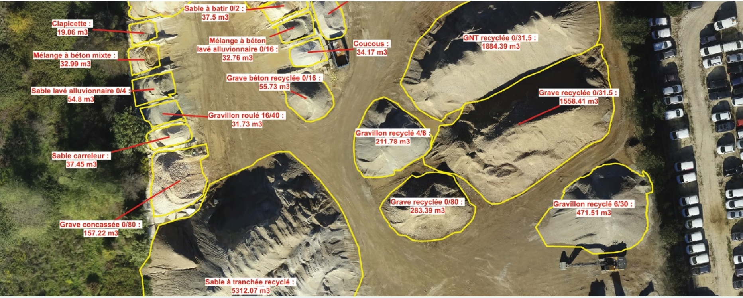
Stockpile inventory example
Photogrammetric survey with a fine ground sampling distance can achieve average error estimation from 2 to 5%
Notes:
Managing stockpile inventory, that is, finding a solution for accurate volume measurement and easy inventory management, is one of the biggest challenges in the mining industry. These top mining companies claim that by applying the photogrammetry workflow with Pix4Dmapper, they can achieve measurement accuracies of around 2-5% for their stockpile volumes.
High-resolution images give you more details of the mapped stockpiles
When it comes to stockpile volume measurements, stockpiles do not conform to a perfect shape. A photogrammetric survey with a fine ground sampling distance (GSD, which indicates the actual distance each pixel represents) is able to better describe irregular stockpiles in detail. Horizontally, high-resolution photogrammetric results create more precise stockpile models, and thus better volume measurement accuracy than ones interpolated from certain measured points. Vertically, they lower the uncertainty in Z values, which is proportional to the resolution. For example, flatter stockpiles will benefit more from a high GSD than taller stockpiles.
Pix4Dmapper allows you to adjust the reference base above which you want the volume to be measured
Why is setting a precise reference base important for getting accurate volume measurement? Imagine we have a 10-meter-tall crushed gravel stockpile in a cone shape, with a 45° angle of repose:
The error of the height values will have much more influence for the bottom flat part than the tip. This also explains how important to well-define the base surface is in order to obtain an accurate volume measurement.
In addition to generating precise 3D models for the purpose of measurements, Pix4Dmapper performs accurate stockpile volume measurements because of its ability to customize base surfaces.
The software provides 6 different base surface-defining options in its volume management module; for more complicated conditions, users can import their own base surface (or ground-surveyed points which form the base surface) and use them as a base to calculate stockpile volumes.

Slide 24
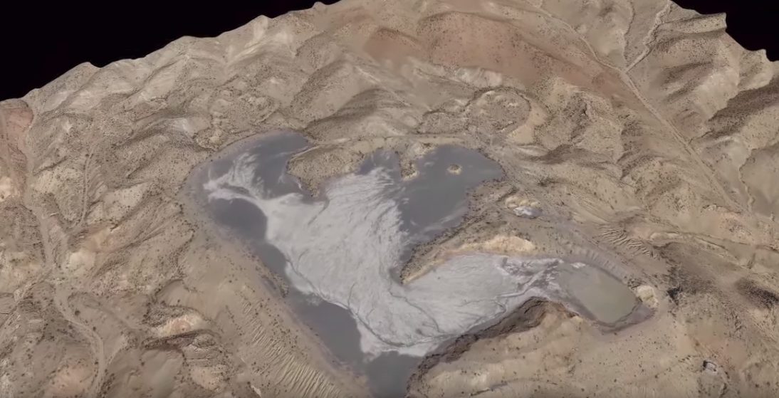
Environmental monitoring
Monitor erosion and contamination for active and abandoned mining sites
Notes:
Maps and surface models must be generated for monitoring and assessment of remediation. Drainage and contamination need to be permanently monitored long after mining sites are deactivated. 2D map and 3D surface models provide high-resolution reconstruction results to assist in decision making. In addition, point clouds and digital surface models help compute slope elevation, and simulations could be conducted to predict damage in the form of erosion, contamination, landslides, earthquakes, etc. In advanced ERP solutions, you can capture and monitor the necessary actions to keep the environment safe. Safety is paramount to mining operations. Every year, there are xx fatal accidents caused by mining activities worldwide. Drone imagery are particularly valuable around pit walls where putting people in the situation is either physically impossible, expensive, or dangerous. Drones can conduct safety reviews more comprehensively and frequently to ensure safe operating conditions, by detecting non-compliant safety blocks, berms and highwalls from the sky. Operations managers can use dynamic 3D visualization tools to safely and quickly identify potential risks and excavation footprints. In addition, it can reduce response time to accidents in remote areas by alerting on-site supervisors and emergency vehicles of the location. Mining companies are responsible for monitoring the environment surroundings of their sites. Since many mine sites are located in indigenous, sensitive areas, any potential infringement can result in losing operating license. Drone data can help get mining permits and monitor the environment regularly by detecting if there are spills, leaks or improper operations.

Slide 25
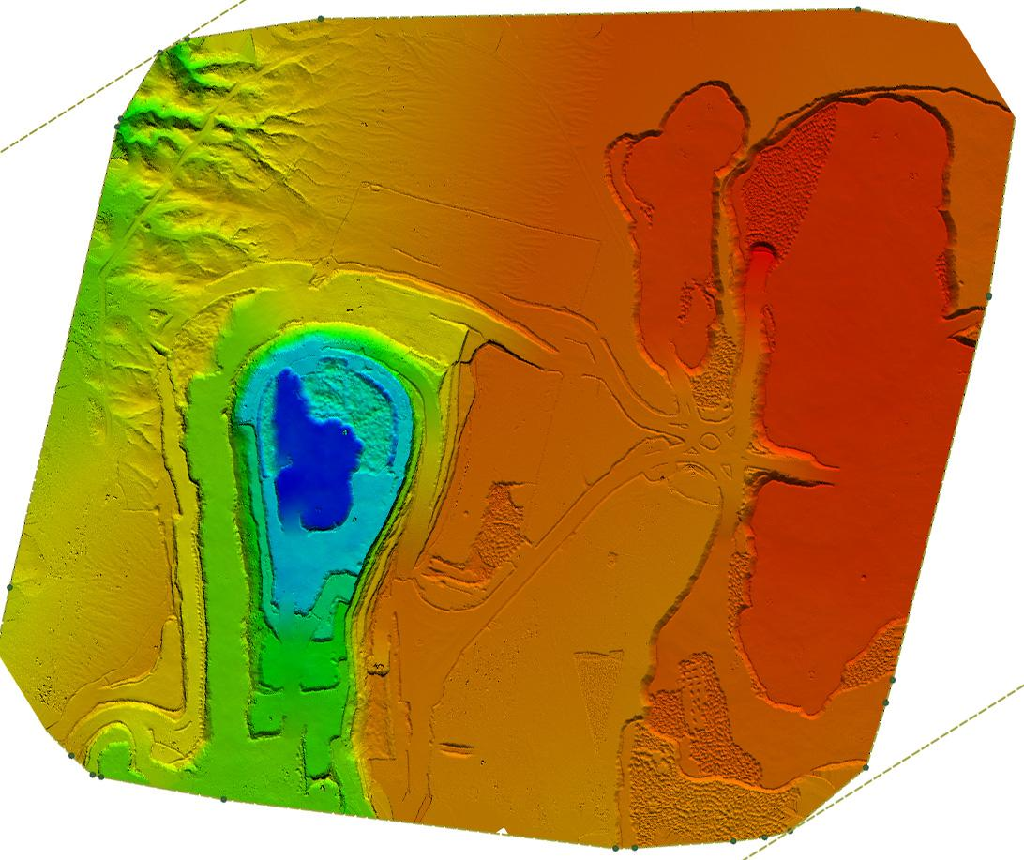
Use case Survey world’s 2nd largest uranium mine in Namibia
Notes:
Uranium mine in Namibia desert
https://drive.google.com/drive/u/0/my-drive?ogsrc=32
https://wingtra.com/redefining-the-possible-africas-largest-uranium-mine-surveying-with-wingtraone-drone/

Slide 26
Use case Survey world’s 2nd largest uranium mine in Namibia
Place | Husab mine in the Namib Desert, Namibia
Company | Strydom & Associates Land Surveyors
Size of the mine | 15 sq.km (1500 ha)
No. of flights | 4
GSD | 5 cm/px
No. of images | 1500
Flight height | 390 m above ground
Drone | VTOL WingtraOne
GCPs | Yes
Purpose | Stockpile volumetric measurements for the year end audit and main mine surveying

Slide 27
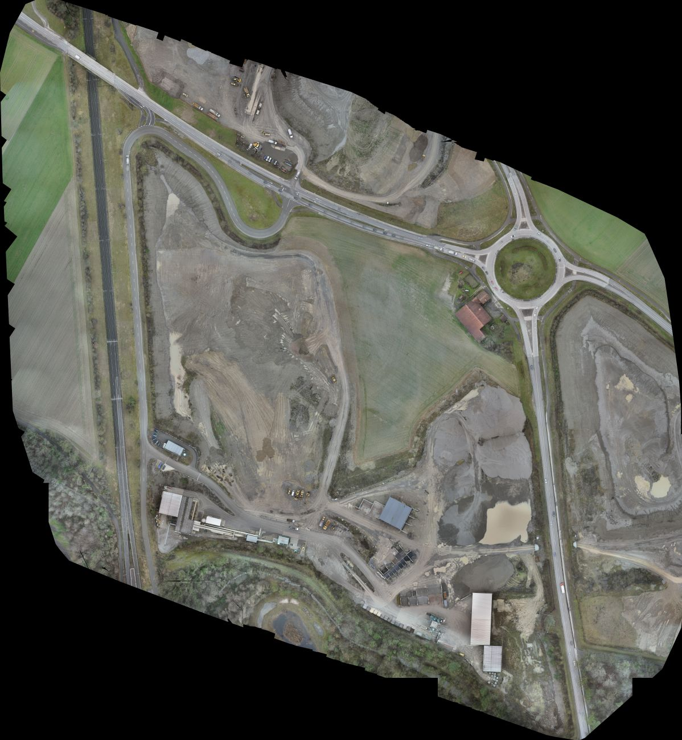
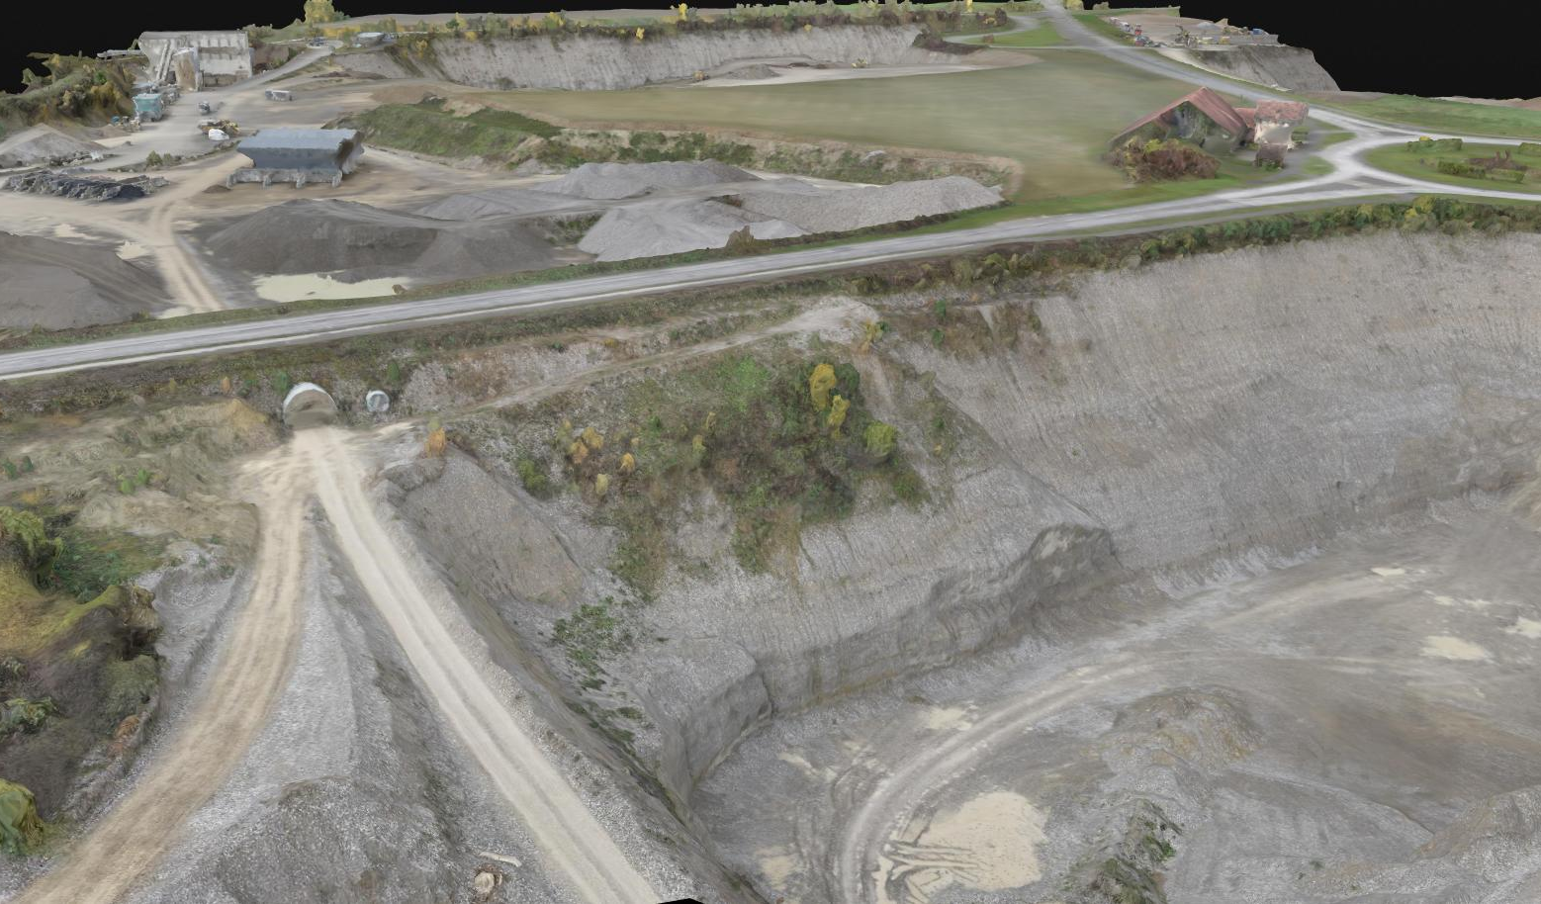
Use case: Quarry survey in Switzerland
Orthomosaic 3D model of the mine
Notes:
https://wingtra.com/how-drone-surveys-can-save-time-and-improve-data-accuracy-in-mining/
https://drive.google.com/drive/u/0/my-drive?ogsrc=32

Slide 28
Use case: Quarry survey in Switzerland
Place | Haberland and Ziegli mines in Canton Zuerich, Switzerland
Company | Kies AG
Size of the mine | 20 ha
GSD | 0.97 cm
Accuracy | 1.3 cm horizontally, 2.3 cm vertically
No. of images | 946
Drone | VTOL WingtraOne
GCPs | No
Purpose | Cost and revenue forecasting, operational planning

Slide 29

Looking ahead…
Enterprise integration

Slide 30
Enterprise integration unlocks higher value
Fully integrate drone and image-based end-to-end solutions into the existing enterprise systems
Achieve higher business impact in critical operations
Seamlessly integrated into the existing ERP, field operations and data-driven business decisions

Slide 31

Thank you
www.pix4d.com

