Slide 1
Surveying & mapping

Slide 2
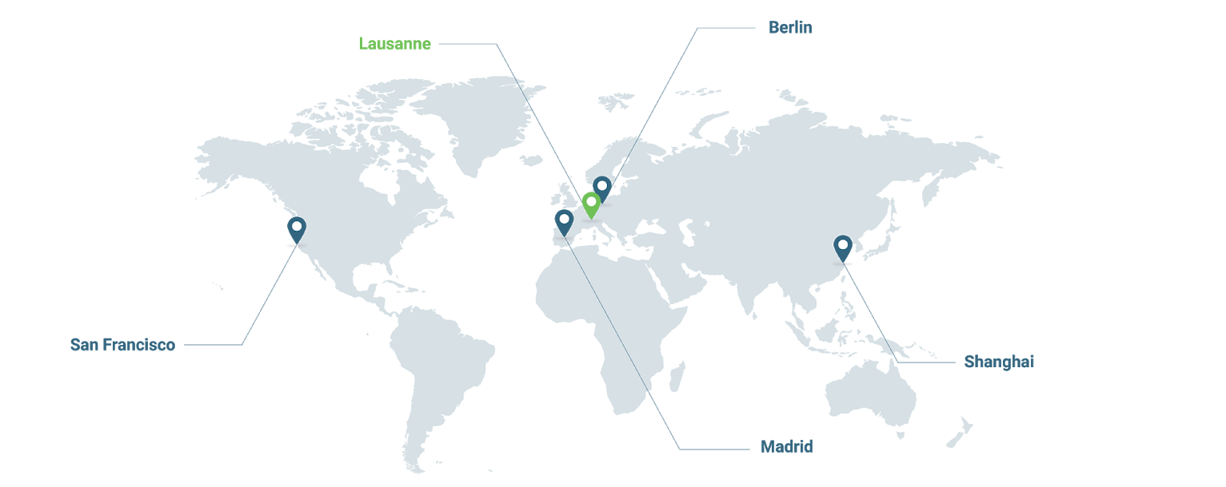



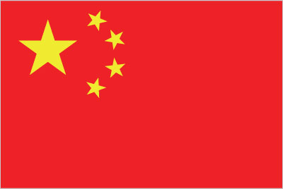

About Pix4D
170+ global employees
23 nationalities
60% R&D talent
SAN FRANCISCO
U.S.A.
LAUSANNE
SWITZERLAND
BERLIN
GERMANY
SHANGHAI
CHINA
MADRID
SPAIN

Slide 3

The power of drones and photogrammetry

Slide 4
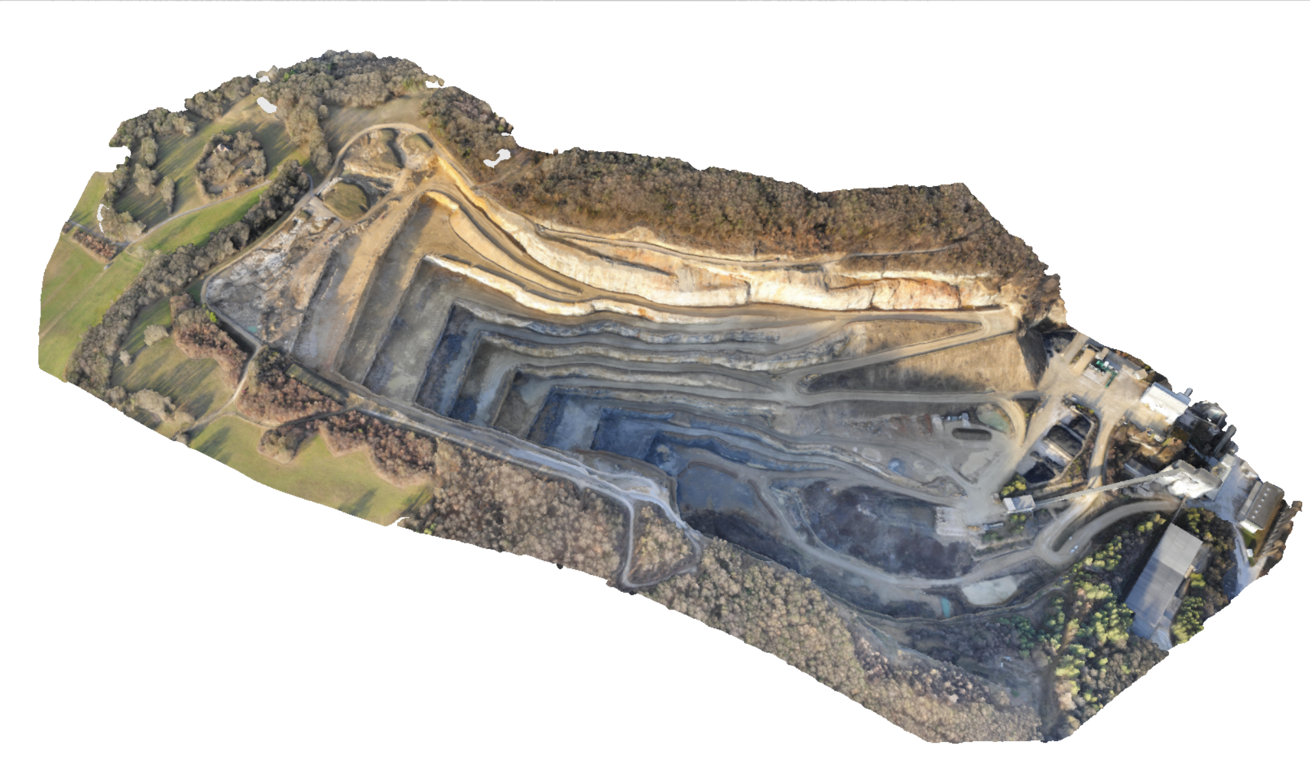
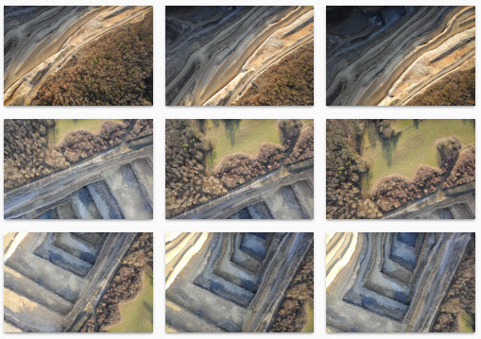
What is photogrammetry ?
{ }
Information from images
for better and faster decisions
Notes:
Pix4Dmapper: get accurate 3D or 2D representation of reality:Photogrammetry software for
professional drone mapping
Pix4Dcapture: get the images for photogrammetry: Free app to plan, fly and get optimized images for professional drone mapping

Slide 5
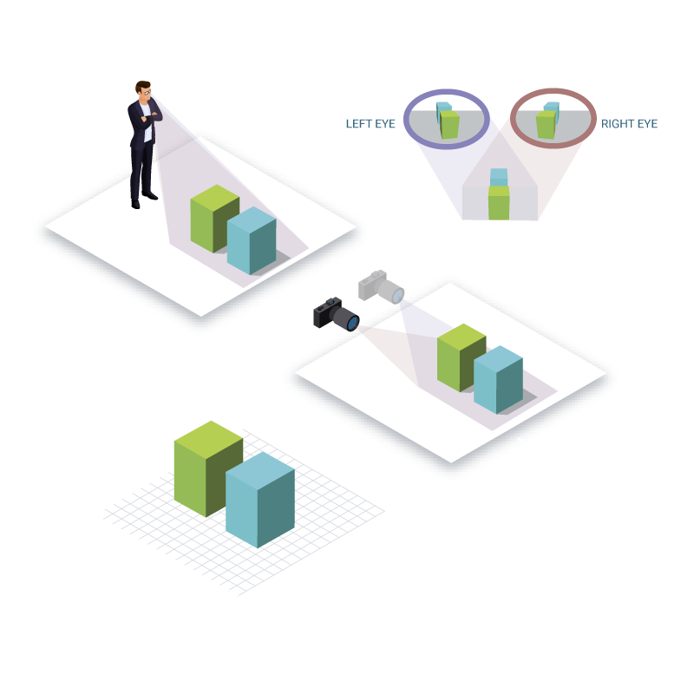
What is photogrammetry ?
Photogrammetry allows to digitize the world, purely from images

Slide 6
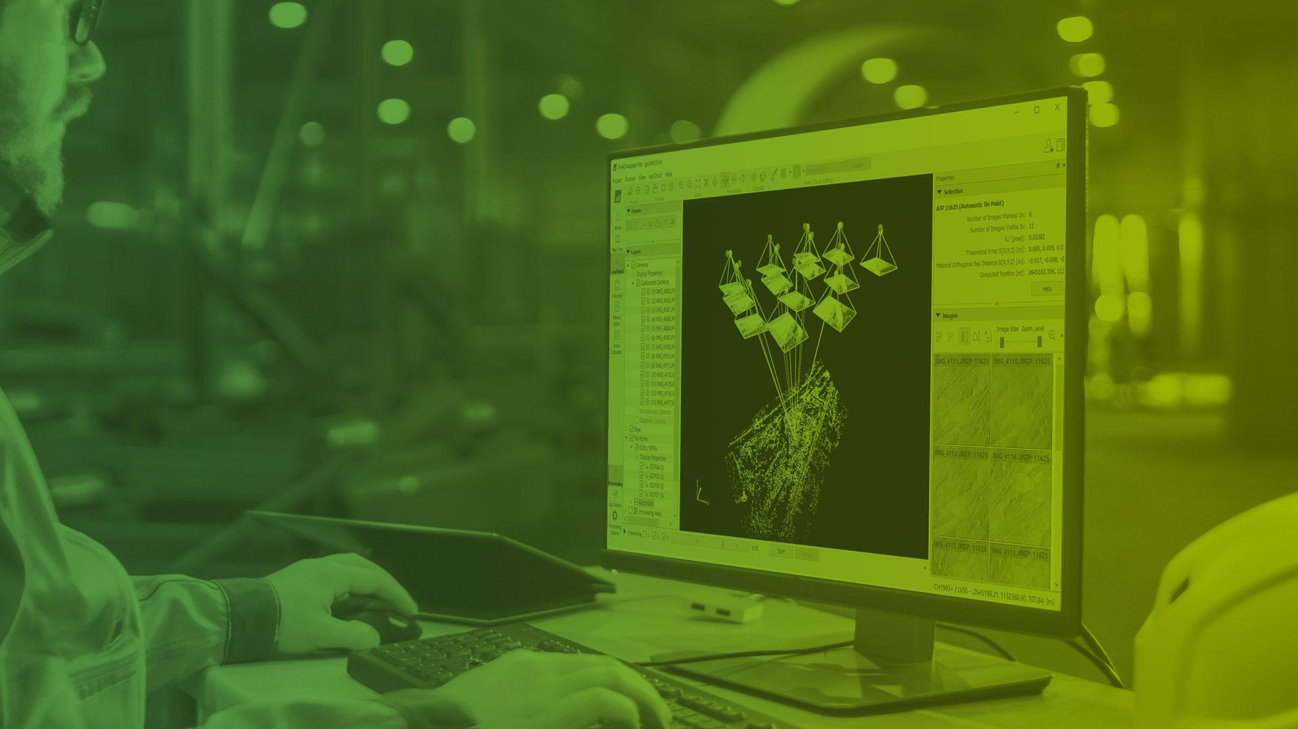
Pix4D unique software solutions

Slide 7
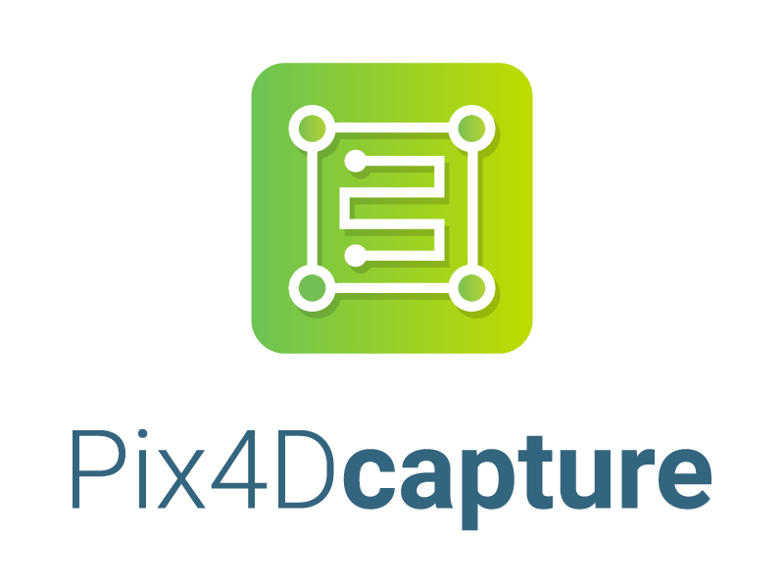
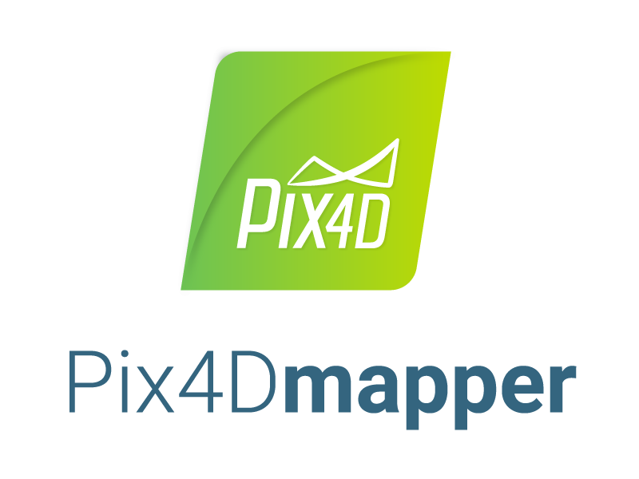
Pix4D software : surveying & mapping
Free mobile flight planning app
Desktop & Cloud software
Notes:
Pix4Dmapper: get accurate 3D or 2D representation of reality:Photogrammetry software for
professional drone mapping
Pix4Dcapture: get the images for photogrammetry: Free app to plan, fly and get optimized images for professional drone mapping

Slide 8

Pix4D workflow
1. Capture
2. Digitize
3. Check,
Measure & Inspect
4. Share

Slide 9

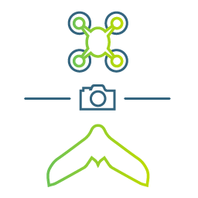






Inputs
RGB images
Drone images
Multispectral images
Thermal images
Fisheye images
360° camera images
Camera rig images
Videos
Notes:
We do measurements from images. That’s why we are compatible with all images as long as they are in .JPEG or .TIF format. These images can come from different types of cameras (RGB, multispectral, thermal, 360°, fisheye,...) and even videos!
The rise of drones made cameras an even powerful tool as images can be acquired from the air. We facilitate image acquisition from drones with Pix4Dcapture.

Slide 10


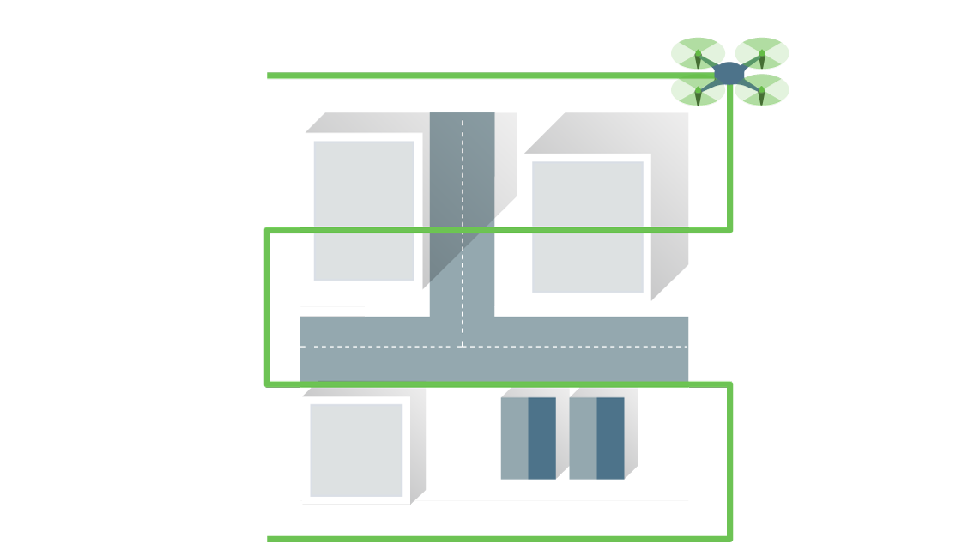
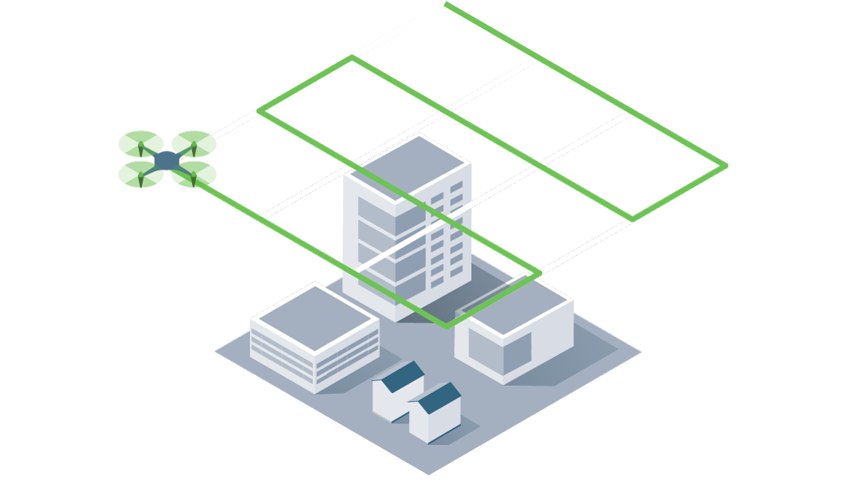
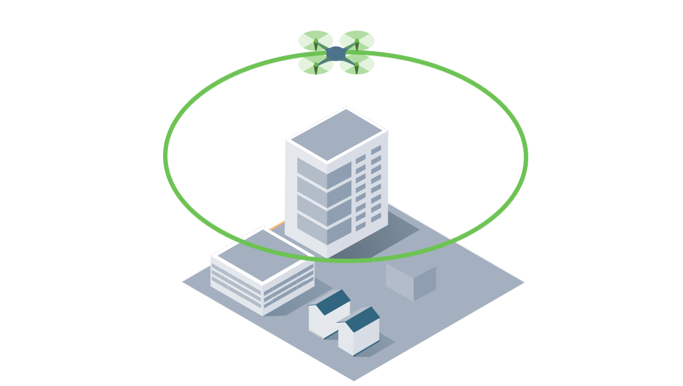

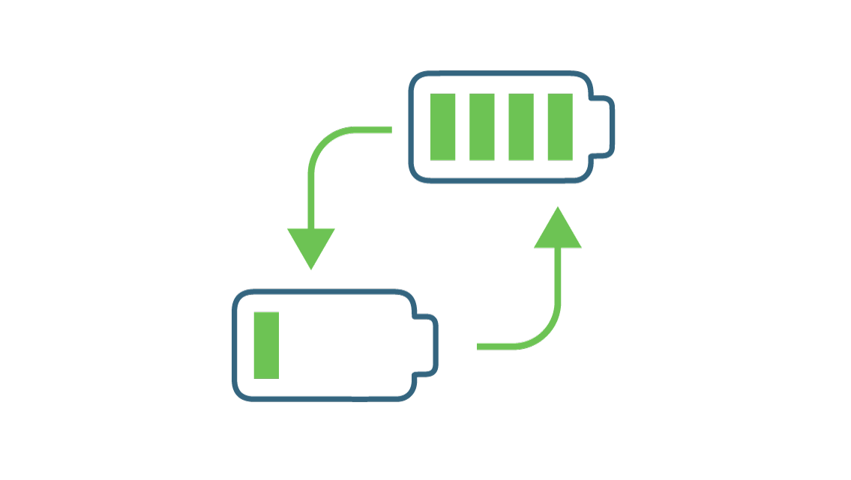
Flight missions
Plan and control drone flights for professional mapping and data capture
iOS & Android
DJI, Parrot, and Yuneec drones
Polygon
Grid
Double grid
Circular
Free flight
Multi-battery
Notes:
We do measurements from images. That’s why we are compatible with all images as long as they are in .JPEG or .TIF format. These images can come from different types of cameras (RGB, multispectral, thermal, 360°, fisheye,...) and even videos!
The rise of drones made cameras an even powerful tool as images can be acquired from the air. We facilitate image acquisition from drones with Pix4Dcapture.

Slide 11
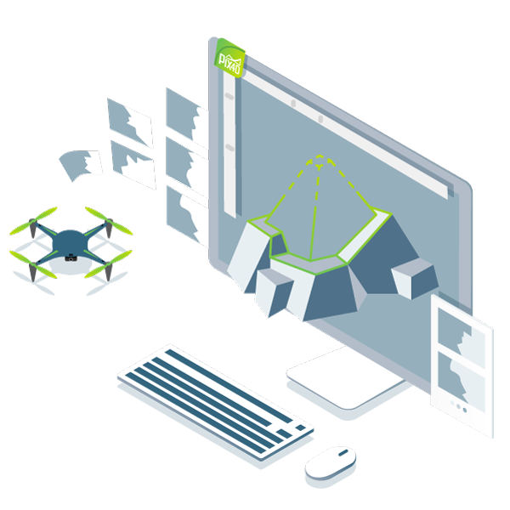
Digitize
Transform your images into accurate digital outputs.
Process your projects locally on Pix4Dmapper Desktop or online on Pix4Dmapper Cloud.

Slide 12
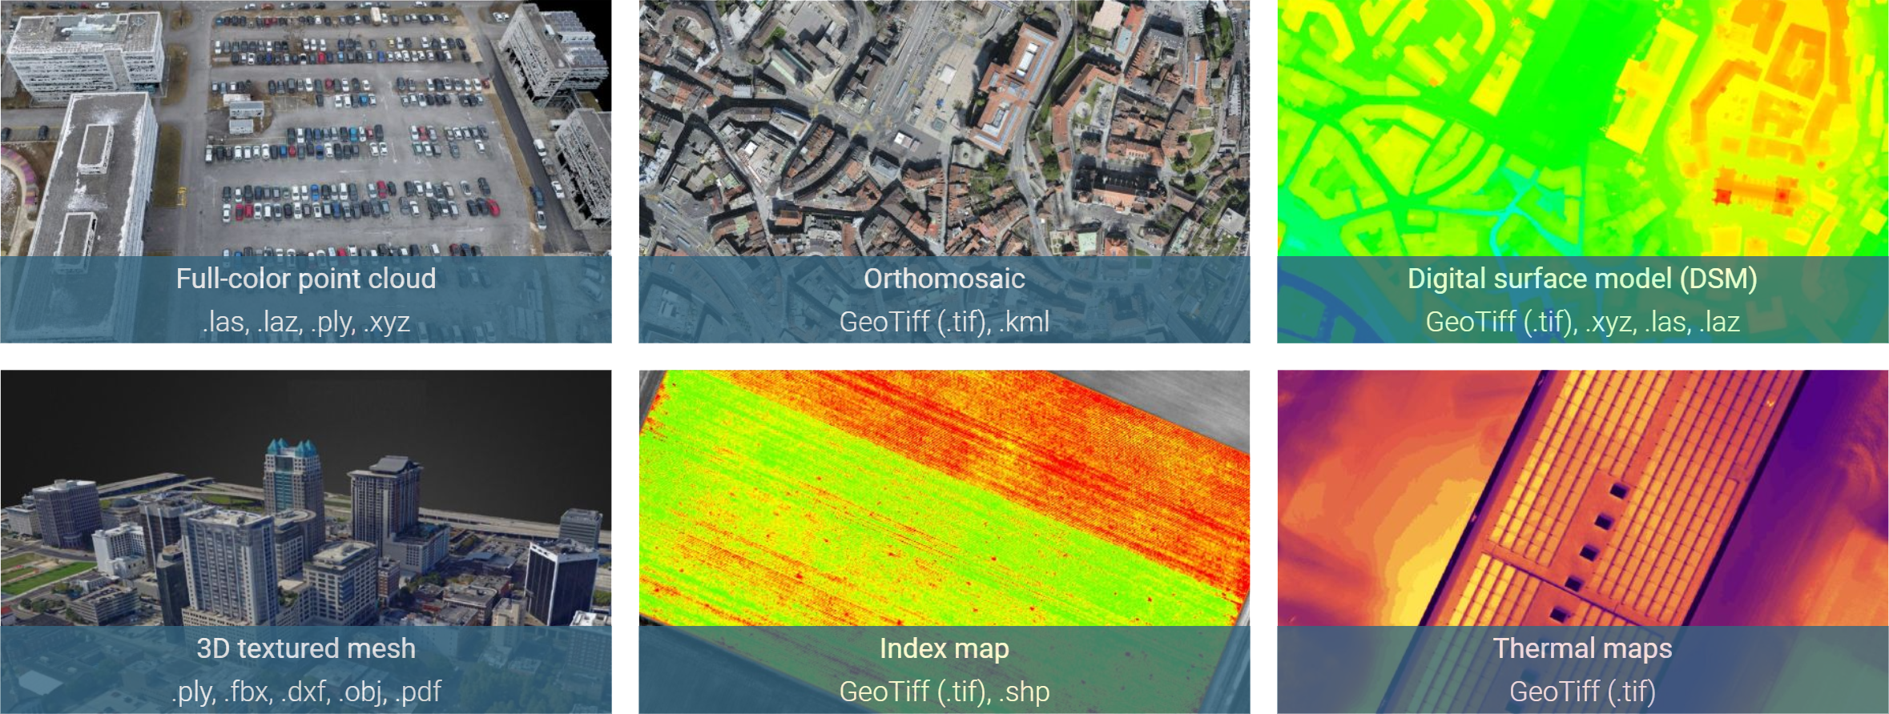
Outputs
And more...
Notes:
Once you have the images, you can process them with Pix4Dmapper to get these outputs, e.g. point cloud, orthomosaic,...

Slide 13
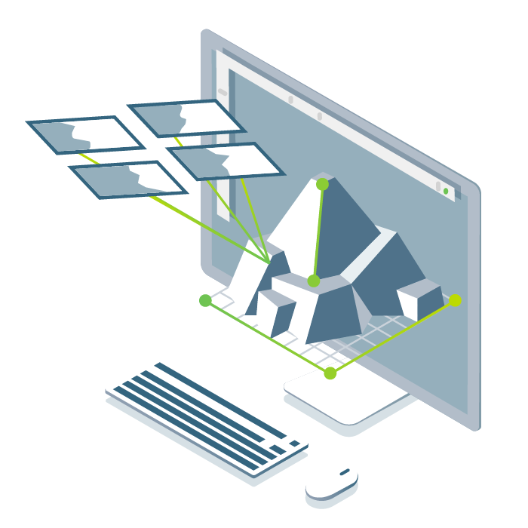
Check
Assess and improve the accuracy of your project with the quality report and the rayCloud™.

Slide 14

Measure & Inspect
Measure distances, areas, and volumes
Extract elevation profile data
Perform virtual inspections

Slide 15

Collaborate & share
Export individual files
Work with third-party software
On the Cloud, selectively and securely share data only with an URL
Notes:
Streamline communication and teamwork.
Export outputs for further analysis with third-party software, or selectively and securely share project data and insights through Pix4D cloud.

Slide 16



Why mapping with Pix4D?
Increased productivity
Reduce field time and surveying time
Reduce operational risks
Accurate results
Assess and improve your data accuracy
Updated maps
Simple workflow
Easily repeatable data capture
Notes:
Pix4Dmapper: get accurate 3D or 2D representation of reality:Photogrammetry software for
professional drone mapping
Pix4Dcapture: get the images for photogrammetry: Free app to plan, fly and get optimized images for professional drone mapping

Slide 17
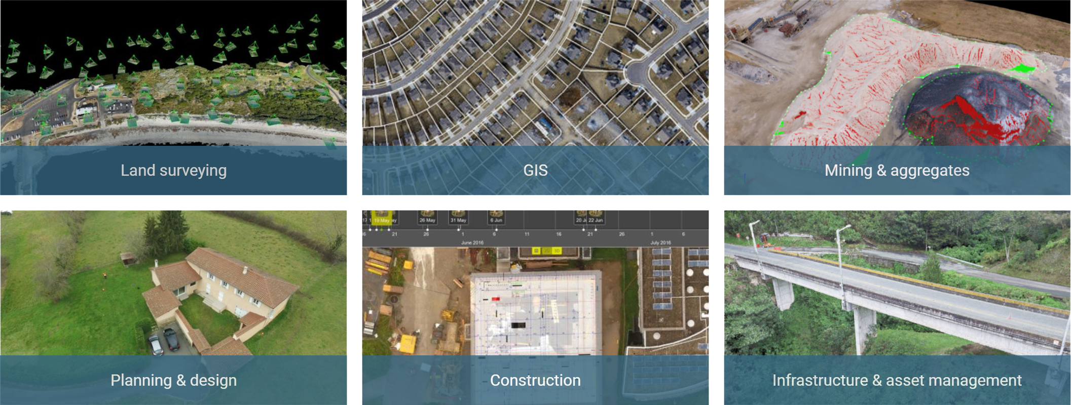
Applications
Notes:
There are many applications for measurements from images. The majority of clients are surveyors and drone service providers whose job requires them to work across industries.
Why do they purchase our geospatial products?
Survey-grade results: accuracy, accuracy assessment, control.
Reduce surveying time: more efficient workflow (drones to cover large areas,...), data redundancy and increased worker safety.
Expand your possibilities: flexible solution that works across applications, reach inaccessible areas (e.g. below a bridge) and combination of different types of imagery.

Slide 18
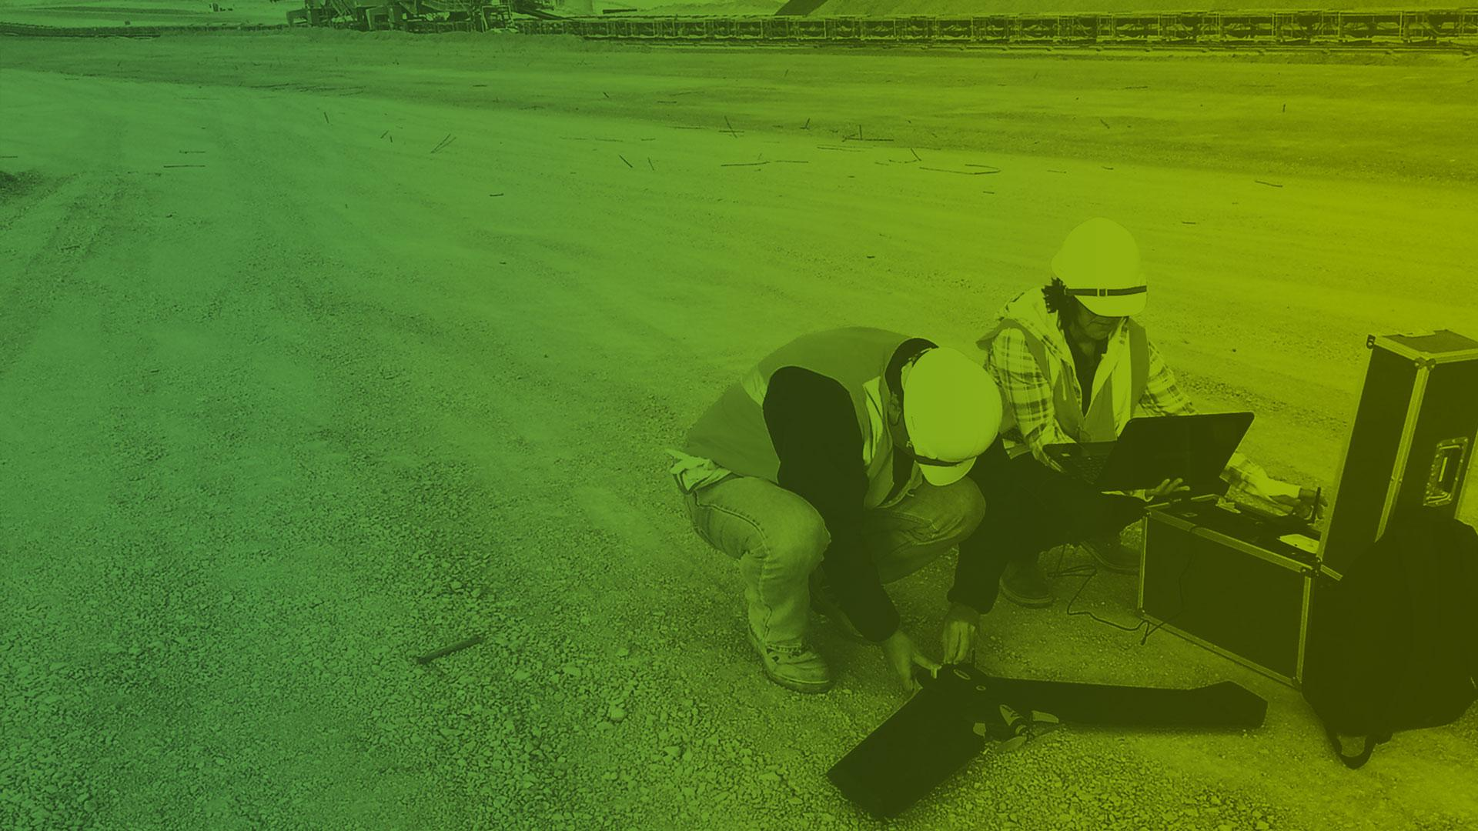
Case study

Slide 19
Surveyor
[noun]
A person whose job is to measure and record the details of areas of land.* *https://dictionary.cambridge.org/dictionary/english/surveyor

Slide 20
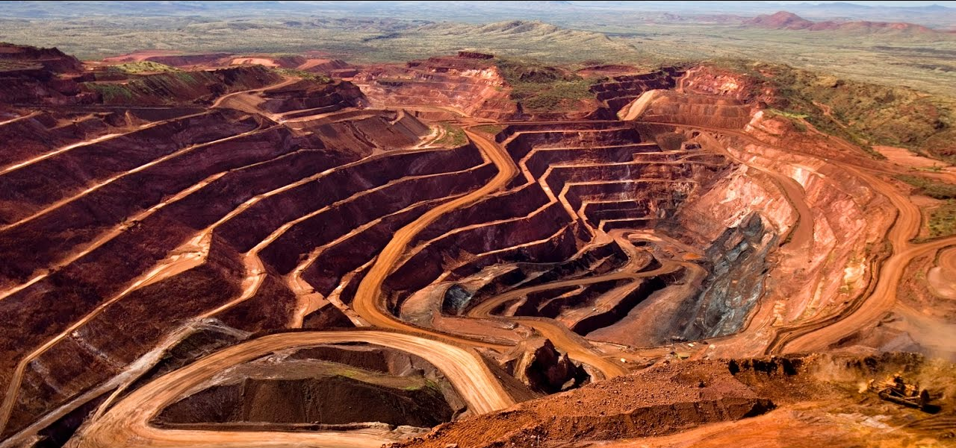


The traditional surveyor
Notes:
Surveyor is an adventurer, outside, dangerous and unknown places (e.g. lost city of Z), conquerors, royal societies,...=> goes on the terrain => risky (terrain, animals, weather conditions,...)

Slide 21
Digital Surveyor
[noun]
A person whose job is to measure and record the details of areas of land with cutting-edge digital technology.* *Pix4D

Slide 22
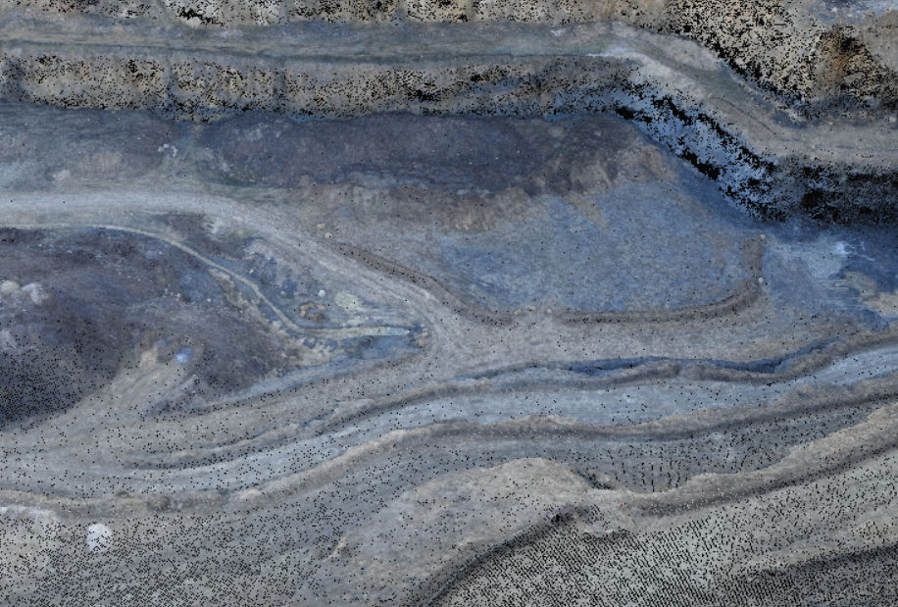
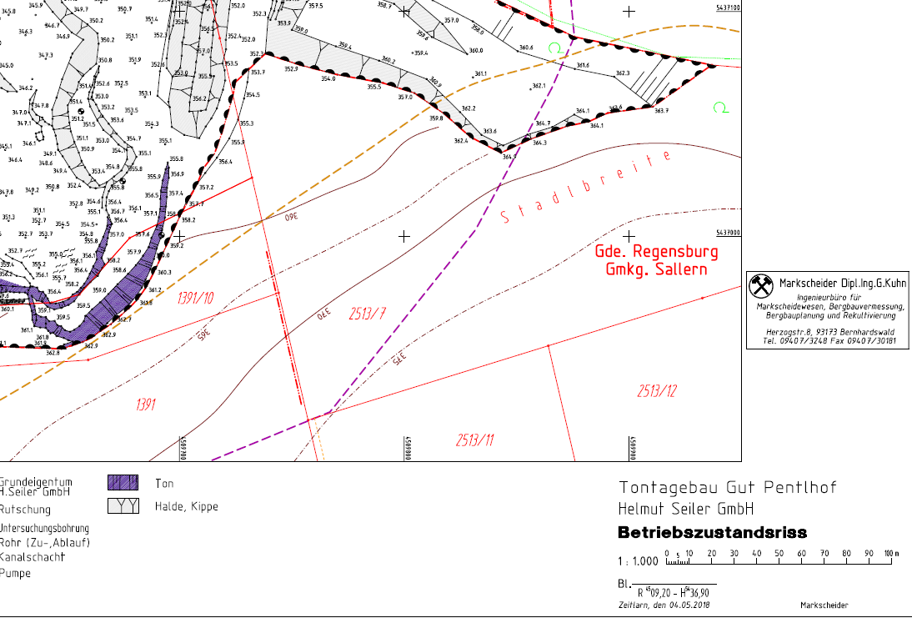

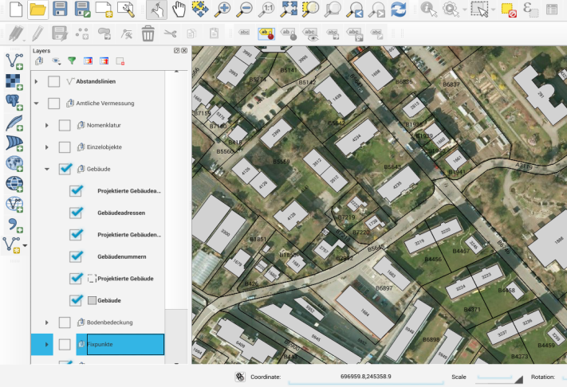
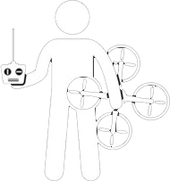


The digital surveyor
Capture (inputs)
Process (outputs)
CAD/GIS
Now I have the terrain in my office.
I am working in CAD/GIS software.

Slide 23
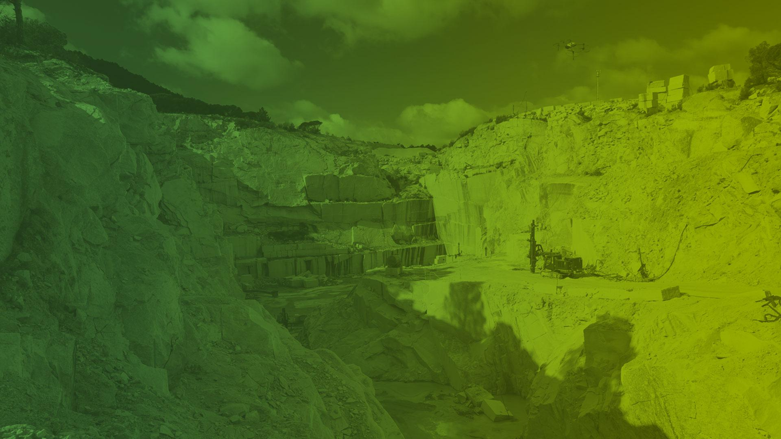
Q&A

Slide 24
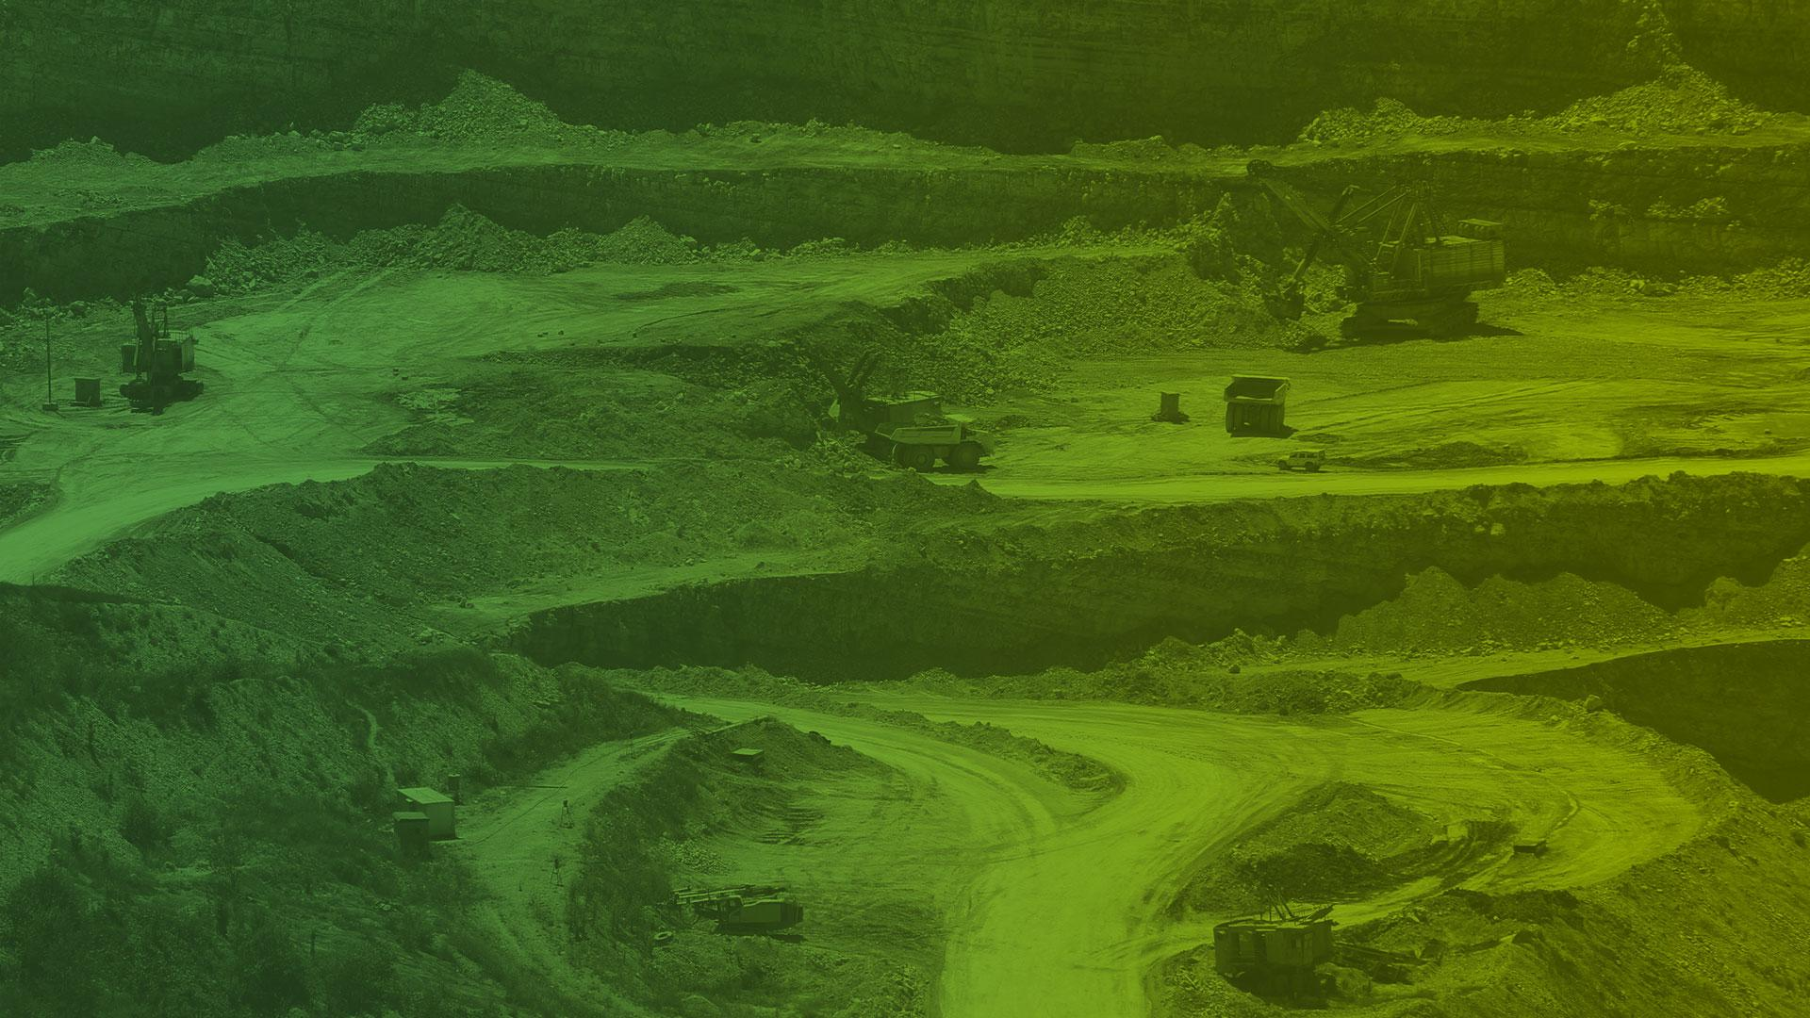
Thank you

