Slide 1

Pix4D Partner Portal Guide

Slide 2
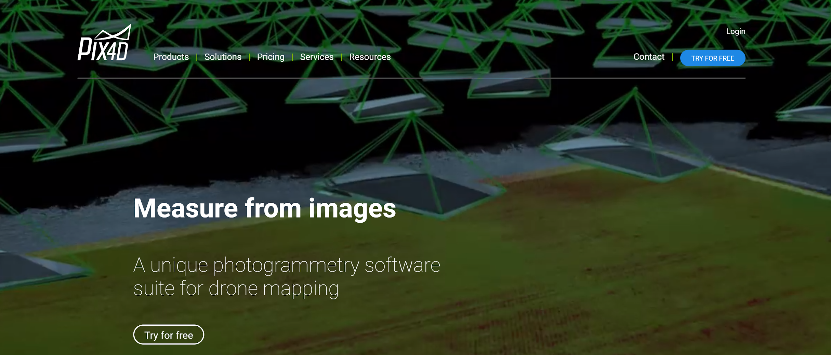
Partner Portal – how to log in
Go to www.pix4d.com
Login to your account

Slide 3
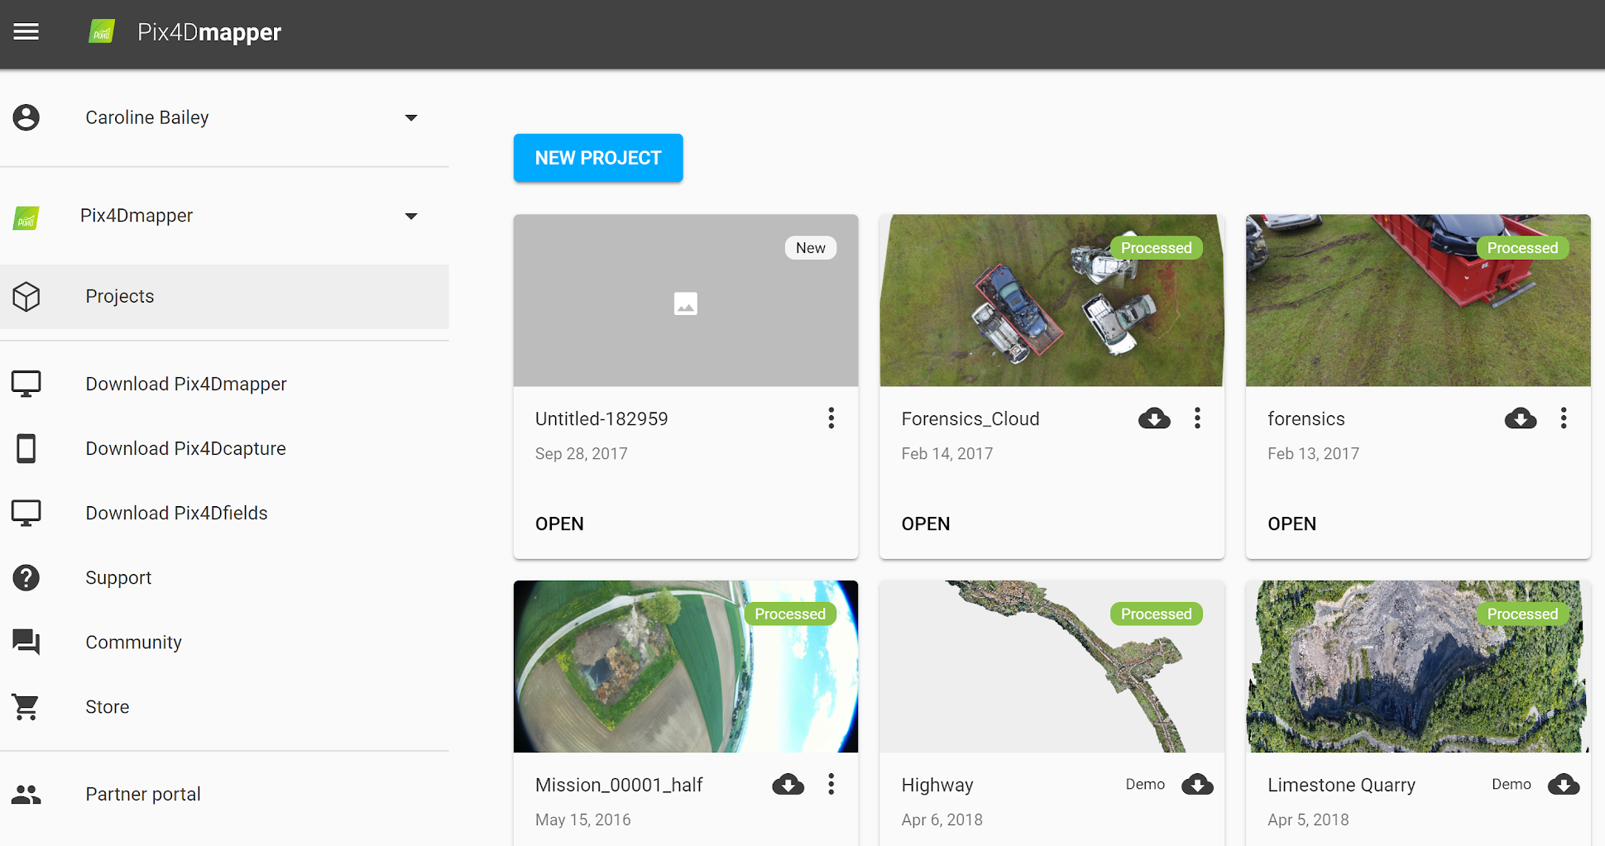
Partner Portal – how to log in
Login to Partner Portal

Slide 4
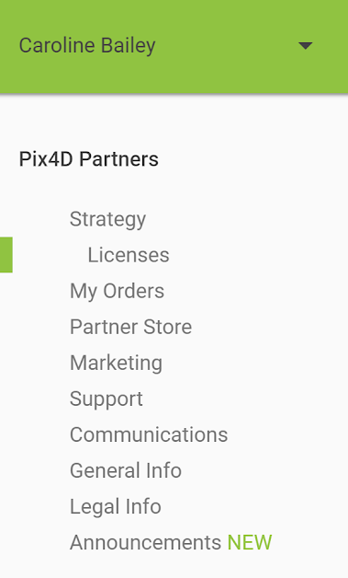
Partner Portal – Landing page
Strategy Sales & marketing activity record
Licenses All licenses (sold & trial) attached to Partner
My orders All Invoices & Proformas (PDFs downloadable)
Partner Store Buy licenses here with Partner discounts
Marketing Links to printable marketing material
Support Links to support site and training material
Communications Archive of Partners newsletters
General Info Contact info, link to contract, official logo & certificate
Legal Info Complementary terms related to contract
Announcements Information about important topics

Slide 5
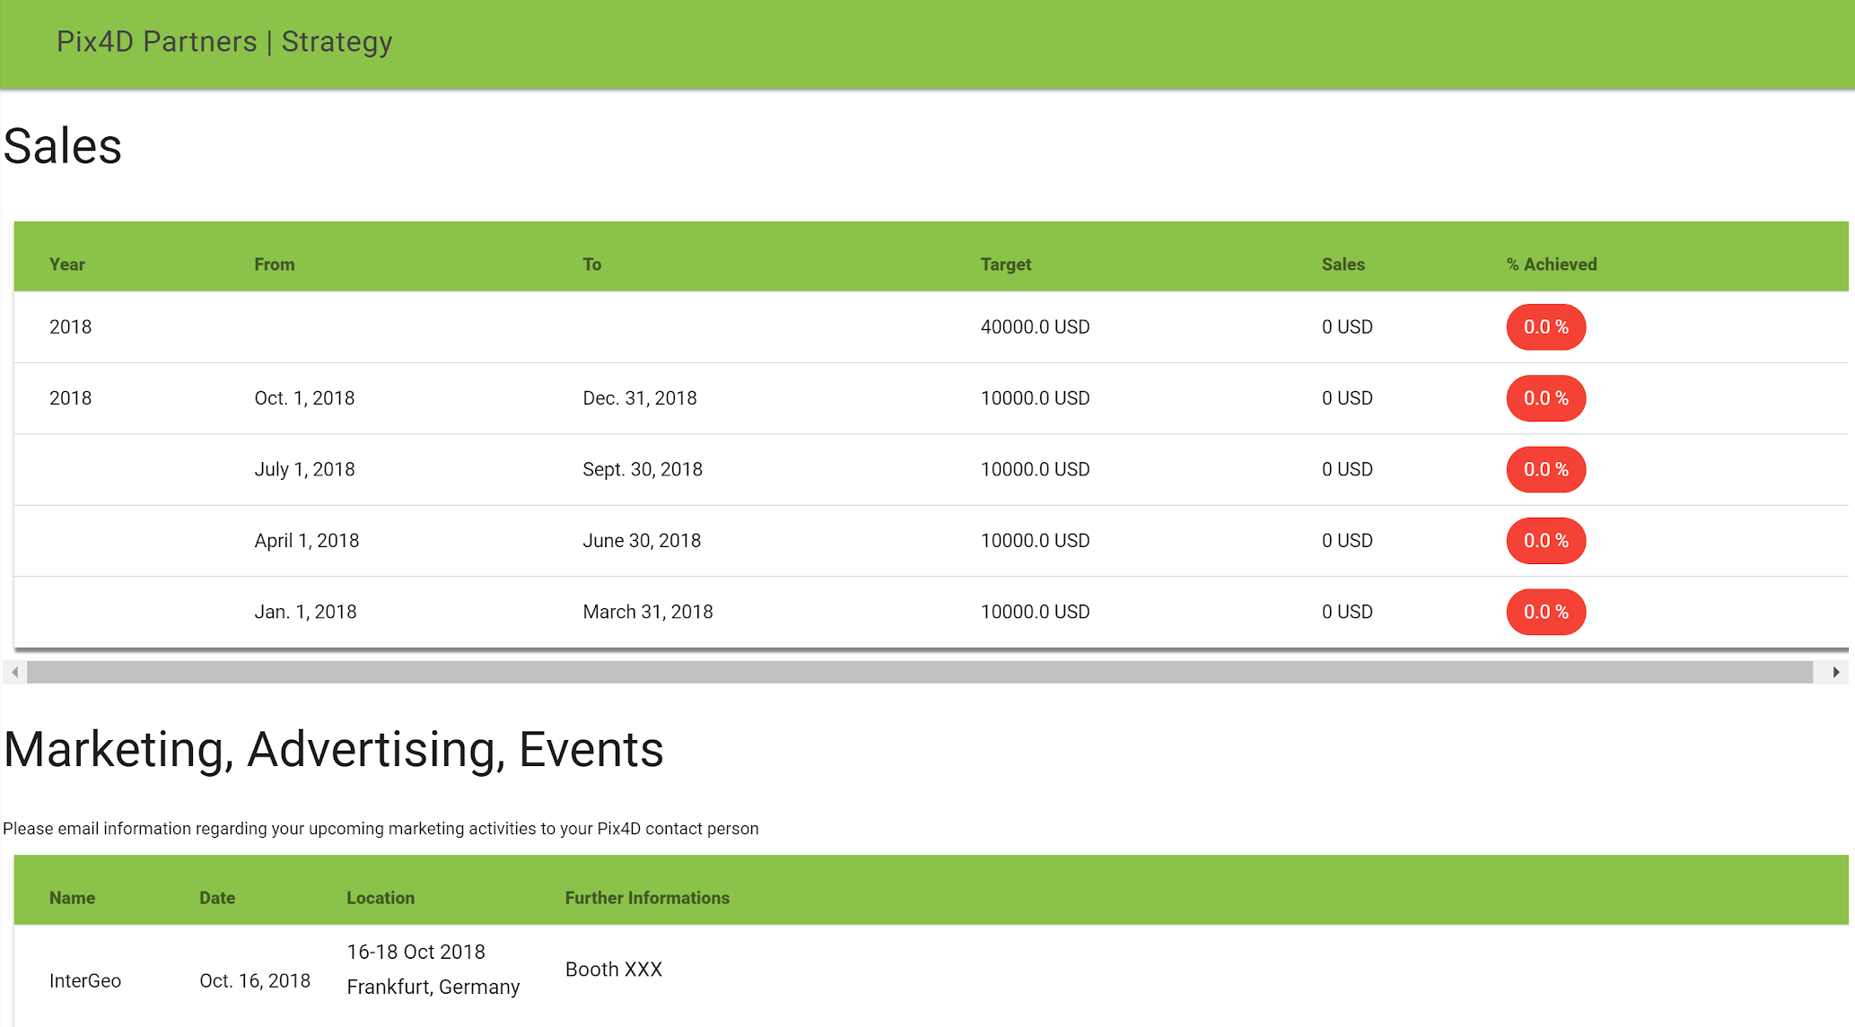
Partner Portal – Strategy
Sales
Target versus Sales
per year and
per financial quarter
Marketing
Record of marketing and events done on behalf of Pix4D.
Please inform us of your activities!

Slide 6
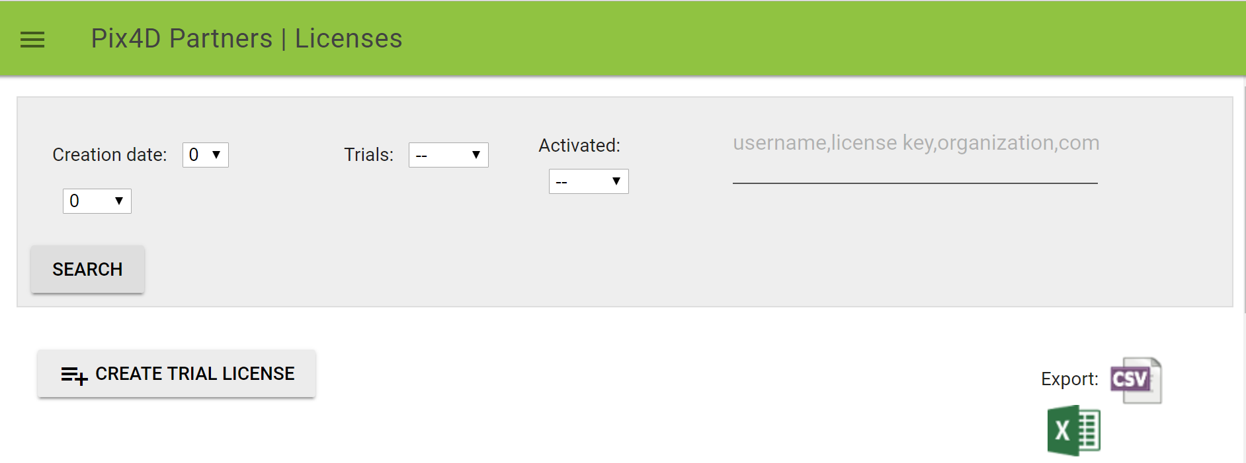
Partner Portal – Licenses
Page shows all licenses in which your company email address is the “reference user”.
Search for specific license with license key/ user name/ organization name
Create trial licenses for potential clients (max two per client)
Export license data as Excel or CSV file

Slide 7


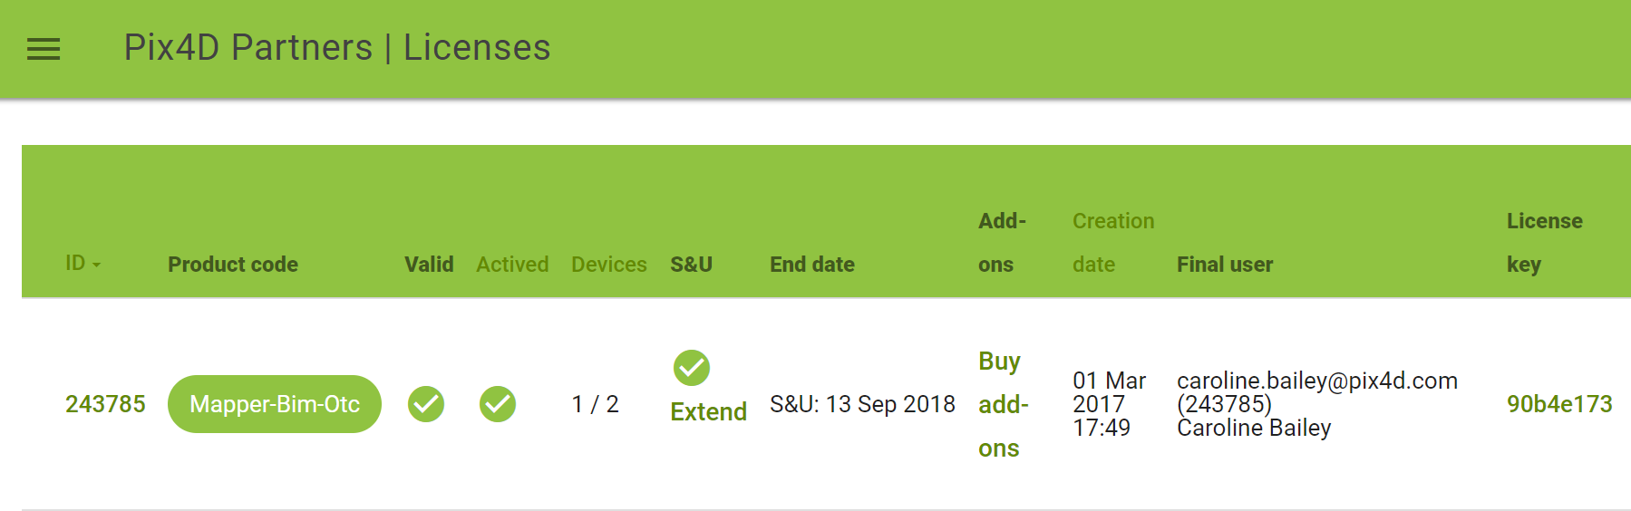
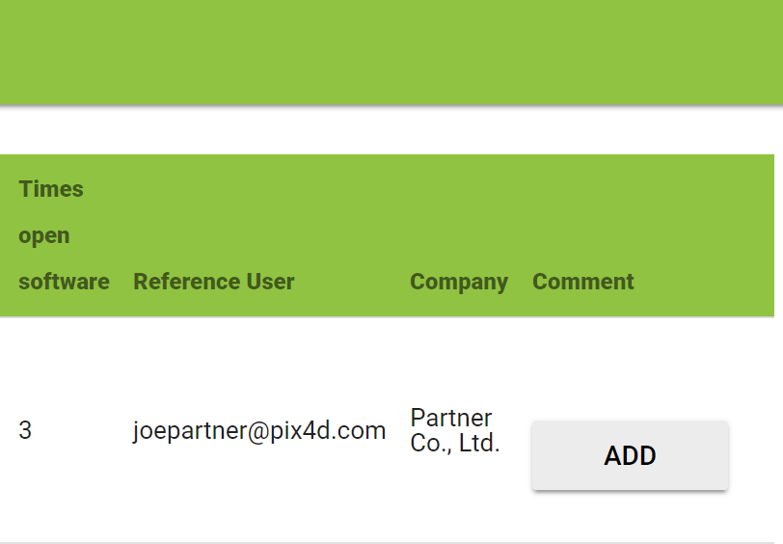
Partner Portal – Licenses
Product code = License type
Valid = license not expired, license expired
Activated = license used, license unused
Devices = Number of devices (computers) in use out of possible total number
S&U (Support & Upgrades) = S&U valid, S&U expired
End date = S&U expiry date (if perpetual) or license expiry date (if rental)
Creation date = license creation date
Final user = Pix4D account email address of end user
License key = Product certificate; click to download license PDF for client
Reference user = Pix4D account email address of partner company
Company = Partner company

Slide 8
Partner Portal – Licenses
S&U extensions are purchased from “Licenses” page, not “Partner Store”
S&U can only be purchased after license is activated (used at least once)
Click Extend and you will be send to the “Partner Store”
Enter the quantity of S&U that you wish to purchase
Click “Proceed to checkout”
Click to buy S&U for a specific license

Slide 9
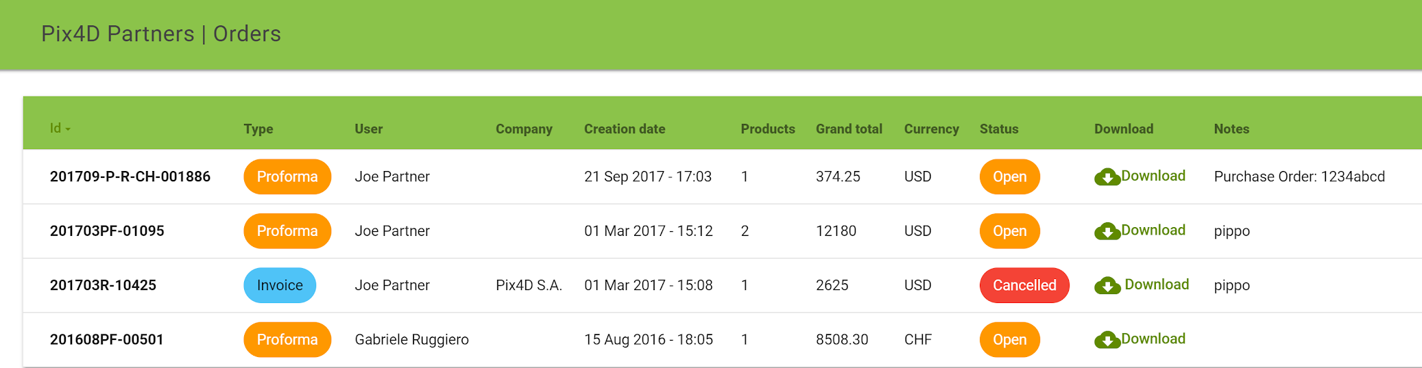
Partner Portal – My orders
Keep track of what you have ordered and bought through the Partner Portal
Type = Pro Forma: license ordered (non-binding). Invoice: license ordered (binding).
Status = Open: not paid. Paid: paid
Creation date = date on which Pro Forma or Invoice was created
Download = download Pro Forma or Invoice as PDF
Download invoices

Slide 10
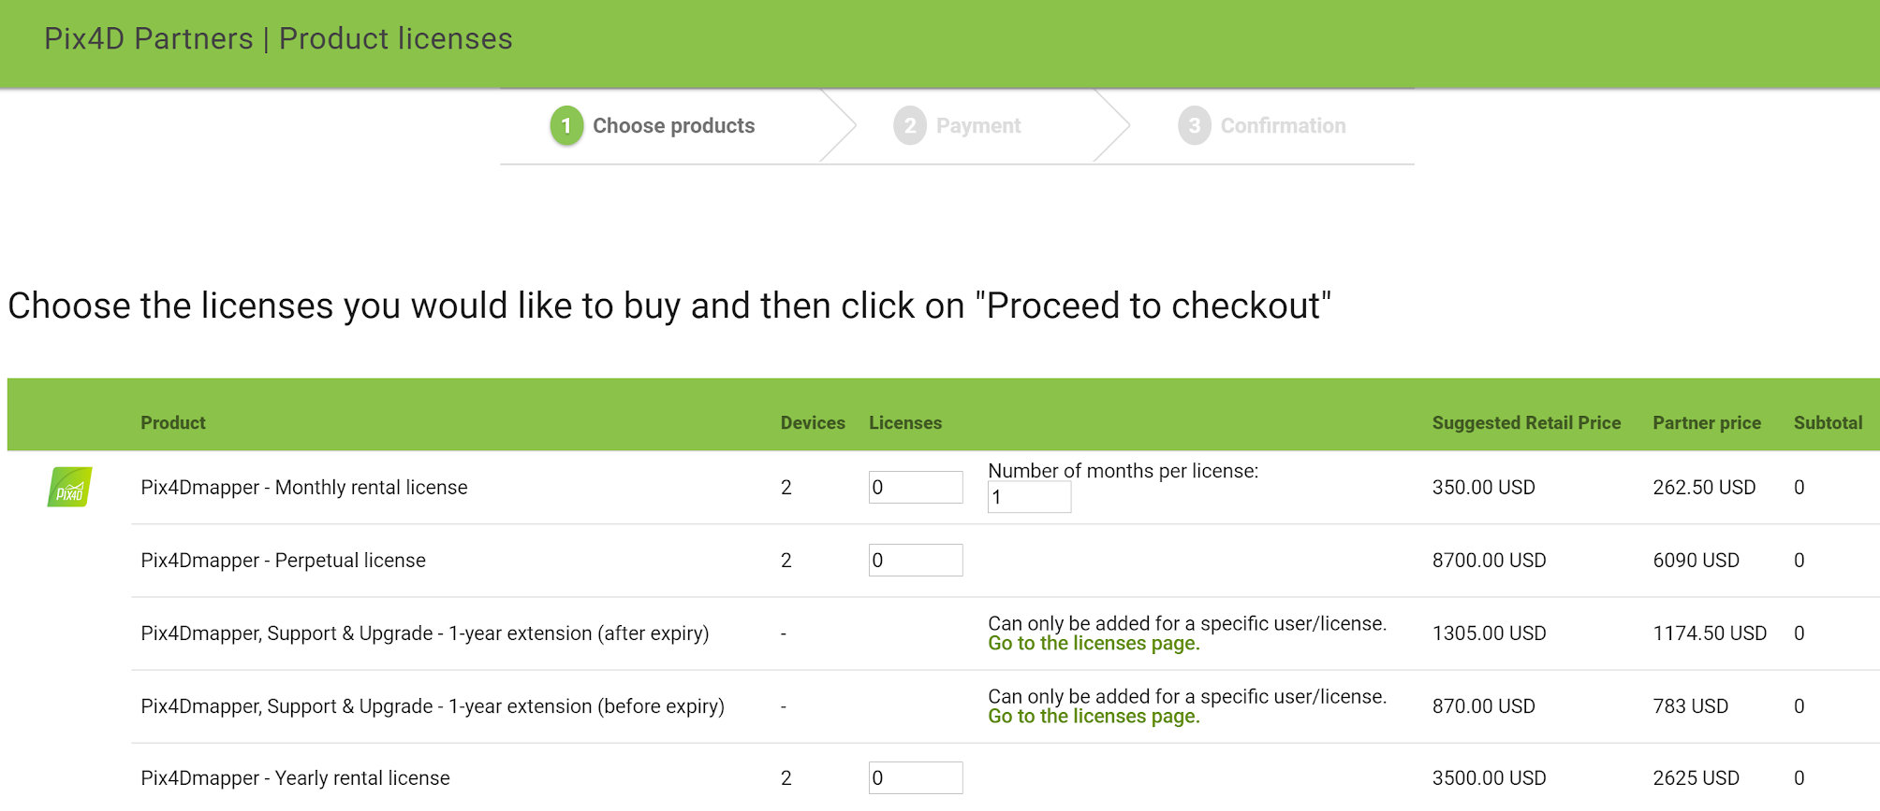
Partner Portal – Partner store: Choose products
Perpetual and Yearly rental licenses: select number of licenses that you wish to buy
Monthly rental licenses: select number of licenses & months per license that you wish to buy
Click “Proceed to checkout”
For S&U
go to “Licenses”

Slide 11
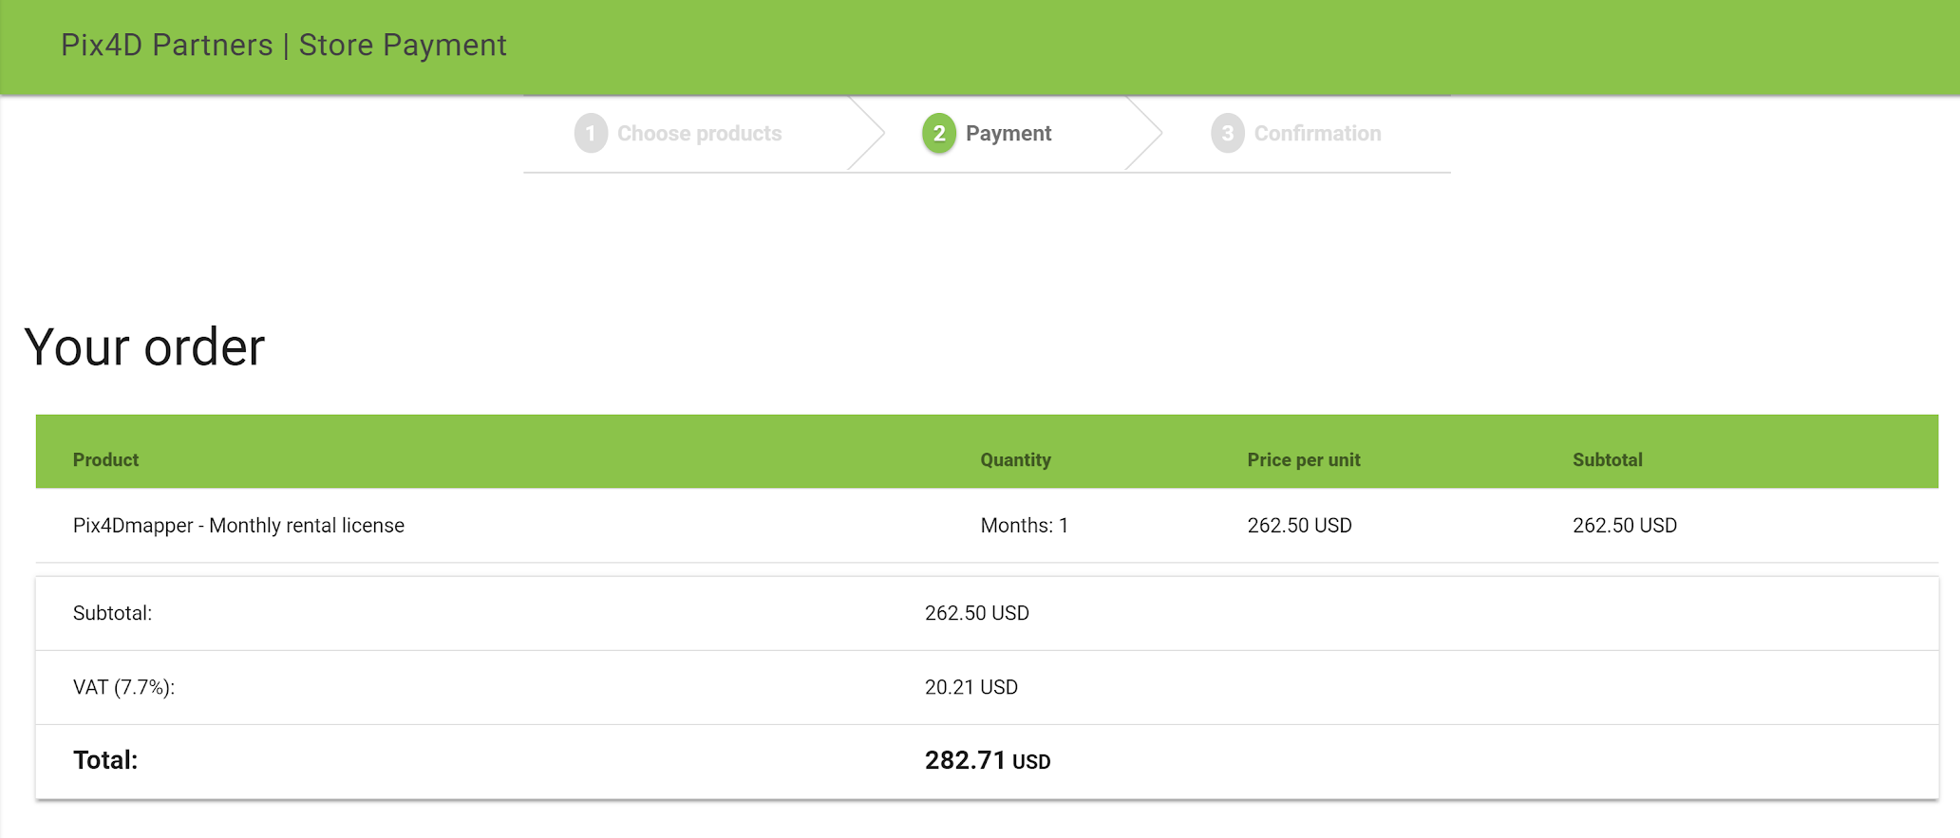
Partner Portal – Partner store: Payment
Check your order
Note that VAT is not charged (0%) outside of Switzerland

Slide 12
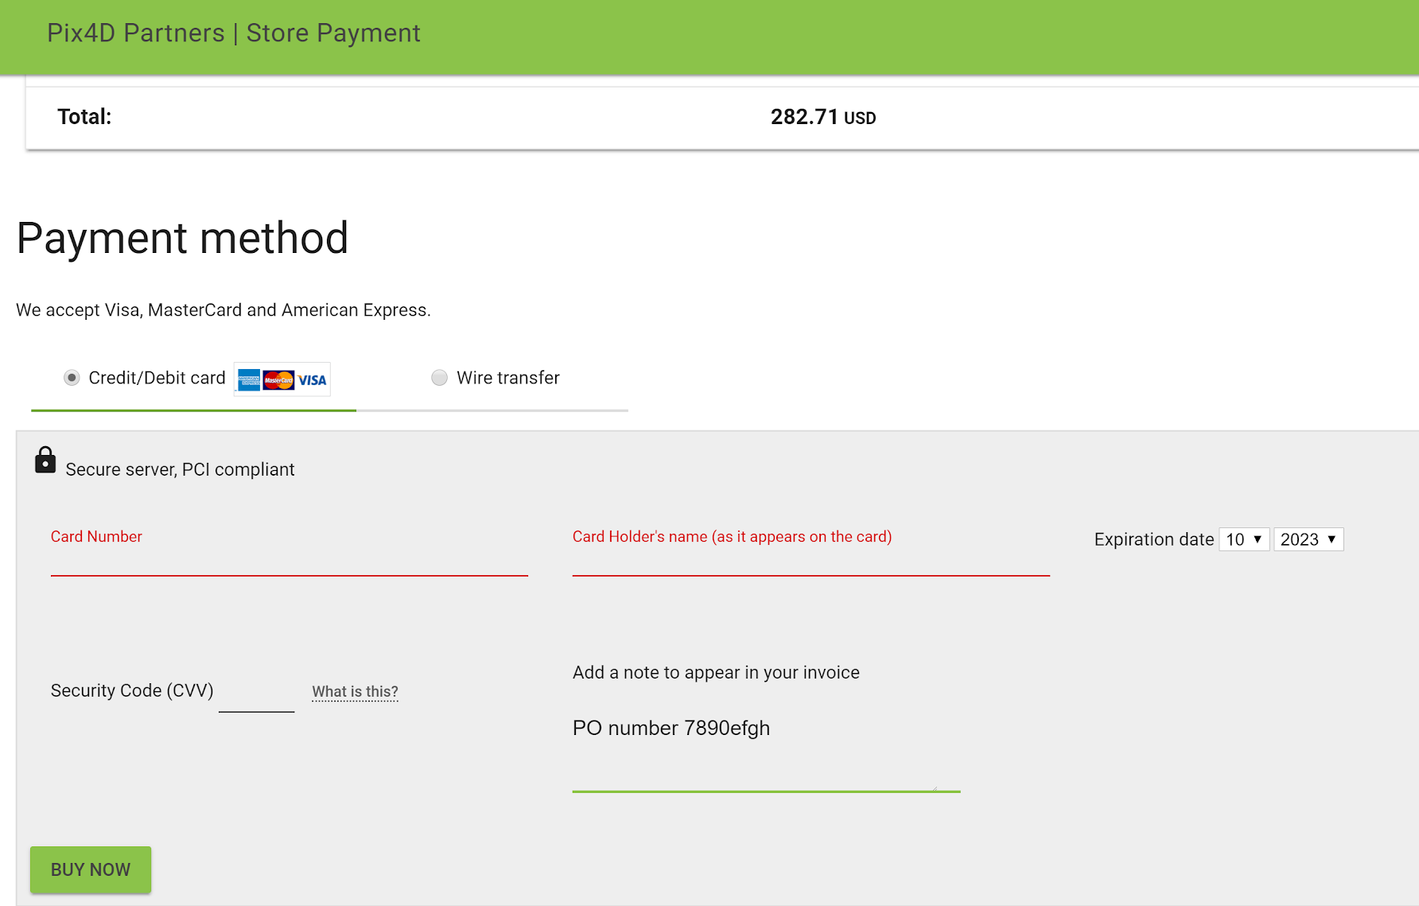
Partner Portal – Partner store: Payment (Credit/Debit card)
Pay via
Credit/Debit Card
Add note
E.g client/sub-dealer/ PO number

Slide 13
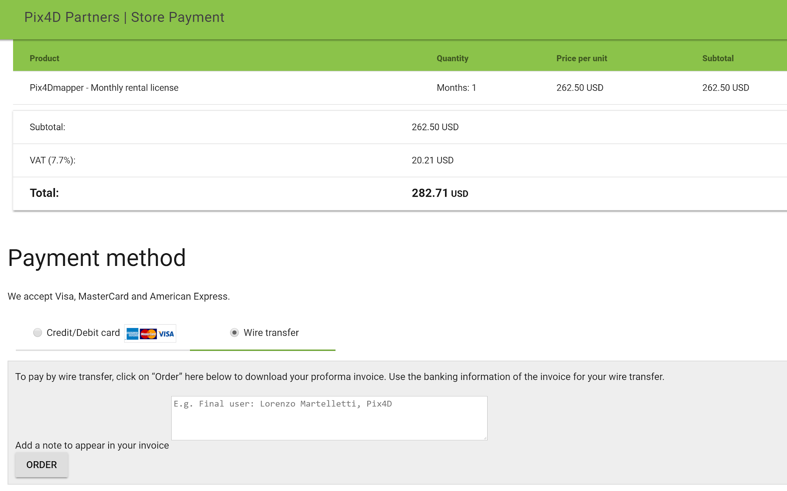
Partner Portal – Partner store: Payment (Wire Transfer)
Add note
E.g client/sub-dealer/ PO number
Pay via
Wire Transfer

Slide 14
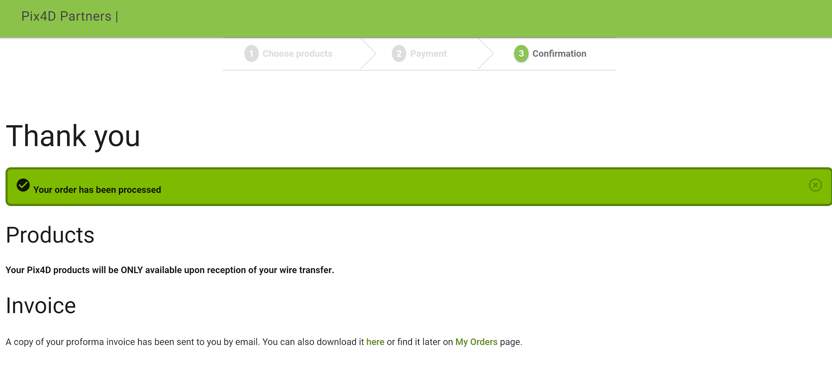
Partner Portal – Partner store: Confirmation

Slide 15
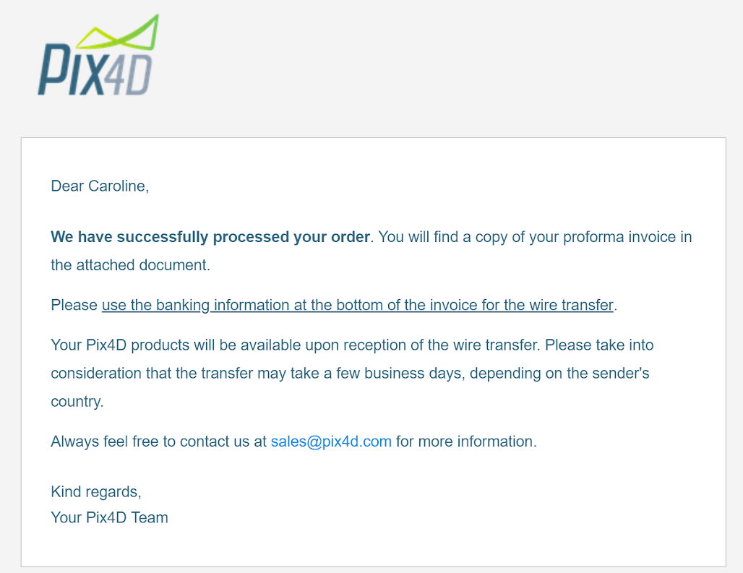
Partner Portal – Partner store: Confirmation
After placing your order, you receive automatic email confirming order.
The new orders can now be viewed in “My Orders”

Slide 16
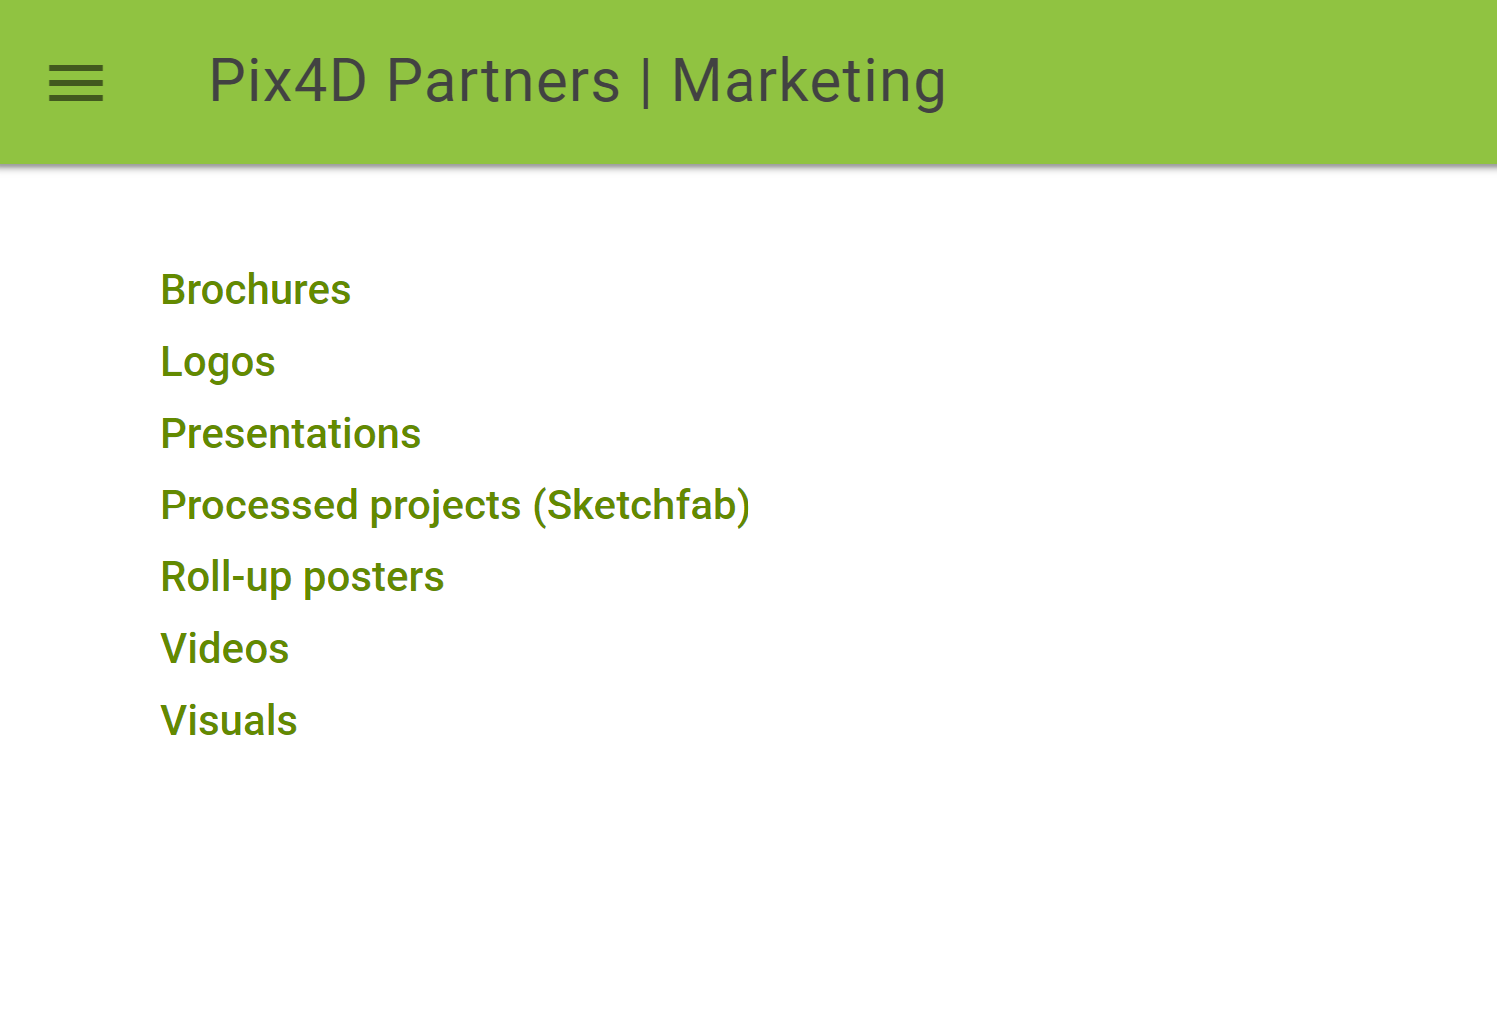
Partner Portal – Marketing
Links to printable and digital promotional material to use on your website, at events and display in your office.

Slide 17
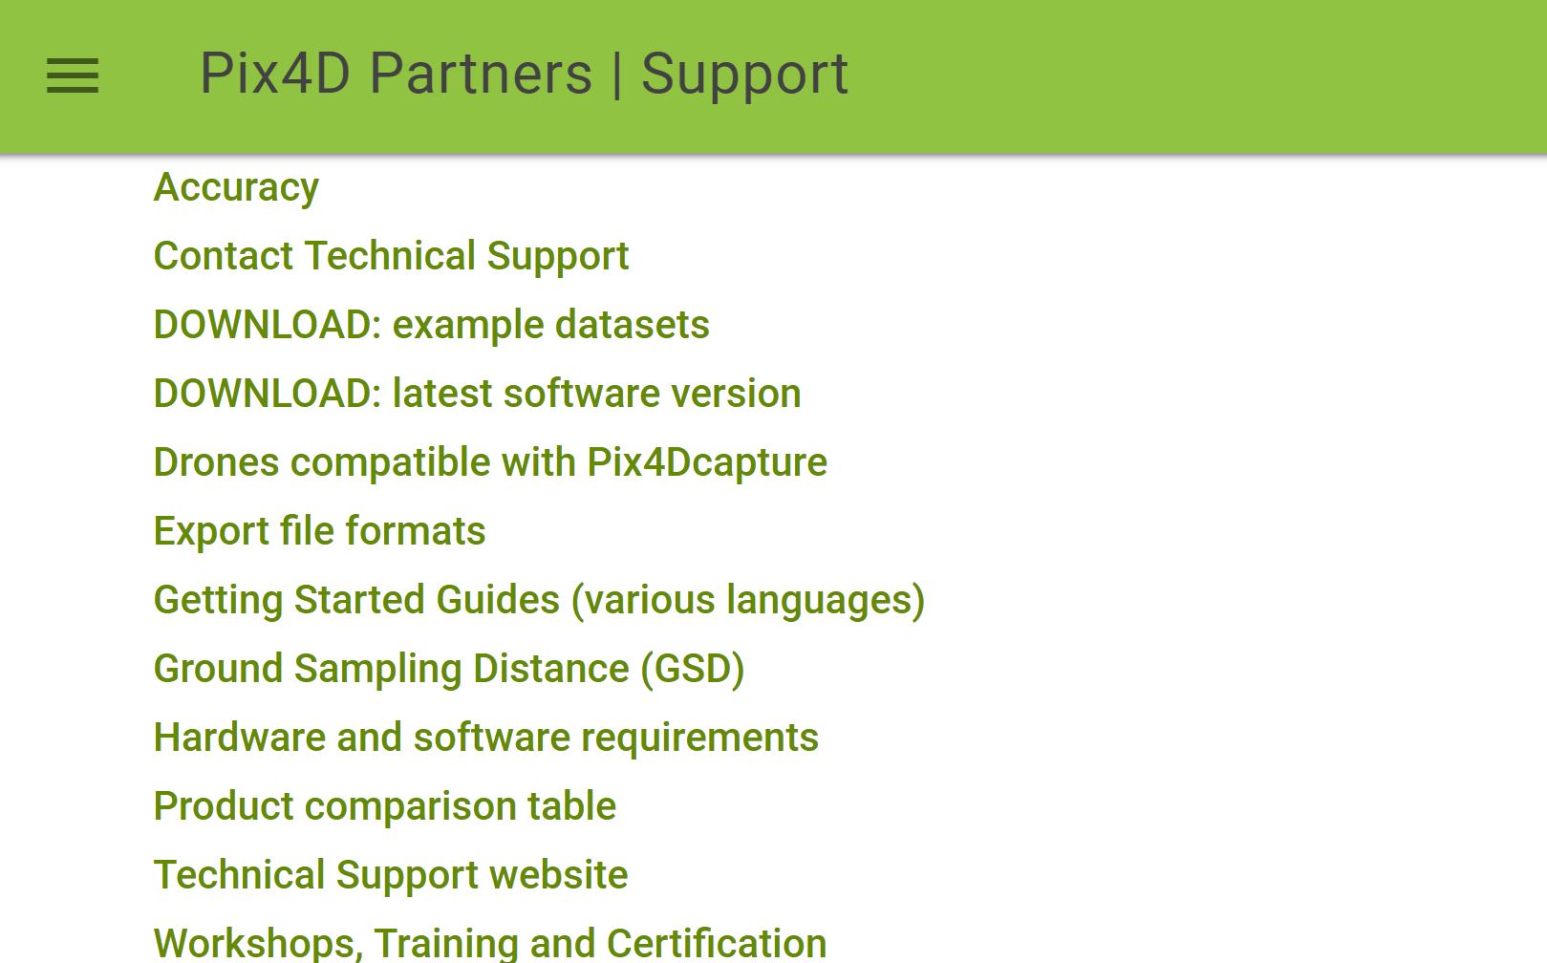
Partner Portal – Support
Links to the Pix4D Support website to help you:
- answer technical FAQs / direct customers to our Technical Support team for help
- direct customers to our free downloads for trials
- direct customers to our and training options.

Slide 18
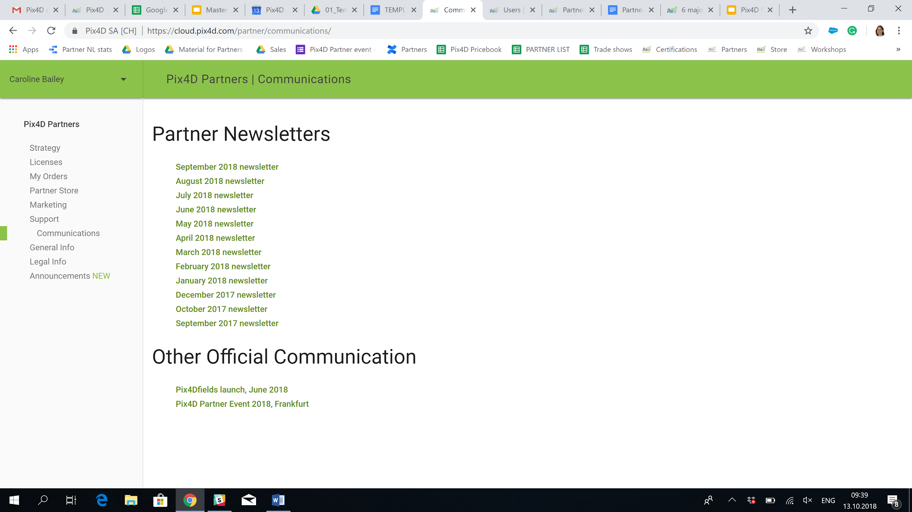
Partner Portal – Communication
Archive of all Newsletter communications. Please contact Pix4D to update your mailing list.

Slide 19
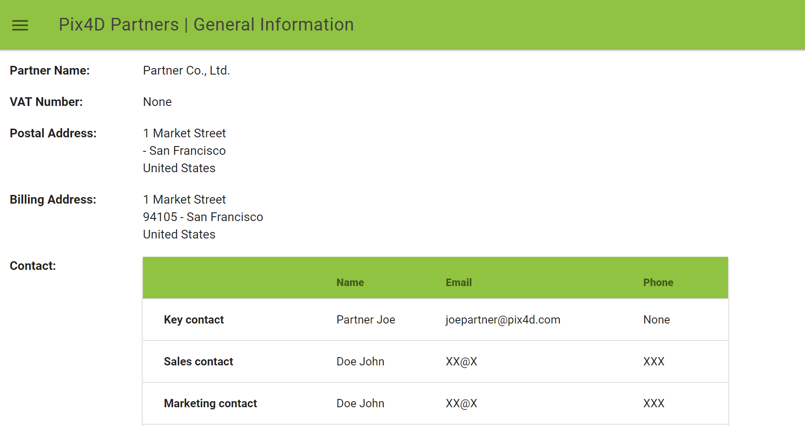
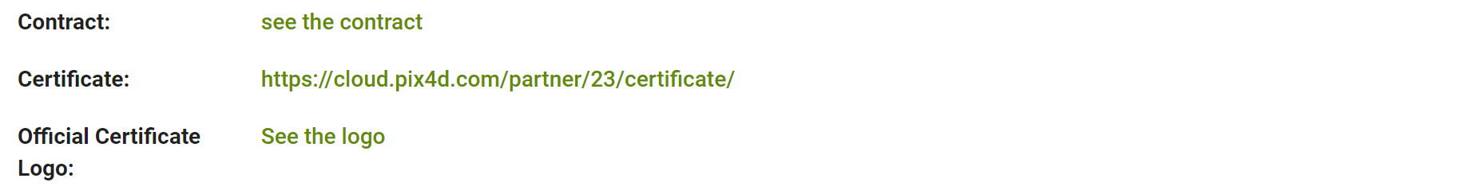
Partner Portal – General Info
General company and contact info
Link to Partner contract, official certificate and logo
Partner/Resseller logo

Slide 20
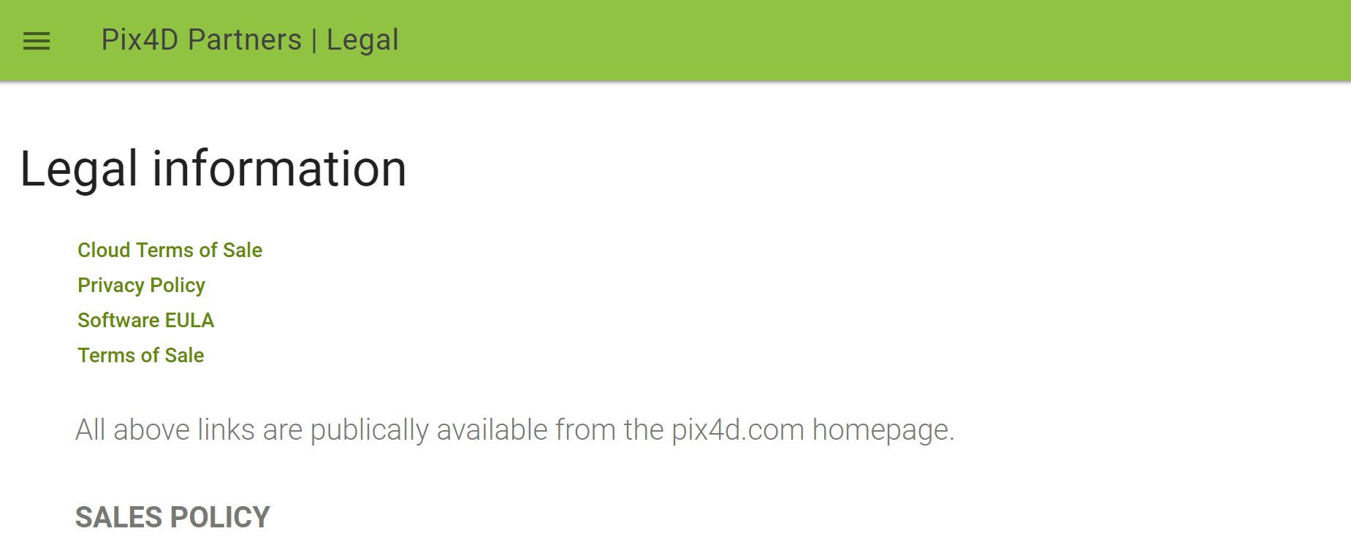
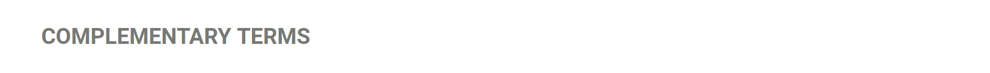
Partner Portal – Partner store: Confirmation
Links to legal info regarding product sale and usage
Sales policy instructions
Complementary Terms, related to Partner contract

Slide 21
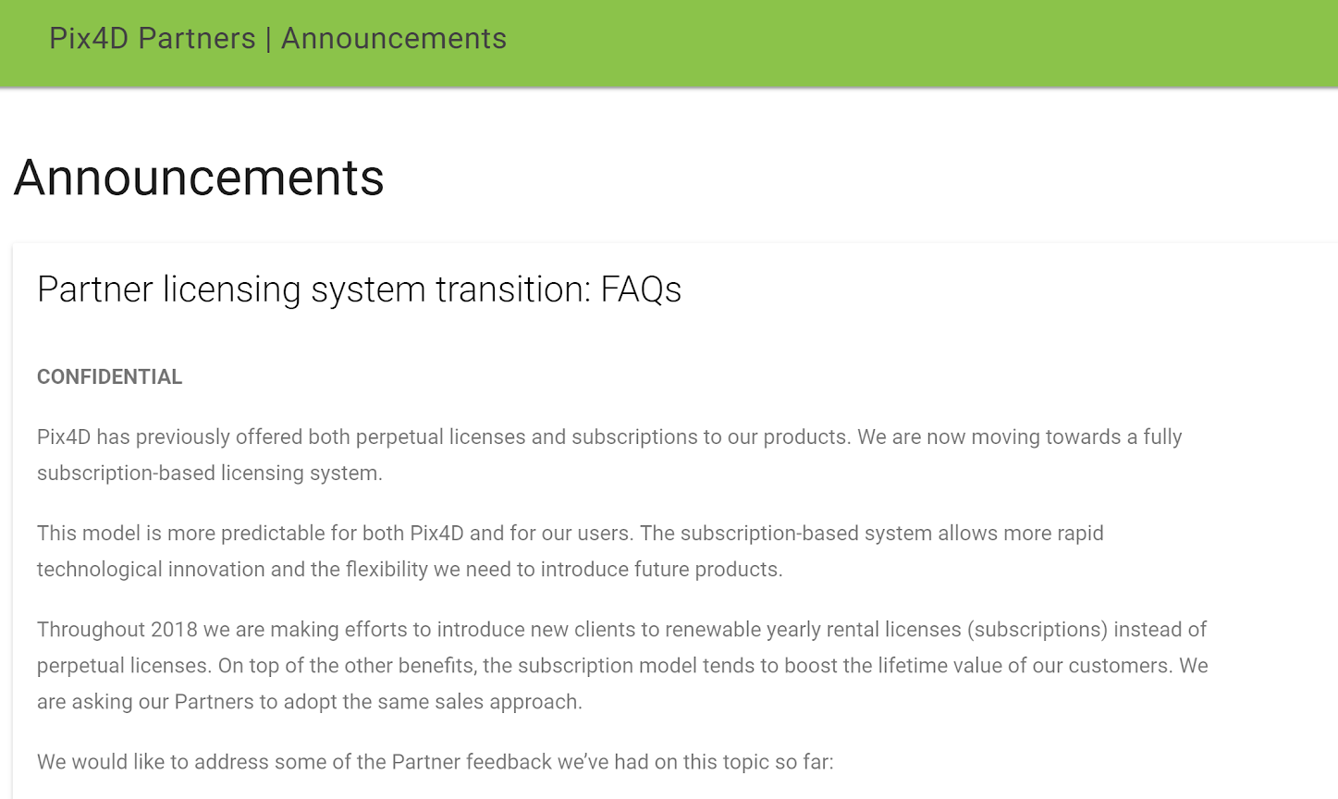
Partner Portal – Announcements
Detailed information that you may need to refer to

Slide 22

Thank you
www.pix4d.com

