Slide 1

Presentation title
Presenter name/last name
Presenter job title

Slide 2
Agenda
Welcome
Introducing Pix4D
  Few words about the presenter
  Corporate
  Products
Getting started
  Drones in agriculture
  Cameras in agriculture
Introducing Pix4Dfields
  Pix4Dfields workflow
  Inputs
  Outputs
  Agriculture workflows
Pix4Dfields tools and features
Pix4Dfields use cases
Demo
Q&A

Slide 3

Introducing Pix4D

Slide 4
Speaker Notes:
Name
Job title
Couple of words about me

Slide 5
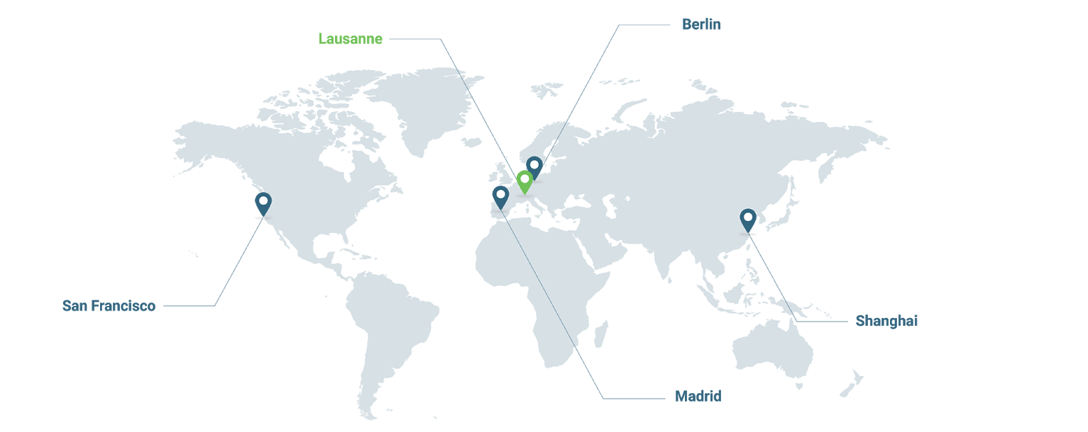




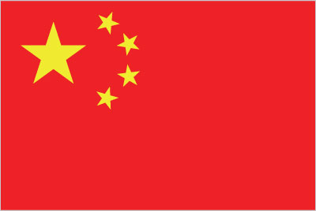
Offices
160+ global employees
23 nationalities
26 business languages spoken
SAN FRANCISCO
U.S.A.
MADRID
SPAIN
LAUSANNE
SWITZERLAND
BERLIN
GERMANY
SHANGHAI
CHINA

Slide 6
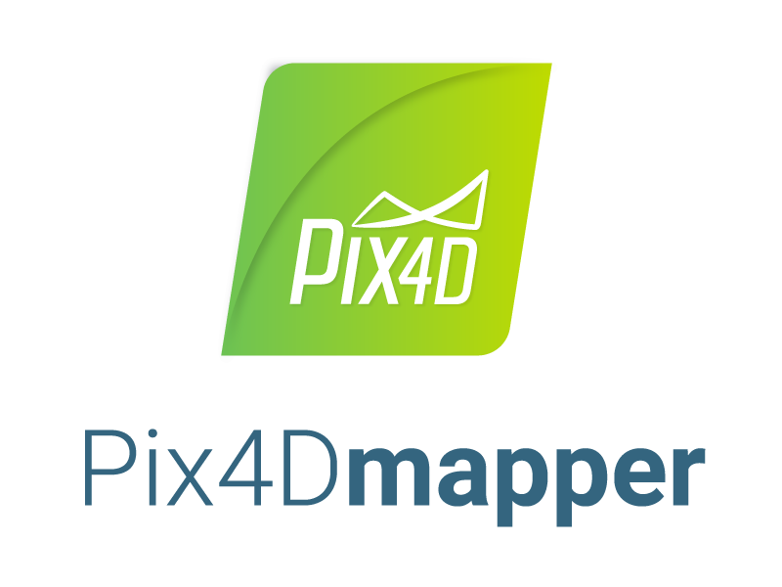
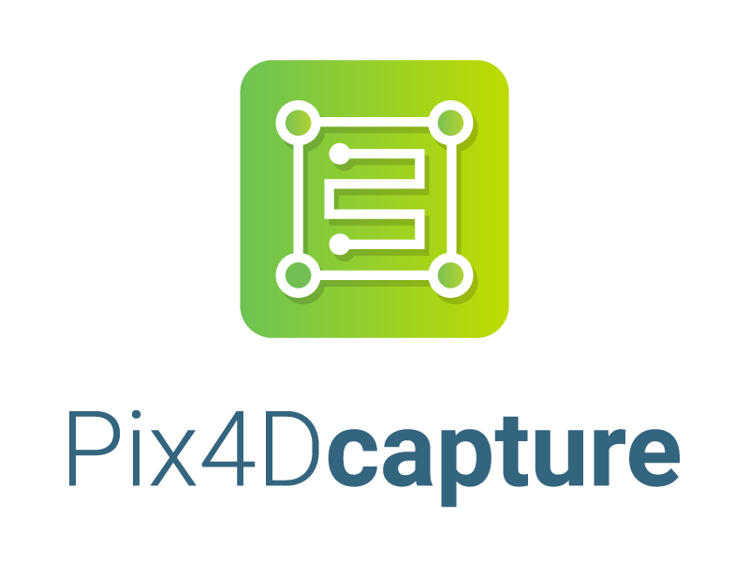




Pix4D products: agriculture

Slide 7

Getting started

Slide 8
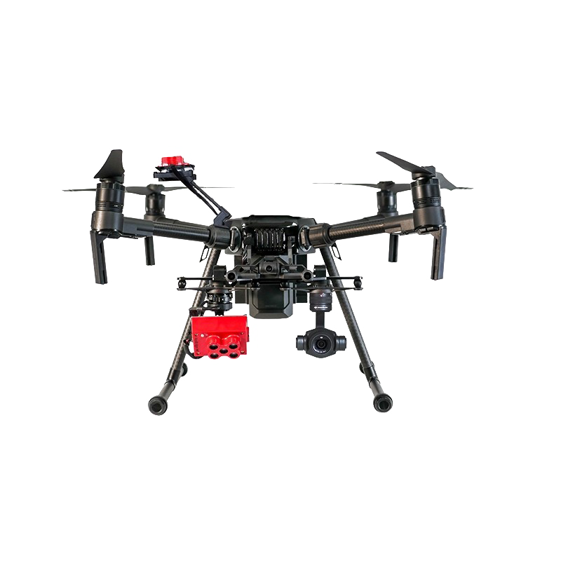
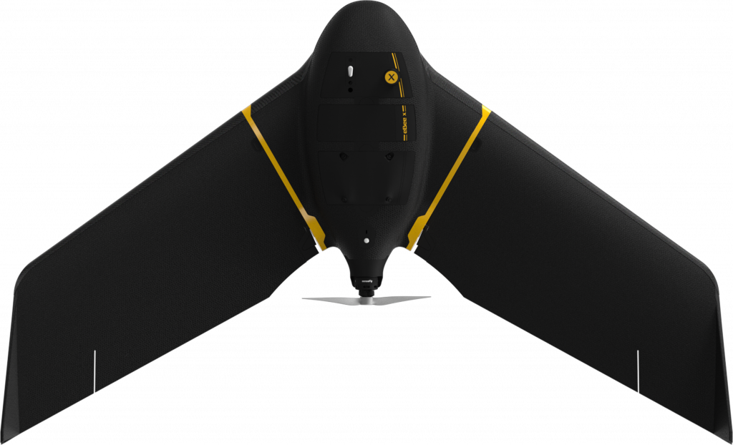
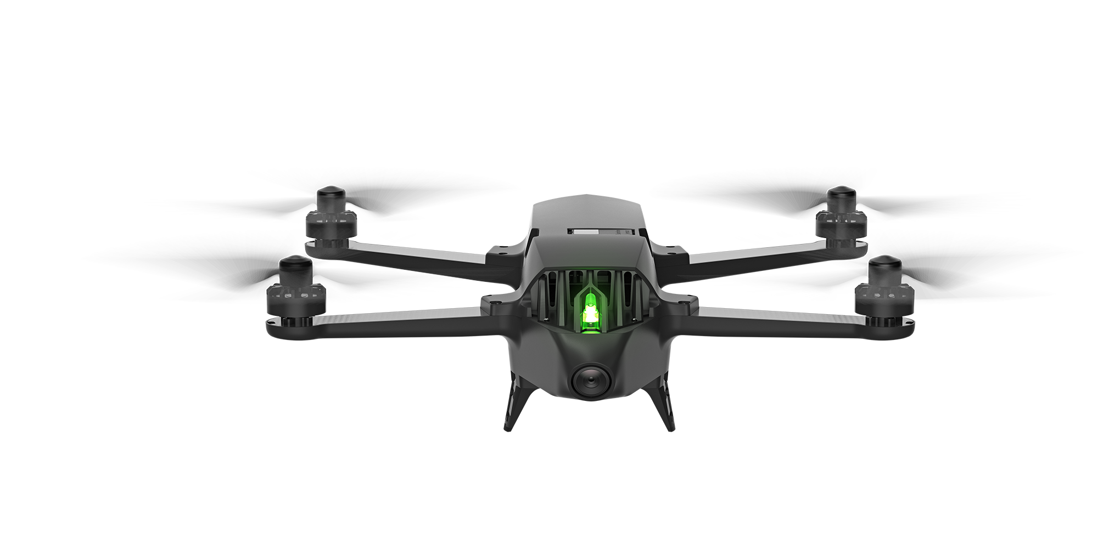
Drones in agriculture
Fixed Wing
Multi-rotor
Longer Flight Time
Large project areas
Nadir camera orientation
Longer take off and landing zone
Shorter flight time
Small project areas
Nadir and oblique camera orientation
Vertical takeoff and landing

Slide 9
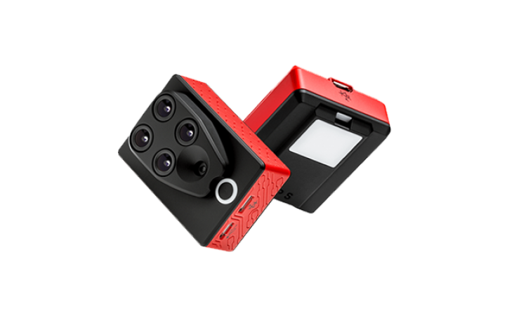
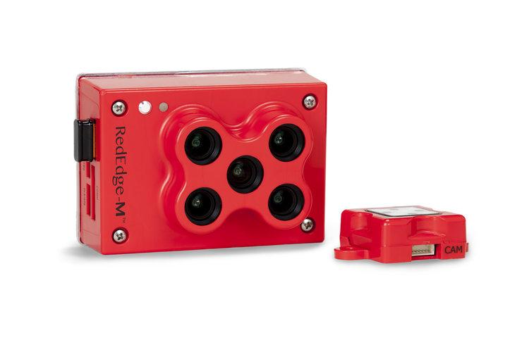
Cameras in agriculture: multispectral
MicaSense RedEdge-M
Parrot Sequoia+

Slide 10
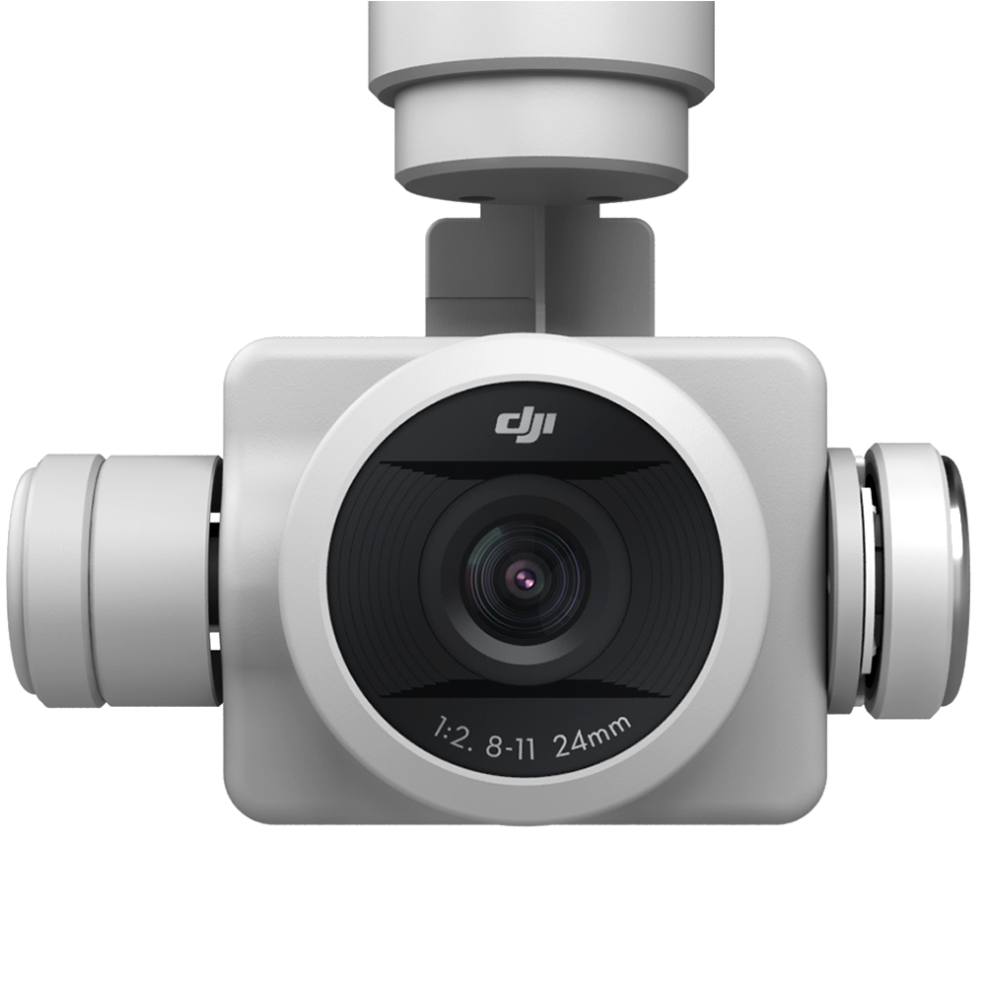
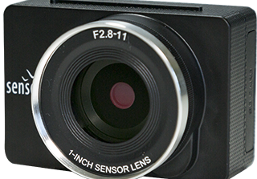
Cameras in agriculture: RGB
senseFly S.O.D.A
DJI Phantom 4 PRO

Slide 11
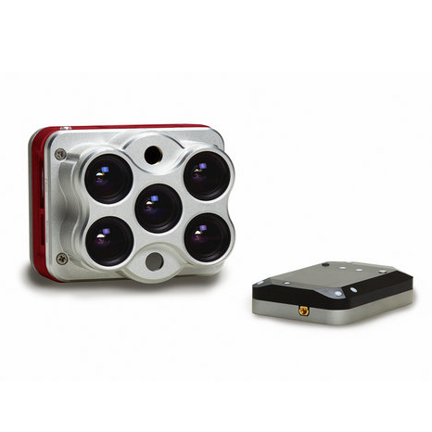

Cameras in agriculture: thermal and modified
MicaSense Altum
MAPIR cameras

Slide 12

Introducing Pix4Dfields

Slide 13
Pix4D products: agriculture
Aerial crop analysis
for digital farming

Slide 14



The three pillars behind Pix4Dfields
Accurate
Instant
Intuitive

Slide 15






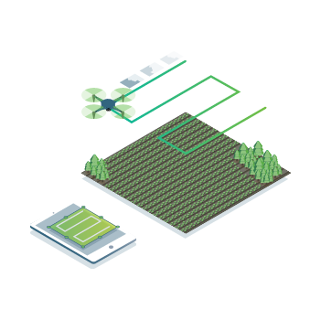
Pix4Dfields workflow - capture
Capture
Process
Scout
Analyze
Share
Integrate
Capture
Collect images with any standard RGB or a selected multispectral camera like Parrot Sequoia+ and MicaSense RedEdge.
Use our Pix4Dcapture app to easily plan and control your drone flight.

Slide 16

Pix4Dfields workflow - process
Capture
Process
Scout
Analyze
Share
Integrate
Process
Process imagery with the new instant processing engine and get your maps directly in the field: 4.1 GB, 1800 images, 1.5 min (MacBook Pro 2018).

Slide 17
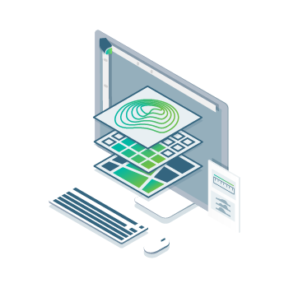
Pix4Dfields workflow - scout
Capture
Process
Scout
Analyze
Share
Integrate
Scout
Generate orthomosaics, digital surface models, index maps, zones and prescription maps.
Trim your fields to a desired field boundary to create more targeted outputs.

Slide 18

Pix4Dfields workflow - analyze
Capture
Process
Scout
Analyze
Share
Integrate
Analyze
Visualize and understand your crop stages and stress levels.
Compare different layers of information for a full insight into your crop performance.

Slide 19

Pix4Dfields workflow - share
Capture
Process
Scout
Analyze
Share
Integrate
Share
Share your maps with all project stakeholders for seamless collaboration.

Slide 20
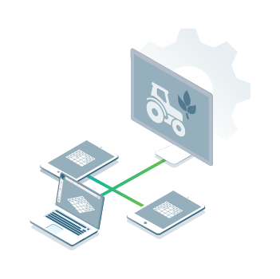
Pix4Dfields workflow - integrate
Capture
Process
Scout
Analyze
Share
Integrate
Integrate
Download all outputs and import into the Farming Management Platform of your choice in various industry standard formats.

Slide 21
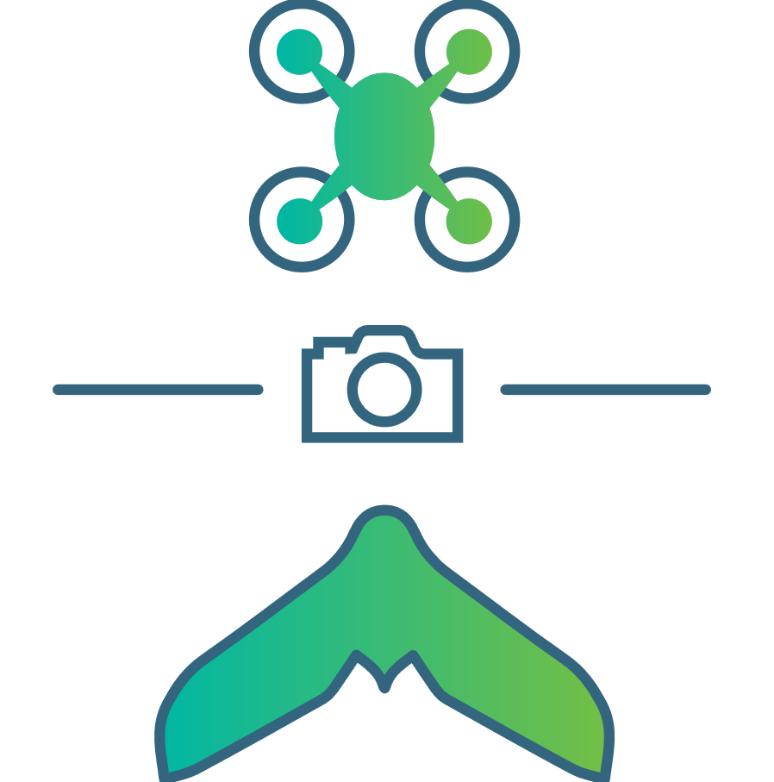


Pix4Dfields inputs
Multispectral images
RGB cameras,
drone images
Modified cameras

Slide 22
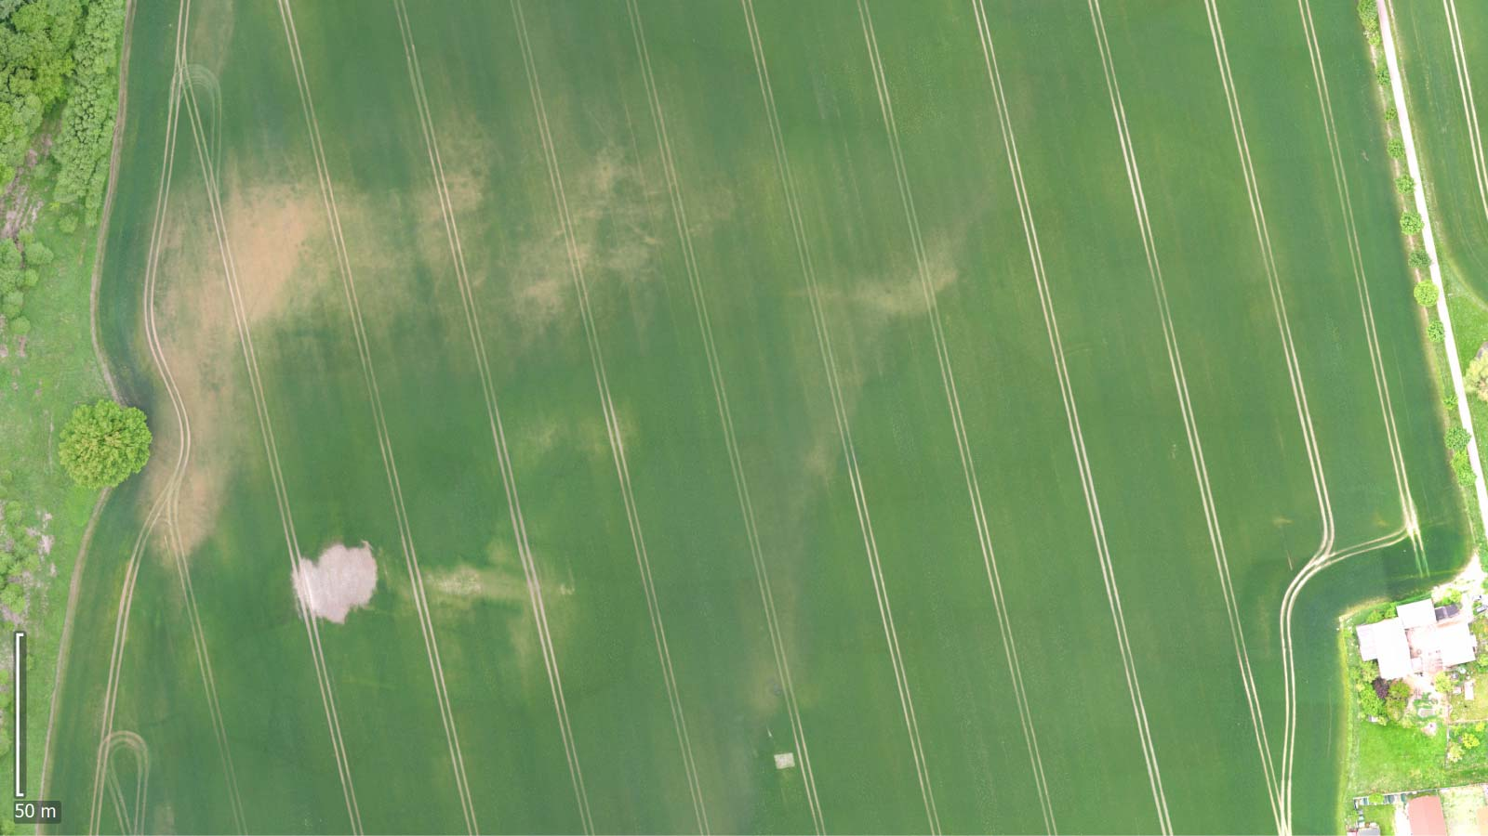
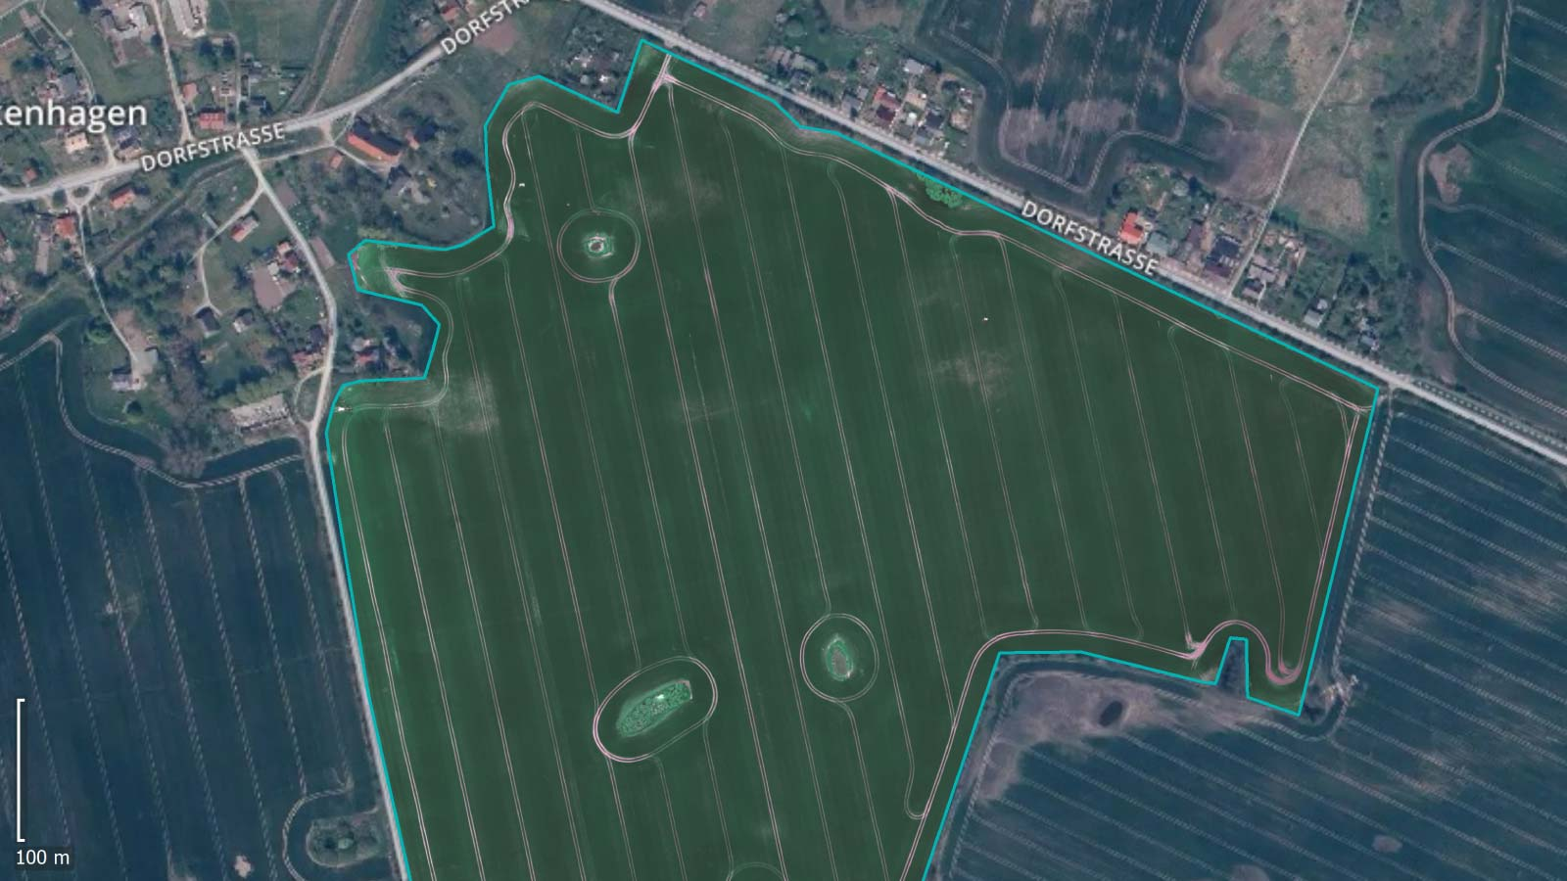
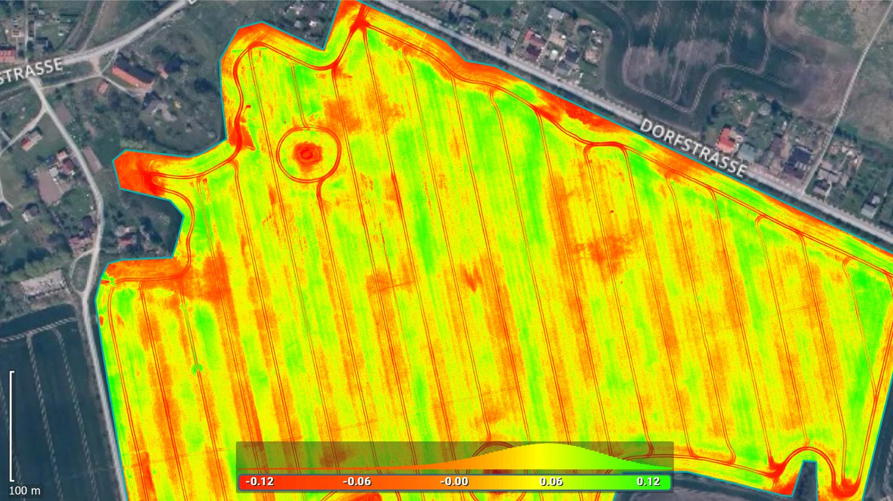
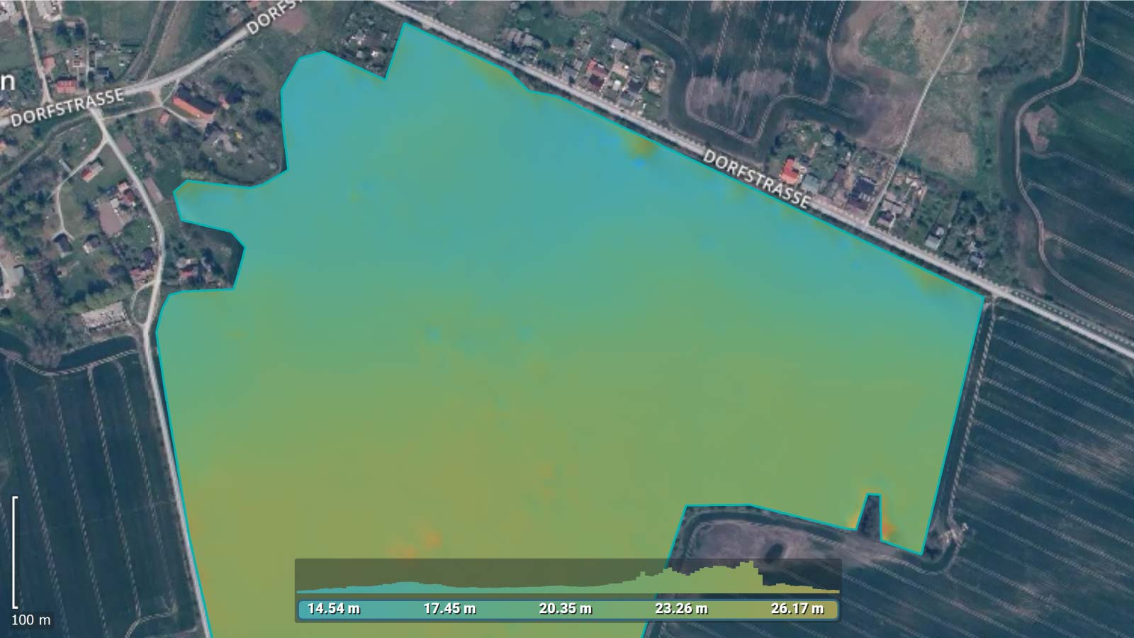
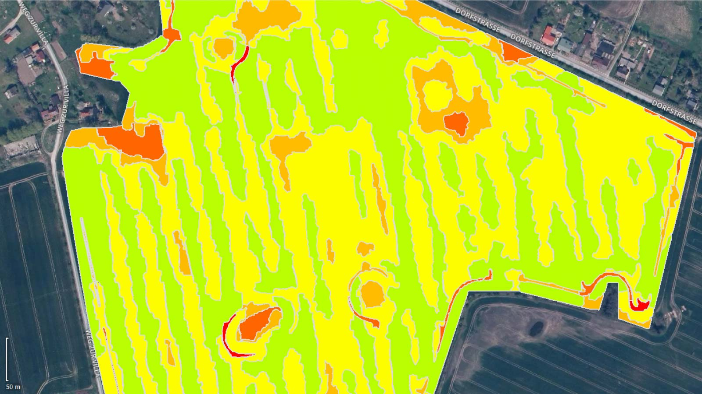
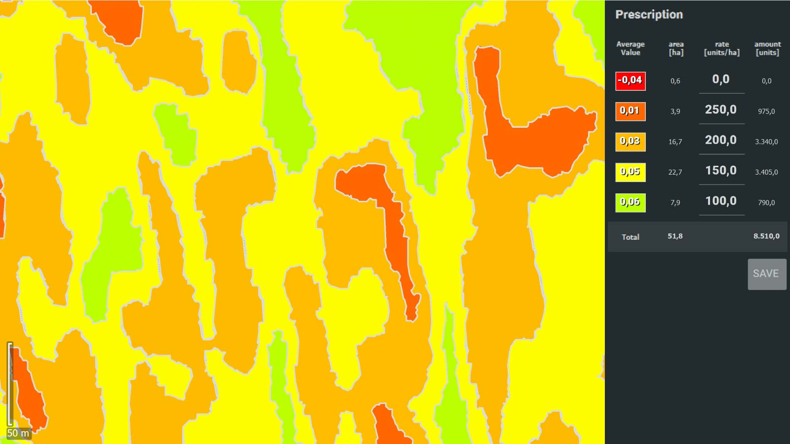
Pix4Dfields outputs
Orthomosaic
Field boundaries
Vegetation index map
Digital surface model
Zonation map
Prescription map

Slide 23
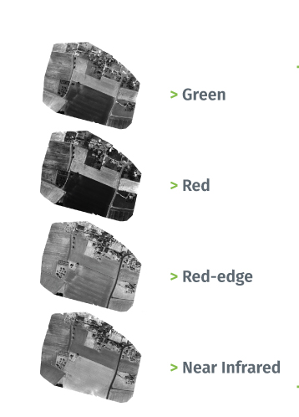
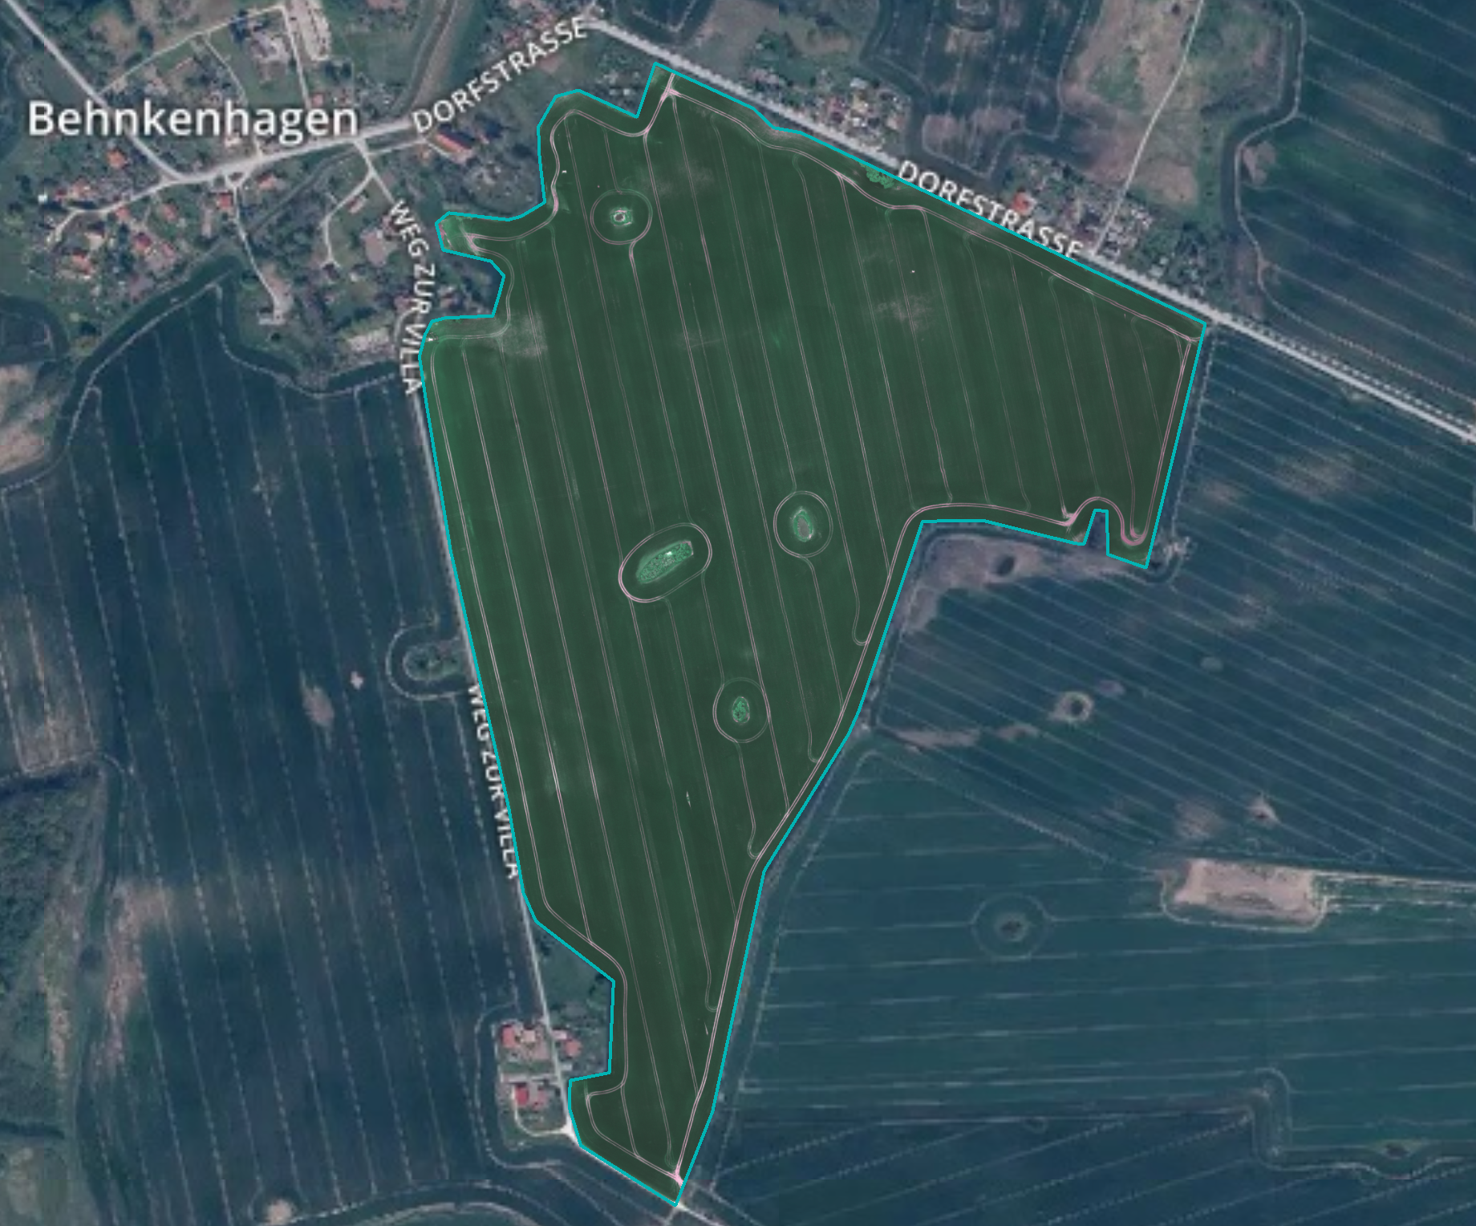
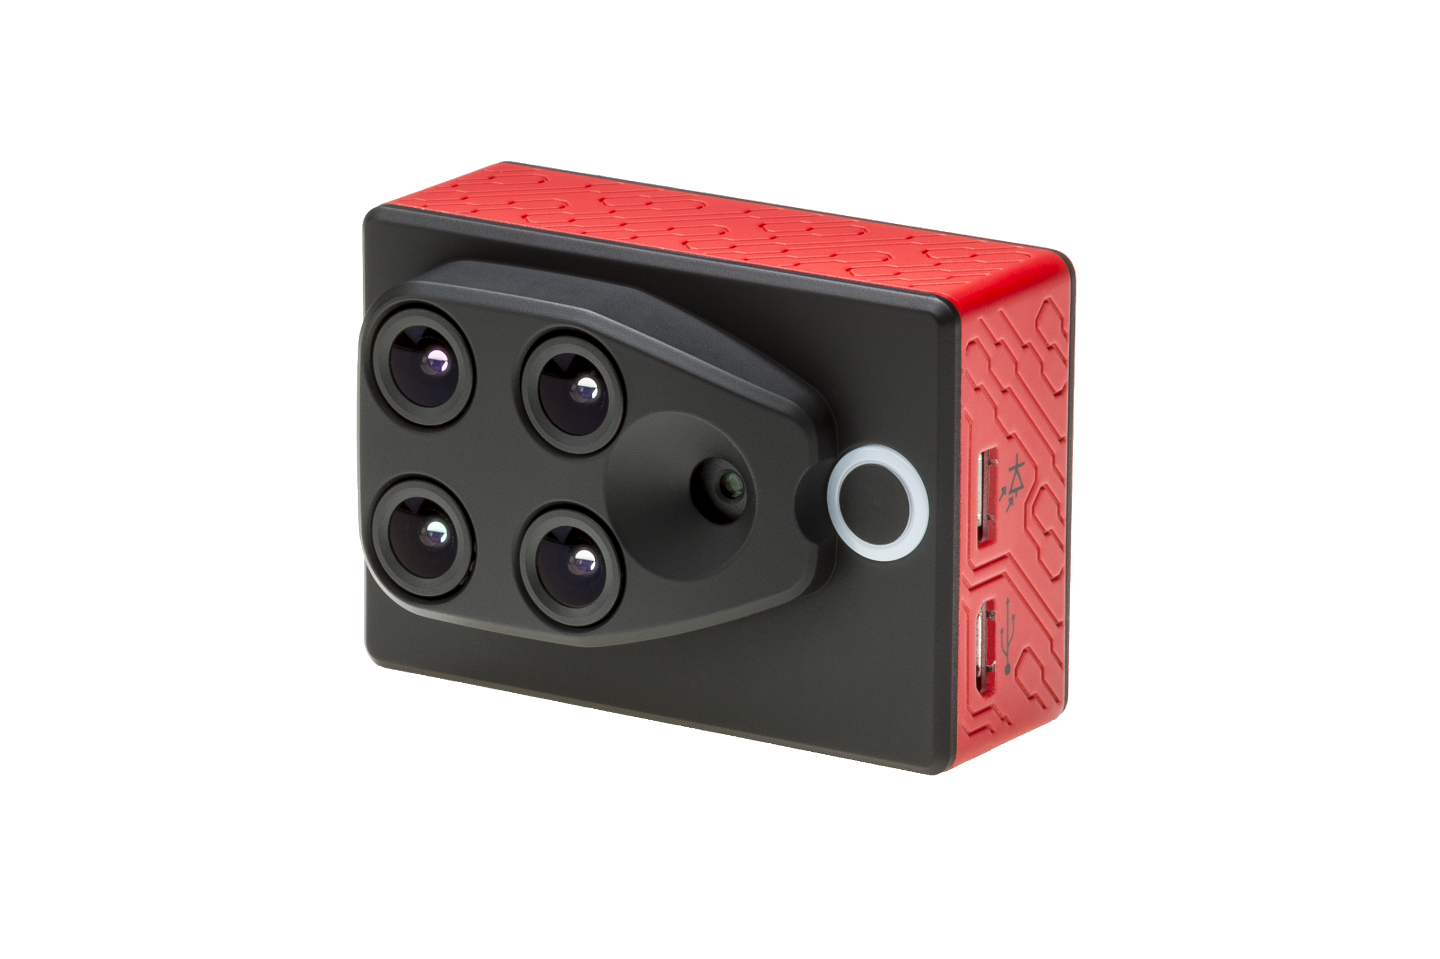
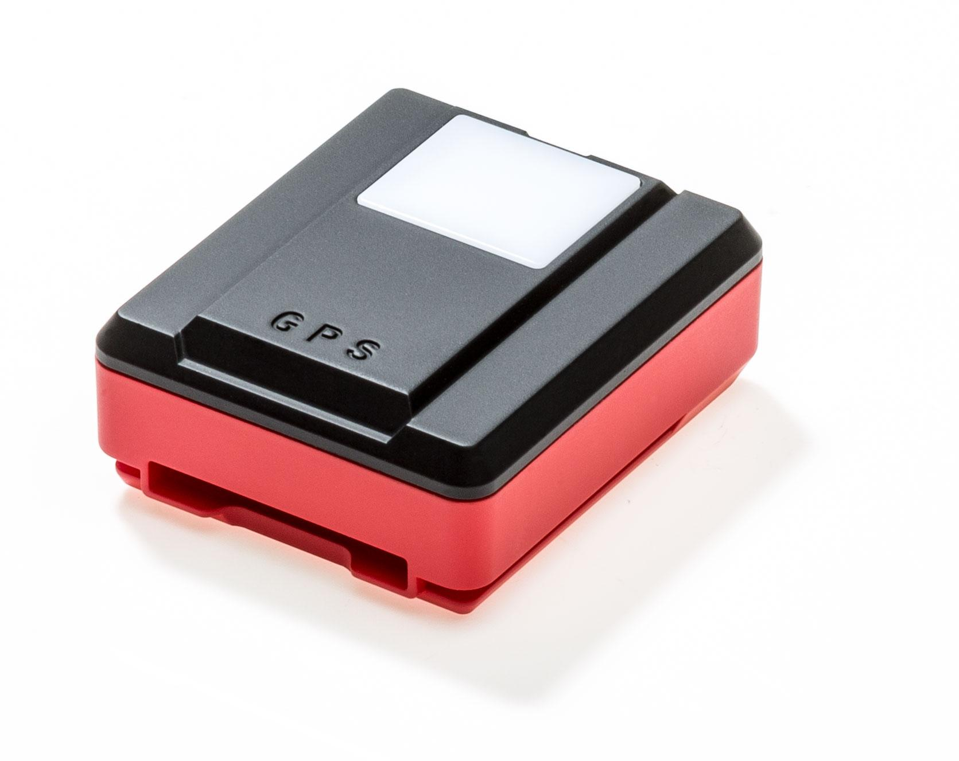


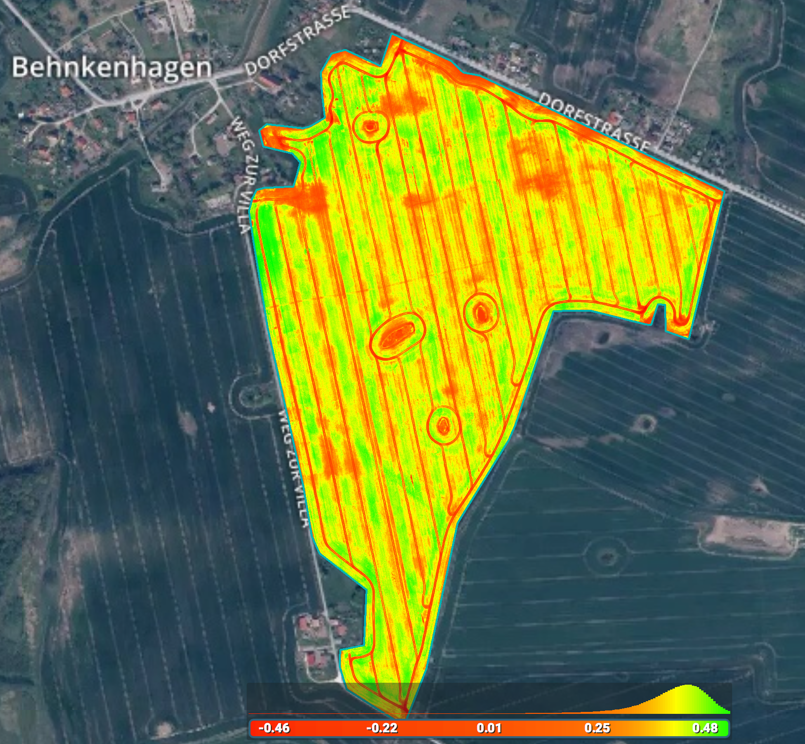


Multispectral workflow
Index
formula
Orthomosaics
(or false- RGB orthomosaics)
Multispectral images
Reflectance maps
Index map (ie NDRE)

Slide 24


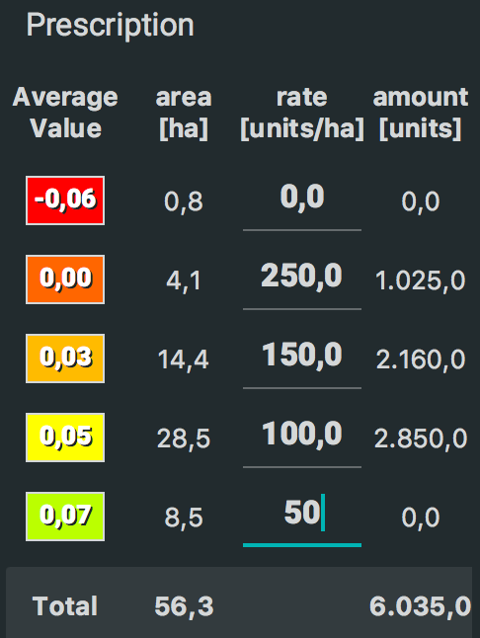




Drone-to-tractor workflow
Prescription map
(or Variable Rate Application Map - VRAM)
Index map (ie. NDRE)
Zonation map
Farming Management Platforms (examples)

Slide 25
Digital agriculture workflow
Orthomosaic
Field boundaries
Farming Management Platforms (examples)
Vegetation index map
Digital surface model
Zonation map
Prescription map

Slide 26
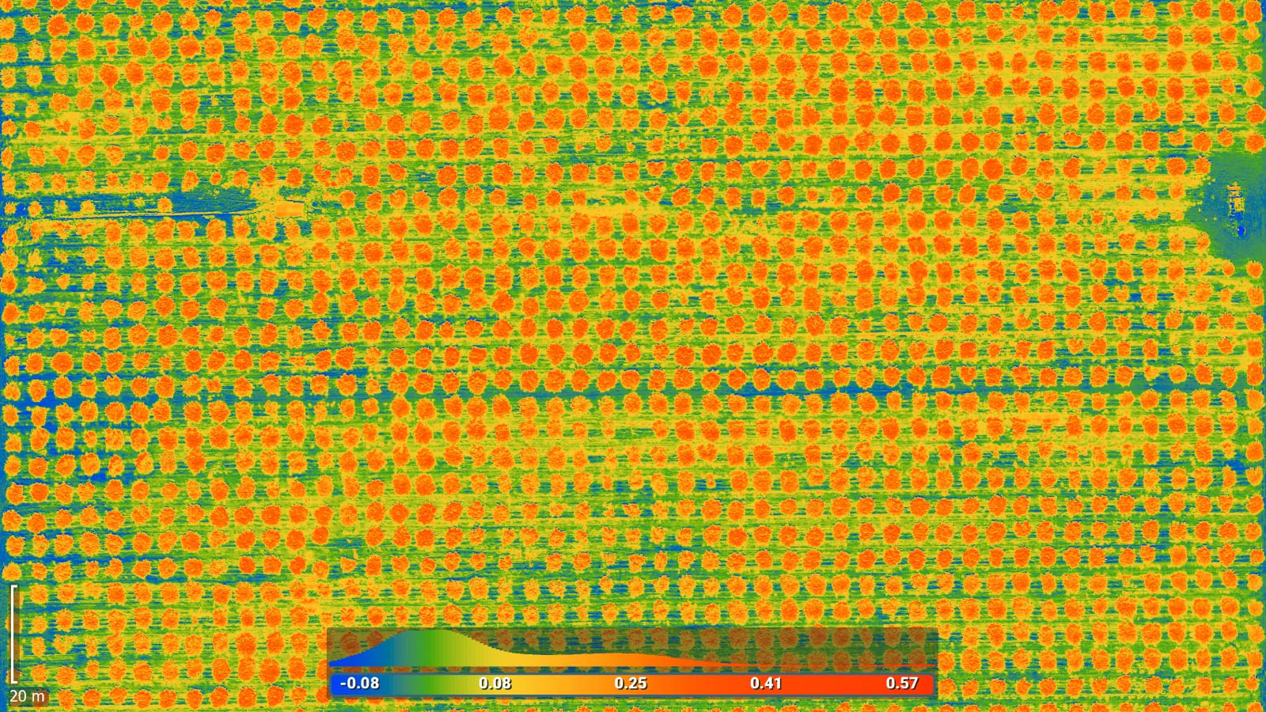
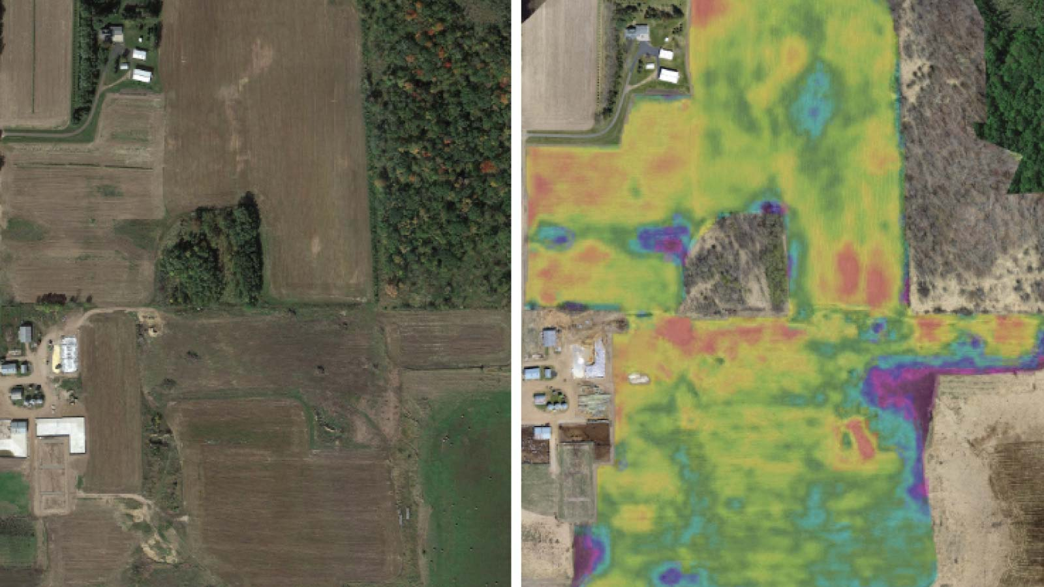
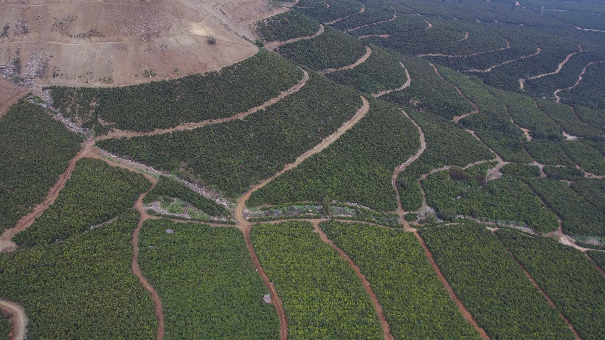
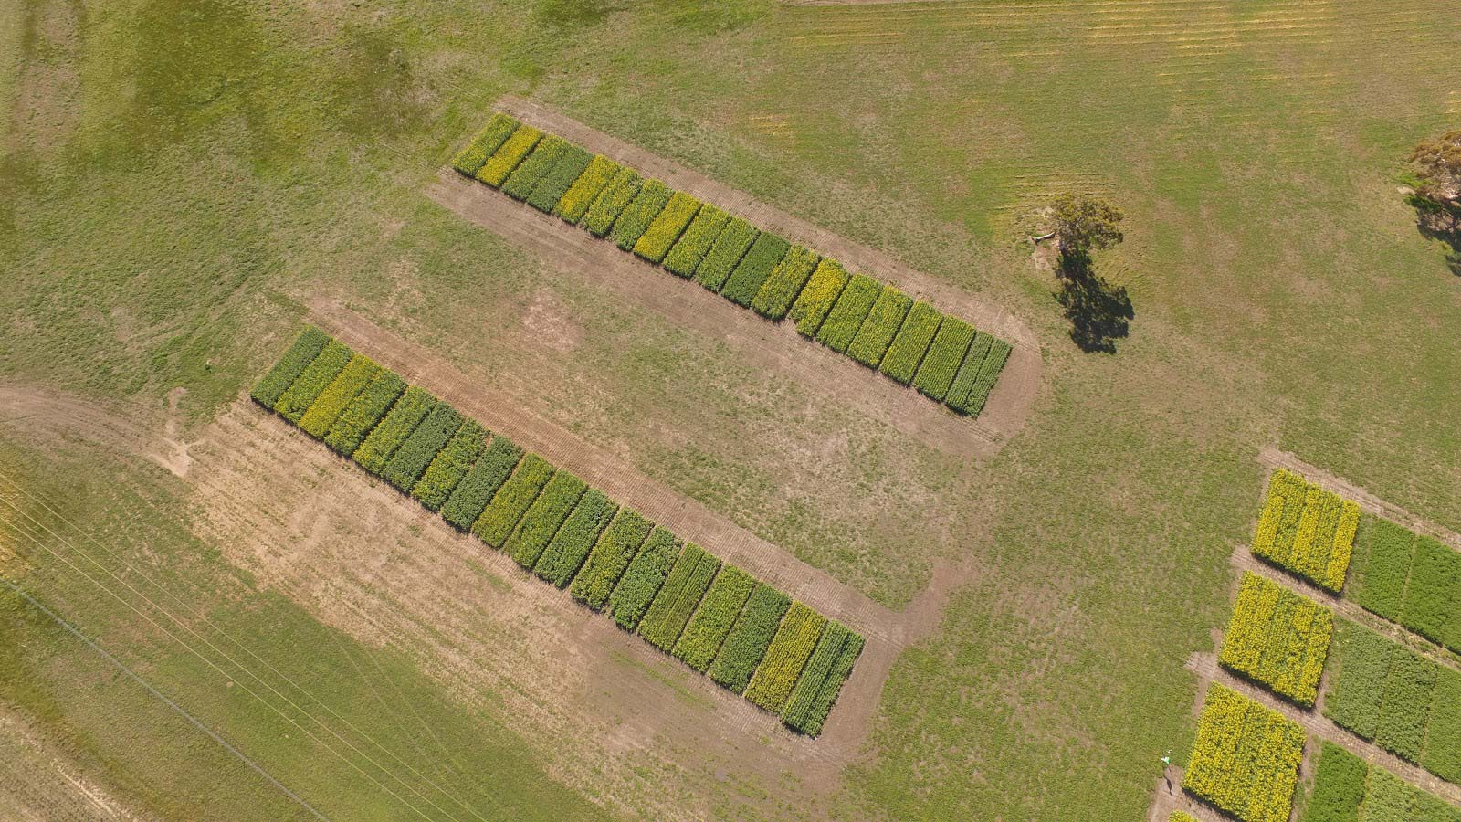
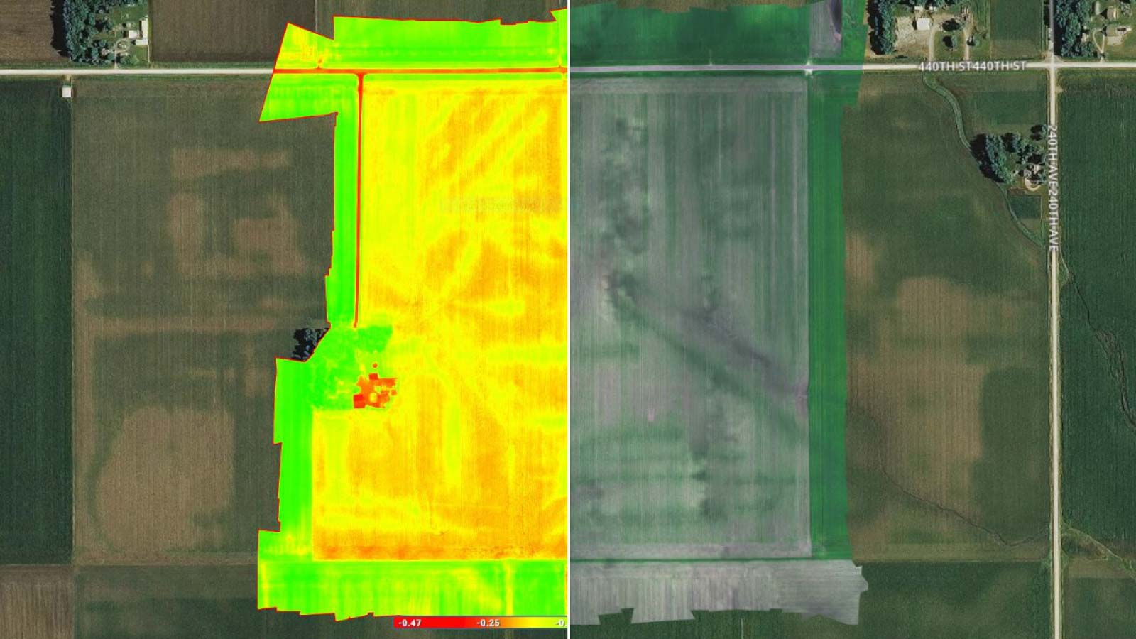
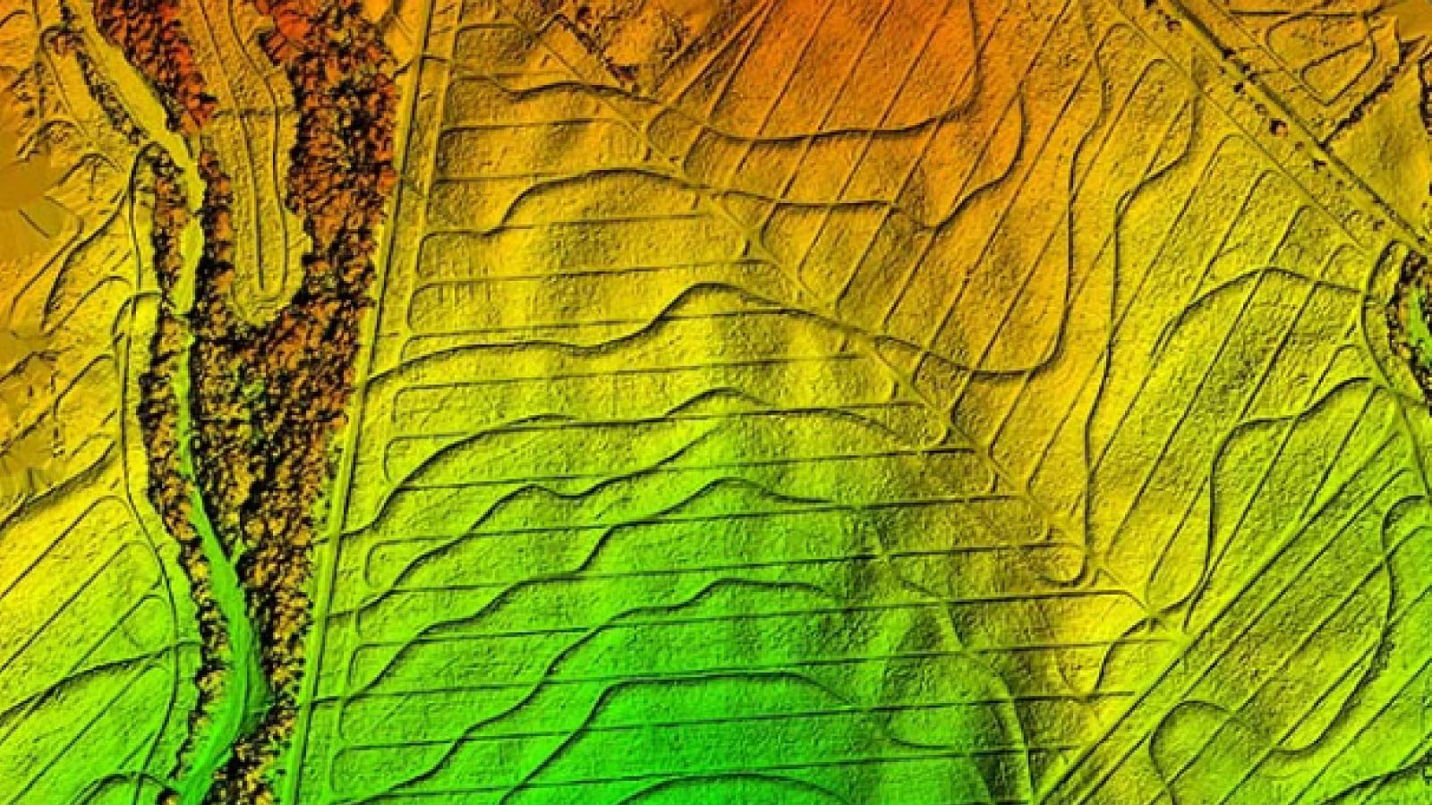
Fields of applications
Digital scouting and crop protection
Crop production
Insurance
Breeding
Irrigation management
Erosion control

Slide 27
Tools and features

Slide 28
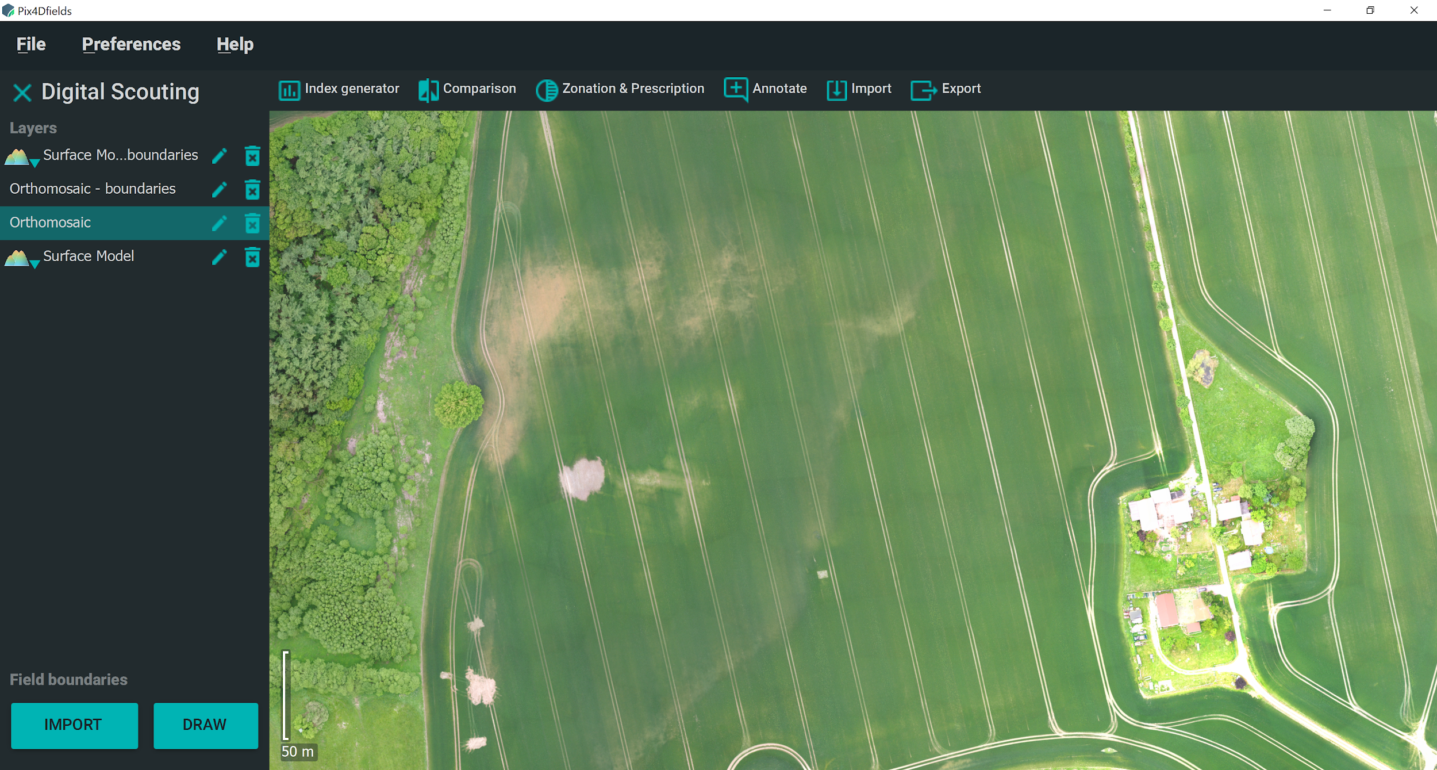
Pix4Dfields - instant mapping

Slide 29
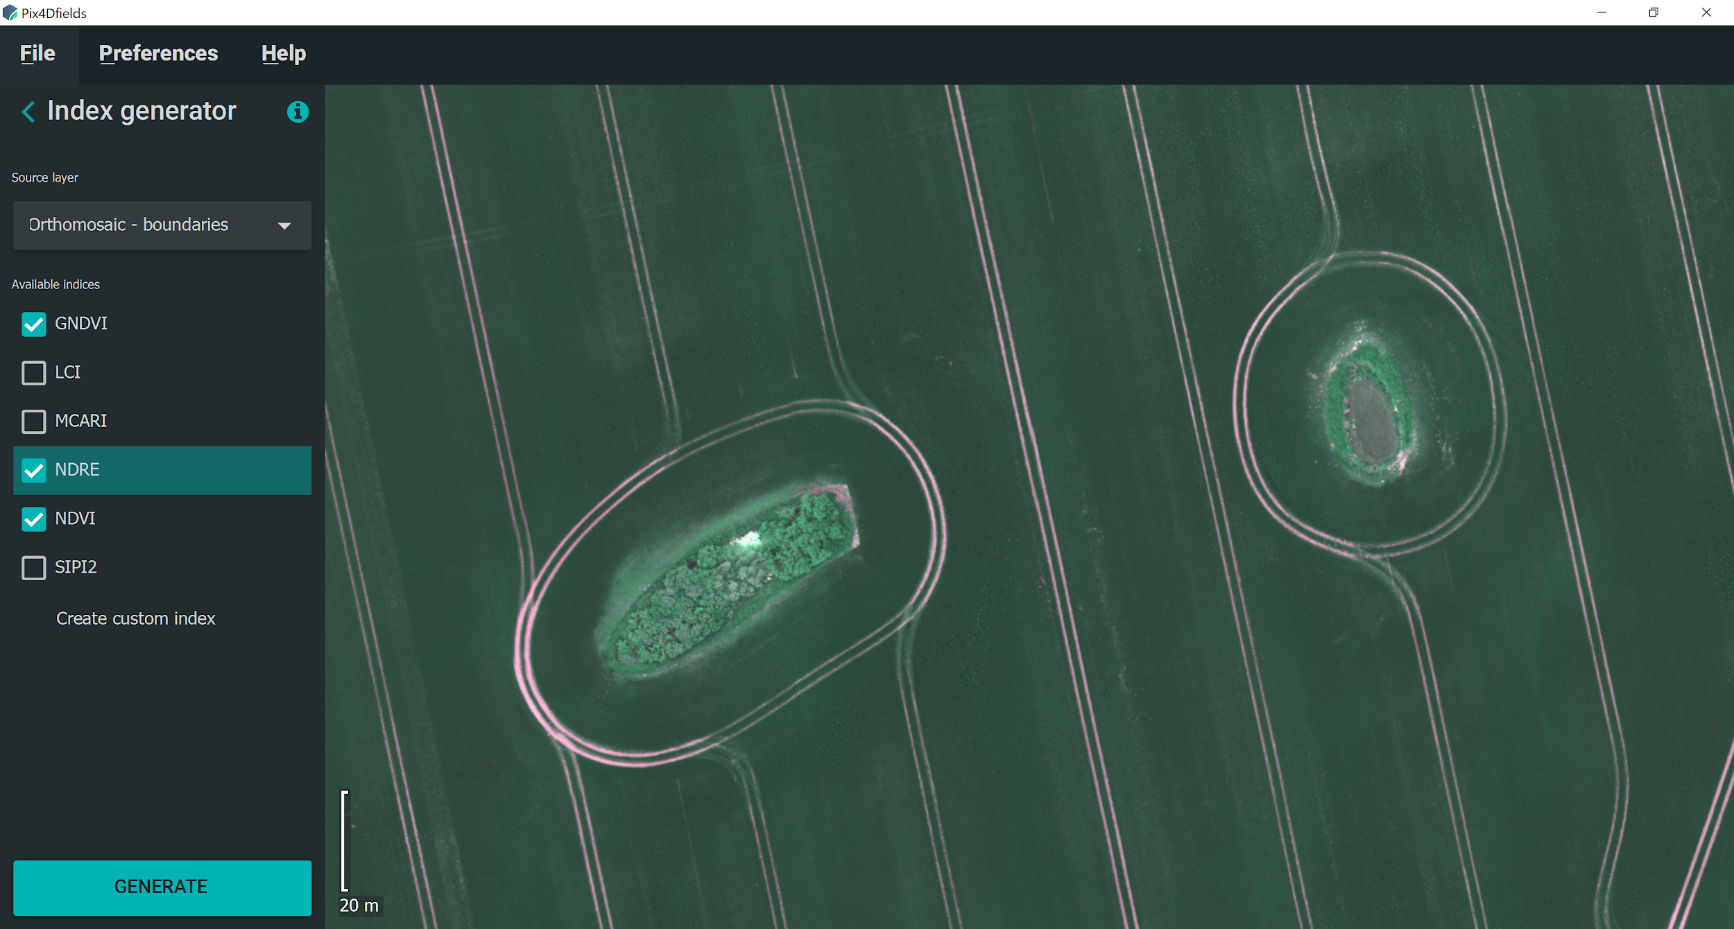
Pix4Dfields - index generator

Slide 30
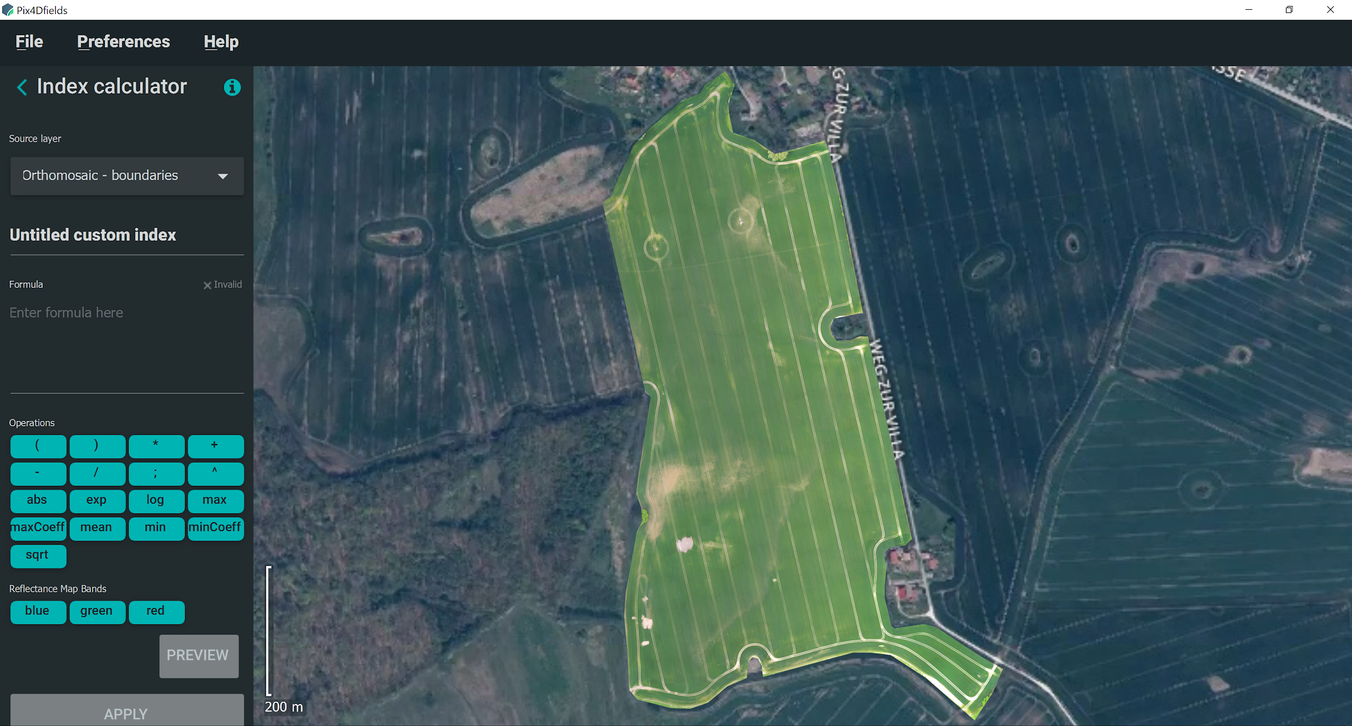
Pix4Dfields - index calculator

Slide 31
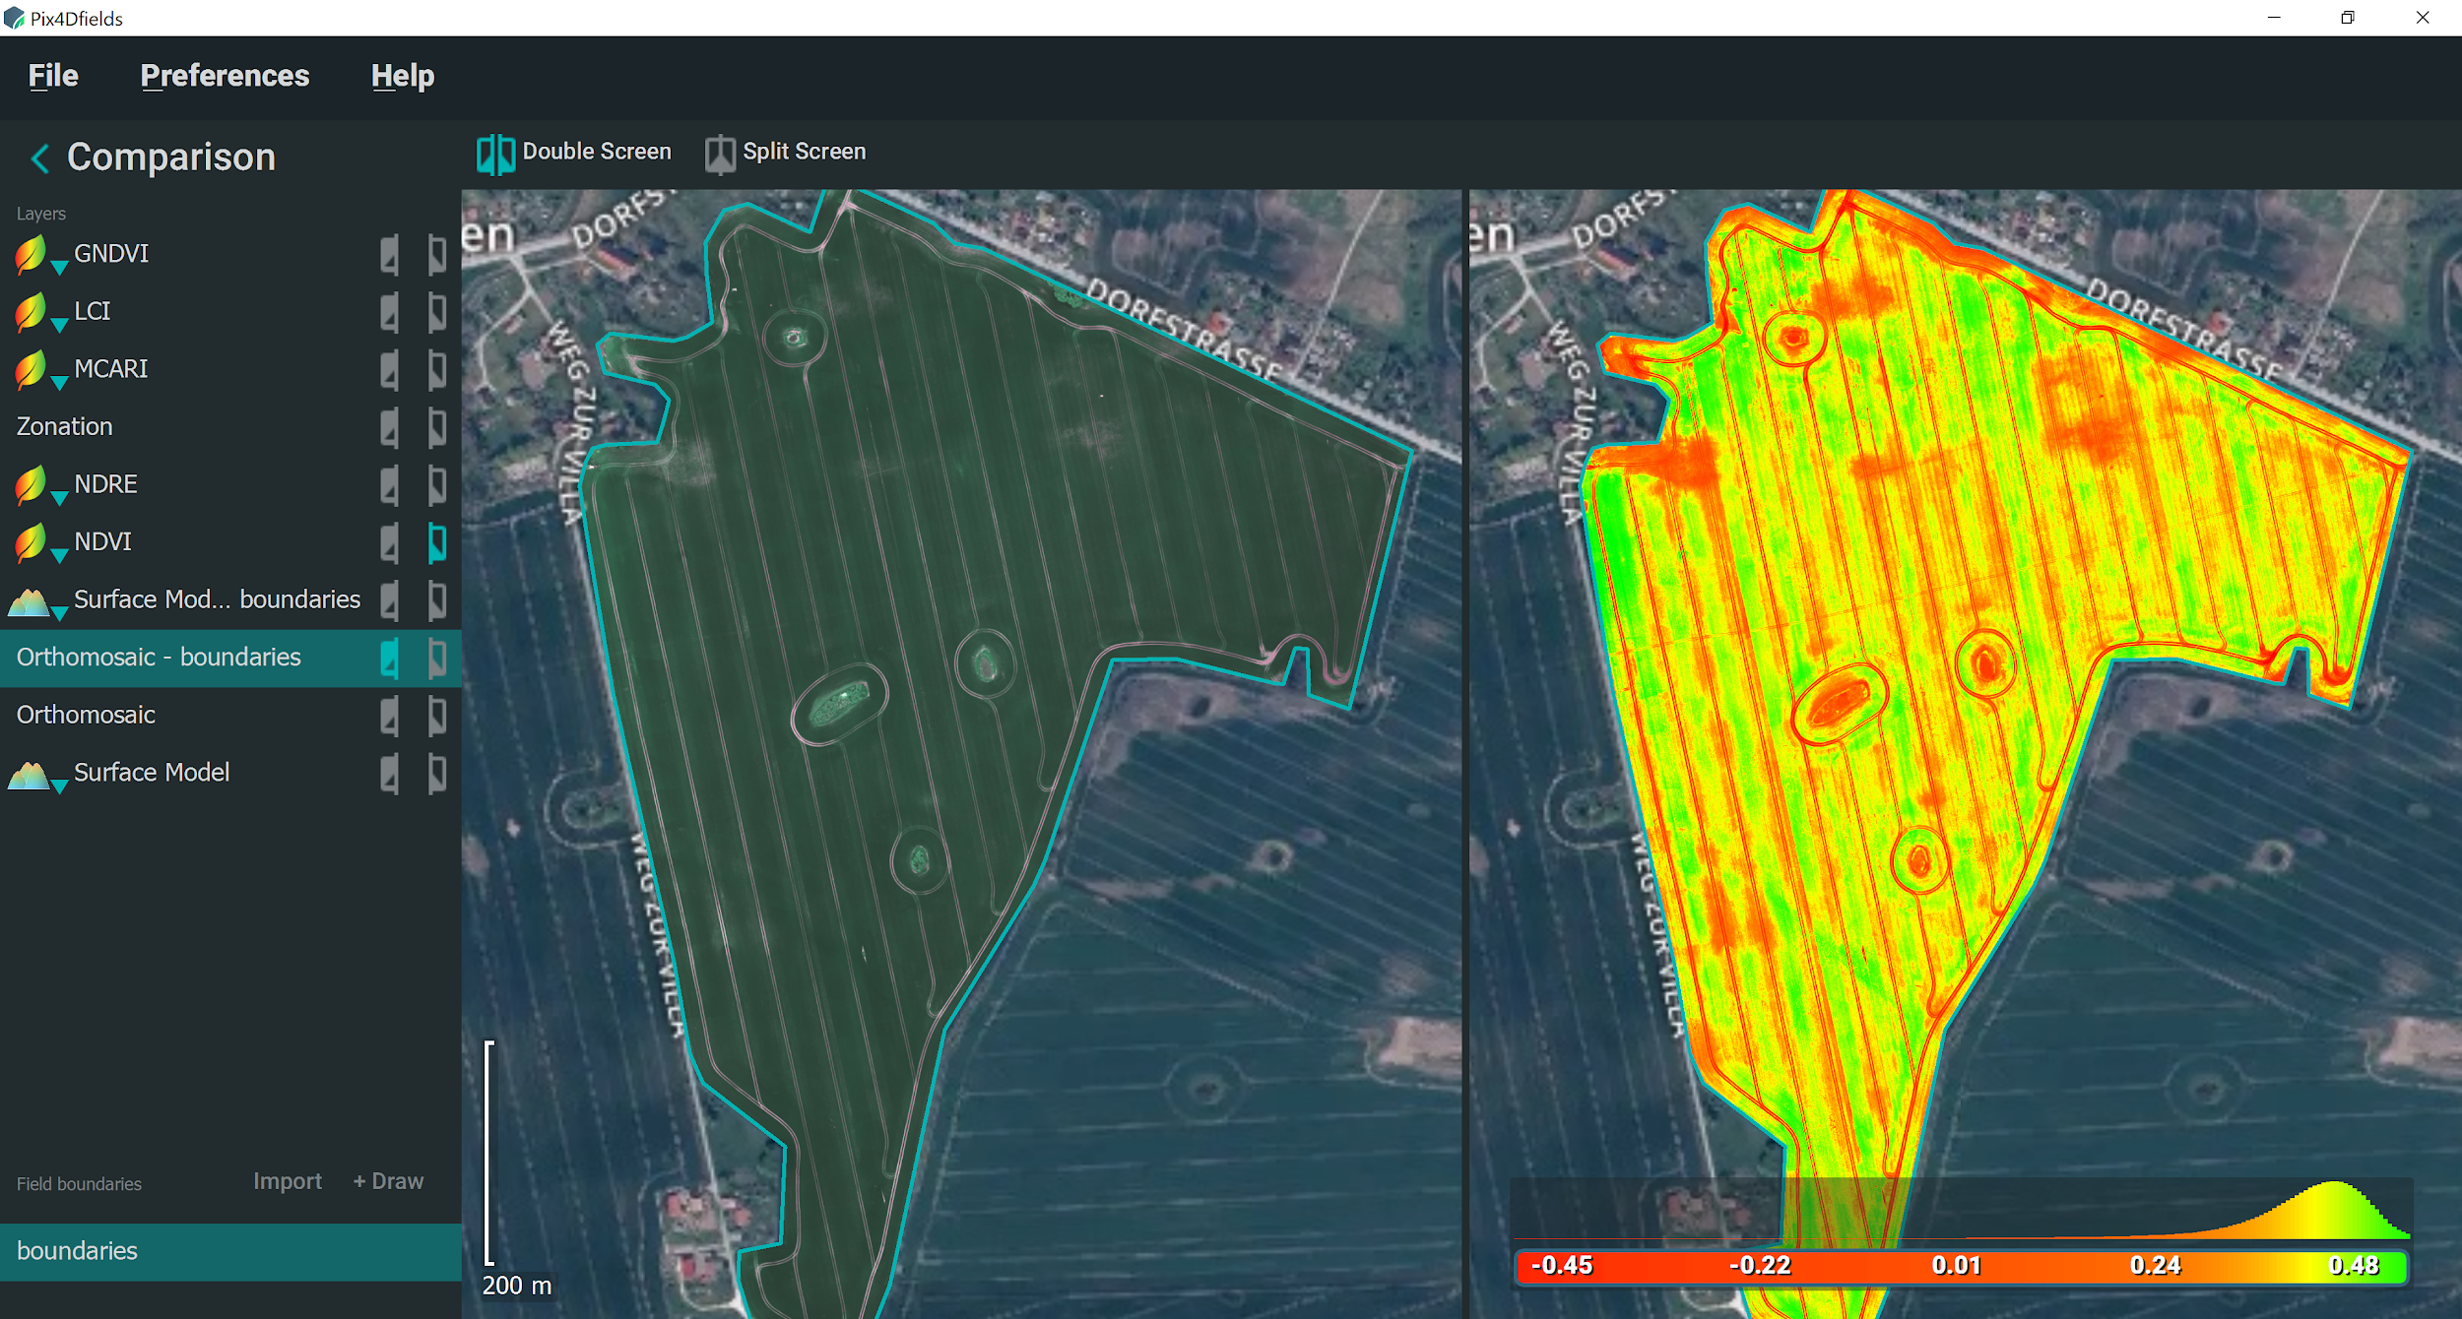
Pix4Dfields - comparison

Slide 32
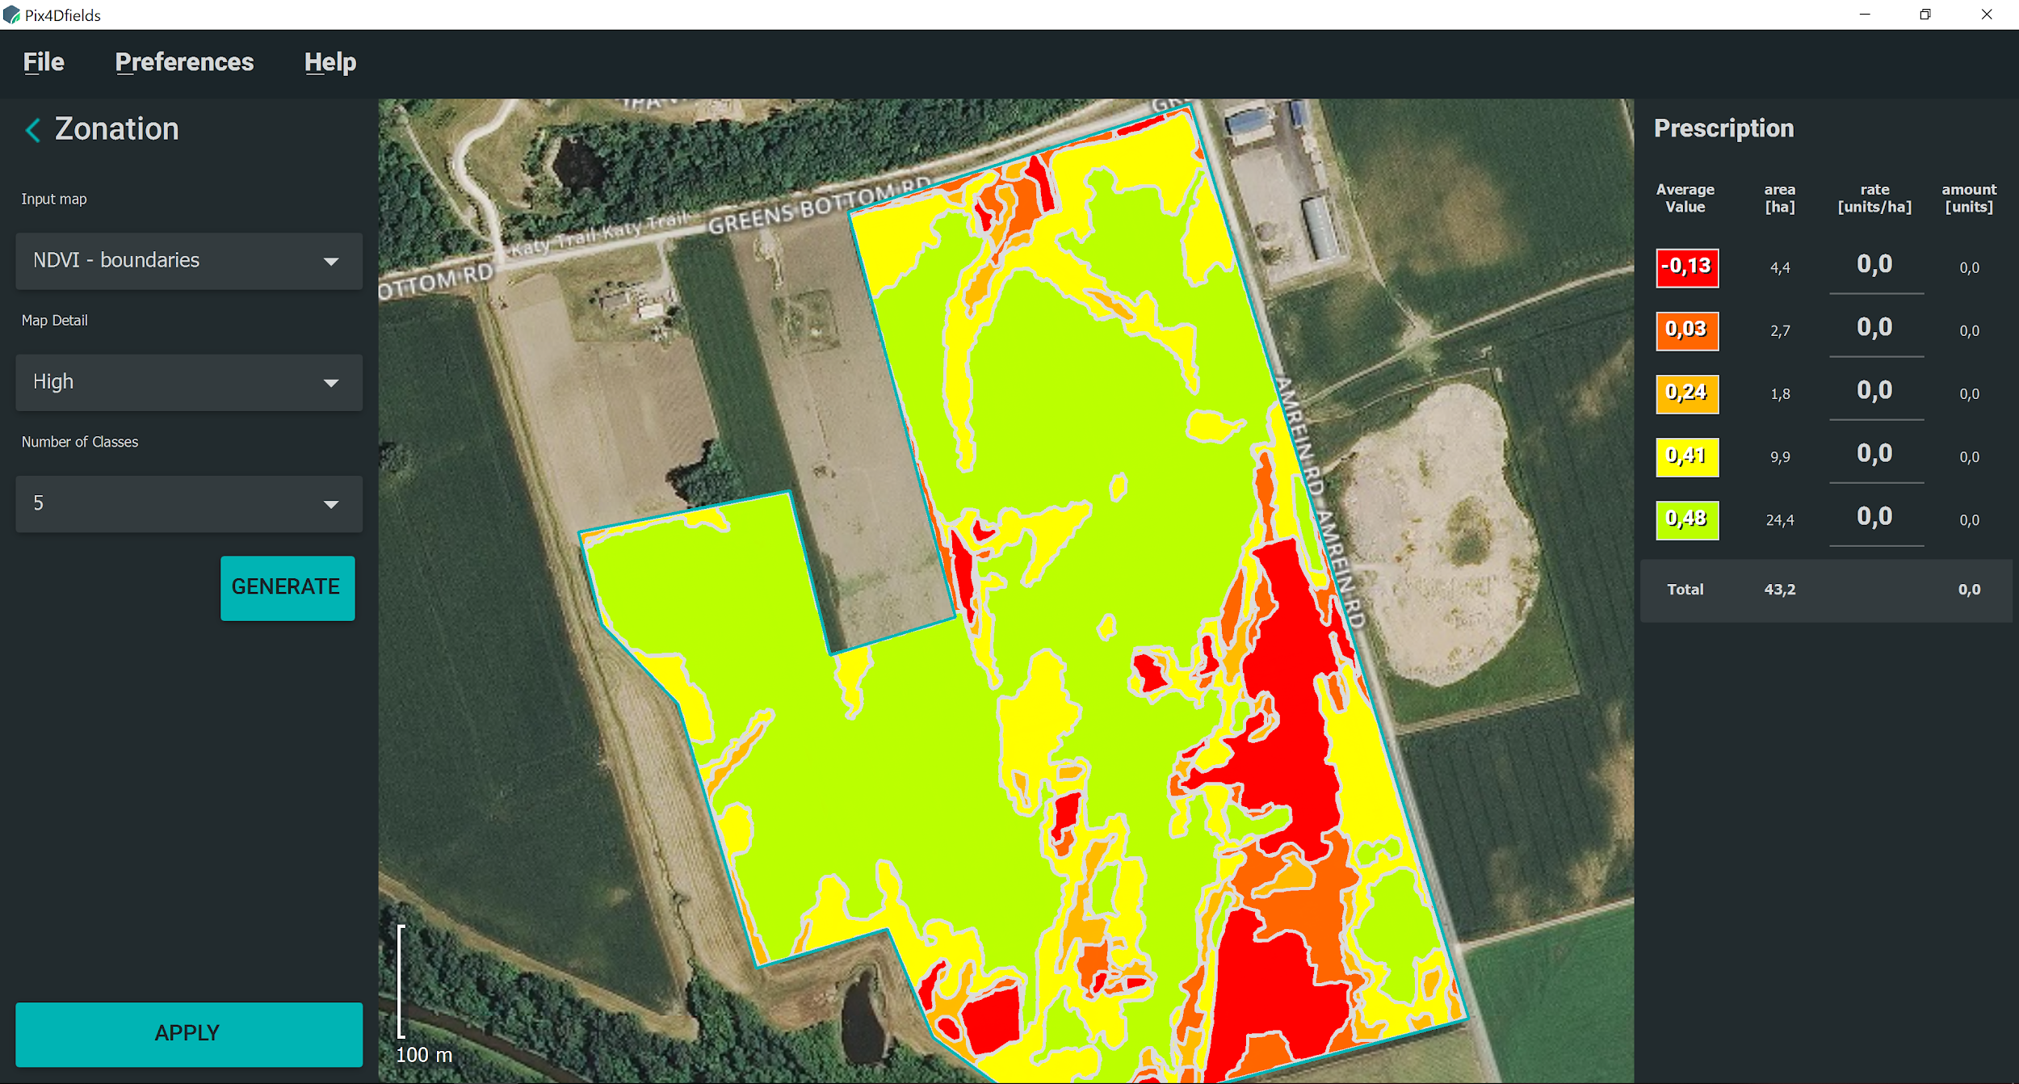
Pix4Dfields - zonation and prescription

Slide 33
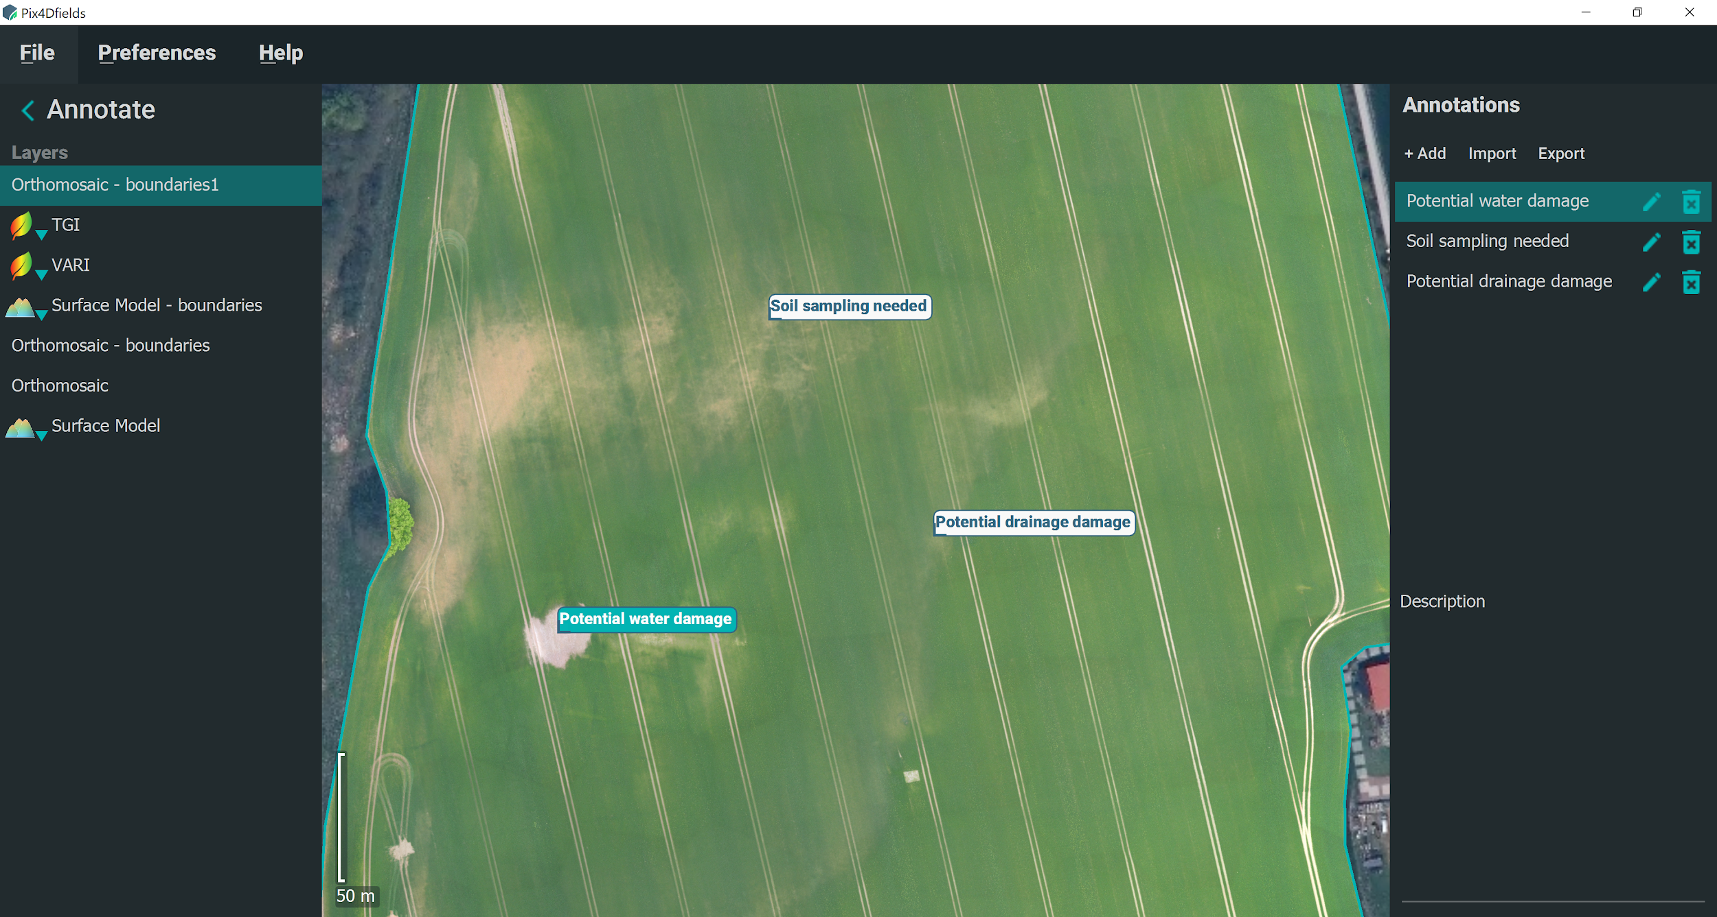
Pix4Dfields - annotations

Slide 34
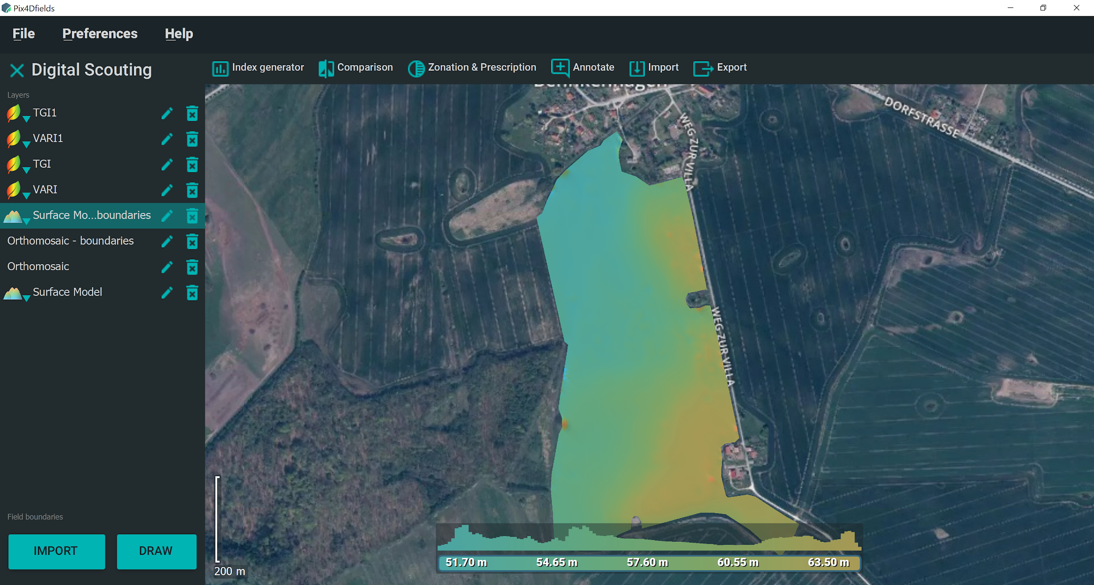
Pix4Dfields - digital surface model

Slide 35
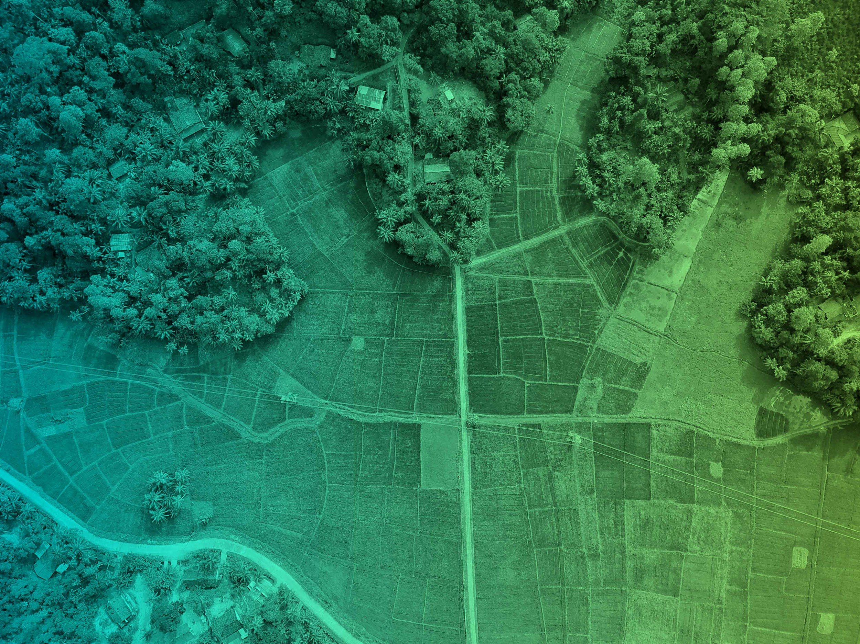
Use cases

Slide 36
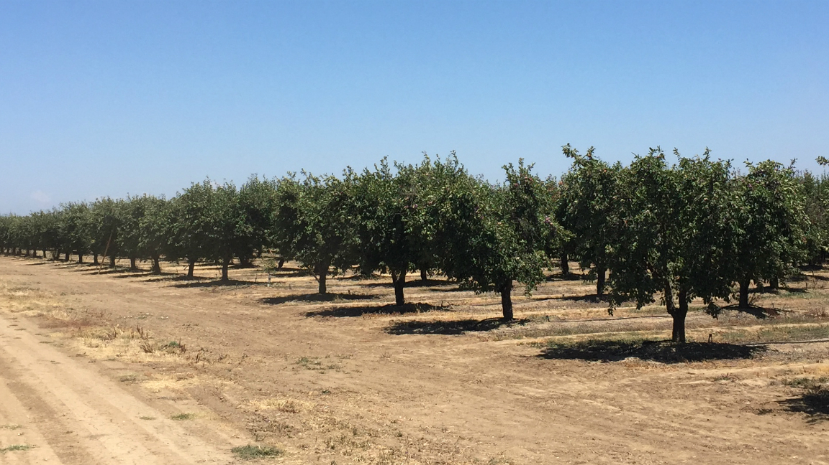
Use case - digital scouting and crop protection
Problem statement
Prunes from this farm are tunnel dried ahead of packaging and are sold per ton per acre. The price (ton per acre) depends on the sugar quantity and fruit quality.
In other words, each tree matters and having stable and fast tools for crop protection has a direct impact on farm management – and consequently on farm’s profit.
Notes:
Prunes are European plums with a high sugar content that allows them to dry without fermenting around the pit and are almost all marketed dried, as prunes or dried plums. California produces 96% of the prunes grown in the US and around half of California’s prunes are consumed domestically and half exported.
Prunes from this farm are tunnel dried ahead of packaging and are sold per ton per acre. Depending on the sugar quantity and fruit quality the price varies from 1,300USD up to 2,000USD per ton with an expected yield of three tons per acre. In other words, each tree matters and having stable tools that produce accurate and fast results brings immediate value through enhancing agriculture workflows.

Slide 37
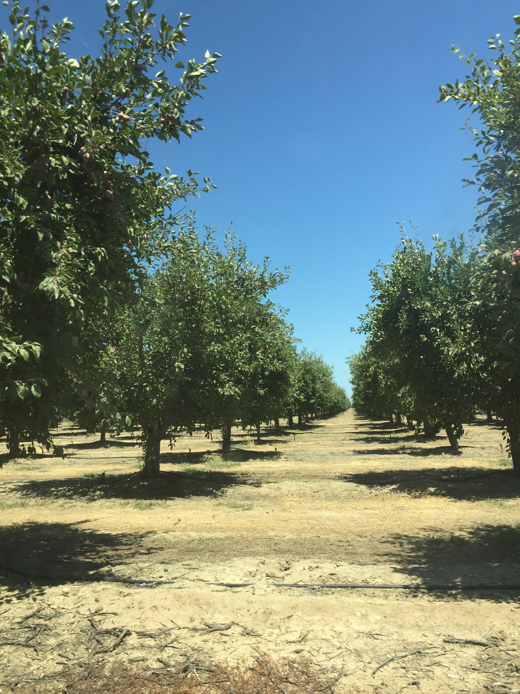
Use case - digital scouting and crop protection
Challenge 1
How to assess farm’s health after the last foliar nitrogen application?
Challenge 2
How to process 6.35GB of data while being in the field?
Challenge 3
How to deliver meaningful results in less than 30 minutes?

Slide 38
Use case - digital scouting and crop protection
Solution
Process the images and generate an orthomosaic.
Generate two index maps: NDVI and NDRE.
Use the comparison tool with the orthomosaic and NDVI to do a quick comparison of the field.
Use the zonation tool to create an “easy to read” map of the problem areas.
Use annotations to highlight the ‘focus areas’ and add more information to them.
Notes:
The five-step workflow serves as the basis of his recommendations to clients.
Generate the orthomosaic.
Generate two index maps: NDVI and NDRE.
Use the comparison tool with the orthomosaic and NDVI to do a quick comparison of the field.
Use the zonation to create an “easy to read” map of the problems areas which he then focuses on.
Use annotations to highlight the ‘focus areas’ and adds more information to them.
Having the Pix4Dfields image processing done in 5 minutes, PAS was enabled to do the image analysis on site, discuss the results and immediately scout the focus areas with the Farm Manager.

Slide 39
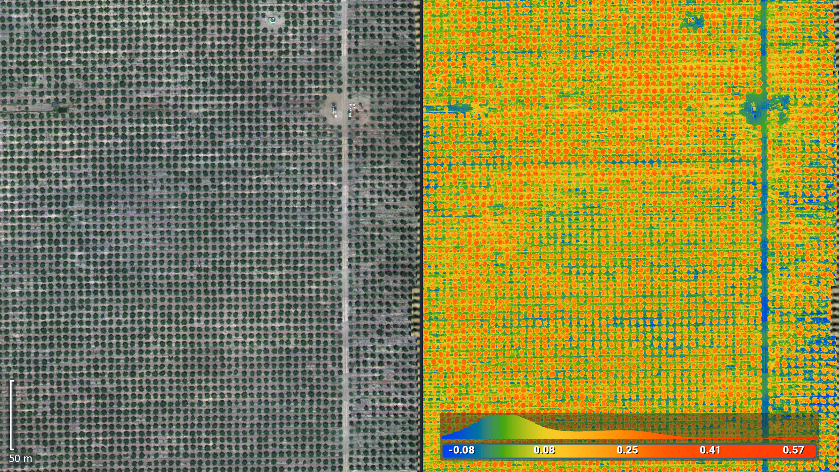
Use case - digital scouting and crop protection
Notes:
Pix4Dfields comparison tool:
Orthomosaic on the left and NDVI map on the right

Slide 40
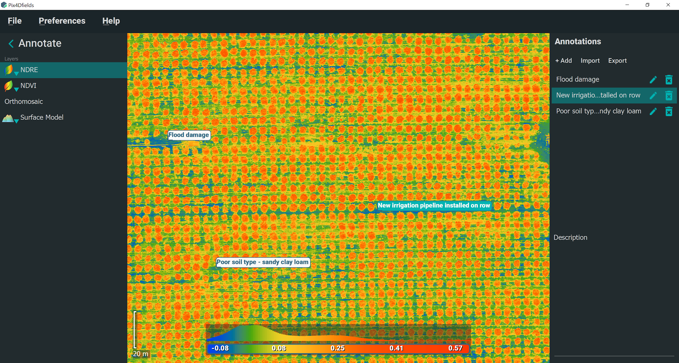
Use case - digital scouting and crop protection
Notes:
Pix4Dfields NDRE index map used with annotation tool to highlight the problem areas
Once the team arrived at the identified area we confirmed the results from the data; around 28 trees were growing less densely than their neighbors. The farmer immediately began the process of gathering soil and leaf samples to figure out what exactly is causing the issue.
With the help of the Pix4Dfields instant processing and analysis tools, PAS enabled the Farm Manager to make the timely and focused decisions on site as a part of their every day workflow.

Slide 41
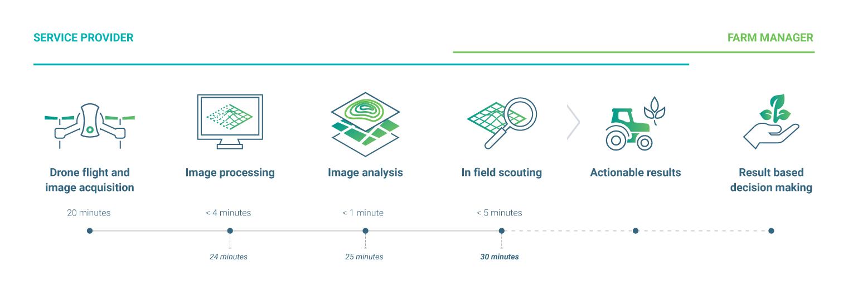
Use case - digital scouting and crop protection
Notes:
Pix4Dfields enables the Service providers like PAS to do their jobs in a faster and more accurate manner while at the same time providing Farm Managers with actionable data in the field. Pix4Dfields has a direct impact on farm management – and consequently on farm’s profit.

Slide 42
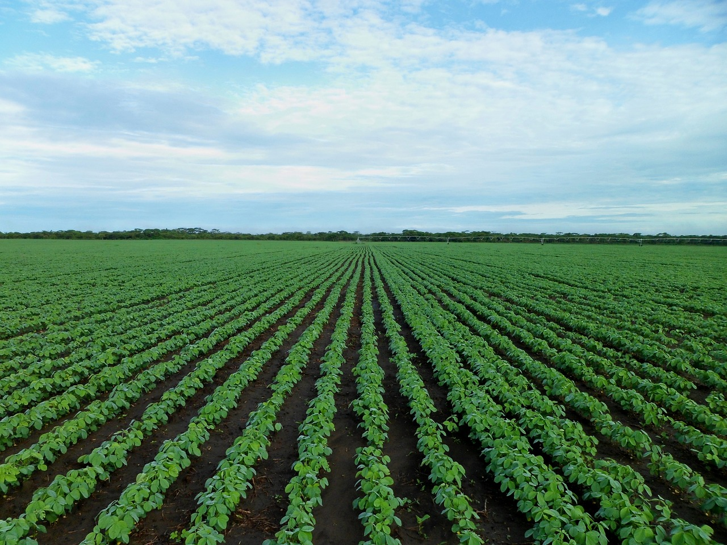
Use case - irrigation management
Problem statement
Drainage tiles are extremely important because they help control moisture levels in soil, and are also a significant investment for farmers.
Knowing where existing pipes are can save growers lots of time and money while ensuring optimal crop growth.
Notes:
HeartWood Labs, a part of Arrowmaker Group Inc., is a drone service provider offering multispectral imaging for agriculture. Earlier this season, one of their customers, a soybean farm in Northwest Iowa, hired them to identify where existing drainage tiles were located in some of their fields.
Drainage tiles are extremely important because they help control moisture levels in soil, and are also a significant investment for farmers. Knowing where existing pipes are can save growers lots of time and money while ensuring optimal crop growth.

Slide 43
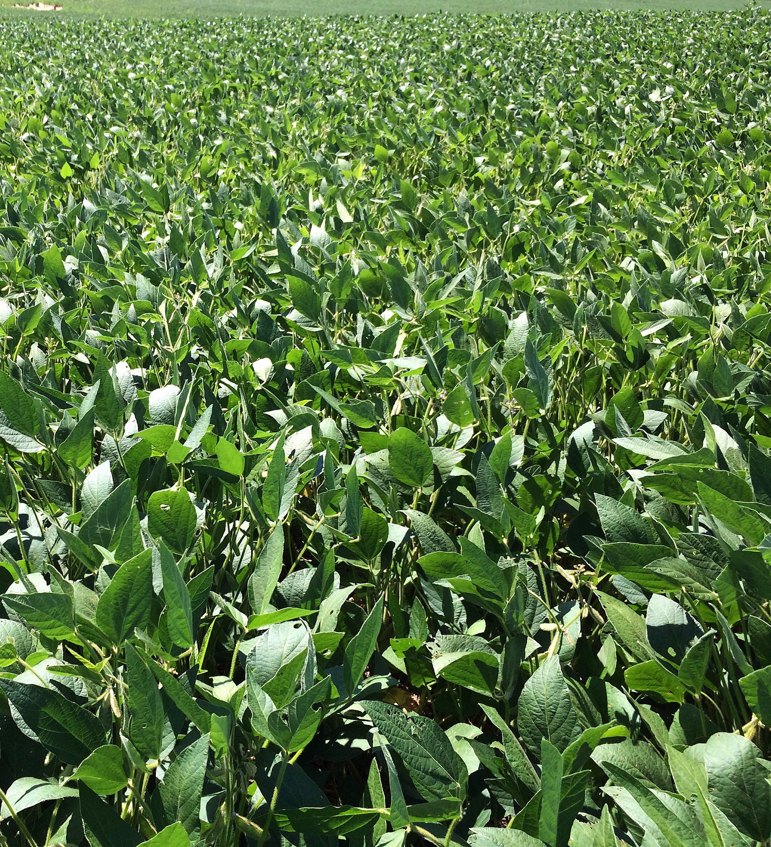
Use case - irrigation management
Challenge 1
How to identify where existing drainage tiles are located in your fields?
Challenge 2
How to cut down on the processing time by a large margin for a 160 acre / 65 hectare farm?
Challenge 3
How to present the results in an intuitive way to your customer while still in the field?

Slide 44
Use case - irrigation management
Solution
Process the images and generate an orthomosaic.
Generate an NDRE index map.
Use the comparison tool (split-screen mode) to highlight the differences between layers while in the field.
Use the zonation tool to delineate areas of the field that are experiencing more stress.
Use annotations to mark the spots where the tile lines are throughout the field.
Use the the DSM generator to show how water behaves on the field due to the low slopes and small hills that aren’t always obvious.
Notes:
Process the images and generate an orthomosaic.
Generate an NDRE index map.
Use the comparison tool (split-screen mode) to highlight the differences between layers while in the field.
Use the zonation tool to delineate areas of the field that are experiencing more stress.
Use annotations to mark the spots where the tile lines are throughout the field.
Use the the DSM generator to show how water behaves on the field due to the low slopes and small hills that aren’t always obvious.

Slide 45
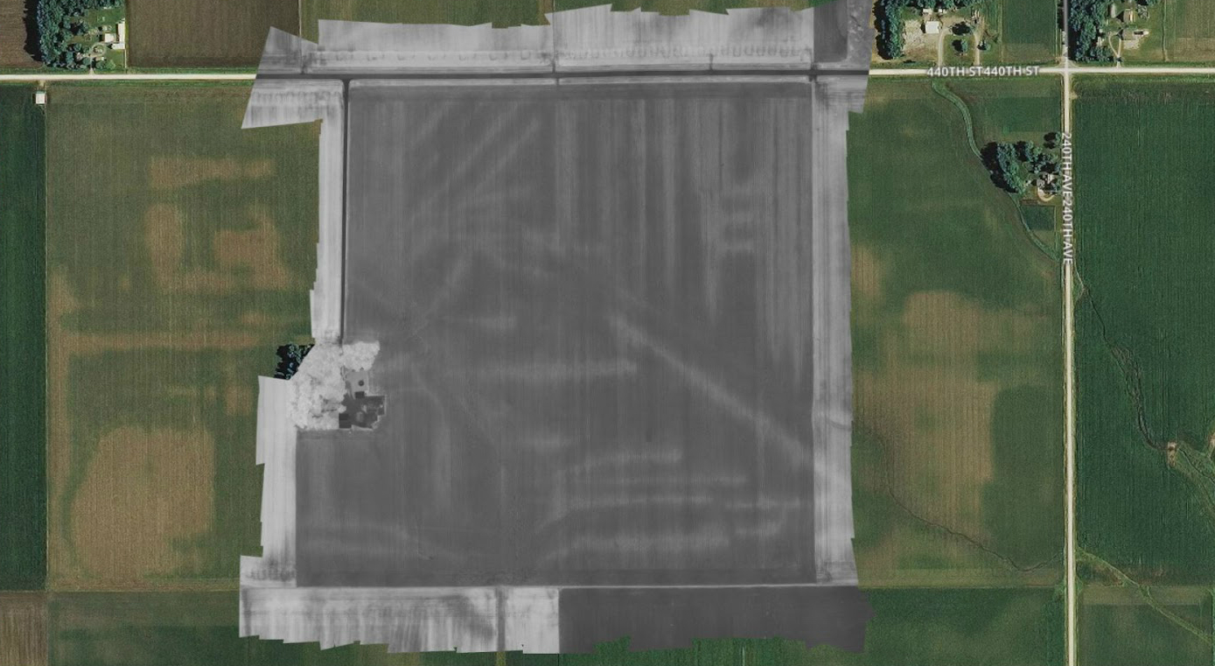
Use case - irrigation management
Notes:
The team was able to identify the drainage tiles using the NDRE index, an index that can only be calculated if the red edge band is available. Since the RedEdge sensor captures the red edge band, the team was able to spot the differences in the vegetation growing along the field. The plants over the tile lines were healthier than the plants not directly over the lines.

Slide 46
Use case - irrigation management
Notes:
With the tiles identified, the team presented the results to the customer using the split-screen tool in Pix4Dfields to highlight the differences between layers.

Slide 47

Use case - irrigation management
Notes:
The RGB ortho was unable to show the tile lines, while the calibrated multispectral NDRE results showed them perfectly.

Slide 48

Demo

Slide 49

Q&A

Slide 50

Thank you

