Slide 1
Construction
15th October 2018

Slide 2
Summary
1. Drone mapping solutions for construction
Products
Workflow
Applications
2. Pix4Dbim
Pix4Dbim workflow
Pix4Dbim tools and features
Pix4Dbim outputs
3. Crane Camera solution
Crane Camera workflow
Crane Camera outputs
4. Use Cases
Pix4Dbim use case
Crane Camera use case

Slide 3

Drone mapping solutions for construction

Slide 4


Pix4D Products for Construction
Crane Camera
3D mapping software for earthworks, construction and infrastructure management
Automated and daily 2D and 3D as-built updates of construction sites

Slide 5

Pix4D Workflow
1. Capture
2. Process & Output
3. Analyze
4. Share & Integrate

Slide 6
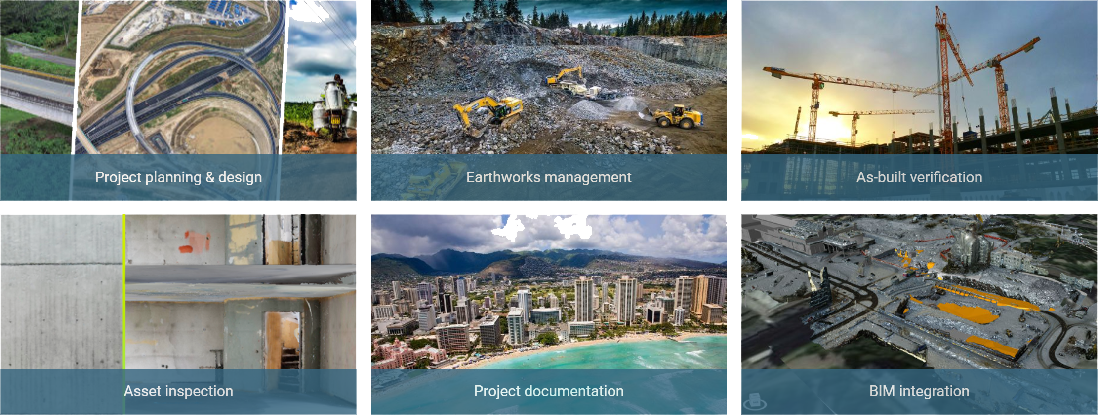
Applications

Slide 7


3D mapping software for earthworks, construction and infrastructure management

Slide 8



Three Pillars behind Pix4Dbim
Repeatable, accurate results
Rely on our processing to get the survey-grade results you expect
Instant analysis
Get instant view of any jobsite with online results that you can analyze and share.
BIM integration
Import ready-to-use data within BIM/CAD software for seamless management of your project.

Slide 9
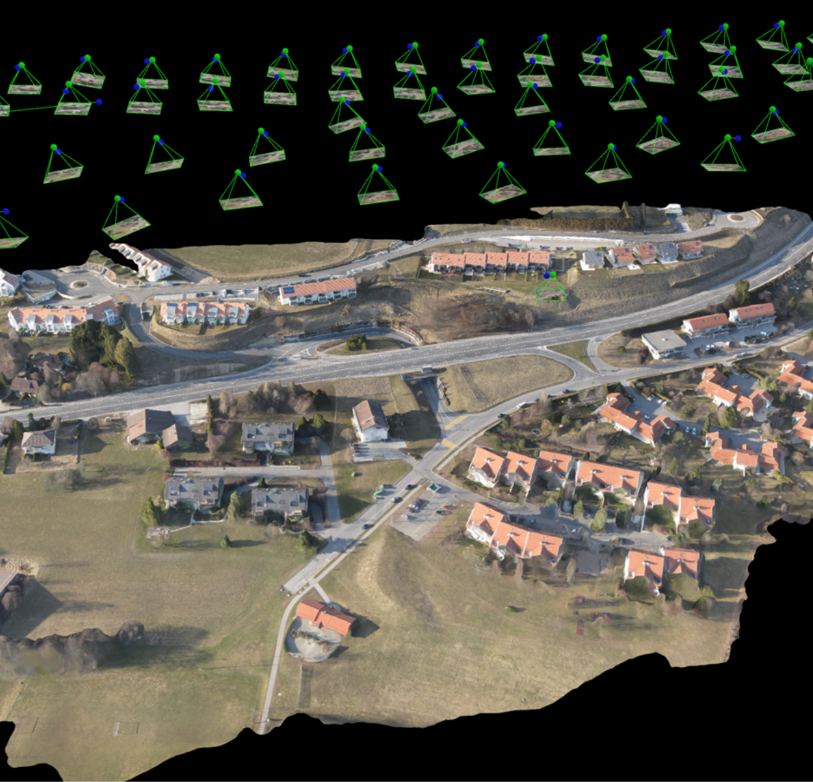
Applications and Deliverables
Planning & Design
3D models
2D mapping
GIS deliverables
Notes:
B

Slide 10
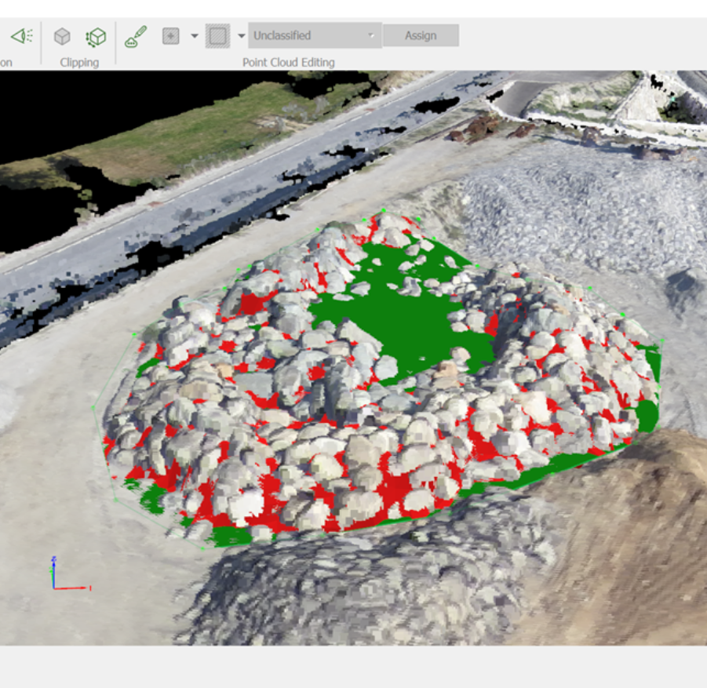
Applications and Deliverables
Earthworks
Stockpile measurements
Volume calculations
Cut and fill analysis
Contours
Elevation maps
Notes:
B

Slide 11
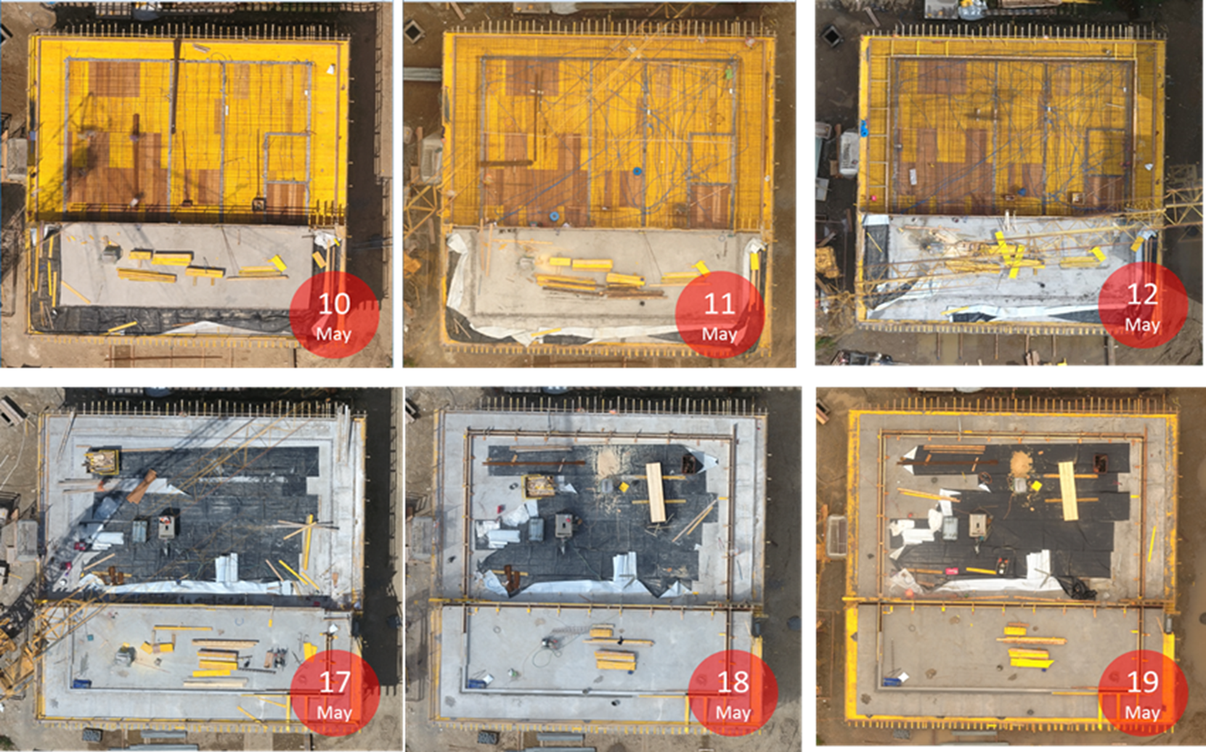
Applications and Deliverables
Site Surveys
2D orthophotos
3D point clouds
3D mesh models
Operational planning and communication
Progress monitoring
Finding errors early
As-built vs as-design
Notes:
B

Slide 12
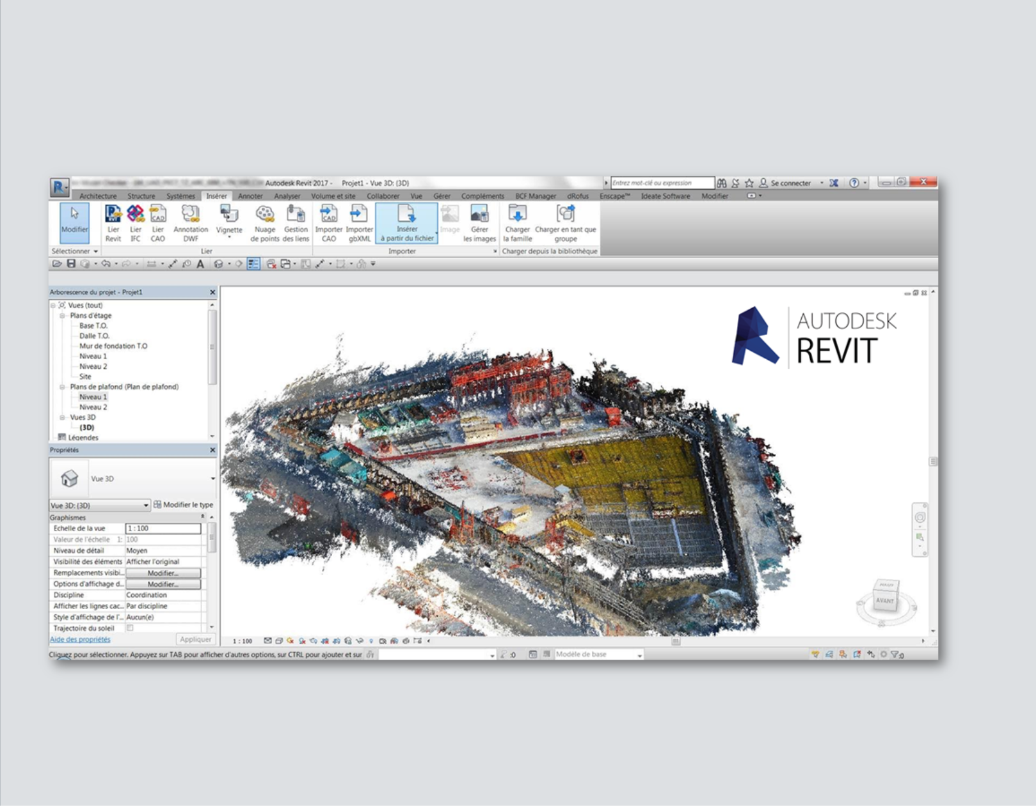
Applications and Deliverables
BIM Integration
As-built data integrated with your 3D design and collaboration software
Notes:
Thanks to the universal export format of the generated outputs, you can easily load them into your daily software:
-Autodesk suite ( Revit, Autocad, Navisworks,…)
-Graphisoft Archicad
-Solibri
-Tekla
-Plancal
-Revitzo
-Synchro 4D
-….

Slide 13
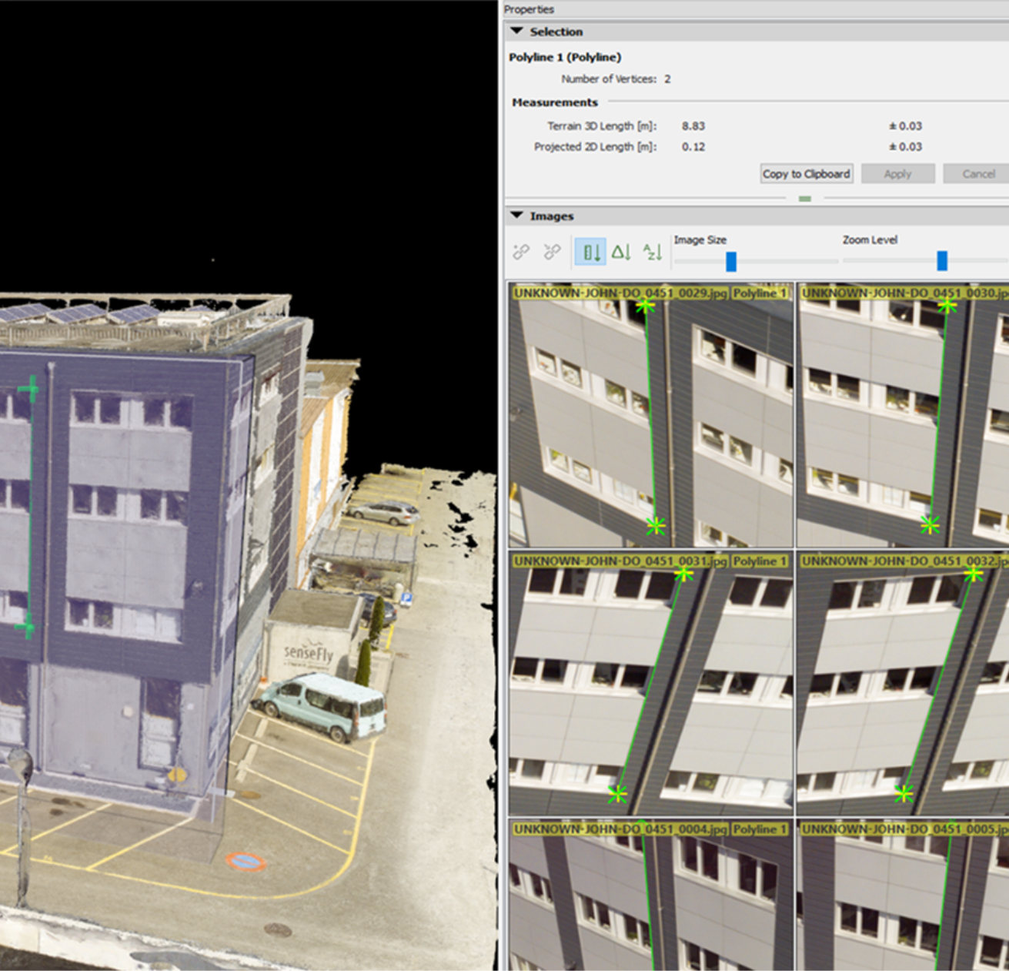
Applications and Deliverables
Inspection
High resolution images indexed from the 3D models
Notes:
B

Slide 14
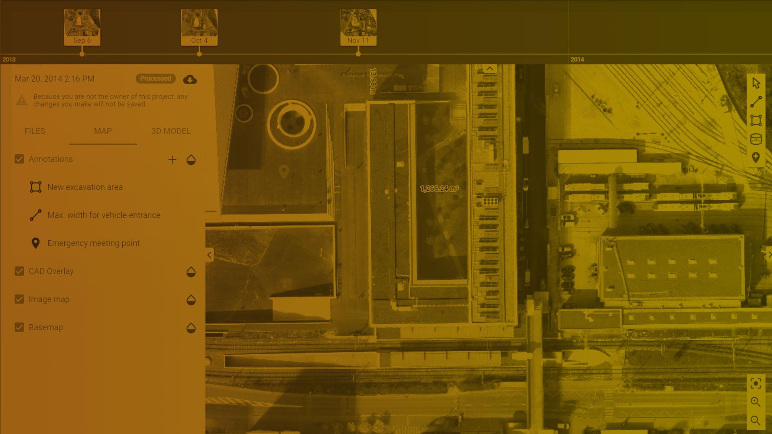
Tools and Features

Slide 15
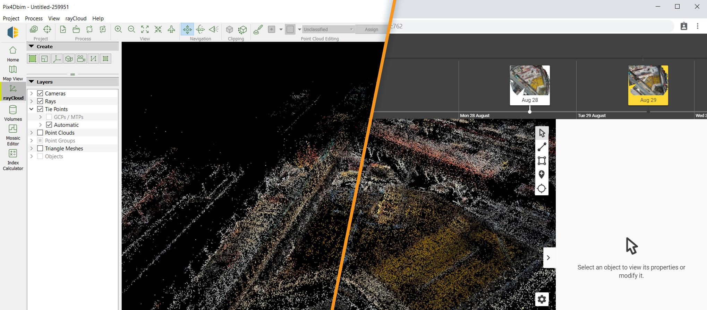
Seamless Integration between Desktop & Cloud
Desktop
Cloud

Slide 16
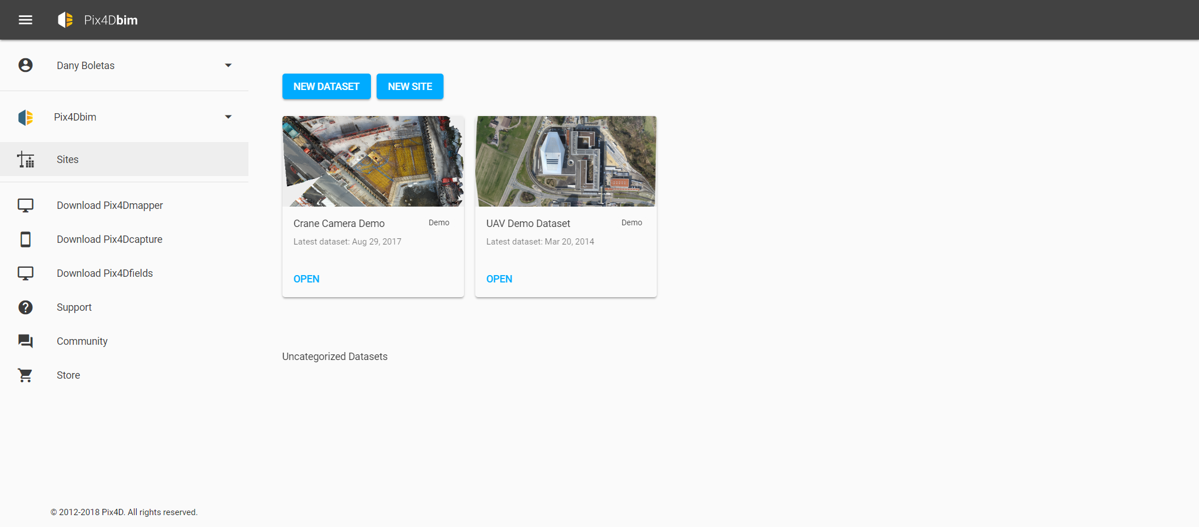
Pix4Dbim Projects and Sites Management

Slide 17
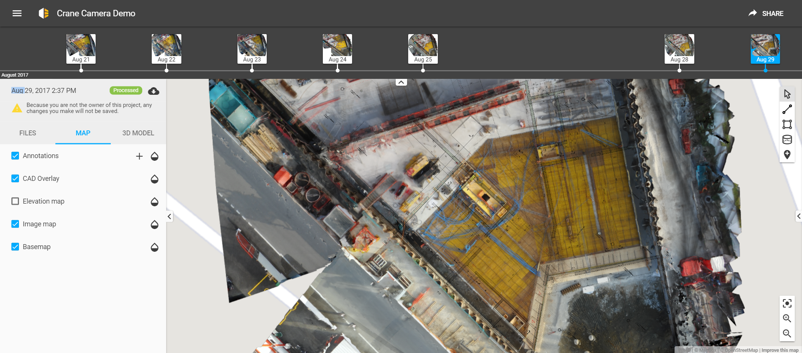
Timeline

Slide 18
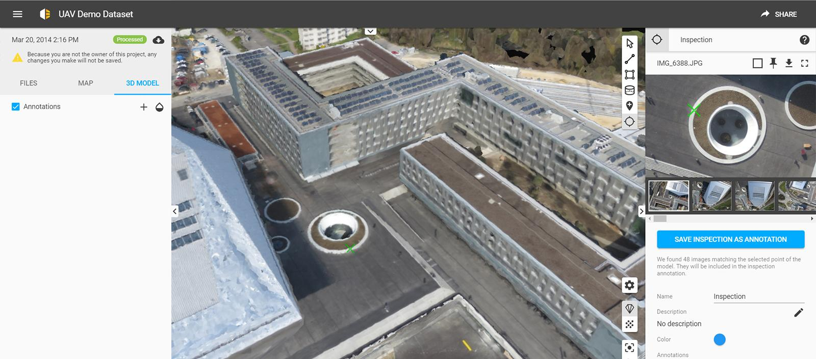
Virtual Inspector

Slide 19
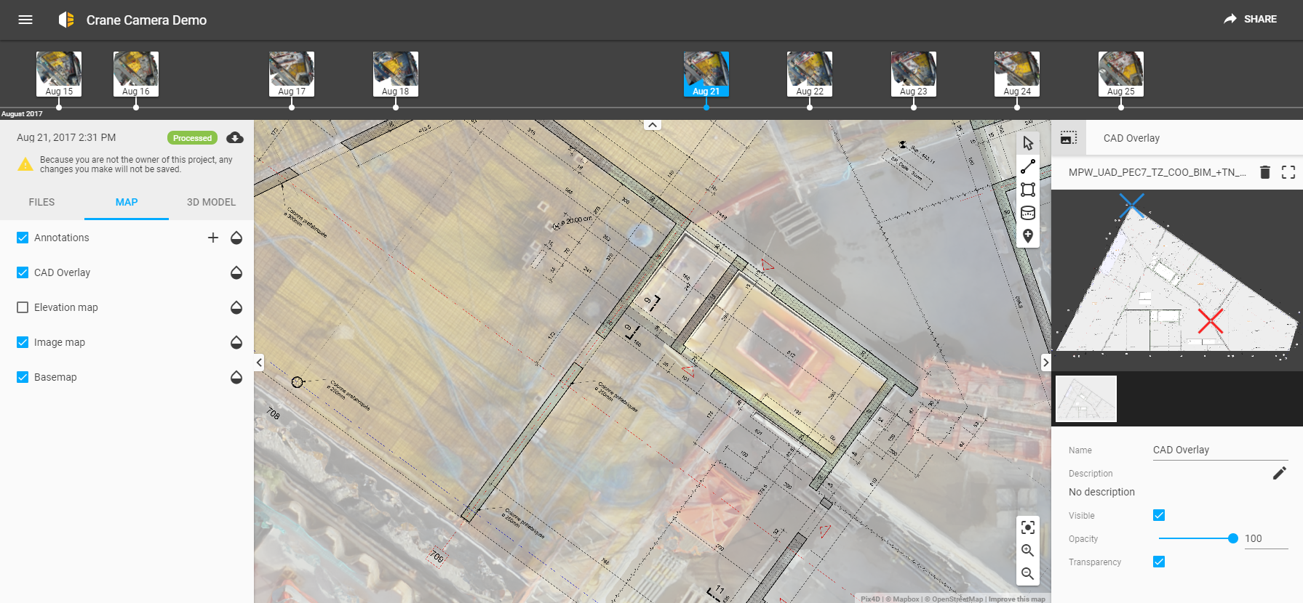
CAD Overlay

Slide 20
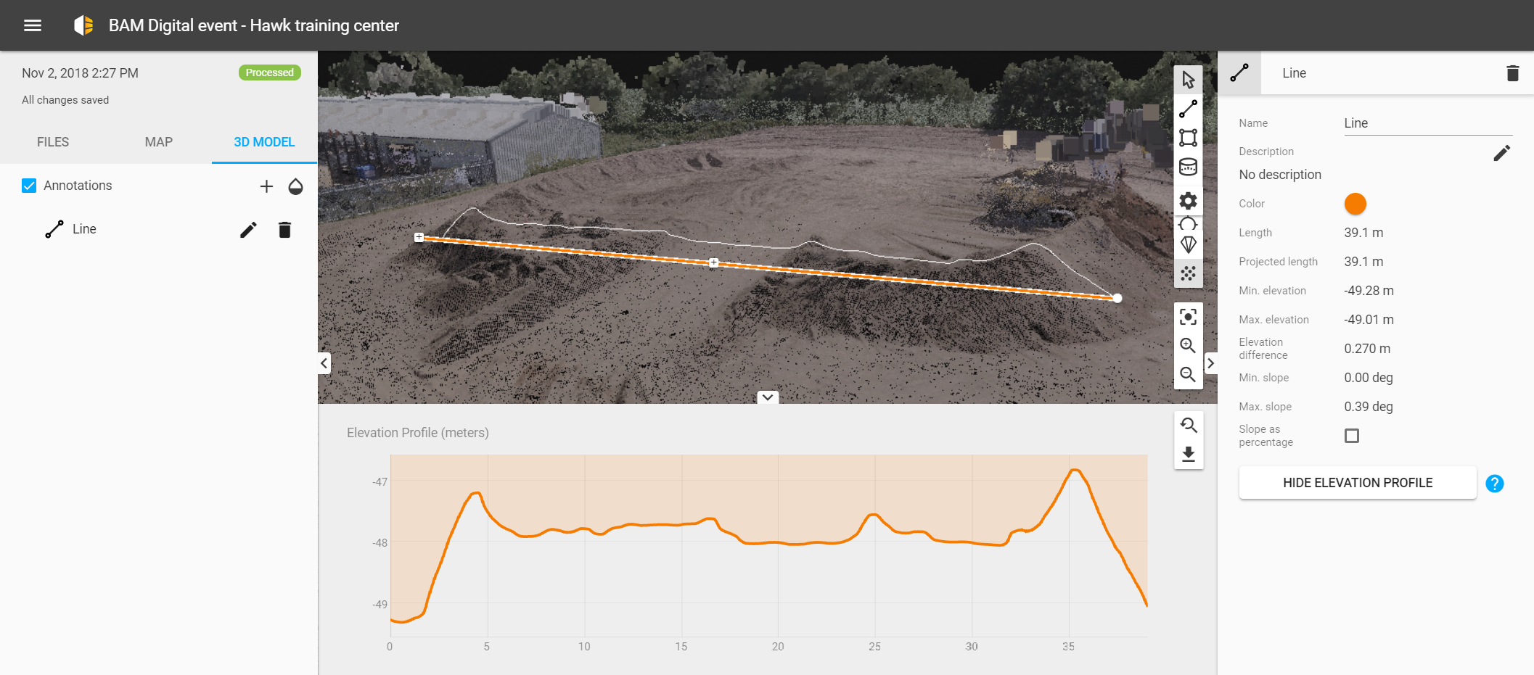
Elevation Profile

Slide 21
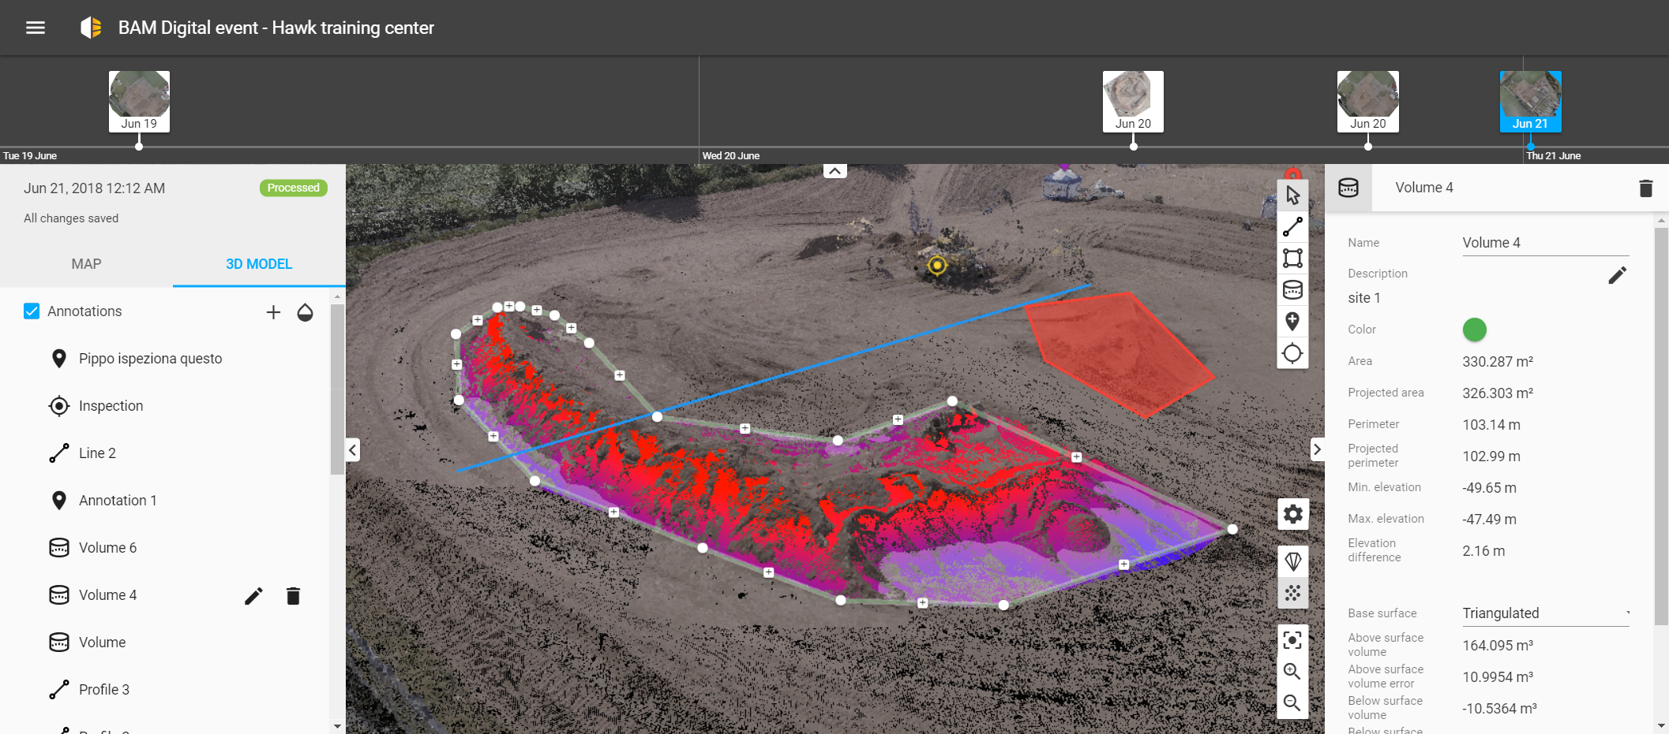
Volume Calculations

Slide 22
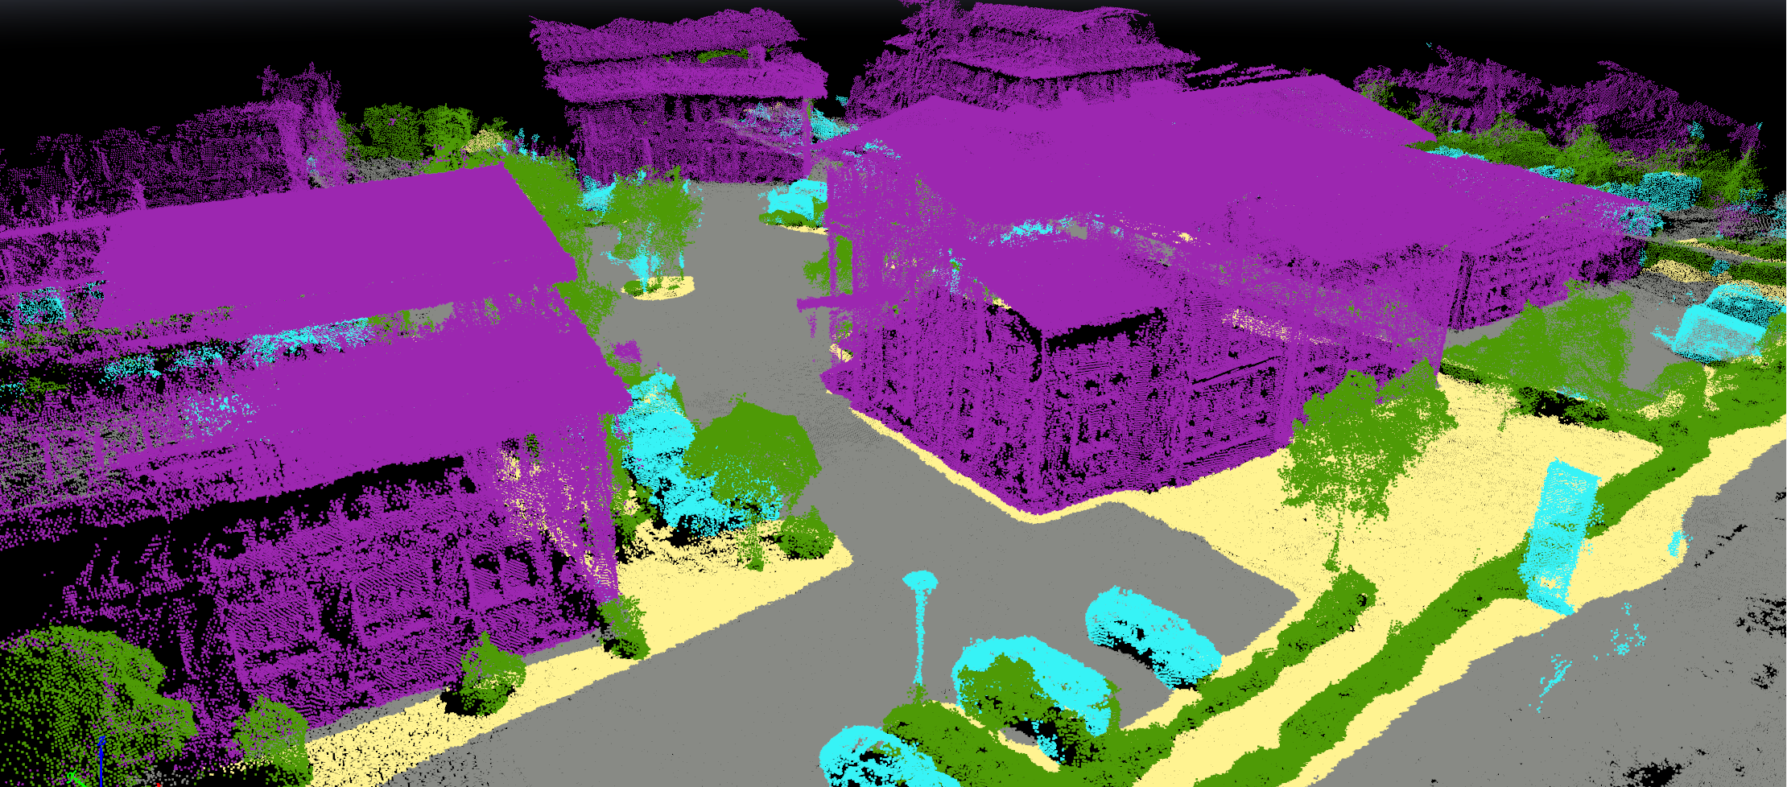
Automatic Point Cloud Classification

Slide 23
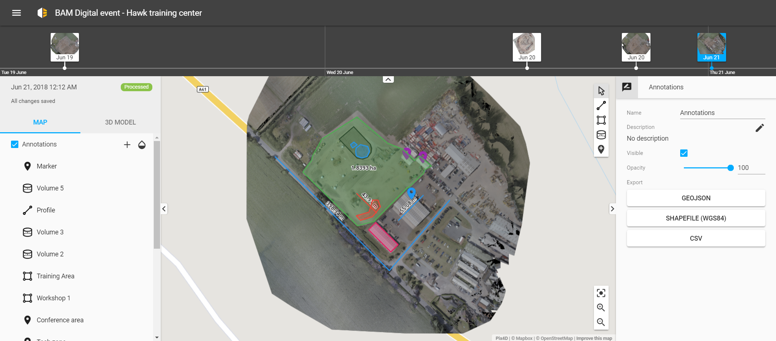
Exporting

Slide 24
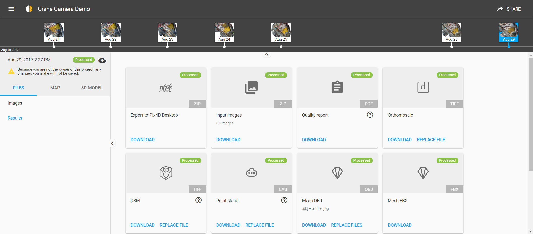
Exporting

Slide 25
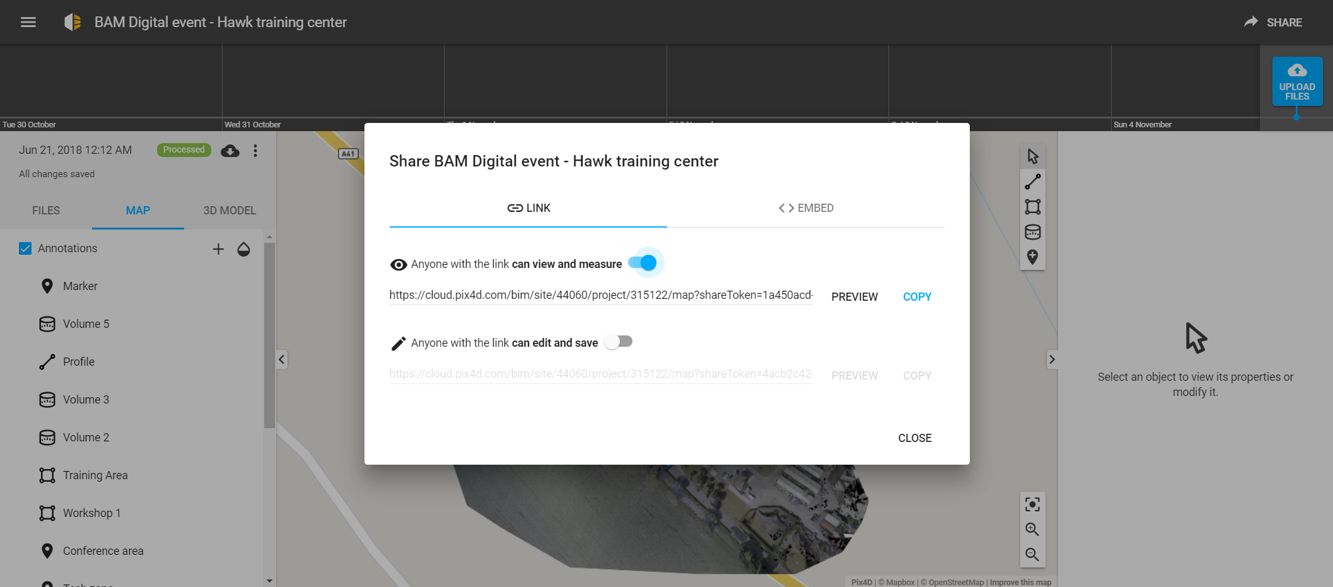
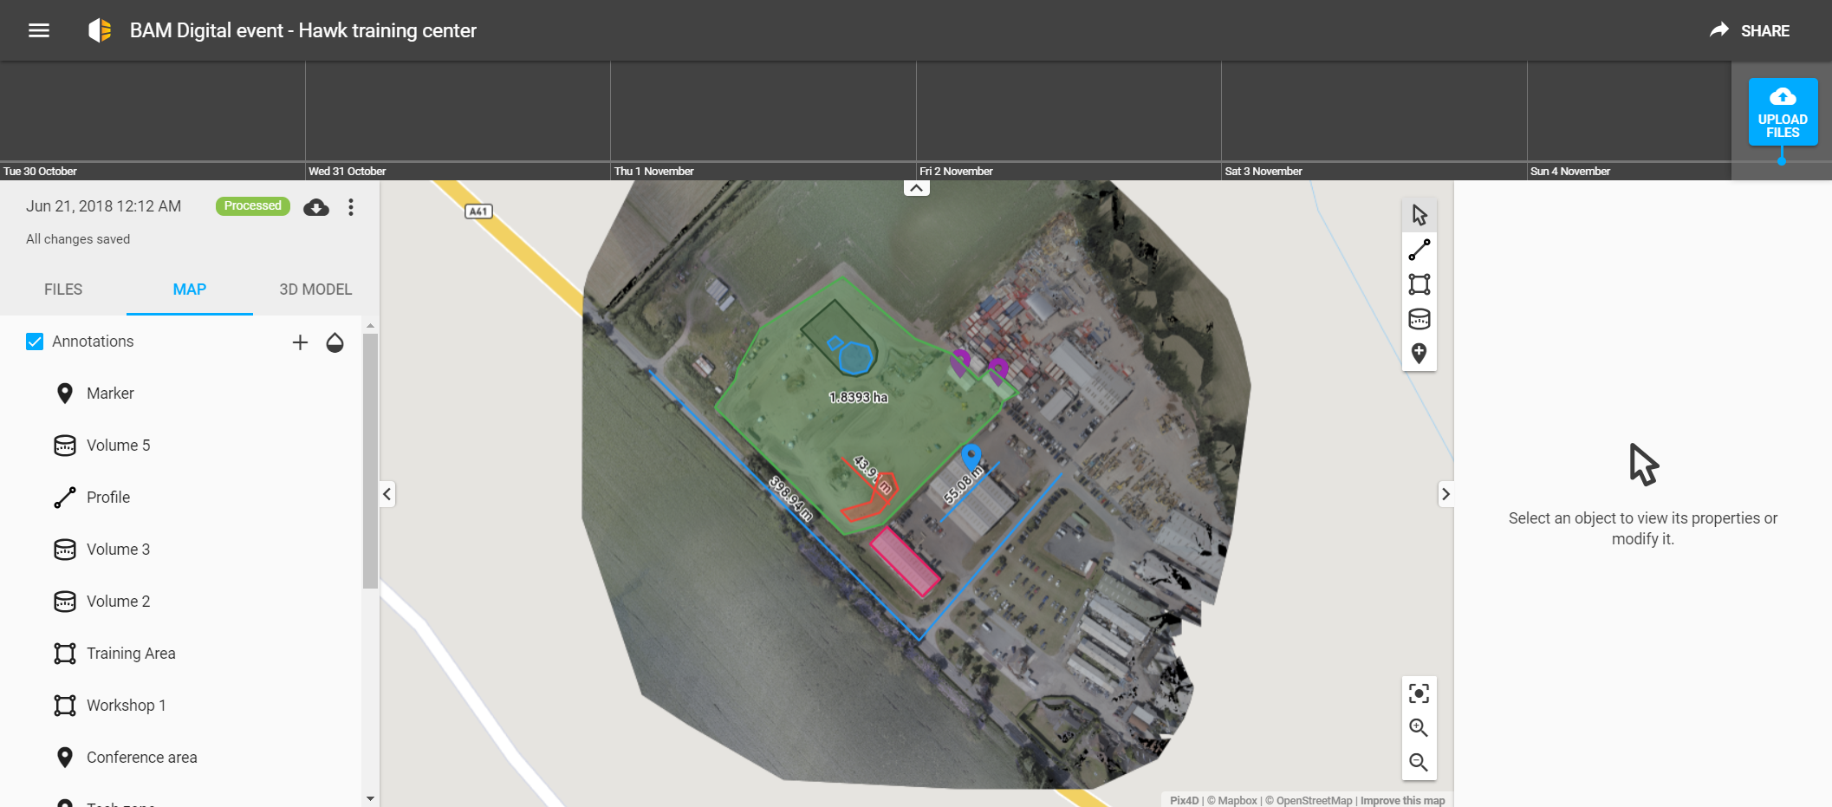
Sharing Options

Slide 26
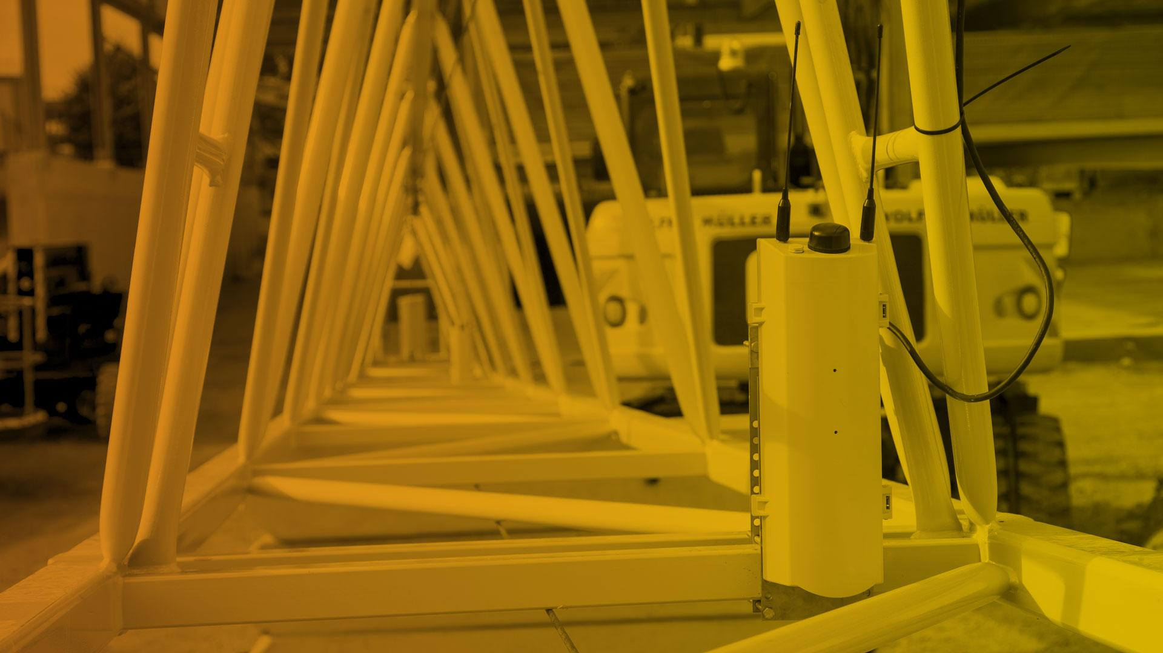

v
Crane Camera solution

Slide 27



Three pillars behind Pix4D Crane Camera solution
A trouble-free system
Capture site images automatically and remotely without human resources or interference with site operations.
Daily automated site monitoring
Control your project with daily visual updates in 2D and 3D available online and rapidly detect.
Ready-to-use data
Measure, inspect, annotate, compare to CAD drawings, share and export to CAD/BIM software for a complete BIM integration.

Slide 28

Workflow
1. Capture images automatically
2. Transfer and process images automatically on Pix4Dbim cloud
3. Display results online

Slide 29
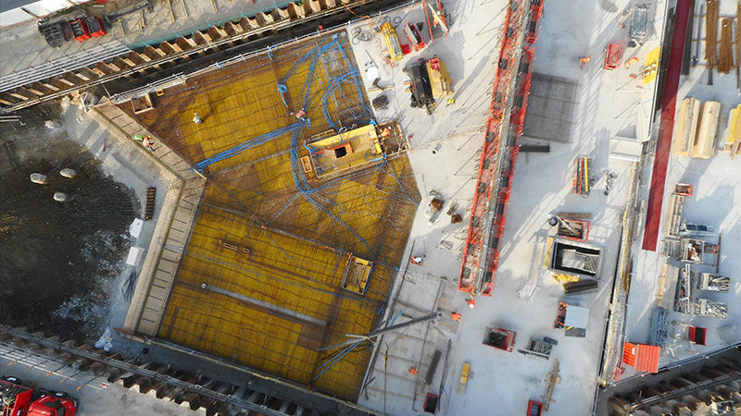
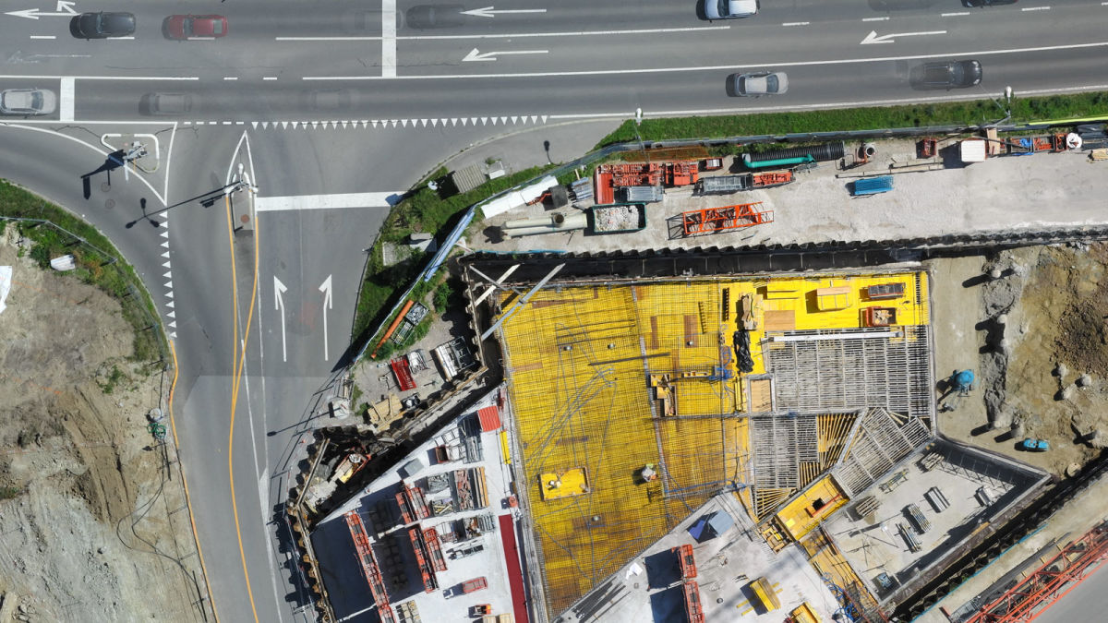
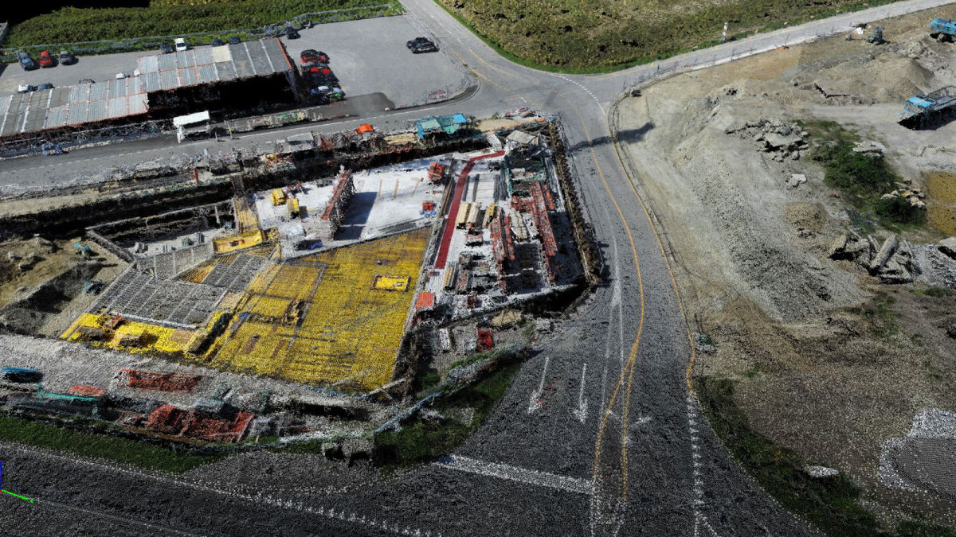
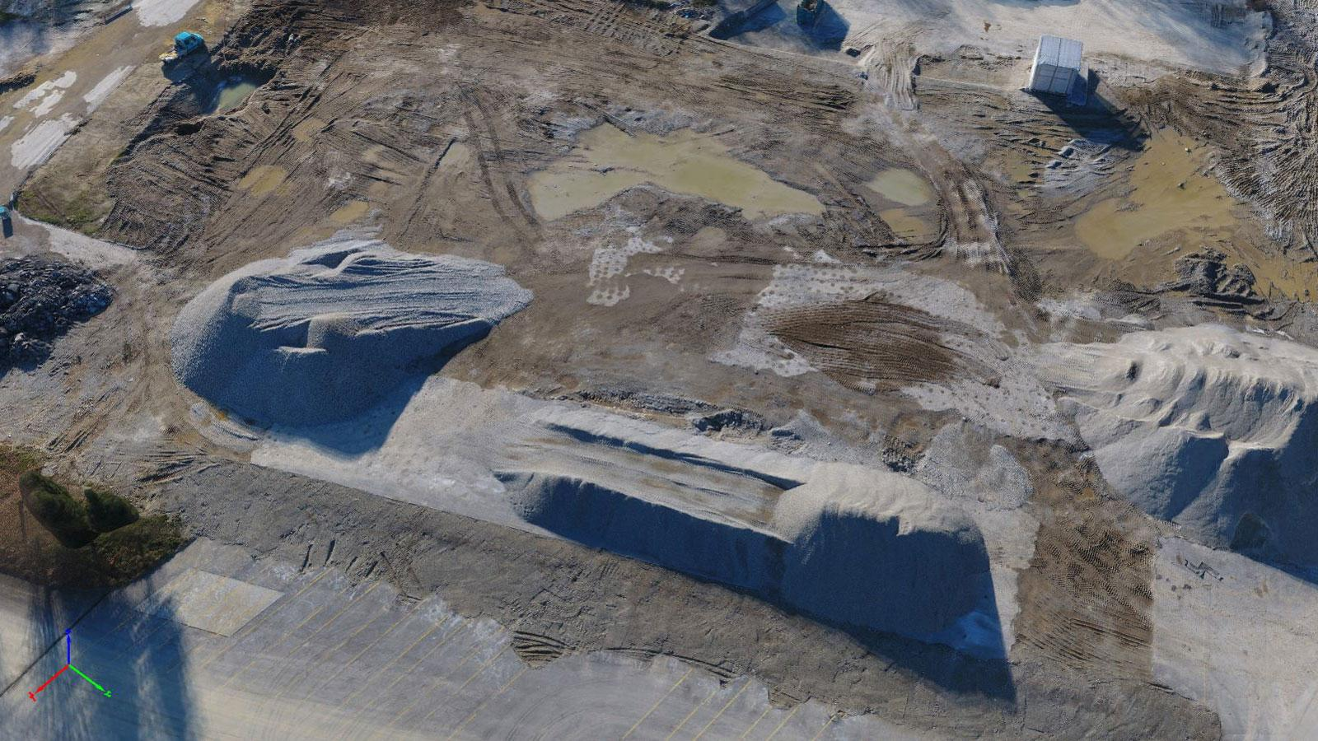
Outputs
Original High-res images
2D orthomosaic
3D Point cloud
3D mesh models

Slide 30
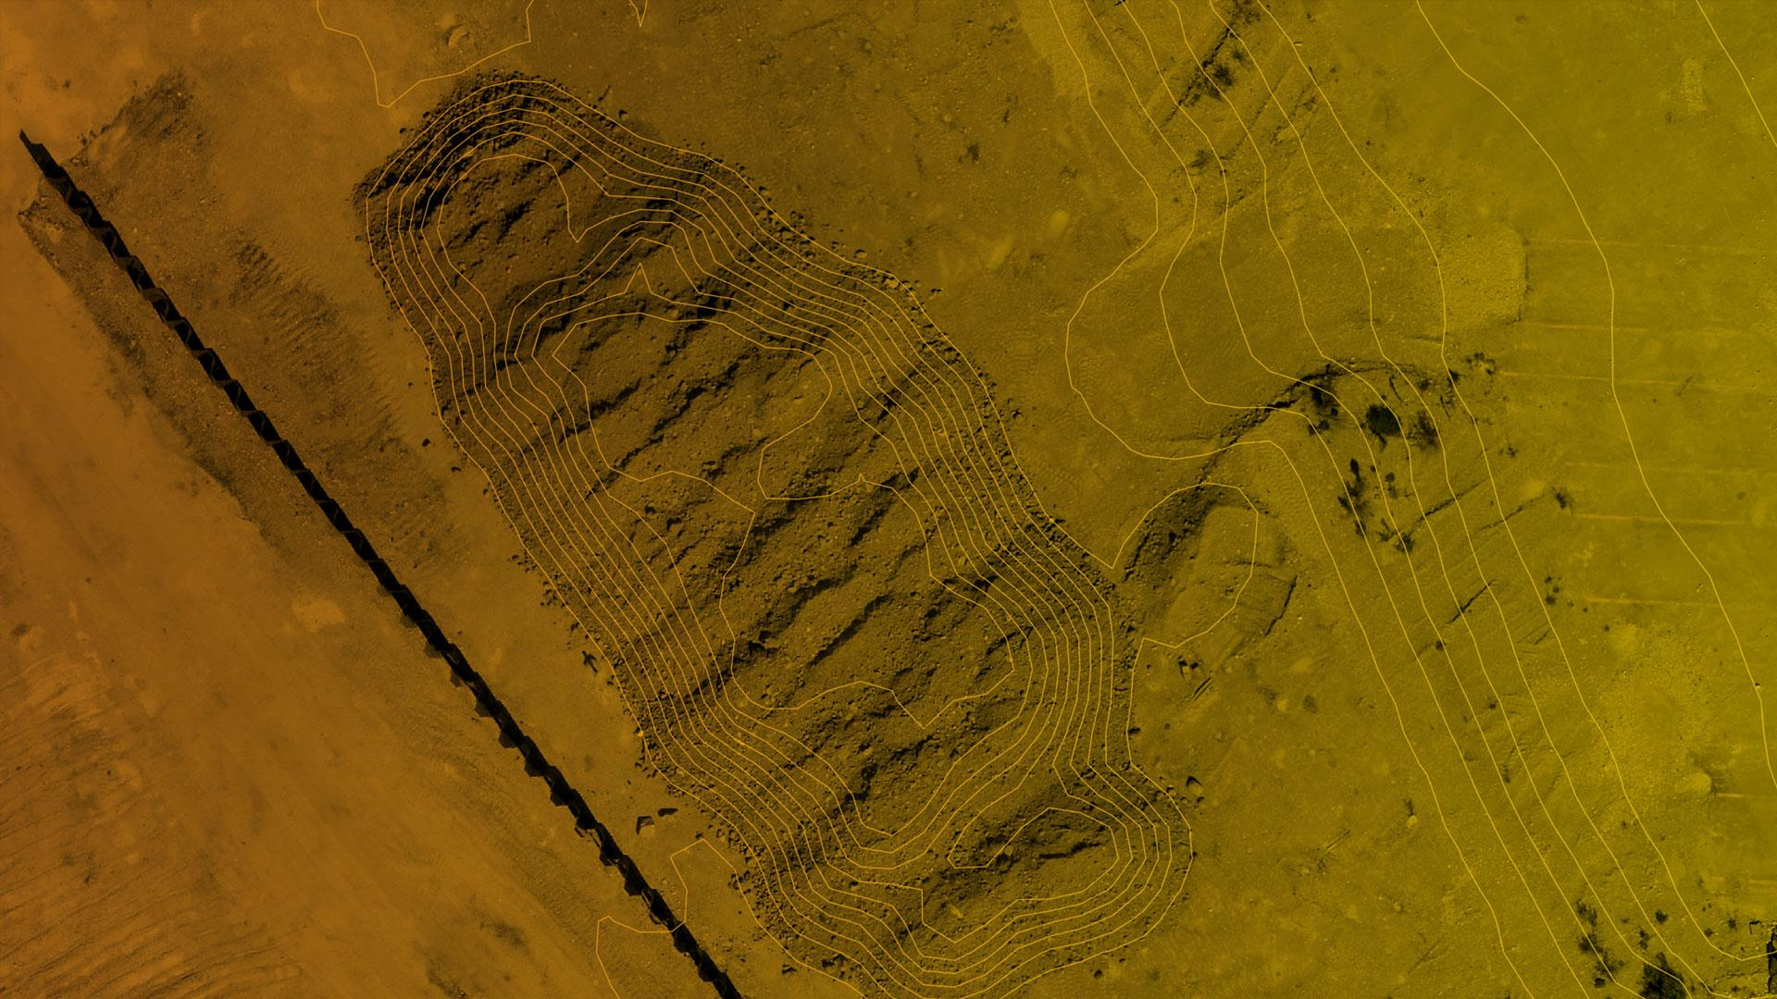
Use cases

Slide 31
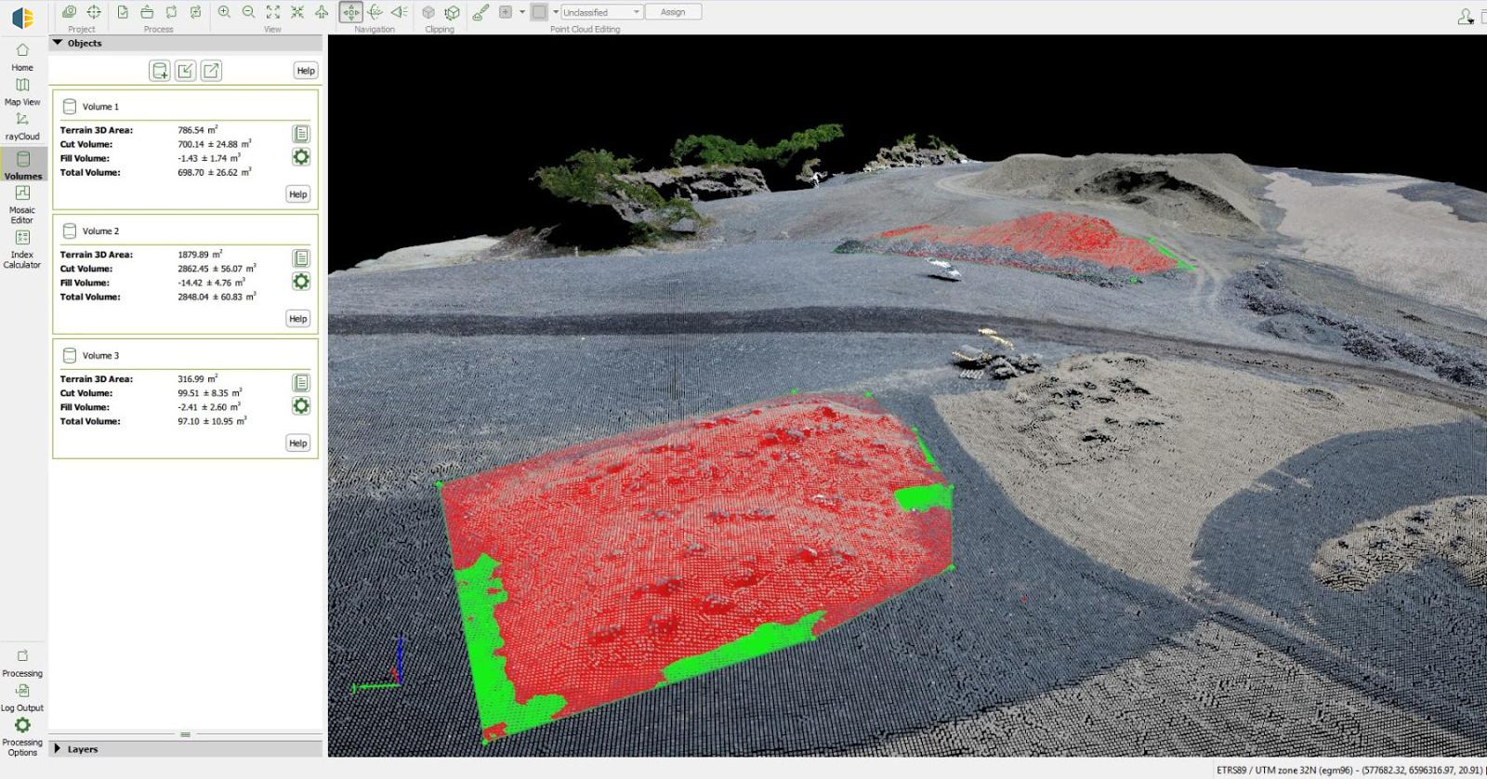
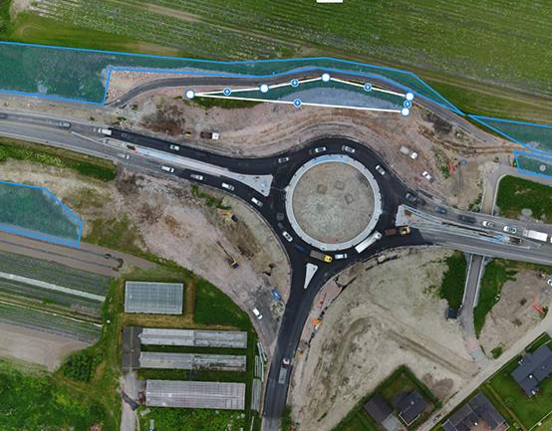
Save Time and Money with Pix4Dbim and Drone Mapping
Read full use case
Notes:
Using drones, Pix4D’s drone mapping software and a smart combination of desktop and cloud processing, the construction company Isachsen routinely monitors projects, keeps track of and document changes, and easily communicates the site status to all stakeholders, including their end-client.
For Isachsen, drones have become one of the most cost-effective tools for surveying projects and help the ground decision-making process. Drone mapping is so inexpensive, non-intrusive and fast that the company can afford to do it over-and-over again during the entire project— something not possible before with traditional surveying.

Slide 32
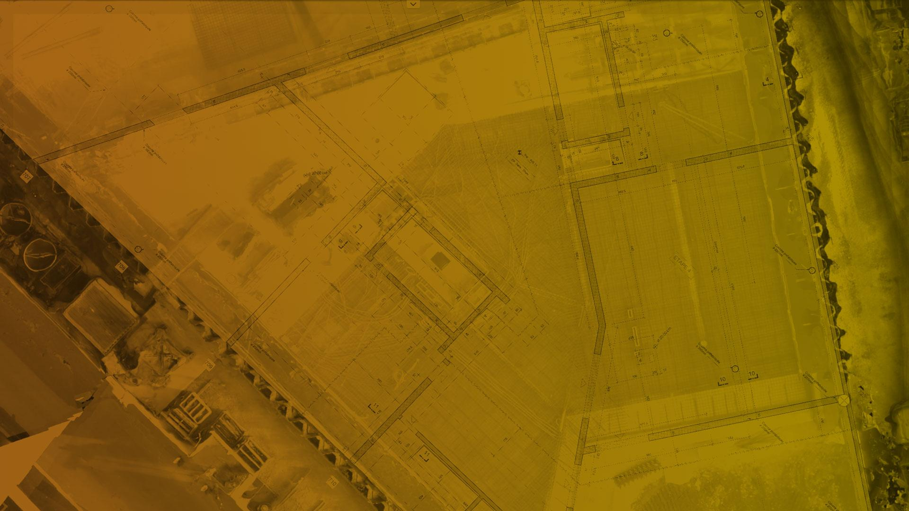
Crane Camera solution
Use cases

Slide 33
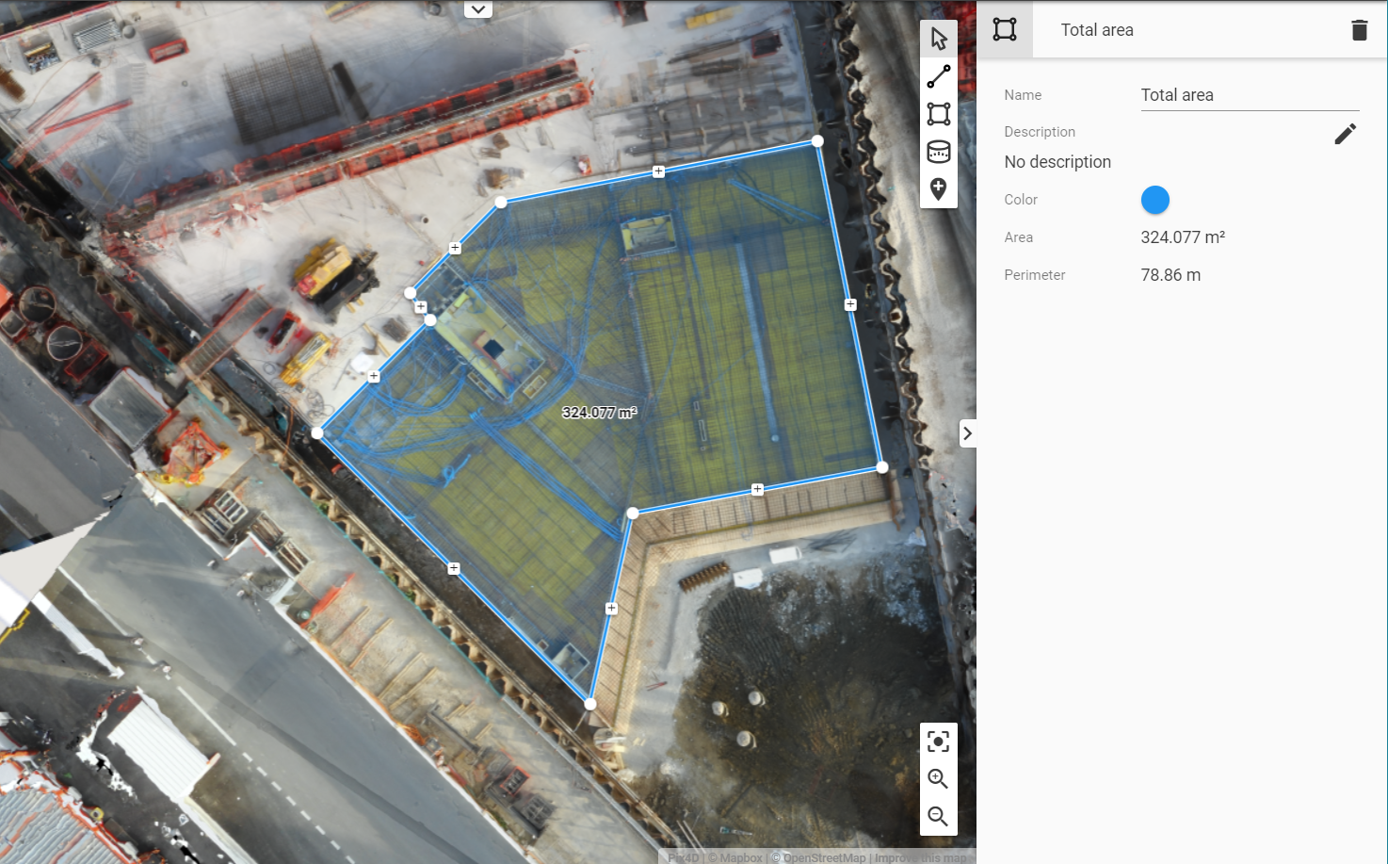
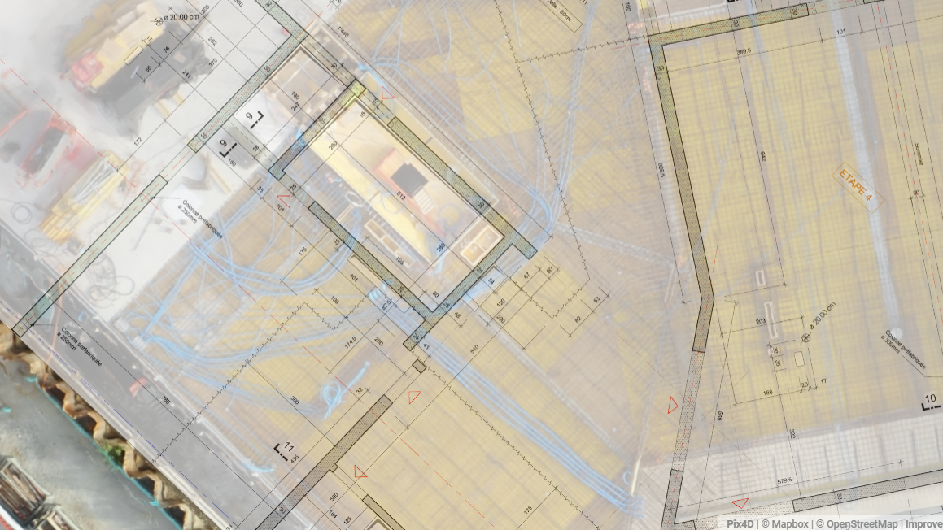
Collect and Verify As-built Data Automatically
Measurements and annotations
CAD Drawing overlay
2D Orthomosaics
3D point clouds
Read full use case
Notes:
The project: Already using drone technology, a major construction company in Denmark wanted to go further and experience the Pix4D Crane Camera solution to get as-built data automatically on a day-to-day basis, without allocating more resources or impacting their budget.
How does it work? After capturing images of the as-built hospital site, data is automatically sent to the cloud to be processed and turned into 2D and 3D models. The project BIM Manager can visualize results on the Pix4D Cloud every day and share those with all project team members. Data collected in the morning is available to the team in the early afternoon.
How data is used - Coordination and scheduling are critical in a construction project. Many problems and errors in projects stem from poor communication or lack of coordination, directly impacting the project schedule. Knowing precisely what’s happening on site – what has been done so far and what remains to be done – is quite often time-consuming, not to say challenging, for project managers and BIM managers.

Slide 34
Best Practices for a Sales DEMO
Workflow 1:
In Desktop, import images + GCP, run Rapid Check Temp. in Pix4D desktop
Workflow 2:
In Desktop, import images + GCP (mark into basic editor)
Push and upload to Pix4D Cloud
Workflow 3:
Just in Pix4D Cloud

