Slide 1
Measure from images
[Main title]
[Presenter name]
[Position]
Notes:
At Pix4D were we make professional sofwtare easy to use.
I’m going to show you how easily you can gain competive advantage with drone images.

Slide 2
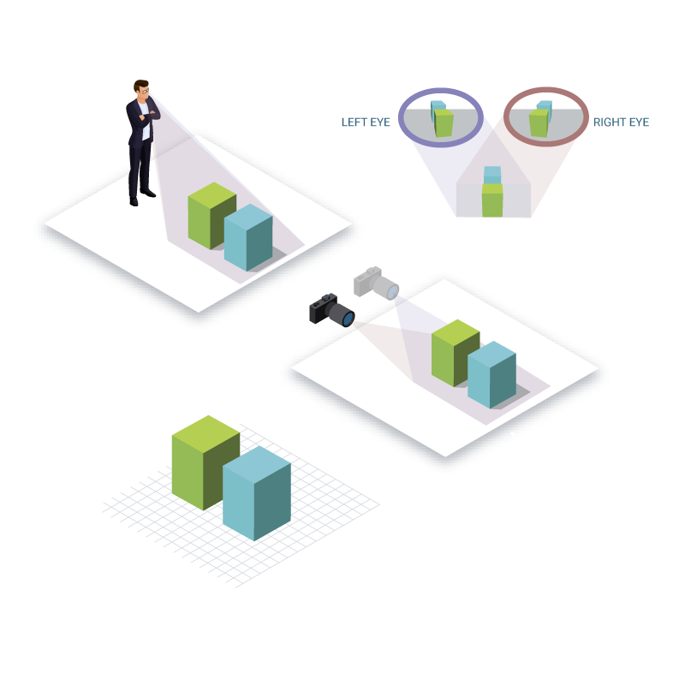
Photogrammetry
“Evolution favours eyes that perceive the world in 3D”.
Christoph Strecha, Founder and CEO of Pix4D
Notes:
Pix4D software turns your images into highly precise, georeferenced 2D maps and 3D models. They’re customizable, timely, and complement a wide range of applications and software.
Safer, more efficient and less time consuming
Different industries

Slide 3
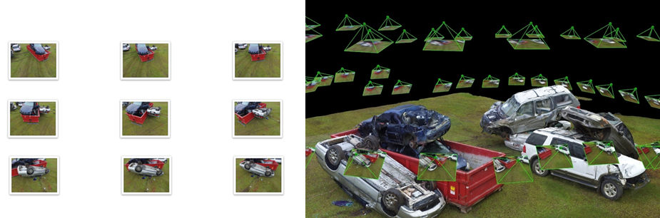
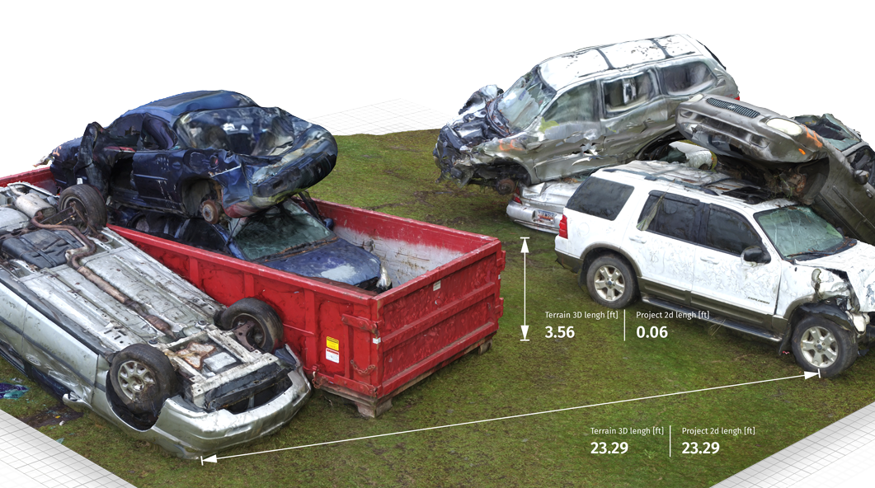
Critical information from images to make better decisions faster
Notes:
Pix4D software turns your images into highly precise, georeferenced 2D maps and 3D models. They’re customizable, timely, and complement a wide range of applications and software.
Safer, more efficient and less time consuming
Different industries

Slide 4
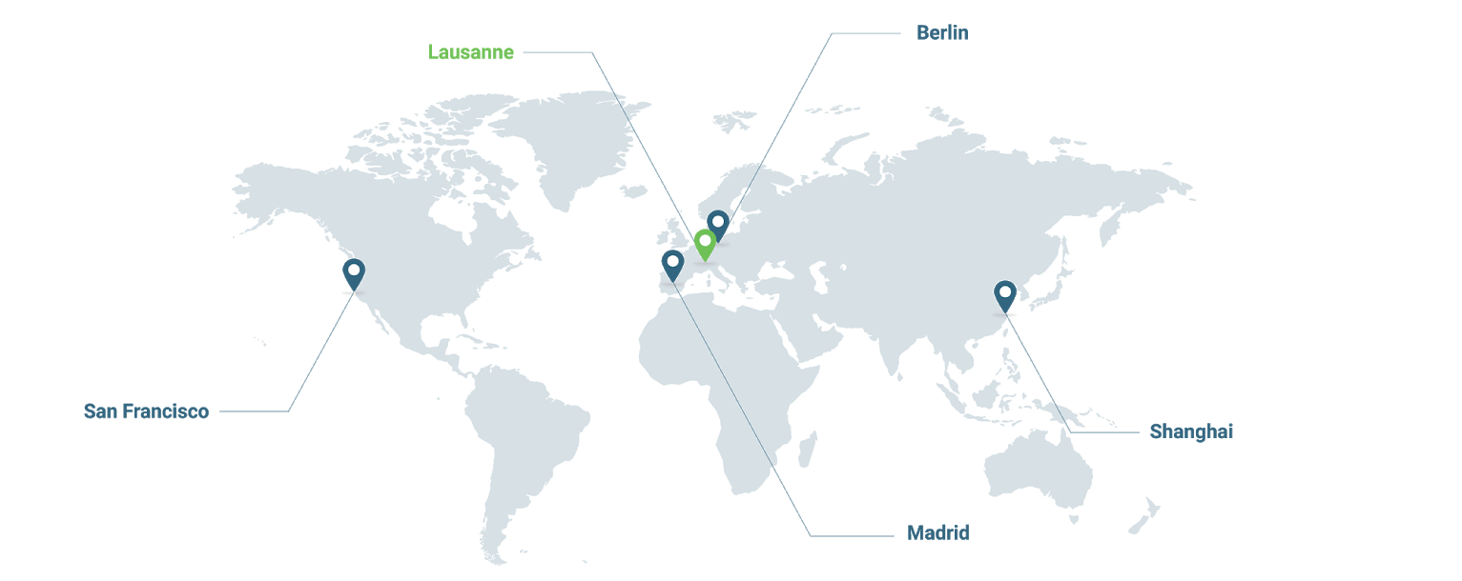





Overview
50 000 active users
100’000’000 acres of reality modeled
170+ global employees
60% R&D talent
SAN FRANCISCO
U.S.A.
LAUSANNE
SWITZERLAND
BERLIN
GERMANY
SHANGHAI
CHINA
MADRID
SPAIN

Slide 5

Pix4D workflow
1. Capture
2. Digitize
3. Check,
Measure & Inspect
4. Share

Slide 6
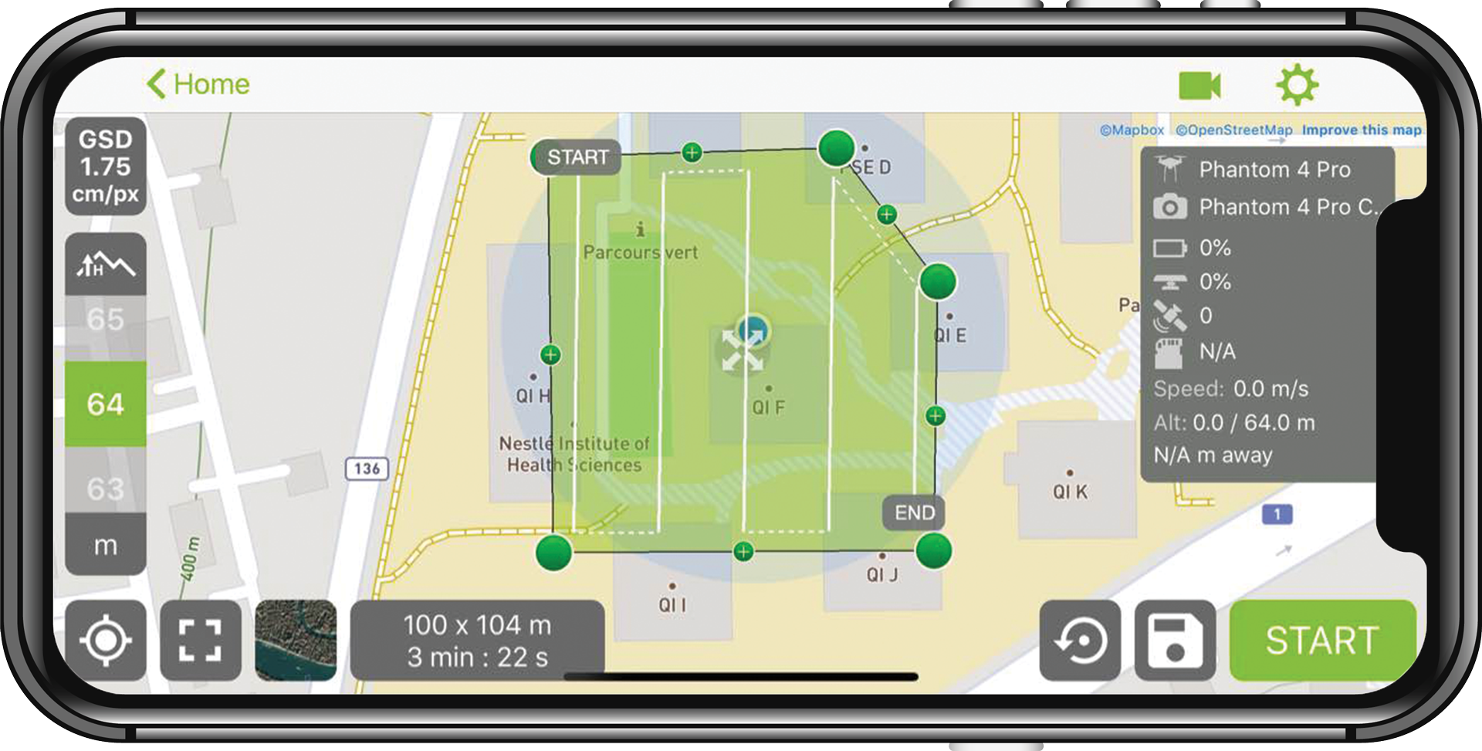
Capture
RGB
Thermal
Multispectral
With any camera or drone
Pix4Dcapture for automated flights
Notes:
If consumer drone, free flight planning app for optimal mapping data.
Or iOS and Android, Select drone > select >mission > adjust flight parameters > start and fly

Slide 7

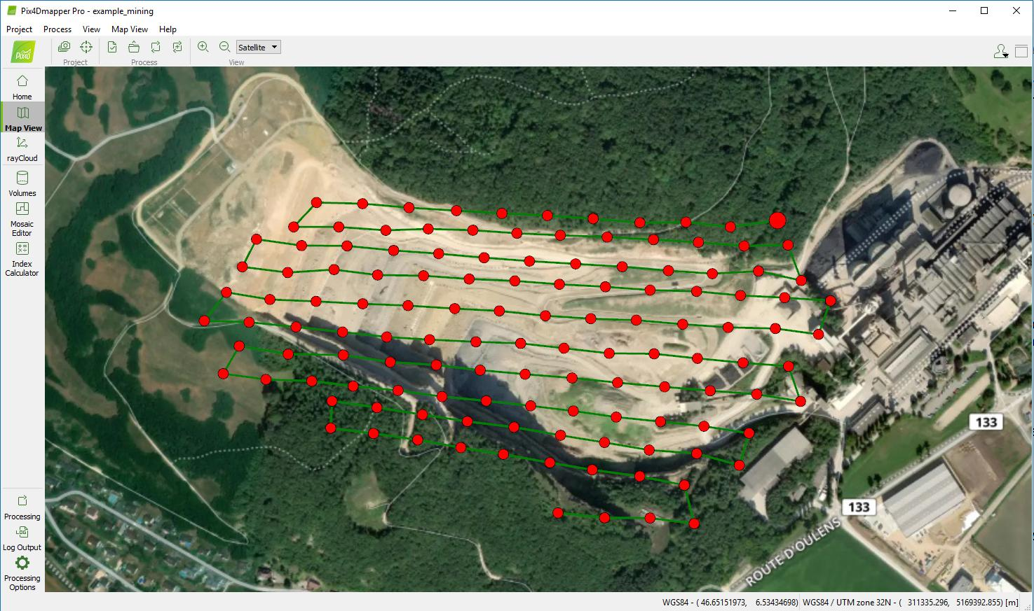

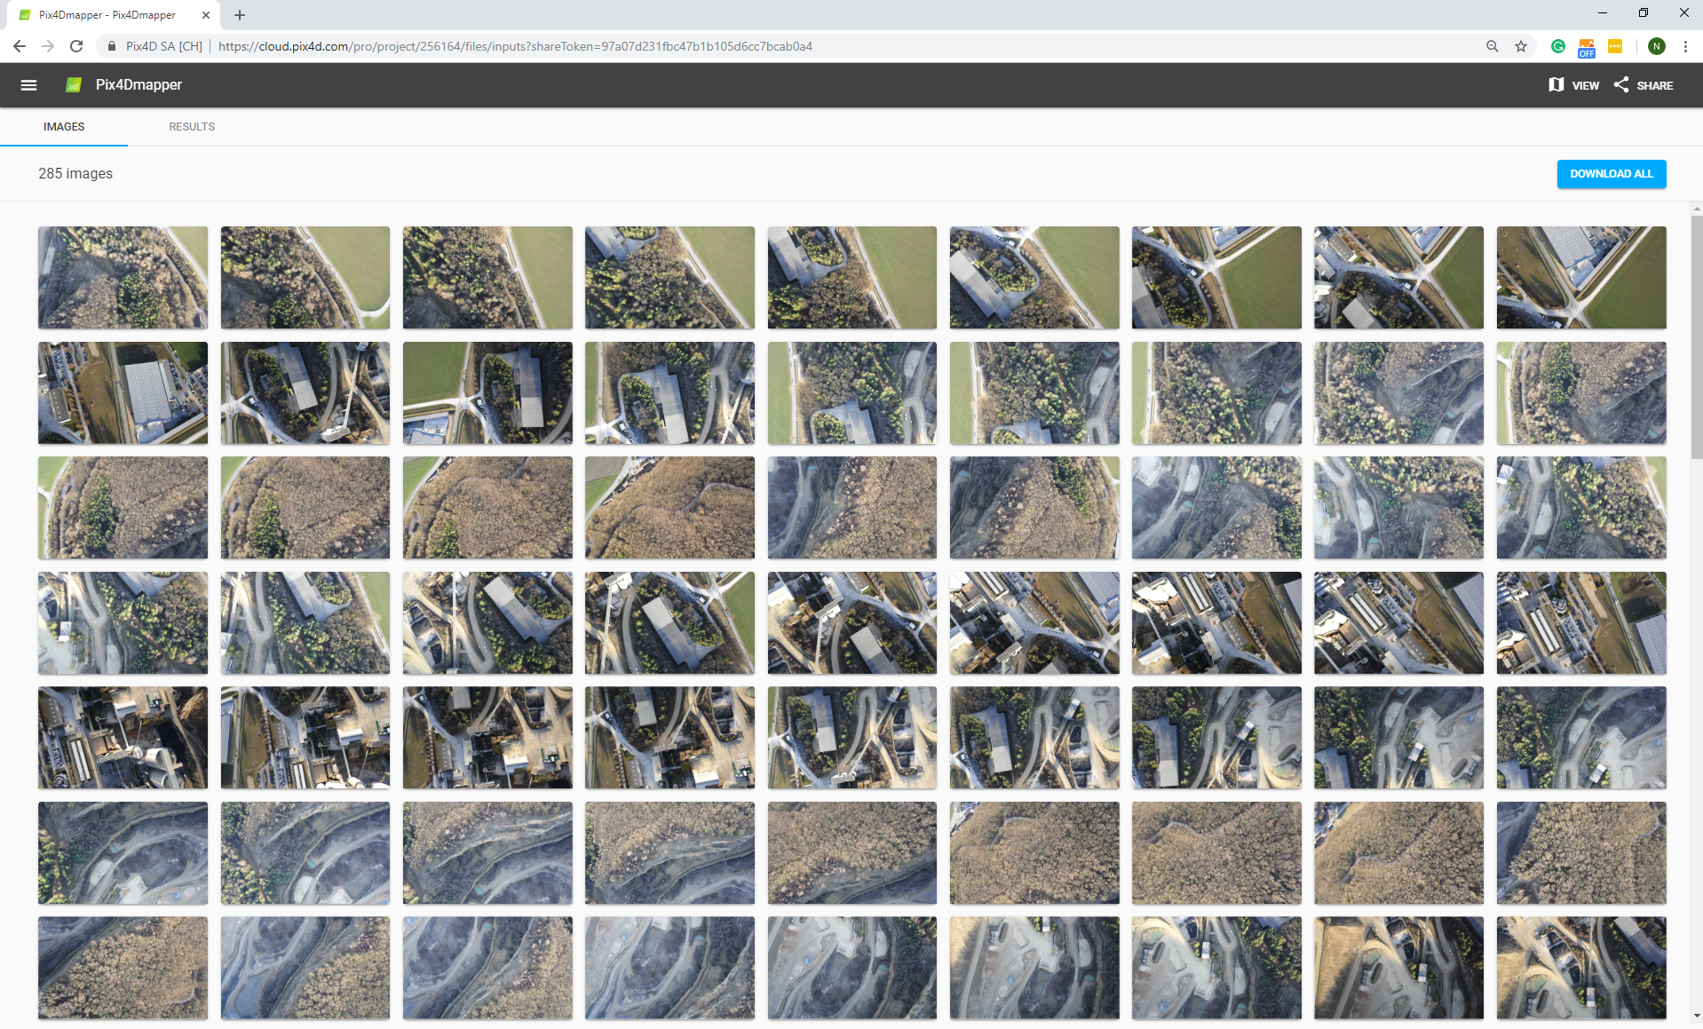
Process
On desktop
On the cloud

Slide 8
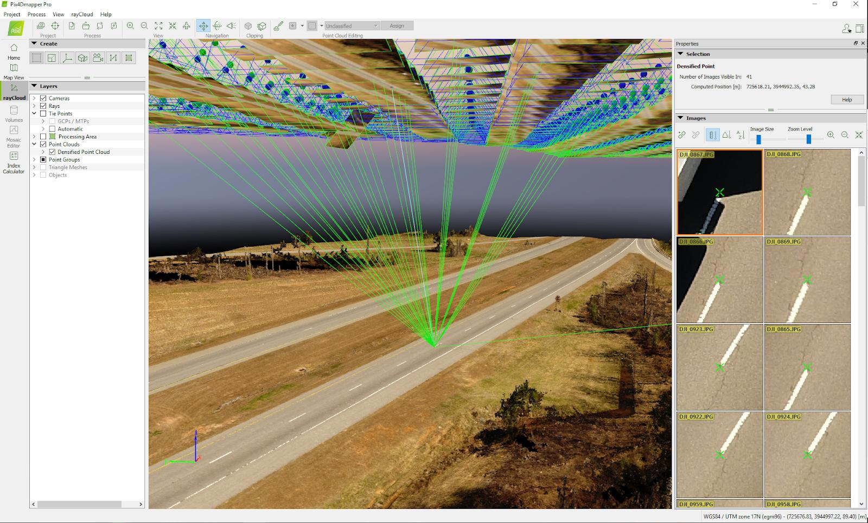
Analyze
Unique rayCloudTM environment connecting your original images to each point of the 3D reconstruction
Notes:
Unique rayCloud view

Slide 9
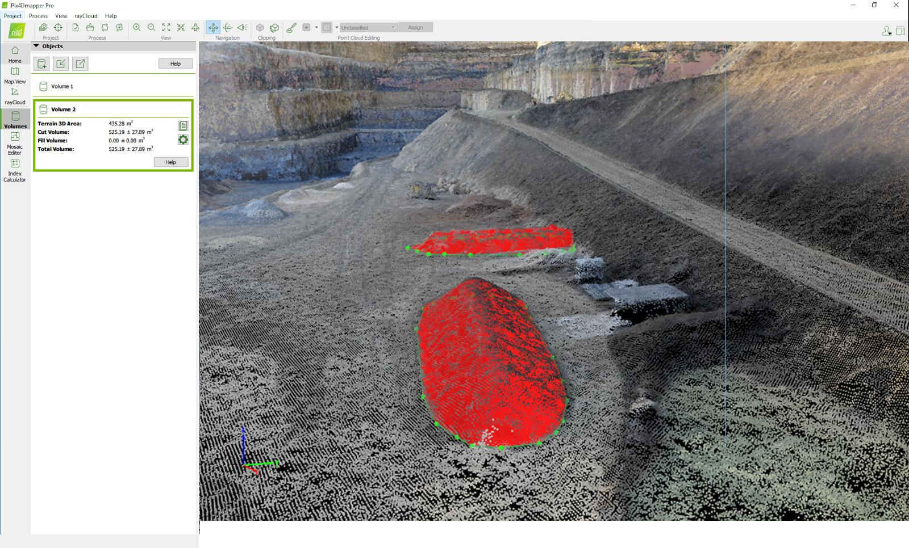
Analyze
Volume calculations

Slide 10
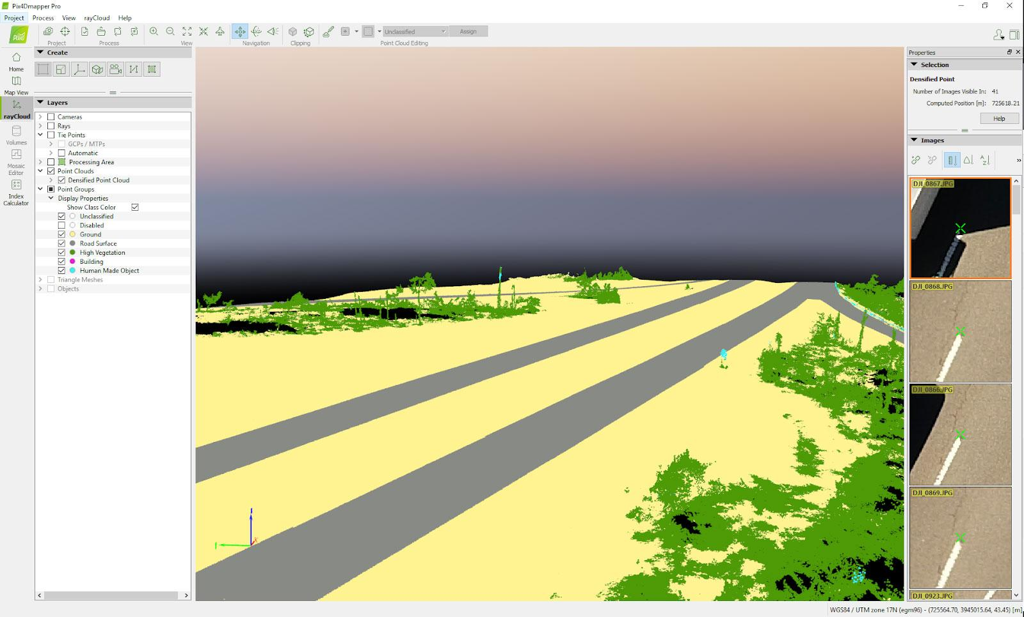
Analyze
Automatic point cloud classification
Notes:
Supervised machine learning algorithms
Automatically classify your dense point cloud
Fastly isolate the data of interest

Slide 11
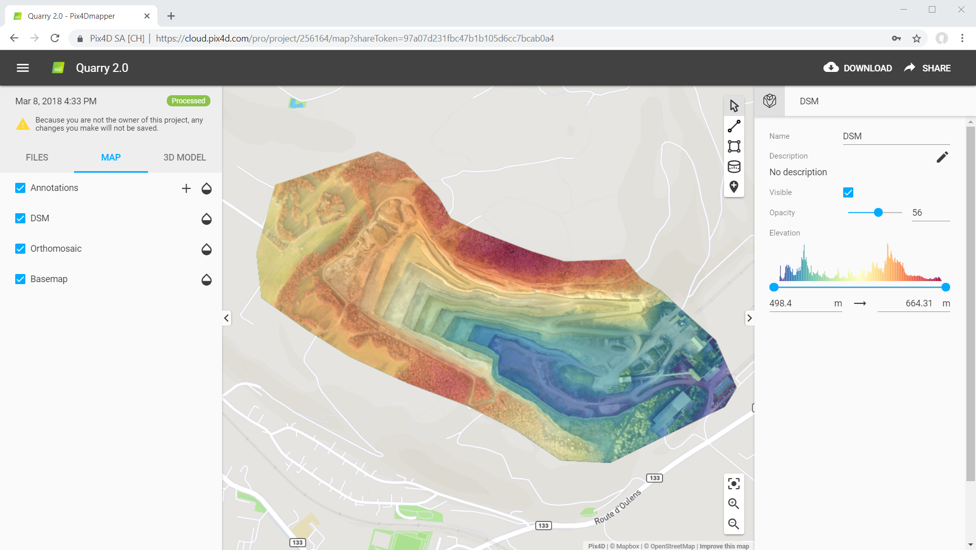
Analyze
DSM on the Cloud

Slide 12
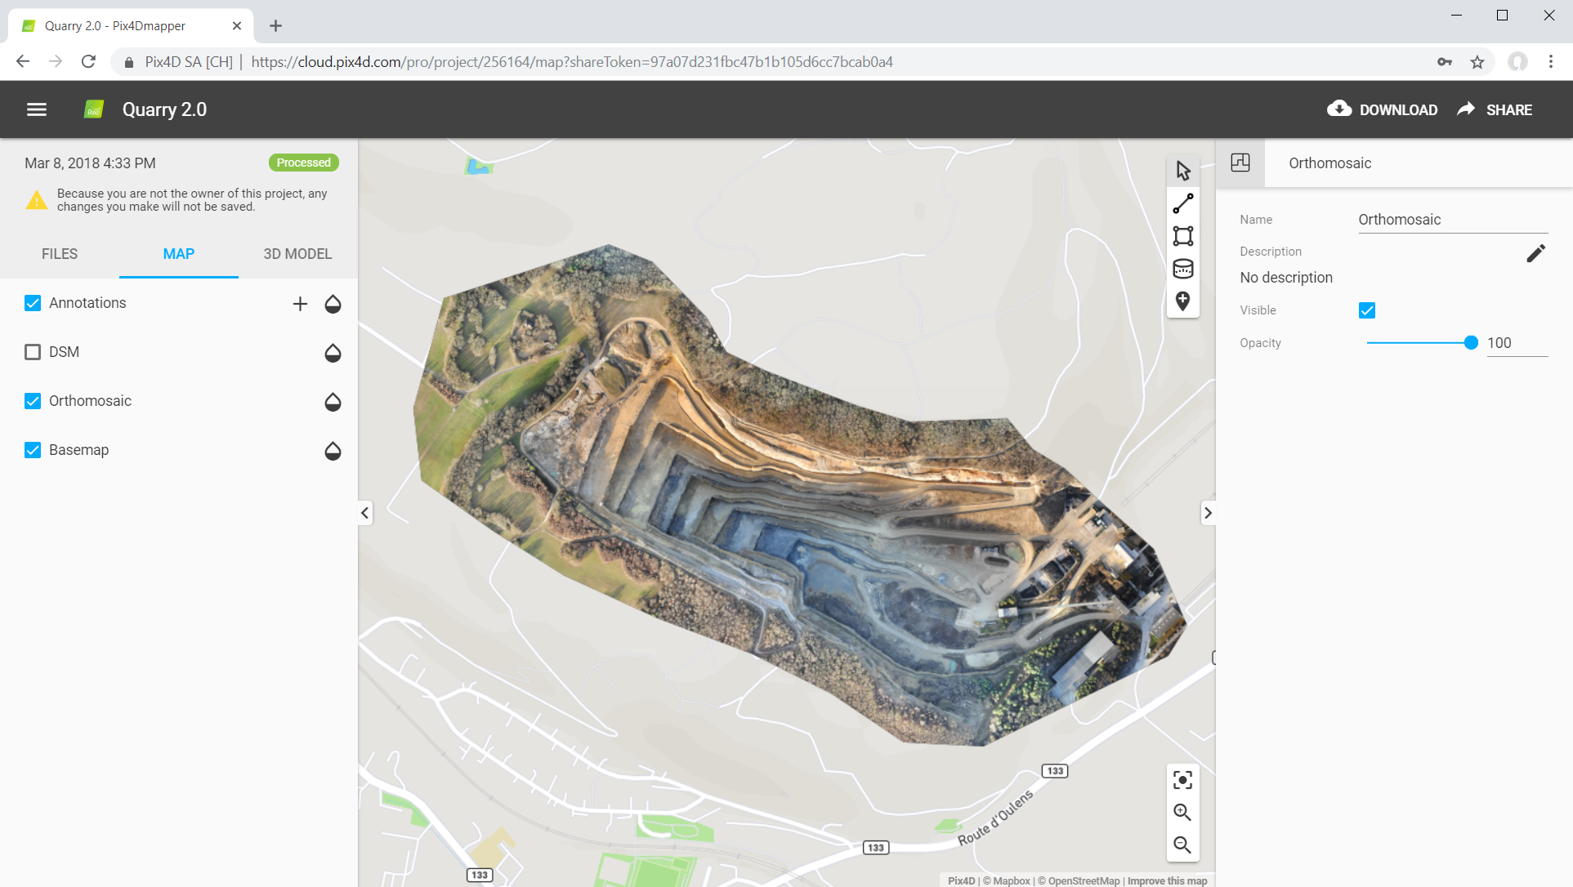
Analyze
Orthomosaic on the Cloud

Slide 13
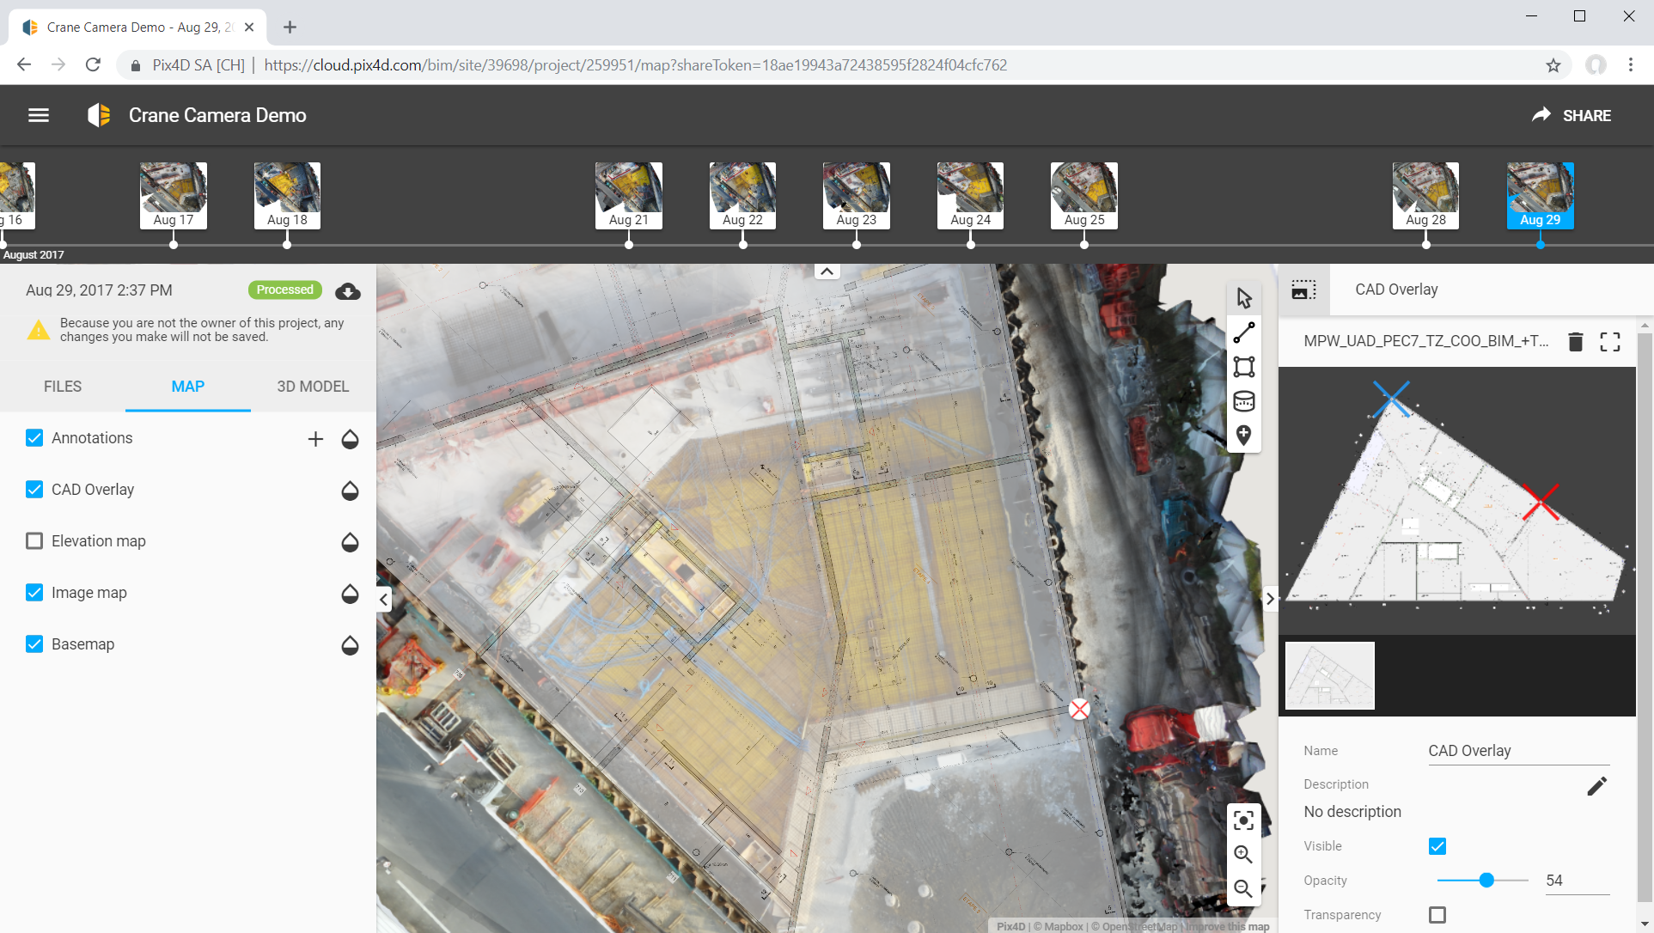
Analyze
Pix4Dbim’s timeline for monitoring changes
Notes:
Compare as-built with as designed
By importing drawings (overlay)

Slide 14
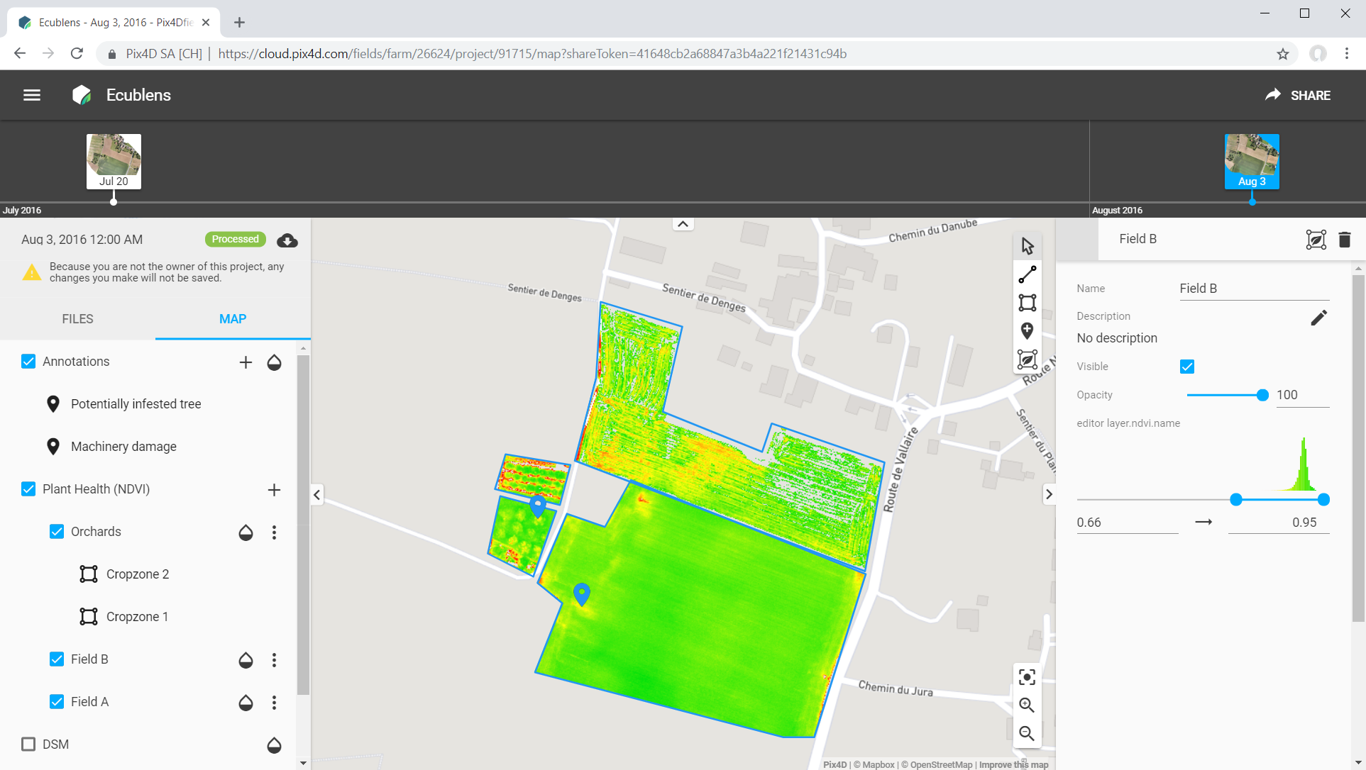
Analyze
Index calculations on the Cloud

Slide 15
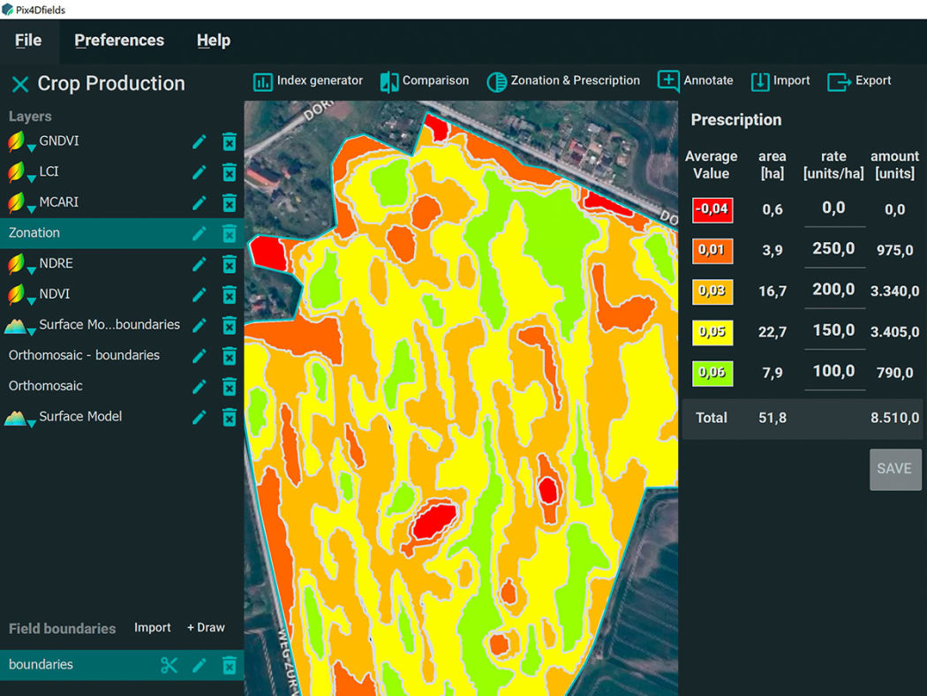
Analyze
Pix4Dfields instant mapping and prescription maps

Slide 16
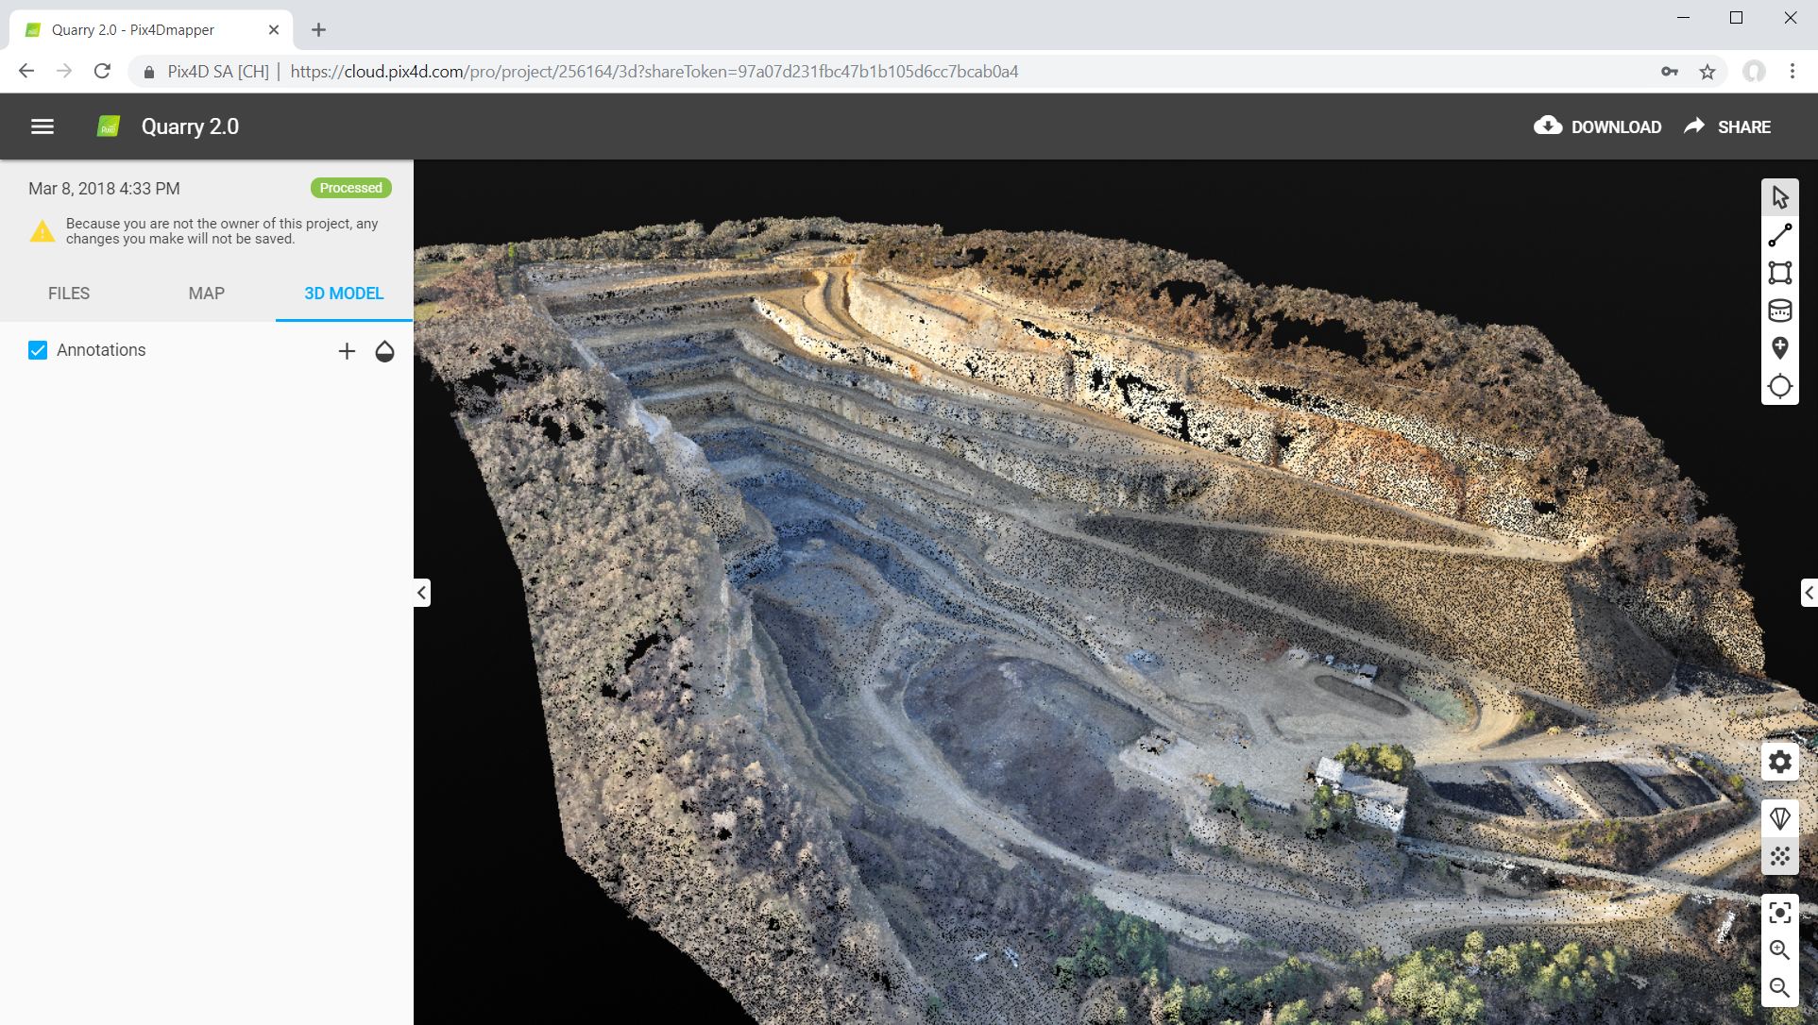
Analyze
Point cloud view online

Slide 17
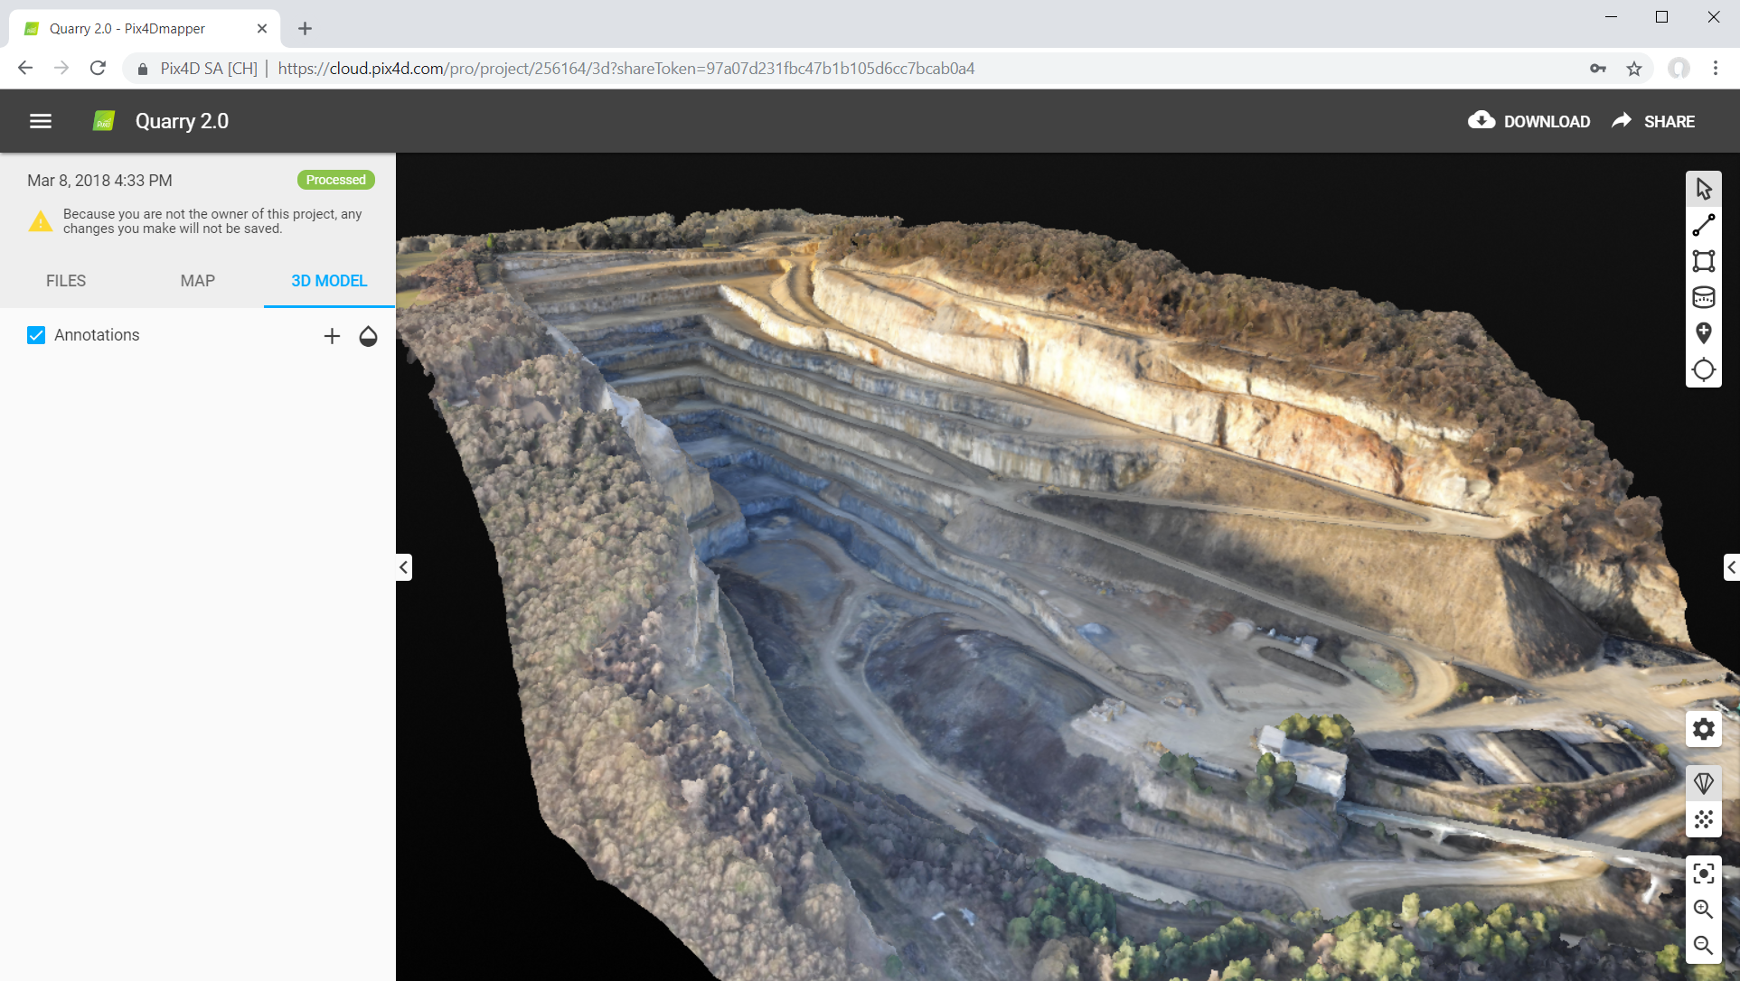
Analyze
Mesh viewer online

Slide 18
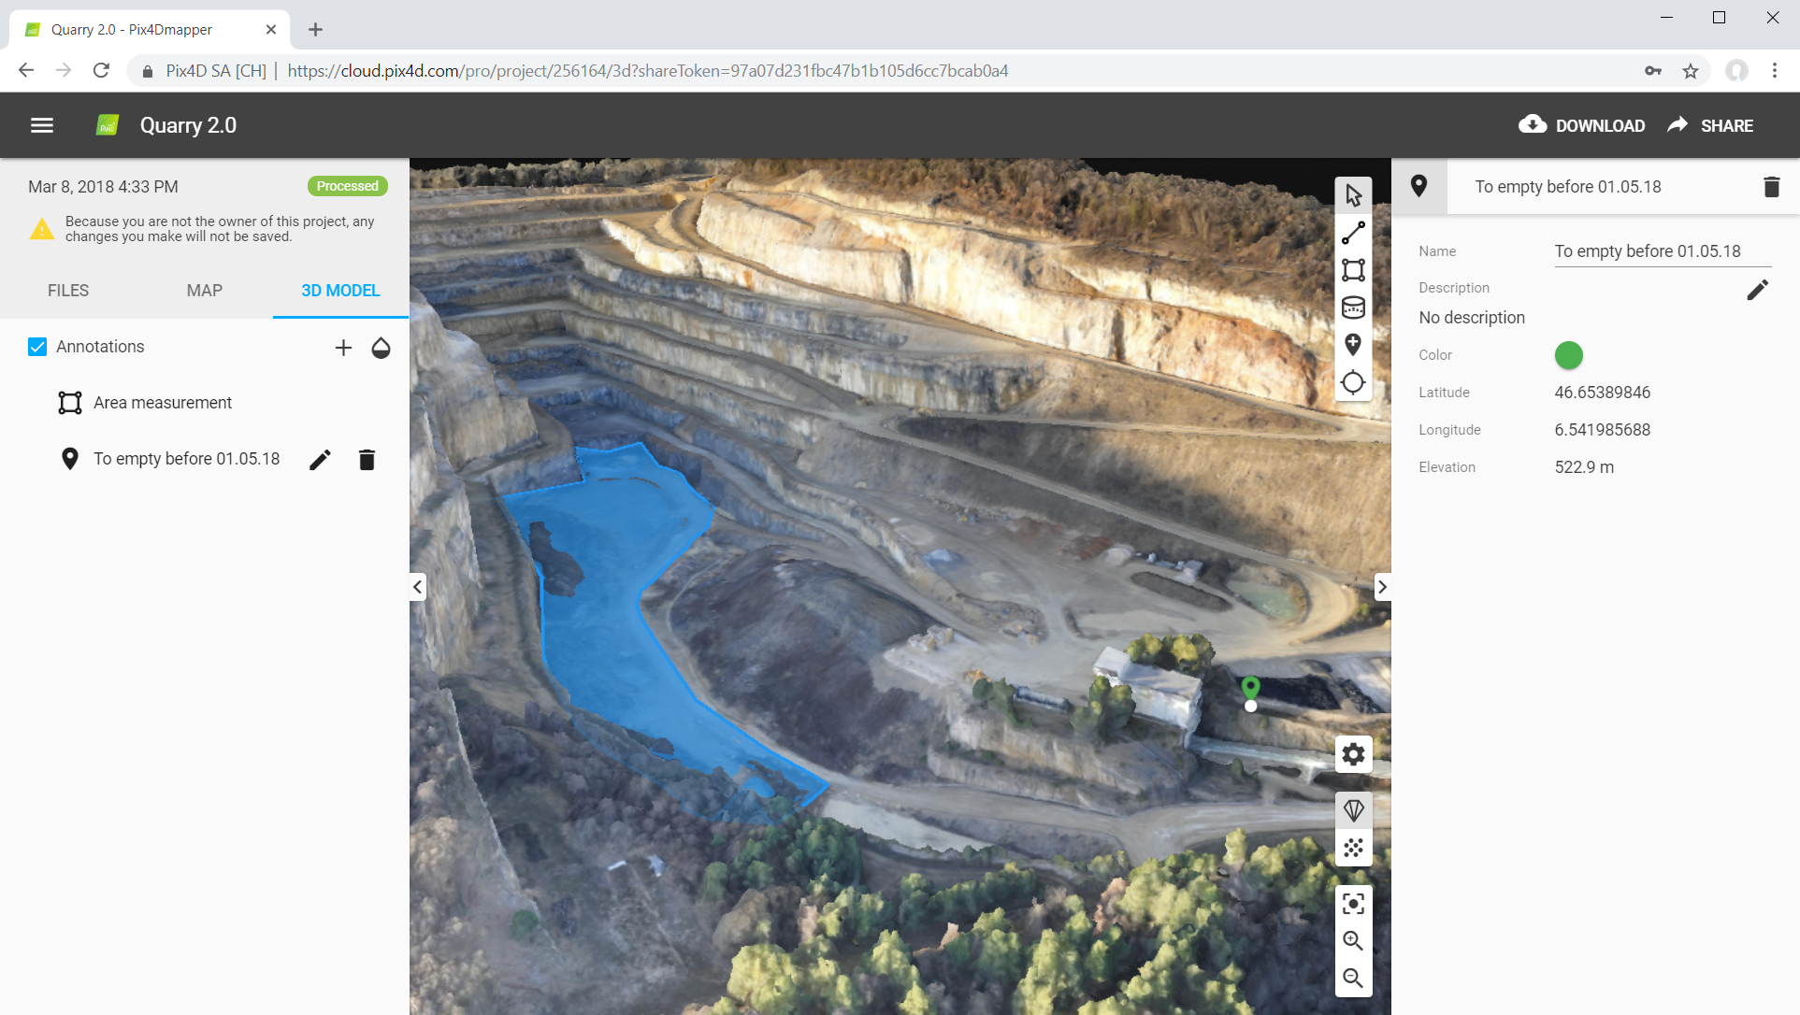
Analyze
Measure surfaces

Slide 19
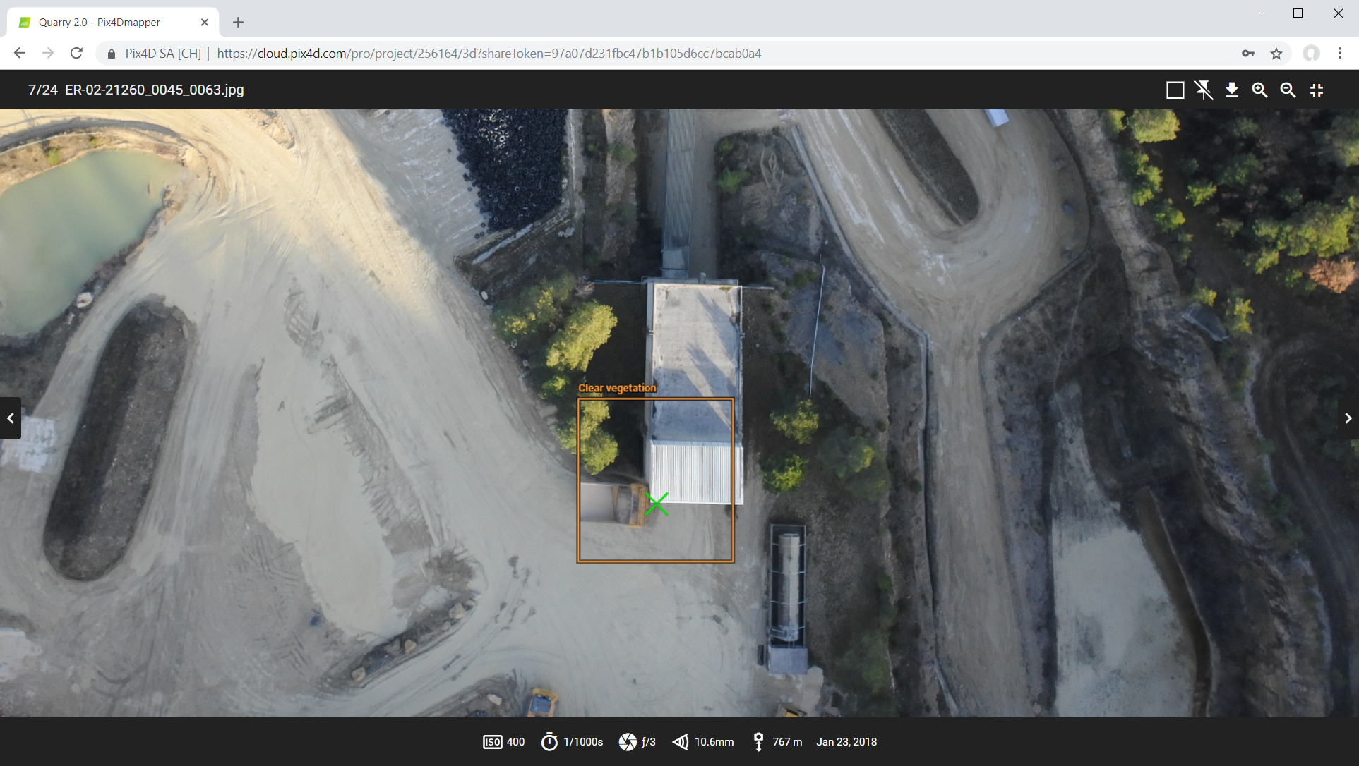
Analyze
Locate and identify the points of interest in the 3D model then inspect all of the images that contribute to the point in the reconstruction

Slide 20
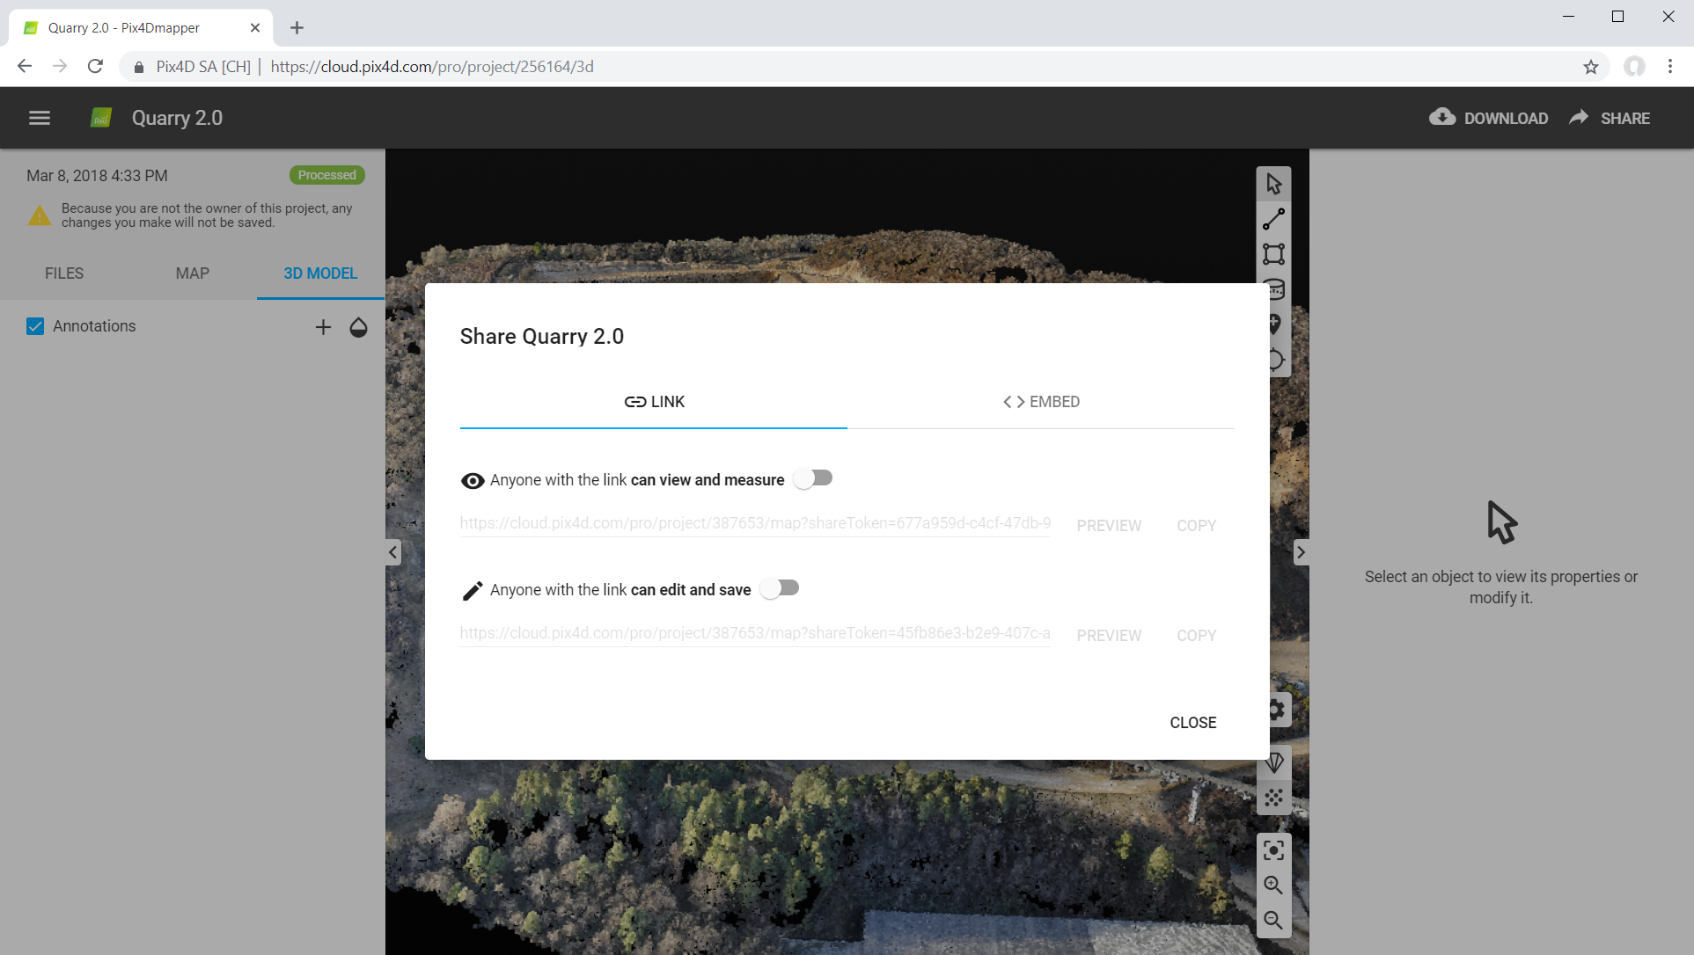
Share
Share your Cloud projects with custom sharing rights

Slide 21

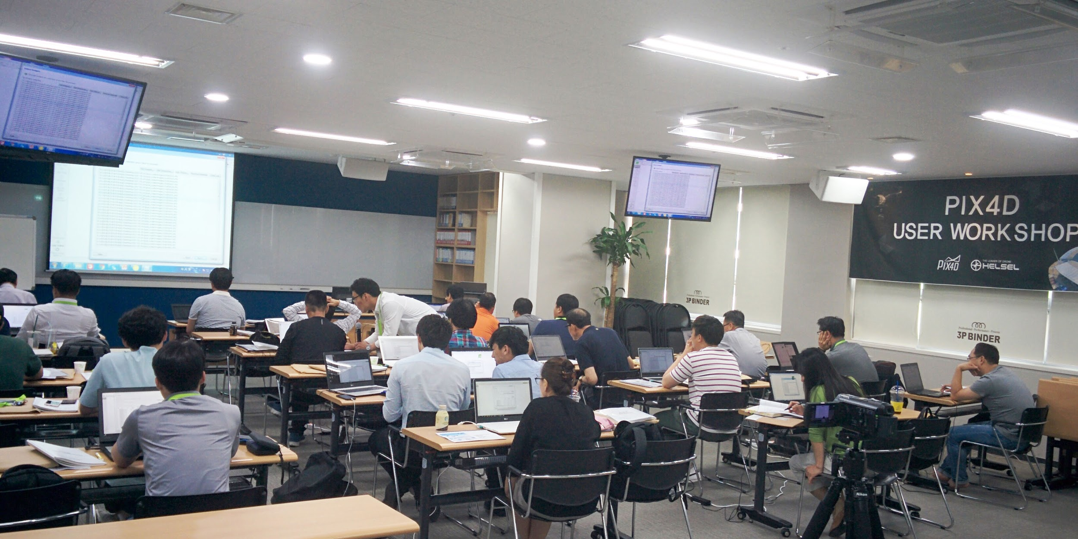
Learn
Pix4D User Workshops
Private trainings
Certification

Slide 22
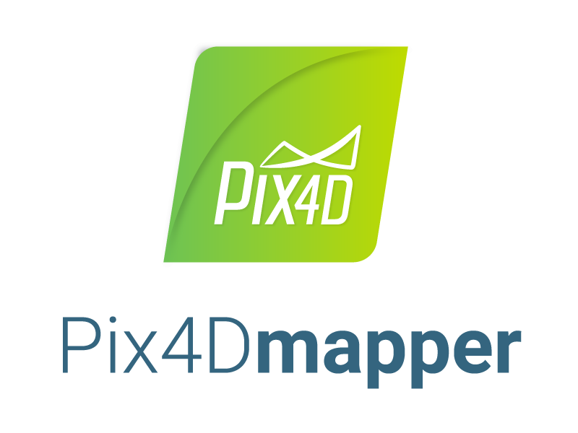
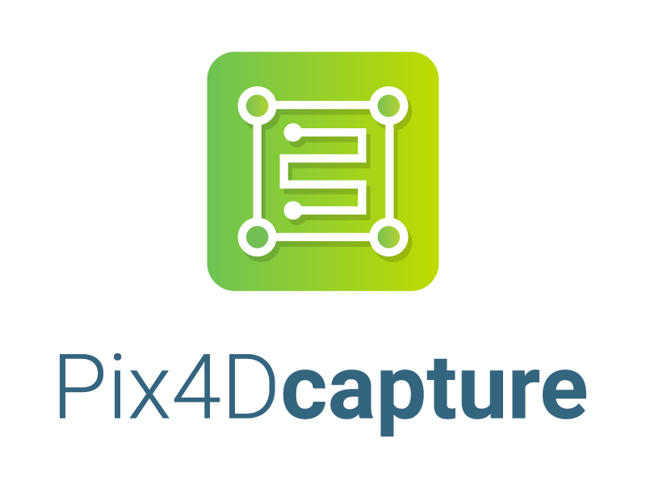




Pix4D products

