Slide 1
BriefCam @ Work in Retail
Solution Overview
November 2018

Slide 2
BriefCam @ Work in Retail
Solution Overview

Slide 3
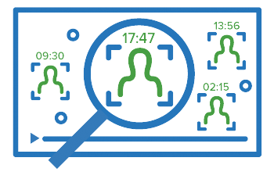
Innovative & Extensible Platform
Transform Video Into Actionable Intelligence
 | Transformation | Benefit | Capability
 | Searchable Enables video investigators to review hours of video in just minutes and rapidly pinpoint people and objects of interest. | Productive | Review hours of video in minutes and pinpoint objects of interest.
 | Quantifiable Tracks people and vehicle movement patterns over time, trending demographic segmentations, identifying hotspots and running A/B tests. | Predictive | Derive quantitative insights for operational efficiency and data driven decision making.
 | Actionable Unlocks the ability to trigger a call to action, bringing relevant events to the forefront and allowing quick review by those individuals who can provide an accurate assessment. | Proactive | Leverage advanced analytics to provide near real-time notifications to effectively balance sensitivity, accuracy and efficiency.
Notes:
SEARCHABLE, QUANTIFIABLE & ACTIONABLE
BriefCam uniquely fuses Computer Vision and Deep Learning technologies making video Searchable, Quantifiable and Actionable.
BriefCam’s high accuracy object detection, classification and recognition enables pinpointing objects of interest like “a child in black, wearing a hat and carrying a backpack, walking south, along the sidewalk”, and it patented Video Synopsis™ technology enables the review of hours of video in just minutes.
This unique combination of advanced analytical capabilities enables breakthrough time to target for video investigators, dramatically increasing their productivity.
BriefCam’s embedded BI platform utilizes the extracted and aggregated video metadata such as; men, women, and children; vehicles; size, color, and speed; path, direction, and dwell time, enabling users to quantitatively analyze their video, derive actionable insights, and visualize them within customizable dashboards.
Finally, BriefCam’s near real-time alerting capabilities, leverages all its advanced search and filter capabilities, effectively balancing sensitivity, accuracy and efficiency, to proactively manage critical events as they unfold.

Slide 4
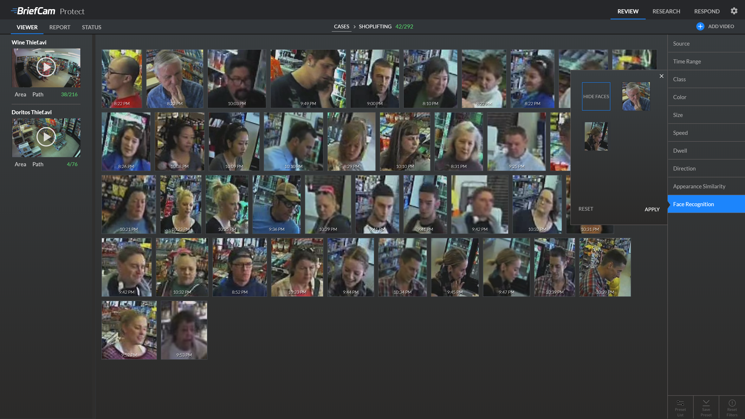
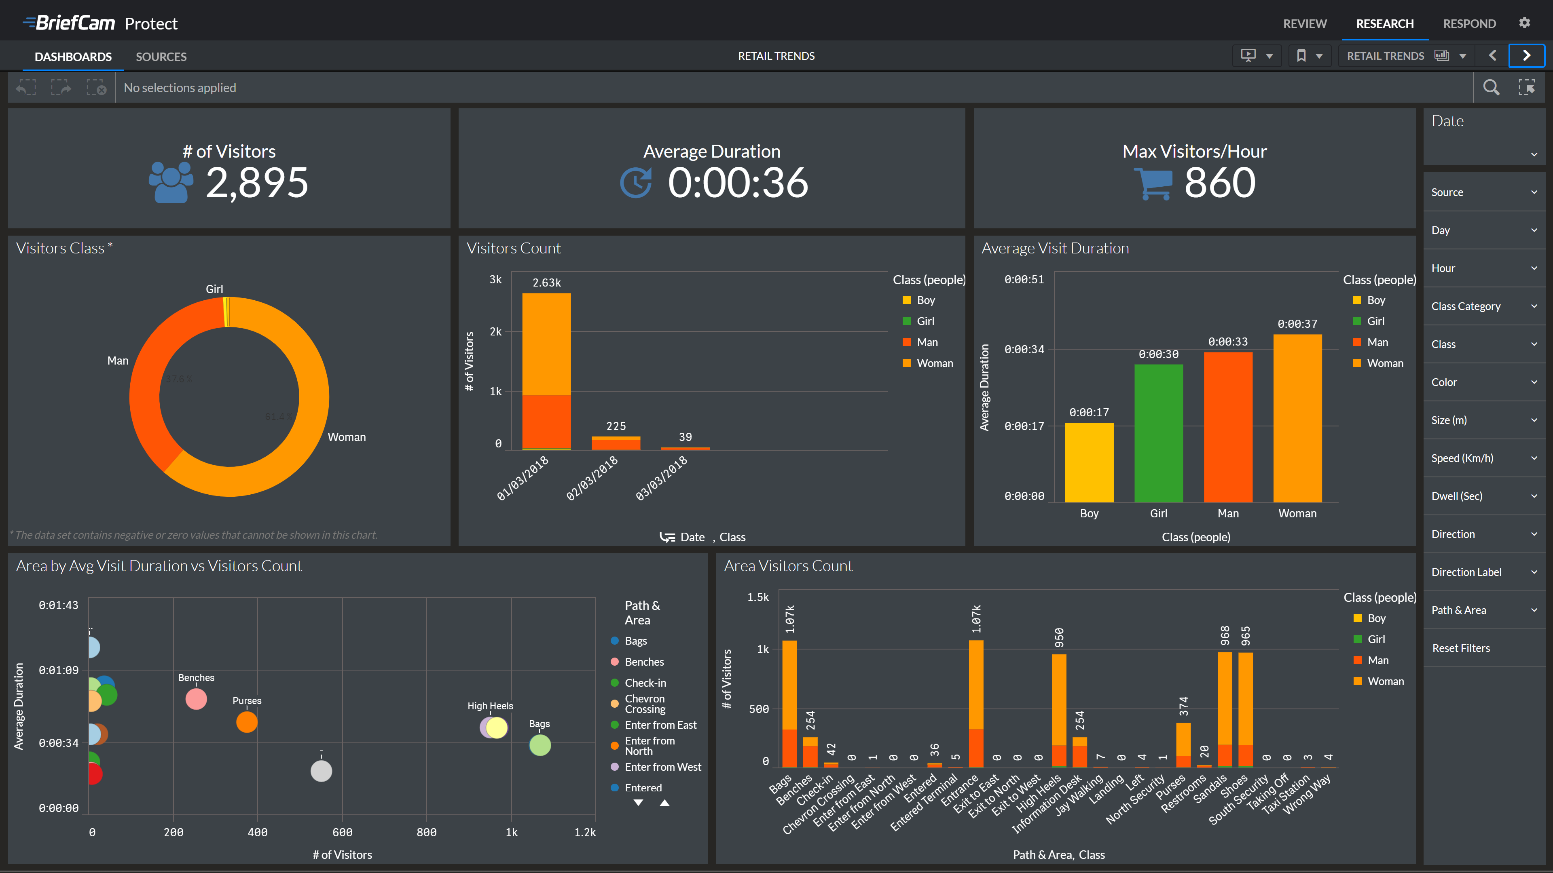
Process-Once-Use-Many
Transform Video Into Actionable Intelligence
Searchable
Quantifiable
Input
Processing
Actionable
Raw
Video
Structured Data
BriefCam’s unique fusion of computer vision and Deep Learning technologies, together with its patented Synopsis® application, drives exponential value from existing surveillance system investments
Notes:
Key Messages:
BriefCam analyzes the entire content of video and creates a structured database of information out of the unstructured video data
Process-Once-Use-Many: Unlike other video analytics solutions, BriefCam unique approach to processing and indexing the entire video content, enables organizations to leverage each of their cameras for a multitude of use cases, e.g. security & safety, operations, and marketing -- all using the existing surveillance ecosystem
BriefCam provides a broad set of applications supporting various user profiles within an organization e.g. search view for investigators, dashboard interface for management, and alerts for live monitoring and response

Slide 5
Detect, Track, Extract, Classify & Catalog
Transform Video Into Actionable Intelligence
Object Tracking
Full Scene Coverage
Rich Metadata
Woman
Bicycle
White
Black
10 mph
South
Notes:
Key Messages:
Every object in the video scene is being detected, tracked, extracted, classified and cataloged into the BriefCam database
BriefCam “understands” the entire scene & its background.
All metadata is stored to support granular searching, comprehensive reporting and smart alerting

Slide 6
BriefCam’s 5 Platform Tenets
Transform Video Into Actionable Intelligence
Comprehensive & Extensible: A robust portfolio of critical video analytics capabilities fully integrated for a “better together” paradigm.
Unmatched Accuracy: Market leading accuracy for detection, classification and recognition across object classes, attributes, behaviors, and faces.
Superior Performance: Effectively supports the requirement for both on-demand and real-time analytics for full camera coverage.
Flexible Architecture: Designed to meet the business needs of today and tomorrow with on premise, cloud, hybrid, centralized and distributed deployment options.
Ease of Use: Quickest time to value and lowest total cost of ownership drives productivity, accelerates time to target and gains the competitive edge.

Slide 7
BriefCam @ Work in Retail
Use Cases & Case Studies

Slide 8
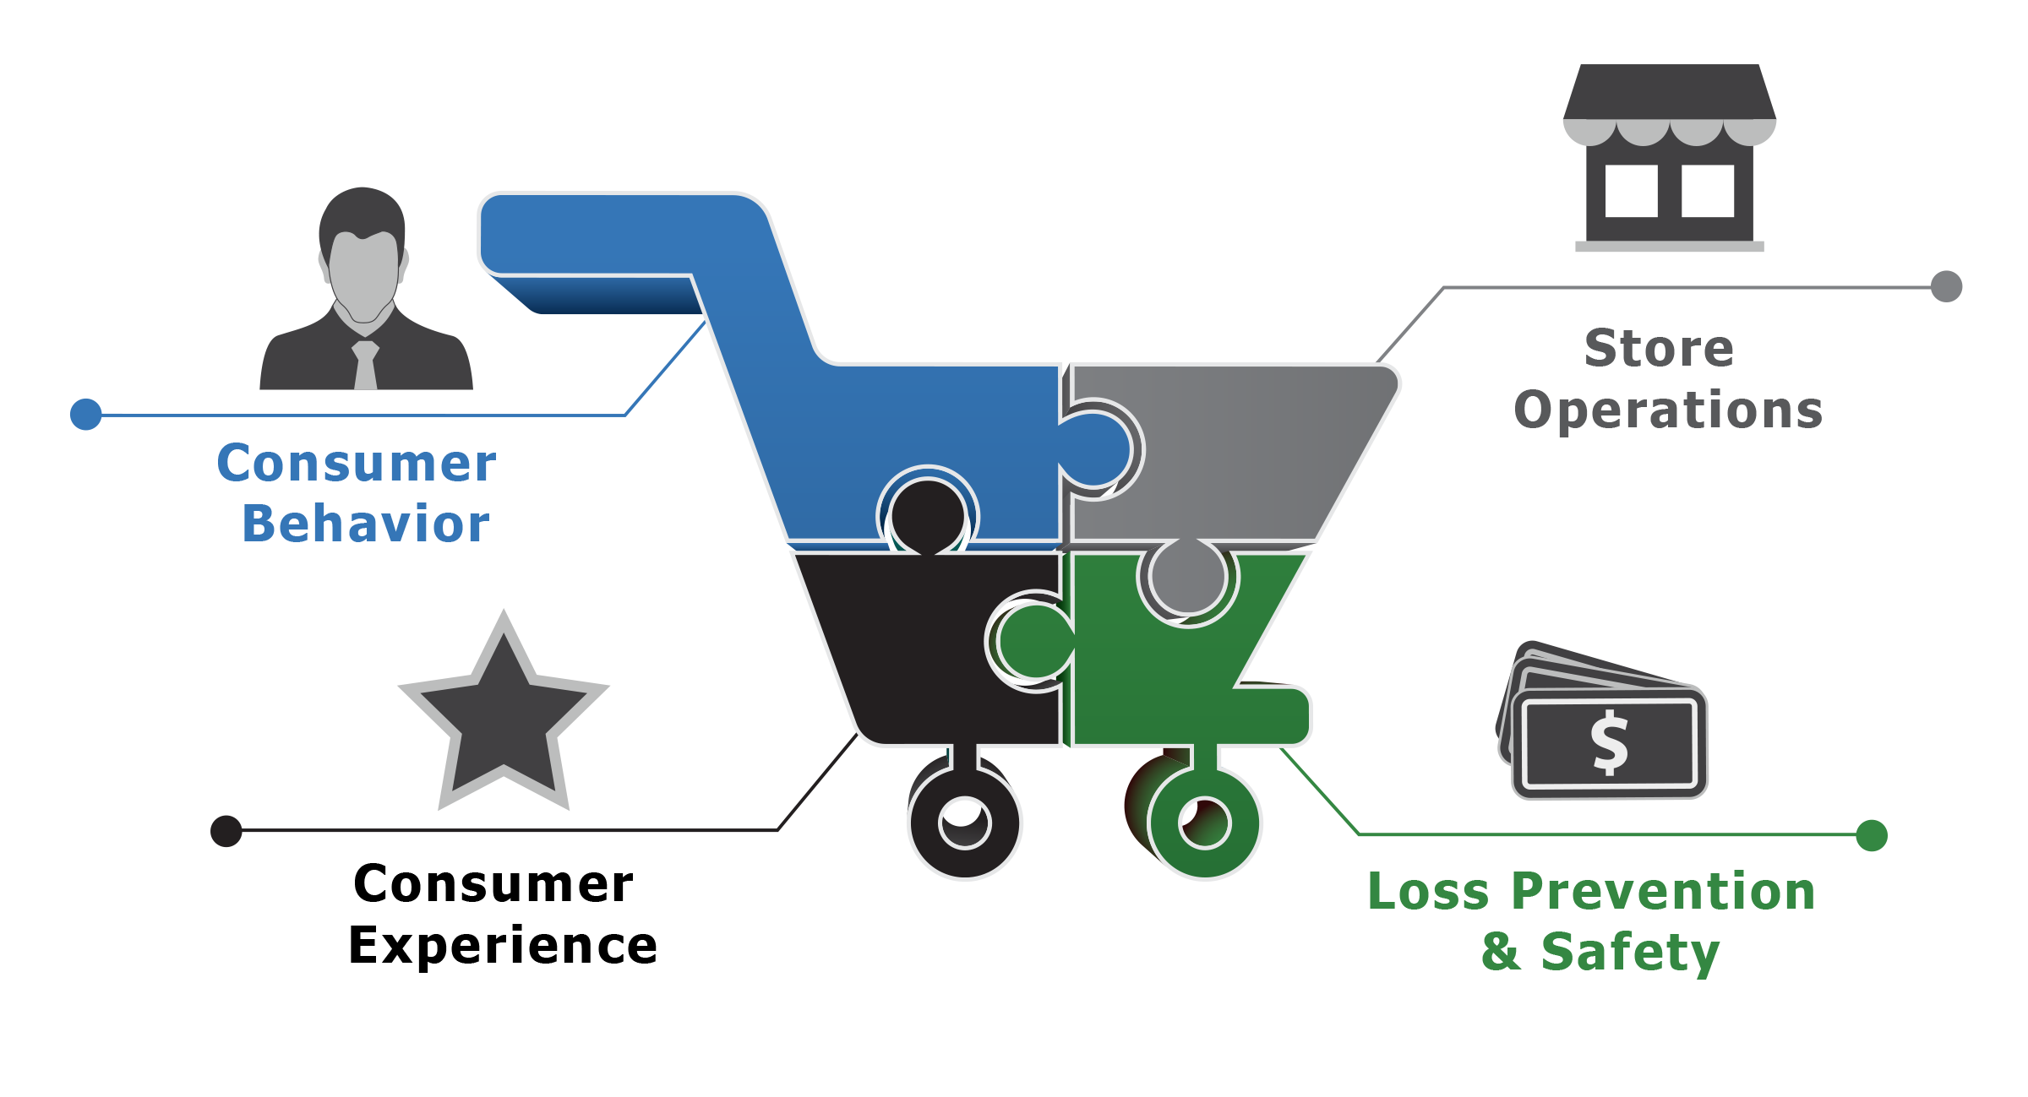
BriefCam @ Work in Retail
Transform Video Into Actionable Intelligence
In-store video analytics introduce a new, critical dimension in delivering actionable insights, enabling strategies that enhance the shopping experience, stimulate shopper retention and increase sales.

Slide 9
Consumer Behavior and Store Operations
BriefCam @ Work in Retail
Consumer Behavior: Correlate campaign effectiveness with shopper engagement and sales, while understanding shopper behavior by demographic and store location.
Consumer Experience: Drive customer loyalty by leveraging real-time identification of VIP Customers to enhance their in-store experience.

Slide 10
Consumer Experience & Loss Prevention
BriefCam @ Work in Retail
Store Operations: Maximize store layout and product placement by identifying strategic high-traffic areas and underutilized spaces, and optimize staff placement.
Loss Prevention & Safety: Rapid review and search of video content facilitates reduction of shrinkage, vandalism and theft, while real-time response to situational threats protects customers and employees.

Slide 11
Leveraging Advanced Technologies
BriefCam @ Work in Retail
Consumer Identification
Demographics
Attributes
Color, Size, Direction & Speed
Similarity Identification
Face Recognition
Consumer Behavior
Hotspots
Dwell Time
Traffic Flow
Object Interactions
Quantitative Analytics
People & Object Counting
Data Aggregation & Trending
Customizable, Real-time Dashboards
Situational Awareness
Real-time Notifications
Watch List Management
Face Recognition
Data Correlation
POS Systems
Time Management
Access Control

Slide 12
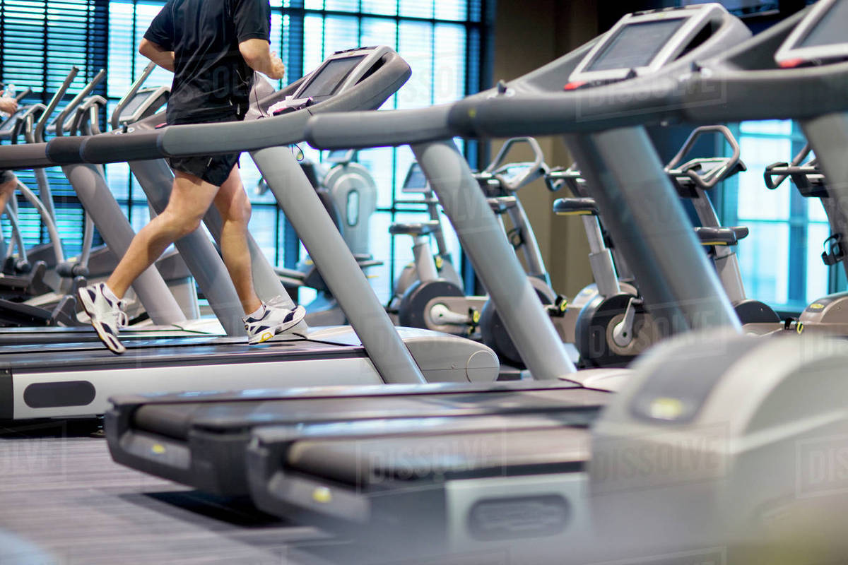
National Health Club Chain
Case Study
Customer Profile
151 Locations
7,000 Cameras
Use Cases
Membership Statistics & Usage Patterns
Utilization of equipment and space by demographic
Gym Floor Layout & Usage
Areas of congregation, navigation paths, and object interactions
Shared Workspace Membership Trial
Shared work space utilization analysis – areas of interest and demographics
Safety & Security of Members
Alert on off-hour entry into pool areas

Slide 13
Fortune 500 Retail Clothing Chain
Case Study
Customer Profile
2,300 Locations in the USA
500 Cameras (today) / 30,000 Cameras (future)
Use Cases
Visitor Traffic Monitoring
Store activity levels, occupancy, demographic patterns
Store Layout and Navigation
Areas of congregation, navigation paths, and object interactions
A/B Testing
Understand behavior around store layout and product presentation
Safety & Security of Employees*
Advanced Alarming on Watchlists

Slide 14
Fortune 500 Coffeehouse Chain
Case Study
Customer Profile
9,000 Locations in the USA
45,000 Cameras in the USA
Use Cases
People Counting & Interactions
Corporate campus population and behavior analysis
Driving Operational Efficiency
Roasting plans and manufacturing
Retail Store Analysis
# of people that walk in and leave ‘hook pattern’
Separating team members from customers

Slide 15
BriefCam @ Work in Retail
Demo & Screenshots

Slide 16
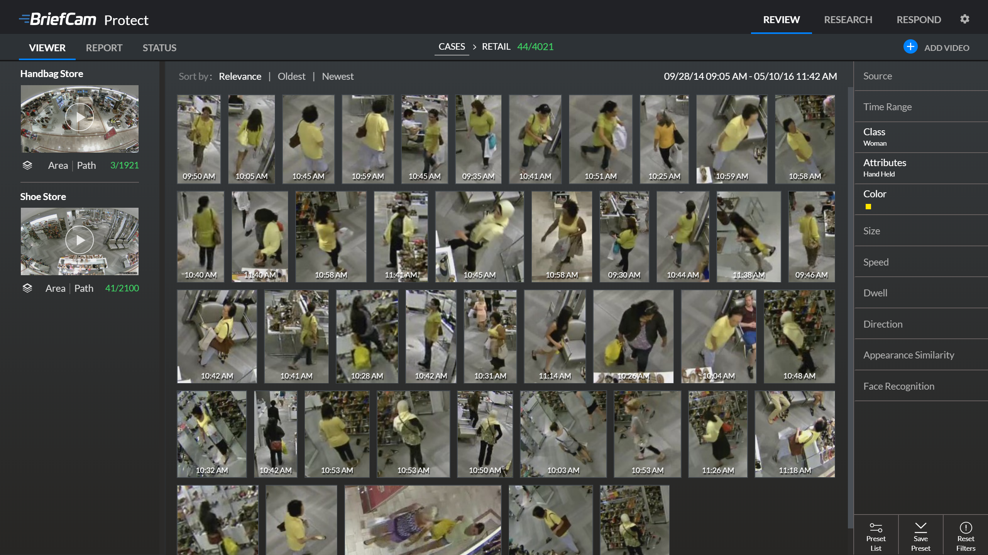

Slide 17
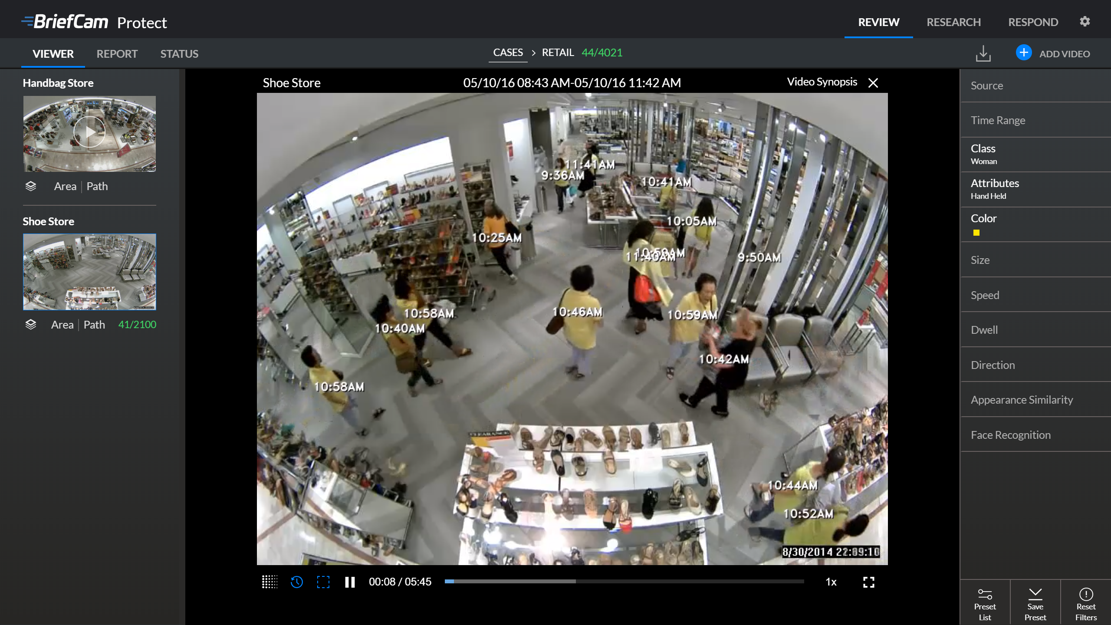

Slide 18
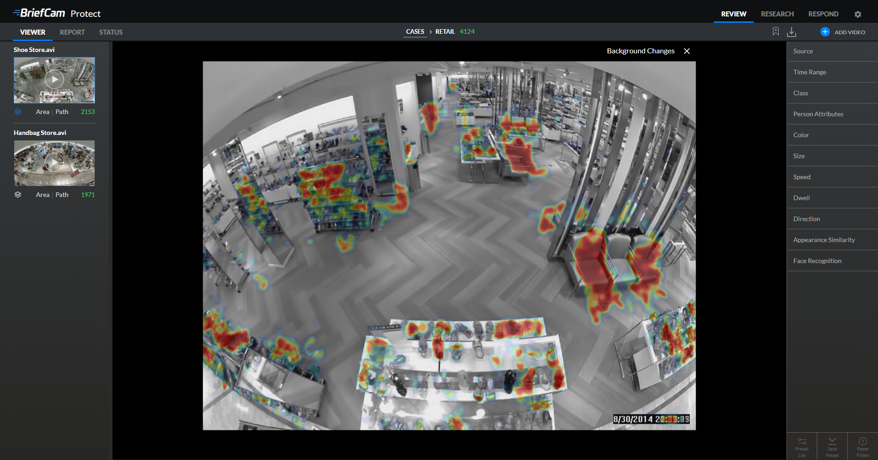

Slide 19
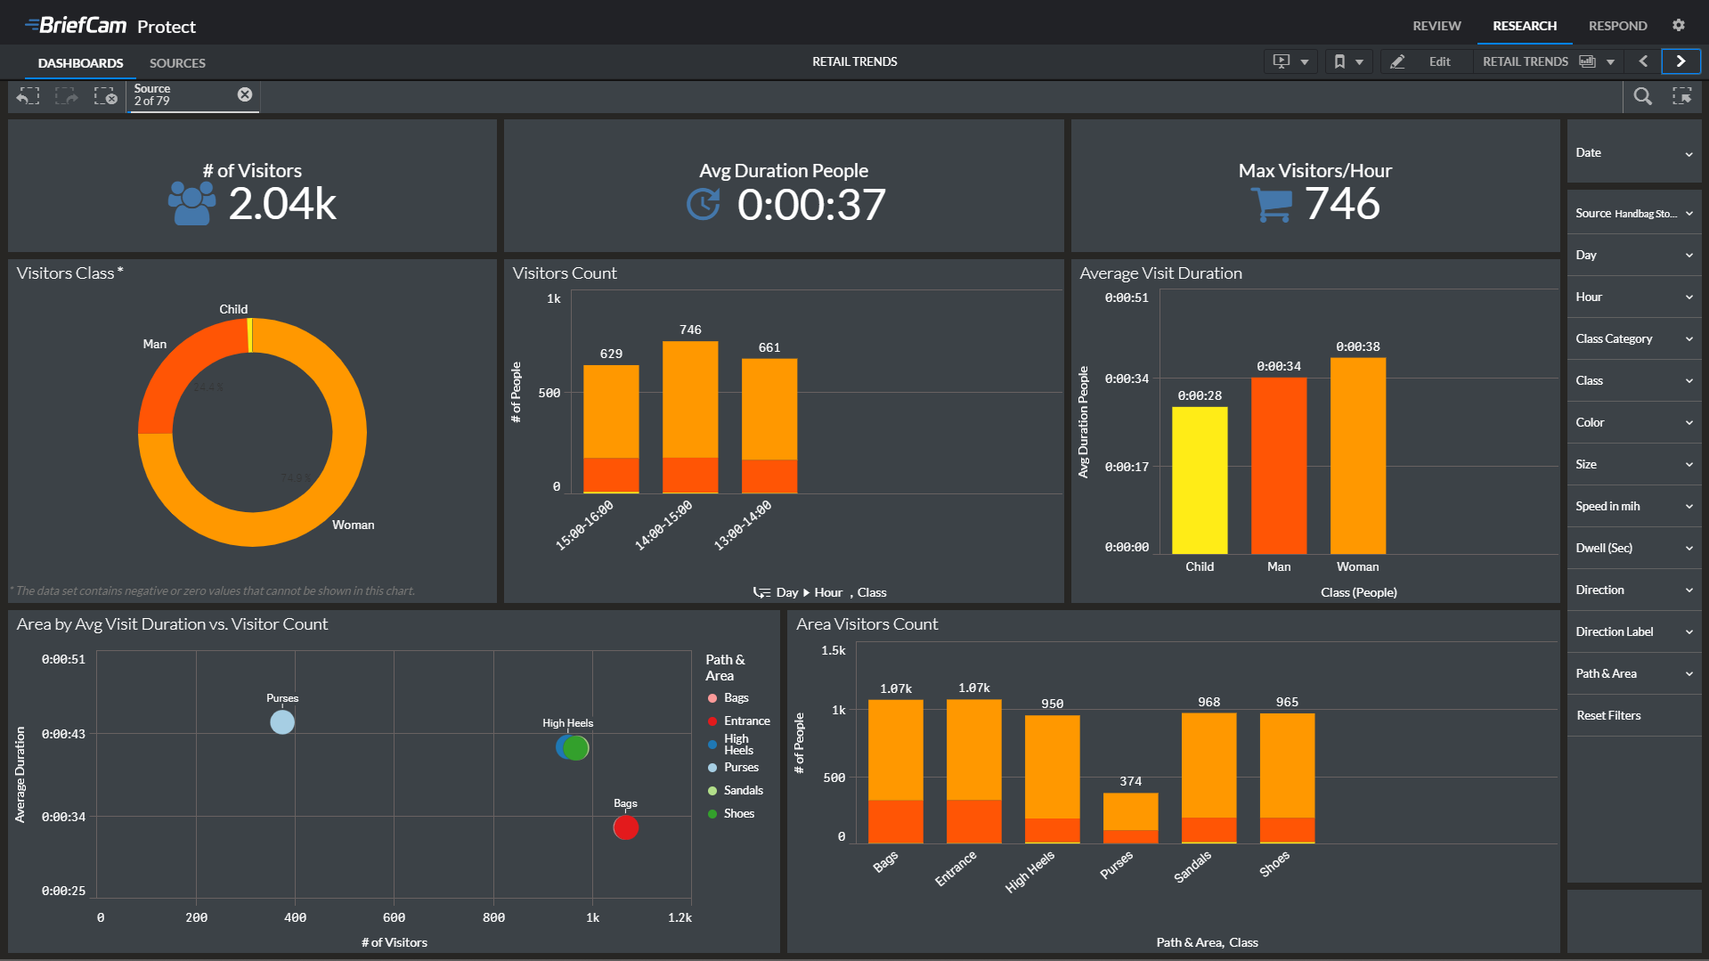

Slide 20
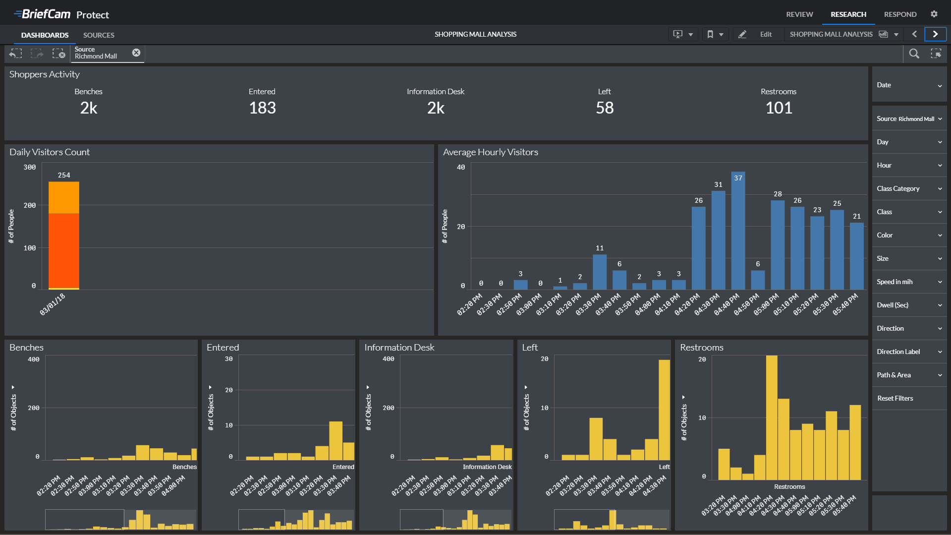

Slide 21
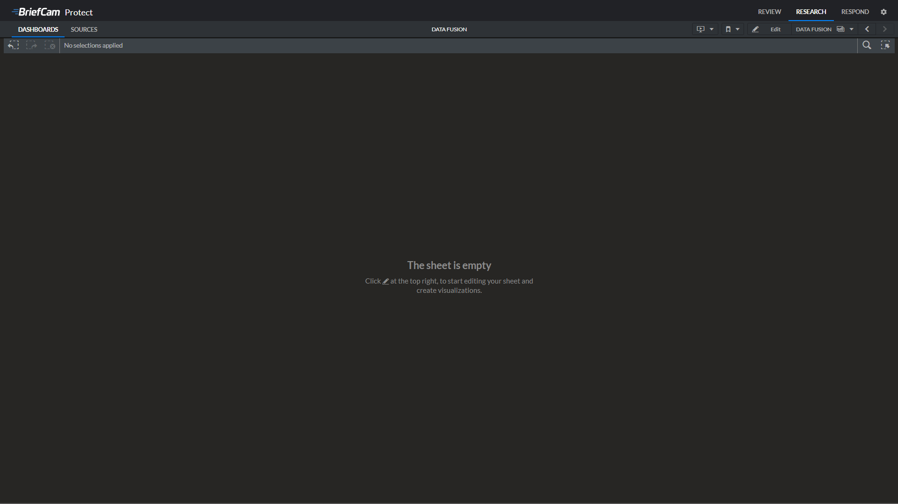
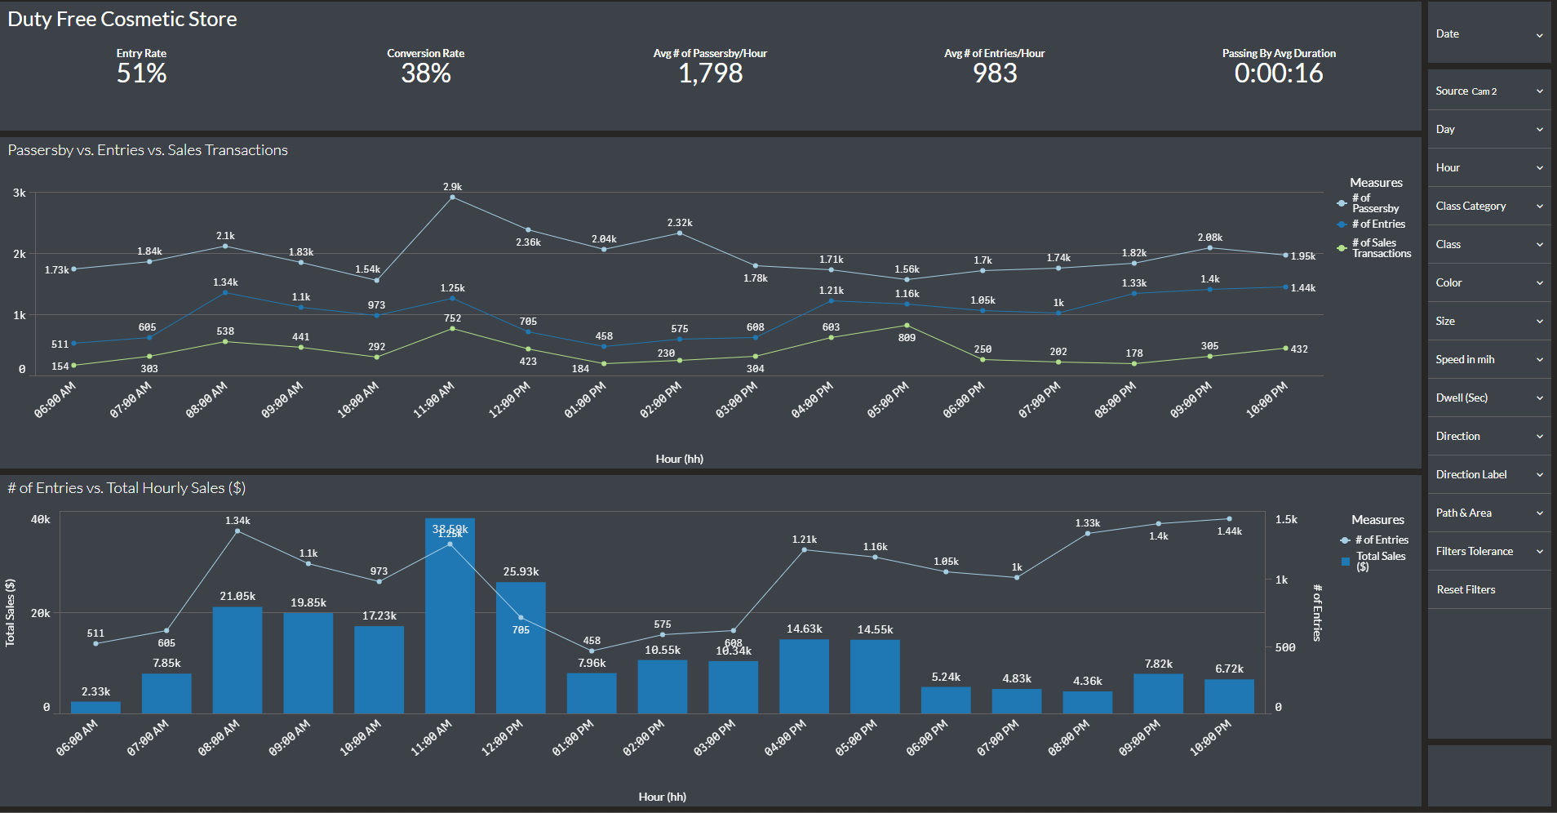

Slide 22
Correlating External Data Sources
BriefCam @ Work in Retail
The previous dashboard shows correlation between surveillance camera and POS data used in a duty free cosmetic store
BriefCam provides the cosmetic store with analysis of the # of people who passed by the store, the # of people who actually entered into the store, and the resulting Entry Rate (i.e.Entry Rate= # of entered /# of passersby)
The POS provides the cosmetic store with the analysis of the Total Sales per Hour and the # of Sales Transactions per hour
By correlating the data between the two data sources the cosmetic store is able to analyze the Conversion Rate (i.e. of sales transaction /# of people) of people who entered into the store
The dashboard shows that there is a correlation between the number of people who pass by the store and enter the store, however the number of sales transaction does not increase accordingly
The retailer now has to work out why that is, i.e. Product Offering, Sales Person, Store Layout, or Pricing, etc.

Slide 23
