Slide 2


Bryan Rose
MFG. Team Lead
513-621-9500 Office
brose@terillium.com
David Moon
Senior Consultant
513-621-9500 Office
dmoon@terillium.com

Slide 3
Work Shop Structure
4 sessions
40 – 10 – 10 breakout
Mix of PowerPoint and demonstrations
Please feel free to ask questions throughout the presentations
We are here to help!

Slide 4
Agenda
Background and Introductions
MRP – Getting Better Results Instead of Noise
Manage Assets Like a Pro!
Keep Your Shop Floor Capacity in Check
Manufacturing Analytics Made Simple
Q & A Following Each Session

Slide 5
We Know JD Edwards.
Implementations
Upgrades
Managed Services
Special Projects
Software Licensing
Cloud Integrations
Hosting
Custom Development

Slide 6
We Know JD Edwards.
15-Time Oracle Excellence Award Winner
170+ full-time employees across the United States
Average of 18 years experience among consultants
Global leader in JDE upgrades
100% managed services customer retention in 2017, 2018 & 2019
700+ customers chose us

Slide 7


Slide 8

TERILLIUM TAVERN
BOOTH #659
Stop by for some:
  Texas Hold Em’
  Terillium “Ale”
  Prizes

Slide 9

Apple Gift Card Drawing
$500 Gift Card
Raffle tickets given for each session you attend (up to 4 tickets per person)

Slide 10
MRP – Getting better results instead of noise
When MRP best practices and setups are utilized, JDE’s MRP is an extremely valuable tool that can help a company’s supply chain tremendously. From making sure long lead time products are available to generating work orders based on monthly demand, JDE MRP tool is the jack of all trades. In this session we will talk about MRP best practices and the key areas that normally cause MRP to fail or be in-accurate. After this session you will have a better understanding of what your MRP environment should/could look like.
Objectives
  Understand key requirements for successful MRP processing
  Increase end user familiarity and comfort levels within MRP
  MRP best practices

Slide 11
Key Requirements of JDE Planning
Data
Data
Data
Good Data
Robust Demand Planning Process
Collaboration
Product Segmentation
  What should be planned?
  How should items be planned?
Message Management

Slide 12
Planning in JDE
DRP
MRP
MPS
DRP – Distribution Requirements Planning
MRP – Material Requirements Planning
MPS – Master Production Scheduling
Project Requirements Planning
Resource Capacity Planning
Single Plant vs. Multiple Plants
Single Level vs. Multiple Levels

Slide 13
Key Concepts of MRP
Orders
Inventory
Forecast
Balancing Supply and Demand
Defining Sources of Demand
  Independent vs Dependent Demand
Defining Sources of Supply
Pegging
Time Fences
Planning Horizon
Notes:
Hold Codes?

Slide 14
Key Data Elements of Planning
BOM
Routing
Item
Plan
Item Data
Bill of Materials
Routing
Work Centers/Work Center Rates
Branch Relationships
Supplier Schedules
Safety Stock

Slide 15
Fields that Impact Planning
Stocking Type
Planner Number
Buyer Number
Supplier
Lot Process Type
Master Planning Family
Category Code
Unit of Measure
Order Policy Code
Value Order Policy
Planning Code
Planning Time Fence
Freeze Fence
Message Display Fence
Time Basis
Shrink Factor
Lead-times
Reorder Quantities

Slide 16
BOM Explosion – Multi Level

Slide 17
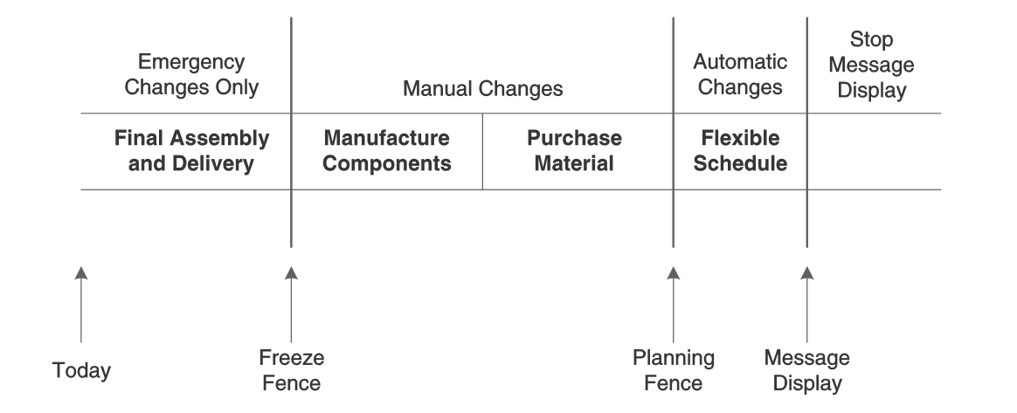
Planning Fences

Slide 18
Understanding Planning Messages
A Warning Messages
B Order and Expedite
C Cancel
D Defer
E Expedite
F Frozen Order
G Increase Order Quantity to
H Decrease Rate Quantity to
I Increase Rate Quantity to
L Decrease Order Quantity to
M Manual Reminder
N Create Rate
O Order
P Firm Order
S FPO Adjustment Suggestion
T Past Due Order
W Warning, Create Related PO

Slide 19
Data Structure
Planning Family
Planner
Item 1
Item2
Item 3
Master Planning Family
Planner Number
Buyer Number
Supplier Number

Slide 20
MRP Best Practices
Understand the results
How often should I run planning
  Planning vs. Exception Management
Understanding Company Metrics (KPI’s)
  Conflicting Goals
Alerts and Notifications
Improved Performance
  Planning Configuration
  Parallel Processing
Utilize the new tools provided by Oracle
Good inventory Management Practices
  Cycle Counting
#1 in Customer Satisfaction

Slide 21
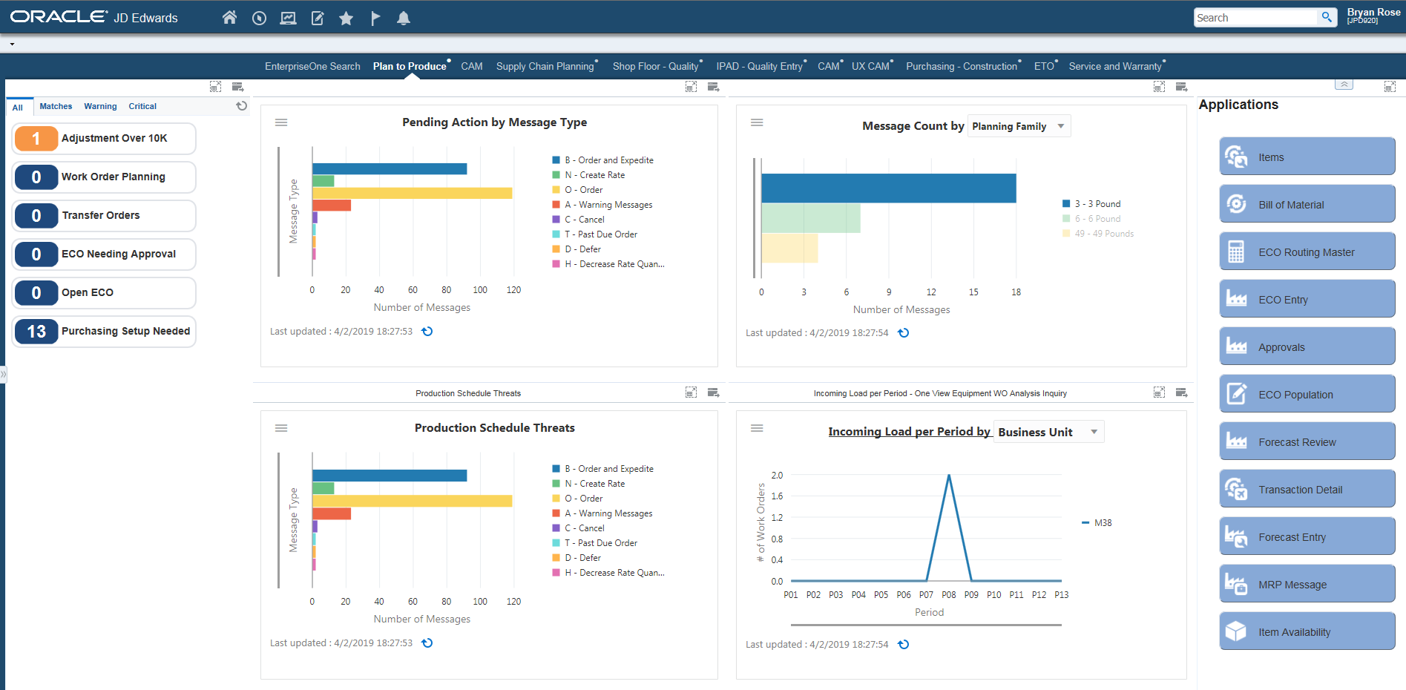
UX One Planning Page

Slide 22
Advanced Planning Solutions
ASCP – Advanced Supply Chain Planning
Demantra – Advanced Forecasting
PS - Production Scheduling

Slide 23
Manage Assets Like a Pro! - Agenda
High Level Overview Of Asset Management
  Equipment / Asset Master
  PM Schedules
  Meter Readings
Orchestrator Overview
Q & A

Slide 24
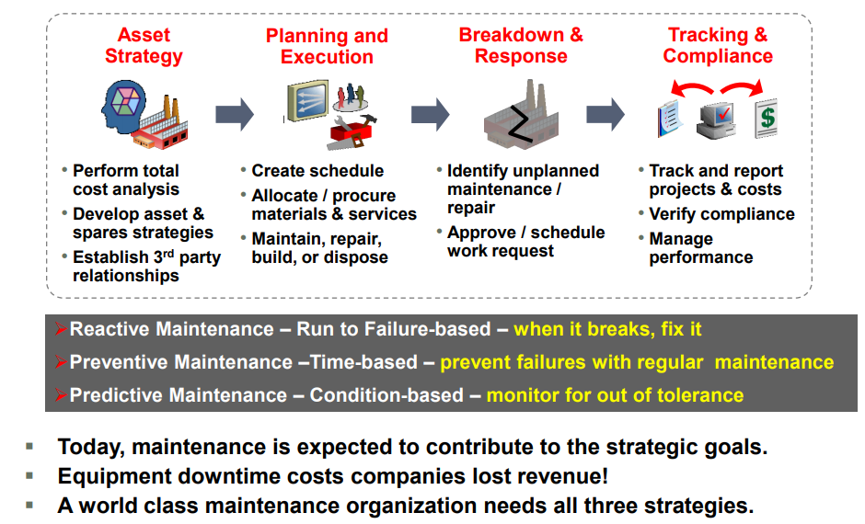
Asset Management Strategies

Slide 25
Asset Management Blocks
Equipment Master
PM Schedules
Meter Readings
Maintenance Work Orders

Slide 26
Equipment / Asset Master
What is the Equipment Master?
  The “Item Master” for Equipment
  Holds all basic information about a piece of equipment:
    ID Numbers
    Category Codes
    Dates
    Location
    Status
    Etc.

Slide 27
PM Schedules
What is a PM Schedule
PM schedules are the foundation of the preventive maintenance program. PM schedules determine the types of service and the frequency of each service type for each piece of equipment that you maintain.
This includes:
  Rules : Maintenance rules determine when the system schedules preventive maintenance tasks
  Routes : Create a maintenance route when you need to perform identical routine maintenance tasks, such as equipment inspections, on multiple pieces of equipment
  Associations: For each piece of equipment that you maintain, you can link several related service types to a primary service type

Slide 28
Meter Readings
What are Meter Readings?
Meter reading programs enable you to enter or update meter information about the equipment. You use meter readings to monitor equipment use and initiate maintenance tasks that are based on accumulated statistical units such as miles.
Track up to 6 individual meter types
  Hours
  Miles
  Fuel Level
  Etc.

Slide 29
PM Schedules / Meter Readings
Why do most PM Schedule implementations fail?
DATA!!!
  No time to capture
  Manually capturing opens the process up for mistakes
  Using a disconnected 3rd party software to capture data

Slide 30

There Must Be a Better Way!

Slide 31
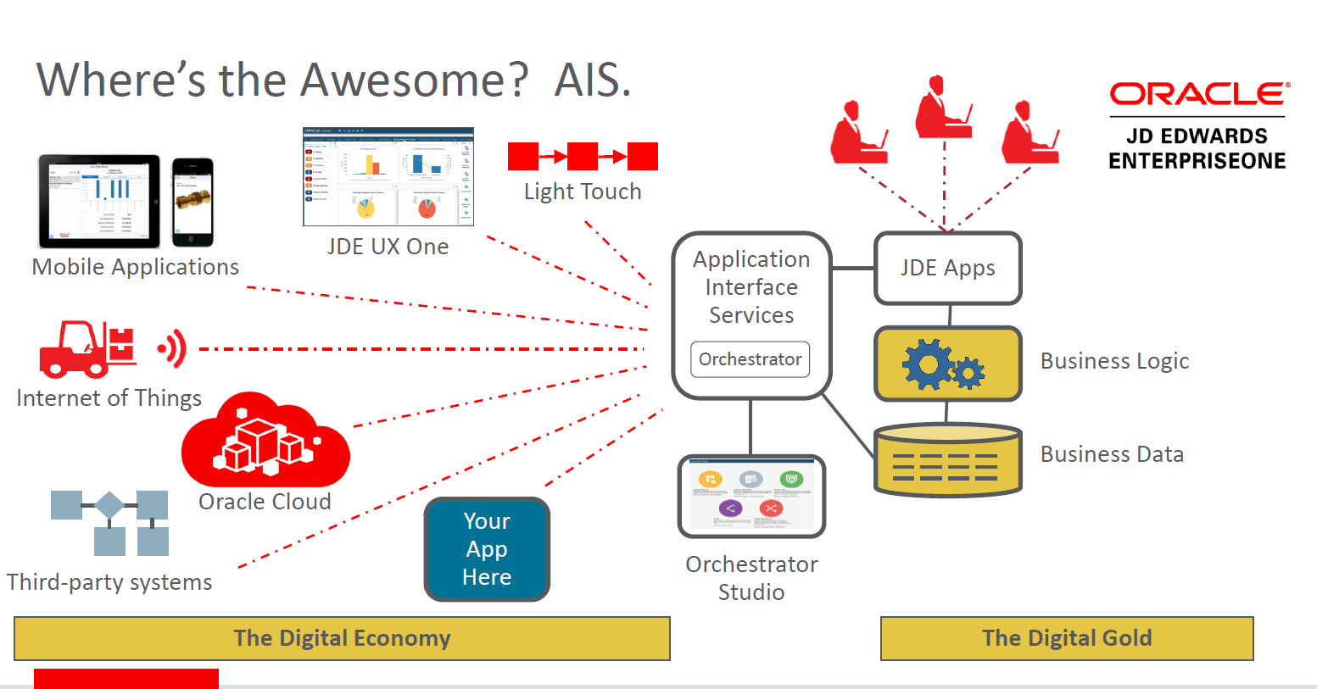

Orchestrator

Slide 32
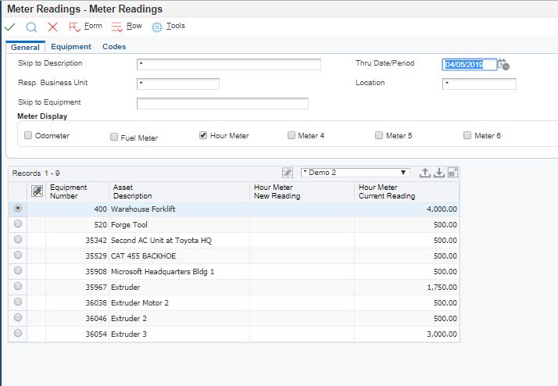
Old Fashion Way (Manual)

Slide 33


Collection Types : Mobile Meter Reading

Slide 34


Collection Types: 3rd Party API Pieces

Slide 35
Collection Types : Excel Sheet

Slide 36
Understanding Orchestrator
The JD Edwards EnterpriseOne Orchestrator leverages the Application Interface Services (AIS) server to integrate, automate, and extend business processes within E1.
Orchestrator accesses the “digital gold” within the EnterpriseOne application layer to perform business logic as-if an E1 application was performing the actions being orchestrated.

Slide 37
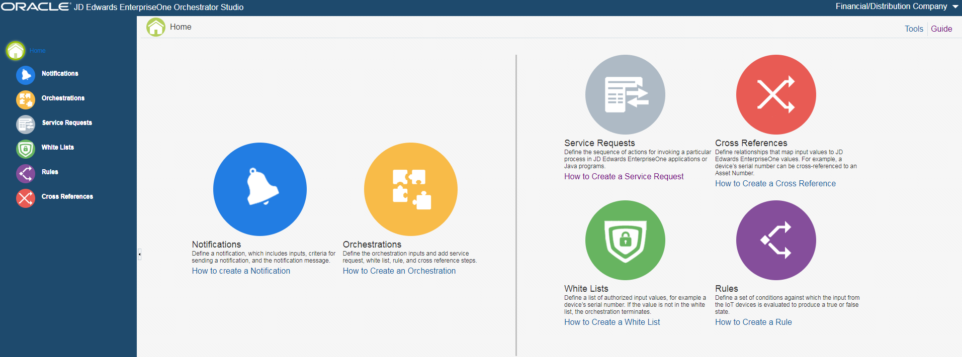
Orchestrator Tools
Orchestrator Studio

Slide 38
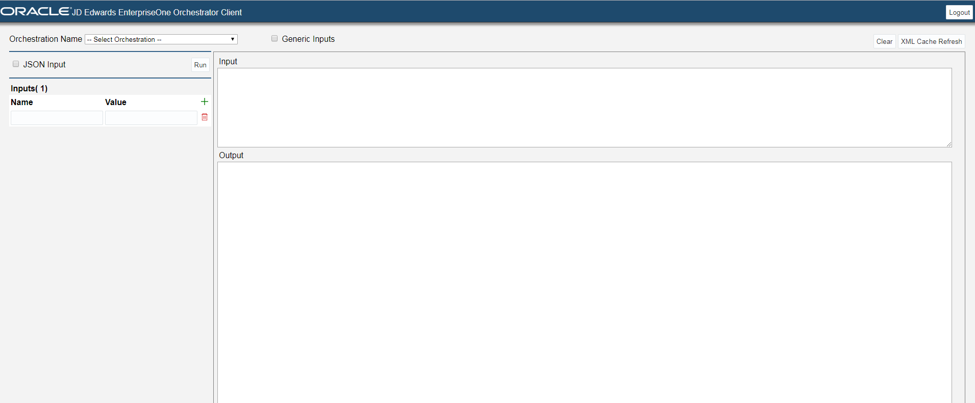
Orchestrator Tools
Orchestrator Client

Slide 39
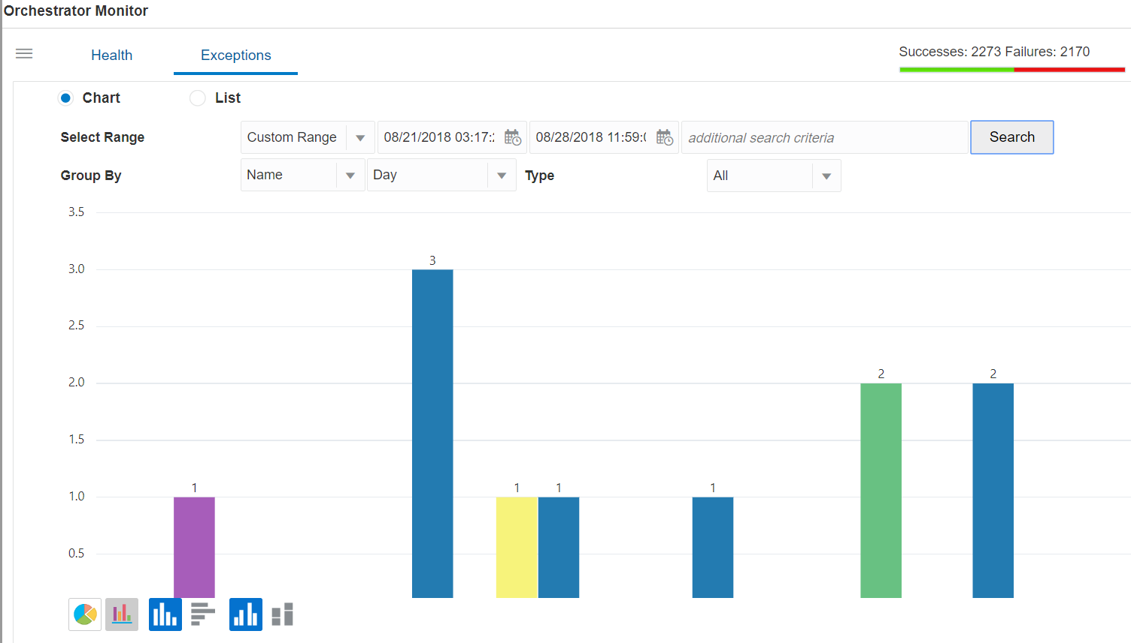
Orchestrator Tools
Orchestration Monitor

Slide 40
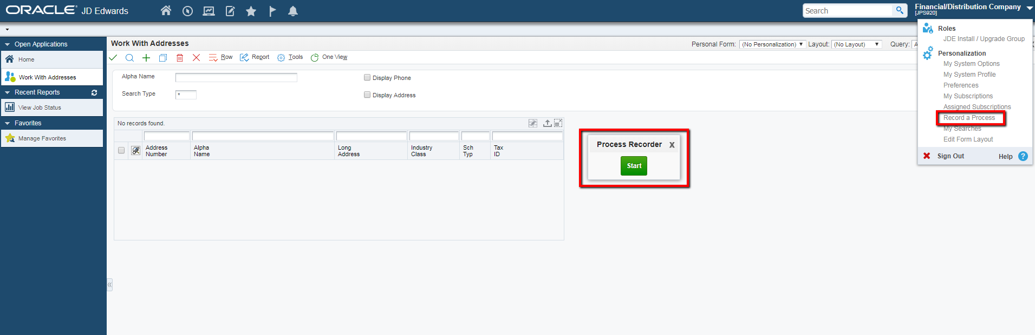
Orchestrator Tools
Process Recorder

Slide 41
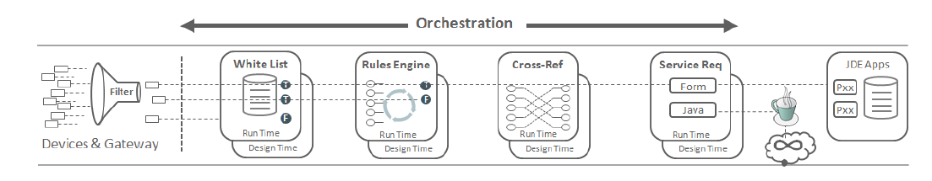
Orchestrator Components

Slide 42
Orchestrator Components
Orchestration
The master process that defines the inputs for the orchestration and provides a unique name for the orchestration process in the Orchestrator.

Slide 43

Orchestrator Components
Service Request
An invocation of a JD Edwards EnterpriseOne interactive application or a Java application via a REST service call to the EnterpriseOne Application Interface Services (AIS) Server.

Slide 44
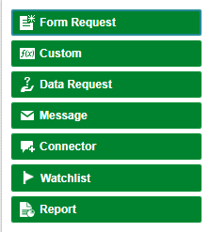
Orchestrator Components
Service Request Types

Slide 45

Orchestrator Components
Rule
Contains a set of conditions against which the orchestration input is evaluated to produce a true or false state.
Rules can be nested to produce complex evaluations.
Rules determine how the orchestration is processed at runtime.

Slide 46

Orchestrator Components
Cross Reference
A set of data relationships defined by the designer of the orchestration that enriches the minimal input from devices.
For example, a device's serial number can be cross-referenced to a JD Edwards EnterpriseOne Equipment Number for use in service requests.

Slide 47

Orchestrator Components
White List
An initial rudimentary pass/fail check of the incoming message's device signature against a predefined list of signatures.
A white list provides an additional layer of security to the Orchestrator security.

Slide 48

Orchestrator Components
Connections
Connector service requests require soft coding records to provide a secure access to external resources, such as a REST service, database, or an orchestration or notification on another EnterpriseOne system

Slide 49
Orchestrator UDO Features

Slide 50

Demonstration:

Slide 51
Round Table / Questions

Slide 52
Keep your Shop Floor Capacity in Check
Are you having issues scheduling your facility due to capacity reasons? In this session you will learn about the JDE capacity planning module and how it can help get your production line within your specific capacity constraints. We will also include best practices for grouping like orders and products together to increase efficiencies.
Objectives
  Better understanding of Capacity planning based on defined capacities
  How to categorize like items for increasing shop floor throughput
  Paperless processing to better coordinate scheduling and shop floor employees
  Supplier Shipment Reference

Slide 53
Better understanding of Capacity planning based on defined capacities
Three levels of Capacity Planning
  Resource Requirements Planning (RRP)
  Rough Cut Capacity Planning (RCCP)
  Capacity Requirements Planning
Primary Capacity Constraints
  Machine
  Labor
Critical Work Centers

Slide 54
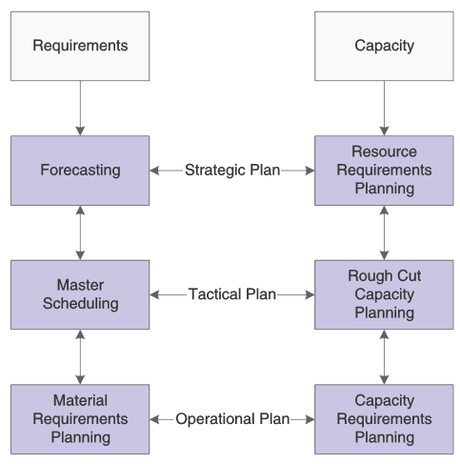
Capacity
Planning
Objectives

Slide 55
Work Center Definition for Capacity Planning
Assembly
Line 1
Line 2
Packaging
Cell 1
Cell 2
Cell 3
Dispatch Groups
Prime Load Codes
  Labor, Machine, Setup
Critical Work Center
Standard Capacity
  Min/Max
Capacity Offsets
  Queue hours, Move Hours
  Replenishment Hours
Efficiency
Utilization

Slide 56
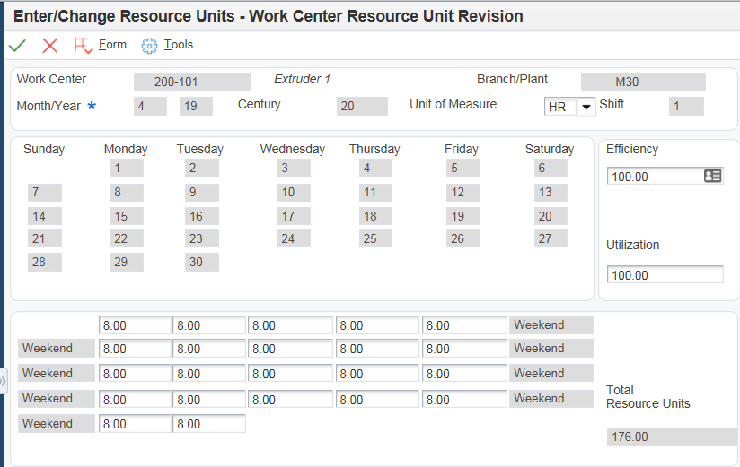
Work Center Resource Units

Slide 57
How to categorize like items for increasing shop floor throughput
Dispatch Group Fabrication
Dispatch Group Assembly
Dispatch Group Packaging
Dispatch Groups
  Similar/interchangeable
Work Centers
Critical Work Centers
Product Structures
Results of a good sequence
  Minimize Changeovers
  Improve throughput

Slide 58
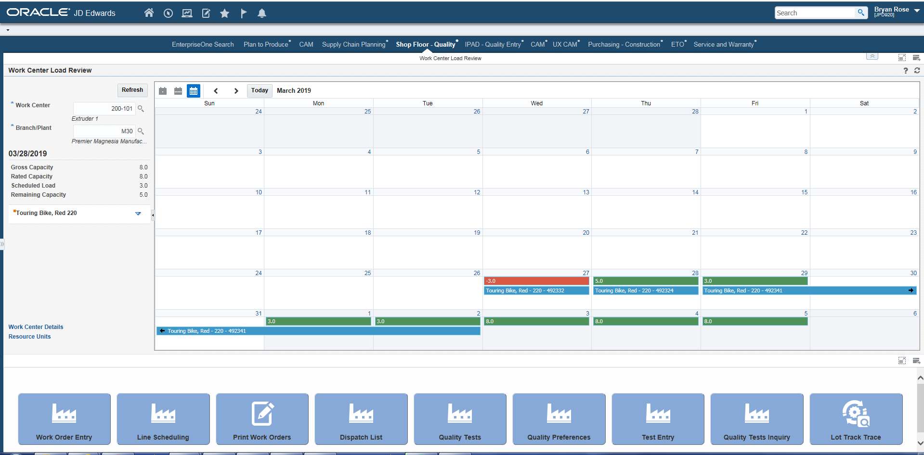
Work Center Capacity

Slide 59
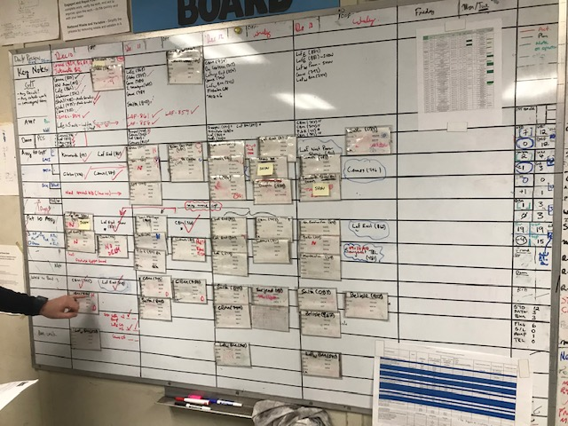
Paperless processing to better coordinate scheduling and shop floor employees
Visual Displays of Schedule
on shop floor
Realtime Data Processing
Meter Reading/Counting
LEAN processing
Watchlists
Notifications

Slide 60
Supplier Shipment Reference
Consistent Shipping Information
Optimizing material flow
Minimize Production Interruption’s
Better Schedule Attainment
Supplier Self Service
Supplier Collaboration

Slide 61
Manufacturing Analytics Made Simple - Agenda
High Level Overview of UX One
UX One Components
  Watchlists
  Composite Pages
  Notifications
  E1 Search
Q & A

Slide 62
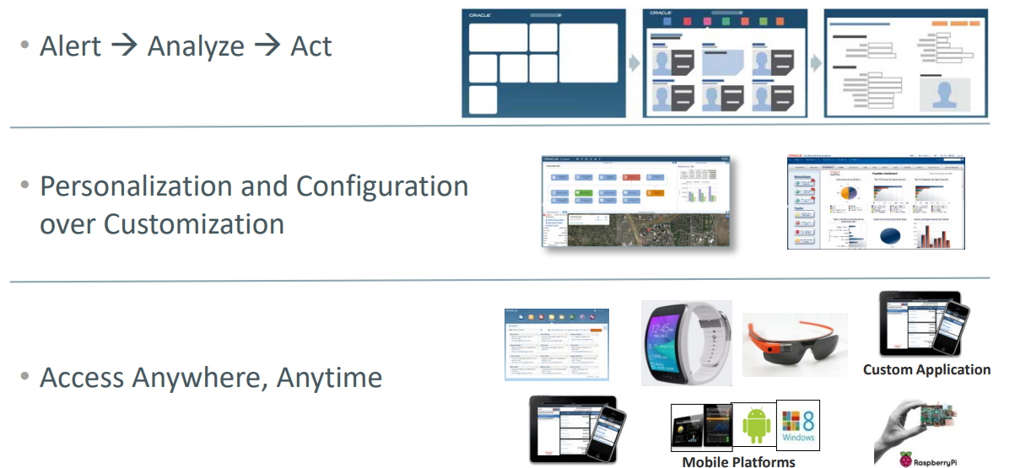
Alert → Analyze → Act

Slide 63
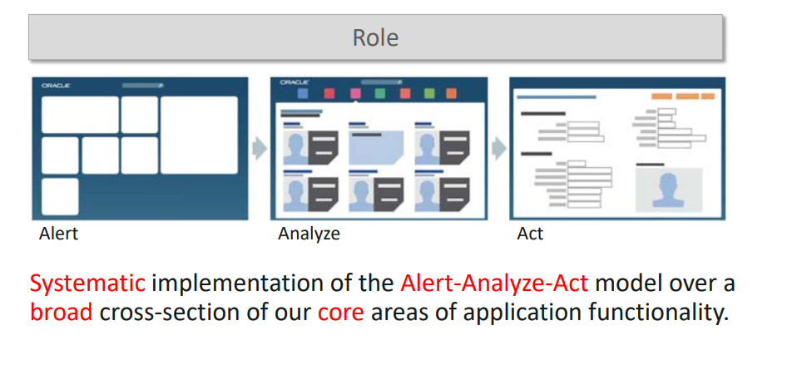
Role Based Solutions
Over 50 out of the box role based solutions
  Accounts Payable Manger
  Inventory Control Manager
  Procurement Manager
  Much more

Slide 64
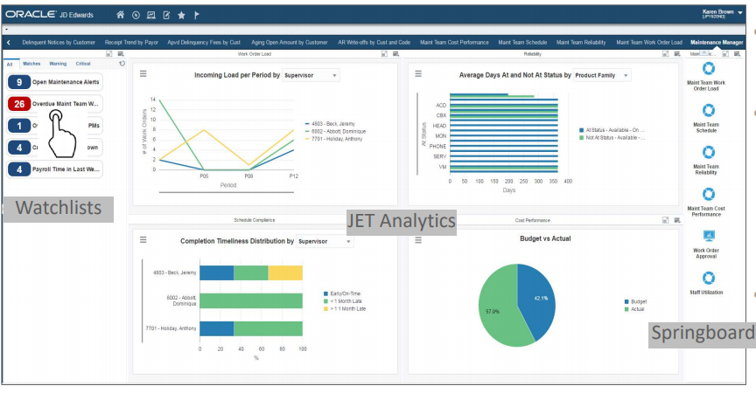
Example of Role Based Page

Slide 65
Composite Pages Overview
Composed EnterpriseOne Pages are user defined layouts that you can create and design. They provide a user experience that enables you to access multiple content types from a single page. Composed EnterpriseOne Pages enable you to access web pages, EnterpriseOne application forms, One View Reports, Classic Pages, Designer Panes, Watchlist Panes, Springboard Panes, OBIEE objects, and ADF applications from page layouts you create in EnterpriseOne.

Slide 66

Technical Requirements
Must be running a minimum of EnterpriseOne Tools Release 9.2

Slide 67
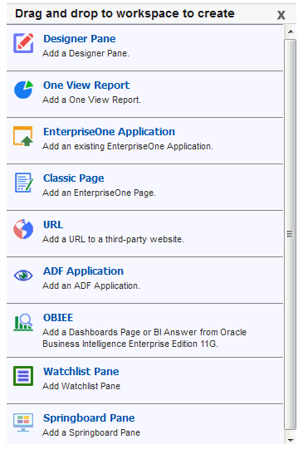
Content Types

Slide 68
Demonstration:

Slide 69
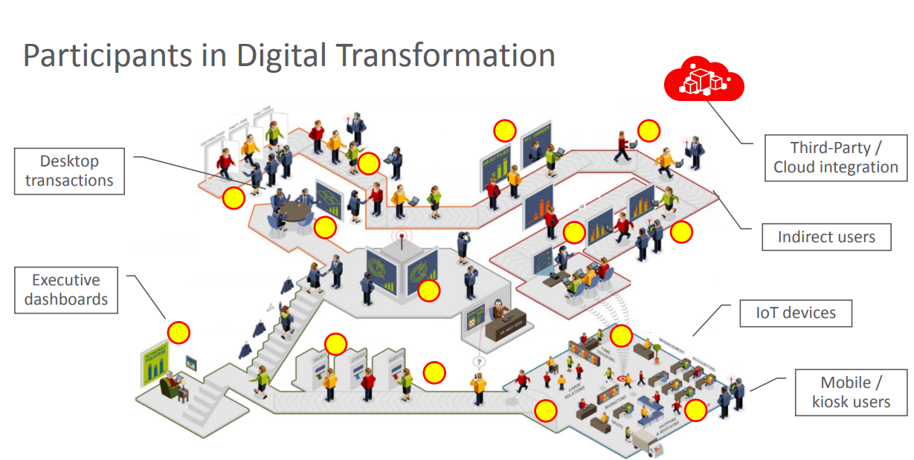
Notifications Overview
JD Edwards EnterpriseOne Notifications enable you to improve your business efficiency through the use of proactive notifications that are actionable. Proactive notifications enable the system to notify users of business events as they happen without the need for the user to be online

Slide 70
Technical Requirements
Must be running a minimum of EnterpriseOne Tools Release 9.2.2
Deploy an Application Interface Services (AIS) Server

Slide 71
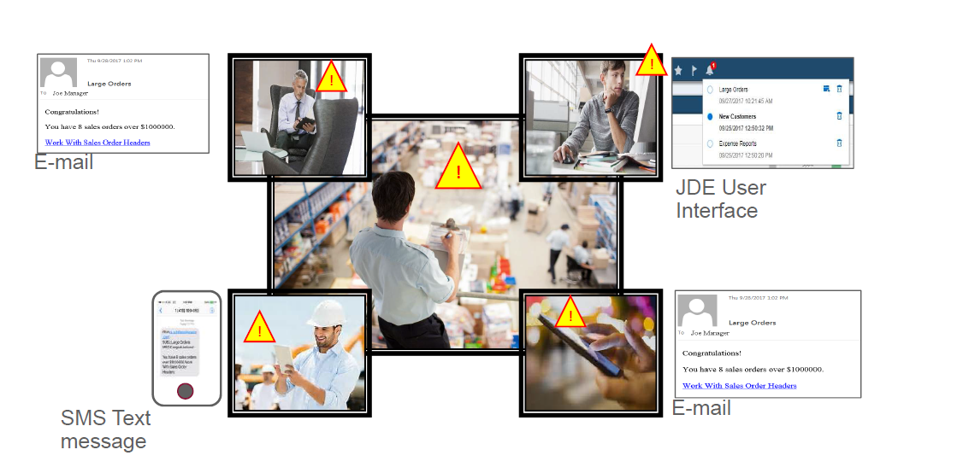
How it Works?
Notifications use inputs, such as counts from Watchlists or data collected through orchestrations, and apply rules to decide whether a notification message should be dispatched to subscribers.

Slide 72

Notification Types - Simple
Simple Notification. A simple notification provides a way to send reminders or updates and include shortcuts to applications in a notification message. This type of message is not dependent on any business event tied to the data in JD Edwards EnterpriseOne

Slide 73
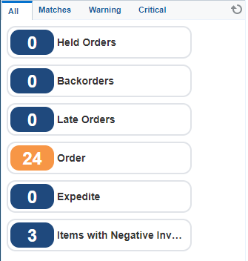
Notification Types - Watchlist
Watchlist-based Notification. A notification based on a Watchlist enables you to use existing Watchlists to send notification messages that include threshold levels, counts, and application shortcuts to subscribers.

Slide 74
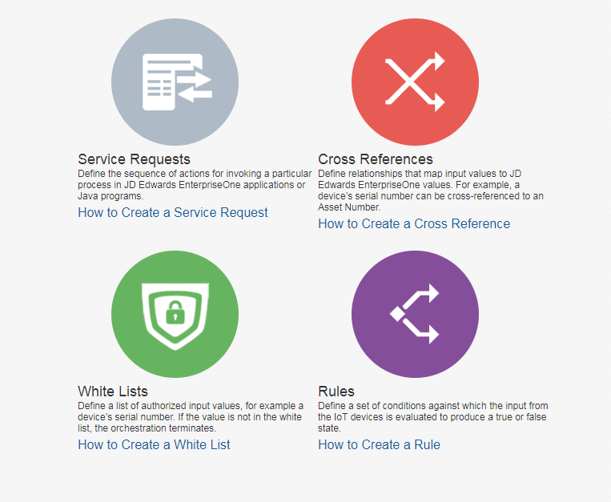
Notification Types - Orchestration
Orchestration-based Notification. A notification based on an orchestration enables you to use all of the functionality available in an orchestration and proactively deliver the data to subscribers in a notification message.

Slide 75

Schedules
A schedule defines how often the system executes a notification. You can define a schedule using minutes, hours, days, or a Cron string (for example, every Tuesday at 2:00 pm). The schedule is then attached to a notification to determine how often the notification runs. You can attach the same schedule to multiple notifications.

Slide 76
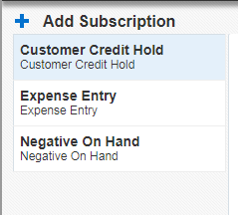
Subscriptions
Once a notification is built, users or business analyst must define the “Subscription” List
These can applied by user or role

Slide 77
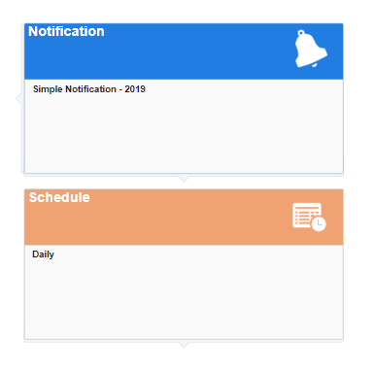
Use Cases: Labor Entry
Problem: Some of Company A's employees have been forgetting to enter their work time or entering them late.
Solution: Company A's manager schedules a notification message to be sent each morning to remind them to enter their expenses.

Slide 78
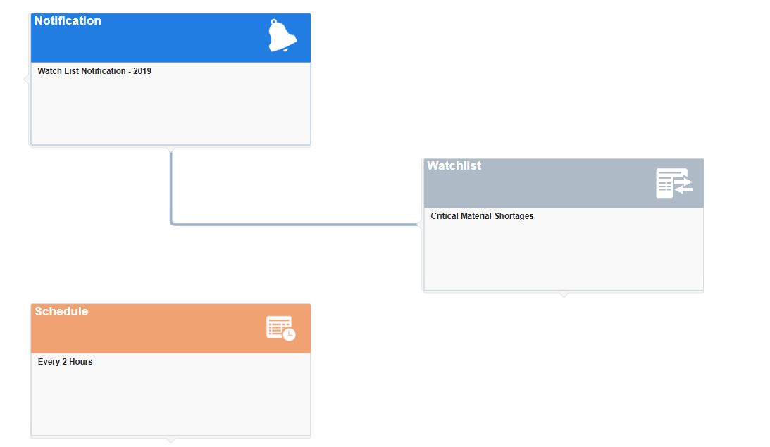
Use Case: Material Shortages
Problem: Company C is having issues managing part shortages on work orders
Solution: Company C schedules a notification message based on an watchlist to be sent to the production scheduler who manages work orders.

Slide 79
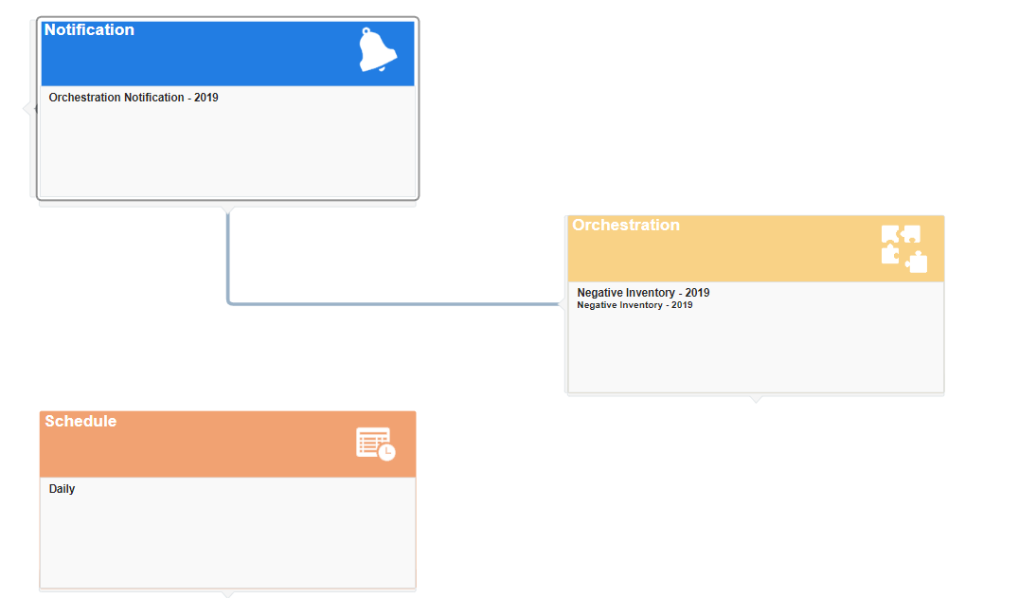
Use Case: Negative Inventory
Problem: Company B’s has trouble being timely on managing negative inventory.
Solution: Company B schedules a notification message based on an Orchestrations to be sent to the inventory control group when an item goes negative.

Slide 80
Demonstration:

Slide 81
Round Table / Questions

