Slide 1
Managed Open Source
A practical model for development teams that accelerates development speed and reduces risk

Slide 2
Open source = the modern development platform
It is fundamental to our development process and essential to our applications
It is a blessing (productivity boost) and a curse (dependency hell and other maintenance headaches)
of professional applications contain open source components
92%
Source: Tidelift 2018 Professional Open Source Survey

Slide 3
Most applications are built on top of a foundation of 70% or more open source code
20%
Our custom application code/ business logic
Top layer of our app, our job to support
Open source application components
70%
Examples: Babel, Vue.js, Gulp, Material-UI, Fabric, Celery, Jekyll, Active Admin
Most of our app, but no one’s job to support
10%
Commodity infrastructure
Examples: Linux, Kubernetes, MongoDB, Docker
Supported by big vendors or cloud providers

Slide 4
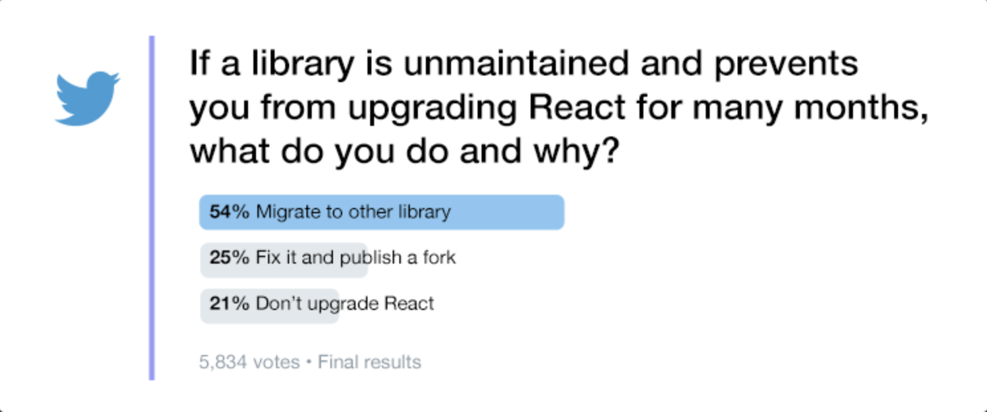
Open source is free—if our time is worth nothing
THE CHALLENGE
Unmaintained code slows us down and adds risk
At least 20% of the open source packages used in the average application are completely unmaintained
➜ Wasted developer resources
➜ Security exposure
➜ Intellectual property risk

Slide 5
How can we make our development team more productive?

Slide 6
Hiring developers is tough, so improving productivity of our existing team is vital
C-Level
Executives
How much of a priority is it for upper management to increase the productivity of its developers?
High / medium priority
96%
Not at all / low priority
3%
How much of an impact can developers have to help your company with each of the following challenges?
(moderate/major)
Bringing products to market faster
71%
Increasing sales
70%
Differentiating products / services vs. competitors
69%
Internal reporting / visibility
65%
https://stripe.com/reports/developer-coefficient-2018

Slide 7
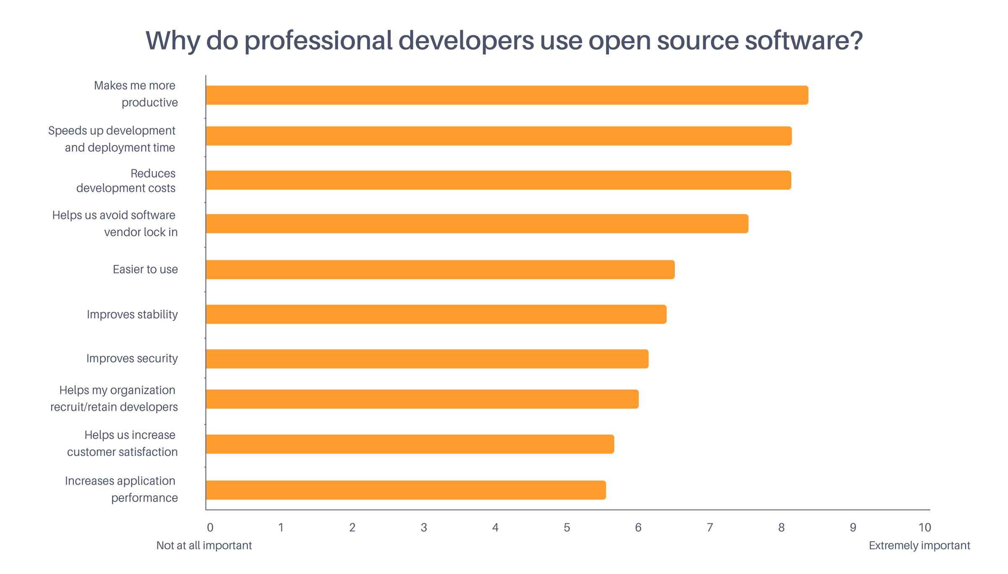
Our development team relies on open source to quickly and inexpensively add new features
➜ In a recent survey, developers like ours ranked the productivity boost open source gives them as its biggest benefit
➜ #2 was speeds up development and deployment time and #3 was reduces development costs
Source: Tidelift 2018 Professional Open Source Survey

Slide 8
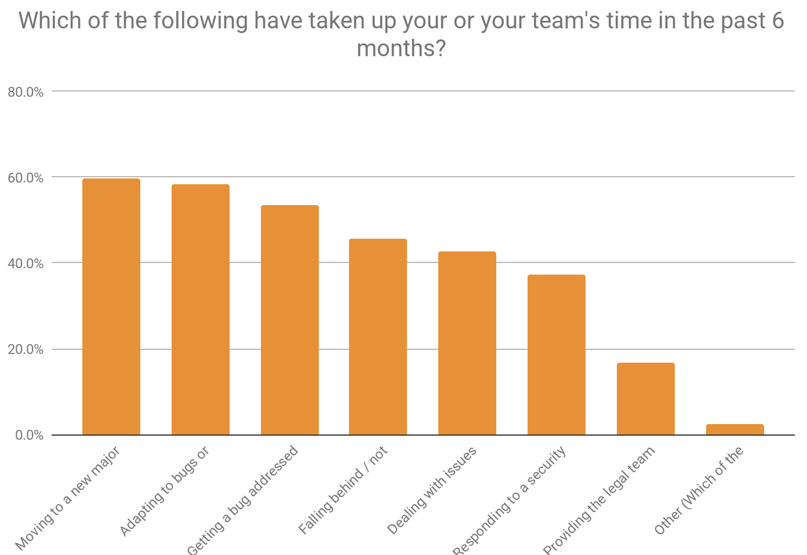
But unmanaged open source drains productivity
Moving to a new major version of a framework or library
Adapting to bugs or breaking changes in an updated dependency
Getting a bug addressed or a feature added in a dependency
Falling behind / not staying current with a package
Dealing with issues related to an unmaintained dependency
Responding to a security issue in a dependency
Providing the legal team with licensing information or responding to legal-related questions
Other
Source: Tidelift survey report: Key open source usage trends in professional development teams

Slide 9
How can we manage open source-related risk?

Slide 10
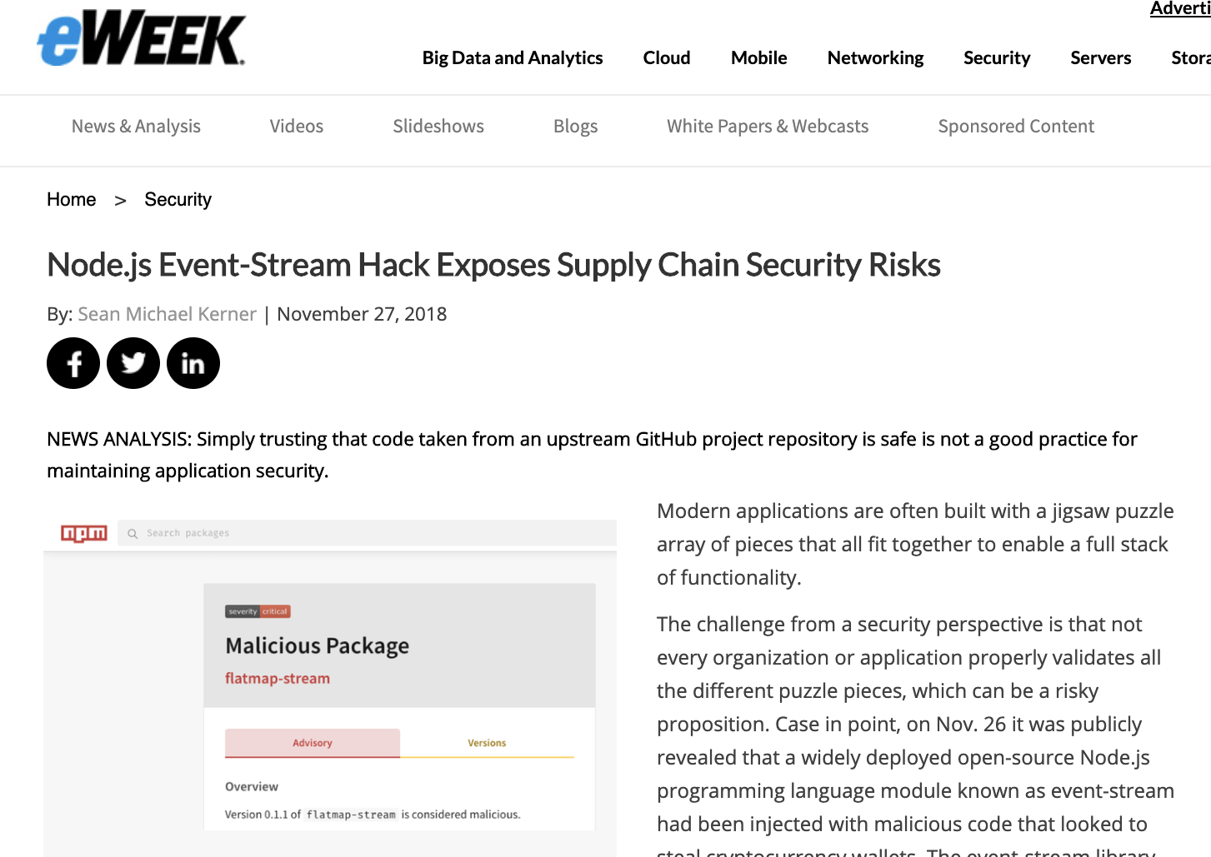
What can happen when code isn’t professionally maintained?
One example: event-stream, an npm package with over 100 million downloads and no active maintainer, is taken over by a malicious actor trying to steal bitcoin.
Other horror stories
heartbleed

Slide 11
Managing open source risk today presents tough trade-offs
➜ Purchase expensive (money and/or time to learn/use) scanning tools
➜ When there’s an issue, we need the people on staff to chase it down ourselves, chase a maintainer down, or hire expensive outside consultants (if we can find them) to solve it for us
➜ Move fast, sometimes knowing risks, sometimes not
➜ So far it’s worked out OK (knock on wood)
?
?
➜ Scan everything manually, know all risks
➜ Avoid risky packages by using other (suboptimal) ones, trying to contribute to preferred package or rewrite our own
➜ All of which places a huge drag on development velocity
Is there a happy medium?

Slide 12
A historical analogy: life before cloud computing?
15 years ago if we were launching a new SaaS app we would need to:
➜ Rent space from a reputable hosting facility
➜ Buy and install servers to ensure our app has appropriate backup / failover
➜ Configure all of the software we need on those servers
➜ When something goes physically wrong with a server, drive or fly to the hosting facility, swap it out, install software updates, etc.
Today, same scenario:
➜ AWS or another cloud provider takes care of hosting, we take care of our app
Yet when it comes to the numerous open source components our apps rely on, today development teams like ours still do a lot of the heavy lifting themselves.
https://stripe.com/reports/developer-coefficient-2018

Slide 13
A new offering designed to solve these problems for us

Slide 14
The Tidelift Subscription
A managed open source subscription backed by creators and maintainers. Giving us the flexibility to build with open source and the confidence of commercial-grade software.

Slide 15
The Tidelift Subscription manages our dependencies for us
Understand and monitor our open source usage
Pay the maintainers of the packages we use, to ensure they meet our standards
Proactively address issues with our dependencies
Measure and improve dependency health
Get commercial assurances open source doesn’t normally have

Slide 16
Bottom line:
Less time grappling with open source issues, more time building our apps.

Slide 17
Understand and monitor our open source usage
Tidelift provides the tools we need to continuously catalog and understand the open source software that our application depends on.
They provide us with a managed way to use a wide range of open source components more safely and effectively, including recommended upgrade paths and package recommendations.

Slide 18
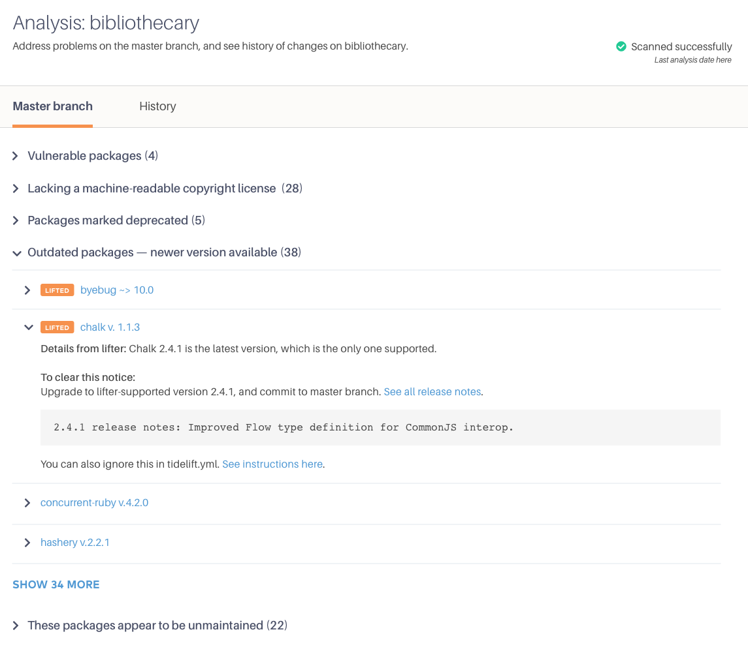
Pay the maintainers to proactively address issues for us
Tidelift works directly with participating open source maintainers to proactively identify and resolve new security, licensing, and maintenance issues on our behalf.
Our subscription pays the maintainers of the exact packages we use, which means less issues for us to fix on our own.

Slide 19
Measure and improve dependency health
By partnering directly with maintainers, Tidelift helps us measure and improve our open source dependencies' health—which improves our app’s health.
They also give us a short list of high-impact steps our team can take to improve them even more.

Slide 20
Commercial assurances like indemnification and support
Tidelift adds commercial assurances that don't come for free with open source packages, like intellectual property indemnification and support under a service level agreement.
We expect these guarantees from proprietary software, why shouldn’t we have them for open source?

Slide 21
We help open source get better,
and we get better too

Slide 22
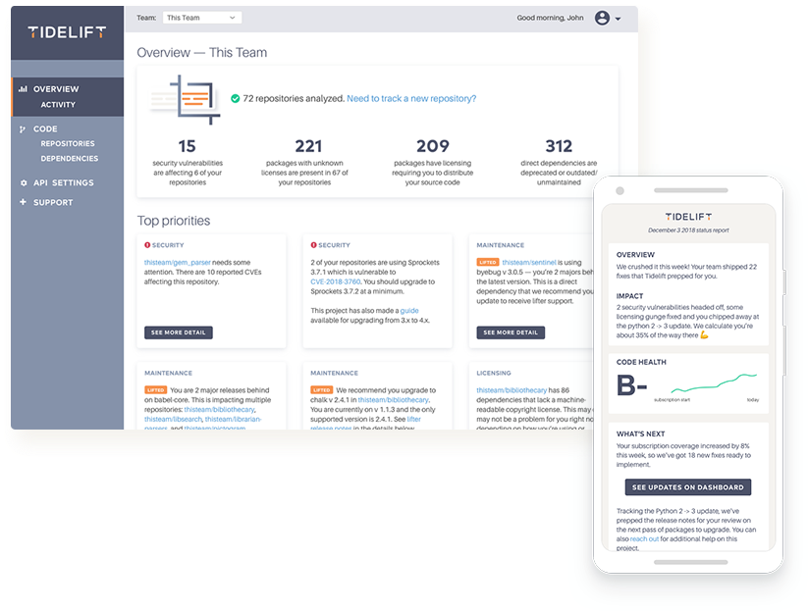
When we pay the maintainers, we get better software faster
1
We purchase a managed open source subscription from Tidelift
2
Maintainers of the packages we use get paid and spend more time making their packages better
“This model helps us move closer to a future where many more maintainers like me can afford to work on their projects full time.”
—Evan You, founder of Vue
3
Which makes our apps perform better, while becoming more secure and reliable

Slide 23
The ROI makes sense

Slide 24
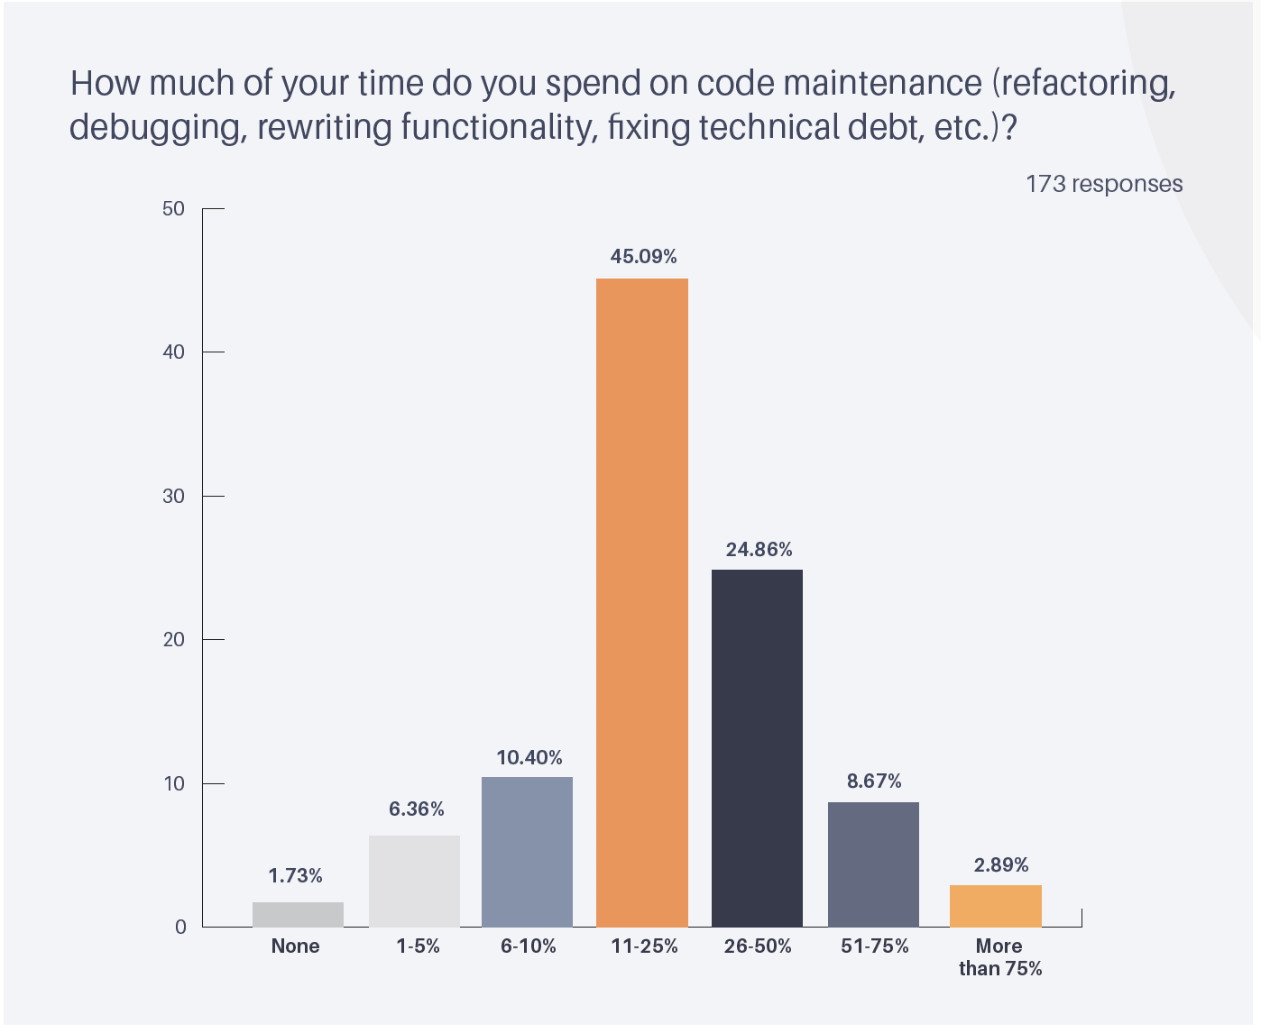
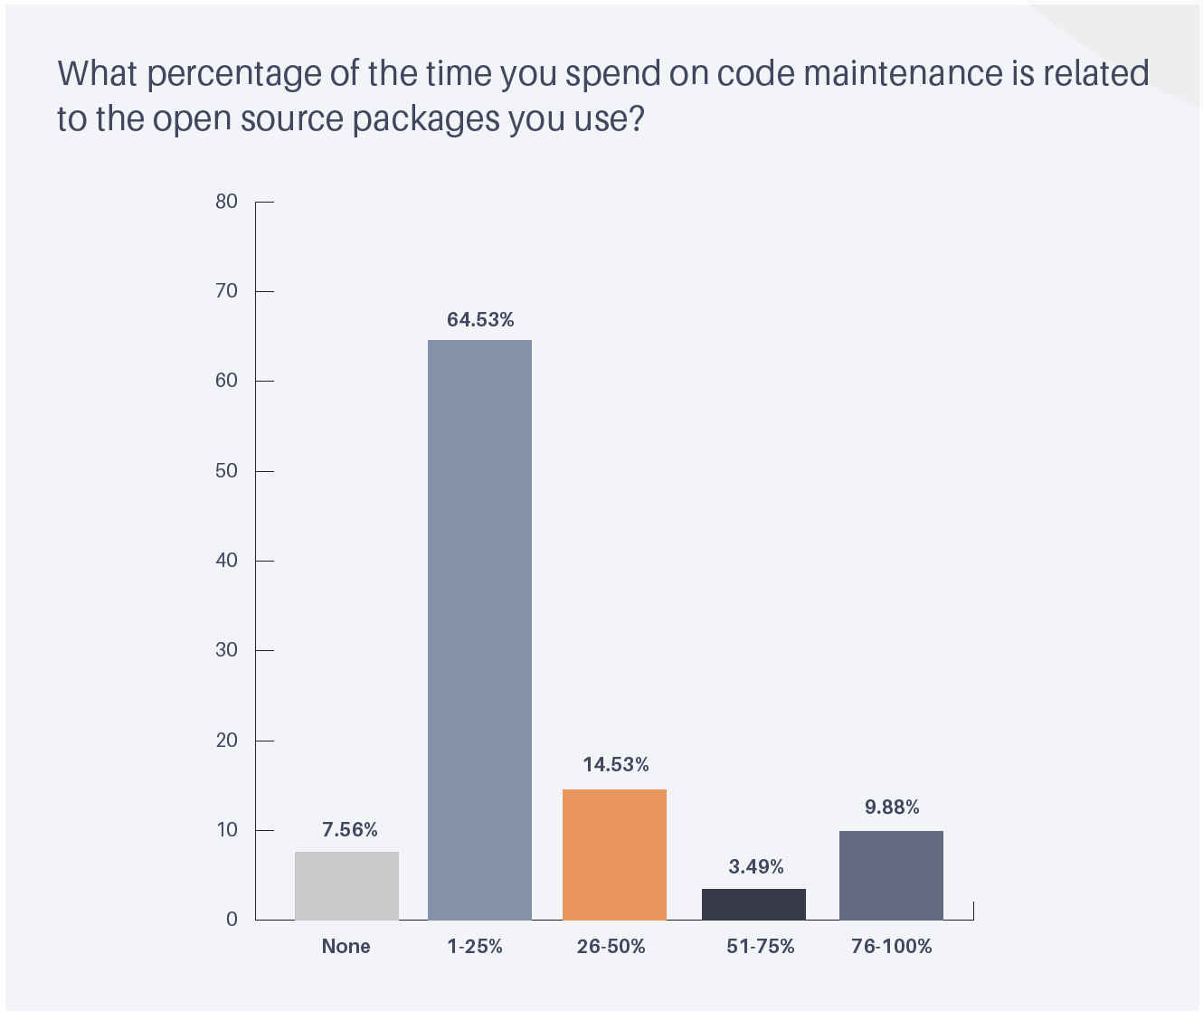
How much time do we spend on maintenance?
➜ A recent survey found developers spend 30% of their time on software maintenance tasks
➜ 25% of this time is directly related to the open source packages they use
Source: Tidelift survey report: Key open source usage trends in professional development teams

Slide 25
The ROI for the Tidelift Subscription
Number of developers | 25 | $3,750,000 per year
% of time developers spend on maintenance | 30% | $1,125,000 per year
% of maintenance time spent on open source | 25% | $281,250 per year
Time reclaimed with the Tidelift Subscription | 25- 50% | $70,313 - $140,625 per year
Assumptions: 40 hour work week, average developer salary $150,000
Customize these numbers with our ROI calculator

Slide 26
From unmanaged to managed open source
Our stack today
Our stack with Tidelift
Our custom application code/business logic
Managed open source subscription
Understand and monitor open source usage
Open source application components
Pay the maintainers of the exact packages we use
Dependable open source backed by maintainers
Proactively address issues with our dependencies
Measure and improve dependency health
Commodity infrastructure
Get commercial assurances for open source

Slide 27
Thank you

