Slide 1
Introduction to managed open source

Slide 2
Managed Open Source
A way for application development teams to offload the complexity of managing open source components.
Save time. Reduce risk.

Slide 3
Open source = the modern development platform
It is fundamental to the development process and essential for building applications
It is a blessing (productivity boost) and a curse (dependency hell and other maintenance headaches)
of professional applications contain open source components
92%
Source: Tidelift 2018 Professional Open Source Survey

Slide 4
Most applications are built on top of a foundation of 70% or more open source code
20%
Your custom application code/ business logic
Top layer of your app, your job to support
Open source application components
70%
Examples: Babel, Vue.js, Gulp, Material-UI, Fabric, Celery, Jekyll, Active Admin
Most of your app, but no one’s job to support
10%
Commodity infrastructure
Examples: Linux, Kubernetes, MongoDB, Docker
Supported by big vendors or cloud providers

Slide 5
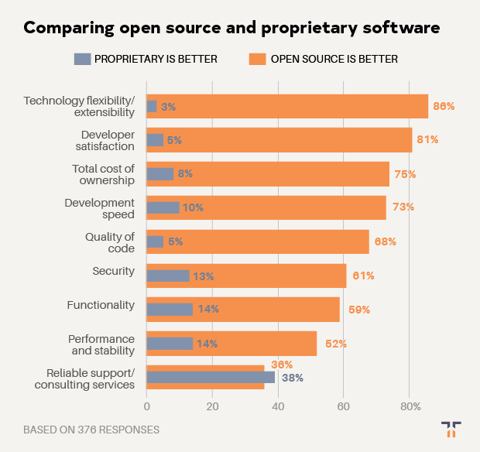
Who’s supporting the 70% of components you use to build your apps?
Historically, reliable support for open source is the only pain reported by many development teams.
Open source outclasses proprietary software in every other category.
Source: Tidelift 2019 Managed open source survey

Slide 6
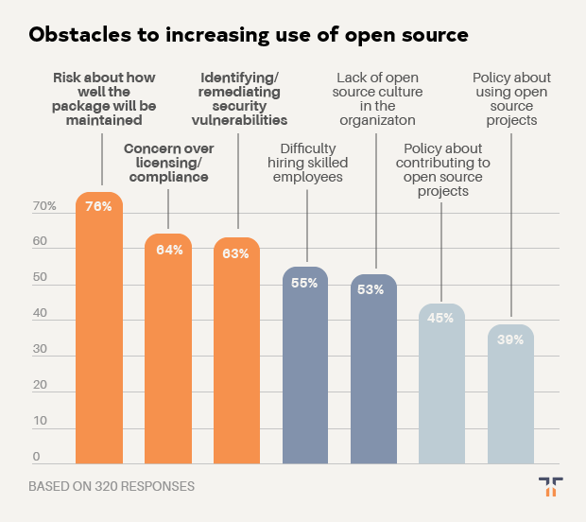
The big three support challenges: maintenance, security, and licensing
In multiple surveys, the biggest obstacles for development teams using open source have been remarkably consistent:
➜ Maintenance
➜ Security
➜ Licensing
Source: Tidelift 2019 Managed open source survey

Slide 7
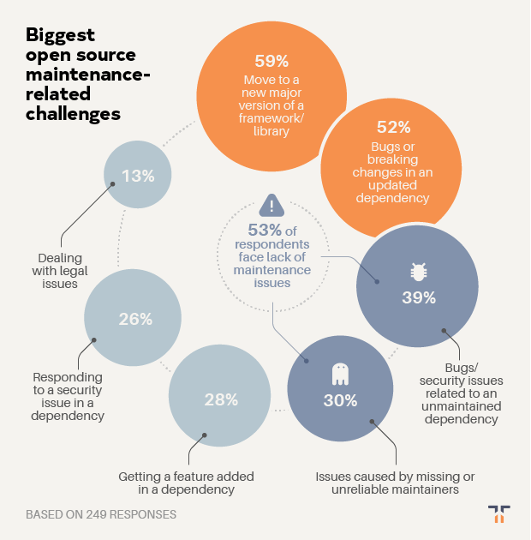
Unmanaged open source drains productivity
Biggest maintenance challenges include moving to a new major version of a framework or library and bugs or breaking changes in an updated dependency affecting their software supply chain. Over half of development teams regularly face challenges related to poorly maintained open source dependencies.
Source: Tidelift 2019 Managed open source survey

Slide 8
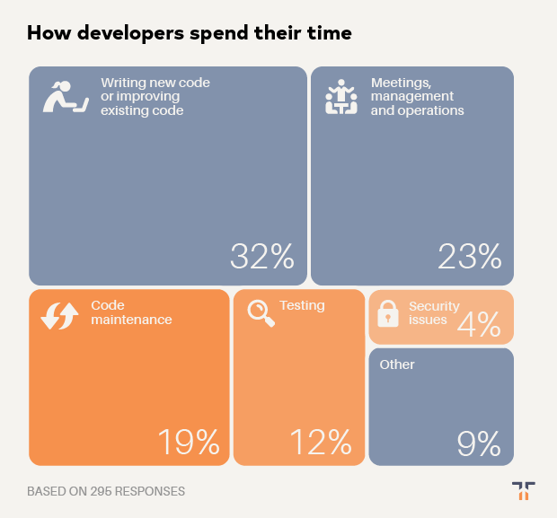
While taking up valuable time that could be spent writing code
Developers spend more time on code maintenance, testing, and security issues than they do writing code.
Source: Tidelift 2019 Managed open source survey

Slide 9
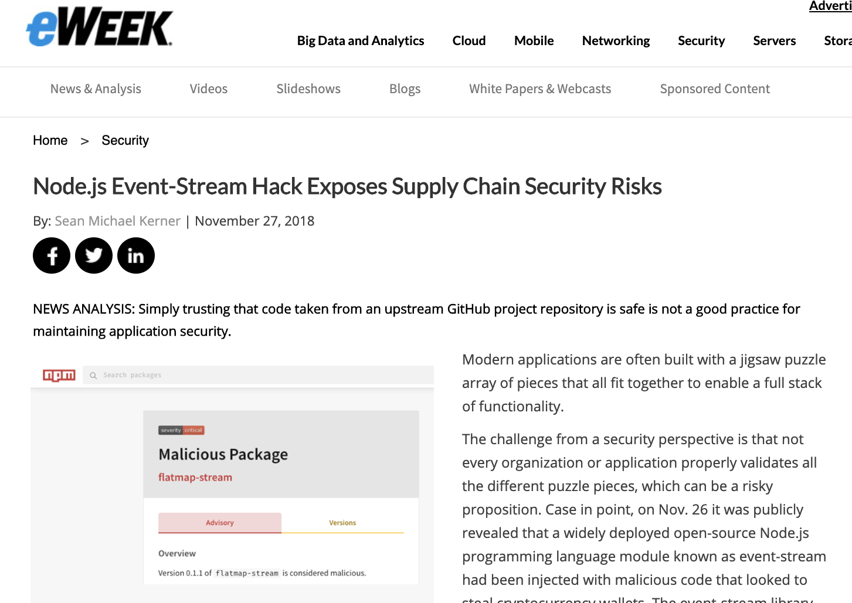
What can happen when code isn’t professionally maintained?
One example: event-stream, an npm package with over 100 million downloads and no active maintainer, is taken over by a malicious actor trying to steal bitcoin.
Other horror stories
heartbleed

Slide 10
How can development teams using open source
address these issues?
AND UTILIZE OPEN SOURCE TO ITS FULL POTENTIAL

Slide 11
A historical analogy: life before cloud computing?
15 years ago if you were launching a new SaaS app you would need to:
➜ Rent space from a reputable hosting facility
➜ Buy and install servers to ensure your app has appropriate backup / failover
➜ Configure all of the software you need on those servers
➜ When something goes physically wrong with a server, drive or fly to the hosting facility, swap it out, install software updates, etc.
Today, same scenario:
➜ AWS or another cloud provider takes care of hosting, you take care of your app
Yet when it comes to the numerous open source components our apps rely on, today development teams still carry the burden themselves.
https://stripe.com/reports/developer-coefficient-2018

Slide 12
The Tidelift Subscription
THE SOLUTION
Managed open source for application development teams
The Tidelift Subscription is a managed open source subscription for application dependencies covering millions of community-led open source projects across JavaScript, Python, Java, PHP, Ruby, .NET, and more. Save time. Reduce risk. Improve code health.

Slide 13
Enterprise-ready open source software— managed for you
Tidelift uses a layered approach to keep your open source dependencies trouble-free and enterprise-ready.
Tools. We provide tools to keep track of all the dependencies you use, flag issues, and enforce policies.
Management. We manage core, mission-critical packages on your behalf, including researching and resolving issues so you don't have to anymore.
Maintainers. We recruit maintainers for many important projects and pay them to proactively prevent problems and address the root causes of issues.

Slide 14
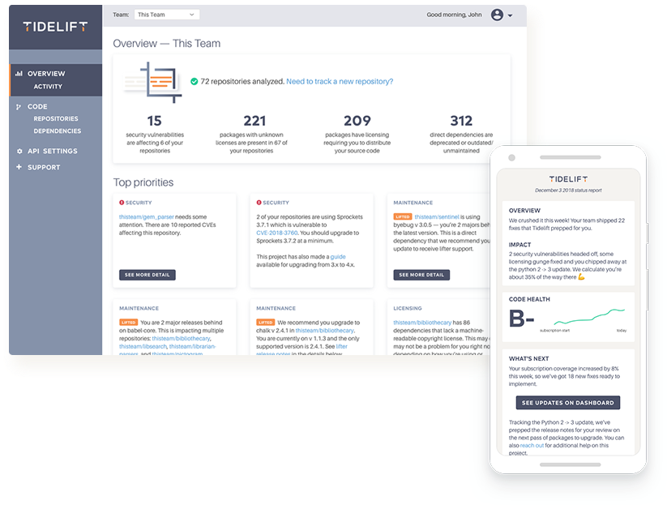
A managed open source subscription backed by maintainers
1
You purchase a managed open source subscription from Tidelift
2
Maintainers of the packages you use get paid and spend more time making their packages better
“This model helps us move closer to a future where many more maintainers like me can afford to work on their projects full time.”
—Evan You, founder of Vue
3
Which makes your apps perform better, while becoming more secure and reliable

Slide 15
Key benefits of the Tidelift Subscription
Security
updates
Licensing verification and indemnification
Maintenance and code improvement
Package selection and version guidance
Roadmap input
Tooling and cloud integration

Slide 16
Security updates
Tidelift’s security response team coordinates patches for new security vulnerabilities and alerts immediately through a private channel, to keep your software supply chain more secure.

Slide 17
Licensing indemnification and verification
Tidelift verifies license information to enable easy policy enforcement and adds intellectual property indemnification to cover creators and users in case something goes wrong. You always have a 100% up-to-date bill of materials for your dependencies to share with your legal team, customers, or partners.

Slide 18
Maintenance and code improvement
Tidelift ensures the software you rely on keeps working as long as you need it to work. Your managed dependencies are actively maintained and we recruit additional maintainers where required.

Slide 19
Package selection and version guidance
We help you choose the best open source packages from the start—and then guide you through updates to stay on the best releases as new issues arise.

Slide 20
Roadmap input
Take a seat at the table with the creators behind the software you use. Tidelift’s participating maintainers earn more income as their software is used by more subscribers, so they’re interested in knowing what you need.

Slide 21
Tooling and cloud integration
Tidelift works with GitHub, GitLab, Bitbucket, and more. We support every cloud platform (and other deployment targets, too).

Slide 22
Bottom line:
All the capabilities you expect and require from commercial software. But now, for all of the key community-led open source software you depend on.

Slide 23
The Tidelift Subscription covers application development in JavaScript, Python, Ruby, PHP, Java, .NET, and more
https://stripe.com/reports/developer-coefficient-2018

Slide 24
From unmanaged to managed open source
Your stack today
Your stack with Tidelift
Your custom application code/business logic
Open source application components
Managed open source backed by maintainers
Managed open source subscription
Commodity infrastructure

Slide 25
Thank you

