Slide 1
Safer Schools
Presentation for Primary Staff

Slide 2
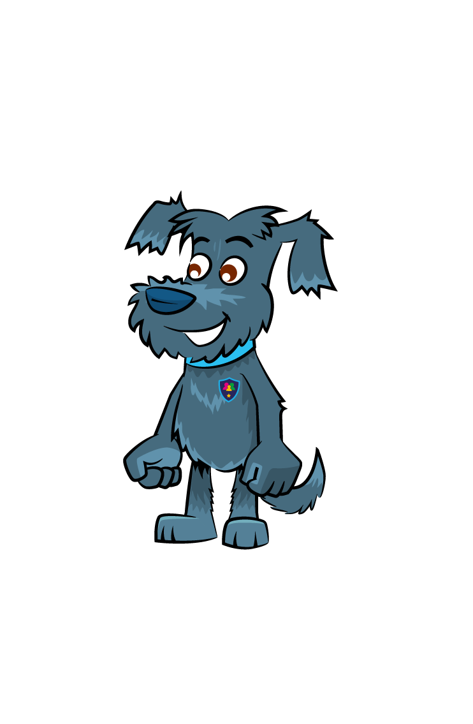
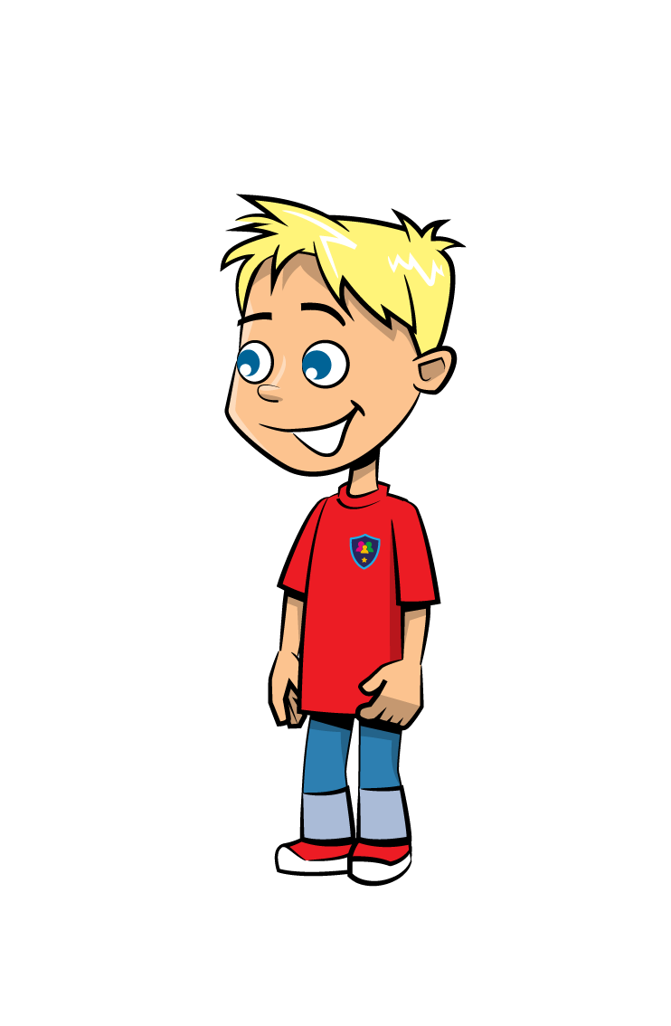
Our school is launching the Safer Schools App
Notes:
The Safer Schools App helps to educate, empower and protect children and those charged with helping to keep them safe as they navigate the world of technology and social media.
The App is designed to support and protect children by educating and empowering them in school and at home. Teachers have a tailored version of the app which will empower and educate you to best support the children in your care in the digital world.
So, let’s take a look at what type of things are on the App.

Slide 3
Online Safety Centre
Notes:
Has a child in your class been bullied on Snapchat? Do you know have the knowledge to teach them how to block and report someone on Snapchat?
Well, if you go on to the Online Safety Centre you can find out how!

Slide 4
Digital Safety
Notes:
Heard pupils in your class talking about Fortnite or Roblox and don’t have a clue what they are? Check out the Digital Safety section to find out more about Gaming.
This section also contains other topics with credible, contemporary and relevant information that we need to safeguard children in the digital world.

Slide 5
Professional Development (incl. Safeguarding Level 1)
Notes:
Don’t know where to turn to for credible, relevant information on key safeguarding issues such as Safeguarding Level 1, FGM and Mental Health? Look no further than the Professional Development section of the App.
This includes a CPD accredited digital tests for these topics (Safeguarding Level 1, FGM, Mental Health). You can complete tests in the Digital Tests section and receive your certificate via email.

Slide 6
Push Notifications
Notes:
If you enable push notifications, you will receive alerts from the Safer Schools team on all of the latest trends and threats.
This can also be used by our school to send out push notifications with school news. This is a great communication tool for the school, which helps keep you up to date.

Slide 7
Step 1
Search for ‘Safer Schools’ in the store
Notes:
Step 1: Open up your App Store or Google Play and search for ‘Safer Schools’

Slide 8
Step 2
Type in your school name
Notes:
Step 2: Type in our school name – INSERT SCHOOL NAME HERE

Slide 9
Step 3
Type in the code _ _ _ _
Notes:
Step 3: Type in the code – You will get a handout with this code on it also. Keep this code safe.

Slide 10
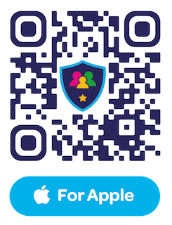
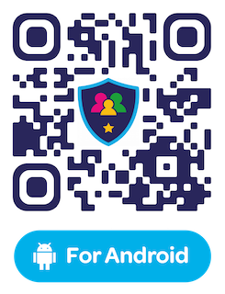
Download the App now!

