Slide 1
Safer Schools
Presentation for Secondary Pupils

Slide 2
Our school is launching the Safer Schools App
Notes:
This app looks at making you safer, both in the digital world and in the real world. It will help you with social media and gaming, while also teaching you about bullying and your well-being.
So, let’s take a look at what type of things are on the App.

Slide 3
Notes:
Raise your hand if you have seen or used any of these apps, games or websites?
The online world can be tricky to navigate. The Safer Schools App helps teach us all about these games and apps to make sure we stay safe and responsible while having fun!

Slide 4
Online Safety Centre
Notes:
Need to know how to block or report someone on Social Media? The Online Safety Centre on the App can show you how!
This screen recording shows you how to block someone on TikTok.
It’s really that simple!

Slide 5
Digital Safety
Notes:
Hands up who plays games online? Want to learn more about games and how to be safe when playing?
Simply check out the Digital Safety section of the App.
You can also learn even more about Social Media, Bullying and much much more in this section.

Slide 6
Quick Quizzes
Notes:
Think you know everything about being safe online? Try one of the quick quizzes to test your knowledge.
To learn even more about Passwords, Fortnite, TikTok, and how to be safe online, you need to use the Safer Schools App.
When you go home today, the first thing you need to do is download the app on your device.
The following slides will give you instructions on how to do it.

Slide 7
Step 1
Search for ‘Safer Schools’ in the store
Notes:
Step 1: Open up your app store or google play and search for ‘Safer Schools’

Slide 8
Step 2
Type in your school name
Notes:
Step 2: Type in our school name – INSERT SCHOOL NAME HERE

Slide 9
Step 3
Type in the code _ _ _ _
Notes:
Step 3: Type in the code – You will get a handout with this code on it also, just to make sure you remember it. Perhaps keep this code inside your homework diary or inside your phone cover.

Slide 10
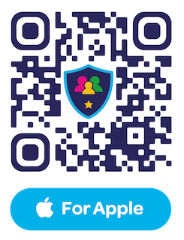
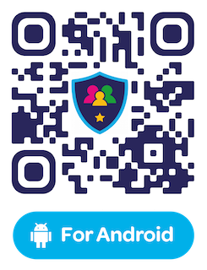
Download the App now!

