Slide 1
Lincoln MoneyGuard® Solutions
Materials & Digital Cobranding Opportunities
For agent or broker use only.

Slide 2
Agenda
Long-Term Care Awareness (3-5)
Available Marketing Material
Email & Cobranding Campaigns
Lincoln MoneyGuard® Solutions Core Material (6-10)
Available Marketing Material
MoneyGuard Transformation Enhanced Submission Process
Lincoln Concierge Care
Get to Know the Process
Expanded Flex Pay
Women and Long-Term Care (11-13)
Available Marketing Material
Email Campaign
Caregiving and Alzheimer’s (14-16)
Available Marketing Material
Email Campaign
Webinar Opportunities (17-18)
Digital Tools (19-20)
Wholesaler Maps (21)

Slide 3
LONG-TERM CARE AWARENESS

Slide 4
LONG-TERM CARE AWARENESS
Making the long-term care conversation an integral part of retirement planning
As more Americans are living longer, long-term care planning is increasing in importance. Being
proactive before care is needed can make a lasting impact on a client’s quality of care, ability to
maintain dignity and their family’s financial security.
CLIENT
ADVISOR
Client workbook* : MGR-CONV-FLI005
Give this fillable workbook to your clients before you meet so they can be ready to discuss their plans.
10 reasons client flier*: MGR-CONV-FLI006
Make your clients aware that they should be talking about long-term care with you and their loved ones now.
Infographic*:MGR-CONV-APH001
Show clients this information about sharing their thoughts about long-term care with their families.
*Available for use in all states except AZ, CA, CT, DC, DE, FL, HI, IN, MT, ND, NJ, NY, SD, VI.
Training Seminar: MGR-CONV-PPT003
Show agents how to incorporate long-term care planning into their practice.
LTC Article: MGR-CONV-ARC001
Learn why having discussions is one of the best ways clients can prepare for long-term care.
10 reasons advisor flier: MGR-CONV-FLI008
See 10 reasons why you should be talking with your clients about long-term care.
LTCE Decision Tree:
MG-LTHC-BRC001
Indemnity vs. Reimbursement flier:
MGR-IVR-FLI001
Visit our what care costs website: www.whatcarecosts.com/Lincoln Sponsor code: Lincoln

Slide 5
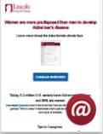
LONG-TERM CARE AWARENESS: COBRANDING
E-mails can be customized on your behalf. Please share your logo and contact information with your wholesaler if you’d like a campaign to be created for you.
Topic | Women & Caregiving | Alzheimer's & Women | Alzheimer’s Disease and LTC | LTC Planning as a family
Order Code | MGR-FALL-oML001 | MGR-FALL-oML002 | MGR-FALL-oML003 | MGR-FALL-oML004
Thumbnail
Notes:
Not for use with the general public. Emails/material is intended for agent or broker use.

Slide 6
LINCOLN MONEYGUARD SOLUTIONS

Slide 7
LINCOLN MONEYGUARD SOLUTIONS
Lincoln MoneyGuard Solutions can help you protect your clients’ retirement from long-term care expenses with affordable, flexible options beginning at age 40.
CLIENT
ADVISOR
MoneyGuard Client Seminar
MGR-ICC-PPT007 (ICC version)*
MGR-CLT2-PPT007 (for use in AZ, CT, DC, DE, FL, HI, IN, MT, ND, NJ, SD, VI)
MGR-CA-PPT025 (CA version)
MoneyGuard Reserve Client Seminar
MGR-NY-PPT002 (NY version)
MoneyGuard presubmission qualification guide
MGR-QUA2-FLI008
MGR-CA-FLI056 (CA version)
MoneyGuard II Client Product Guide:
MGR-ICC-BRC014 (ICC version)*
MGR-CLT2-BRC012 (for use in AZ, CT, DC, DE, FL, HI, IN, MT, ND, NJ, SD, VI)
MoneyGuard II Client Trifold:
MGR-ICC-BRC015 (ICC version)*
MGR-CLT2-BRC013 (for use in AZ, CT, DC, DE, FL, HI, IN, MT, ND, NJ, SD, VI)
States other than AZ, CA, CT, DC, DE, FL, HI, IN, MT, ND, NJ, NY, SD, VI
PHI Tool for MoneyGuard solutions
MGR-PHI2-FLI002
MGR-PHIC-FLI002 (CA version)
MoneyGuard II California Trifold
MGR-CA-BRC025
MoneyGuard II CA Product Guide
MGR-CA-BRC026
MG Reserve Trifold
MGR-NY-BRC003
MoneyGuard Reserve Client Guide
MGR-NY-BRC007 (NY only)
The Power of Starting Early Flier:
ICC Version: MGR-STAR-FLI001
Non-ICC Version: MGR-STAR-FLI002
MoneyGuard Quadrant Flier
MGR-QUAD-FLI004
MoneyGuard II Advisor Seminar
MGR-ADV2-PPT007
MoneyGuard Underwriting at a Glance Guidelines Brochure
MGR-ADV2-BRC004
Lincoln Concierge Care Coordination Seminar
MGR-LCC-PPT001
LTC Planning for Couples flier
MGR-PLAN-FLI001
Indemnity vs. Reimbursement Flier
MGR-IVR-FLI001
MoneyGuard Playbook
MGR-PLAY-BRC002

Slide 8
MONEYGUARD TRANSFORMATION - ENHANCED SUBMISSION PROCESS
Have greater control of the total Lincoln MoneyGuard experience
with our enhanced submission process.
CLIENT
Pre-submission flier (For us in all states except CA)
MGR-QUA2-FLI009
CA Pre-submission flier (For use in CA only)
MGR-CA-FLI058
PHI Worksheet (For use in all states except CA, NY & VI)
MGR-PHI2-FLI003
CA PHI Worksheet (For use in CA only)
MGR-PHIC-FLI003
NY & VI PHI Worksheet (For use in NY & VI only)
MGR-PHI2-FLI002
Pre-submission Video (For use in all states)
MGR-PRE-VID002
PHI Video (For use in all states except CA)
MGR-PHI-VID004
CA PHI Video (For us in CA only)
MGR-PHIC-VID001
ADVISOR
Overview Flier
MGR-PROC-FLI003
Advisor FAQ
MGR-FAQ-FLI002
Advisor User Guide
MGR-MGT-BRC001
Bucklee/Milligan Video
MGR-PROC-VID001
Nash Video
MGR-PROC-VID002

Slide 9
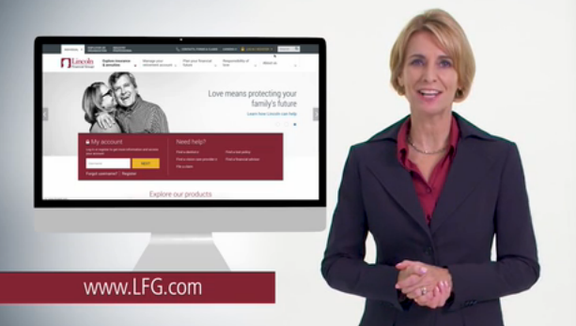
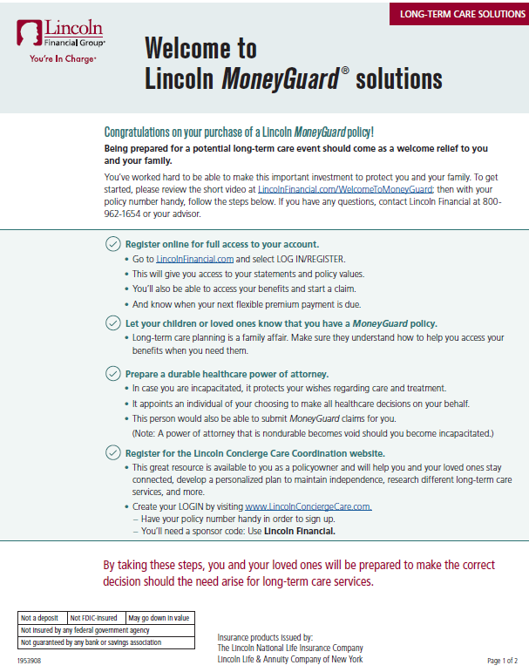
Lincoln Concierge Care Coordination
Click HERE to view our welcome video
New Welcome Flyer:
MGR-CLT-FLI003
For advisors and policy holders only. Not for use with the general public.

Slide 10
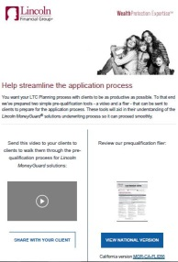
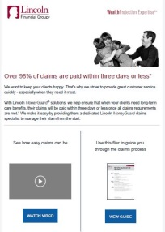
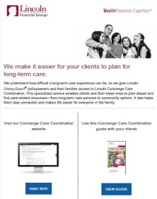
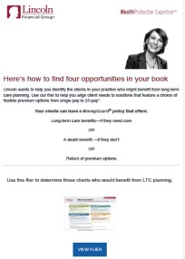
LINCOLN MONEYGUARD® - GET TO KNOW THE PROCESS
E-mails can be customized on your behalf. Please share your logo and contact information with your wholesaler if you’d like a campaign to be created for you.
Topic | Lincoln MoneyGuard® Underwriting Process Get to know our underwriting process | Lincoln MoneyGuard® Claims Process Get to know our claims process | Lincoln MoneyGuard® Concierge Care Coordination Get to know how valuable Lincoln Concierge Care Coordination can be during planning | Lincoln MoneyGuard® ‘Who is Your Client Playbook’ Find the right client for Lincoln MoneyGuard
Order Code | MGR-PRO-OML004 | MGR-PRO-OML002 | MGR-PRO-OML001 | MGR-PRO-OML003
Thumbnail
Notes:
Not for use with the general public. Emails/material is intended for agent or broker use.

Slide 11
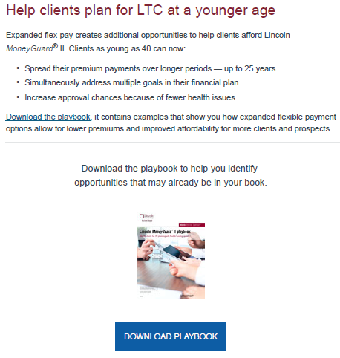
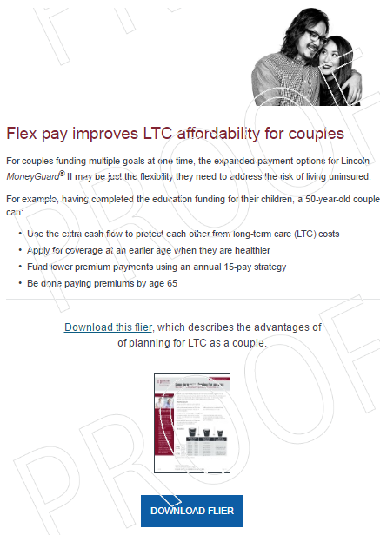
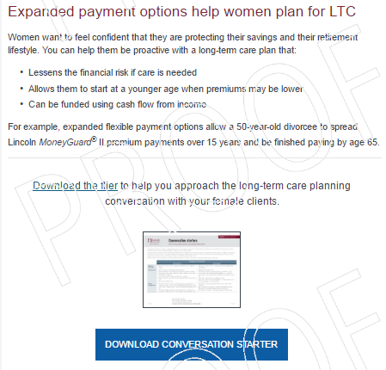
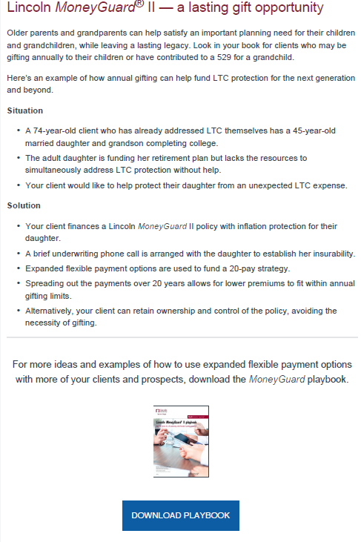
LINCOLN MONEYGUARD® - EXPANDED FLEX PAY
E-mails can be customized on your behalf. Please share your logo and contact information with your wholesaler if you’d like a campaign to be created for you.
Topic | Lincoln MoneyGuard® Expanded Flex Pay Plan for LTC at a younger age | Lincoln MoneyGuard® Expanded Flex Pay Affordability for couples | Lincoln MoneyGuard® II Expanded Flex Pay Women and LTC | Lincoln MoneyGuard® II Expanded Flex Pay For more ideas on how to use flex pay, use the MoneyGuard playbook
OMC Order Code | MGR-FLEX-oML002 | MGR-FLEX-oML003 | MGR-FLEX-oML004 | MGR-FLEX-oML005
Thumbnail
Notes:
Not for use with the general public. Emails/material is intended for agent or broker use.

Slide 12
WOMEN AND LONG-TERM CARE

Slide 13
LINCOLN MONEYGUARD® - WOMEN AND LTC
Expand long-term care planning penetration among female clients and prospects. Help women protect wealth from long-term care expenses by planning for themselves and family before the need arises.
CLIENT
ADVISOR
A LTC conversation with Mom Flier
MGR-INFO-FLI006
A LTC questionnaire
LFD-QUES-FLI001 (ICC version)*
LFD-QUES-FLI002 (for use in AZ, CT, DC, DE, HI, IN, MT, NJ, NY, SD, VI)
Women and LTC Client Whitepaper
MGR-WI-WPR001 (ICC version)*
MGR-WI-WPR002 (for use in AZ, CA, DC, DE, HI, IN, MT, ND, NY, SD)
* States other than AZ, CA, CT, DC, DE, FL, HI, IN, MT, ND, NJ, NY, SD, VI
Women and LTC Client Seminar
MGR-WI-PPT003 (ICC version)*
MGR-WI-PPT004
Women & LTC Infographic
MGR-WI-FLI001 (ICC version)*
Advisor Seminar
MGR-WI-PPT001
Advisor White Paper
LFD-WI-WPR001
Advisor Conversation Starters
MGR-WI-FLI002
Advisor Women & LTC Toolkit
MGR-WI-FLI003
LTC Planning for Couples flier
MGR-PLAN-FLI001

Slide 14
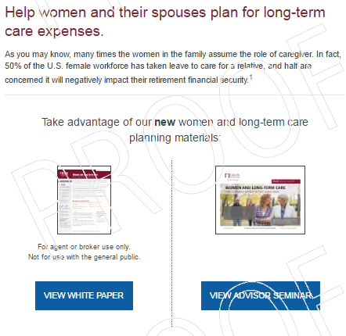
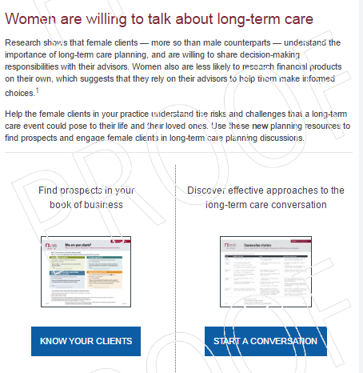
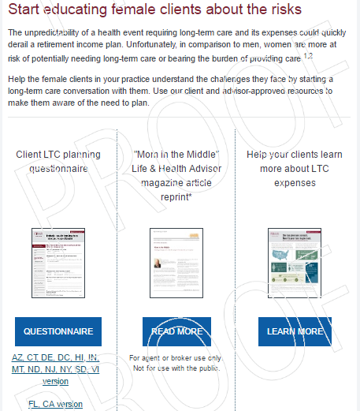
LINCOLN MONEYGUARD® - WOMEN AND LTC
E-mails can be customized on your behalf. Please share your logo and contact information with your wholesaler if you’d like a campaign to be created for you.
Email Topic | Women and Long-term Care Overview | Women & LTC - Conversation Starter | Women and Long-term Care Planning Tools
Order code | MGR-WI-oML001 | MGR-WI-oML002 | MGR-WI-oML003
Thumbnail
Notes:
Not for use with the general public. Emails/material is intended for agent or broker use.

Slide 15
CAREGIVING AND ALZHEIMER’S

Slide 16
LINCOLN MONEYGUARD® - CAREGIVING AND ALZHEIMER’S
Educate on the two sides of caregiving and help individuals protect wealth from long-term care expenses by planning before the need arises for cognitive impairment, dementia, and Alzheimer’s Disease.
CLIENT
ADVISOR
Alzheimer's Awareness Flier
MG-ALZ-FLI001
Alzheimer’s Infographic
MGR-ALZ-FLI010
Health and Wealth Checklist
MGR-CARE-FLI001
Tips for Caregivers
MGR-CARE-FLI003
Living-well longer Article
MGR-ALZ-ARC001
Creating lasting memories Article
MGR-ALZ-ARC003
* States other than AZ, CA, CT, DC, DE, FL, HI, IN, MT, ND, NJ, NY, SD, VI
Alzheimer’s Client Seminar
MGR-ALZ-PPT003 (ICC version)*
MGR-ALZ-PPT004 (for use in AZ, DC, DE, FL, HI, IN, MT, ND, SD)
Caregiving Infographic
MGR-CARE-APH002
Alzheimer’s Advisor Seminar
MGR-ALZ-PPT002
Caregiving Advisor Seminar
MGR-CARE-PPT001
Article Reprints:
3 New Findings About LTC Planning Prospects’ Emotions:
MGR-LTC-ARC012
IRI Winter Insight Magazine article
MGR-CARE-ARC003

Slide 17
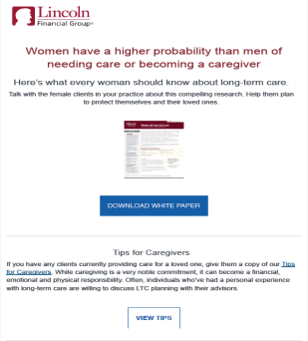
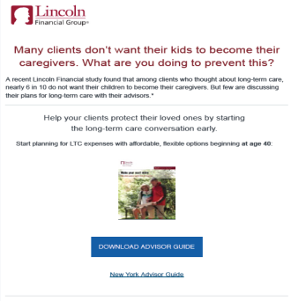
LINCOLN MONEYGUARD® - CAREGIVING
E-mails can be customized on your behalf. Please share your logo and contact information with your wholesaler if you’d like a campaign to be created for you.
Material | Women & Caregiving | Alzheimer’s Awareness E-mail | The link between Alzheimer’s & LTC | LTC Planning as a family
Order Code | MGR-FALL-oML001 | MGR-FALL-oML002 | MGR-FALL-oML003 | MGR-FALL-oML004
Thumbnail
Notes:
Not for use with the general public. Emails/material is intended for agent or broker use.

Slide 18
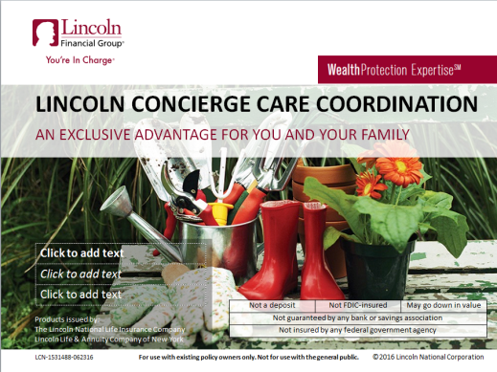
WEBINAR OPPORTUNITIES
Topic | 2017 MoneyGuard II Advisor PPT | Lincoln Concierge Care Coordination | LTC Conversation
Advisor/Client Facing | Advisor | Advisor | Advisor
Description | This seminar talks about planning for long-term care expenses and the importance of helping to protect the clients' wealth and their loved ones. | This seminar shows the value of Lincoln Care Coordination, the access to resources, and how to file a long term care claim. | Show agents how to incorporate long-term care planning into their practice.
OMC Order Code (click to preview) | MGR-ADV2-PPT006 | MGR-LCC-PPT001 | MGR-CONV-PPT003
Thumbnail

Slide 19
WEBINAR OPPORTUNITIES CONT’D
Topic | Who’s talking to the kids? | Women and Long Term Care | Alzheimer’s
Advisor/Client Facing | Advisor | Advisor | Advisor
Description | To maintain a healthy practice in an era of aging clients you want to look at multigenerational strategies that fit your unique skills and strengths. This presentation and companion Brainshark is full of engagement ideas and best practices to position your business for the future. | This seminar explores why women are ideal candidates for long-term care planning. It sheds light on the factors that make women more at risk for long term care than men and the financial sacrifices of not having a plan in place. | We’ll take a look at the prevalence, disease process, funding for care and services as well as the resources available.
OMC Order Code (click to preview) | MGR-MULT-PPT003 | MGR-WI-PPT001 | MGR-ALZ-PPT002
Thumbnail

Slide 20
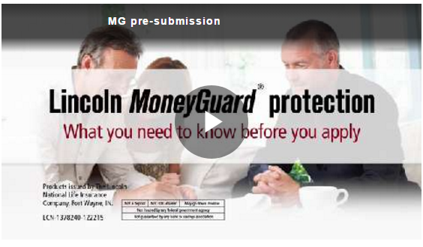
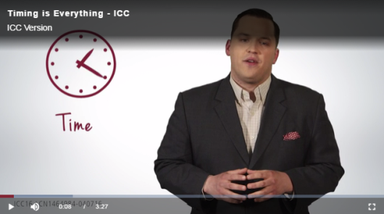
DIGITAL TOOLS TO HOST ON YOUR WEBSITE
Topic | Pre submission video | LTC Digital Experience | Timing is everything (LTC)
Link to view | View Here | View Here | ICC Link Non ICC Link
Thumbnail
Topic | Why LTC | Bill Nash – Digital Experience Video | Claims Video
Link to view | ICC Link Non ICC Link | View Here | View Here
Thumbnail
Notes:
Please do not host these links without consent from Lincoln.

Slide 21
Lincoln’s What Care Costs Website
Visit our what care costs website:
www.whatcarecosts.com/Lincoln
Use sponsor code: Lincoln

Slide 22
THANK YOU!
For more information regarding Lincoln MoneyGuard® Marketing opportunities, please reach out to your Lincoln MoneyGuard® representative.
Sales desk number: 877-533-0114
MGA Territory: MAP
LFA Territory: MAP
AGBA-GA Territory: MAP

Slide 23
IMPORTANT DISCLOSURES
Lincoln Financial Group® affiliates, their distributors, and their respective employees, representatives and/or insurance agents do not provide tax, accounting or legal advice. Please consult an independent advisor as to any tax, accounting or legal statements made herein.
This material is provided by the insurance company that issues the product[s] described herein; it is intended for use with the general public. The issuing insurance company is not undertaking to provide investment advice for any individual or any individual situation, and you should not look to this material for any investment advice. The issuing insurance company, as well as affiliated companies, have financial interests that are served by the sale of these products. Ask your financial advisor for assistance with your situation.
Lincoln MoneyGuard® II is a universal life insurance policy with a Long-Term Care Acceleration of Benefits Rider (LABR) that accelerates the specified amount of death benefit to pay for covered long-term care expenses. Long-Term Care Extension of Benefits Rider (LEBR) is available to continue long-term care benefit payments after the entire specified amount of death benefit has been paid. The return of premium options are offered through the Value Protection Rider (VPR) available at issue; Base option (1) is included in the policy cost; Graded option (2) is available at an additional cost. Any additional surrender benefit provided will be adjusted by any loans/loan interest/loan repayments, withdrawals taken, and claim payments made; and may have tax implications. Accelerated death benefits may be taxable and may affect public assistance eligibility. The cost of riders will be deducted monthly from the policy cash value. The insurance policy and riders have limitations, exclusions and/or reductions; and are subject to medical underwriting. Long-term care benefit riders may not cover all costs associated with long-term care costs incurred by the insured during the coverage period. All contract provisions, including limitations and exclusions, should be carefully reviewed by the owner.
Issued by The Lincoln National Life Insurance Company, Fort Wayne, IN, on Policy Form LN880/ICC13LN880 with the following riders: Value Protection Rider (VPR) on form LR880 and state variations/ICC15LR880 Rev; Long-Term Care Acceleration of Benefits Rider (LABR) on form LR881/ICC13LR881; optional Long-Term Care Extension of Benefits Rider (LEBR) on form LR882/ICC13LR882.

Slide 24
IMPORTANT DISCLOSURES
Lincoln MoneyGuard® Reserve universal life policies are issued by Lincoln Life & Annuity Company of New York, Syracuse, NY, on Policy Form LN850 (8/05) with a Convalescent Care Benefits Rider on Rider Form LR851 (8/05), a Terminal Illness Accelerated Death Benefit Rider on Rider Form LR853 (8/05), a Right to Purchase a Long-Term Care Policy on Endorsement Form LR856 (8/05), and a Nonforfeiture Benefit Rider on Rider Form LR855 (8/05).
All guarantees and benefits of the insurance policy are subject to the claims-paying ability of the issuing insurance company. They are not backed by the broker-dealer and/or insurance agency selling the policy, or any affiliates of those entities other than the issuing company affiliates, and none makes any representations or guarantees regarding the claims-paying ability of the issuer.
Products and features, including benefits, terms, and definitions, may vary by state.

