Slide 1
Is Your Board Structured for Impact?
Insights from Leading with Intent 2017
Join the conversation! Use our hashtag, #BuildYourBoard
Hosted by
Sponsored by

Slide 2
Today’s Conversation
Vernetta Walker
Vice President of Programs & Chief Governance Officer BoardSource
Dr. David Renz
Director, Midwest Center for Nonprofit Leadership at the University of Missouri-Kansas City
Anne Wallestad
President & CEO
BoardSource

Slide 3
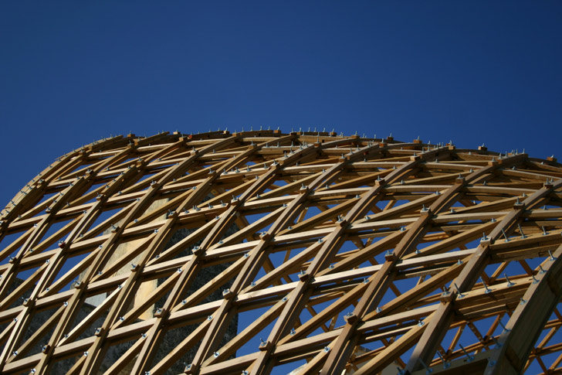
Does Board Structure Matter?

Slide 4
About the Study
Biennial study of board composition, culture, and performance.
First data collected in 1994.
Moment in time snapshots of board strengths and challenges.
Convenience sample of executives and board chairs.
Available for download at leadingwithintent.org.

Slide 5
About the Respondents

Slide 6
A Snapshot of Who Boards Are and How They Work
The People
The Culture
The Work
The Impact

Slide 7
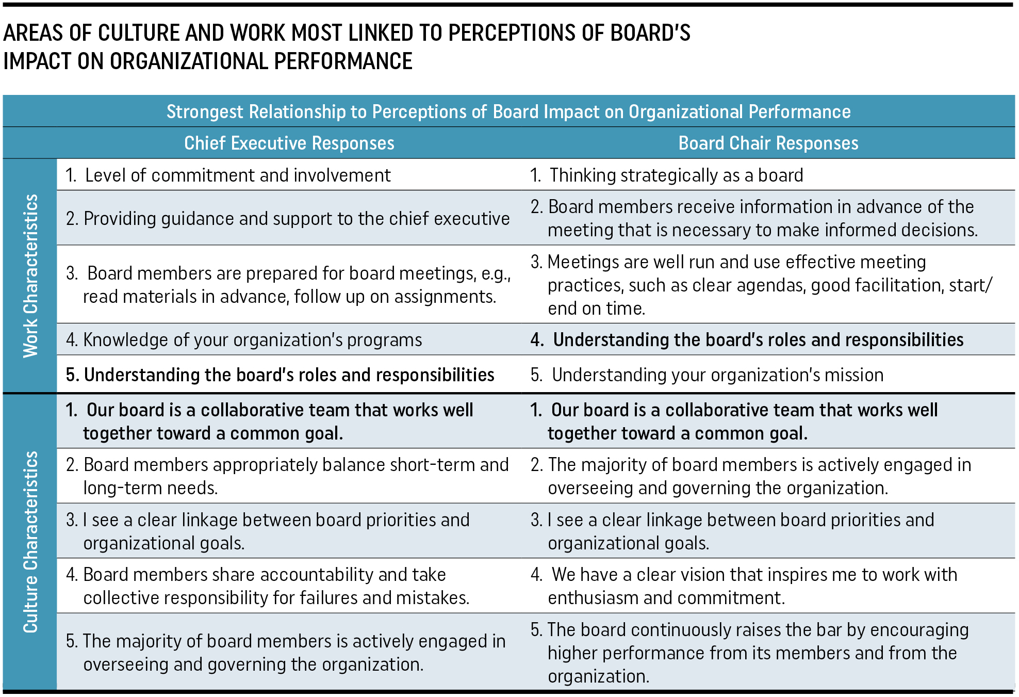
What Matters Most?

Slide 8
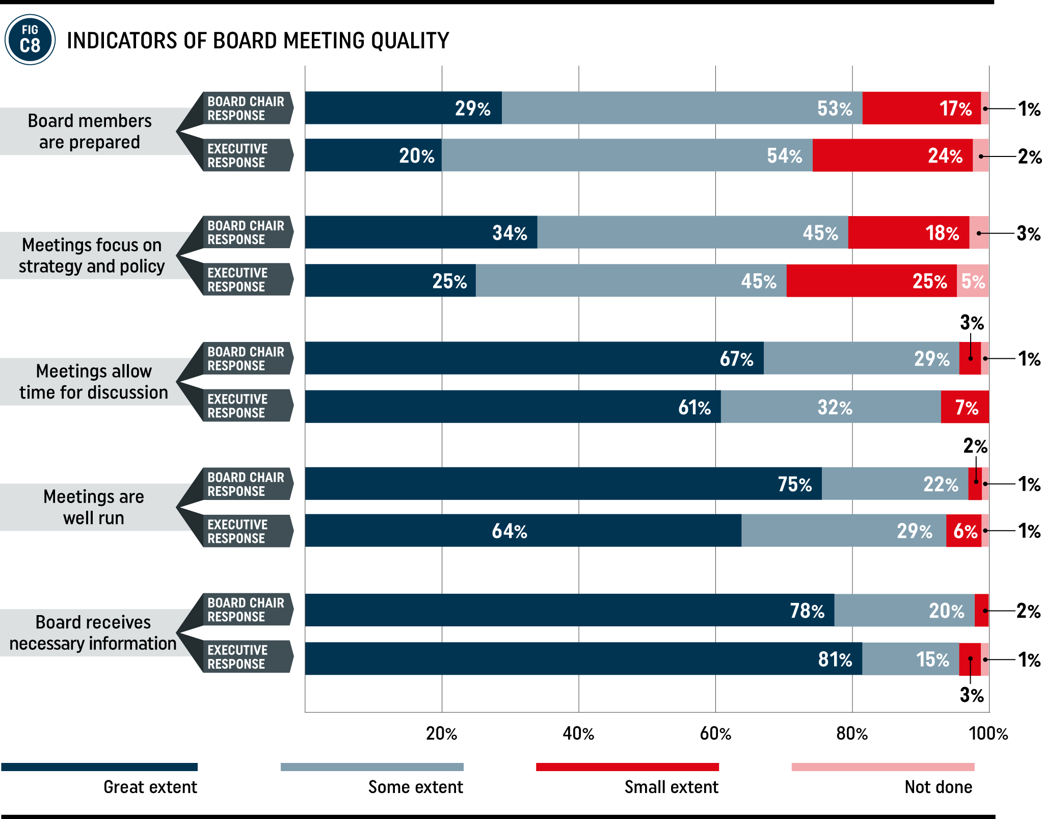
Structuring Quality Board Meetings

Slide 9
Structuring Quality Board Meetings

Slide 10
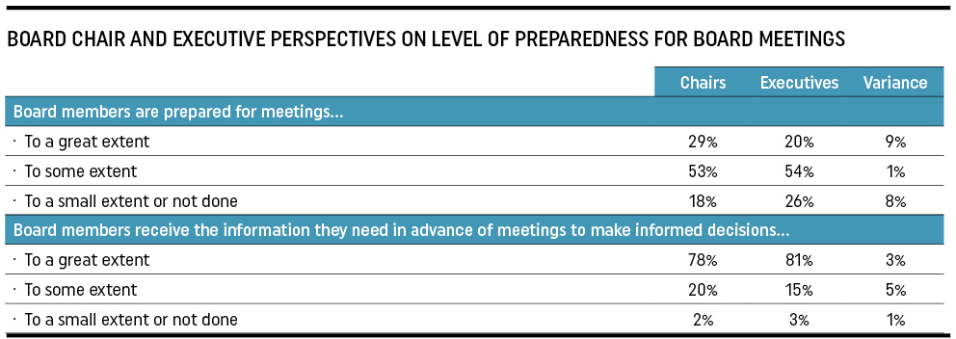
Board Meeting Preparation

Slide 11
A Potential Blind Spot for Executives
The Information Needed to Make Decisions
Time to Read and Prepare
Board’s Culture and Impact on Organizational Performance

Slide 12
Board Size: Trend toward smaller boards

Slide 13
Meeting Practices by Board Size

Slide 14
Reflection on Board Size
A board might be too small if…
it does not have access to the expertise and perspectives it needs
A board might be too big if…
there are too many board members to engage in a full-board conversation.
real deliberation sits with an executive committee
board members are disconnected from the board’s governing role
it struggles to maintain independence or exert influence
it does not have access to the networks it needs to build its reach and reputation

Slide 15
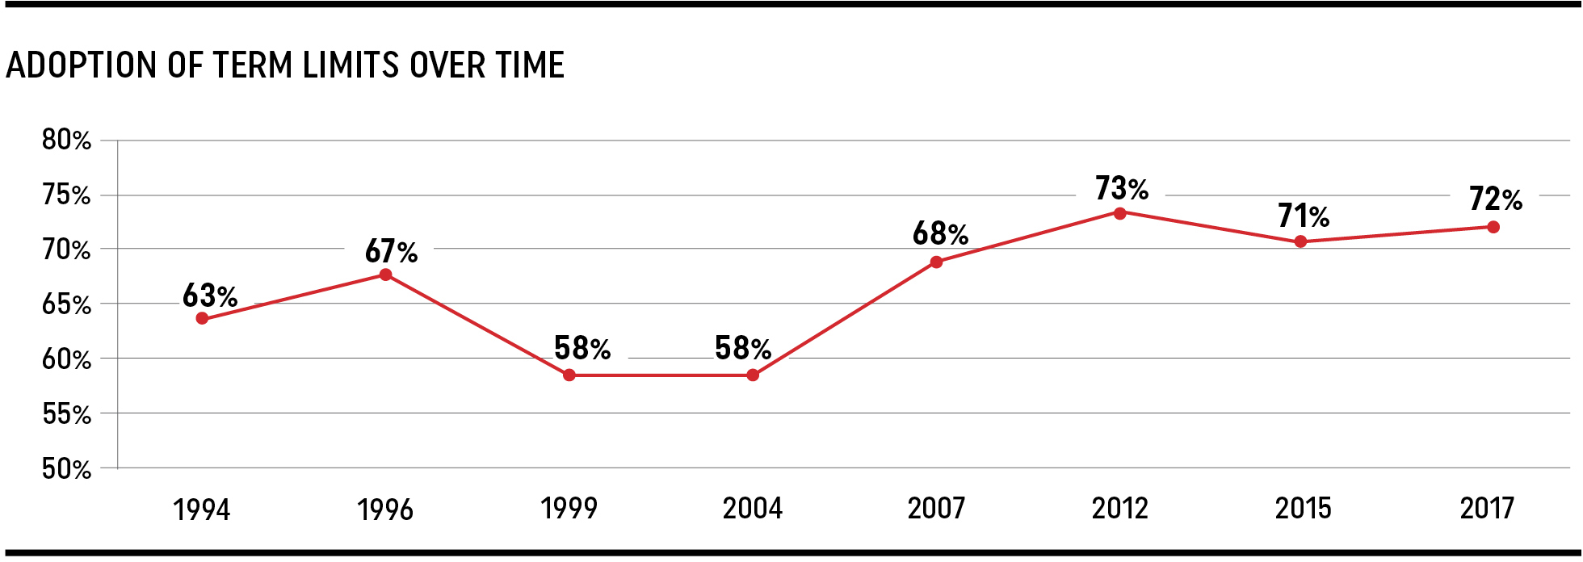
Term Limits: Adoption rates over time

Slide 16
Committees
Average number of standing committees is 4.5 (down from 6.6 in 1994)
Most common committees:
Executive (76%)
Finance (76%)
Governance (70%)
Fundraising (53%)

Slide 17
Reflection on Standing Committees
A good case for a standing committee
There is an ongoing need for board work on a particular issue or set of issues
Signs that a standing committee isn’t the answer
The need is short-term
The work can be effectively delegated to a smaller group of the board
The role of the group is unclear or duplicative of a staff function
Risk of usurping the full board’s governing responsibilities

Slide 18
The Importance of the Governance Committee

Slide 19
Learn More & Take Action
Download the report at leadingwithintent.org
Join future webinar discussions, hosted by Nonprofit Quarterly:
November 14th: The Importance of Board Understanding of Programs
December 12th: The Critical Role of Board Chairs
Use “Opportunities for Reflection” as a starting point for board discussion

Slide 20
Thank you for joining us!
Nonprofit Quarterly relies on your generous support. If you enjoyed this webinar, please consider donating today!
https://nonprofitquarterly.networkforgood.com/
Share what you learned! Use our hashtag, #BuildYourBoard
Sponsored by

