Slide 1
The Financial Risks of US Nonprofits
and How to Manage Them
February 2018

Slide 2
Why is “risk management” a hot topic right now?
Board members, executive directors, funders and policy makers are increasingly focused on financial risk, but there is little to guide them
A sense that the status-quo is unsustainable and the environment isn’t getting any easier (tax cuts, opioids, managed care, inequality, aging, etc.)
In response, we have done a series of analyses varying by depth, geography and sector:
Risk Management for Nonprofits (2016)
The Financial Health of Philadelphia-Area Nonprofits (2017)
The Financial Heath of the United States Nonprofit Sector (2018)
A National Imperative: Joining Forces to Strengthen Human Services in America (2018)
Our goals:
Fact-based baseline for discussion
Actionable recommendations
A call to action for organizations and funders

Slide 3
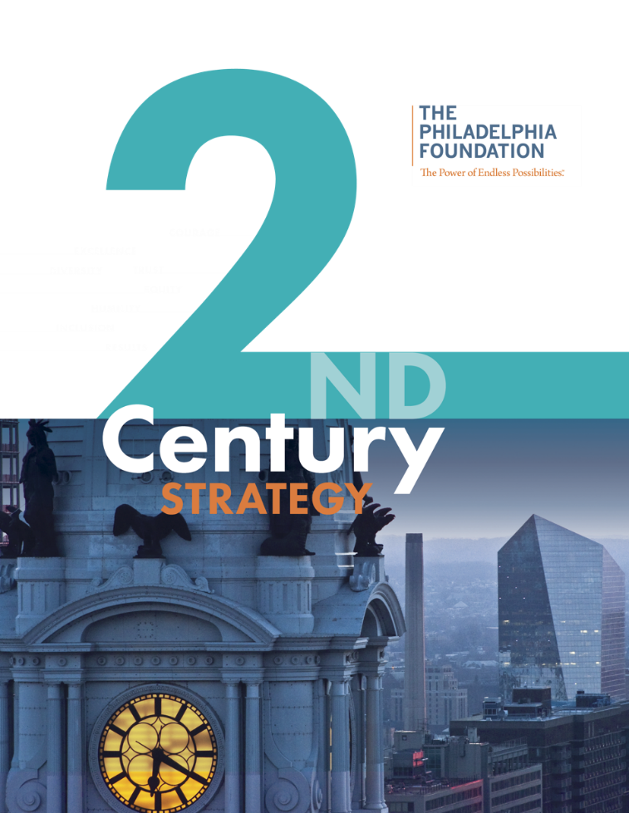
Impact/Asset Growth
Turn-to Resource
Our Organization
Civic Leadership

Slide 4
The Philadelphia Context
The Philadelphia Foundation has 10 years of capacity building grantmaking experience
Strong belief that good governance + strong leadership + solid financials = bigger impact and better outcomes
Committed to a “Rising Tide …” and Diversity, Equity and Inclusion
Philadelphia has not had hard data on the financial health of its nonprofits that are crucial to the quality of life
The environment isn’t getting any easier with a precarious social safety net and fragile government funding
New York report report was a good base but needed to be made locally relevant through data, language and local sponsorship
The report was well received and has been generating discussion at the country and city level where much of the real action is

Slide 5
US nonprofits – central to society, providing vital services and employing ~10% of workers – are in a precarious position¹
While the median nonprofit is “okay”:
3-year margins of 2.2%,
4.4 months of expenses in cash and investments
A healthy balance of public and private (~25%) funding
This masks considerable weakness:
7-8% are technically insolvent (i.e. liabilities exceed assets)
30% have lost money over the last three years
30% have less than two months of cash
50% have less than one month of operating reserves
Restoring the solvency gap would require $40-$50 billion
1 Based on Form 990s for 219,987 organizations with $2.45 trillion of expenses collected and maintained by GuideStar

Slide 6
But it is largely meaningless to talk broadly about the “nonprofit sector” given the diversity of the organizations within it . . .
Scale and concentration:
Very Small (<$1 million, 66% of orgs., 2% of spend)
Large and Very Large (>$10 million, 2% of orgs., 80% of spend)
For $10 million+ orgs., 70% have less than 15% philanthropy, 50% have less than 3% philanthropy)
Hospitals (9% orgs., 46% spend), Education (16% orgs., 25% spend)
Sub-sector diversity:
Environment, Religious, Arts & Culture (philanthropy of 50%+)
Health and Human Services, Youth Development, Community Capacity (philanthropy ranges between 3%-15%)

Slide 7
On an aggregate basis, what can we say about drivers of financial health?
Size matters (a little):
Similar levels of insolvency
May face more liquidity issues
Lower margins – on average – but lower range of margins
Sub-sector matters a lot:
Government contracts/fee for service (Hospitals, Human Services, Education) = more debt, smaller reserves
High philanthropy = less debt, larger reserves
Geography does not matter much

Slide 8
What does this all mean?
No surprise and no shame:
Hard problems, cost-minus (and inflexible) funding, one-way bets
Zero-sum philanthropy, cost disease, recruiting & retention
But those living close to the edge must focus on managing financial risk:
Little margin for error
Few ways to recover
Risk of becoming a “zombie”
Distress – including bankruptcy – creates hardship among clients and employees
Funders must help as the scale of the problem means nonprofits cannot do it alone

Slide 9
How do nonprofits fail?
Fragile to begin with
Longstanding challenge in recruiting/retaining a strong CFO
Crisis precipitated by an event (departure of ED, non-renewal of a funder, real estate project, contingent liability, etc.)
Failed to do explicit scenario planning
Board was not fully aware of important long-term trends because of focus on annual budgets and backward-looking comparisons
Board did not get timely, actionable information at the appropriate level of detail early in the crisis
Board took too long to realize there was a problem and then delayed taking action even when they knew it was necessary
Boards and EDs suffered from magical thinking

Slide 10
What should nonprofits do?
Review our data (or better data if you can find it) and see where you fit among your peers in terms of size, margin, reserves, etc.
Develop a plan to adopt the other risk management processes:
Assign explicit governance responsibility for risk management
Board composition
Environment scan, benchmarking, self-rating
Reporting and disclosure
Scenario and continuity planning
Culture and a willingness to say “No”
Recognize that partnerships, consolidations, divestments, even orderly wind-downs are part of a vibrant non-profit sector

Slide 11
What can funders do?
Encourage grantees to take a risk management approach
Support the full cost of operations
Offer advice and flexible funding
Consider pooled and/or nontraditional (i.e. non-grant) forms of support
“Normalize” the discussion of outsourcing, shared services, collaborations and even orderly wind-downs
Look at grantees’ boards of directors
Use multiple approaches to assess nonprofit health

Slide 12
Discussion

Slide 13
Thank you!
Nonprofit Quarterly provides these webinars free to our community; please consider going to
https://nonprofitquarterly.networkforgood.com/
to support us!

