Slide 1
Strategic Reserves and Endowments:
Guidance for Forward-Thinking Funders and Grantees
A conversation with:
Hilda Polanco, FMA
Joann M. Ricci, Greater New Orleans Foundation
Kellie Chavez Greene, Greater New Orleans Foundation
Melissa Sawyer, Youth Empowerment Project
, #???
Sponsored by

Slide 2
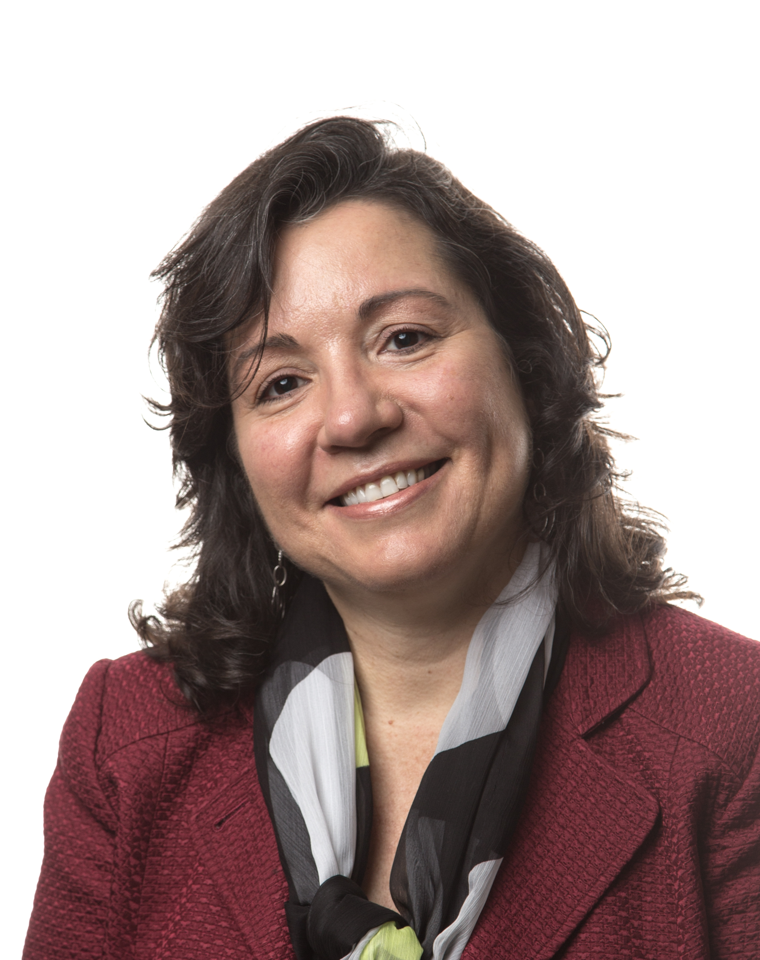
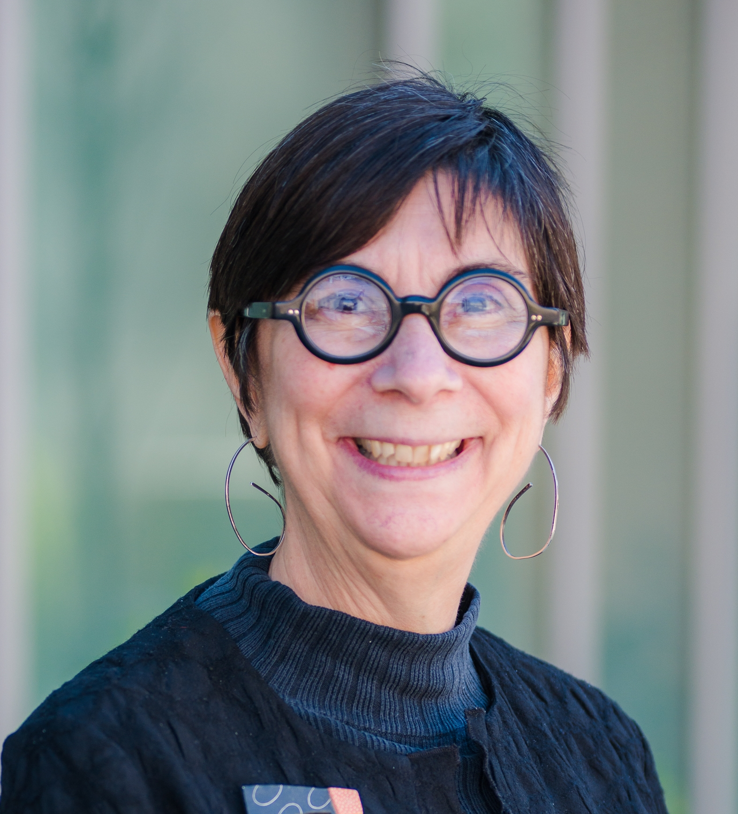
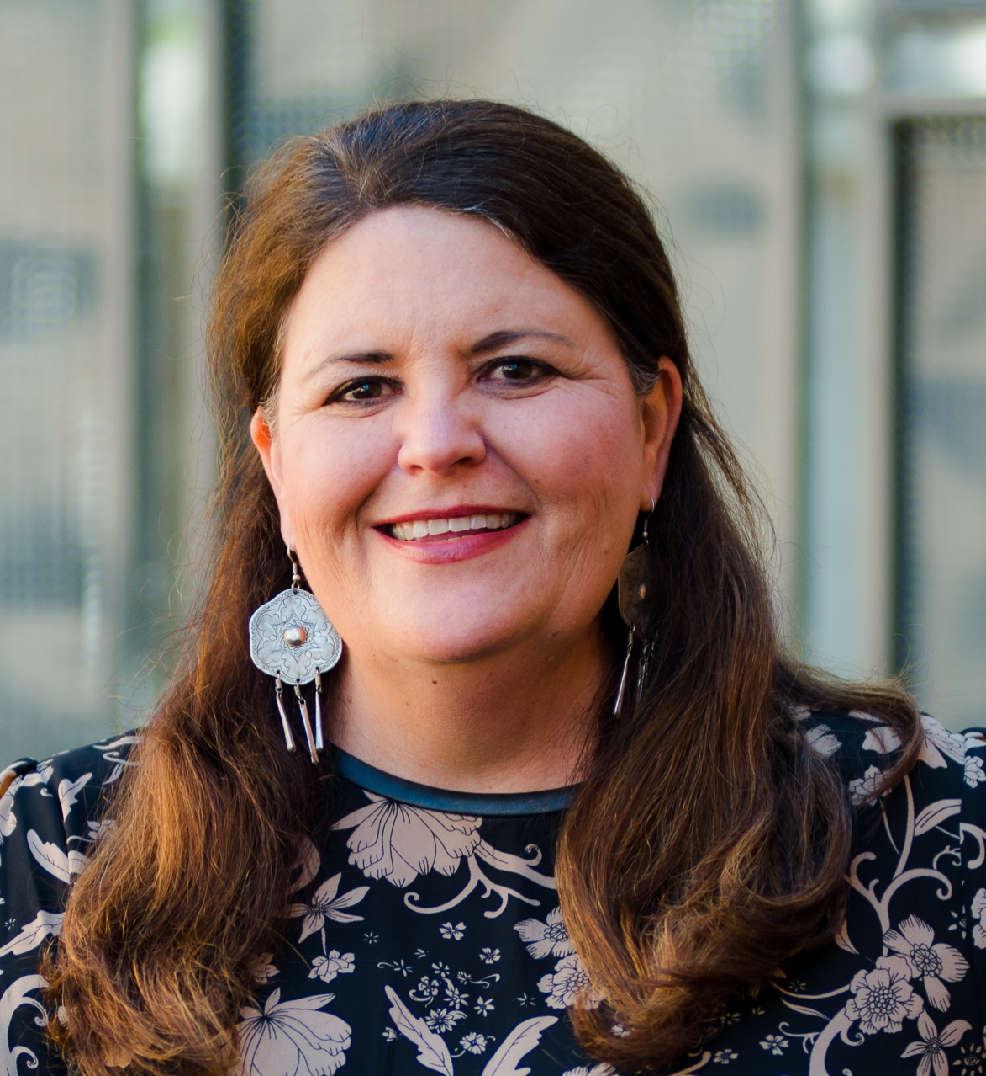
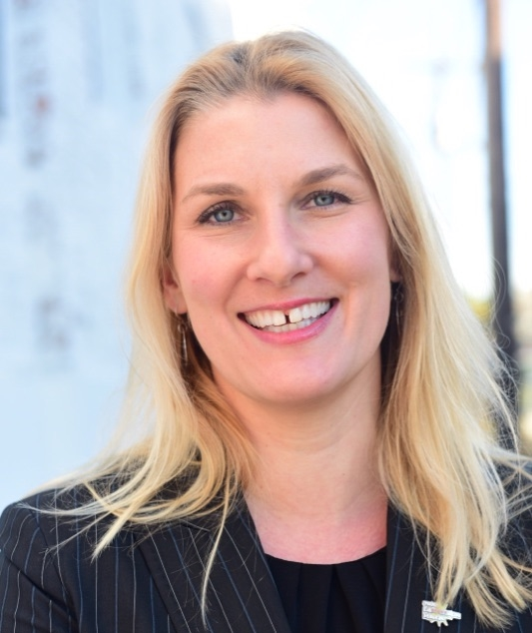
Welcome & Introductions
Today’s Presenters
Hilda Polanco
Founder & CEO, FMA
Joann M. Ricci
Vice President of Organizational Effectiveness,
Greater New Orleans Foundation
Kellie Chavez Greene
Senior Program Officer for Organizational Effectiveness,
Greater New Orleans Foundation
Melissa Sawyer
Co-founder / Executive Director, Youth Empowerment Project

Slide 3
Reserves vs. Endowments
Reserves vs. Endowments
Definition: Operating Reserves
The portion of unrestricted net assets that are available for use to sustain financial operations in the unanticipated event of significant unbudgeted increases in operating expenses and/or losses in operating revenues
Definition: Endowment
A fund that is made up of donations that are subject to a requirement that the principal be maintained intact and invested to create a source of income for the organization
Source: Operating Reserve Policy Toolkit for Nonprofit Organizations, sponsored by the National Center for Charitable Statistics, Center on Nonprofit and Philanthropy at the Urban Institute, and United Way Worldwide

Slide 4
Uses of Financial Capital
Capital for Change and Security
Type of Capital
Capacity Goal
Liquidity
Operating Reserve / LUNA
Security
Facility Reserves
Maintaining & Replacing Facilities
Growth & Expansion
Change Capital
Innovation (R&D)
Replenishment

Slide 5
Strategies for Creating Reserves
Reserves
Annual Surplus Designation
Budgetary Line Item for Annual Replenishment
Targeted Foundation Investment

Slide 6
The Freeman Challenges
Joann M. Ricci
Kellie Chavez Greene

Slide 7
The Freeman Challenges
Melissa Sawyer
Co-founder / Executive Director

Slide 8
Questions?

Slide 9
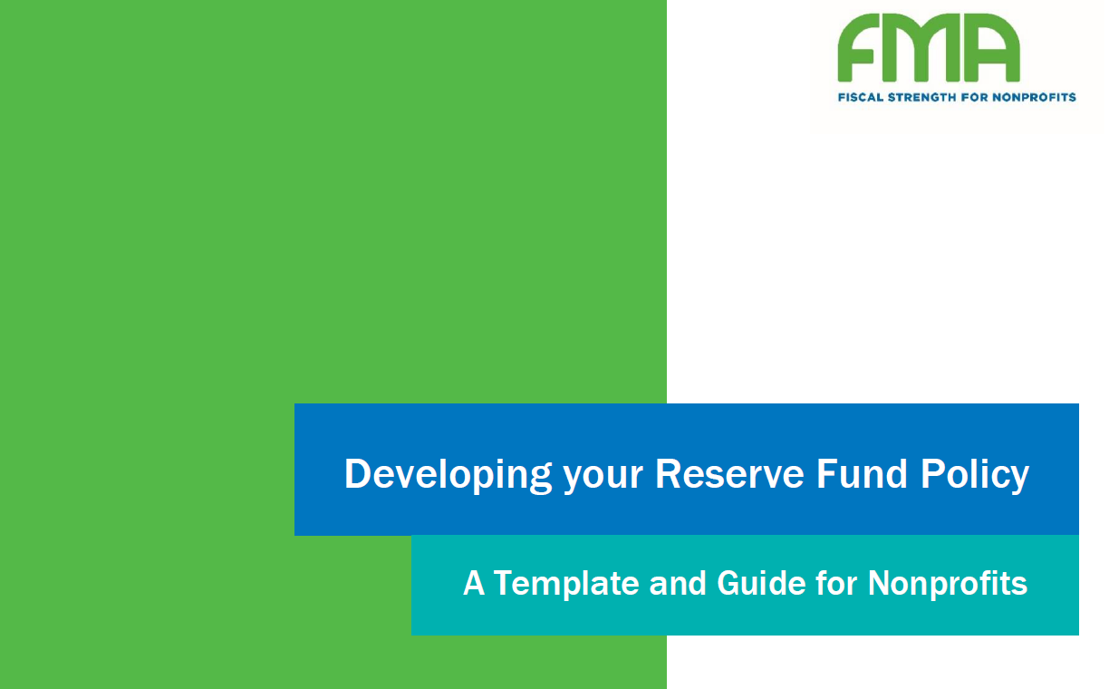
Resources: Full Cost
Resources: Reserves Policy Guide
Download at: www.fmaonline.net/NPQreserves

Slide 10
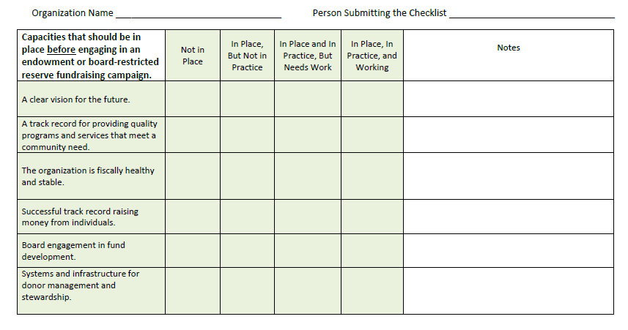
Resources: Full Cost
Resources: Readiness Checklist
Download at: www.fmaonline.net/NPQreserves

Slide 11
Resources: Full Cost
Resources
Keeping It in Reserve: Grantmaking for a Rainy Day, Hilda Polanco and John Summers, Nonprofit Quarterly, 2016: https://nonprofitquarterly.org/2016/05/02/keeping-it-in-reserve-grantmaking-for-a-rainy-day/
Nonprofit Capital: How to Think Differently About Its Use in Your Organization, FMA & Nonprofit Quarterly, November 2016: https://nonprofitquarterly.org/2017/04/12/think-differently-money-capital-explored

Slide 12
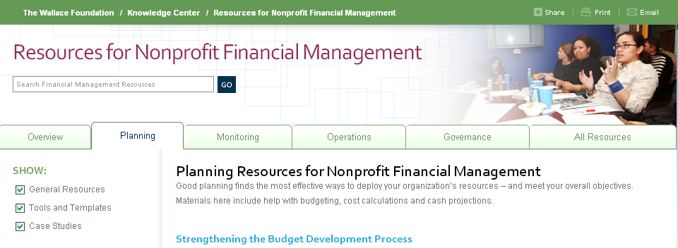
Resources
Resources
StrongNonprofits.org
In collaboration with the Wallace Foundation, FMA has created a library of tools and resources to help organizations become “fiscally fit”
Four Topic Areas: Planning | Monitoring | Operations | Governance

Slide 13
Resources
Resources
Online Tutorials for StrongNonprofits.org
FMA offers complimentary orientation one-hour webinars that feature an overview of the website and drill down on several of its key resources
Upcoming webinar dates:
September 25, 2018 at 2:00pm EST
November 13, 2018 at 2:00pm EST
To register, or see upcoming webinar dates:
http://fmaonline.net/events
For a 15-minute, on-demand webinar tour of the site:
http://fmaonline.net/SNPonDemand

Slide 14
Established in 1999 to serve not-for-profit organizations around the country
Provides customized financial management, accounting, software, organizational development, and other consulting services
Works directly with organizations or through funder-supported management and technical assistance programs
Hilda Polanco, CPA, CCSA®, CGMA
Founder & CEO
(212) 931-9240
hpolanco@fmaonline.net
@FMA4Nonprofits
/FiscalManagementAssociates
FMA exists to build a community of individuals with the confidence and skills to lead organizations that change the world
/company/fiscal-management-associates-llc
www.fmaonline.net
New York ● Chicago ● Oakland ● Los Angeles

Slide 15
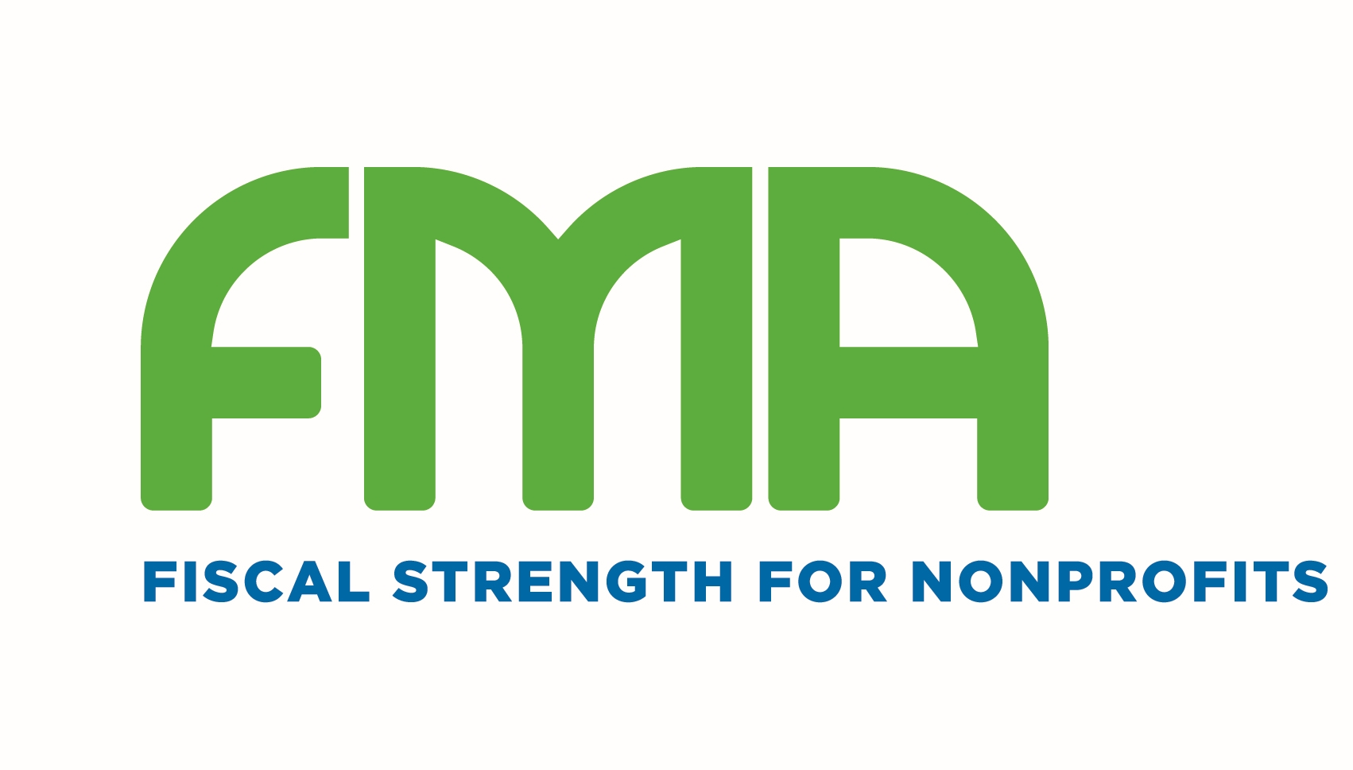
Thank you for joining us!
Nonprofit Quarterly relies on your generous support. If you enjoyed this webinar, please consider donating today!
https://nonprofitquarterly.networkforgood.com/
Sponsored by

