Slide 1


Remaking the Economy
March 19, 2020
Steve Dubb, Nonprofit Quarterly
Andrew Delmonte, PUSH Buffalo
India Walton, Fruit Belt Community Land Trust
Bob Doyle, Westminster Economic Development Initiative
Hon. April Baskin, Erie County Legislator
#RebuildTheEconomy
image courtesy of artist Heather Goodwind

Slide 2
Why have an NPQ Series on
Remaking the Economy?
Build awareness
Identify examples
Question narratives
Highlight pathways to change
Emphasize critical links

Slide 3
Buffalo
Population (city): 256,300
White 44%
Black 37%
Latinx 12%
Asian 6%
Native 1%
Median income $36K
Poverty rate 30.3%
(based on census data, rounded)

Slide 4
Buffalo: Economic History & Present
Erie Canal
“City of Light”
Steel and grain
Over 100,000 college students at 20 universities
Social enterprise development leader

Slide 5



Rebuilding the Economy in Buffalo
Fruit Belt Community Land Trust
People United for Sustainable Housing (PUSH)
Westminster Economic Development Initiative (WEDI)
500 × 150

Slide 6
Remaking the Economy: 2019-2020 webinar season
NPQ goes on the (virtual) road
New Mexico
Indian Country
Los Angeles
10-17-2019
11-21-2019
1-16-2020
Black Belt/
Miss. Delta
Fresno/
Central Valley
Buffalo
2-20-2020
3-19-2020
4-16-2020
Chicago
And beyond!
5-21-2020

Slide 7
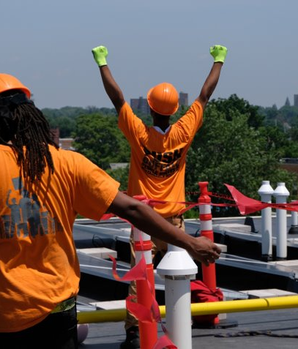
PUSH Buffalo
Aaron Bartley and Eric Walker founded PUSH in 2005 to:
create strong neighborhoods
decrease the rate of housing abandonment
develop neighborhood leaders

Slide 8
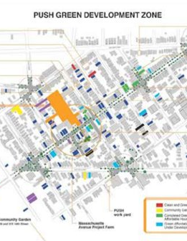
Sustainable Housing
Hiring Hall - trained over 224 workers and placed over 48 workers into good jobs ​
PUSH Green - helped weatherize over 1,000 homes and create dozens of living wage green jobs ​
PUSH Blue - installed green infrastructure on 19 acres

Slide 9

Energy Democracy and Climate Justice
Policy Advocacy
Demonstration Projects
Organizing

Slide 10
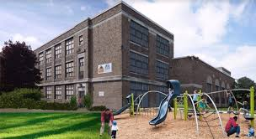
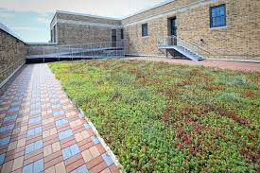
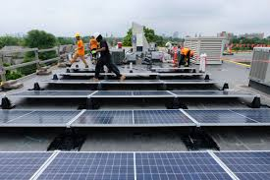
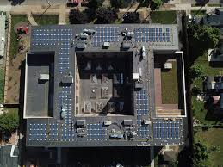
School 77
PUSH Buffalo
Ujima Theatre
Peace of the City
30 apartments
Community gym & meeting space
Community solar array
Green roof

Slide 11
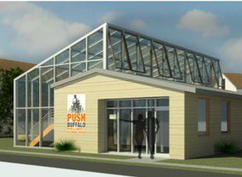


New Economy
Hiring Hall
PUSH Blue
Cooperation Buffalo
Community Solar & Sustainability

Slide 12
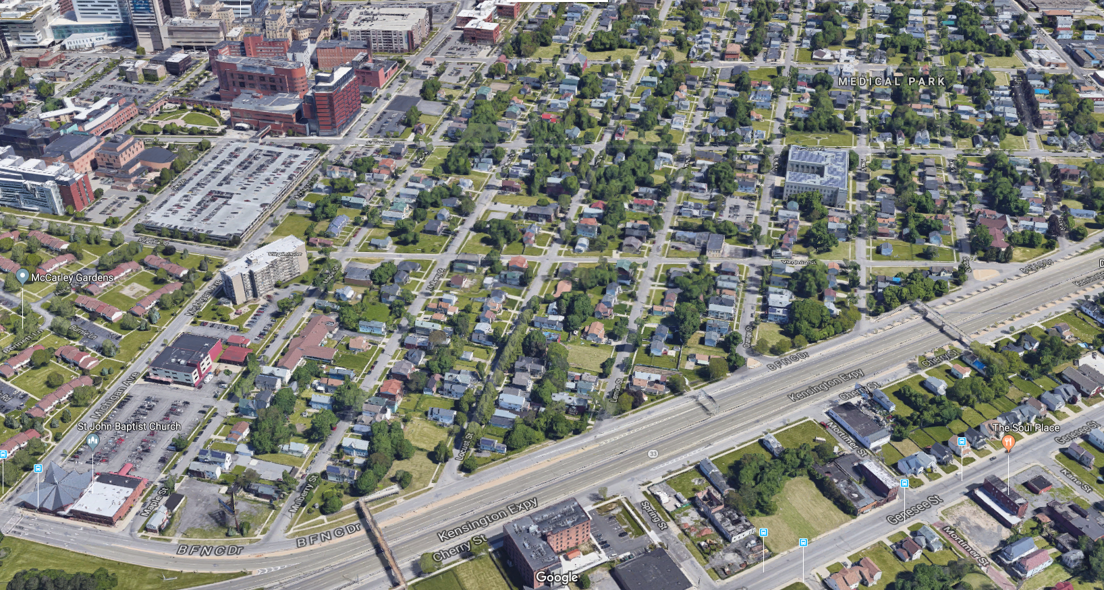

Slide 13
A bit of background…
Buffalo Niagara
  120 Acres
  9 million sq. ft of research, clinical, and support space
  More than $750M in public/private investment
Fruit Belt Neighborhood
  > 200 vacant lots
  Well-documented health disparities
  Case study of negative impact

Slide 14
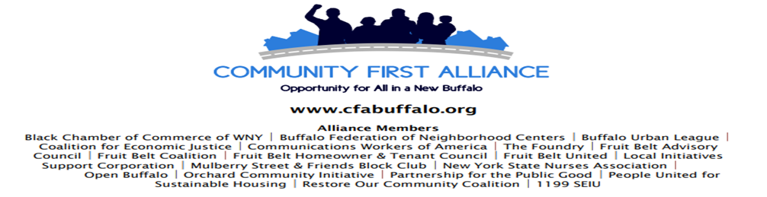
Response to rapid expansion of the BNMC
Goal of CBA
Ellicott district councilmember and Council President Darius Pridgen & the moratorium on the sale of any city owned properties in the Fruit Belt
Neighborhood plan adopted & approved

Slide 15

Staying in Place
“It won’t matter what benefits we win if we are not the community anymore.”

Slide 16
Since 2017…
Incorporated and obtained 501(c)(3) status
Launched a membership drive that yielded more than 100 new members
Positioned ourselves in the national spotlight among CLTs
Hired our first Executive Director
Acquired our first 4 lots for development of 2 single family homes in partnership with Habitat for Humanity Buffalo

Slide 17









Notes:
Partnerships are crucial
Relationships ar CRITICAL

Slide 18
WEDI
Westminster Economic Development Initiative, Inc.

Slide 19
What is WEDI?
Neighborhood stakeholders
  Westminster Presbyterian Church
  Common Council Member David Rivera, and a number of community groups and individuals
Housing → Microloan / Business focus
Diversity
Economic Development
Community Development
Education
$1 Million in Microloans
Portfolio: Who’s in?

Slide 20
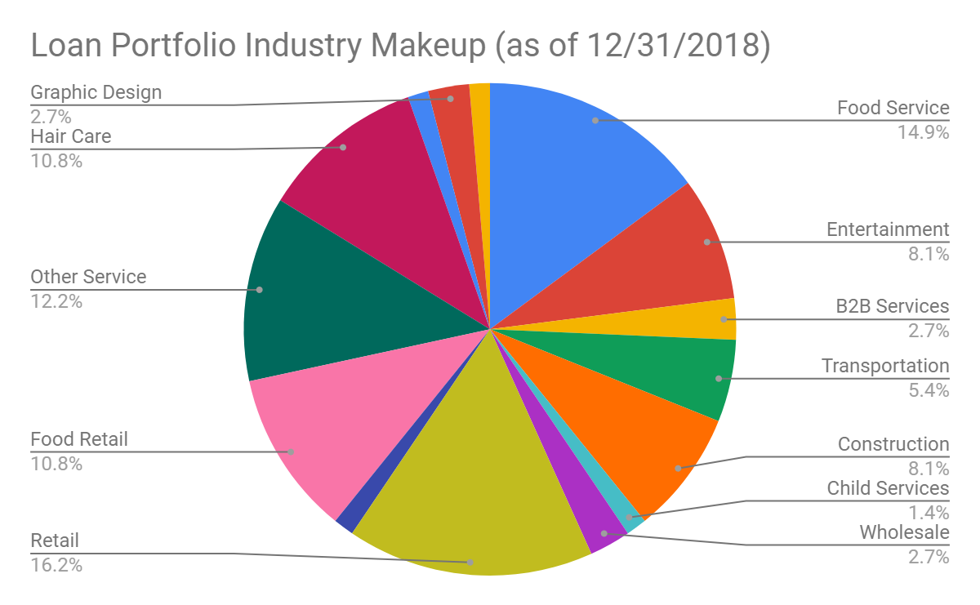
2 C’s of Credit – Character & Capacity

Slide 21
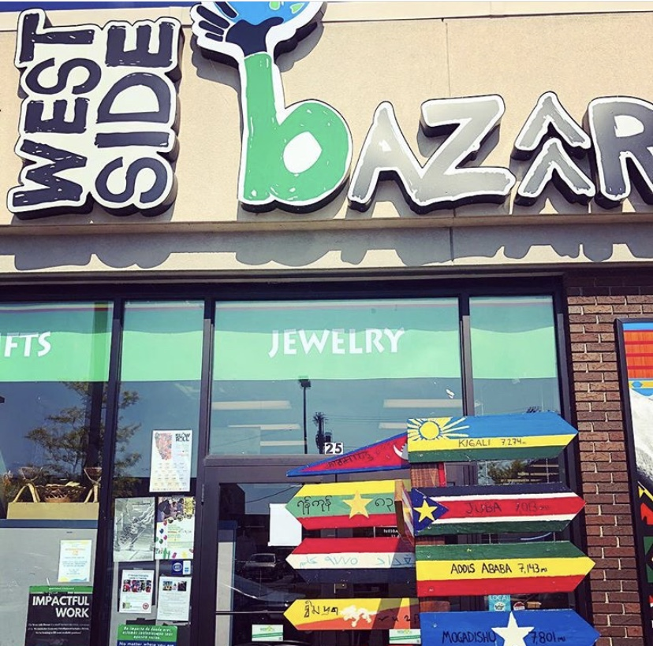
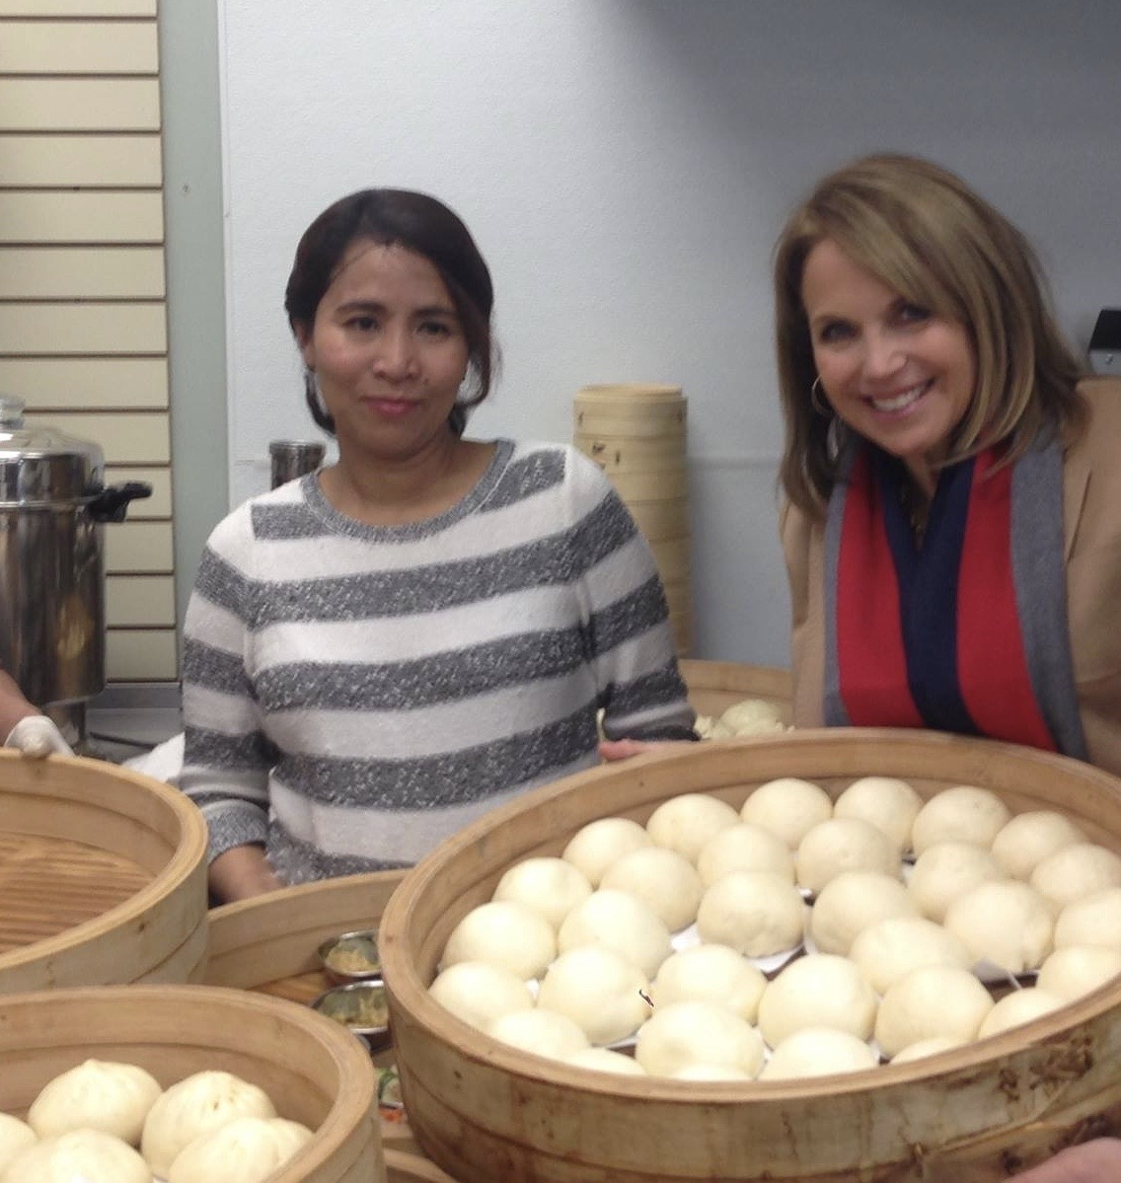
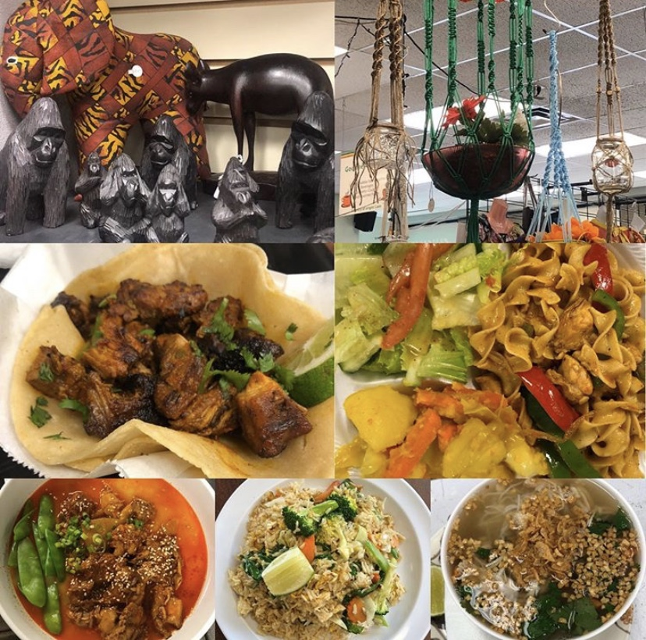
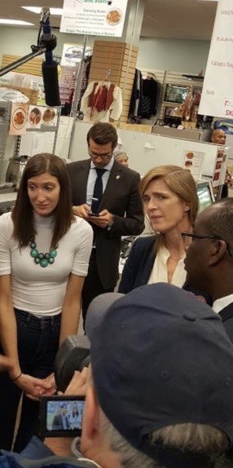
What is West Side Bazaar?
WEDI’s small business incubator
Founded in 2011, moved to current location in 2012
Expanding in 2021
9 restaurants and 6 retail businesses
40 businesses with 12 successful graduates
Sasmita Batik, Global Villages, Gourmet Lao
30 languages spoken
Business owners from six different countries

Slide 22
What do we do? Our Impact
Business development & planning
Financial development & planning
Training
Government compliance
Thriving businesses & revenue
Cultural Incubator
Local collaborator
Community anchor & safe space

Slide 23
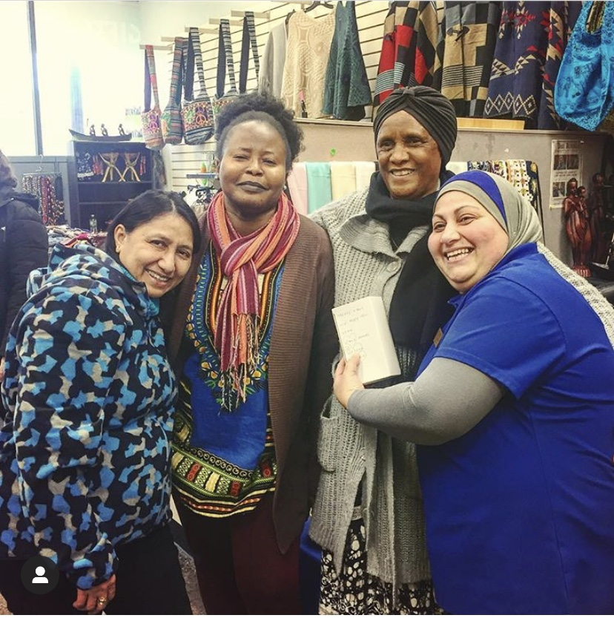
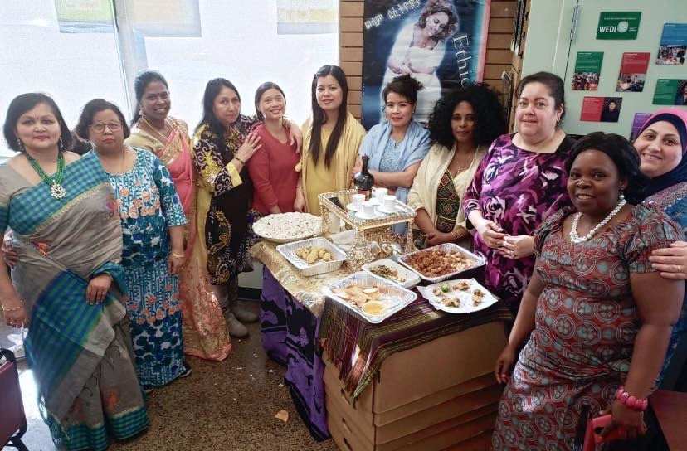
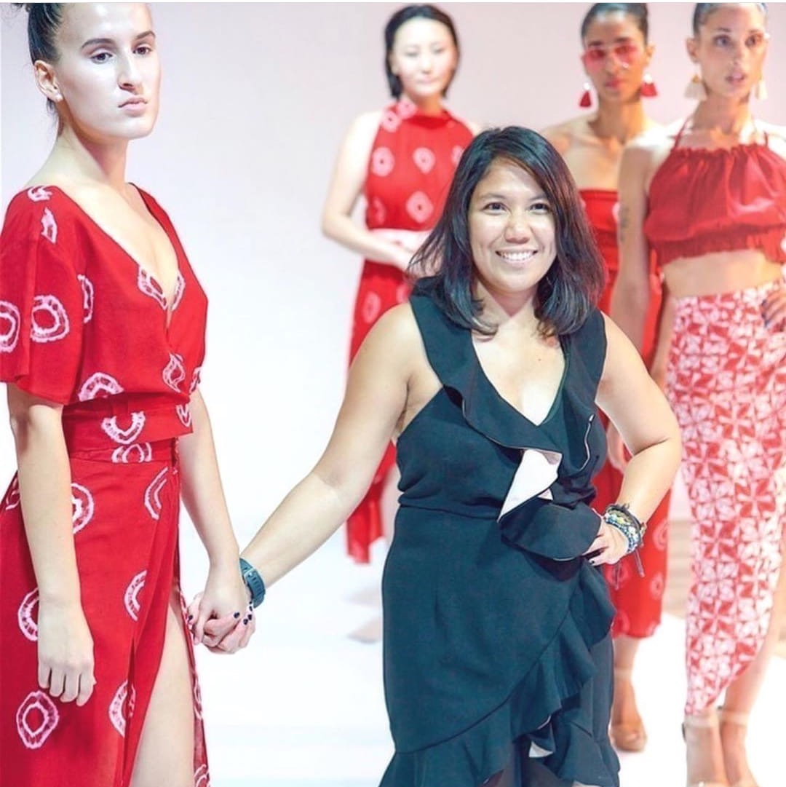
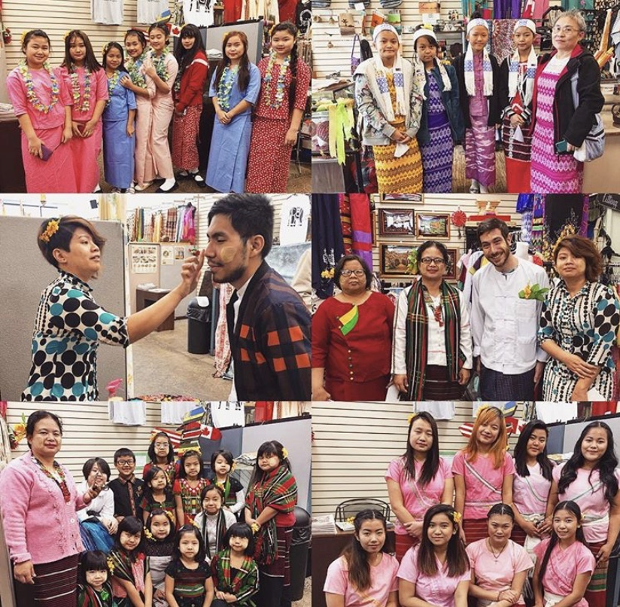
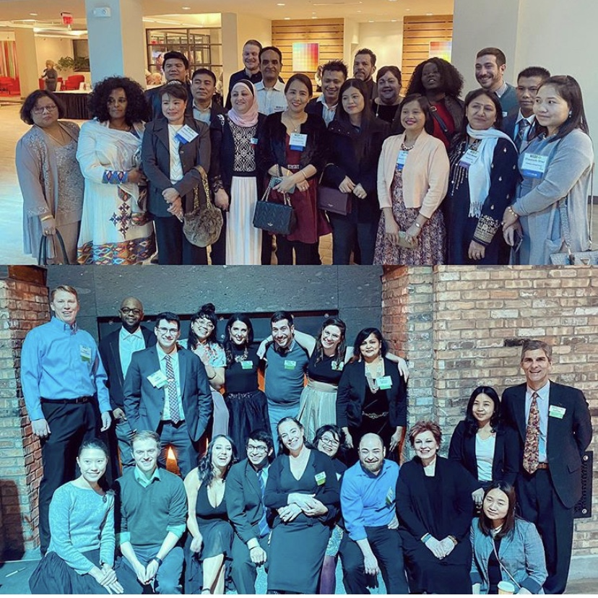
Westminster Economic Development Initiative
436 Grant Street
Buffalo, NY 14213
West Side Bazaar
25 Grant Street
Buffalo, NY 14213

Slide 24

Thank you for joining us!
Nonprofit Quarterly relies on your generous support. If you enjoyed this webinar, please consider donating today!
https://nonprofitquarterly.networkforgood.com/
Tell us what you thought! Use our special hashtag, #RebuildTheEconomy
image courtesy of artist Heather Goodwind

