Slide 1
Preparing for ONE BIG Change:
FASB Updates Nonprofit Reporting
A conversation with:
Hilda Polanco, FMA and
Ruth McCambridge, Nonprofit Quarterly
Follow the conversation on social media with our special hashtag, #FASBready
Sponsored by

Slide 2
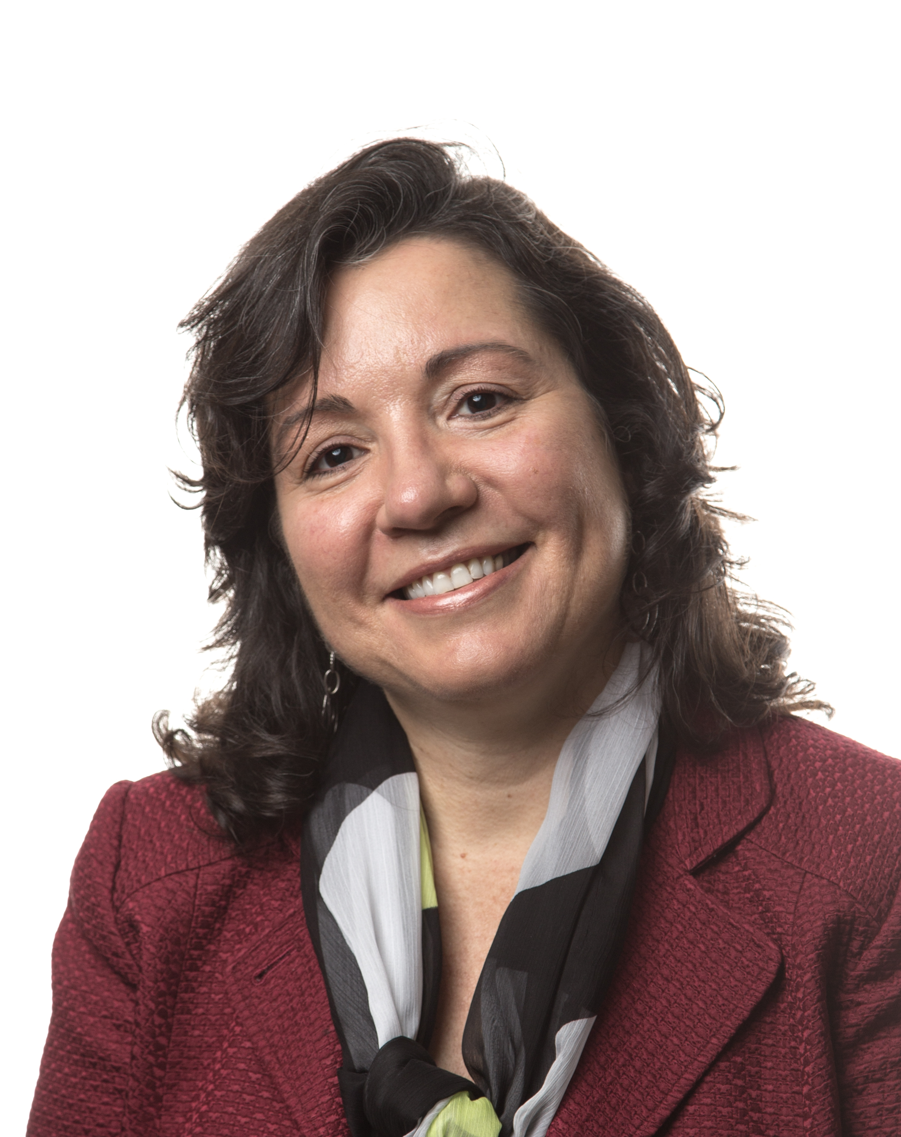
Welcome & Introductions
Today’s Presenter
Hilda Polanco
Founder & CEO

Slide 3
Financial Management Initiative
Accounting Standards Update (ASU)
ASU 2016-14:
First major revision since 1993
Effective Date: Calendar 2018 or Fiscal Year 2019
Issued in August 2016

Slide 4
ASU 2016-14
Key Stakeholders:
Focus:
How others can better read, understand, and make decisions using nonprofit financial statements
Donors & Funders
Financial Institutions
Board of Directors

Slide 5
Financial Management Initiative
What Does the ASU Impact?
Accounting
NO
Financial Statement Presentation
YES
Disclosures
YES

Slide 6
Financial Management Initiative
Key Provisions
ASU 2016-14
Liquidity & Availability
Expenses
Investment Return
Statement of Cash Flows
Net Asset Classification

Slide 7
Financial Management Initiative
Liquidity & Availability of Resources
To Help Stakeholders Assess:
Future Focused
Liquidity and “financial flexibility”
Availability of resources to meet cash needs

Slide 8
Financial Management Initiative
Liquidity & Availability of Resources
How a nonprofit manages its available liquid resources
Availability of financial assets to meet cash needs for general expenditures within one year of balance
sheet date
Qualitative
Quantitative

Slide 9
Financial Assets
“Available financial assets to meet cash needs for general expenditures within one year”
Total Assets
Fixed Assets
Prepaid Expenses
Inventory
Other Illiquid Assets
Financial Assets

Slide 10
Available Financial Assets
“Available financial assets to meet cash needs for general expenditures within one year”
Financial Assets
Board Designated Funds
Endowment Principal
Temp. Restricted Net Assets?
Availability can be based on either internal or external limits
Available Financial Assets

Slide 11
Financial Assets Available w/in 1 yr
“Available financial assets to meet cash needs for general expenditures within one year”
Available Financial Assets
Time Restricted TRNA > 1 year
Receivables > 1 year
Financial Assets Available w/in 1 yr

Slide 12
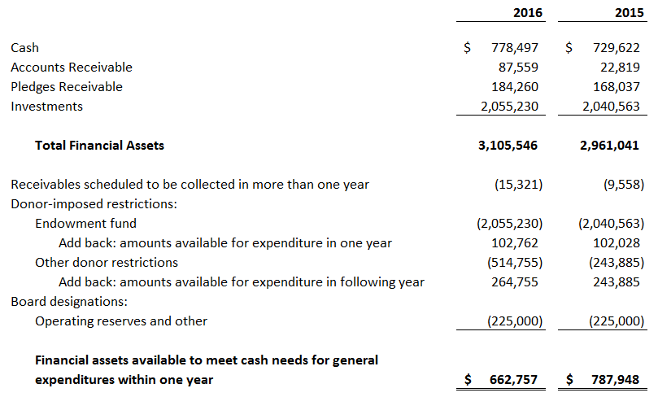
Financial Management Initiative
Liquidity Disclosure: Quantitative

Slide 13
Liquidity Disclosure: Qualitative
Note X – Liquidity and Availability of Financial Assets
Organization ABC’s working capital and cash flows have seasonal variations during the year attributable to the annual cash receipts for subscriptions and a concentration of contributions received near calendar year end. To manage liquidity the Organization maintains a line of credit of $100,000 with a bank that is drawn upon as needed during the year to manage cash flow and is then repaid in full by the end of the fiscal year. See note Y for a description of this line.
The Organization has $897,000 in financial assets as of the balance sheet date, reduced by amounts not available for general use within one year because of donor-imposed restrictions or internal designations. Amounts available include the Board-approved appropriation from the endowment fund for the following year as well as donor-restricted amounts that are available for general expenditure in the following year. Amounts not available include amounts set aside for operating and other reserves that could be drawn upon if the Board of Directors approves that action.

Slide 14
Financial Management Initiative
Effective Date
When will the new rules take effect?
Effective for annual financial statements issued for fiscal years beginning after December 15, 2017
Fiscal Year
(i.e. June 30):
Fiscal year beginning July 1, 2018
Dec 31 year-end: Calendar 2018

Slide 15
Financial Management Initiative
Preparing for the Change
Educate members of the board and leadership on the new requirements
Clarify and document your board’s intentions as they relate to available unrestricted resources
Seek professional advice
Use 2017 as a “dress rehearsal”

Slide 16
Questions?

Slide 17
Resources
Resources
StrongNonprofits.org
In collaboration with the Wallace Foundation, FMA has created a library of tools and resources to help organizations become “fiscally fit”
Four Topic Areas: Planning | Monitoring | Operations | Governance

Slide 18
Resources
Resources
Online Tutorials for StrongNonprofits.org
FMA offers complimentary orientation one-hour webinars that feature an overview of the website and drill down on several of its key resources
Upcoming webinar dates:
September 12, 2017 at 2:00pm ET
November 14, 2017 at 2:00pm ET
To register, or see upcoming webinar dates:
http://fmaonline.net/strongnonprofits
For a 15-minute, on-demand webinar tour of the site:
http://fmaonline.net/SNPonDemand

Slide 19
Fiscal Management Associates, LLC
Established in 1999 to serve not-for-profit organizations around the country
Provides customized financial management, accounting, software, organizational development, and other consulting services
Works directly with organizations or through funder-supported management and technical assistance programs
Hilda Polanco, CPA, CCSA®, CGMA
Founder & CEO
(212) 931-9240
hpolanco@fmaonline.net
@FMA4Nonprofits
/FiscalManagementAssociates
FMA exists to build a community of individuals with the confidence and skills to lead organizations that change the world
/company/fiscal-management-associates-llc
www.fmaonline.net
New York ● Chicago ● Oakland ● Los Angeles

Slide 20
Thank you for joining us!
Nonprofit Quarterly relies on your generous support. If you enjoyed this webinar, please consider donating today!
https://nonprofitquarterly.networkforgood.com/
Follow the conversation on social media with our special hashtag, #FASBready
Sponsored by

