Slide 1
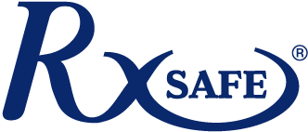
Improving Patient Health with Adherence Packaging
Presenter Name Presenter Title, Organization

Slide 2
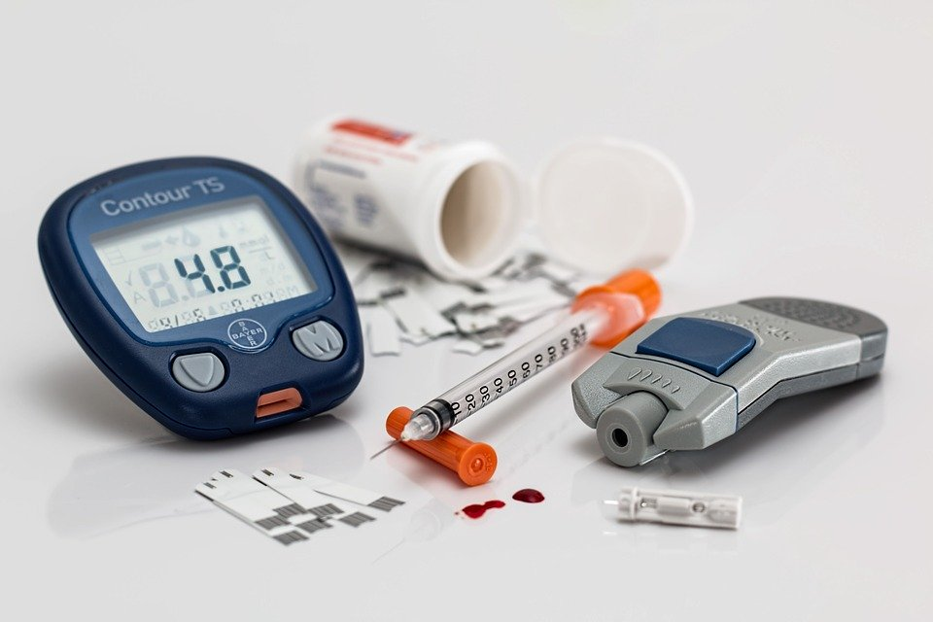
Which Patients Have Highest Risk of Non-Adherence?
Elderly Patients
Patients with Chronic Diseases
Notes:
Elderly patients: the cost of drugs is not affordable, lack the ability to make multiple trips a month to the pharmacy, often forget if they took their medications
Patients with chronic diseases: do not have the the time to make multiple trips to the pharmacy, large prescription becomes overwhelming, lack the ability to properly track which medications they

Slide 3
The Cost of Non-Adherence
Sources: ¹“Multiple Chronic Conditions in the United States”, Rand Corporation, 2017; ² Journal of Managed Care Pharmacy 2008; ^{3”}Medication Adherence in America”, Langer Research Associates; ⁴https://www.ncbi.nlm.nih.gov/pmc/articles/PMC3375198/; ⁵https://www.fda.gov/Drugs/ResourcesForYou/SpecialFeatures/ucm485545.htm
60% of Americans (191M) suffer with chronic disease¹
Over 50% of Americans have 2 or more prescriptions¹
$300B in unnecessary annual healthcare costs²
#1 self-reported reason for non-adherence is forgetfulness (62%)⁴
125,000 unnecessary deaths²
10-25% of admissions to hospitals and nursing homes are caused by poor adherence²
2/3 of Americans with prescriptions are non-adherent³
50% of 1.8B prescription meds dispensed annually within the USA are not taken correctly⁵
Almost 70% of Americans have at least one prescription¹

Slide 4
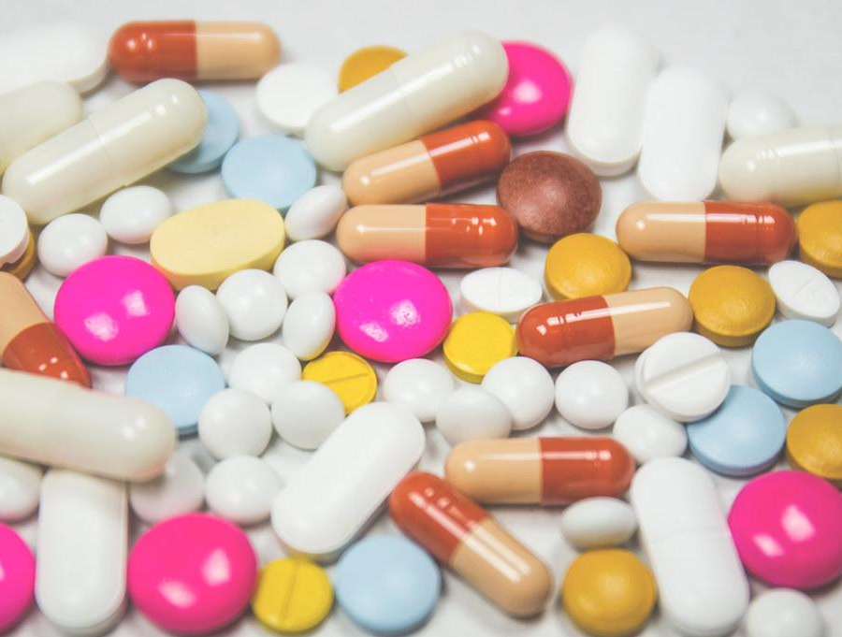
The Cost of Non-Adherence
Non-adherent elderly patients are more likely to experience ADEs (Adverse Drug Events)⁶
Patients often fail to take their prescriptions at the prescribed dosage level or time interval⁷
Non-adherent patients are likely to spend an additional $5000 for healthcare services⁸
Sources: ⁶“Adverse Drug Events Resulting in Patient Error in Older Adults”, PubMed 2007; ⁷ “Thinking Outside the Pillbox” , New England Healthcare Institute, 2009; ^{8”}Non-adherence to antipsychotic medication regimens”, Cambridge Core, 2018

Slide 5
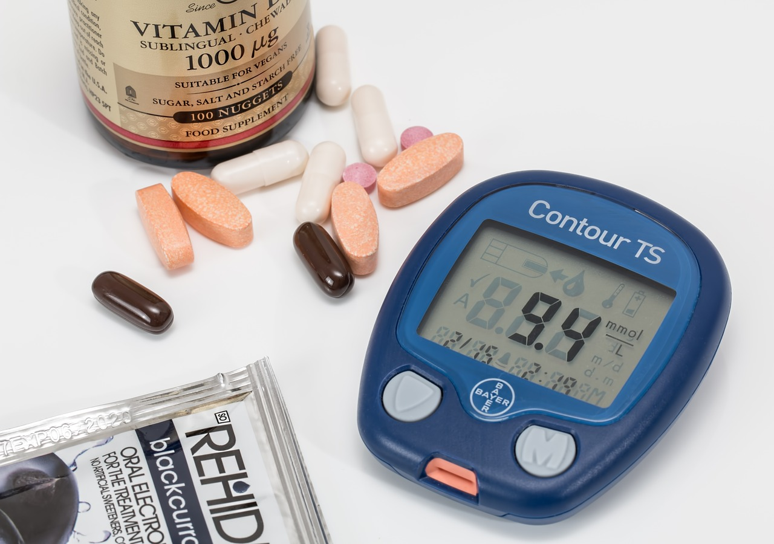
The Cost of Diabetes
On average, type II diabetes patients only take approximately 60% of prescribed oral meds and insulin doses⁹
Non-adherence among patients with diabetes can lead to serious health complications¹⁰:
Kidney failure
Heart attack
Stroke
Vision loss
Amputation and nerve damage
Sources: ⁹ World Health Organization, 2016 ; ¹⁰ American Diabetes Association 2017

Slide 6
How Adherence Helps Diabetes
Improved adherence to diabetes medications is associated with 13% lower odds of subsequent hospitalizations or emergency department visits¹¹
Adherence to medications leads to better control of blood sugar levels¹¹
Improving adherence among patients with diabetes can save approximately $2.22 billion in hospital and emergency visits¹¹
Sources: ¹¹ Greater Adherence to Diabetes Drugs is Linked to Less Hospital Use and Could Save Nearly $5 Billion Annually, 2012

Slide 7
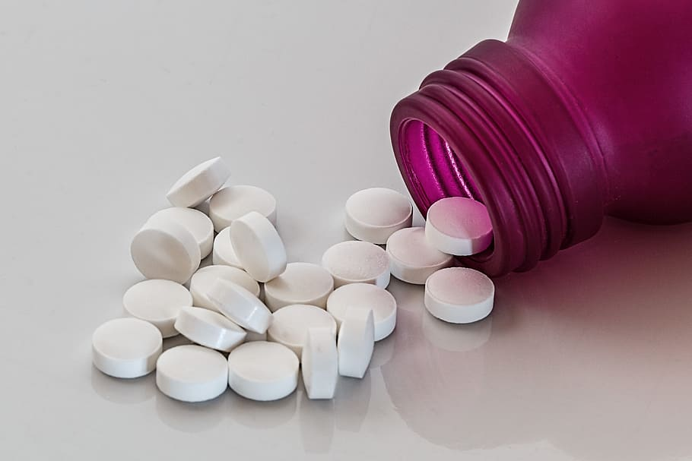
The Cost of Depression
Worldwide, there are more than 350 million people who are affected by depression¹²
Chronically-ill patients with depression have 76% greater odds of non-adherence¹³
One study found that depression results in an average of 8 million ambulatory care visits per year¹⁴
Sources: ¹² WHO, depression fact sheet, 2016 ; ¹³ Randy.org, 2011, ¹⁴ National Center for Statistics, CDC, 2016

Slide 8
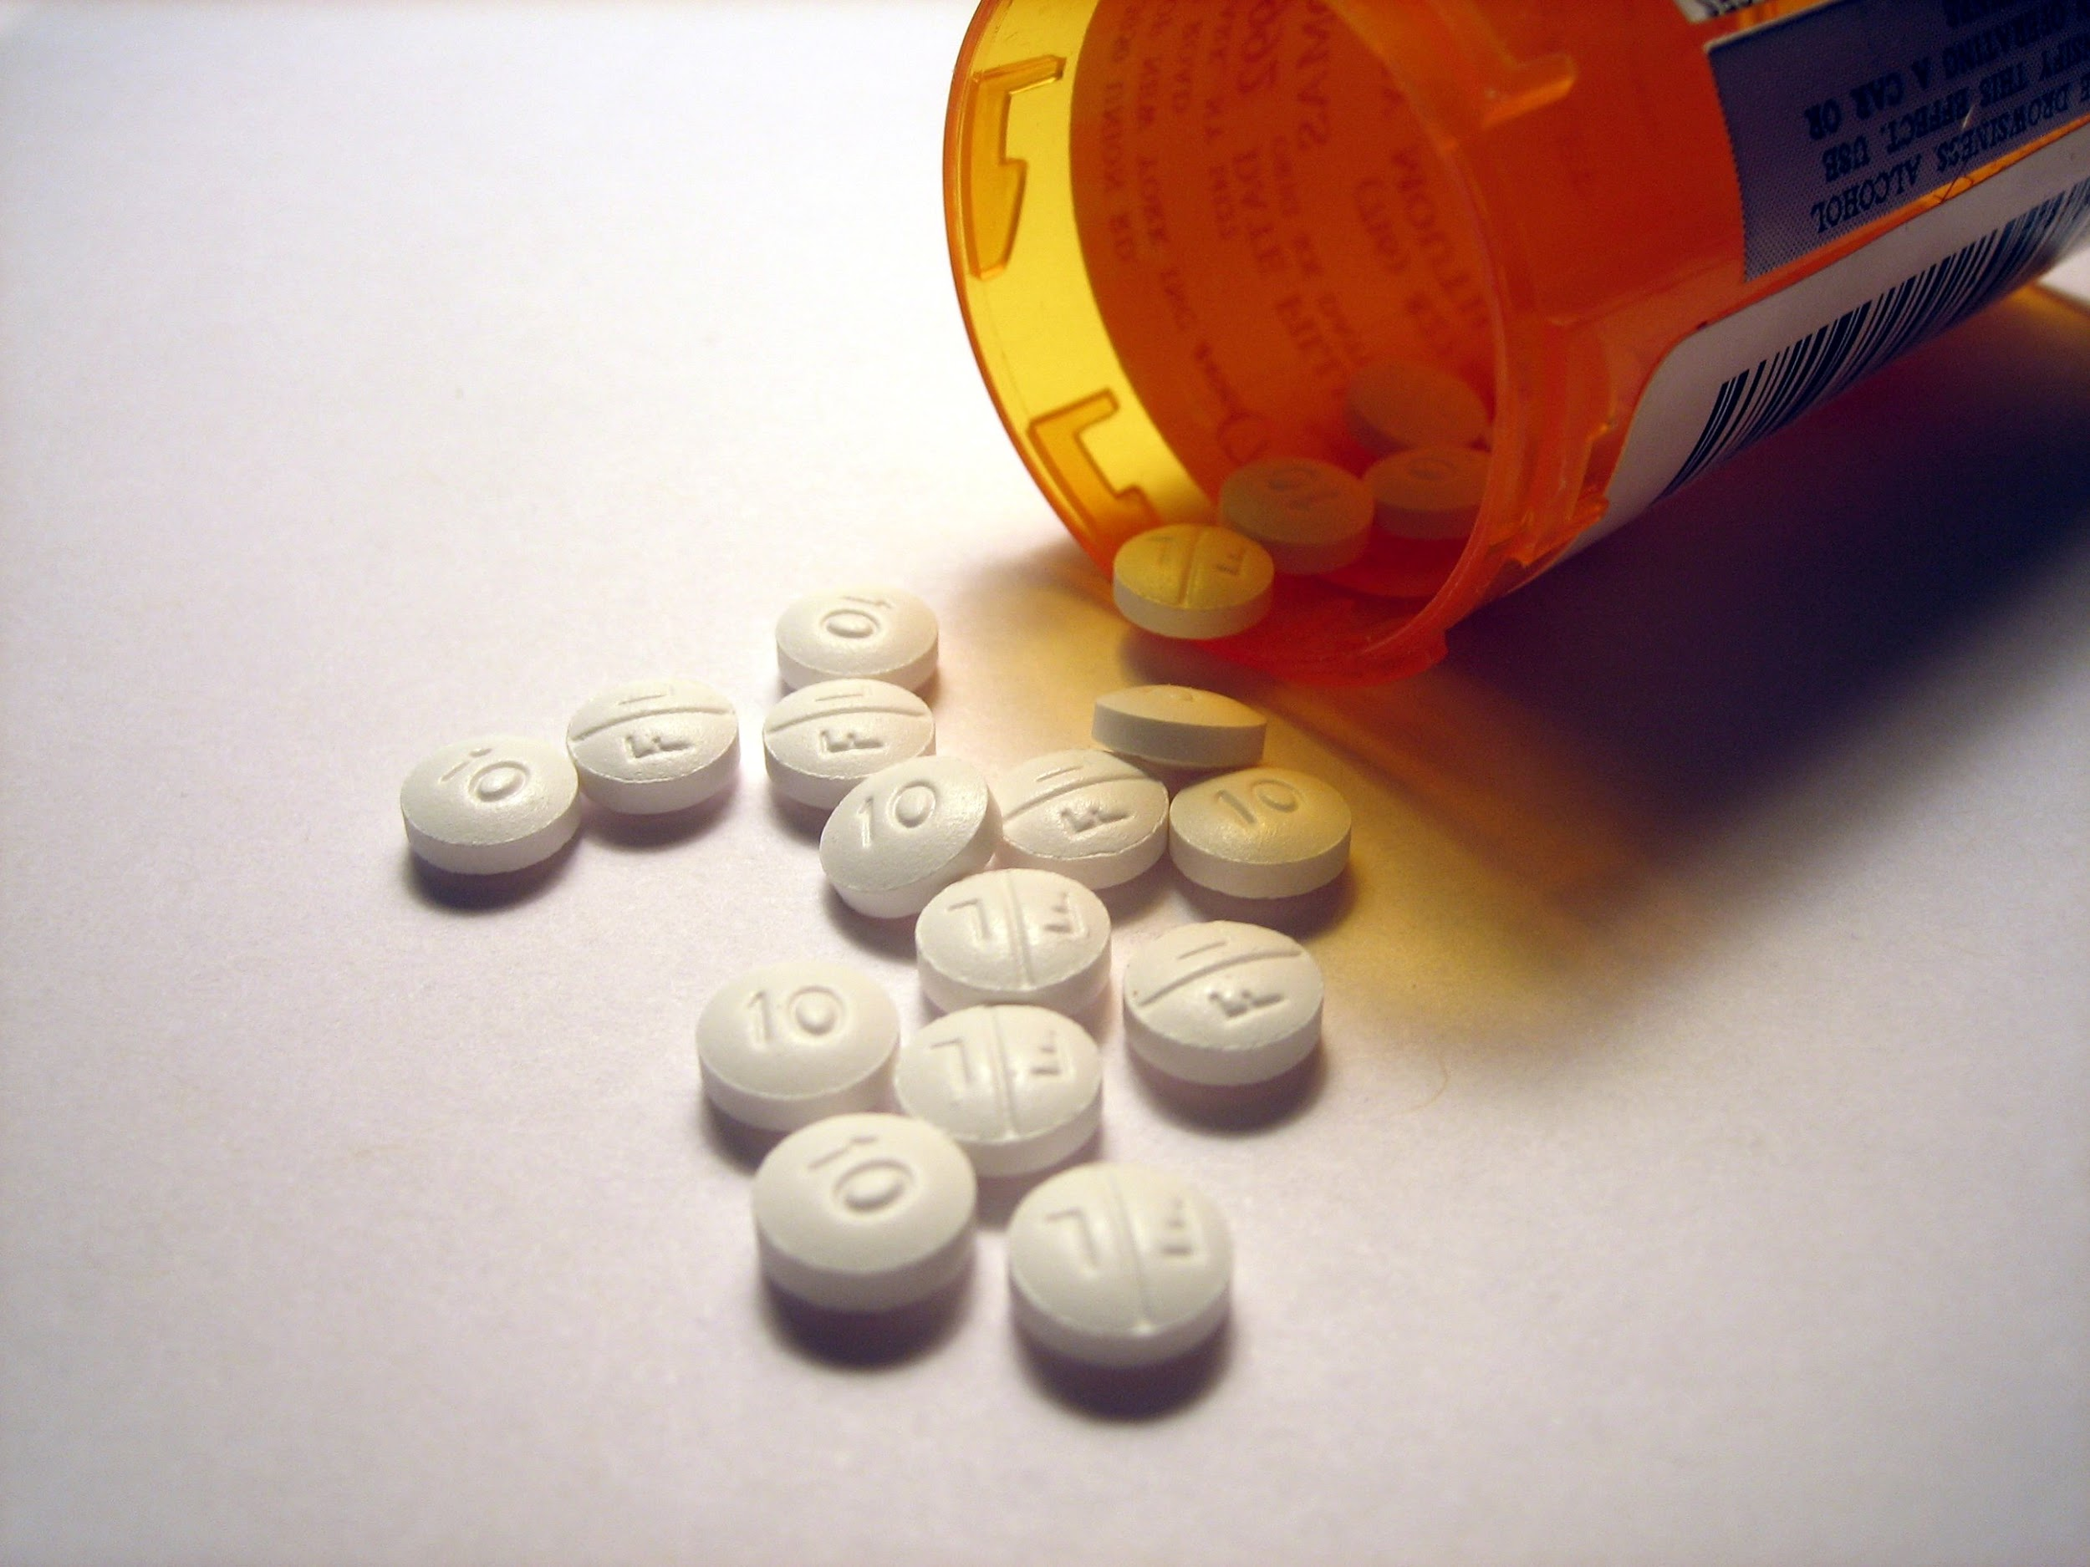
How Adherence Helps Depression
Improving adherence among patients with depression can improve treatment response rate¹⁵
Boosting adherence among patients with depression can decrease medical costs¹⁶
Adherent patients with depression are more likely to manage other chronic diseases¹⁷
Sources: ¹⁵ British Journal of Psychiatry, 2008 ; ¹⁶ Risk Management and Healthcare Policy, 2014, ¹⁷ Journal of General Internal Medicine, 2011

Slide 9
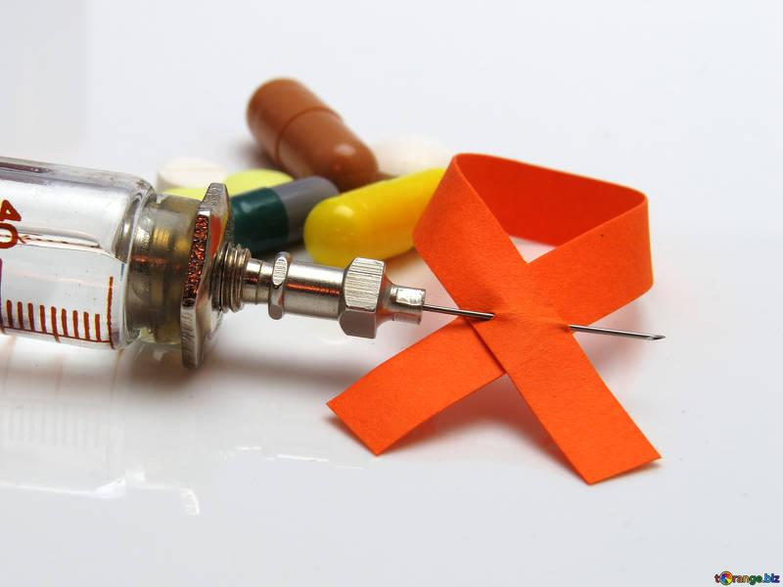
The Cost of HIV/ AIDs
Patient adherence to ART (Antiretroviral Therapy) is roughly 70%, and missing a small monthly dose significantly reduces medication effectiveness¹⁸
Non-adherence to ART is associated with an increased rate of hospitalization, morbidity and mortality¹⁹
Sources: ¹⁸ National Institutes of Health, 2016; ¹⁹ Free Radical Biology and Medicine, 2011

Slide 10
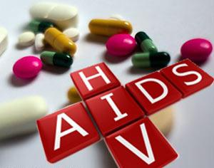
How Adherence Helps HIV/AIDS
When pharmacists get involved, a number of measures improve:
Higher rates of viral suppression
Increased CD4 cell counts
Reduced pill burden and frequency²⁰
Adherence to ART helps patients living with HIV live longer²¹
Proper adherence to ART reduces the risk of transmission to others²¹
Sources: ²⁰ HIV InSite Knowledge Base, 2006; ²¹ National Center for Health Statistics, CDC, 2016

Slide 11
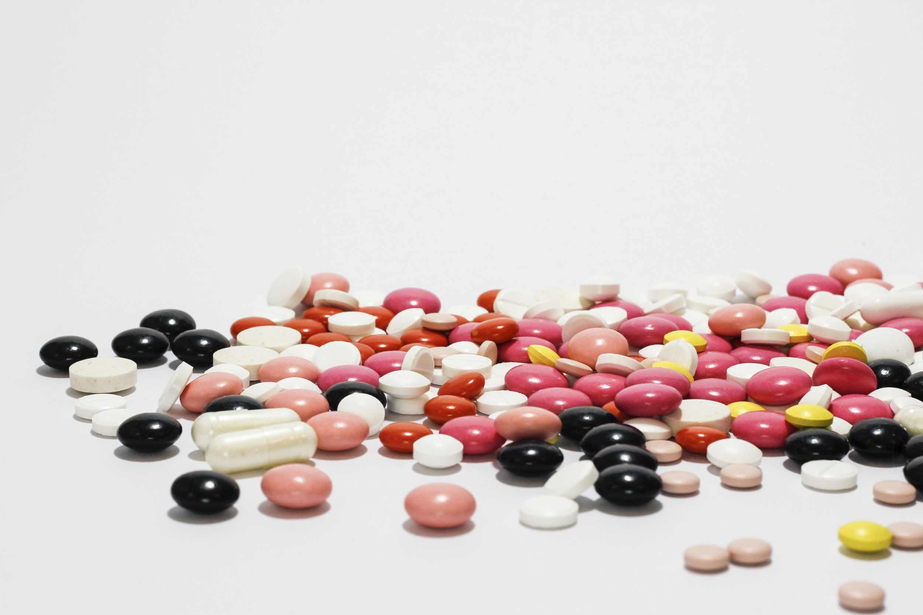
The Cost of Cardiovascular Disease
Cardiovascular disease contributes to nearly $1 billion every day in medical costs and lost productivity²²
Non-adherent heart attack survivors have been found to have an increased risk of death and further health complications²³
More than 60% of those suffering from heart disease in the U.S. are non-adherent²⁴
Sources: ²² CDC Foundation, 2015; ²³ Journal of the American Medical Association, 2007; ²⁴ Archives of Internal Medicine, 1993

Slide 12
How Adherence Helps Cardiovascular Disease
Adherent patients have 15%-19% lower risk of developing heart disease²⁵
Adherent patients have a 29%-45% lower risk of death²⁵
Patients were properly adhere to their medications saw improvements in blood pressure and lipid control²⁶
Sources: ²⁵ CardioSmart, 2013; ²⁶ JAMA, 2006

Slide 13
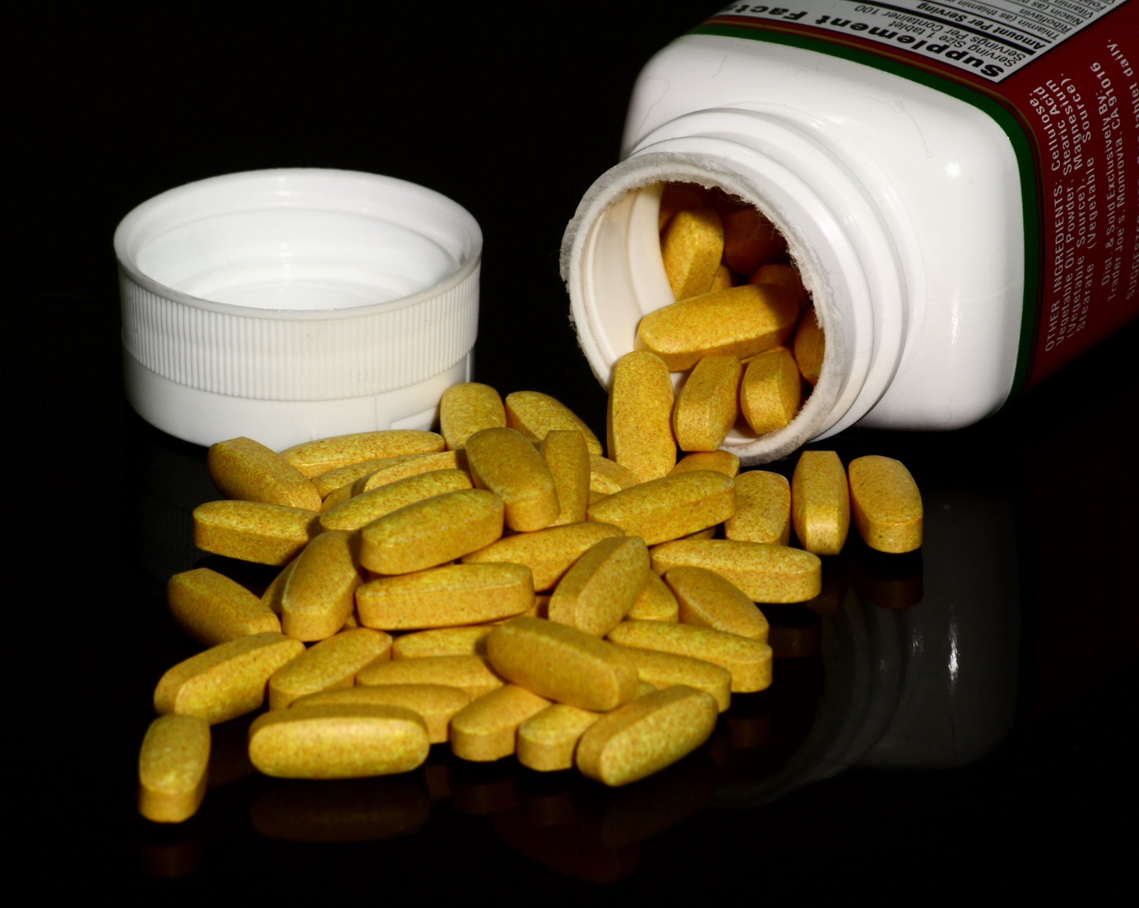
The Cost of Cystic Fibrosis
Approximately 50% of patients with cystic fibrosis adhere to pulmonary medication²⁷
Non-adherence is associated with²⁸:
Pulmonary exacerbations
Lower baseline lung function
Increased hospitalizations
Treatment becomes more complex as disease progresses²⁹
Sources: ²⁷ Curr Opin in Pul Med, 2013; ²⁸Curr Opin in Pul Med, 2013; ²⁹ CF: Renewed Hope Through Research, 2012

Slide 14
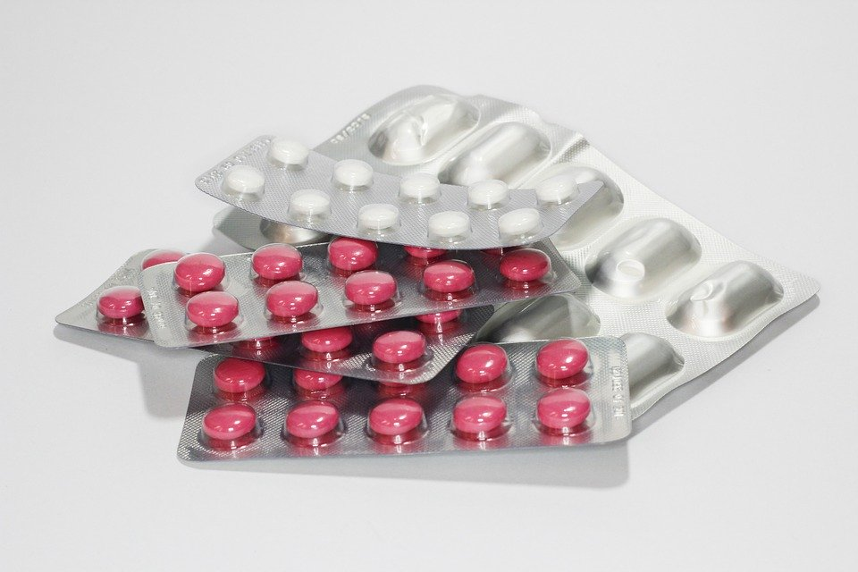
How Adherence Helps Cystic Fibrosis
Adherence to treatment is associated with improved pulmonary status and increased longevity³⁰
When pharmacists support adherence programs, access to cystic fibrosis medications rose from 52% to 98%³¹
Sources: ³⁰ Journal of Pediatric Psych, 2009,³¹ Pediatric Pulmonology, 2014

Slide 15
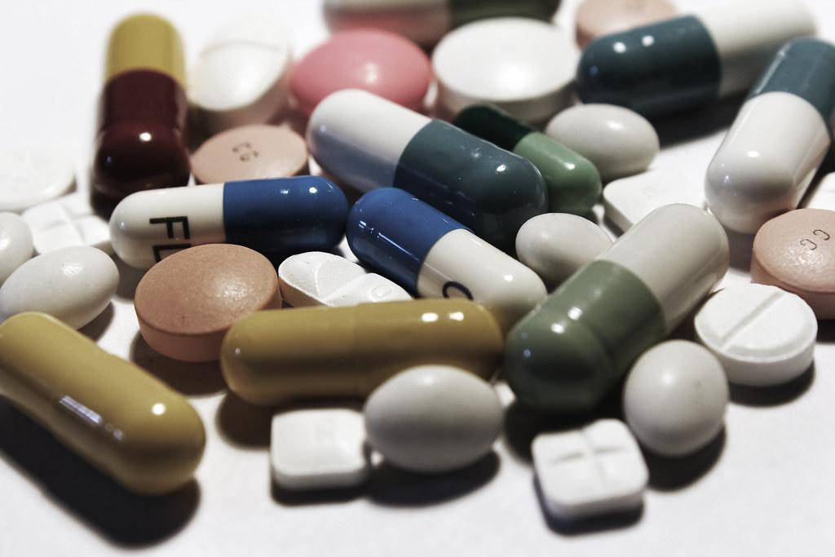
The Cost of Cancer
National costs to treat cancer are expected to reach $156 billion by 2020, up from $125 billion in 2010²²
Some studies have shown oral chemotherapy adherence rates below 20%²³
Complicated medication regimens can pose additional health risks when integrated into patients’ lifestyles and existing drug regimens²⁴
Sources: ²² World Health Organization, 2016; ²⁰ Journal of National Cancer Institute, 2015; ²¹ BMC Research Notes, 2017

Slide 16
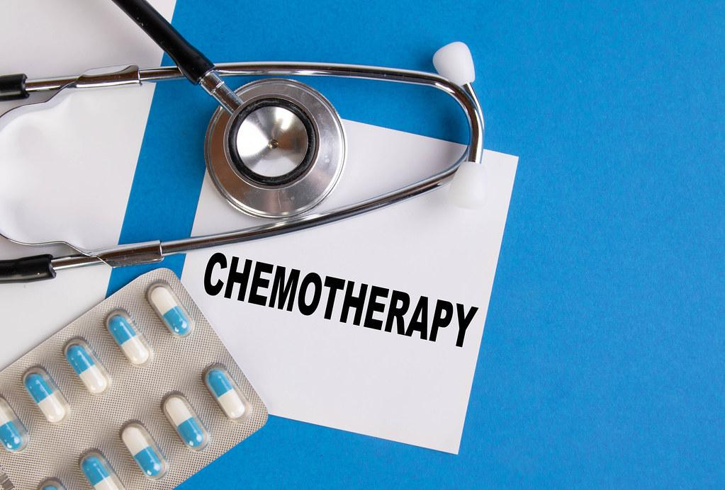
How Adherence Helps Cancer
Improving adherence among cancer patients drastically increases overall survival and life expectancy³⁵
A study found that adherence programs can help increase adherence of chemotherapy by 89.3%³⁶
Adherence programs help patients understand their medication regimen, and make their prescriptions more manageable
Sources: ³⁵ Seminars in Oncology Nursing, 2011, ³⁶ Journal of the American Association for Cancer Education, 2014

Slide 17
Who Can Help Non-Adherent Patients?
Who is closest to the patients?
Who do the patients trust most?
Who is best positioned to offer the solution?
Local Pharmacists and
YOU!

Slide 18
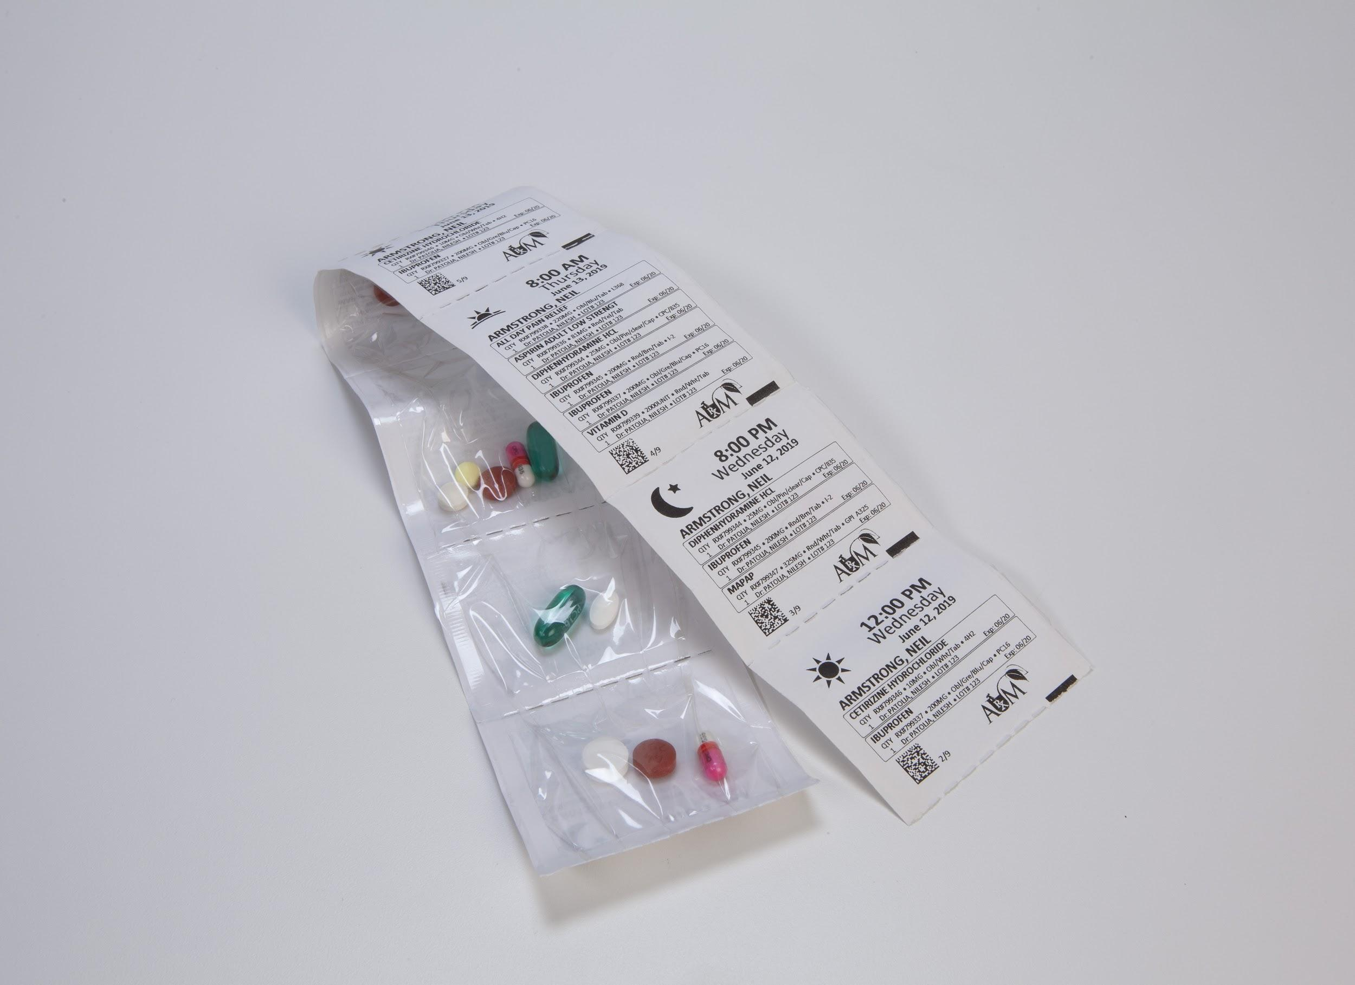
The Benefits of Adherence
Patients with high adherence rates have lower hospitalization rates than non-adherent patients³⁷
Pharmacists who provided automatic prescription refill programs saw an increase in adherent patients³⁸
High adherence among patients can significantly improve star ratings³⁸
Sources: ³⁷“Impact of Medication Adherence on Hospitalization Risk and Healthcare Costs”, Ovid, 2005; ³⁸ “The Influence of a Community Pharmacy Automatic Prescription Refill Program on Medicare Part D Adherence Metrics”, JMCP, 2016

Slide 19
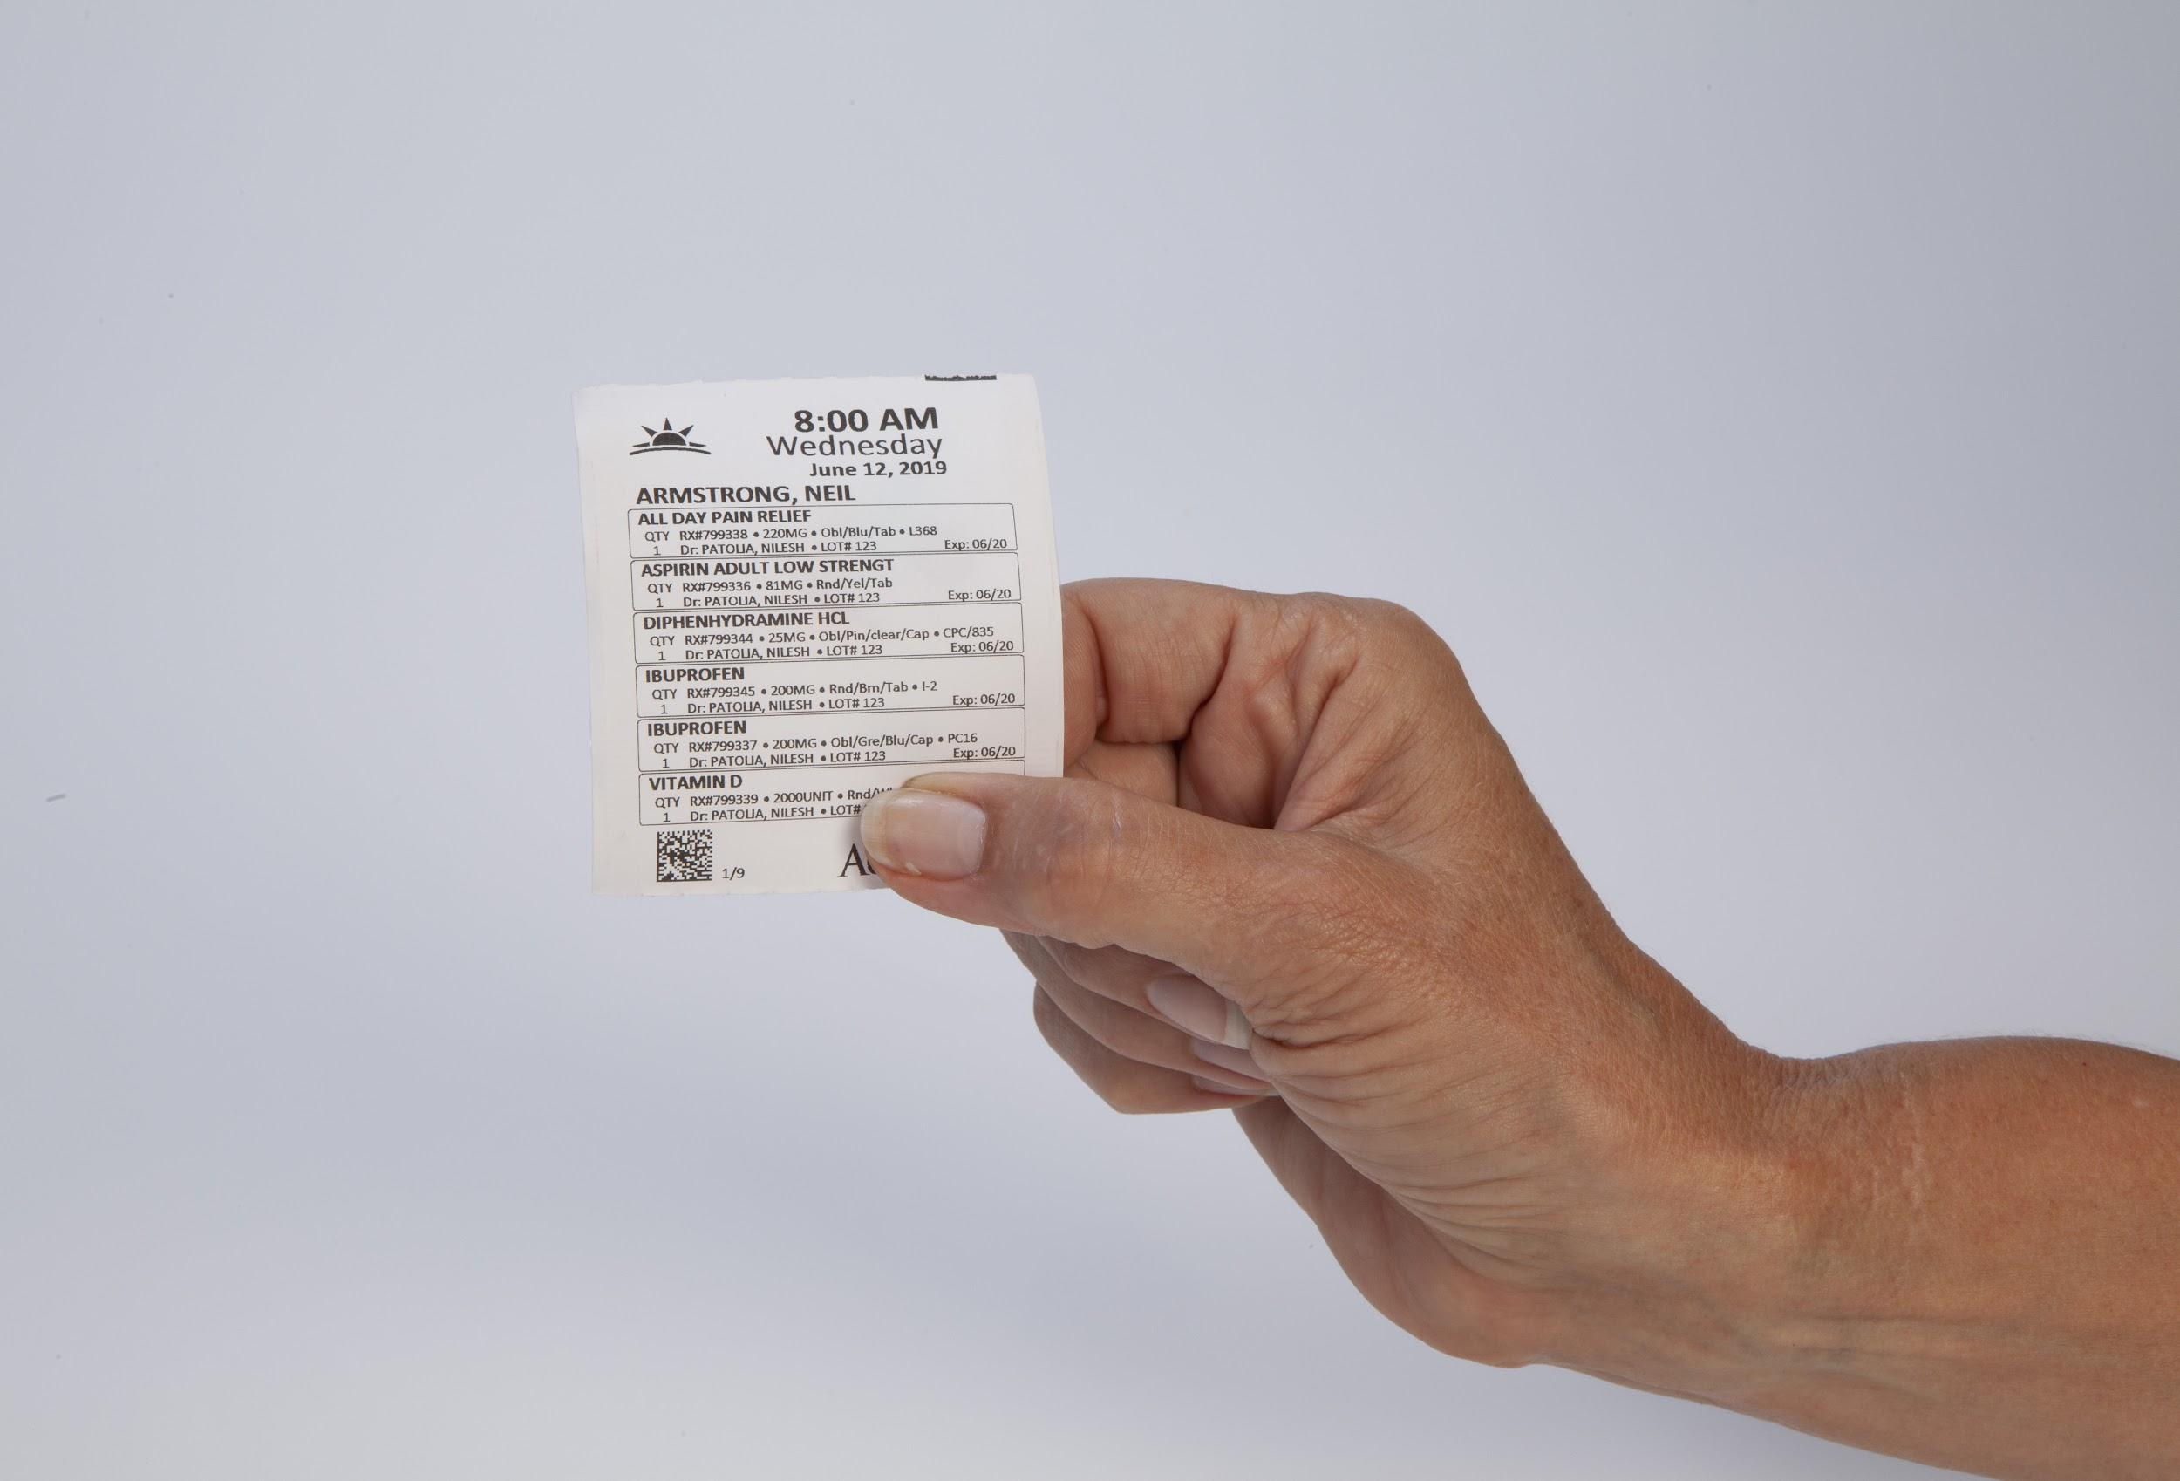
The Benefits of Adherence
Patients enrolled in a med sync program have an adherence rate of 66%-75.5%, compared to non-adherent patients who have a rate of 37%-40.8%³⁹
Pharmacies that run a med sync program experience higher EQuIPP scores⁴⁰
Med sync helps increase prescription volume by 4.8% for pharmacies in the first 6 months⁴⁰
Sources: ³⁹ Journal of American Pharmacists Association, 2013; ⁴⁰ Journal of American Pharmacists Association, 2017

Slide 20
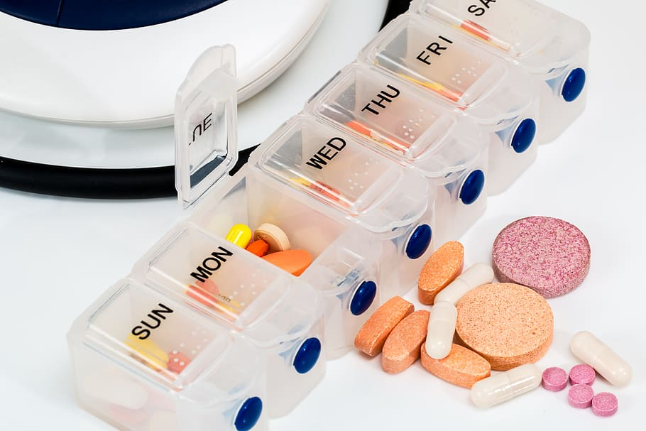
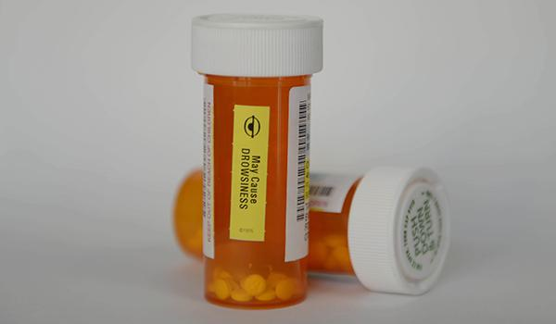
Issues with Traditional Methods
Pill organizer:
Patients can incorrectly organize their medication
Patients must organize their medication weekly
Pill bottle:
Patients can forget when their medication is supposed to be taken
Patients can forget if they took their medication

Slide 21
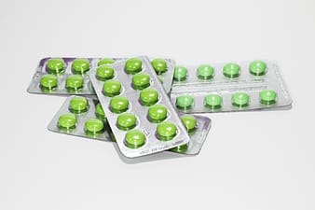
Blister Cards
Blister cards, a type of prescription packaging, are created by sealing pills inside a plastic bubble and foil
What are the inefficiencies of blister cards?
Preparing the blister cards requires a significant amount of time & labor
The sealing of the foil and plastic is time consuming, and can be expensive
Blister cards take up a lot of space and are difficult to travel with

Slide 22
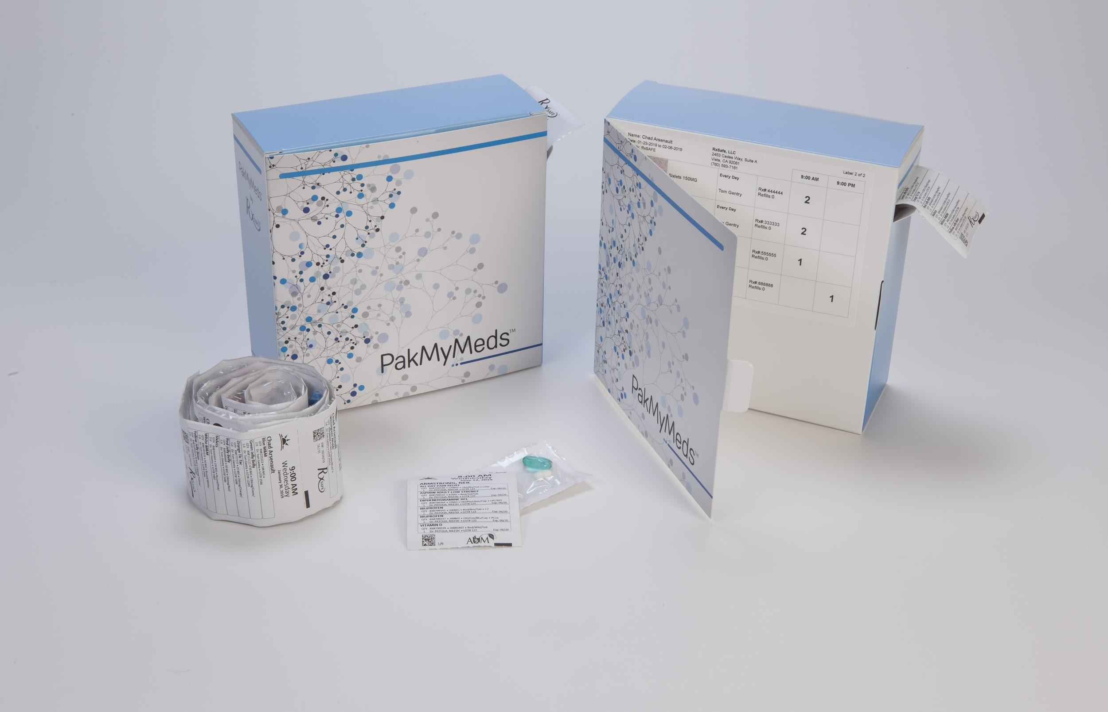
Improving Adherence with Strip Packaging
What is adherence strip packaging?
A strip of small pouches that organizes a patient’s prescriptions
The type of medication, dosage, date, and time the medication needs to be taken, are printed directly on the pouch
Each pouch can easily be torn off the strip and taken on the go
Typically one pouch per med pass, not as bulky as blister cards

Slide 23
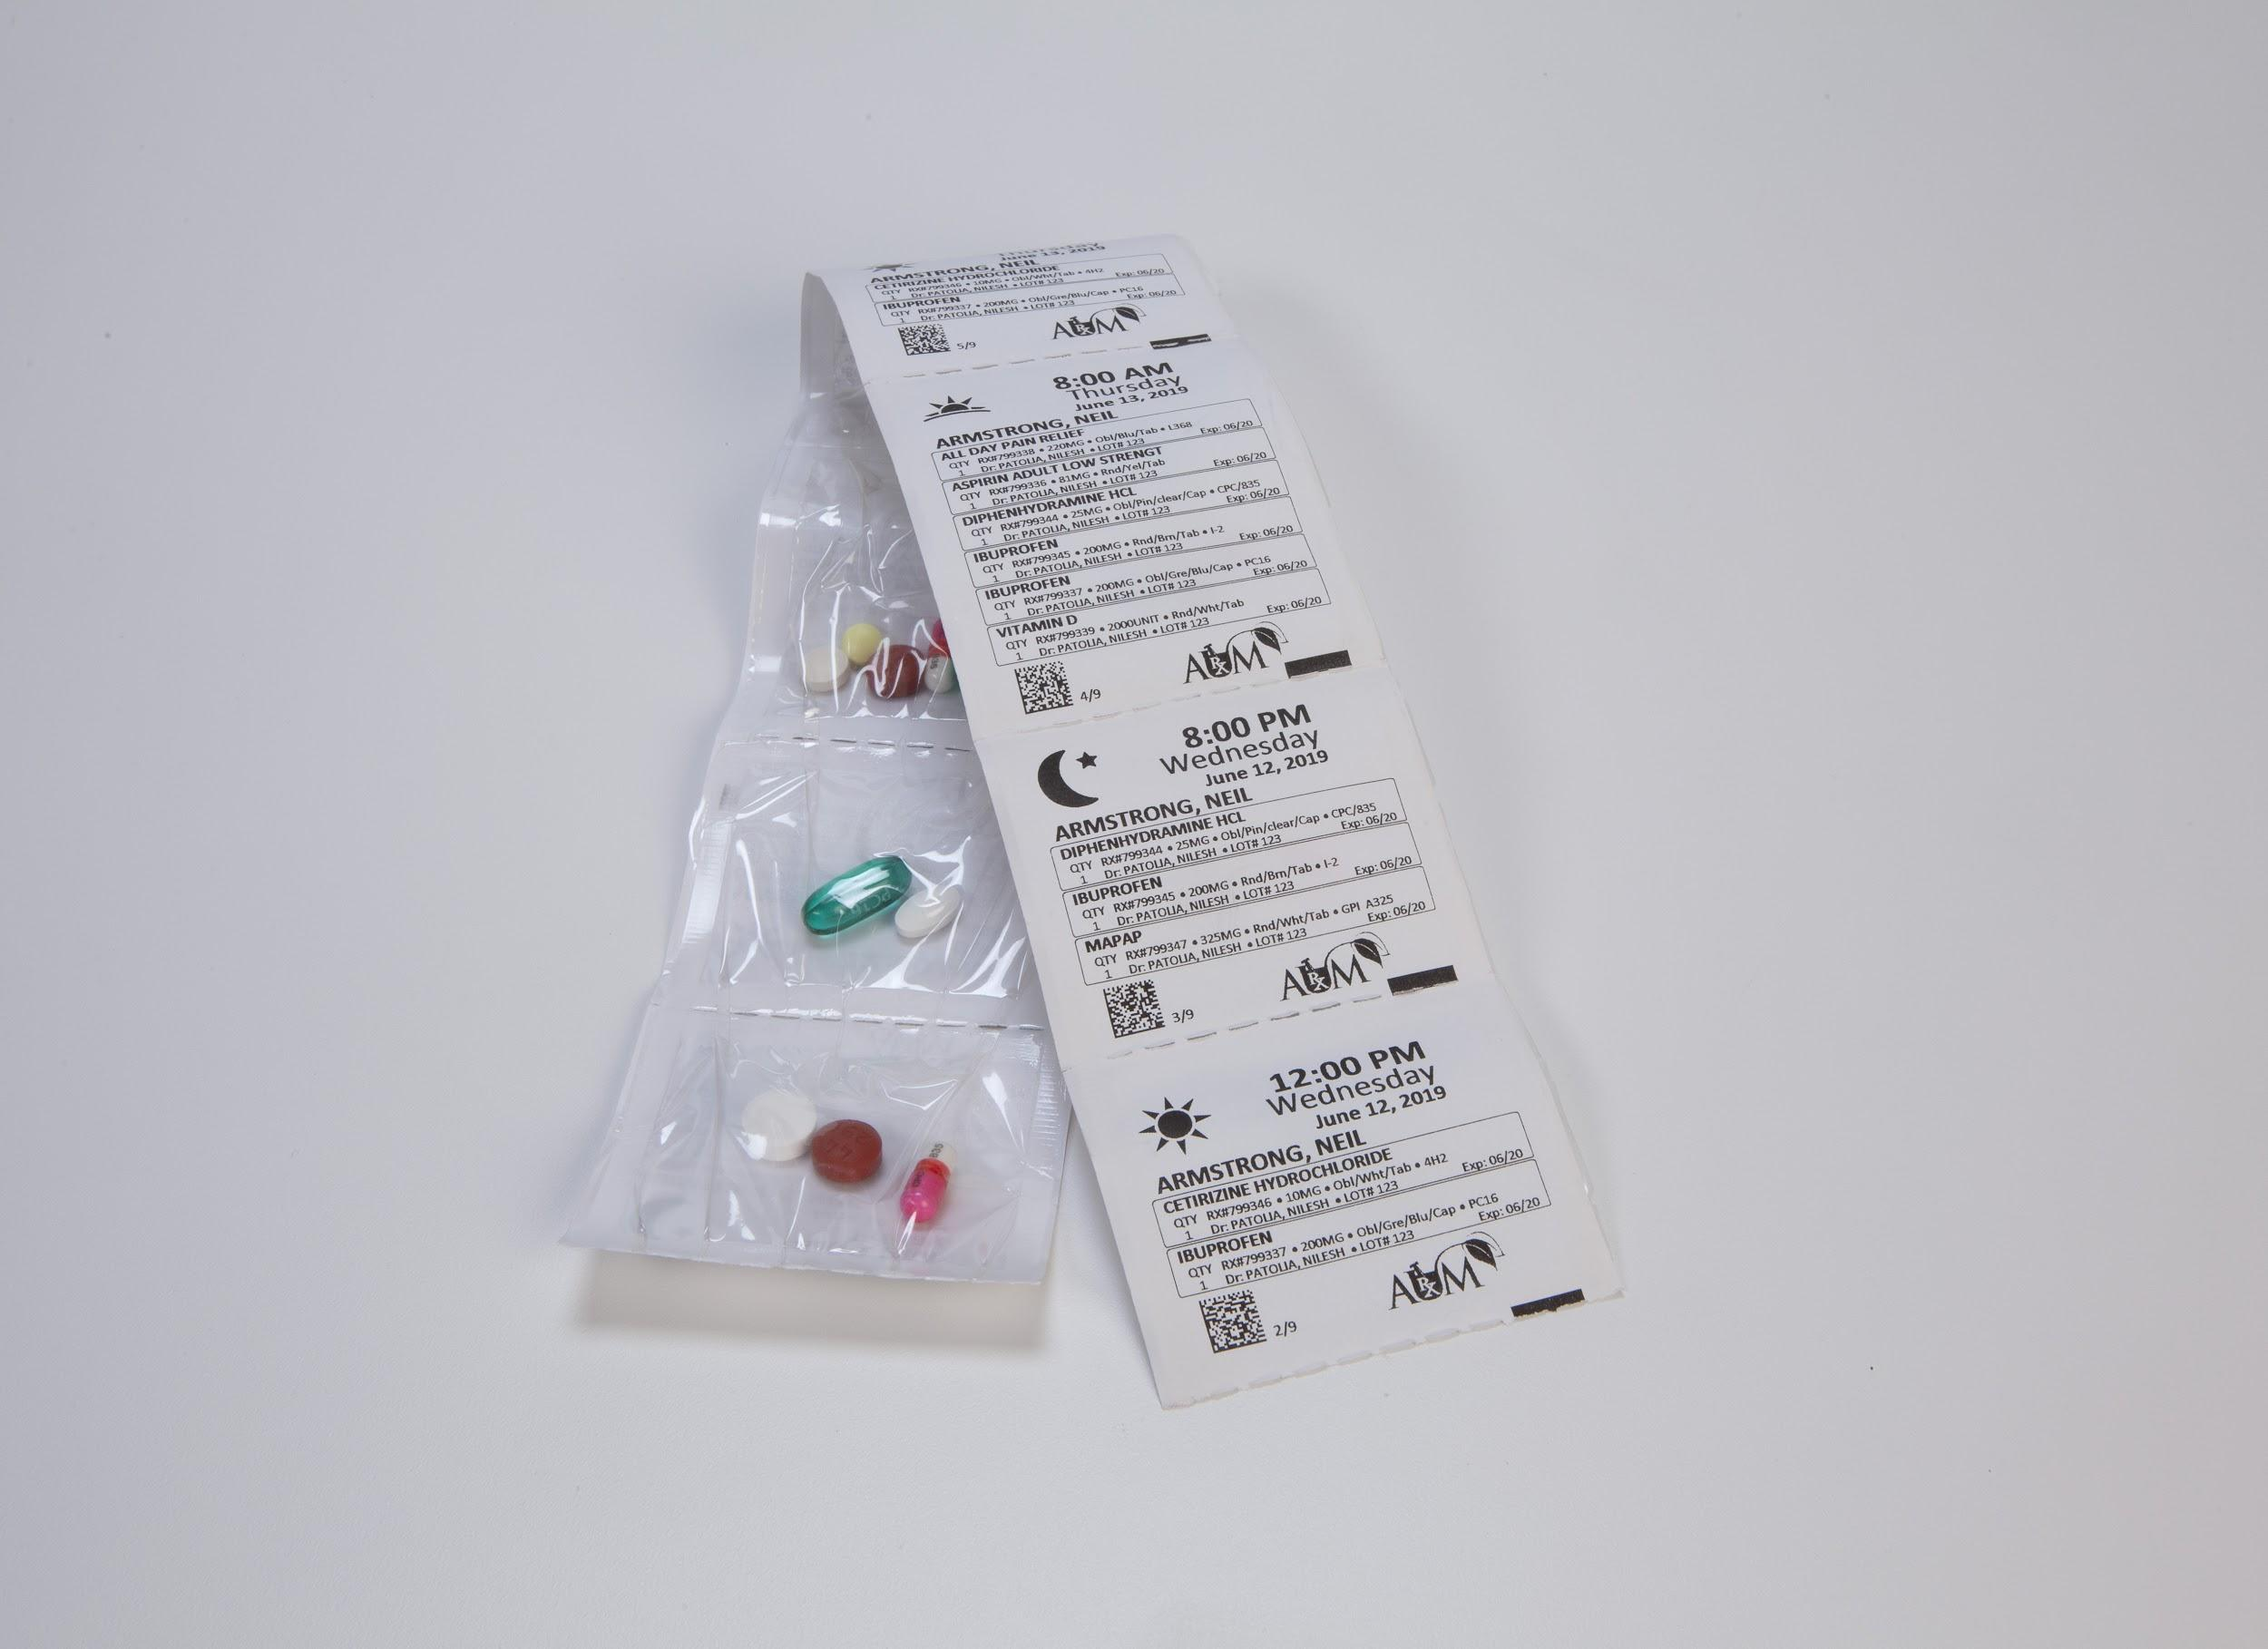
Benefits of Adherence Packaging
One study showed that patients enrolled in 30-day and 90-day automatic refill programs had significantly higher adherence⁴¹
Patients enrolled in the automatic refill programs have significantly fewer days of oversupply⁴¹
Automatic refills are helpful for patients who have difficulty making multiple trips to the pharmacy and have trouble remembering⁴¹
Sources: ⁴¹ Medication Adherence: The Elephant in the Room, 2018

Slide 24
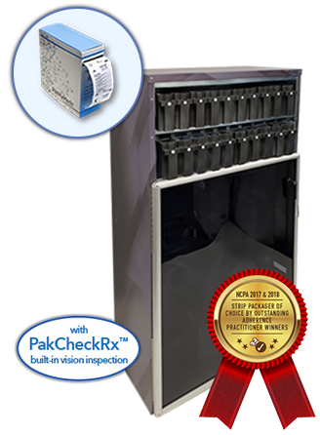
RapidPakRx
RapidPakRx features:
Unmatched speed, flexibility, and accuracy
Runs up to 20 “smart” bulk-loaded, universal cartridges, simultaneously
No exceptions tray (no errors from hand filling)
3-step integrated machine vision, further reduces errors and rework

Slide 25
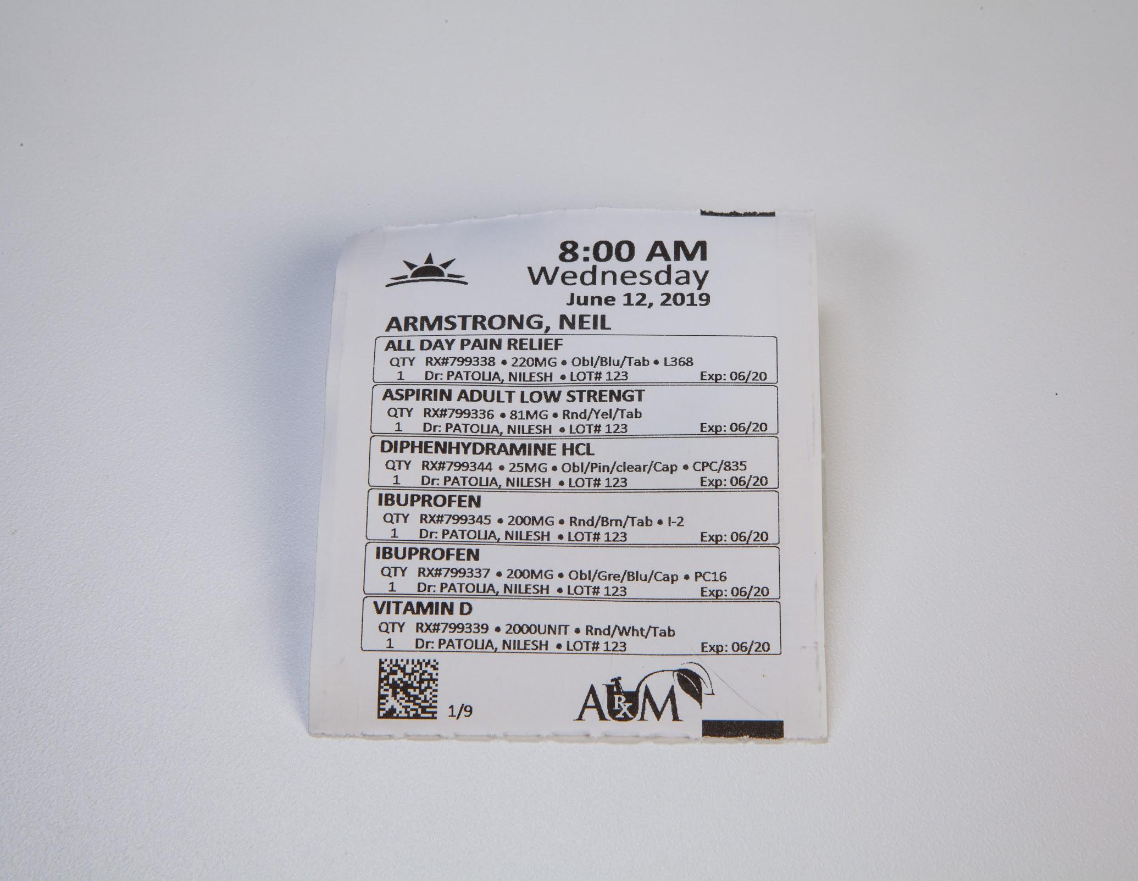
PakMyMeds vs. PillPack: Clearer Label
PakMyMeds label includes:
Patient name
Date & time
Dosage required
Drug name
Description of each pill
Pill expiration date
PillPack label includes:
Date & time
Dosage required
Drug Name

Slide 26
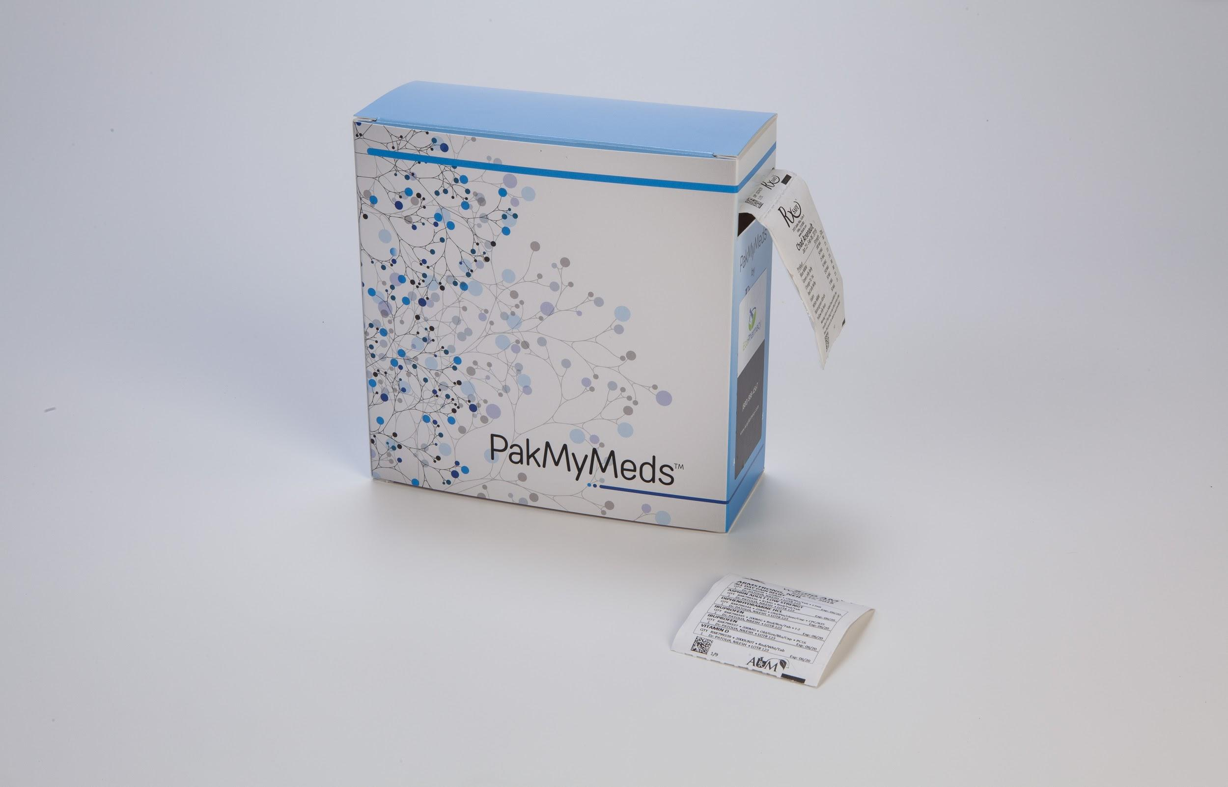
PakMyMeds vs PillPack
PakMyMeds:
Pouches are easier to open
Labeling is easy for patients to understand
PakMyMeds uses only one pouch per med pass
Easy for patients to take their medication on the go
PillPack:
Harder for patients to tear open the pouches
Can require multiple pouches per med pass (5 NDC limit)
Only fills on 30-day cycle

Slide 27
PakMyMeds vs PillPack
PakMyMeds: Local
Pharmacists know their patients
Pharmacy provide patients personalized/quality care
Patients receive recommendations for other pharmacy programs to help improve their health
Prescription changes are easier to communicate and manage
PillPack: Mail Order
No in-person patient consultations
Risk of theft is a concern
Shipping delays are common
Shipping conditions can expose medication to heat and cold that exceeds manufacturer recommendations
Prescription changes take longer to process and implement

