Slide 1
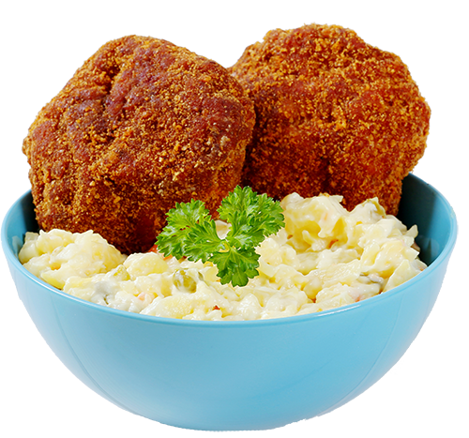
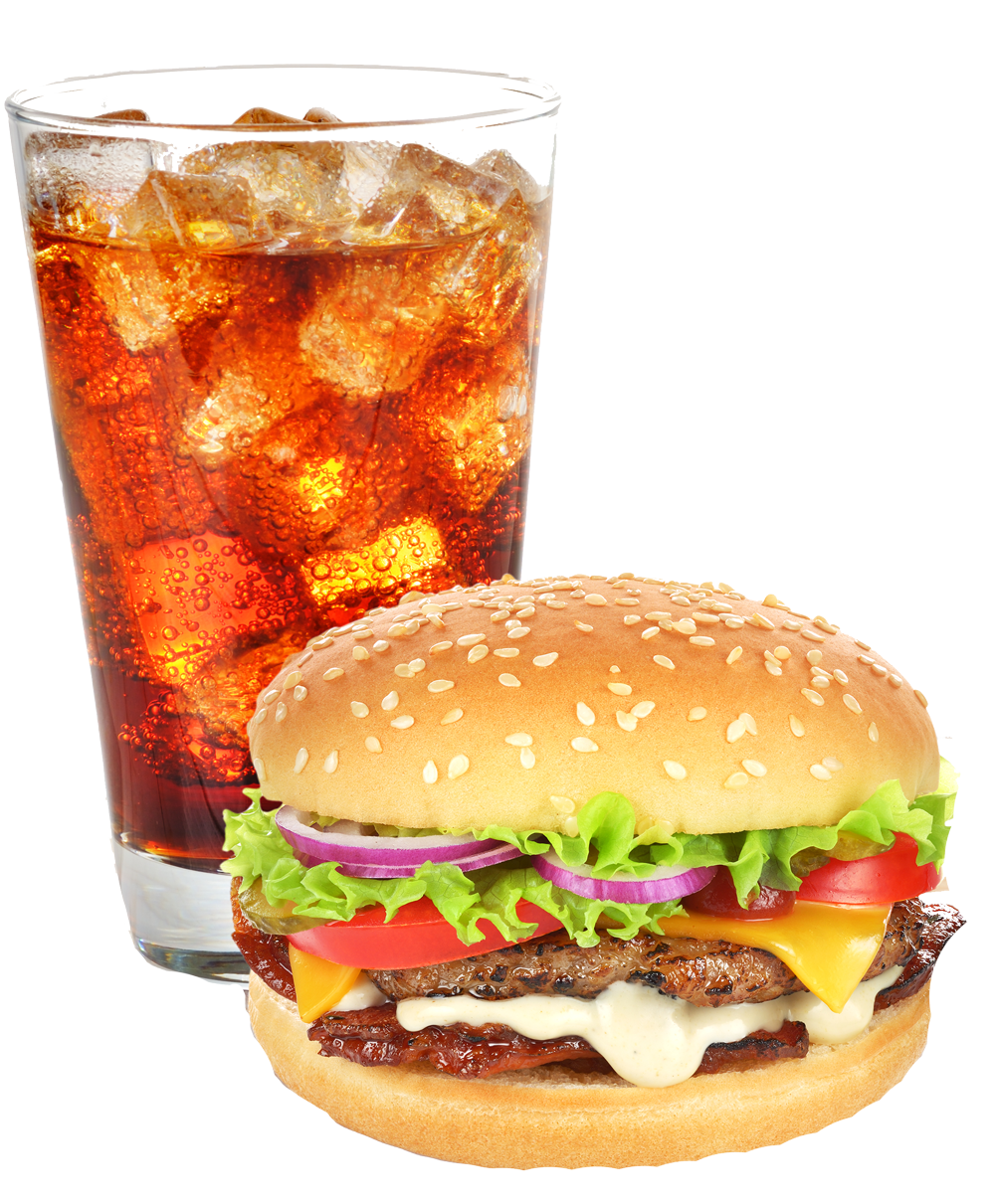
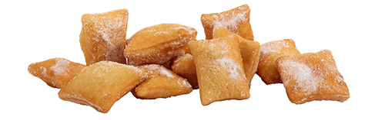
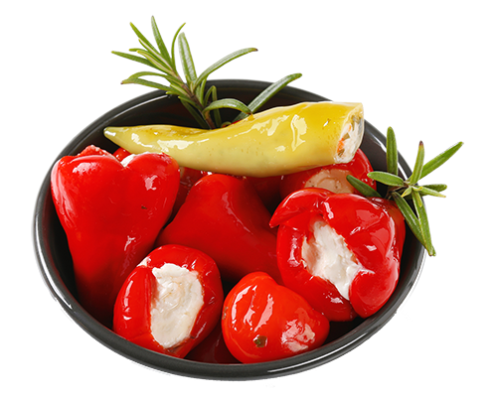
Pick & choose
Hot poppers
20 I 22
Small donuts
20 I 22
Choose a menu
Only 125,- with mineral water
Bacon burger
125 I 130
Cheese peppers
20 I 22

Slide 2


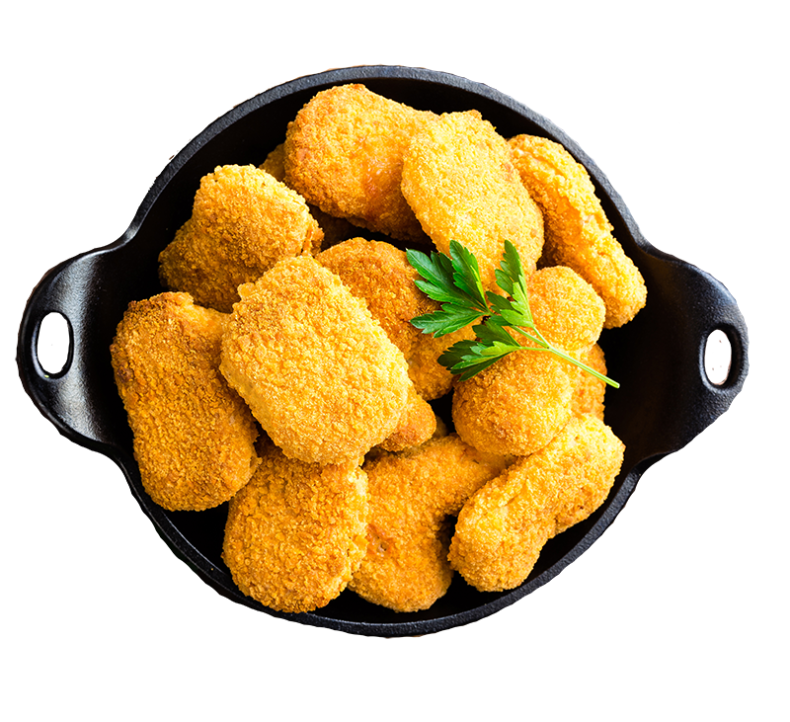
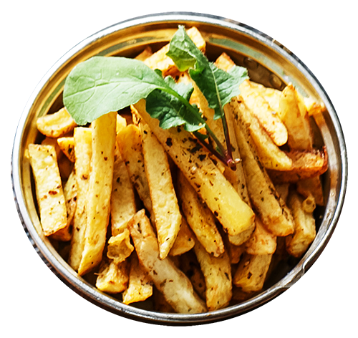
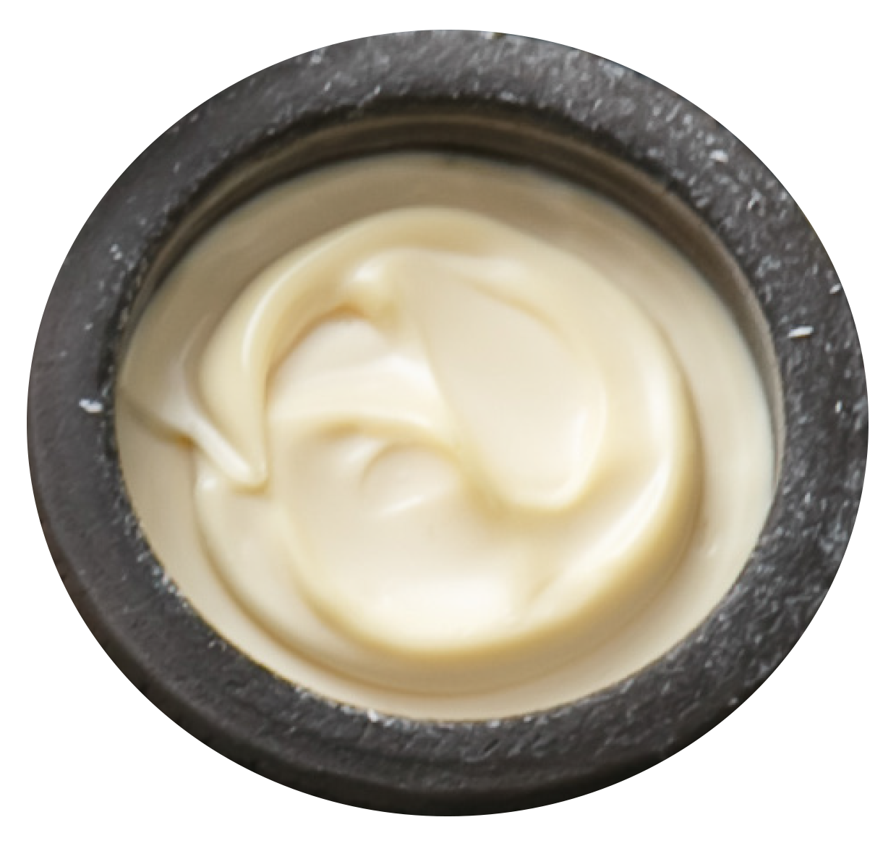
Super Deal
Cheesburger 20 I 22 kr
Dobbel cheese 29 I 32 kr
Chilli cheese 29 I 32 kr
Chicken salsa 25 I 27 kr
Fish´n chips 25 I 27 kr
Hamburger 12 I 13 kr
Milkshake 20 I 22 kr
69,-
Big
18 pieces
49,-
Medium
10 pieces
29,-
Small
6 pieces

Slide 3
Pick & choose
Hot poppers
20 I 22
Small donuts
20 I 22
BACON
Menu
115 I 125
with Coca Cola
Cheese peppers
20 I 22

Slide 4

Choose a menu
Prices from
99,-

Slide 5

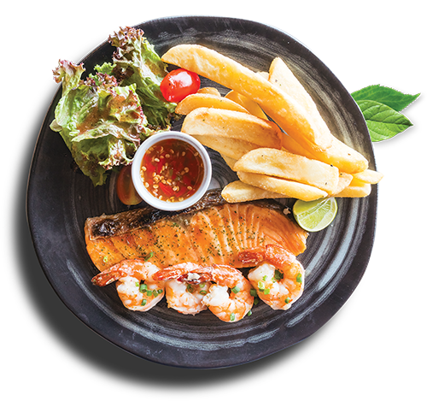

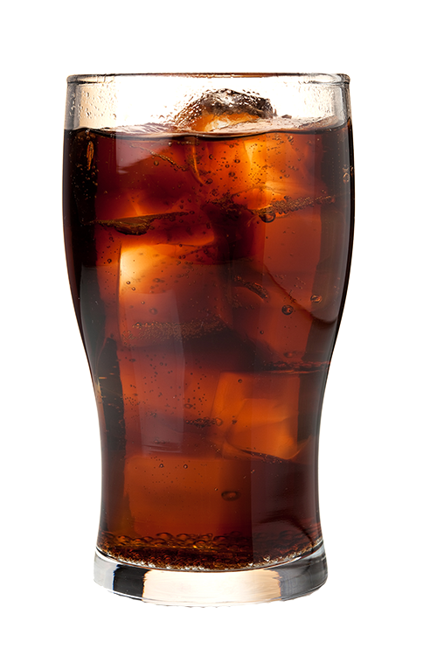
Hot poppers
20 I 22
Pommes Frites
20 I 22
Garlic majo
20 I 22
Cheese
peppers
20 I 22
Fish and chips
125 I 130
Mineral water
20 I 22
Small donuts
20 I 22

Slide 6
Garlic majo
20 I 22
Pommes Frites
20 I 22
Cheese peppers
20 I 22
Hot poppers
20 I 22
Small donuts
20 I 22
Fish and chips
125 I 130
Mineral water
20 I 22

