Slide 1
Notes:
Poll Title: What do you want to learn today? (Vote for an item below, or enter your own response) https://www.polleverywhere.com/discourses/X3UKuhjQWq9RbTr

Slide 6
What in the world is a Leadership Archaeologist™
?

Slide 7
Why Growing Companies Outgrow Leaders … And What To Do About It

Slide 10
Answer

Slide 11
Management is More Important Than Leadership
Leaders 12%
Managers 88%
55
person organization

Slide 12
Management is More Important Than Leadership
Leaders 15%
Managers 85%
400
person organization

Slide 14
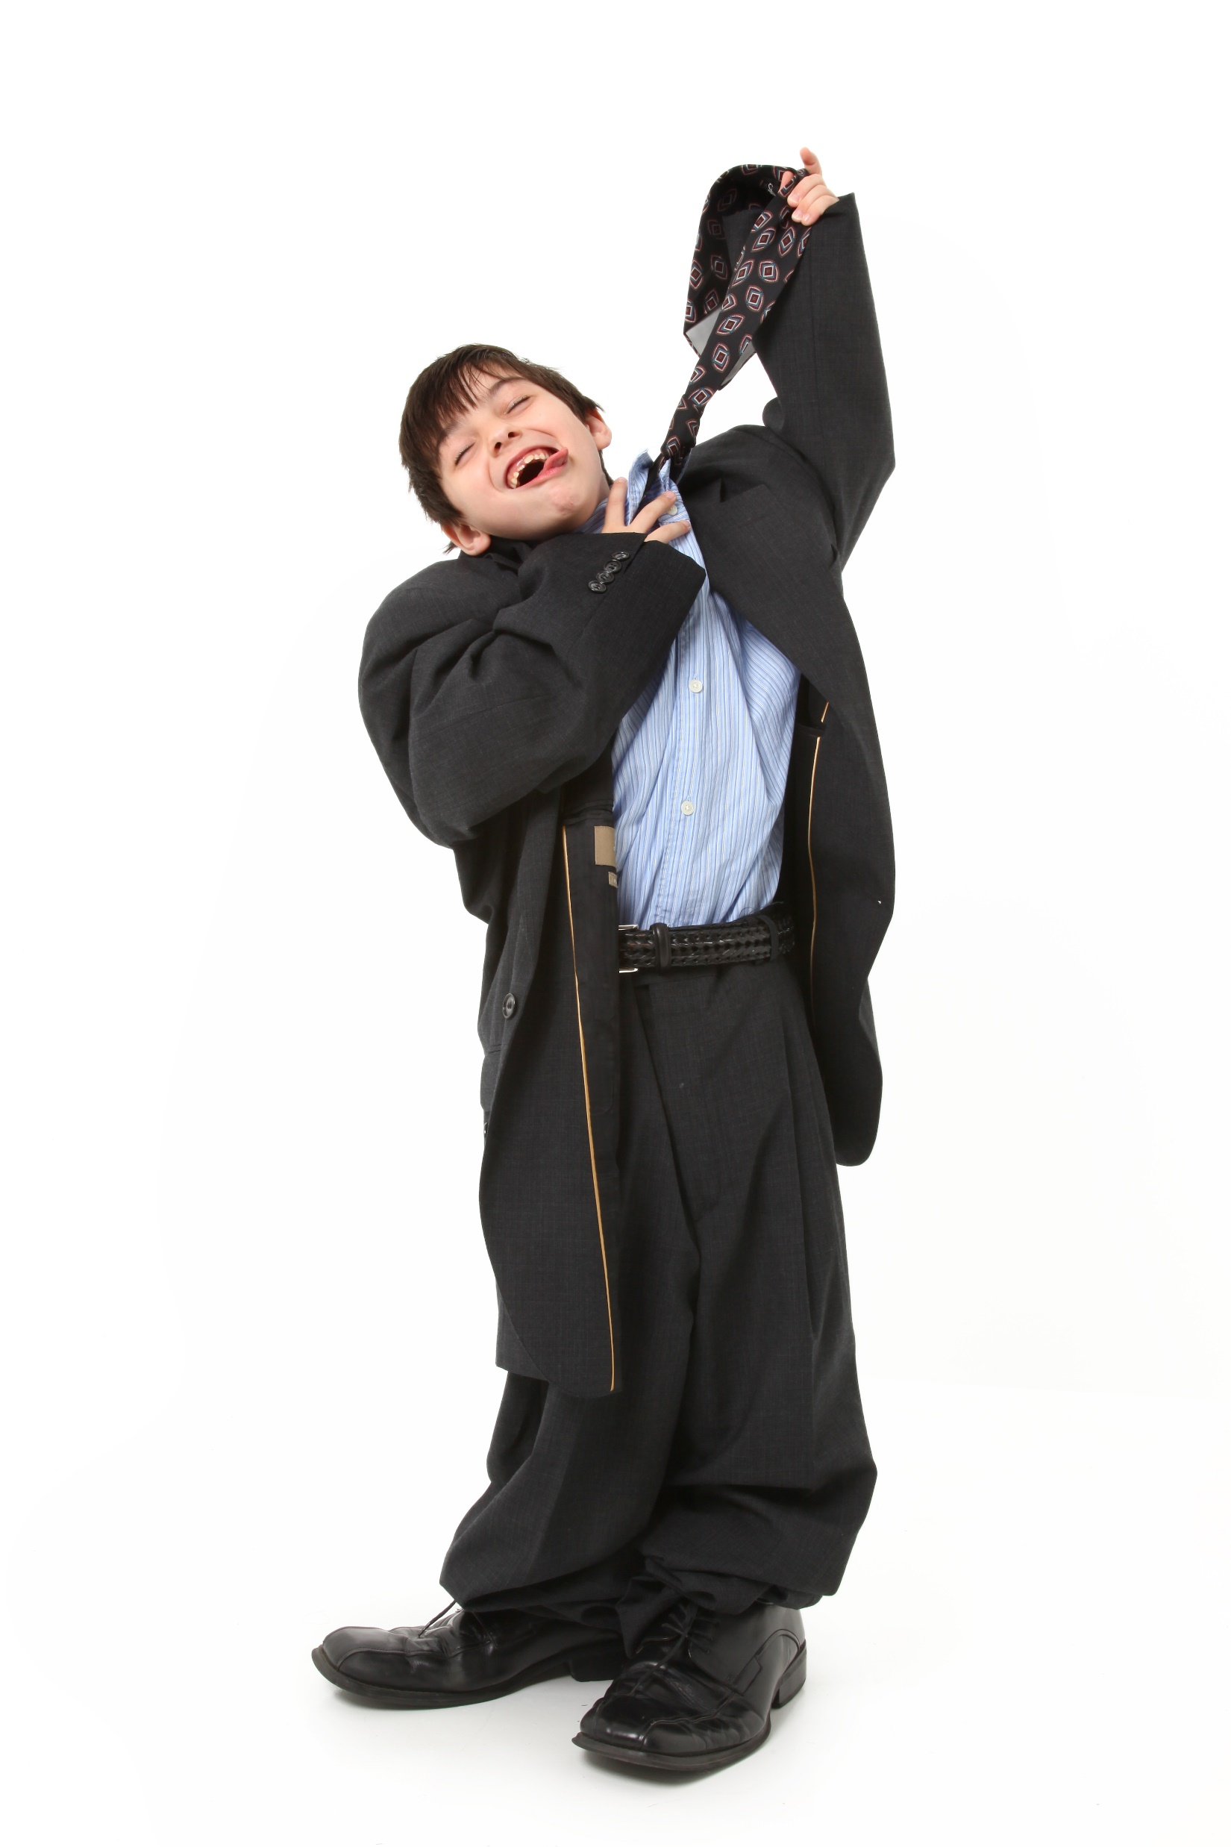

Slide 18
$480,000

Slide 19
5

Slide 20
Agenda
Levels of Leadership 10 min
Assessment – Part 1 10 min
Leadership Skills Q&A 20 min
Assessment – Part 2 10 min
Learn New Skills 2 hours
Next Steps 15 min

Slide 21
Levels of Leadership
Player Coach Up to 10 people
Manager 10 – 30 people
Leader of Managers 30 – 100 people
Functional Leader VP of _______
Business Unit Leader P&L Responsibility
2nd in Command (2IC)
Chief Executive Officer (CEO)

Slide 23
Notes:
Poll Title: Enter the number of the skill you have a question about. Enter one number at a time. https://www.polleverywhere.com/free_text_polls/h0vSHovPcAg1qK4

Slide 26
Notes:
Poll Title: Enter the number of the skill that you want to prioritize today. Enter one number at a time. https://www.polleverywhere.com/free_text_polls/aOTMUgM7kckT1Wv

Slide 27
Delegation

Slide 28
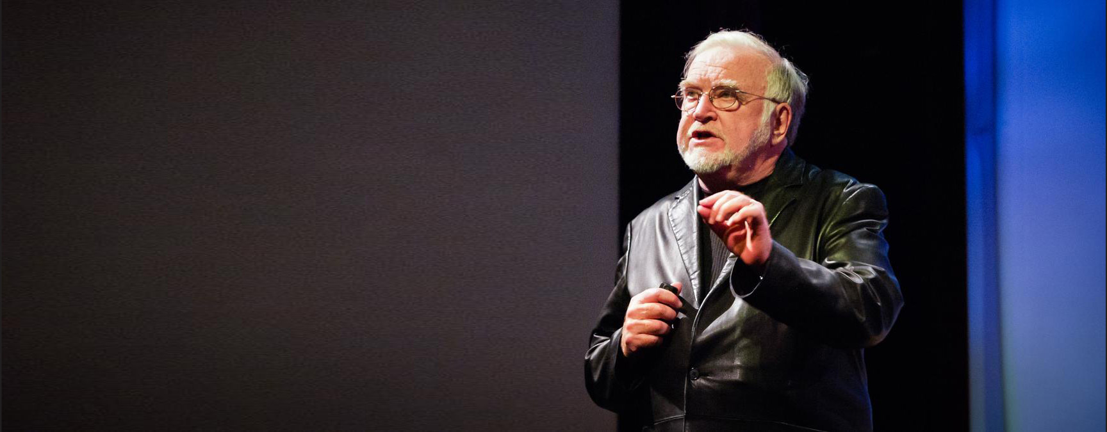
Mihaly Csikszentmihalyi

Slide 29
Task Relevant Maturity

Slide 31
Managerial Leverage

Slide 33
Experiment

Slide 34
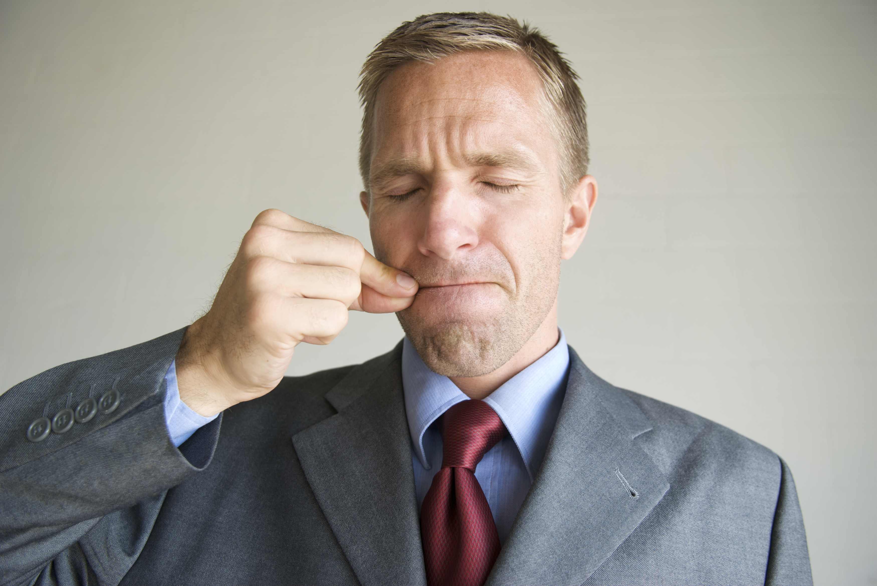
Try a “Talking Diet”

Slide 35
THE TALKING DIET
Allowed
One word questions
Tell me more…
Questions that begin with What, How, Who, When, or Where
Compliments
Not Allowed
“Queggestions”
Should, could, would, must, need to
Why questions
Criticism
Talking more than 30 seconds

Slide 36
Taming Tricky Trophy Troubles

Slide 37
“
Have you ever worked for an organization where you do something right, and you never hear a word. And you do one thing wrong and you never heard the end of it?”
Bob Chapman, CEO ,Barry Wehmiller

Slide 39
Recognize

Slide 40
Encourage
Notes:
Bob taught me the greatest skill of a leader is not criticism, but encouragement. Leaders encourage – they GIVE courage – to people to do great things. I used to be really bad about positive feedback, but some years ago I began training myself to give people positive feedback. I would literally write a diary every day to remind myself to give positive feedback and encourage people. And the results were stunning. It was so much more enjoyable to work with people.

Slide 41
Recognition slide
Acknowledge

Slide 42
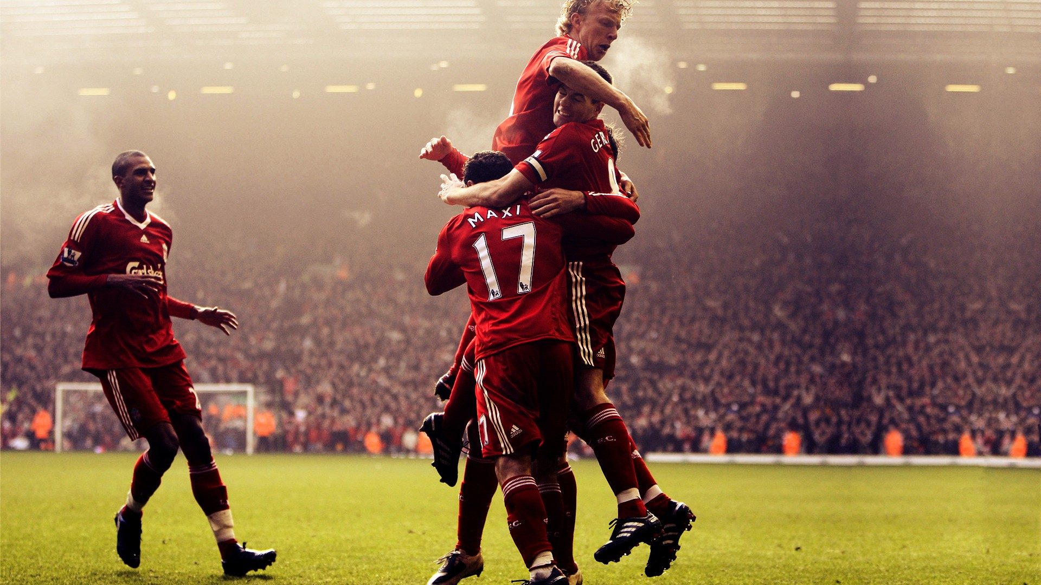
Celebrate
Notes:
Another thing that I’ve learned is the importance of celebration.
For most of my leadership life, I felt that thanks and celebrating success was to be reserved for when someone does something superhuman. I believed that people should be recognized only when they go “above and beyond”.
I am not alone. Many leaders think his way.
Can you imagine being part of a sports team that that only celebrates once per year – when they win the World Cup or the World Series? Imagine going to football match or baseball game where the team only celebrates when they win the game. They don’t celebrate getting a run, they don’t celebrate goals, they don’t celebrate touchdowns. They only celebrate when they win the game.
You see. It’s completely unnatural to only celebrate when people go above and beyond. I wonder, “Is it even possible to have a world-class team that doesn’t celebrate the small wins – the goals, the home runs, the great saves?”

Slide 43
Experiment
Notes:
Here is your experiment
YOU can do this today. At this conference. Commit to sharing the 1%. Share the stuff that’s REALLY happening in your life. And that will be the start of a deep friendship. I guarantee you.

Slide 44
So what’s the solution?

Slide 47
Accountability
What are the 5 action items you will take in the next 6 months?
Action Item Due Date
__________________________________________ _____________
__________________________________________ _____________
__________________________________________ _____________
__________________________________________ _____________
__________________________________________ _____________
Accountability Partner Name __________________________________________________________________________________________ Email: _________________________________________________
Take a picture of this page and email to your accountability partner.

Slide 48
Coming in July

Slide 49
Go to: krister.com/remind-me

