Slide 1





HOSTED BY

Slide 2
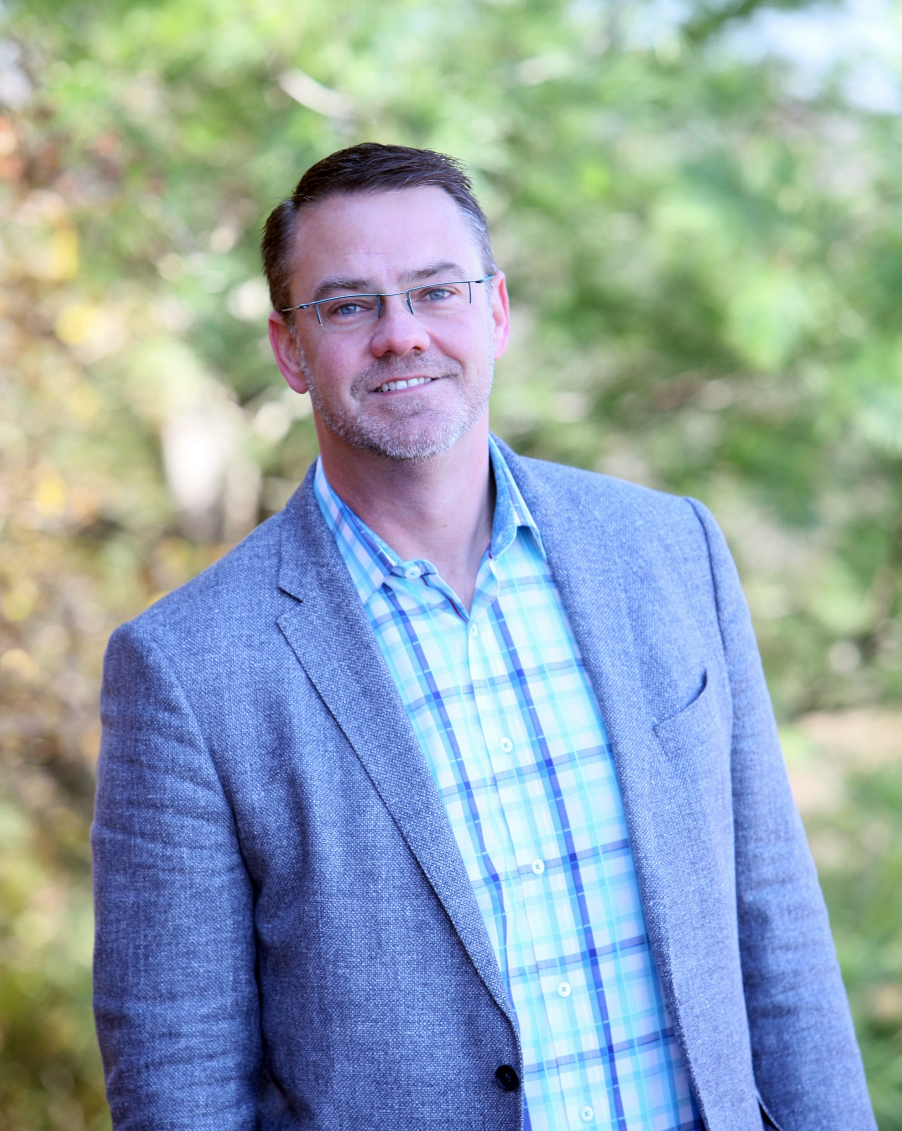
Krister, “The Leadership Archaeologist”
HOSTED BY

Slide 3
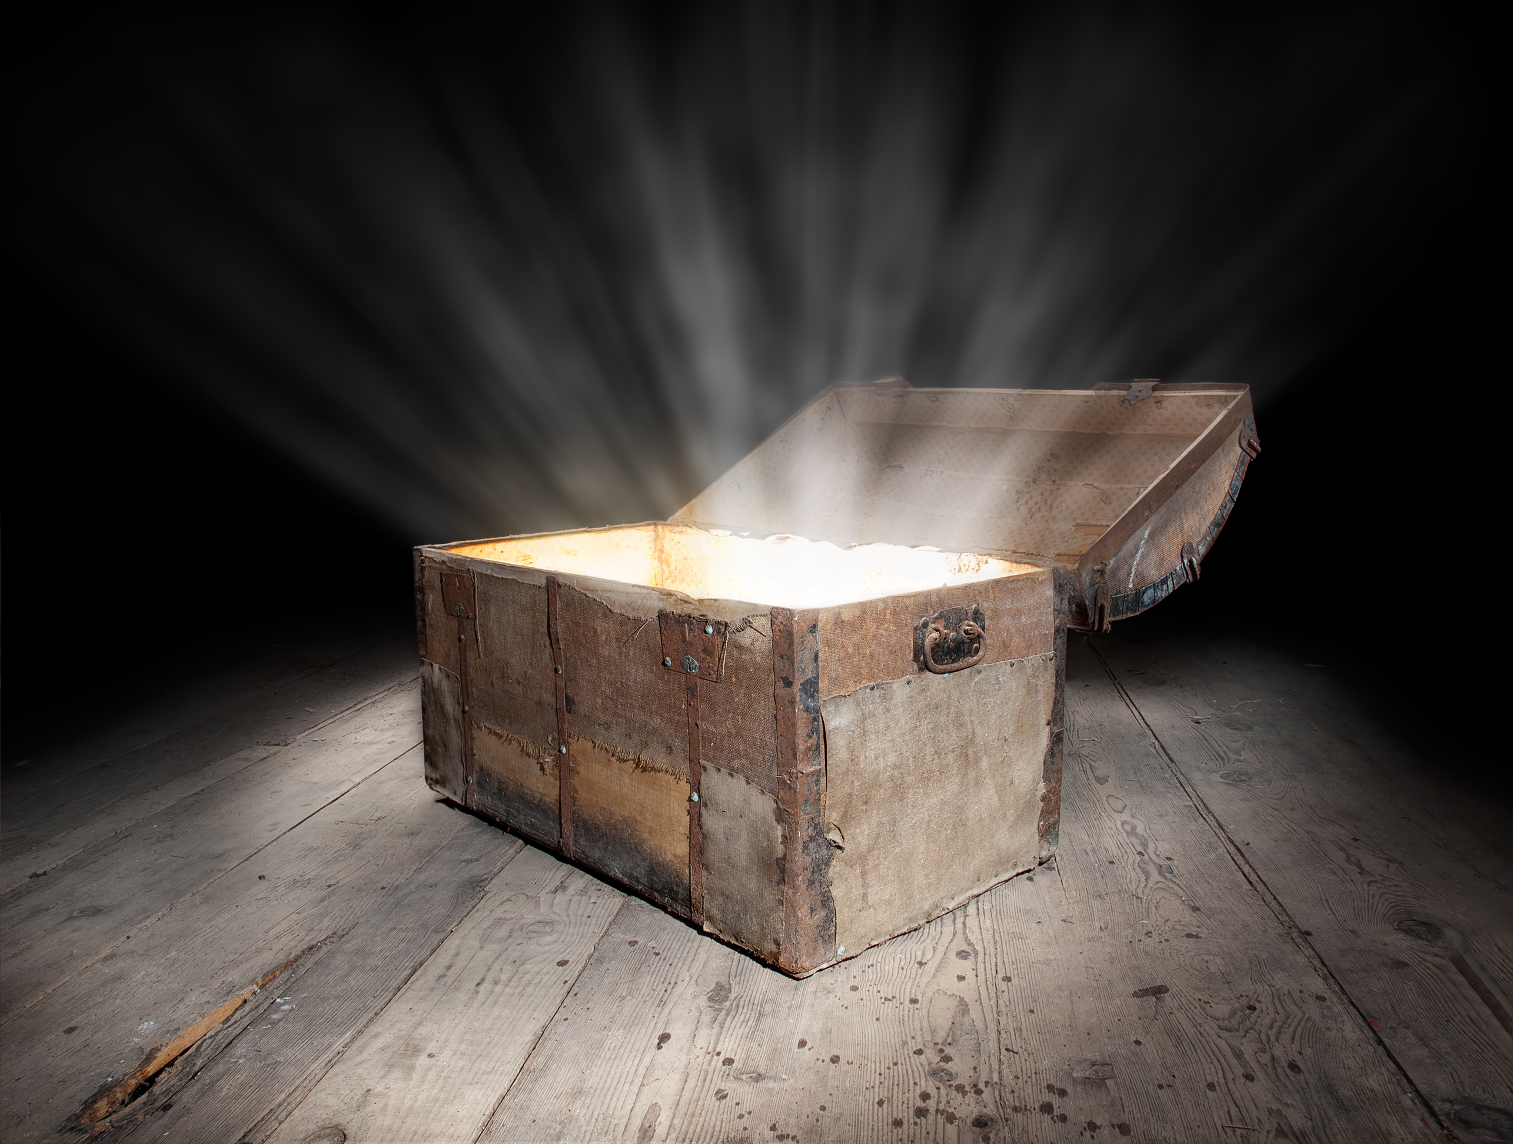
The Leadership Archaeologist’s Tools
To Unearth Unseen Potential

Slide 4

What in the world is a
Leadership Archaeologist™
?

Slide 5
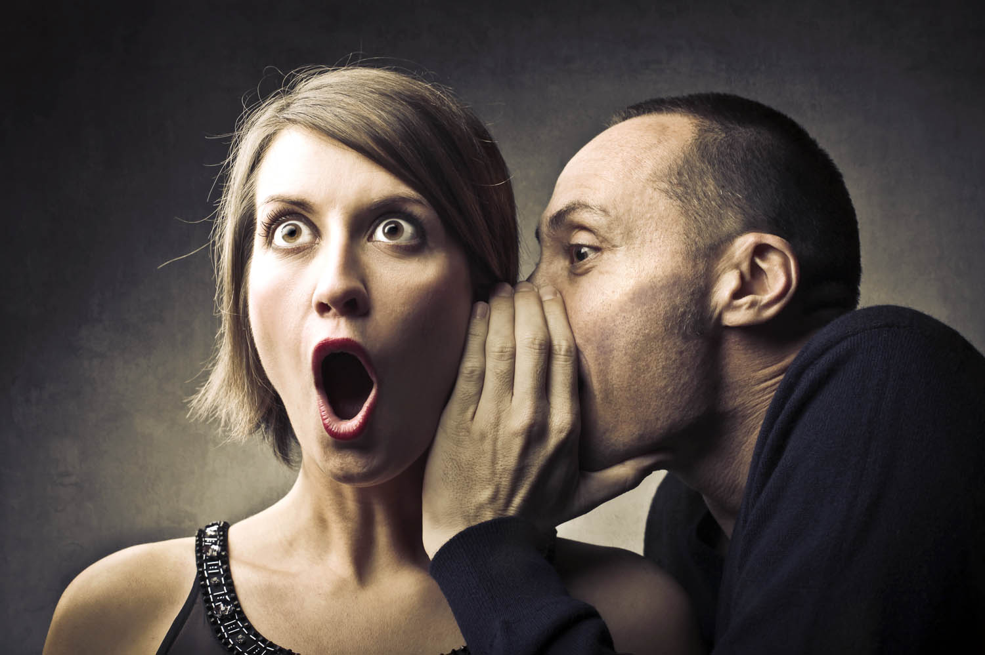
Notes:
Most of all, a Leadership Archaeologist, is a seeker of secrets.

Slide 6

Notes:
What am I doing in LONDON?
I’m on my knees beating a pillow with a tennis racket. Over my shoulder, there’s a 75 year old New Age-y British guy screaming at me.

Slide 7

Notes:
What am I doing in SYDNEY?
I’m in the woods outside of Sydney, dancing with 200 strangers…
And I’m naked.
I’m seeking secrets…

Slide 8

Notes:
HILTON HEAD ISLAND.
I’m staring at an alligator, talking on my cell phone to the world’s expert on divorce and relationships.
I’m seeking secrets…

Slide 9
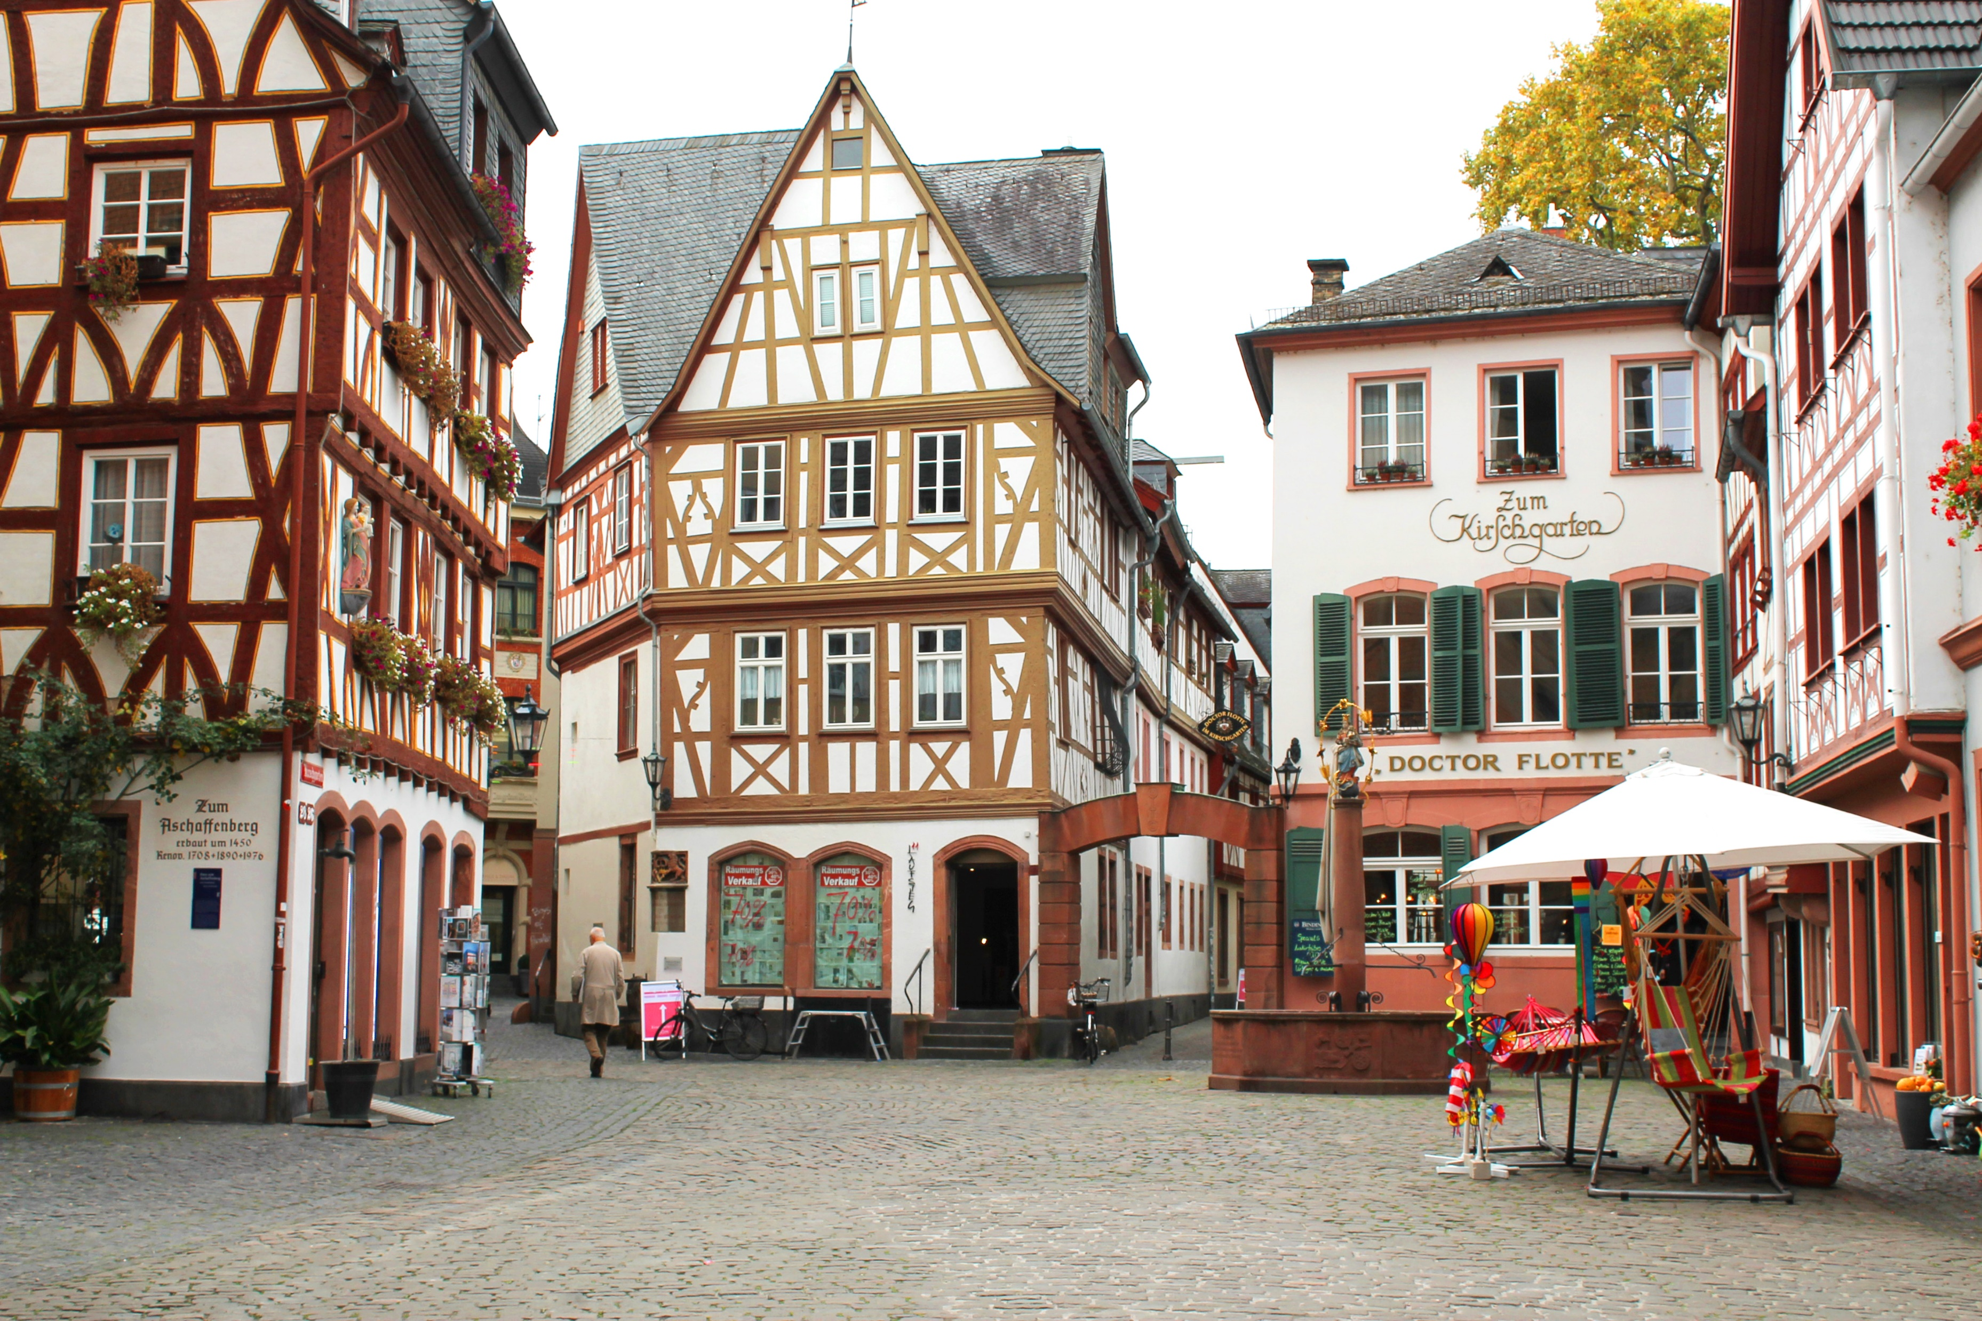
Notes:
“What does reading love letters have to do with leadership?”
If you want to unearth unexpected secrets, you have to dig in places where others don’t dig, like love letters.
As a Leadership Archaeologist, I draw insights by connecting my experience as CEO of a 3,000% growth company with diverse research ranging from cultural anthropology to relationship psychology.
I dig deep in dark places that most don’t dare go.

Slide 10



Slide 11

Notes:
Why am I so passionate about seeking secrets?
The secrets that destroy the best leaders are the secrets we keep from ourselves.
As a Leadership Archaeologist, I dig deep into the psyche of leaders, to help them find their secrets. Secrets are easy to find for the people who have explored the dark places inside of themselves.

Slide 12
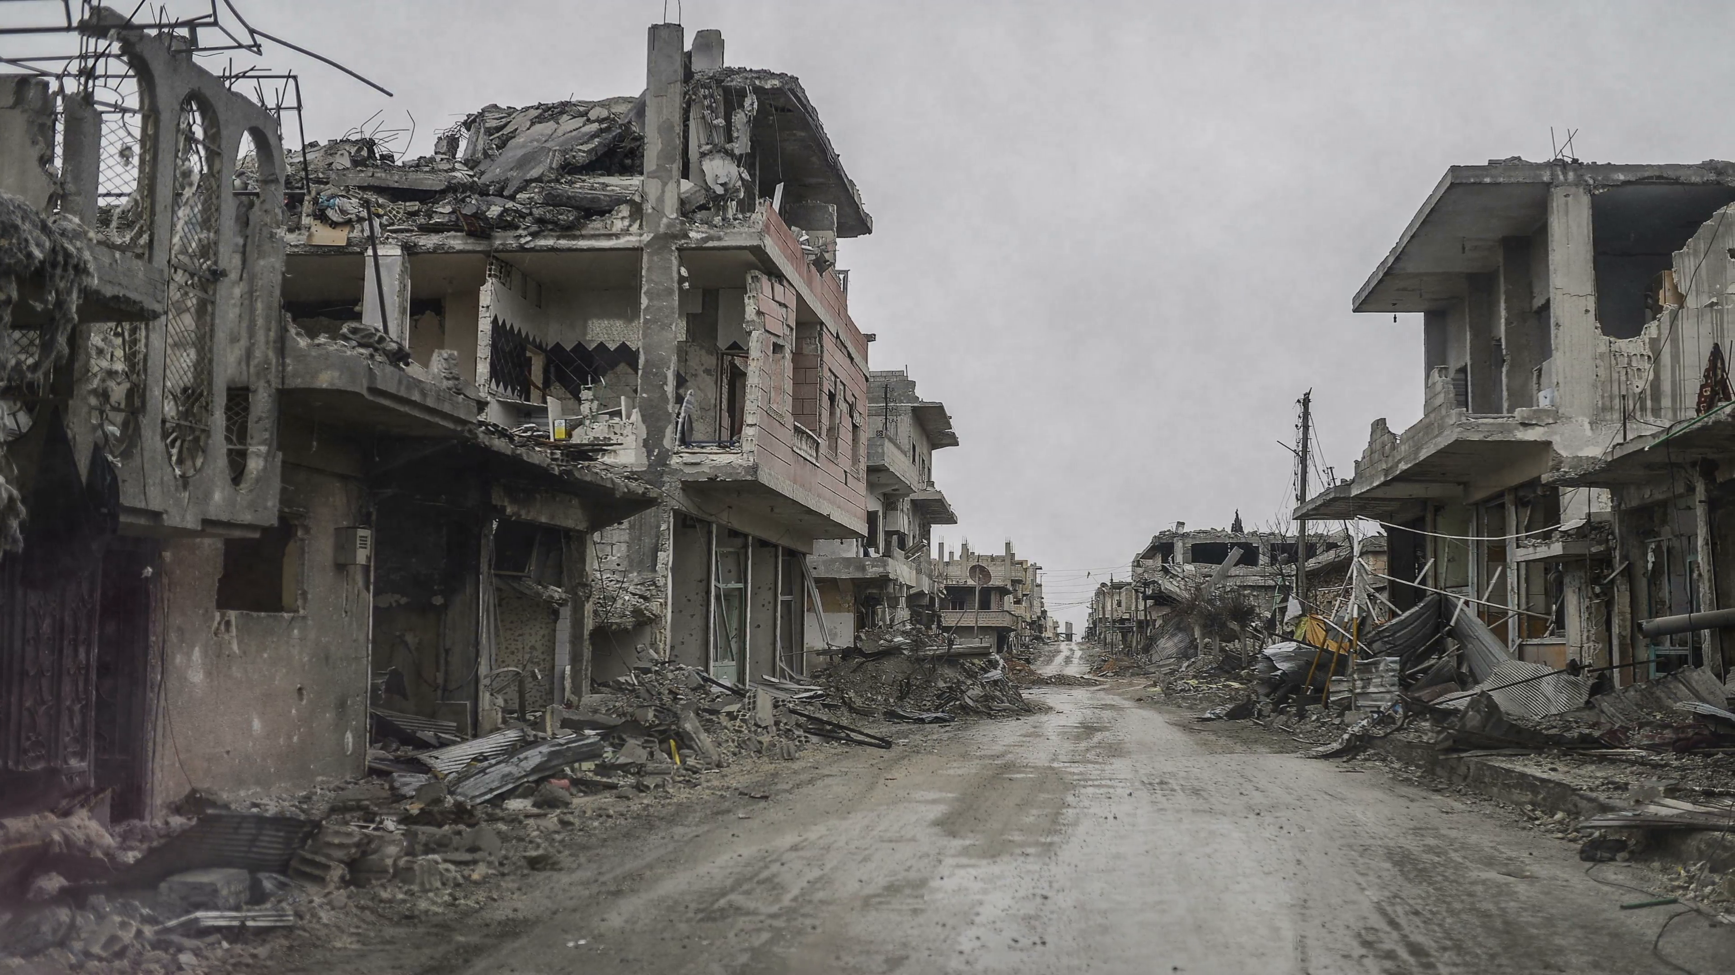
The Root Cause of Broken Businesses
Notes:
In all of my research, the number one cause of broken businesses was broken relationships.
Co-founders or business partners who have a “business divorce”
Two executives
Top salesperson leaving
Families and family businesses
CEO gets divorced

Slide 13



Tools of a
Leadership Archaeologist

Slide 14

#1
Seeking Secrets We Can’t See

Slide 15


Notes:
I’M SHOCKED AND EMBARRASSED.
“He is young,” that’s what one of my employees responded to the question, “What are Krister’s greatest strengths?”
“He is young”… my greatest strength is something I can grow out of!

Slide 16
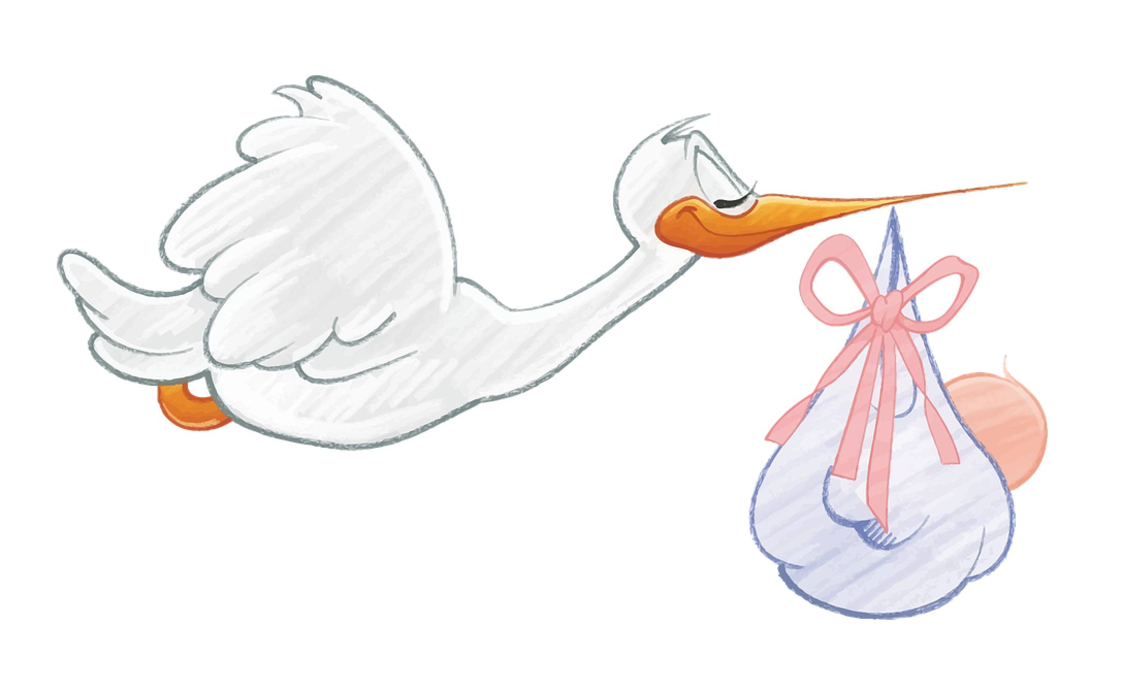
Where do “bad bosses” come from?

Slide 18


Slide 19

Experiments
Download tools and additional resources at
krister.com/tools

Slide 20
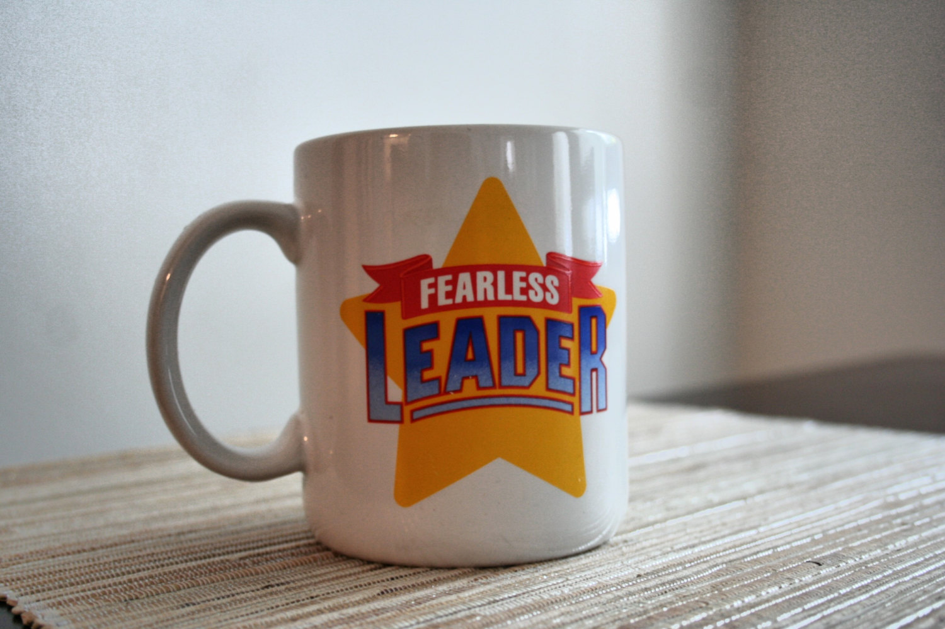
Follow the Fearless Feedback Protocol
What should I start/stop doing?
Thank you. That took courage.
Can I follow up in a week?
Notes:
MOST IMPORTANT TIP:
DO NOT RESPOND IMMEDIATELY. SIMPLY ABSORB THEIR WORDS AND SAY “THANK YOU, I APPRECIATE IT. IT TAKES A LOT OF COURAGE TO SHARE THAT WITH ME. CAN I FOLLOW UP WITH YOU AGAIN IN A COUPLE WEEKS?”
AND THINK ABOUT IT FOR A COUPLE DAYS OR WEEKS BEFORE RESPONDING.
Called “Fearless Feedback” because only courageous leaders undertake it.
But also because following the protocol helps employees feel less fear of sharing feedback with you.
Do you feel comfortable sharing feedback with me?
Placement
How would you describe the best boss or coach you ever had? Get 3-5 adjectives.
Write down the 5 adjectives that you would like your best people to describe you.
On a scale of 1 to 10, rate me on the following: Krister is extremely XXXX.
What is the difference between an 8 and a 9 or 10 for you?
What words do you use to describe me to your closest friend / spouse?
How many days per month would you say that you are mildly frustrated because of something I have said or done?
What could I stop doing?

Slide 21

Best Practices for Executive 360s
20 – 30 online responses
5 – 10 confidential follow-up interviews
Professional & personal responses
Leaders go first
Notes:
20 – 30 online responses
5 – 10 confidential follow-up interviews
Professional & personal responses
Leaders go first

Slide 22

#2
The Man Smarter Than Steve Jobs
Notes:
Dig a little deeper than the surface.

Slide 23
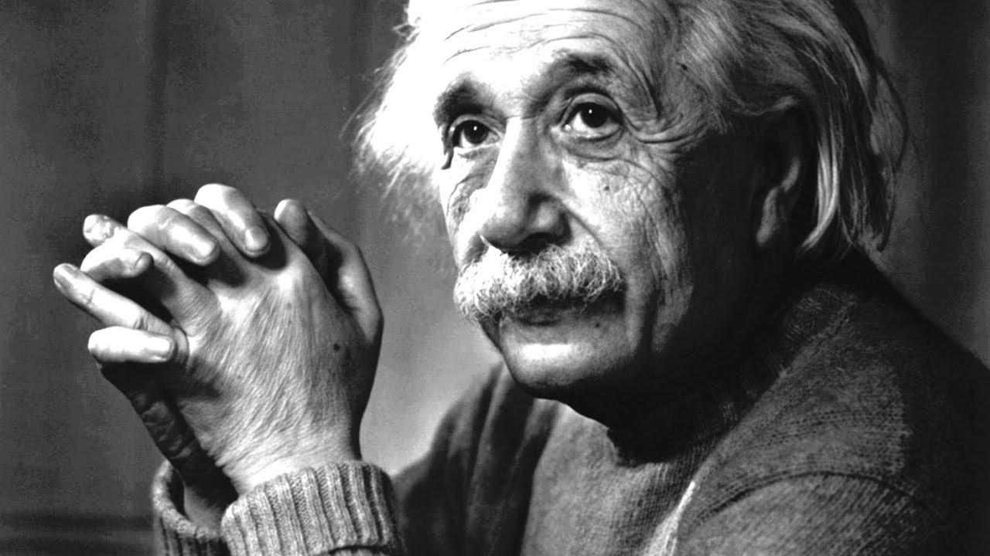
Notes:
We think we are the smartest person in the room.
You believe you’re smarter than anyone else.
You put forth the solution to every problem.
You do most of the talking, and rarely hear anyone else’s ideas.
People do what you say, and they are often successful.
Further reinforcing your belief that you’re the smartest person in the room.

Slide 24
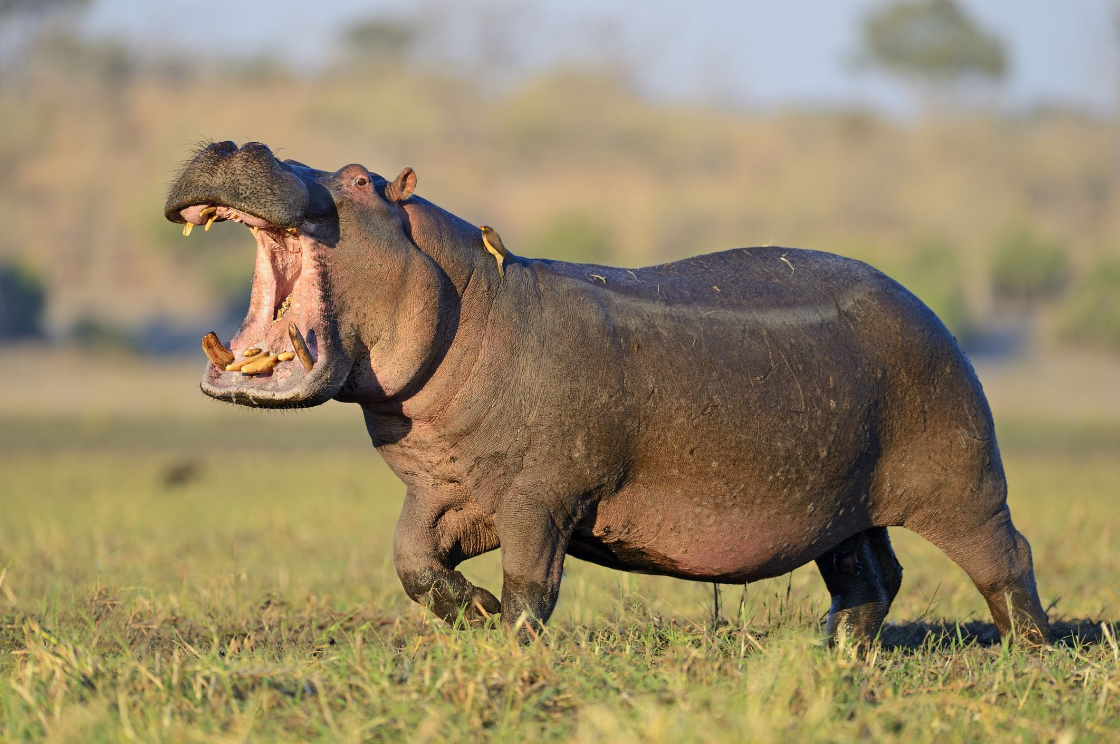


Slide 25
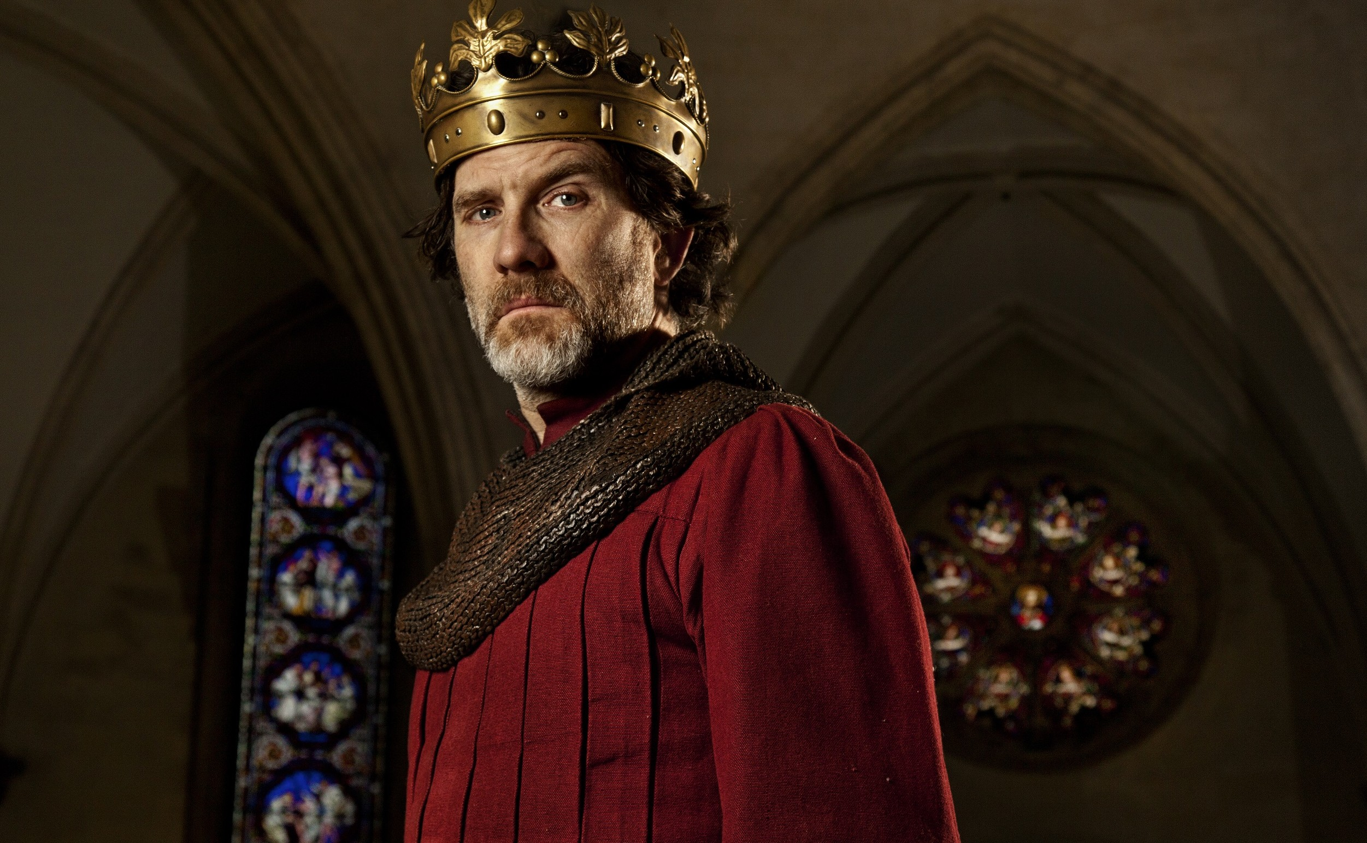

“
People with power suffer deficits in empathy, the ability to read emotions, and the ability to adapt behaviors to others”
“Becoming Powerful Makes You Less Empathetic” xHarvard Business Review, April 2015
Notes:
People with power suffer deficits in empathy, the ability to read emotions, and the ability to adapt behaviors to others.

Slide 26
the boorish, emotionally tone-deaf Steve that we first knew changed into a different man during the last 20 years of his life.”
- Ed Catmull, President Pixar
“
Notes:
"Relentless Steve - the emotionally tone-deaf guy that we first came to know - changed into a different man during the last two decades of his life”

Slide 27

Experiments
Download tools and additional resources at
krister.com/tools

Slide 28
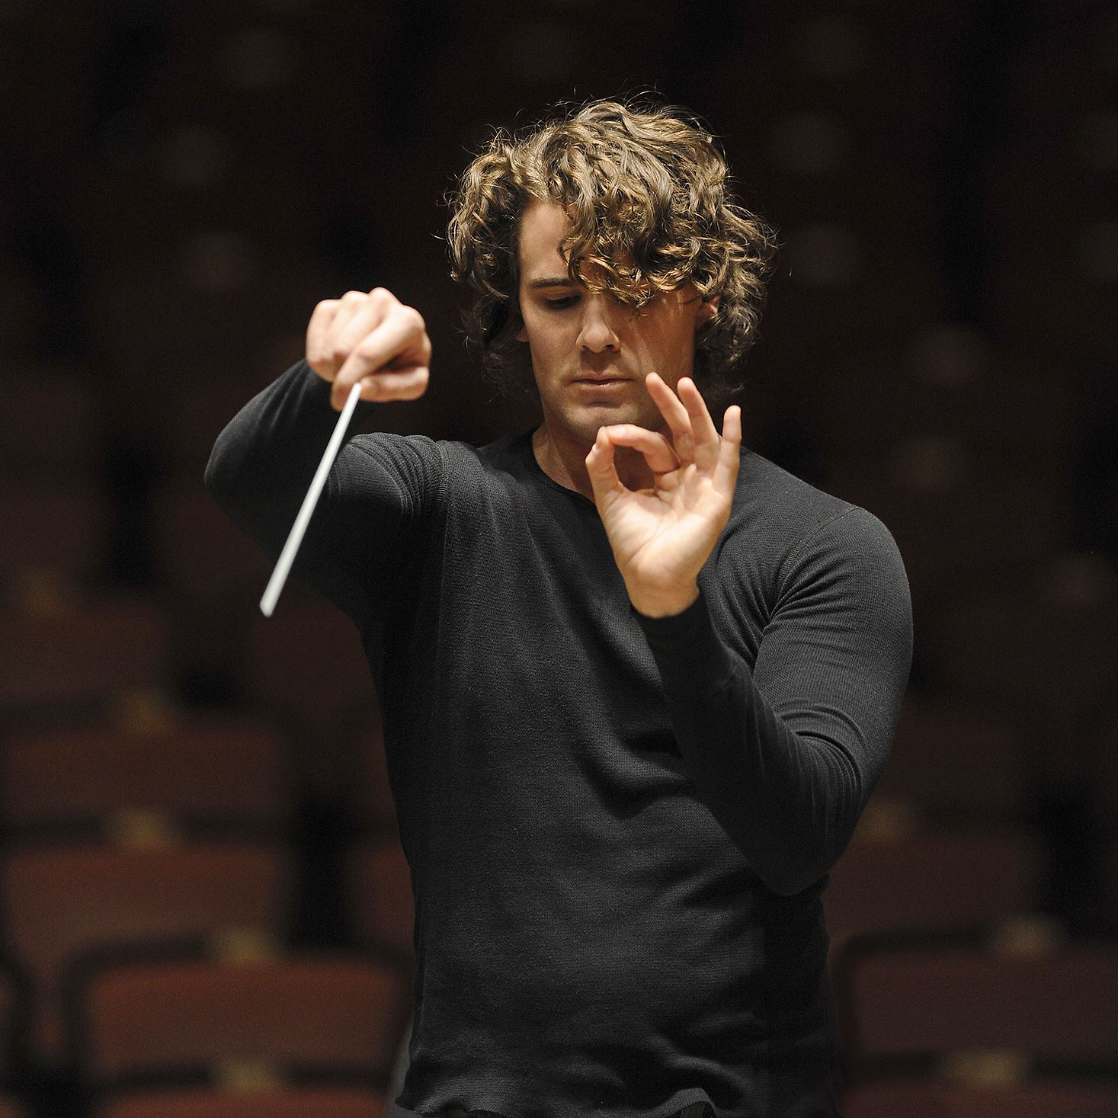
Stop holding meetings.
Start conducting them.

Slide 29

#3 The Trilingual Trifecta

Slide 30
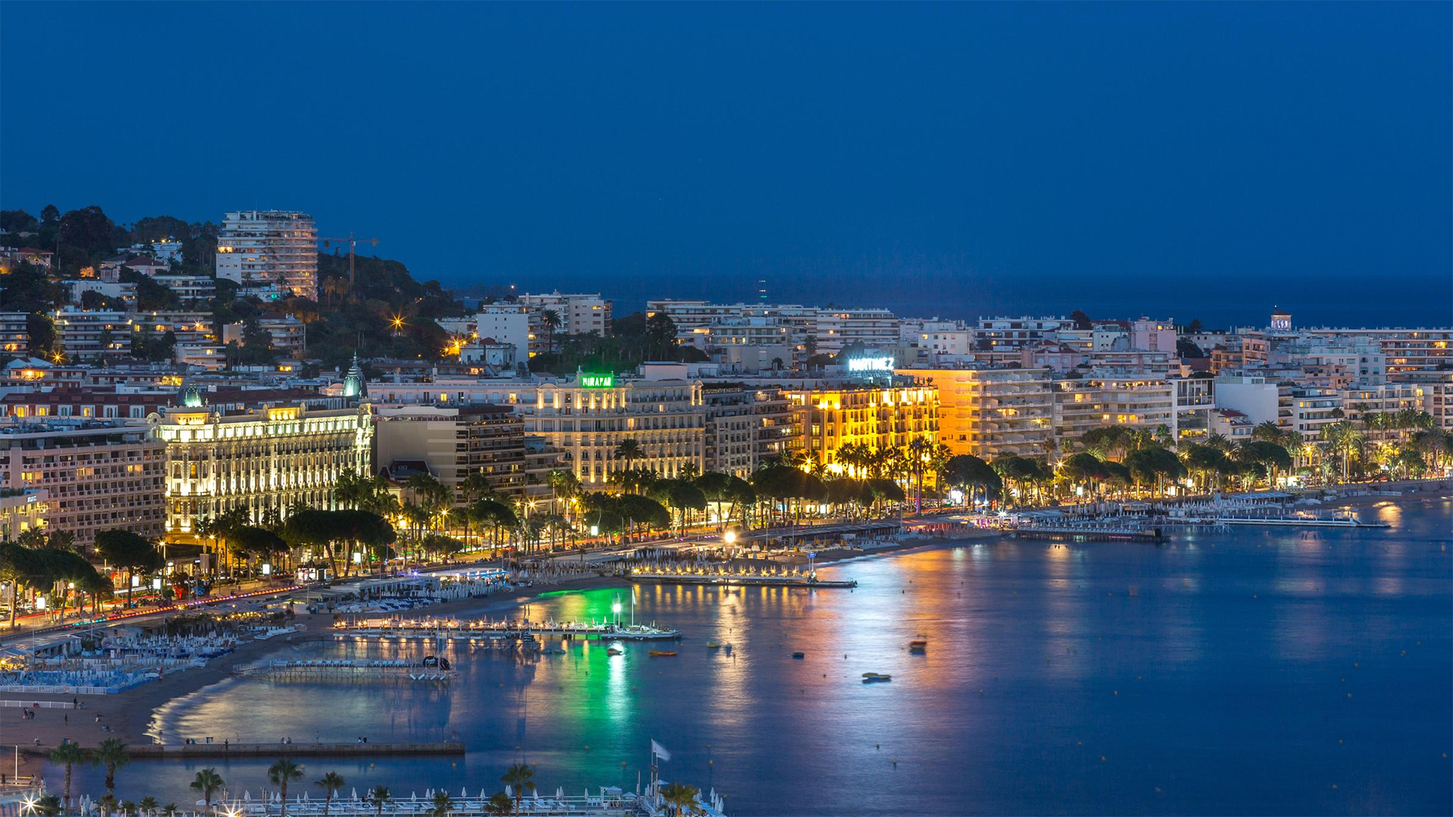

Slide 31


Slide 32

Download tools and additional resources at
krister.com/tools
Notes:
Here’s the experiment to try:
Next week, pick 3 meetings and limit yourself to ONLY asking the following 5 questions and TELL ME MORE
What options are you considering?
What are you working toward?
How can I best support you or help you to think this through?
How clear is your thinking about this?
How long have you been thinking of this?
You are also allowed to say “Interesting. Tell me more.” at any time.
So, now you’re listening, lets talk about the next secret, which is listening to the hardest thing you will ever hear.

Slide 33
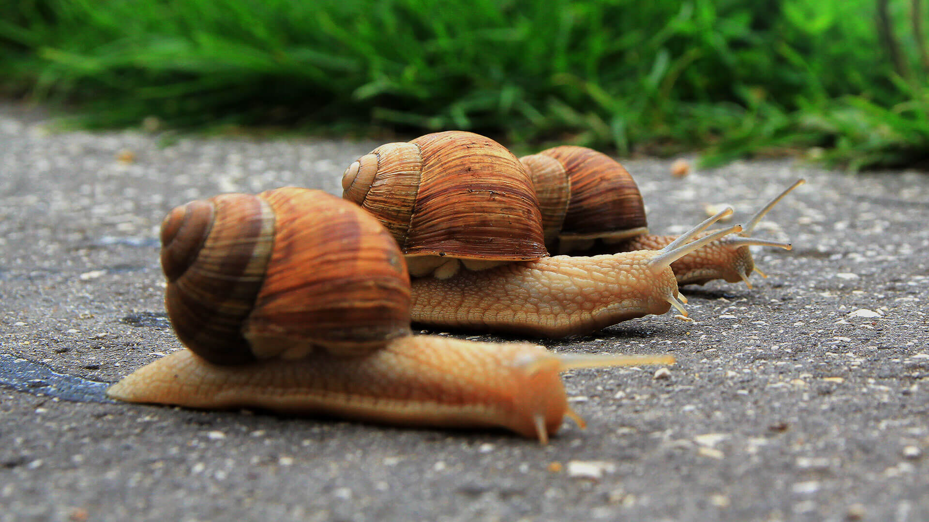
Speak slowly.
Pause every breath.

Slide 34
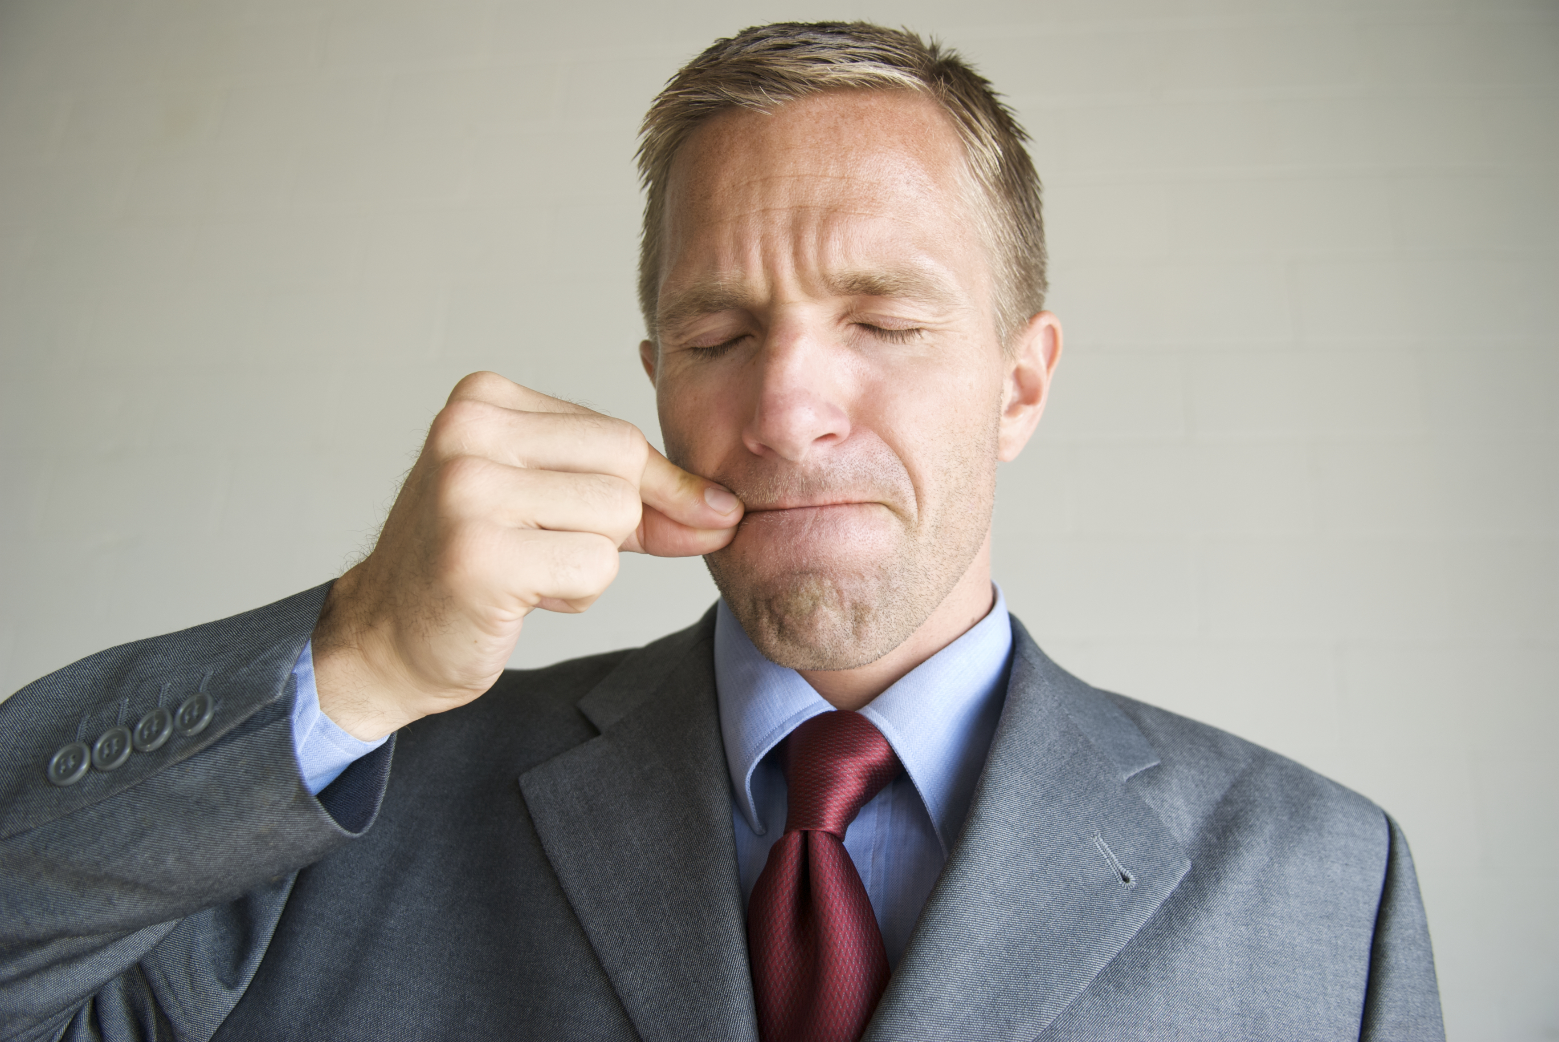
Try a “Talking Diet”

Slide 35


THE TALKING DIET FOR TOP EXECUTIVES
Allowed
One word questions
Tell me more…
Questions that begin with What, How, Who, When, or Where
Compliments
Not Allowed
“Queggestions”
Should, could, would, must, need to
Why questions
Criticism
Talking more than 30 seconds

Slide 36

Perform a team communication
analysis

Slide 37


Slide 38

What’s a Leadership
Archaeologist?
Notes:
A Leadership Archaeologist is a like a connoisseur of outside-the-comfort-zone experiences.

Slide 39
Notes:
What am I doing in LONDON?
I’m on my knees beating a pillow with a tennis racket. Over my shoulder, there’s a 75 year old New Age-y British guy screaming at me.

Slide 40

#4 The Uncorked Leadership Secret,
Cellared 4,000 years

Slide 41
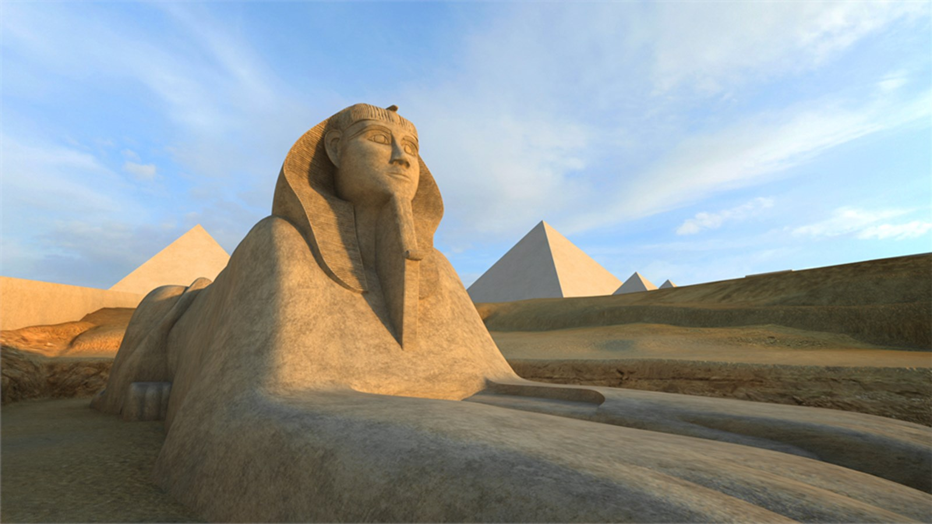
Notes:
So what is this 4,000 year old leadership secret ?
And for that, let me take you back to London.

Slide 42
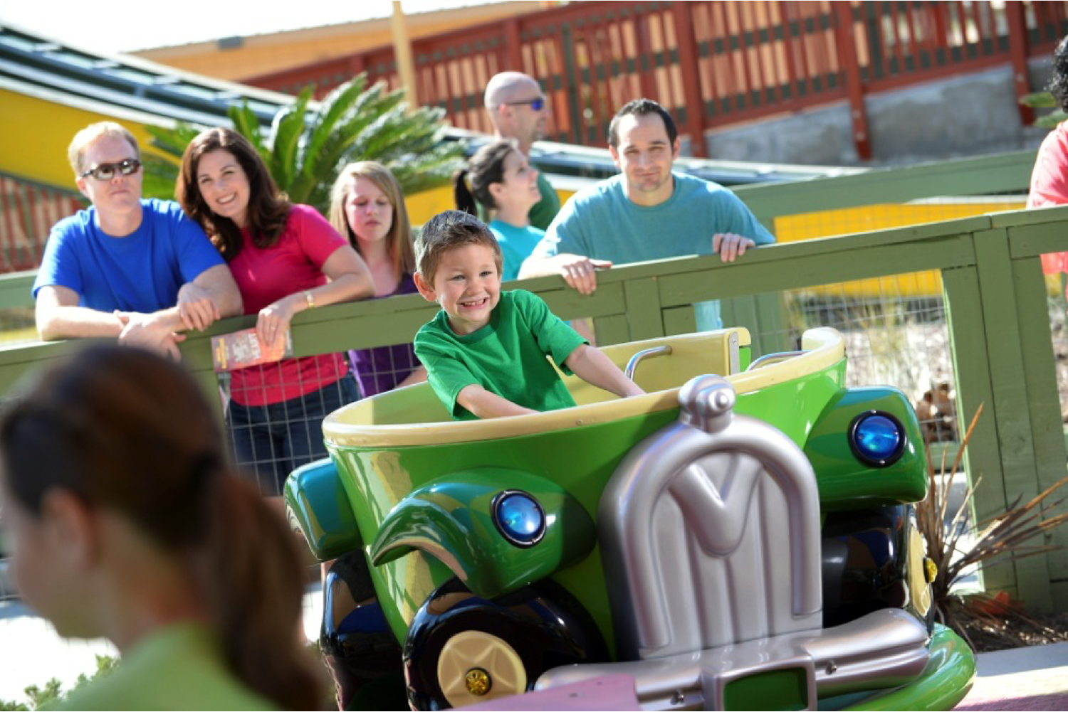




Slide 43

Notes:
They are the owners and operators of the Harlem Globetrotters, Dollywood, Silver Dollar City and Stone Mountain in Atlanta.

Slide 44

Point. Click. Forgive?

Slide 45

Notes:
Corporations have forms for feedback, for disciplinary action, for exit interviews to get feedback on the company or the bosses.
But what there was a form for forgiveness?
It just so happens… there is.

Slide 46

Notes:
So about 3 months after my forgiveness training, I decided to follow this process again. Because forgiveness is an ongoing process. If you choose to continue a relationship with someone who chooses to hurt you, they will likely continue to hurt you, so in that case you have to forgive them again, and again.
So, I did the worksheet.

Slide 47
List the judgments, expectations, how you want this person to change and other ways that they are less than perfect…
Notes:
Corporations have forms for feedback, for disciplinary action, for exit interviews to get feedback on the company or the bosses.
But what there was a form for forgiveness?
It just so happens… there is.

Slide 48
How many of these words are judgements or expectations that the other person could make about you.
Notes:
Corporations have forms for feedback, for disciplinary action, for exit interviews to get feedback on the company or the bosses.
But what there was a form for forgiveness?
It just so happens… there is.

Slide 49

You spot it, you got it
Notes:
List the judgments, expectations, how you want this person to change and other ways in which they are less than perfect…
I wrote
BE MORE EMPATHETIC. APOLOGIZE. ENCOURAGE ME. SAY SOMETHIING NICE.
ACKNOWLEDGE MY CONTRIBUTIONS. STOP CRITICIZING. STOP BELITTLING.
And then, I read the next line in the worksheet. It says “”

Slide 50
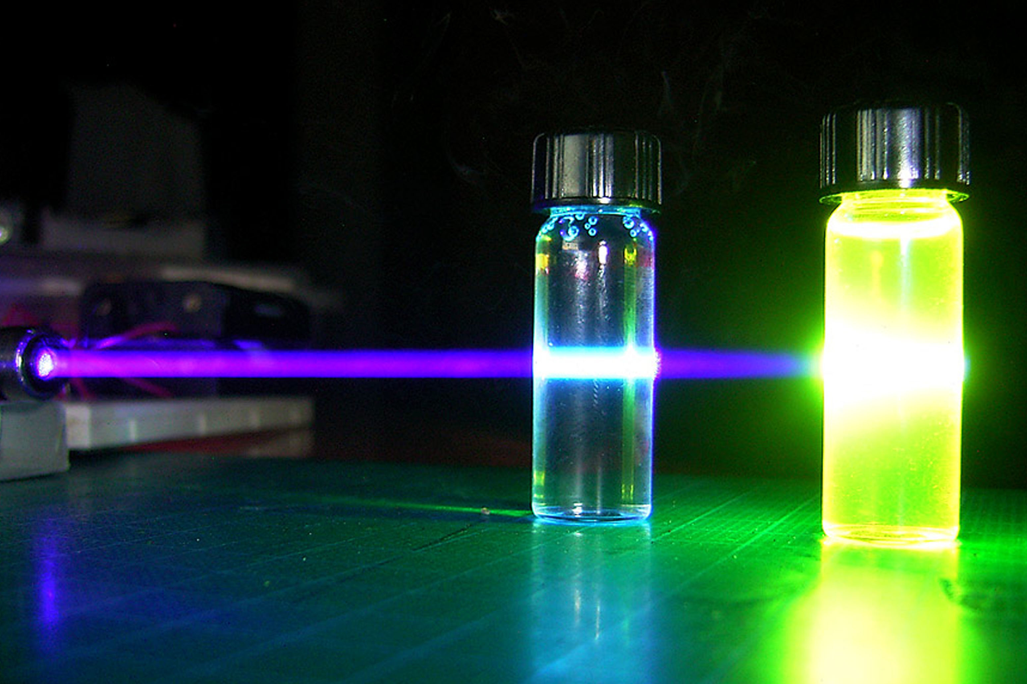
Experiments
Download tools and additional resources at
krister.com/tools

Slide 51

Try the Forgiveness Worksheet
Notes:
“Now read the above words and look to see how many of these are judgements or expectations that you may be able to make about yourself in your interactions with this person”

Slide 52


“Life changing
employee
training
programs.”
Experiment with Forgiveness Training for Employees
Notes:
“Now read the above words and look to see how many of these are judgements or expectations that you may be able to make about yourself in your interactions with this person”

Slide 53

Notes:
Now what does love have to do with leadership??? Well, it just so happens a lot. The experiment that Dr Gottman gave me is also called the “Fast Friends Protocol” It’s even been used to help opposing parties in peace negotiations to bring them close to each other.
The secret to love is SECRETS.
When we share secrets with others, it brings us closer to them.

Slide 54

Hello, my name is ____________
One thing that 99% of people don’t know about me is
_____________

Slide 56


Notes:
These are industry associations. They are all about vulnerability. They are like “support group for top leaders” – a completely confidential environment where leaders can share business issues, personal issues, family issues. It’s been a life changer for me. I honestly don’t know what I would have done if I hadn’t had the 10 people in my life from EO and YPO during the dark time.
In EO and YPO, we talk about sharing the 1% of your life that you don’t share with others. It’s sharing the 1% best and 1% worst. That’s what brings people together. Sharing what is REALLY happening in your life. It’s like a fraternity. You get brought close to people from all walks of life because you are sharing an experience.
You’re sharing your secrets.

Slide 57

Notes:
These are industry associations. They are all about vulnerability. They are like “support group for top leaders” – a completely confidential environment where leaders can share business issues, personal issues, family issues. It’s been a life changer for me. I honestly don’t know what I would have done if I hadn’t had the 10 people in my life from EO and YPO during the dark time.
In EO and YPO, we talk about sharing the 1% of your life that you don’t share with others. It’s sharing the 1% best and 1% worst. That’s what brings people together. Sharing what is REALLY happening in your life. It’s like a fraternity. You get brought close to people from all walks of life because you are sharing an experience.
You’re sharing your secrets.

Slide 58


Slide 59


Slide 60

Download tools and additional resources at
krister.com/tools
Notes:
One of the most inspiring expressions in French is “bon courage”. It rhymes with Bon Voyage.
Bon courage” is a French phrase for which there is no exact English equivalent.
The closest translation is “good luck”.

