Slide 1
Conservation Is Not Neutral
(and neither are we)
Fletcher Durant,
Head of Conservation and Preservation, University of Florida Libraries
Notes:
Thank you all for joining me here this morning. I want to start my talk acknowledging the privilege of speaking here, on the sovereign territories of the Mohegan tribe at what I believe is the first Annual Meeting that AIC has ever held on formally recognized indigenous lands.

Slide 2
Shared Concerns and Shared Goals
Voices Within Conservation:
Sanchita Balachandran, “Race, Diversity and Politics in Conservation,” 2016
Miriam Clavir, “Preserving What Is Valued,“ 2002
Jan Paris, “Conservation and the Politics of Use and Value in Research Libraries,” 2000
And Within GLAM Fields:
La Tanya S. Autry, Chris Bourg, Michelle Caswell, Emily Drabinski, Jarrett M Drake, April Hathcock, Ibram Kendi, Bethany Nowviskie, Nathan “Mudyi” Sentance, Lae’l Hughes Watkins
Further Readings
Social Justice & Museums Resource List
http://bit.ly/1rl1fuV
Archives & Social Justice Reading Group
https://bit.ly/2XRmzJq
#Critlib Reading List
https://www.zotero.org/groups/255376/critlib
Notes:
This talk was sparked by scholarship from practitioners in libraries, archives, and museums, works that spurred me to consider the structures that are in place in our field, and spurred me to undertake a deeper examination of my actions, the approaches that I take in my work, and the type of work that I am even able to engage with within the confines of my employment. I hope this talk sparks similar considerations as part of a larger constellation of conversations that we, conservators, need to have as a field to understand our role and our impact on heritage and on society. Conversations that I am heartened to see emerging conservators grappling with on our listservs, showing that education in our field is a two way street and that we can all learn from each other to grow in our profession.

Slide 3
Is Conservation Neutral?
Notes:
The concept of neutrality may seem like an unusual way to frame our work as conservators, but I think that we like to see ourselves as providing a service to society through our work on heritage, and not about taking a side or making a choice to weigh in on contested social issues.

Slide 4
Neutrality
“The primary goal of conservation professionals, individuals with extensive training and special expertise, is the preservation of cultural property.”
-Preamble to the AIC Code of Ethics
“Vocational awe” refers to the set of ideas, values, and assumptions librarians have about themselves and the profession that result in beliefs that libraries as institutions are inherently good and sacred, and therefore beyond critique.
-Fobazi M. Ettarh (2018)
Notes:
AIC defines conservation as “The profession devoted to the preservation of cultural property for the future.” A goal that has always spoken to me in its simplicity and universality. When I speak of conservation as being a neutral process, it is this idealized conception of a field devoted to the preservation of all cultural property that I picture. Something is damaged, something is mended. A service performed to society. However, in practice, conservation is neither so simple nor so universal. In truth, conservation is about making choices and allocating scarce resources, expertise, and time. Sometimes these choices are difficult and force us to reason with our planned actions. But all too often, I fear that we are blind to the choices that we make, believing that we are neutral actors making neutral decisions that have no negative impact on society or cultural heritage.
All of the objects that we work on contain complex, interwoven multitudes of history. It is our job as conservators, in consultation with curators and owners and stakeholders, to decide which stories we want our objects to tell. Some stories are simpler than others. An accident in transit causes something to break. A patron writes in the margins of a book. We know how to fix these things, and often there isn’t much need for debate over the idealized state of the item.

Slide 5
Firdos Square, Baghdad. April 9, 2003.
“While recognizing the right of society to make appropriate and respectful use of cultural property, the conservation professional shall serve as an advocate for the preservation of cultural property.”
-AIC Code of Conduct Principle III
Image credited to Goran Tomasevic/Reuters.
Notes:
On April 9, 2003, as US military forces began to occupy Baghdad, a group of US Marines and Iraqi citizens pulled down a 39 foot tall statue of soon to be deposed ruler Saddam Hussein in Firdos Square. The act was understood in the media as a symbol of regime change, an act of freedom by a newly liberated people. The winners of a conflict memorializing their new society and refusing to bow to the oppression that had come before. 16 years later, restoring the statue would frame a very different message about the Baathist regime and the American invasion of Iraq.

Slide 6
Durham, North Carolina. August 14, 2017.
“All actions of the conservation professional must be governed by an informed respect for the cultural property, its unique character and significance, and the people or person who created it.”
-AIC Code of Conduct Principle II
Final report of the Durham City-County Committee on Confederate Monuments and Memorials: https://bit.ly/2T1MJaJ
Image credited to Casey Toth, The News & Observer.
Notes:
On August 14, 2017, a group of anti-racist protestors gathered around a statue in downtown Durham, North Carolina and pulled it to the ground, crumpling the hollow metal into an almost unrecognizable shape. The metal is now stored by the City of Durham. Is this twisted bronze trash or is it cultural property? If it is cultural property, whose property is it? Whose history should it embody? Should this statue be restored to its original form to honor the Confederate dead, raised as a symbol of white supremacy in the 1920s? Or should it be left in its damaged state to tell a story of protest by a mixed race coalition reckoning with societal racism in light of a brutal public murder by avowed white supremacists?

Slide 7
“All policies, ideas, and people are either being racist or anti-racist. Racist policies yield racial inequity. Anti-racist policies yield equity.”
- Ibram Kendi (2018)
“In the last decade alone, American taxpayers have spent at least $40 million on Confederate monuments and groups that perpetuate racist ideology.”
-Palmer and Freed Wessler (2018)
Notes:
When the AIC Code of Conduct says “All actions of the conservation professional must be governed by an informed respect for the cultural property, its unique character and significance, and the people or person who created it,” how do we balance competing and contradictory ideas of an object’s unique characteristics and significance? Which stakeholders do we allow to contribute input to our treatments? Can we “respect” something and erase part of its history at the same time? If we are tools in the service of society, shouldn’t we be aware and clearly document whose stories we are privileging and whose stories we are erasing through our work?
I ask these questions not because I think that there is a single right answer that we can use as a guide in our work, but because I believe that we need to be more mindful in how we approach treating contested objects and more critical in how we evaluate stakeholder input. And I believe that we can, and indeed must, do this for all of our treatments.

Slide 8
Demographics
Notes:
Stakeholder input is clearly important for how we approach treatment plans. Stakeholder input is also important for how we decide what gets treated and I want to suggest to everyone here that what we treat is very closely tied to who we allow into this and related fields. I will be the first to admit that the available statistics are imperfect and don’t represent individual experiences or collections, but I think that it is important for us to try to situate ourselves and our work within the larger structures of our field to see how a lack of diversity may influence our work and, through our work, society’s construction of heritage and culture in a manner that is neither neutral nor fair.

Slide 9
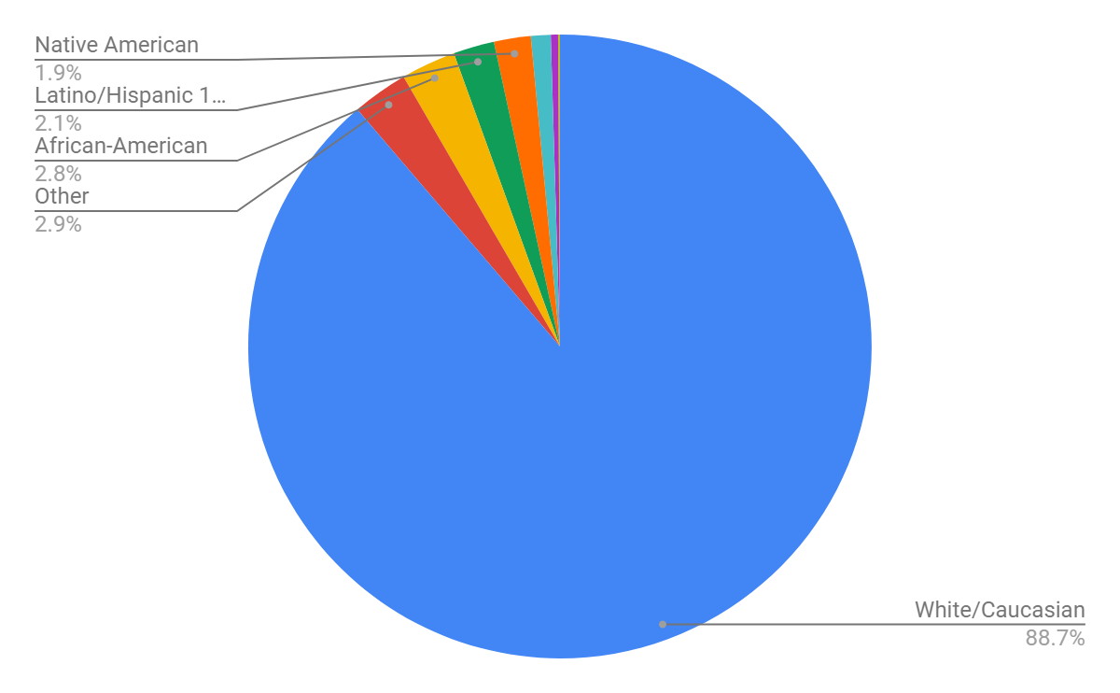
Archives
“Who gets to become an archivist, how archives get organized, and even what counts as an archive have a profound racial impact on what endures as valued historical research.”
-N.D.B. Connelly (2016)
2005 A*Census Data on Race and Ethnicity
Notes:
In the last A-Star census of the archival profession, 89% of all archivists self-identified as white. And that lack of diversity is all too often reflected in the collections. At Arizona State University Archives, in a state that is 30% Latinx, Latinx peoples are only represented in 1-2% of collections. In this same state, one with the largest Native American population in the country, only 6% of archival collections statewide contain material on indigenous peoples.

Slide 10
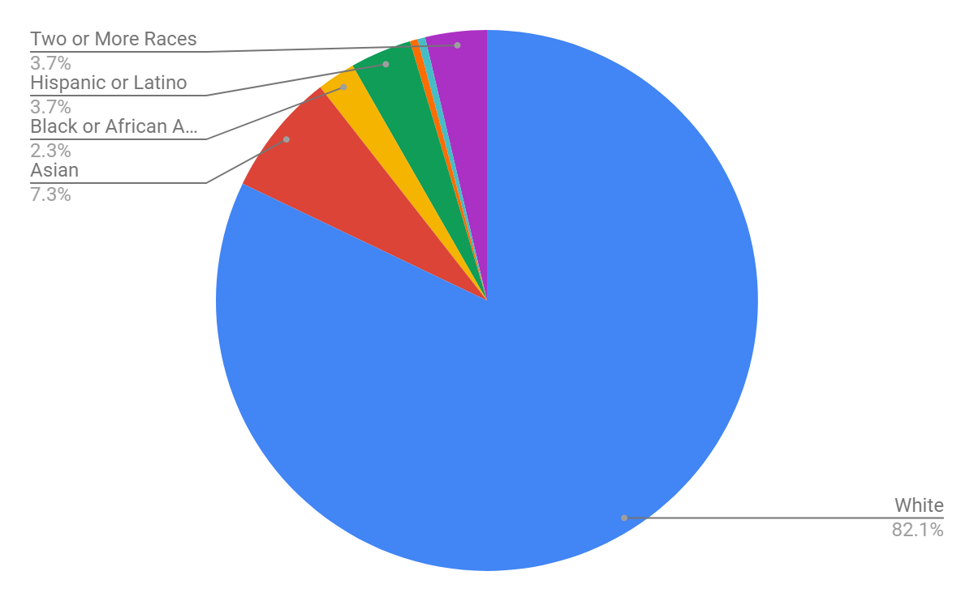
Library Conservation and Preservation
“Since the conception of the modern American public library, librarianship has struggled with consistently standing against racial injustice. Instead, libraries have clung to a colorblind philosophy of neutrality that has allowed for disengagement from communities of color.”
-Gibson, et al. (2017)
Teper, Centeno, and Rani (2018)
Notes:
In libraries, the ALA Membership is 86.7% white. In a recent survey of library preservation and conservation staff the numbers are 82% with over 90% of library conservators identifying as white.

Slide 11
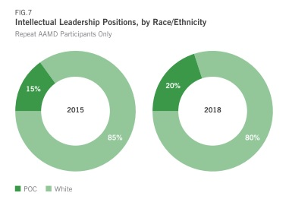
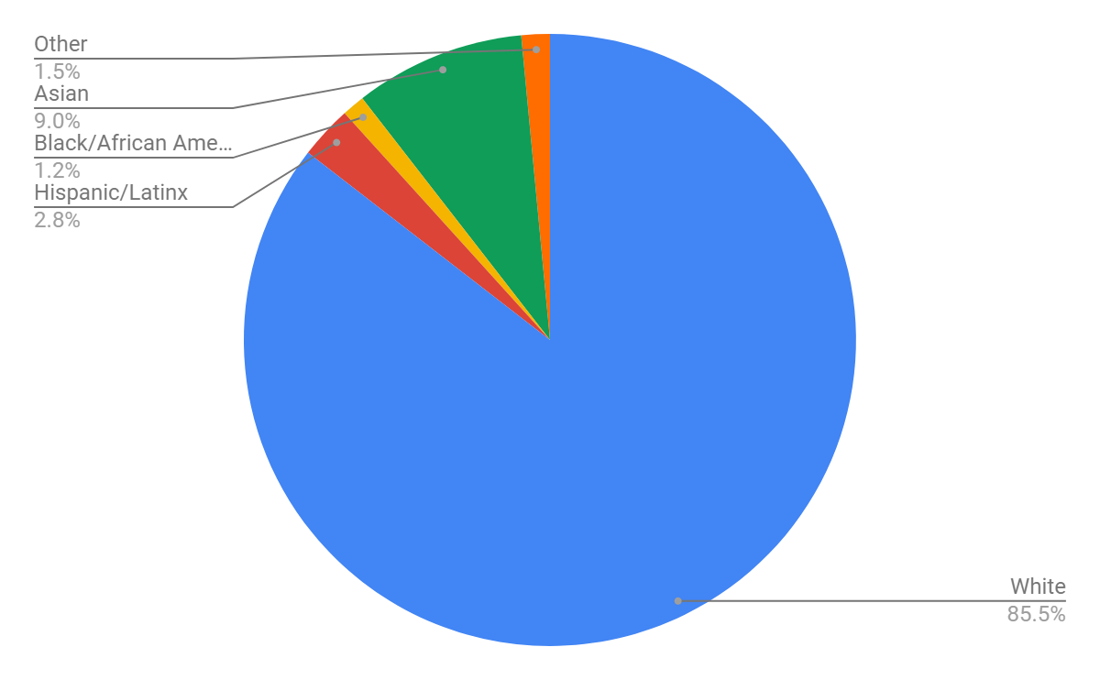
Museums
“Museums exist within a self-perpetuating system of mutually reinforcing judgments that create informal consensus about the relative importance of a given artist or group of artists.”
Susan E. Cahan (2016)
Art Museum Staff Demographic Survey 2018
Topaz, et. al (2019)
https://doi.org/10.1371/journal.pone.0212852
Notes:
From the 2018 Mellon museum survey, we know that 80% of museum leadership and conservators are White (non-hispanic). 79% of museum visitors are white, non-Hispanic. In the collections, recent data from major art museums show that 85% of artists are white. 75% are white men. At the National Gallery of Art over 97% of the artists in its collection are white, and 90% are male. At the Museum of Modern Art, only 11% of the artists in the collection are female, 10% are Asian, and 2% are black or African-American. And since 2008, just 2.4 percent of acquisitions and gifts and 7.6 percent of all exhibitions at 30 prominent American museums have been of work by African American artists.

Slide 12
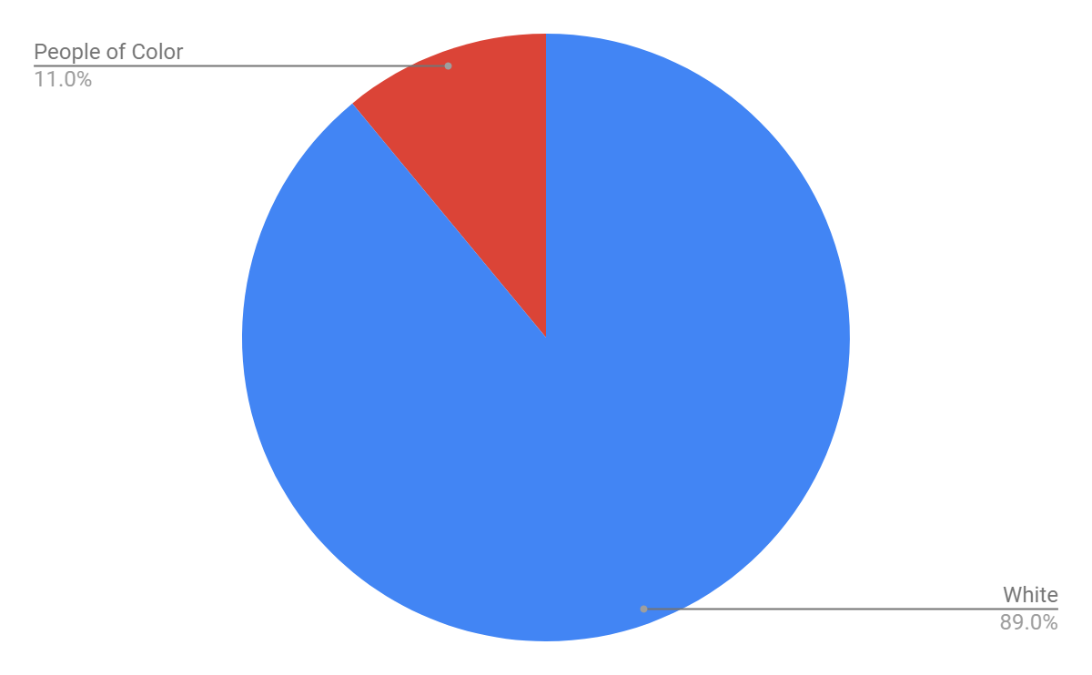
Conservators
“It has become clear that it is time for the AIC to commit to these efforts [of diversity, equity, and inclusion] in a more systematic, proactive manner if meaningful progress is to be achieved.”
- AIC Equity and Inclusion Working Group (2018)
https://www.culturalheritage.org/docs/default-source/publications/reports/equity-and-inclusion-working-group-final-report.pdf
Art Museum Staff Demographic Survey 2018
Notes:
The 1993 AIC Diversity Task Force survey found that our membership was 95% white. The Mellon museum survey data for conservators found that museum conservators are 89% white.
We are a predominantly white field. We work with colleagues who are predominantly white. Many of us work with collections whose creators are predominantly white. And the work that we as professionals do in and for these collections, is predominantly on objects created by and presented to white audiences. These demographics impact our choices and our work. Diverse perspectives make us all better, but we also can’t demand that our few diverse peers carry the burden of making the rest of us better people and better professionals.

Slide 13
Decisions
Notes:
We have even less data on what AIC members treat in the course of their work. There is no annual survey of what we treat, who the artists are, or what culture created the objects. But we can look at what treatments and topics we write on, present upon, and publish about in our professional literature as a surrogate for our treatments.

Slide 14
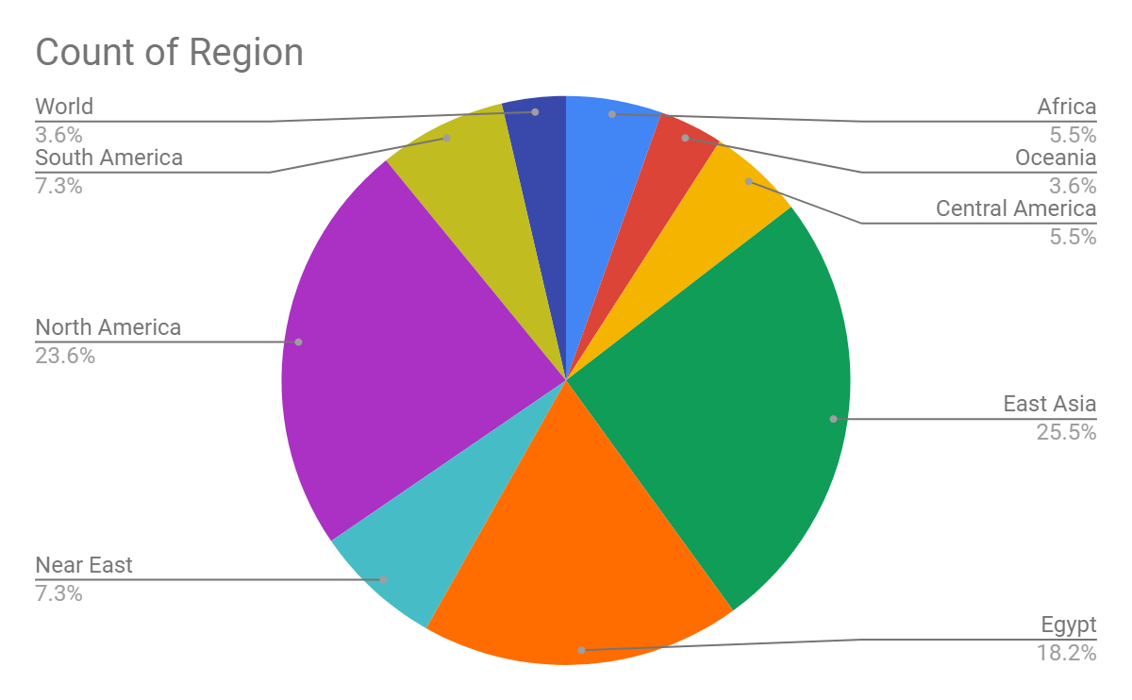
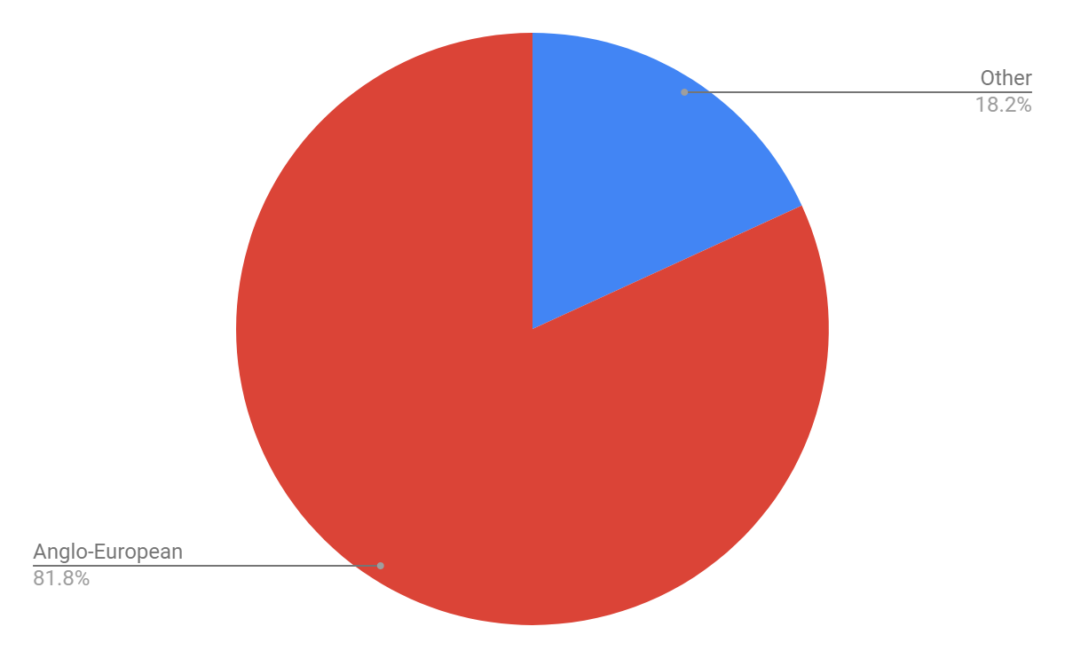
JAIC, 1999-2018
Notes:
In JAIC over the 20 years from 1999-2018, only 18% of the 303 papers engage with non-Anglo-European subjects. 13 papers, or 4% of the total, deal with ethnic minorities in the US and Canada. All of those papers are on indigenous subjects. More than half of those 13 papers are on materials held by the Smithsonian Institution. Zero papers discuss objects created by African Americans. Zero discuss objects created by Asian Americans. Zero discuss objects created by Latinx Americans.

Slide 15
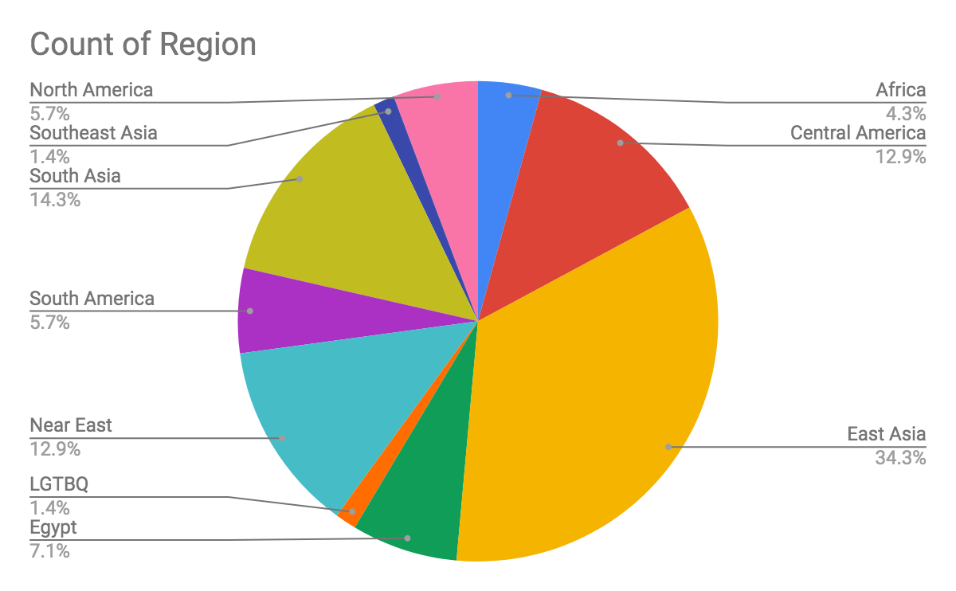
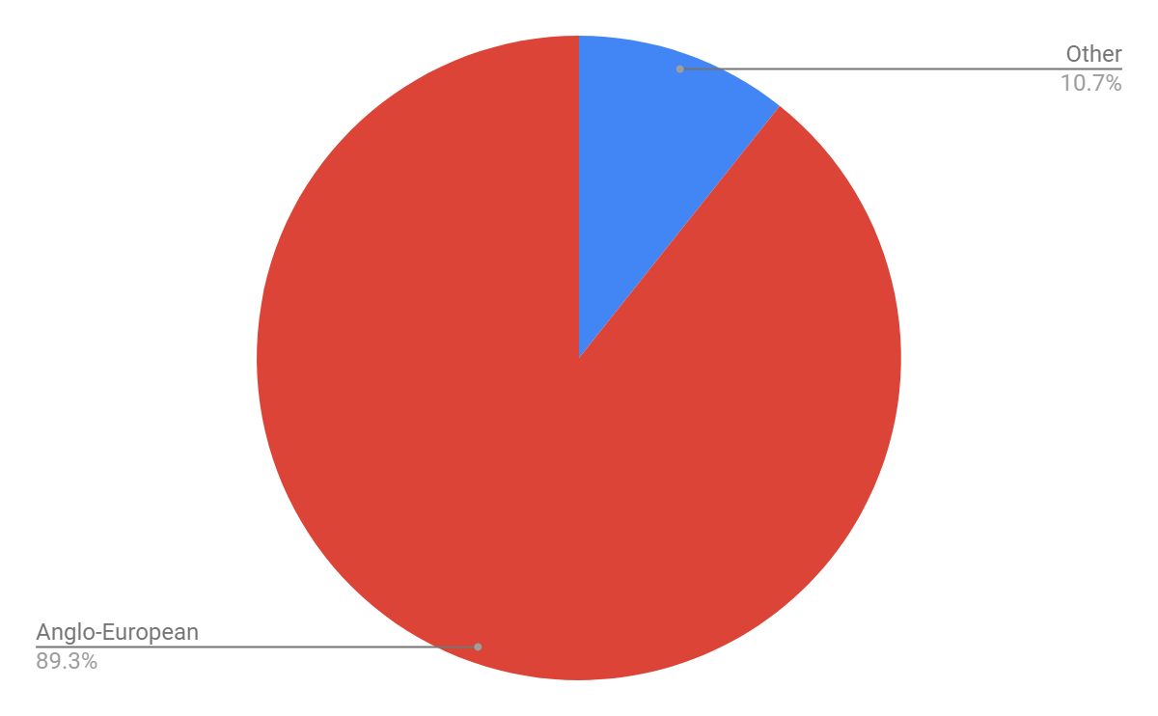
BPG Annual, 1982-2015
Notes:
In the entire corpus of The Book and Paper Group Annual from 1982-2015, encompassing 654 papers, 70 papers, or just 11% deal with non-Anglo-European objects. Just 3 papers, or half a percent, discuss objects by African American creators. 1 paper a Latinx-American creator. 1 paper an explicitly identified LGBTQ creator.

Slide 16
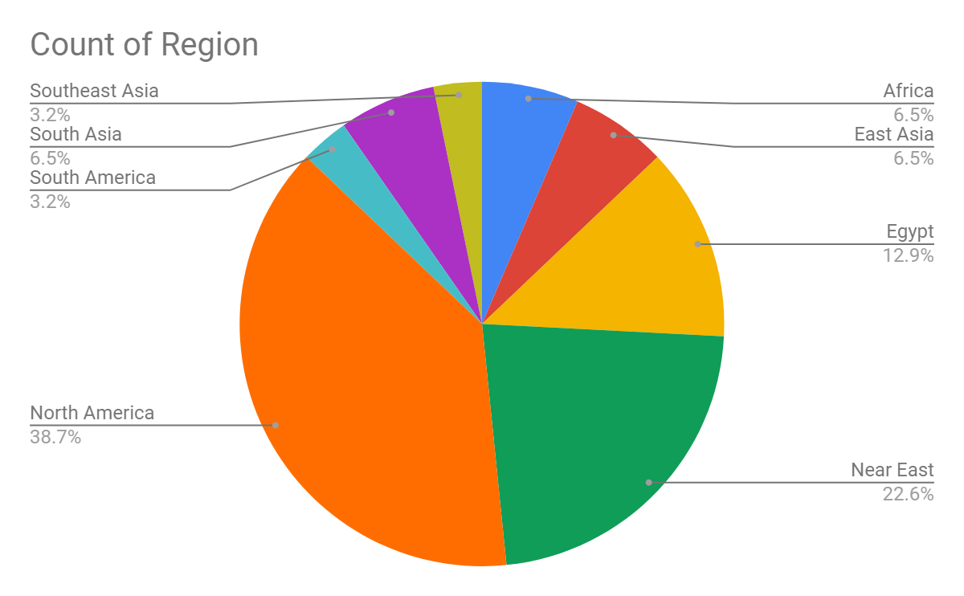
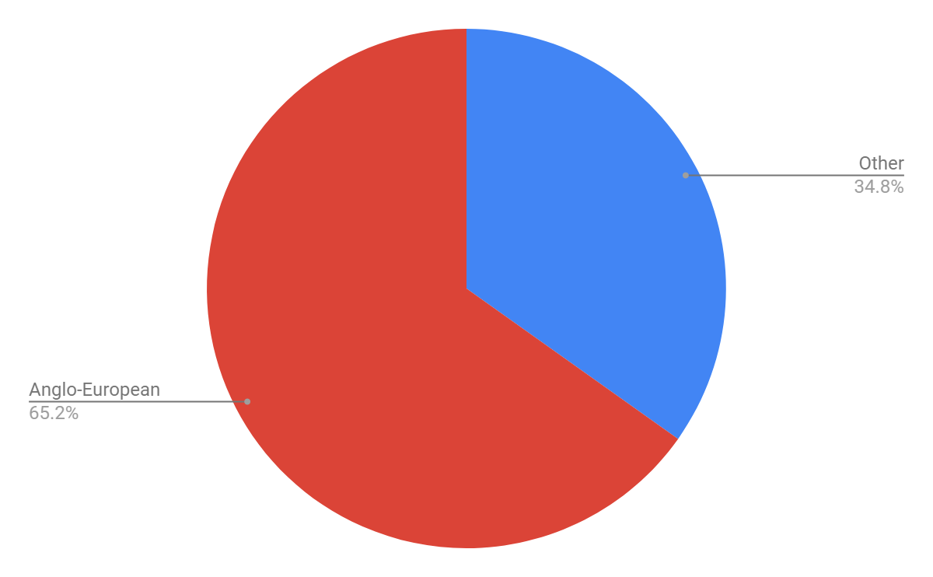
OSG Post-Prints, 2014-2018
Notes:
From 2014-2018 in OSG, 35% of the 89 papers are on non-Anglo-European objects. 9 papers, or 10% of the total, address indigenous objects from the US and Canada. A third of those papers are authored by the team at the Arizona State Museum under Nancy Odegaard. 1 paper is on an object by an African American artist, although he is not identified as such in the published abstract. 1 paper an Afro-Caribbean American immigrant. And 1 paper a Jewish American muralist.

Slide 17
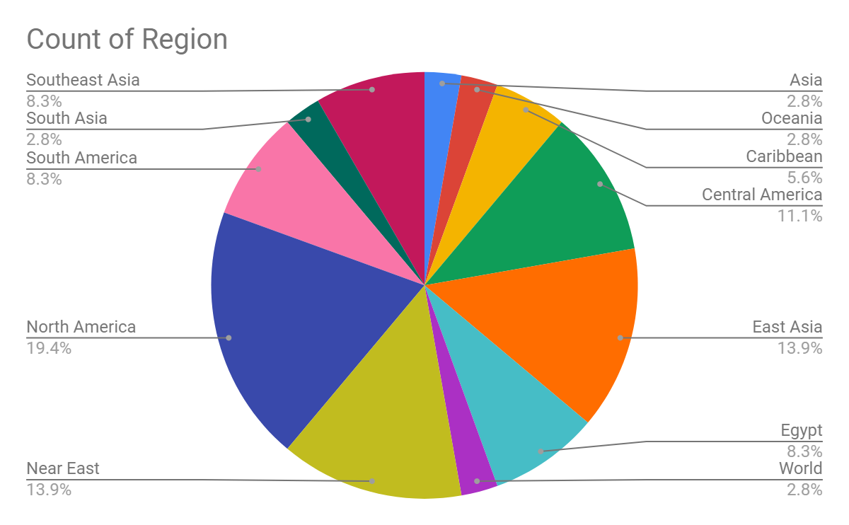
PMG, PSG, RATS, & WAG Most Recent Five Vol.
Notes:
In the most recent 5 volumes from PMG, PSG, RATS, and WAG, of the 383 articles, 9% of the articles are on non-Anglo-European subjects. 6 are on African American creators. 1 is on Native American materials.

Slide 18
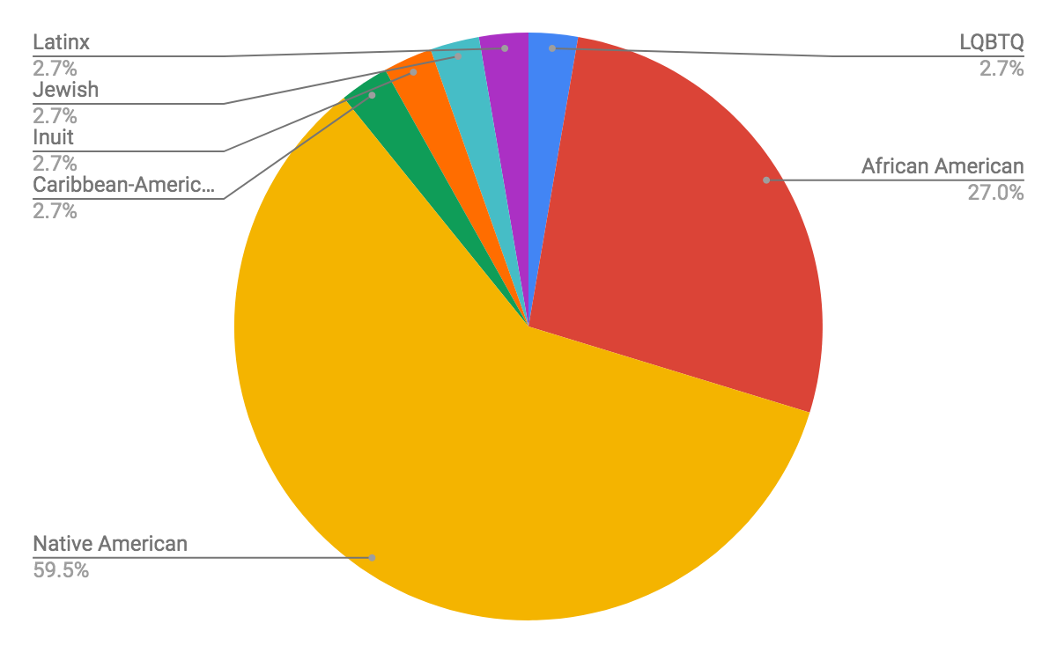
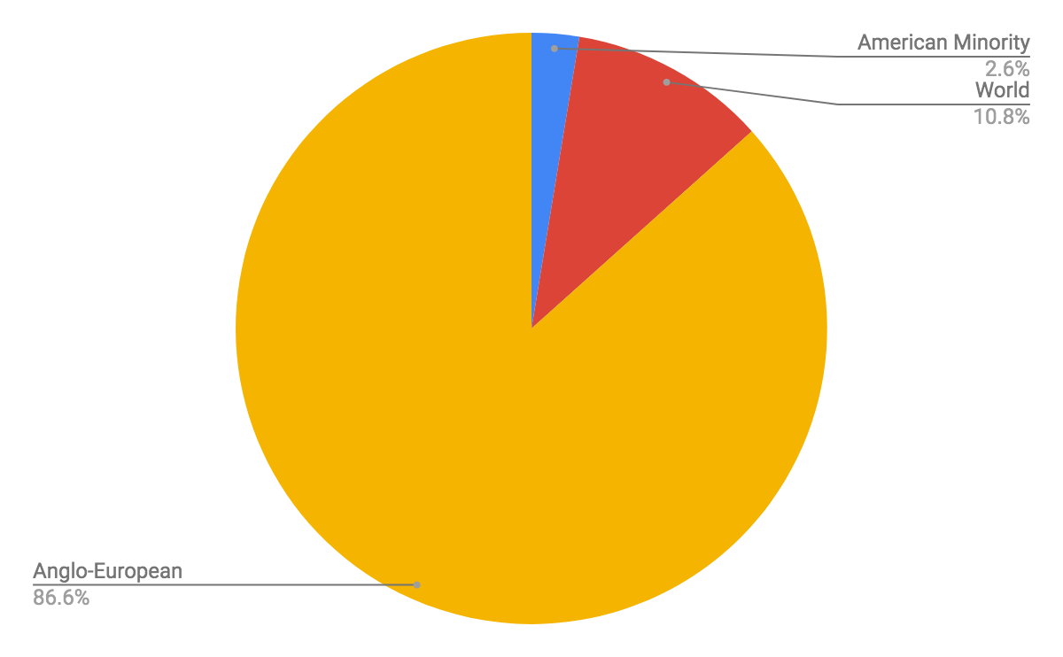
Total AIC Publications Analyzed: 1429 Articles
Notes:
Examining our literature, our membership discusses non-White, American and Canadian heritage and creators in only about 3% of the evaluated research, even as we claim a mission of universality in protecting and advocating for cultural property. And almost half of that small number comes out of work done on indigenous cultural property by the teams at the National Museum of the American Indian, the Arizona State Museum, and the UCLA/Getty program.

Slide 19
“We are committed to the premise that the preservation of cultural heritage is inseparable from our belief that the creative achievements and histories of all peoples must be acknowledged and honored.”
AIC Value of Equity and Inclusion
“Professionalism emphasizes “the work” — its completion, its evaluation, its perpetuity, etc. — without a meaningful critique of how “the work” mandates a replication of the patriarchy, oppression, and violence many in our world experience.”
Jarrett Drake (2017)
Notes:
3% seems like an unreasonable amount considered in the abstract, but I reflect back on my own career, and I don’t know that I have ever treated a special collections book or a manuscript by an African American author. Or a Native American author, or an Asian American author, or a Latinx author. I unquestioningly treated the pieces that were assigned to me. The items that a curator selected for conservation and ended up on my bench. Books that needed to be repaired before going on exhibit. Documents that had been called to the reading room by researchers and were flagged as damaged. It is hard to reflect upon the work that I have done in my career and not wonder how I am meeting AIC’s shared value of equity and inclusion: that “We are committed to the premise that the preservation of cultural heritage is inseparable from our belief that the creative achievements and histories of all peoples must be acknowledged and honored.”

Slide 20
“The task of prioritizing for conservation is always daunting...But for me, it’s critically important that we acknowledge our role as cultural workers who are players - either consciously or not - in the creation of the historical record and public memory.”
Jan Paris (2000)
“An ethic of care is meant to reorient the practitioner’s understanding in two ways. The first is toward an appreciation of context, interdependence, and vulnerability... The second is...toward personal, worldly action and response.”
Bethany Nowviskie (2015)
Notes:
I don’t have a perfect answer for how we as conservators can dramatically change the cultural make up of what items we treat. Our work comes from private owners or is prioritized by curators out of the collections that they control. The authority that conservators possess is derived from our unique perspective on the physical needs of collections: what is damaged, what is at risk, what can be repaired. That authority comes into play in determining HOW conservation treatment is enacted, but not typically in what is selected FOR conservation treatment. And in this self-enforced isolation from the decisions of the broader institution and society, conservators make the choice, whether willfully or passively to hide behind the shield of neutrality and absolve ourselves of responsibility for the racial and ethnic disparities of what items we treat; what items we ensure will have a better chance to survive as shared cultural heritage into the future; and what items we never see, to avoid ever having to include in our own decision-making.

Slide 21
“The conservation professional shall recognize a responsibility for preventive conservation by endeavoring to limit damage or deterioration to cultural property, providing guidelines for continuing use and care, recommending appropriate environmental conditions for storage and exhibition, and encouraging proper procedures for handling, packing, and transport.”
AIC Code of Ethics VIII
[Preventive conservation] “is as much situated in the dynamic social environment of the object as in the dynamic physical environment.”
Miriam Clavir (1994)
Notes:
But the reality is, at least for those of us in institutional positions, we do have responsibilities for ALL of the collections at our institutions, whether the objects come through our labs or not. Preventive conservation allows conservators and collections care professionals to exercise our authority beyond the confines of the lab. To identify objects that may have been poorly tended to in the past, draw attention to their needs, and force action to be taken. Advocating for collections takes engagement, with both the collections and the curators. Surveys and condition assessments can tell us what parts of our collections are under-cared for and give us metrics to track their deterioration or improvement over time. Institutional diversity statements can be leveraged as motivators to select objects whose value has been ignored. Forcing our organizations to take responsibility for parts of the collection that they might not value as highly as others _is_ part of our jobs.

Slide 22
Thank You
Fletcher Durant
Head, Conservation and Preservation
University of Florida
fdurant@ufl.edu
Presentation:
http://ufdc.ufl.edu/l/IR00010800/00001
“Systemic change takes time, vision and nuanced leadership at every level, most especially among donors and museum boards. Selfless investment and fortitude are required. So is a willingness to endure discomfort. To move forward, the entire ecosystem must devote itself to a longer game.”
Olga Viso (2018)
Notes:
Questioning whether conservation is neutral isn’t about whether we as professionals make decisions and do our jobs. The question is whether the decisions we make reflect the totality of our society and do justice to the contributions of diverse groups to a shared heritage or whether our work, our collections, and our institutions are making decisions that fortify racial and ethnic and gender and social hierarchies. In this I fear that I am failing. That we are failing. We shouldn’t claim to be neutral when we are simply avoiding being critical. A claim of neutrality in our treatments is a club wielded in defense of the status quo to reinforce those in positions of privilege, and erase those who are not. We should just be honest with ourselves about that truth when we take on our treatments. I believe that our work as conservators is invaluable in shaping society’s conception of heritage, but we need to wield that power mindfully and equitably.
Thank you.

