Slide 1
Dig Deeper
California Summit Opening Session

Slide 2
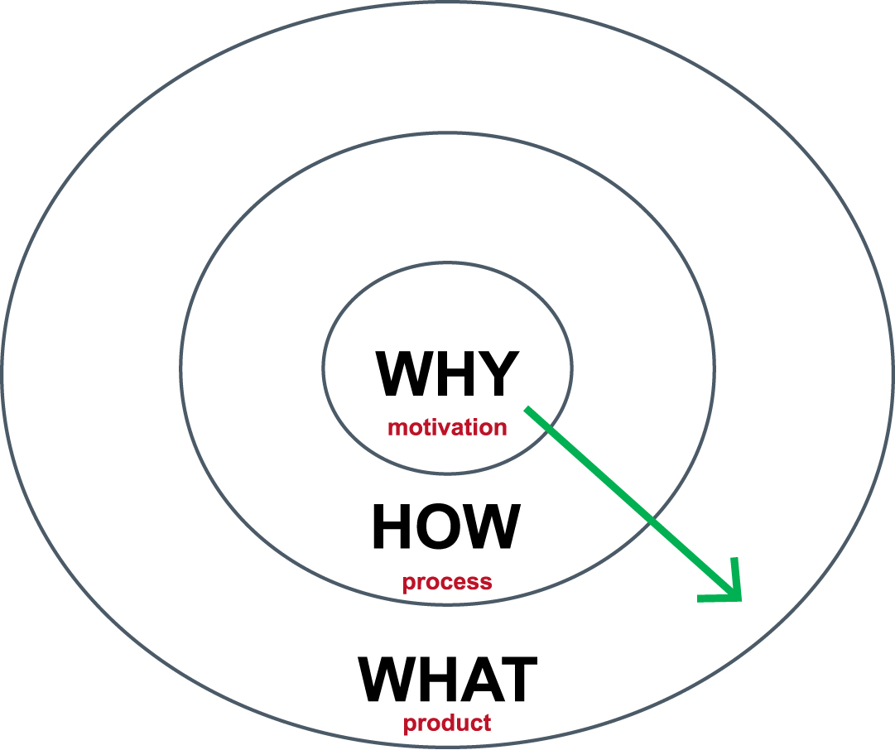
Start with Why
Why do you create a schedule?
For whom?
To what end?
Does your Why drive the How?
Can we better align the How to the Why?
https://youtu.be/IPYeCltXpxw

Slide 3
Student Success Priorities
Momentum year progress
Retention (yr. 1 to yr. 2)
Degree Velocity
On-time completion

Slide 4
Closing Equity Gaps / Meeting New Needs
30+ hours of work and other life commitments
Transportation challenges
Limited support network

Slide 5
Student Success Challenges
Student visibility into job opportunities
Student availability to take classes
Enrollment health of each major
Data-informed pathway refinement
Student-aligned course schedules
Optimized academic space capacity

Slide 6
Student Visibility into Job Opportunities

Slide 7
Student Availability to Take Classes

Slide 8
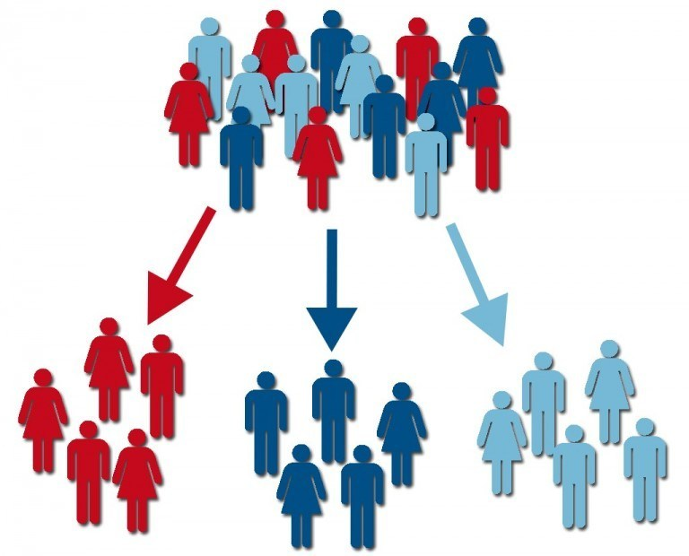
Enrollment Health of Each Major

Slide 9
How Many Pathways can you Support?
popular credentials
market/career needs
Multiple modalities
Multiple locations
Multiple times

Slide 10
Supported Tracks for a Major
Location | Time | Gen Ed Core | Major Requirements
Campus A | Day
 | Evening
Campus B | Day
 | Evening
Online | N/A
Is there an established plan defining supported tracks?
Is this plan communicated to your students and advisors?

Slide 11
Data-informed Pathway Refinement

Slide 12
Student- Aligned Course Schedules

Slide 13
Optimized Academic Space Capacity

Slide 14
New Solutions

Slide 15
Solution Areas and Bundles
Solution Areas
Course Scheduling
Room Scheduling & Calendaring
Student Progress
Student Scheduling
Bundles
Essential
Advanced
Enterprise
Framework Apps
Experience
Impact
Report
Integrate

Slide 16
Framework Basics
Foundational Apps | Essential | Advanced | Enterprise
Experience | Complete | Complete | Complete
Impact | Complete | Complete | Complete
Report | Basic | Complete | Authoring, Portal & Custom
Integrate | Basic | Basic | Custom
Services | Essential | Advanced | Enterprise
Implementation | Quick Start Implementation | Full Implementation | Custom
Consulting | Strategic Workshop | Custom Scoping | Retainer

Slide 17
Course Scheduling Bundles
App | Essential | Advanced | Enterprise
Align | X | X | X
Monitor | X | X | X
Schedule | X | X | X
Predict |  | X | X
Velocity |  | X | X
Simulate |  | X | X
Policy |  | X | X
Intent |  |  | X
Alert |  |  | X
Pathways |  |  | X
Faculty |  |  | X
Cost |  |  | X
Review |  |  | X
Enrollment |  |  | X

Slide 18
Room Scheduling & Calendaring Bundles
App | Essential | Advanced | Enterprise
Schedule | X | X | X
Event | X | X | X
Request | X | X | X
Approve | X | X | X
Calendar | X | X | X
Outlook | X | X | X
Optimize |  | X | X
Attendees |  | X | X
Equipment |  | X | X
Billing |  | X | X
Pay |  | X | X
Promote |  | X | X
Parking |  | X | X
Exam |  | X | X
Timetable |  |  | X
Capacity |  |  | X
Room Scheduling/Calendaring Bundles

Slide 19
Apps Coming Next
Align | Align a rolled forward schedule, informed by change candidates
Monitor | Track registrations for active courses and highlight where late changes are needed
Report | Flexible Sisense reporting platform with partner-institution customization
Predict | Predict seats needed for courses based on student-specific pathway progress
Velocity | Productive progress to pathway completion with aggregation and Momentum Year
Schedule | Ad-hoc section editing, with room scheduling and instructor assignment
Integrate | Visual data mapping, data validation, scheduling and automation tools
Experience | User experience: subscriptions, support cases, projects, documentation and credentialing
Request | Event and room requesting interface with templating
Impact | Impact of our engagement on various fronts with goal settings and longitudinal tracking
Students | Simulated student modeling and data elements for cohort grouping, with PII tokenization
Intent | Student intent and preference survey covering completion date, availability and modality
Simulate | Simulated registration to identify time conflicts and related time change candidates
Calendar | Stand-alone calendar for campus activities
Event | Simple event scheduling
Pathways | Pathways analytics with programs-to-career integration and critical mass analysis

Slide 20
Align (Historical)
Outlook
Intent
Align (Predict)
Request
Promote
Schedule
Impact
Velocity
Integrate
Experience

Slide 21
Solution Theme Roadmap
Theme | 2018 | 2019 | 2020 | 2021 | 2022
Validate New Framework
Replace Platinum Analytics Solution
Integrated Academic Scheduling Bundle (New)
Enrollment Health Bundle (New)
Replace Astra Schedule Solution
Net New Enhancements/Apps/Bundles

Slide 22
Questions?
Tom Shaver
tshaver@aais.com

