Slide 1
‘Ethos, pathos, and logos’ of Strategic Enrollment Scheduling
How to get administrators and faculty to engage with data.

Slide 2
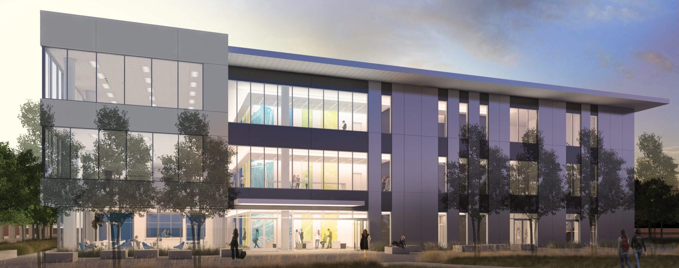
Institutional Background
American River College
Community College, Located in Sacramento California
One of four¹ colleges in the Los Rios Community College District
Serves over 31,000 students in all traditional aspects of a community college:
Basic Skills
Career Technical
Transfer
Job Skill Enrichment
Lifelong learning
Degrees
Certificates
Experiencing
reduction in enrollments
changing funding structures
general structural ennui
¹ One cannot understate how much implementation in a district raises the complexity of developing scheduling ethos, but that’s for another presentation.

Slide 3
Implementation Snapshot
Fall ‘16
“Scheduling” was identified as a major focus area for campus improvement
Spring ’17
American River College Enterprise Level Scheduling System Task Force formed.
Inventory of scheduling processes and procedures performed though surveys and individual interviews.
Fall ’17
Vendor Search by Los Rios District, Ad Astra selected
Spring ’18
Vendor approved by board, Technical implementation began “PeopleSoft, meet Ad Astra. Ad Astra, meet PeopleSoft.”
Spring ‘18-Today
Astra Schedule and Platinum Structural Implementation

Slide 4
Building Trust, Listening to Concerns
The importance of the pre-work

Slide 5
The Scheduling Process Report
The initial interviews and resulting report has been a seminal part of our implementation
By sitting with each office staff responsible for division scheduling and listening:
Inventoried the actual processes used (which were remarkably divergent division to division)
Built relationships with the staff to both assure them that they were being heard and provide them with a conduit directly to the team working on the new system
Identified EARLY facility hiccups which were going to have to be carefully implemented in Astra Schedule.

Slide 6
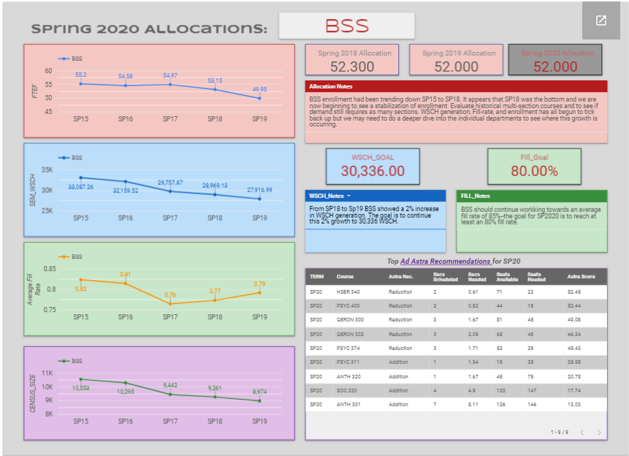
Contextualizing & BRANDING Preliminary Data
Coupling Ad Astra Data with local data.
Fleshing out additional datasets to augment Ad Astra data: WSCH, FTES, FTEF, etc.
Building a matrix which provided access to the data before we were ready to provide access to Ad Astra
Google Datastudio
Python data analysis

Slide 7
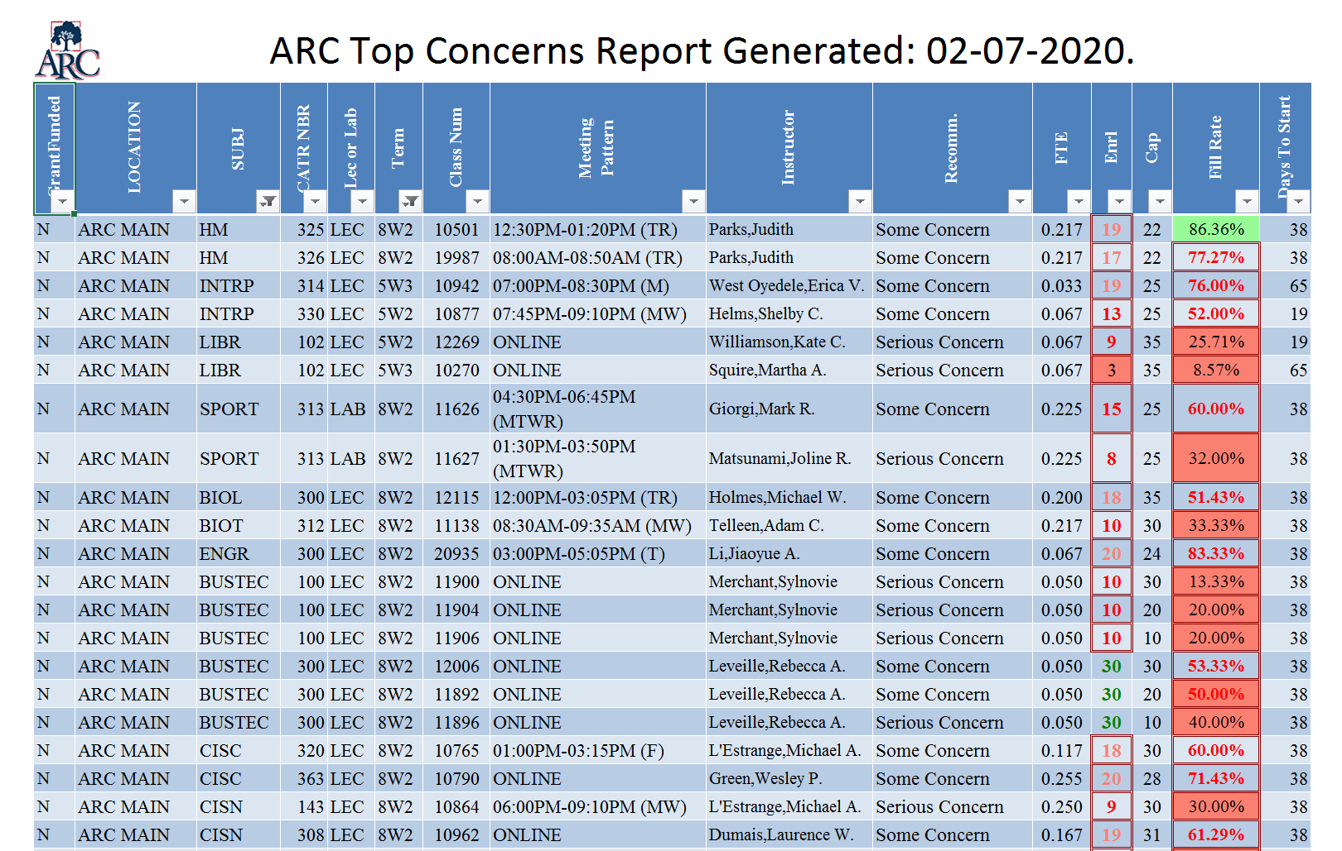
Enrollment Monitoring awaiting Monitor
Daily reports generated and distributed to all Deans & Department Chairs
Liberating data, starting the conversation

Slide 8
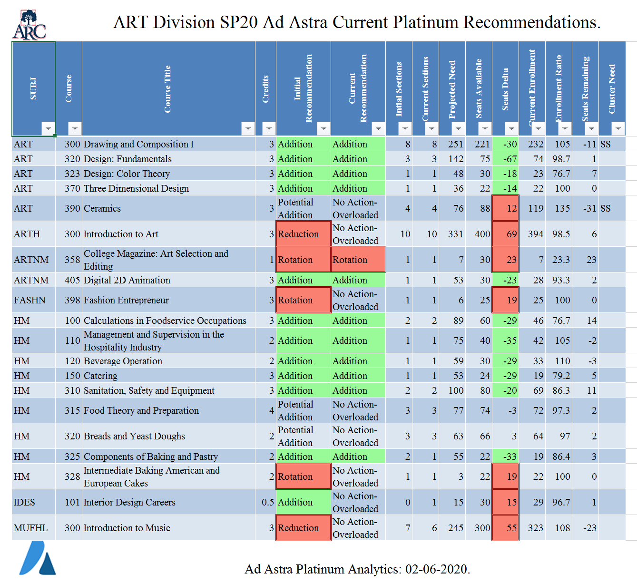
Platinum local reports, awaiting Align
Hey, this looks familiar!
Merging Platinum data and local data that is not captured
FTEF, WSCH, other concerns

Slide 9
Strategic Enrollment Management Report
The Real Work Begins

Slide 10
Ad Astra will not solve any of your structural scheduling issues. (Sorry, Tom)
Strategic Enrollment Management Group, the three areas of concern
Ethos, Pathos, and Logos of scheduling
Why we schedule what we schedule
“Students are the reason we are here, and their education is our primary responsibility.”
Tying scheduling back to the college’s Mission, Vision, and Values
Mechanisms of scheduling
Getting way down into the weeds and documenting how decisions are going to be made.
Documenting where and how data will be used for decision making
Inoculating the process with documentation
Answering the question “What happens if the person in charge of enrollment management wins the lottery, drops the microphone, and moves to Bora Bora?”
Building a structure for iterative schedule change.
Avoiding “paralysis by analysis” and trying to change too much too quickly

Slide 11
Ethos, Pathos, and Logos of Scheduling
The primary purpose driving the development of our Academic Schedule is to provide students access and opportunities to:
develop their abilities;
engage in critical and creative thinking;
succeed in a competitive global work environment;
exhibit responsible citizenship benefit society as well as themselves;
participate in lifelong learning;
ARC’s schedule development process requires:
fiscally sound, efficient, transparent, and accountable practices;
effective communication within the college and with the communities served by the college;
civil and honest communication that promote mutual respect and trust;

Slide 12
Capturing current enrollment esoterica and leaving room for future change
Defining the esoteric
E.g. “We need a minimum of 1,000 FTES at our Natomas Center or we lose $1.5 million.”
What data do we need to ensure this?
Capturing the scheduling zeitgeist
Opt-out scheduling, pathways, legislated changes to curriculum: how do we meet the promises we are making to our students?
What data do we need to keep these promises?
Using the carrot instead of the stick
“Our goal is to consider our published schedule of classes as a promise to the faculty and students. We are working to a place where, unless there is an extremely dire situation, we do not cancel sections that have been placed on the schedule.”
Wow, we’re going to need a lot of trust in our data to get here!

Slide 13
Where does the current suite of Ad Astra tools fit into your current process?

Slide 14
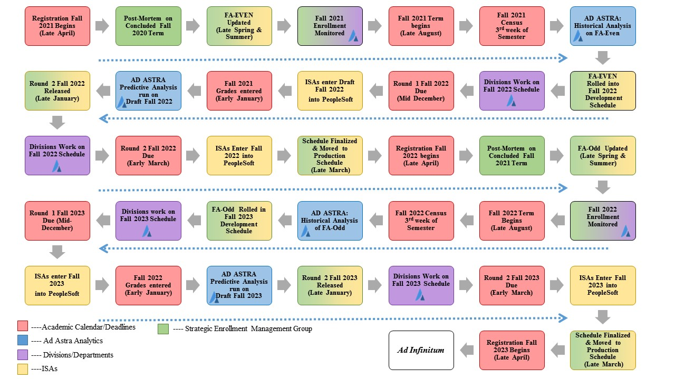
Where and how data will be used:
Where does Astra Data fit into your existing structures?
Where will you need to change your structures?

Slide 15
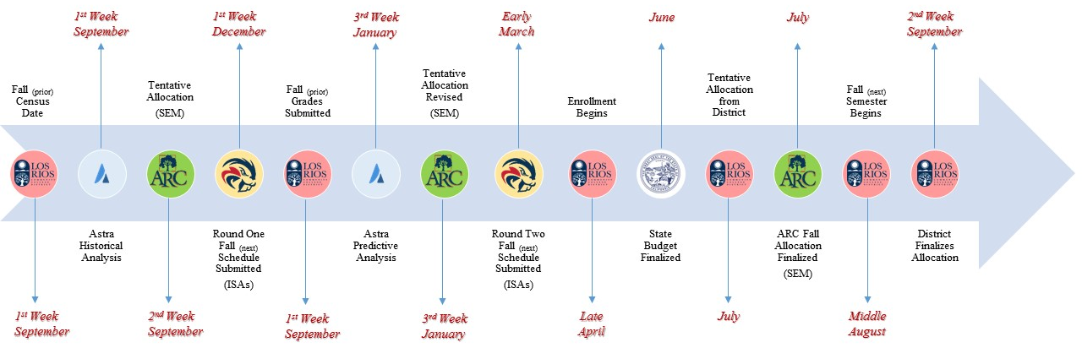
Down in the weeds
Where data fits into the nooks and crannies of building a schedule
What can Astra help with?
What will you need to build yourself?

Slide 16
Questions and discussion. bradenk@arc.losrios.edu

