Slide 1

The Wonders of Ad Astra
Presenter: Max Arb, Valencia College

Slide 2

Agenda
College Information
Implementation Update
Improving Student Outcomes
A History of Saturday
Enrollment Trends
Improved Functions

Slide 3
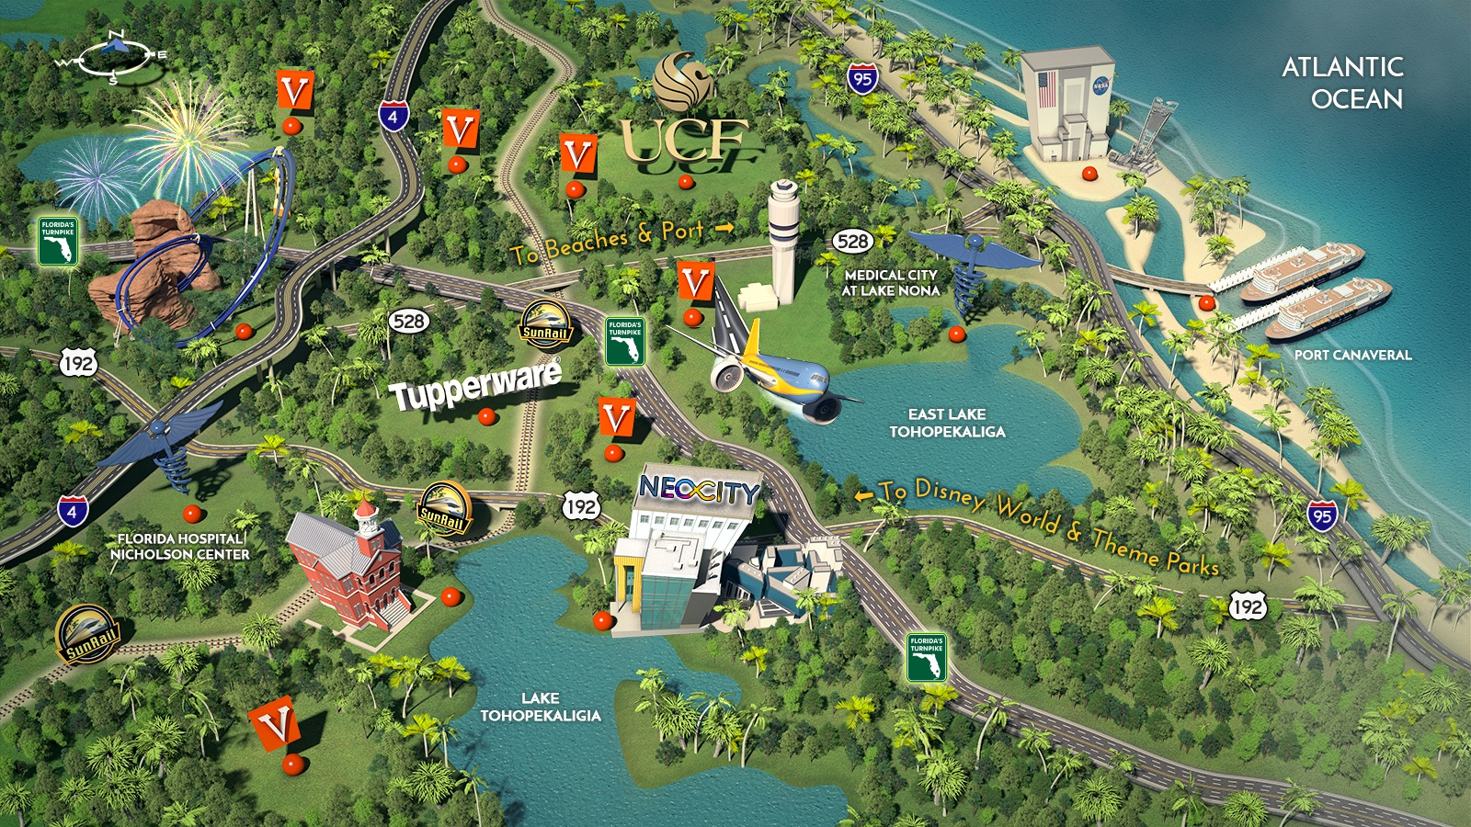

Slide 4
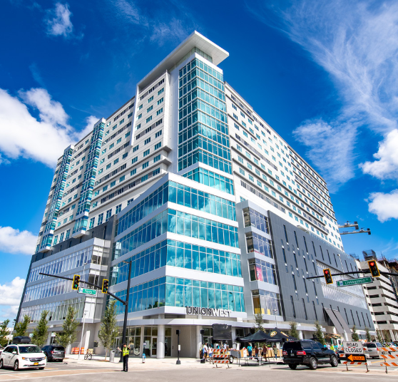
Institution/Presenter Background
8 campuses in Orange and Osceola Counties
Serving over 45,000 students during the Spring 2020 academic term
32 academic buildings and over 500 classrooms
Scheduled over 9,500 events since July, 2017

Slide 5
Implementation Update
 | Centralized | Decentralized
OPPORTUNITIES | Decision making lies with a group or individual at the top | Shared decision-making to managers at various levels
 | Control costs, quality, efficiency, messaging, and overall operations | More focused on relationship building
 | Contribute to organizational success in the right situation | Contribute to organizational success in the right situation
OBSTACLES | May not know local needs | Variations in processes
 | Stakeholder wait time may increase | Decision making process may involve many people

Slide 6

Unique System Utilizations
Energy Conservation
  Friday/Saturday
  Shutting down floors
Scheduling Preferences
  Course driven room requirements
  Faculty office location parameter
Multiple Institutions
  UCF and Continuing Education
  Unique Academic Reporting

Slide 7
Valencia’s Student Outcome Goals
The five-year disaggregated graduation rates for first-time-in-college (FTIC), degree seeking students of each race/ethnicity will exceed 50% so that more than half of all FTIC, degree-seeking students of each race/ethnicity who first enroll at Valencia in the Fall 2025 term will complete an associate degree from Valencia by Summer 2030.
As a leading indicator of Valencia’s graduation rate, more than 75% of all FTIC, degree-seeking students who first enroll at Valencia in Fall 2021 will earn at least 15 college-level credit hours by Summer 2023.
As a leading indicator of Valencia’s graduation rate, more than 50% of all FTIC, degree-seeking students who first enroll at Valencia in Fall 2023 will earn all attempted credit hours in their first five courses at Valencia as defined by earning an A, B, or C in each course.

Slide 8
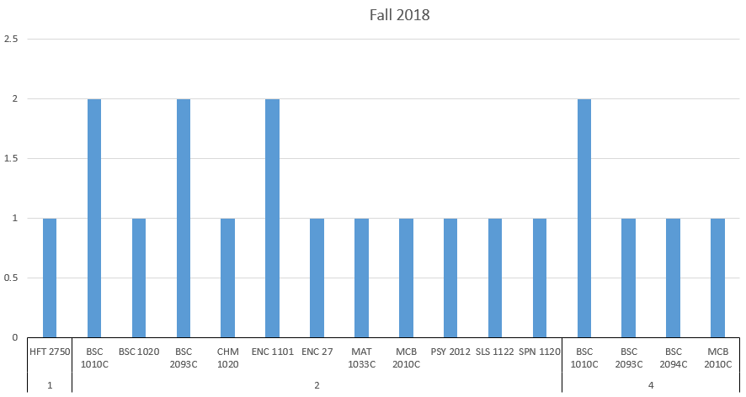
Saturday Couse Schedule
Term | Courses | Connections
Fall 17 | 22 | 3
Fall 18 | 17 | 1
Fall 19 | 23 | 8

Slide 9
Room Utilization Fall 2019

Slide 10
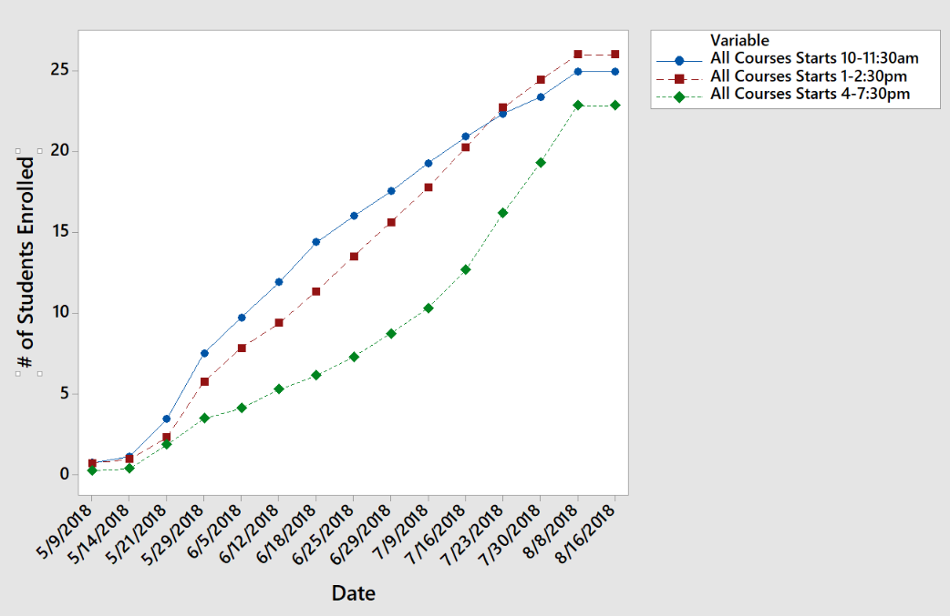
Time Block Enrollment Fall 2018

Slide 11
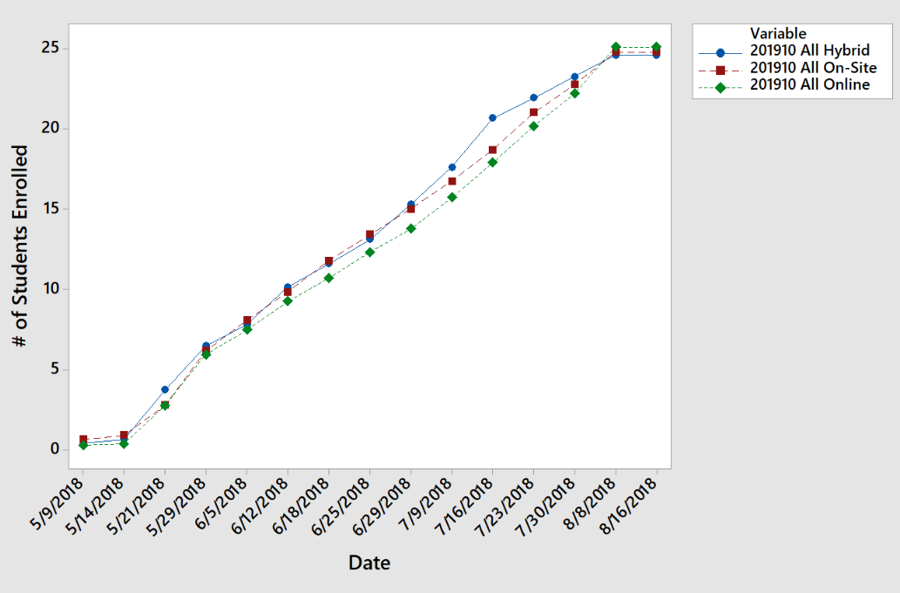
Enrollment by Modality Fall 2018

Slide 12

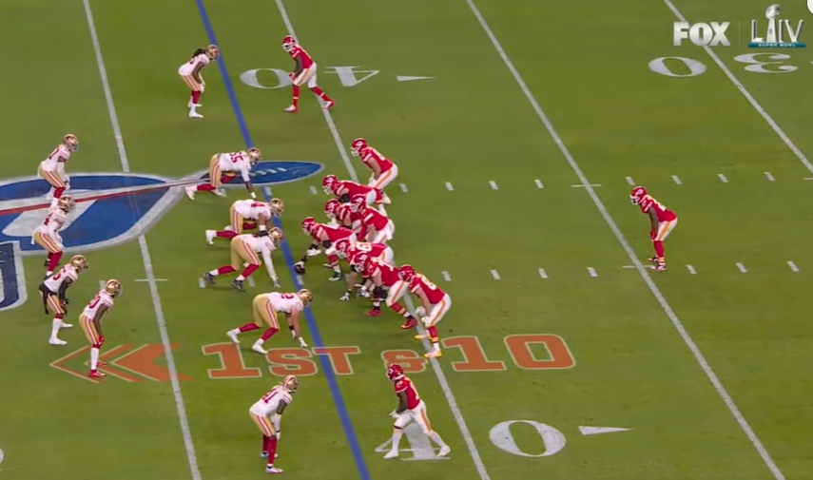

Takeaways and Action Items

