Slide 1

Compuware and
OpenLegacy
New Topaz Integration
October Launch

Slide 2
October Launch Announcement
"Compuware is excited to be collaborating with OpenLegacy. The new integration with Topaz empowers customers to improve their mainframe software delivery quality, velocity and efficiency within a continuously improving Topaz experience."
- Chris O'Malley
“The combination of the two vendors’ offerings gives mainframe developers unprecedented control and flexibility into their API implementations. This partnership empowers customers to incorporate mainframe applications into the modern, cloud-native world.”
- Jason Bloomberg, Intellyx
“The Compuware partnership is an example of the rapid expansion of OpenLegacy through horizontal, vertical, partner, and ISV channels, demonstrating how we can open doors for any company whose clients suffer legacy innovation issues.”
- Zeev Avidan, Chief Product Officer, OpenLegacy

Slide 3
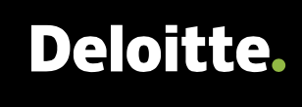
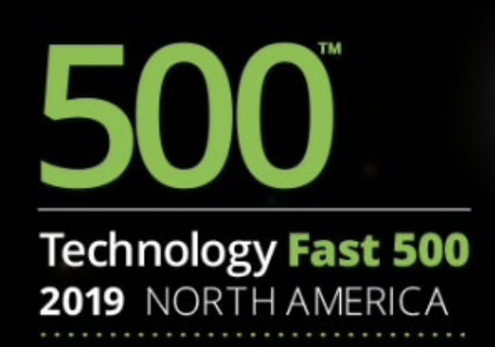
Annual Recurring
Revenue Growth
OpenLegacy Growth
  807%
  +100%
2014-2019
  +50%
#10 in growth 2014-2019
2017-2018
2018-2019
projected
  1.5x
  2x
Notes:
We solve a number of problems for clients… too many to fit on one slide, but here are a few. Do you have any of these challenges?:
So, the first problem is a backlog. You might need 500 different digital services, but you only have 100 and you are late to deliver those and so that's one problem.
A second problem might be scattered technologies. You have multiple Legacy or On-prem stacks and each one of them has their own middleware and integration stack and these become unmanageable and you want to standardize on one specific platform or one specific way of doing integration way of doing integration.
A third one would be technical debt. You are moving forward, you are creating your APIs, but as you go along, you're increasing your technical debt because you need to build more and more things on your Legacy side which adds to the complexity of your existing ESBs and middleware, and basically increases your technical debt as you go along.
Fourth problem might be migration strategy. You have a Legacy application and you know you want to migrate away from it but migrating in just one big bang approach doesn't work and hasn't worked for the last decade, so you really want to think about how you want to create a strategy for phasing out of that Legacy application.
Another one would be DevOps. You might already have DevOps in your organization. That's fairly easy or at least easier to do on the digital side when you are using newer technologies in your processes, but once you are starting to integrate with the Legacy side, that becomes more problematic because things like ESBs and traditional SOA integration stacks do not comply very well with the DevOps principles.
And last, but not least, in many cases the most important one is time to market. You want to do a lot. You want to do those digital initiatives and create digital services for your OmniChannel but that takes you too long. So…you spend 6-9 months creating a single digital service …that's a long time and you need the time to market to be much faster then what it is today.
What kind of systems do YOU have and what types of problems do YOU have?

Slide 4
OpenLegacy Platform Impact
  20x
  faster API creation
  75%
  lower cost per API for the lifecycle
  5x
  API latency improvement
Cut digital transformation project time in
Notes:
Would you agree that results like this are Transformational, Revolutionary, Move the Needled? Now we will show you how these are achievable.

Slide 5
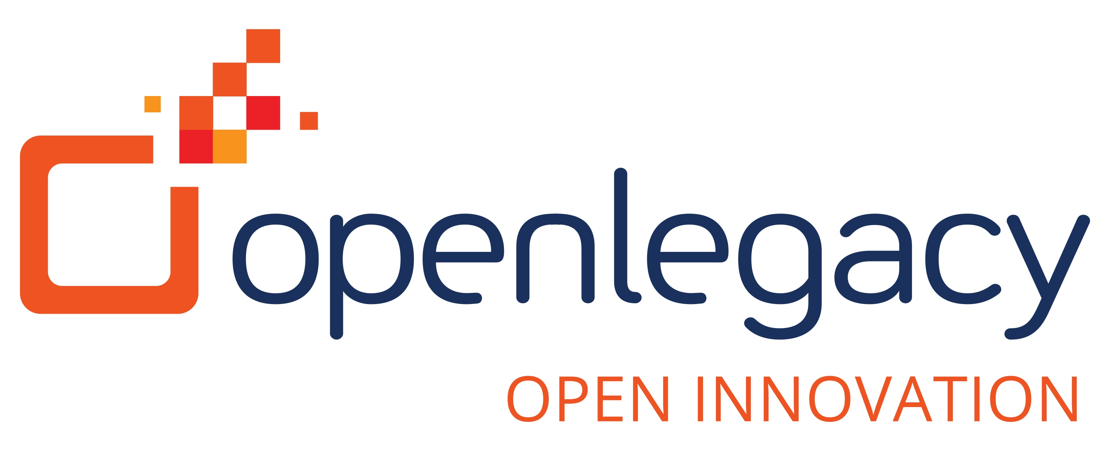
OpenLegacy Overview
What Does OpenLegacy Do?
Why Are We Integrating?
Microservices-based API integration software
Automates API creation
Improves staff efficiency and API performance
Improves reusability of
mainframe applications,
allowing native use
modern architectures
Direct access to OpenLegacy platform from Topaz Workbench speeds software development and delivery
Provides end-to-end framework for on-platform modernization
Enabling best-of-breed,
cross-platform DevOps toolchain
Consistent with “open borders” approach to partnerships
Notes:
Integration is being influenced by
a joint customer
Both companies
Love the mainframe
Compete against IBM & doing nothing

Slide 6
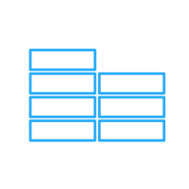
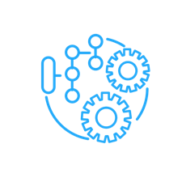
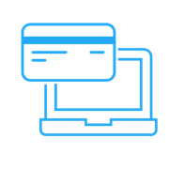
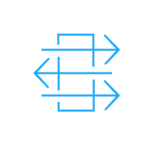
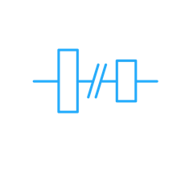
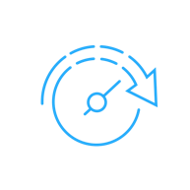
The questions we ask
Backlog
How does our Backlog Look?
Scattered Technologies
How is our communication and follow through?
Technical Debt
What does our strategy to
modernize look like?
Migration Strategy
How are we executing?
Legacy vs. DevOps
What is the impact on modern architecture?
Time to Market
Do we bring out new products quickly?
We both ask similar questions
Notes:
We solve a number of problems for clients… too many to fit on one slide, but here are a few. Do you have any of these challenges?:
So, the first problem is a backlog. You might need 500 different digital services, but you only have 100 and you are late to deliver those and so that's one problem.
A second problem might be scattered technologies. You have multiple Legacy or On-prem stacks and each one of them has their own middleware and integration stack and these become unmanageable and you want to standardize on one specific platform or one specific way of doing integration way of doing integration.
A third one would be technical debt. You are moving forward, you are creating your APIs, but as you go along, you're increasing your technical debt because you need to build more and more things on your Legacy side which adds to the complexity of your existing ESBs and middleware, and basically increases your technical debt as you go along.
Fourth problem might be migration strategy. You have a Legacy application and you know you want to migrate away from it but migrating in just one big bang approach doesn't work and hasn't worked for the last decade, so you really want to think about how you want to create a strategy for phasing out of that Legacy application.
Another one would be DevOps. You might already have DevOps in your organization. That's fairly easy or at least easier to do on the digital side when you are using newer technologies in your processes, but once you are starting to integrate with the Legacy side, that becomes more problematic because things like ESBs and traditional SOA integration stacks do not comply very well with the DevOps principles.
And last, but not least, in many cases the most important one is time to market. You want to do a lot. You want to do those digital initiatives and create digital services for your OmniChannel but that takes you too long. So…you spend 6-9 months creating a single digital service …that's a long time and you need the time to market to be much faster then what it is today.
What kind of systems do YOU have and what types of problems do YOU have?

Slide 7
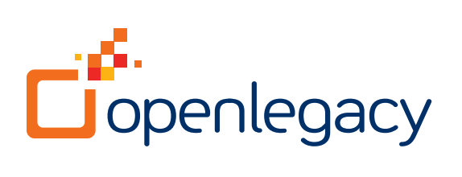

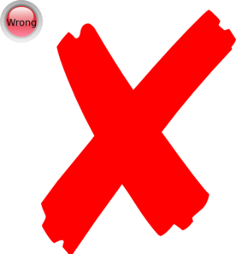
The Compuware & OpenLegacy Approach
Us
IBM & Others
Microservices enabled solution
Open standard-based
Unlimited orchestration
Fully customizing templates
Any runtime environment
End-to-end solution
High performance
Not a Microservices product
Limited flexibility
Dependencies on integration layer
No templating support
Dependent on proprietary runtime
Low performance

Slide 8
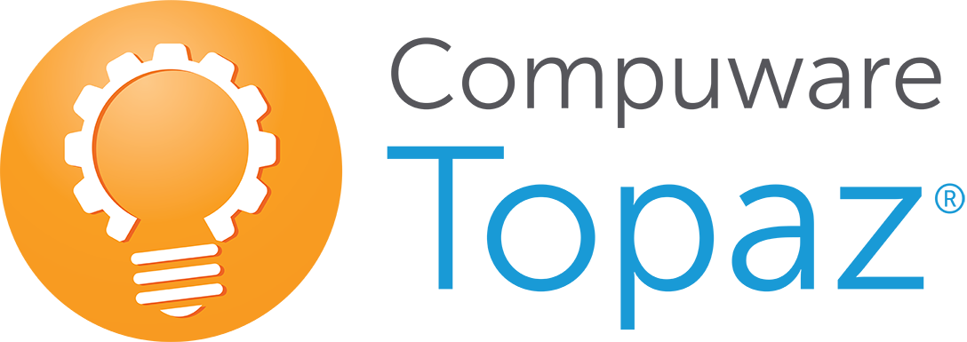
Create a Mainframe Program API
1. API Discovery Process
2. API Definition Process
3. API Deploy Process
Runtime Visualizer
OpenLegacy
OpenLegacy
Program Analysis
Xpediter
ISPW
File-AID Data Tools
Topaz for Total Test
Git
Xpediter
JUnit
Jenkins
Find code/data needed for
mobile app or open systems programs
Define API expose
to clients, generate and test API
Make API available for use
Notes:
Compuware and OpenLegacy fill in each others' gaps
Visual to API
Mainframe to Microservices
What does the process look like? To start, OpenLegacy consumes metadata from the legacy system. The metadata might be something like a Cobol copybook. It might be a database schema. It might be the information about an SAP system, but basically any kind of metadata in the Legacy application can be consumed by the platform. The metadata is extracted in an AUTOMATED process, an SDK is generated and you have complete visibility to code because Java code or a Java project gets created. The SDK is a Java object and it is created within the context of an entire microservice.
Since the code is available and visible to you, you can change whatever you want and extend the functionality as mentioned before. Also, it is created JUnit models for test driven design. So, testing the microservice, both on the SDK level and on the API level is very easy and very standard. That's not a very easy thing to do in the traditional SOA stack and ESBs, but we offer a very straight forward process of just testing through JUnit testing modules.
Also, you can store the code in GIT. Basically anything you can normally do with the process of generating or moving Java code is possible in the Open Legacy platform.
The legacy application business function metadata is extracted in an Automated process, producing a code visible Java Object (no black box). In essence the SDK is a Java Object that is created within the context of the microservice. The microservices can be deployed to any environment that can support Java Microservices, these services can also be deployed optionally as JAR files (FAT).
Meaning it can be any cloud environment; it can be On-prem environment. We support OpenShift; we support Kubernetics; we support Docker. So, all those things are supported. But not only does the platform support of all of those deployment options, it also adds crosscutting concerns. So crosscutting concerns might be claimed by Analytics, Security, Management, Caching and Performance. All of those things are pre-configured so that they are created as part of the microservice and of course they can be completely customized. Again, it's a code based, code first approach so they can be completely customized to meet the organization needs.

Slide 9
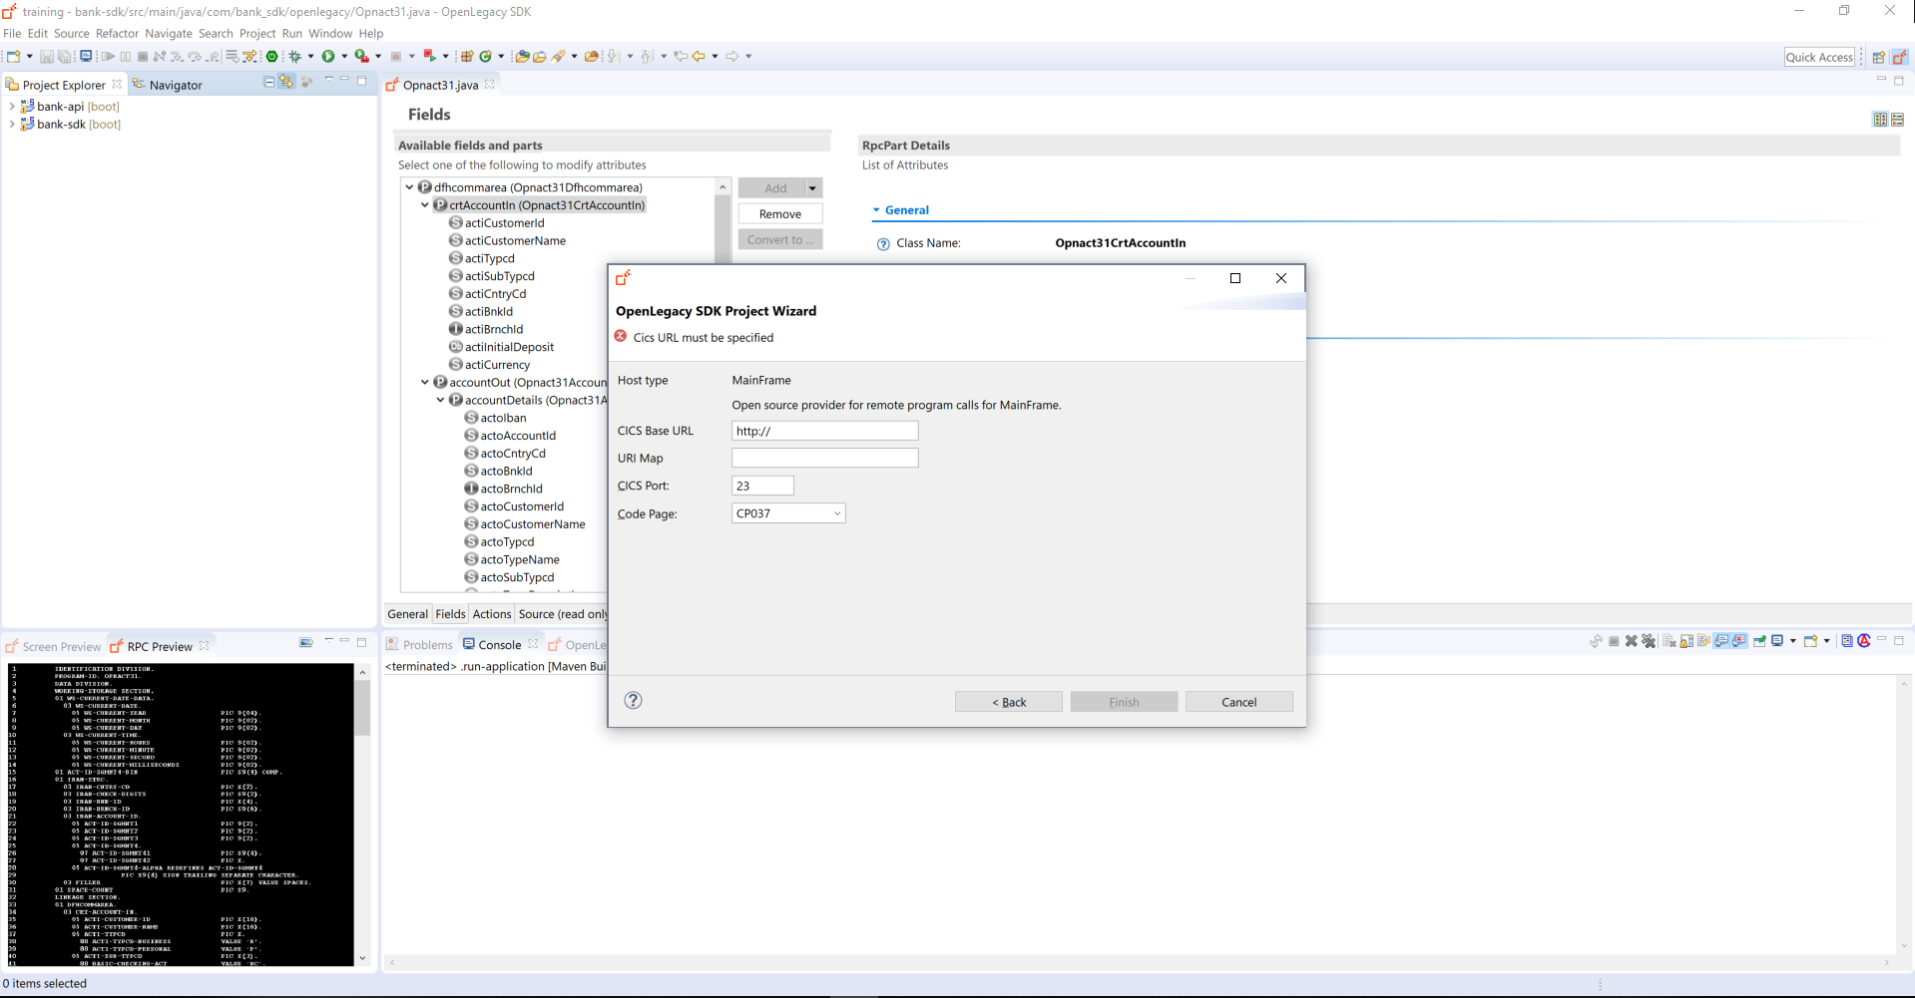
Topaz OpenLegacy Integration
Identify Program information to generate API
Notes:
Paul – get from Glenn use case and integration summary with screen shots from analyst deck (believe it will be 2 slides)
Put in context with some points from TJX

Slide 10
How does this help
Customers
  Leverage what you have – Mainframe Developers and DevOps standards
  Seamless DevOps handoff between Backend & Frontend Developers
  Reduce/Eliminate dependencies on ESB/Middleware (Eliminate Layers)
  End to End Solution – in comparison to Z/OS Connects
OpenLegacy
  COBOL developers, Topaz users involved in the API generations process
  Mainframe to Microservices – One Stop Shop
  Joint debugging of mainframe and Java-based microservices
Compuware
  Enables Topaz users to participate in the API generation process
  Extends our customer choice integration strategy
  Reduces IBM’s messaging impact (z/OS Connect)

Slide 11
© Compuware Corporation 2018 All Rights Reserved.

