Slide 1
Creative thinking
Jamie.Anderson1971
@JamieAndersonBE

Slide 3
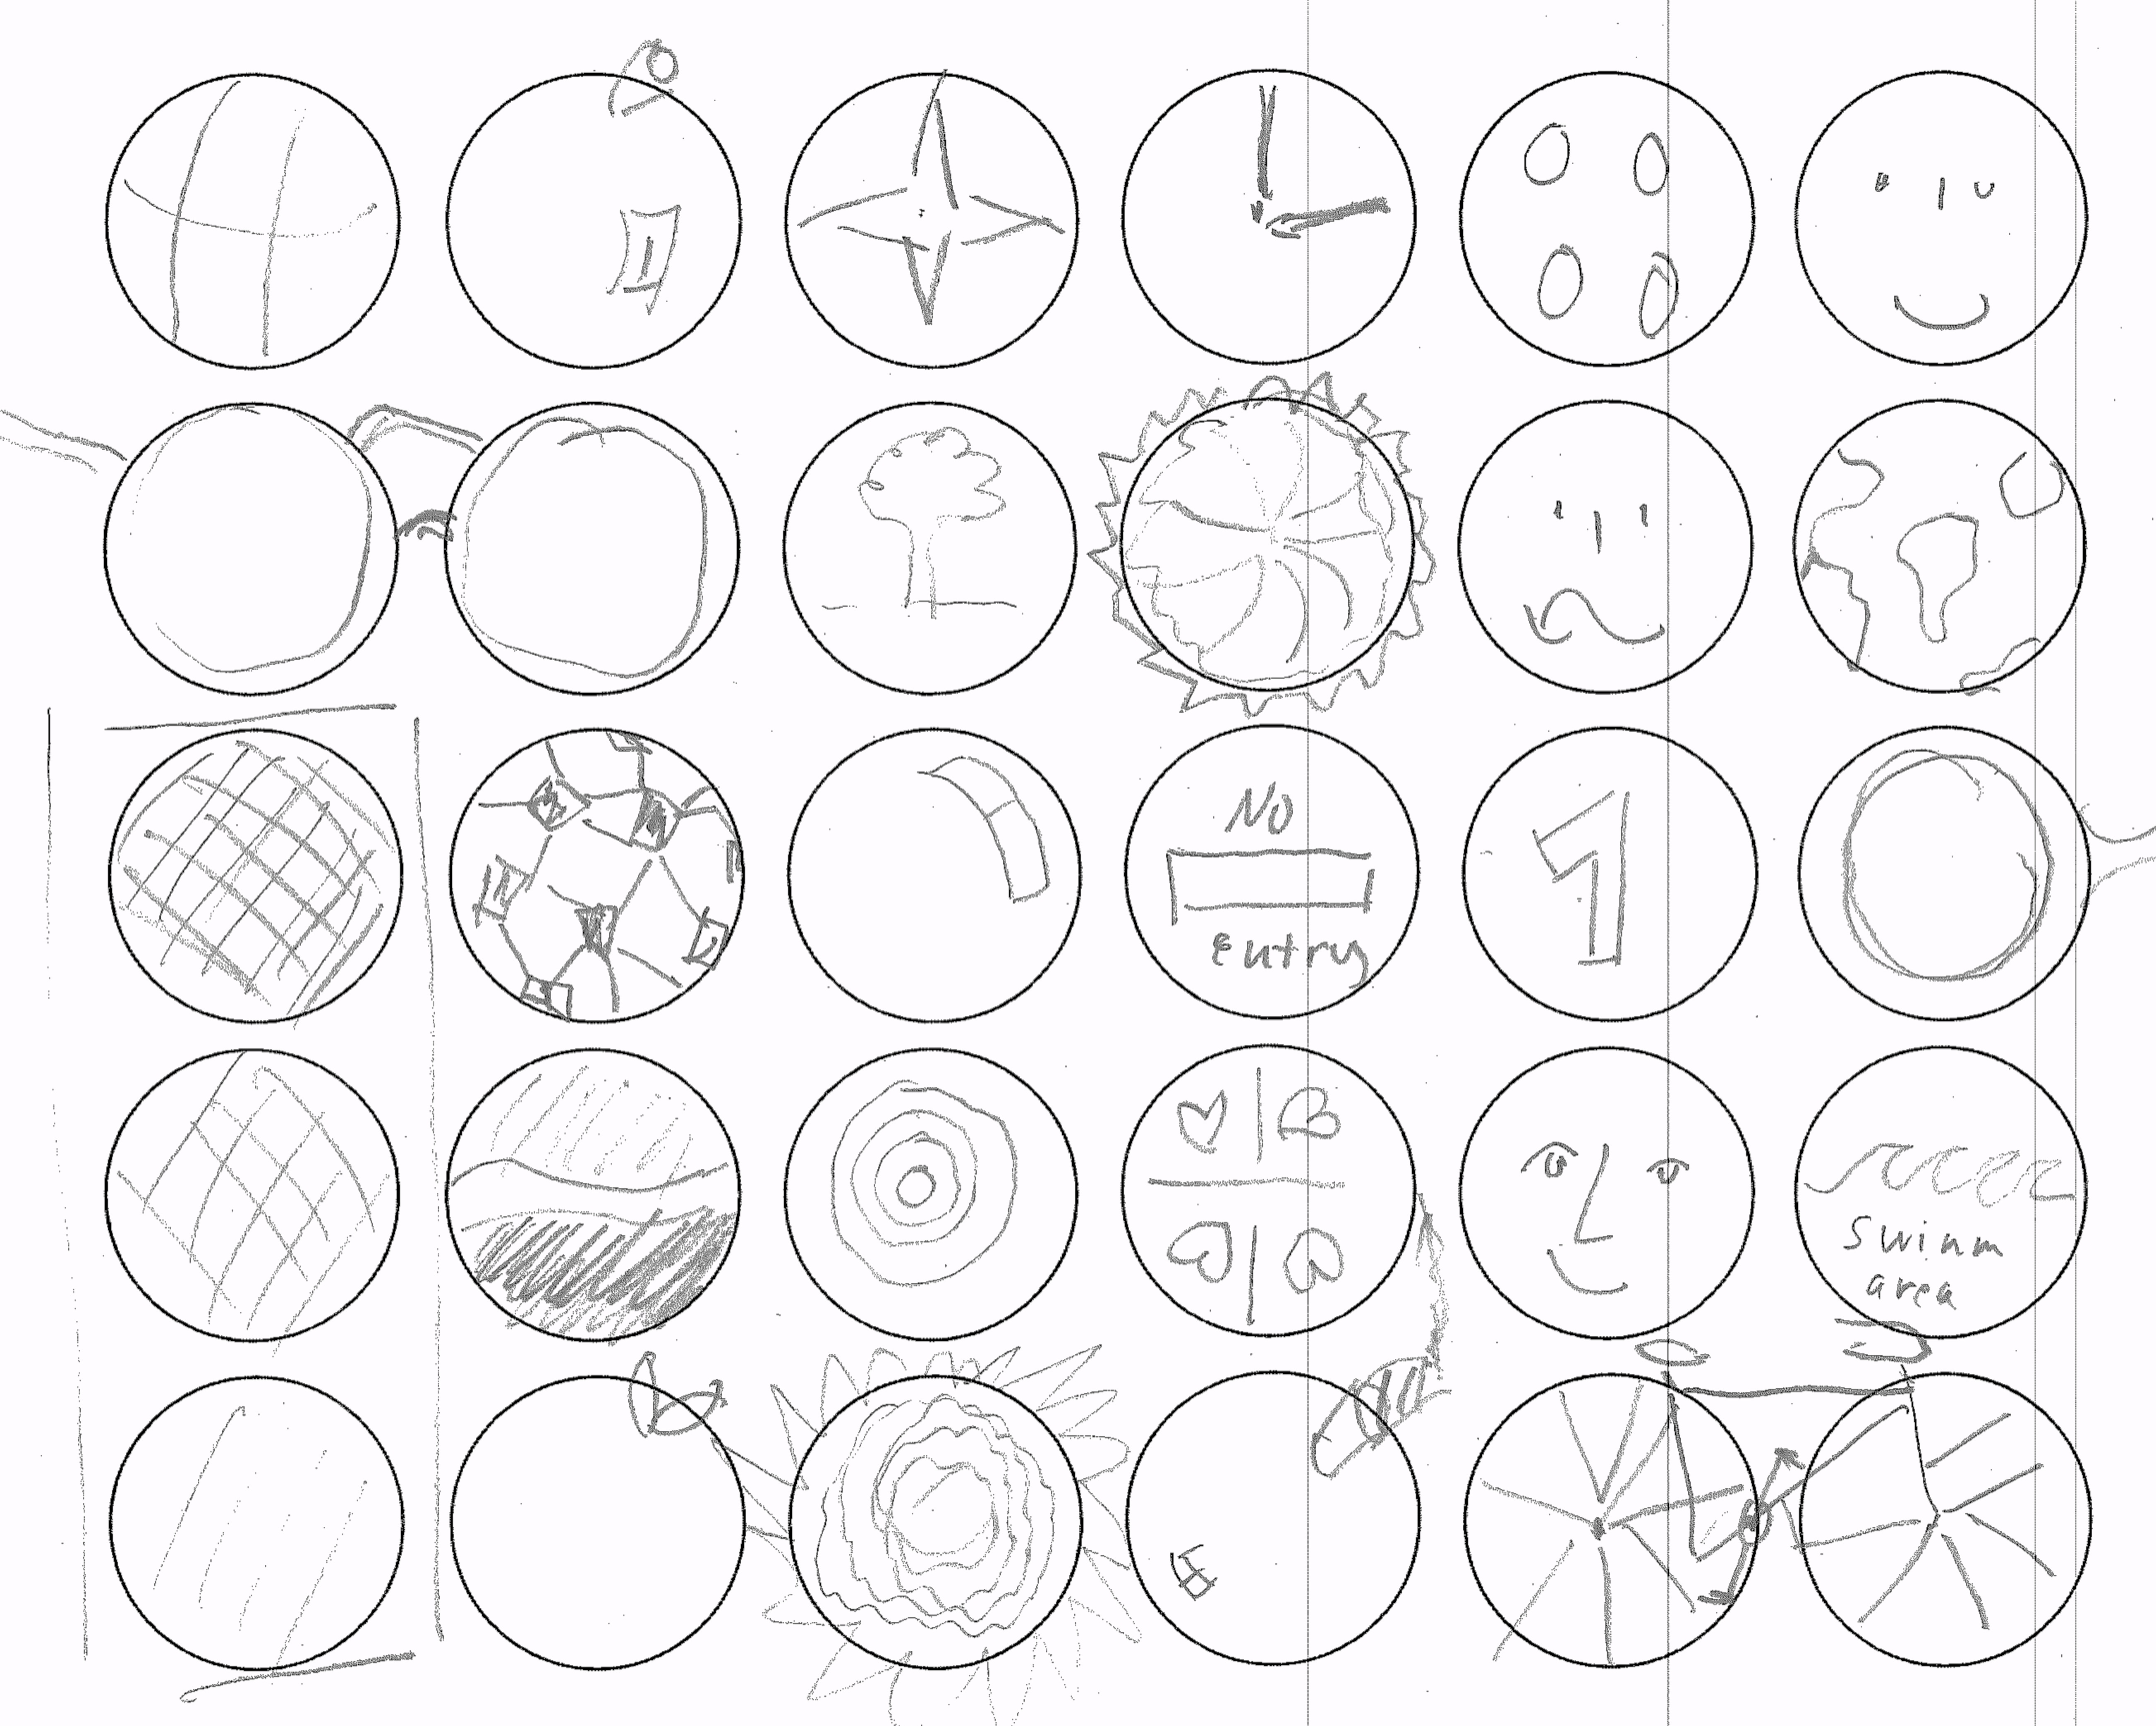

Slide 4
THINK!

Slide 5
cake!

Slide 6
?
Answer: Infinite !
Notes:
2 minutes time
Try to change the circles into as many objects as you can
Please put down you pencils
Reflection:
Who has more than 5 hopefully everybody; 10 keep you hands up, 15 – 20, all 30
Interested in quantity
What counts for creativity is to explore just lots of things and not to judge them at the beginning
It is a about mental flexibility
If you want to open up for creativity: the paradox is, you must produce these images and must be able to let them go
Let’s talk about how to bring creativity to organisations

Slide 7
Notes:
2 minutes time
Try to change the circles into as many objects as you can
Please put down you pencils
Reflection:
Who has more than 5 hopefully everybody; 10 keep you hands up, 15 – 20, all 30
Interested in quantity
What counts for creativity is to explore just lots of things and not to judge them at the beginning
It is a about mental flexibility
If you want to open up for creativity: the paradox is, you must produce these images and must be able to let them go
Let’s talk about how to bring creativity to organisations

Slide 8
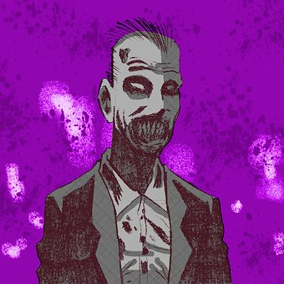
QUESTION!
Learning, Rules & Habits
Resource Barriers
Perceptual Barriers
Emotional Barriers
Cultural Barriers

Slide 10
DRAW!

Slide 11
Emotional blocks to creativity
Fear of Failure
Fear of Being Different
Fear of Rejection
Fear of Criticism
Fear of Ridicule

Slide 13
IDEAS?

Slide 14
Creativity
THINK
QUESTION
3. RELAX*
*or sport and eat foods rich in tyrosine.

Slide 15
Jamie.Anderson1971 @JamieAndersonBE
Professor Jamie anderson

