Slide 1
Organizational Change Management: Migrate your users along with your systems
Asif Rehmani
Microsoft MVP
VisualSP
Download my presentations at:
http://bit.ly/asifconference
Notes:
Don’t forget your users when migrating to a new platform.
Strategies that have worked with organizations around the world as they deal with organizational changes and prepare their users for their new processes and systems.

Slide 2
What the heck is Change Management…?

Slide 3
Notes:
The interlacing fingers test:
Interlace your fingers as you normally do.
Now try doing it the other way where your other thumb is on top.
How does it feel? Would you want to change that behavior forever if it didn’t feel right and you didn’t see any benefit in making the change?

Slide 4
Change Management drives User Adoption

Slide 5
The story of the beautiful intranet with 100% adoption
Notes:
The story of an organization that created a beautiful intranet that was super fancy. They just opened it up one day and All the users flocked to it.

Slide 6
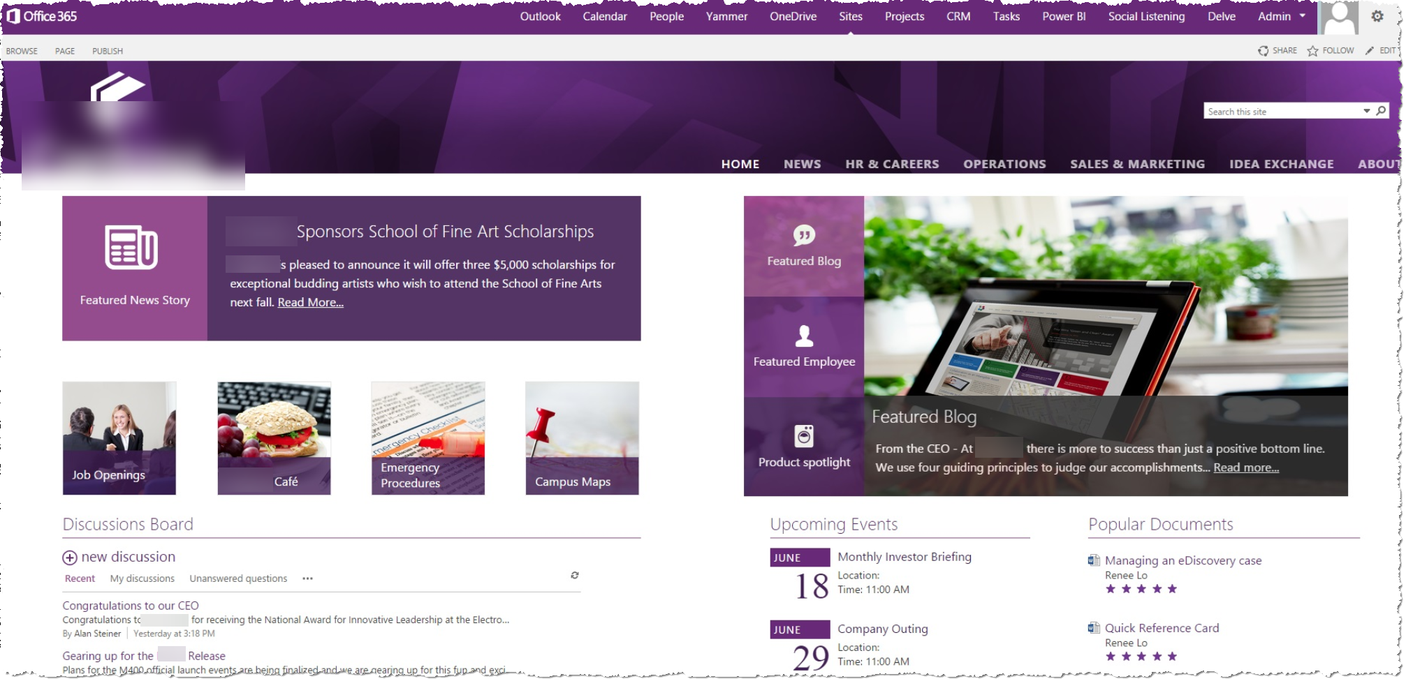
Notes:
Beautiful look and feel and brilliant colors.
All of the Office 365 applications available at their fingertips.
Discussion boards for people to discuss issues.

Slide 7
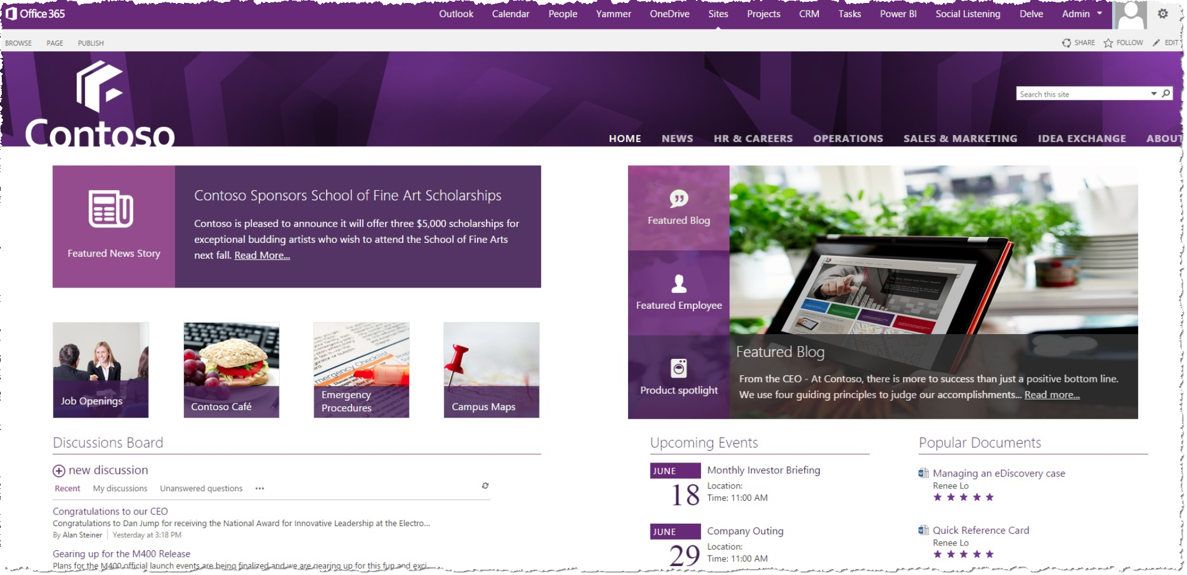
Notes:
Name of corporation: Contoso.
This story is actually a fable ☺. Things don’t work like that in real life.

Slide 8
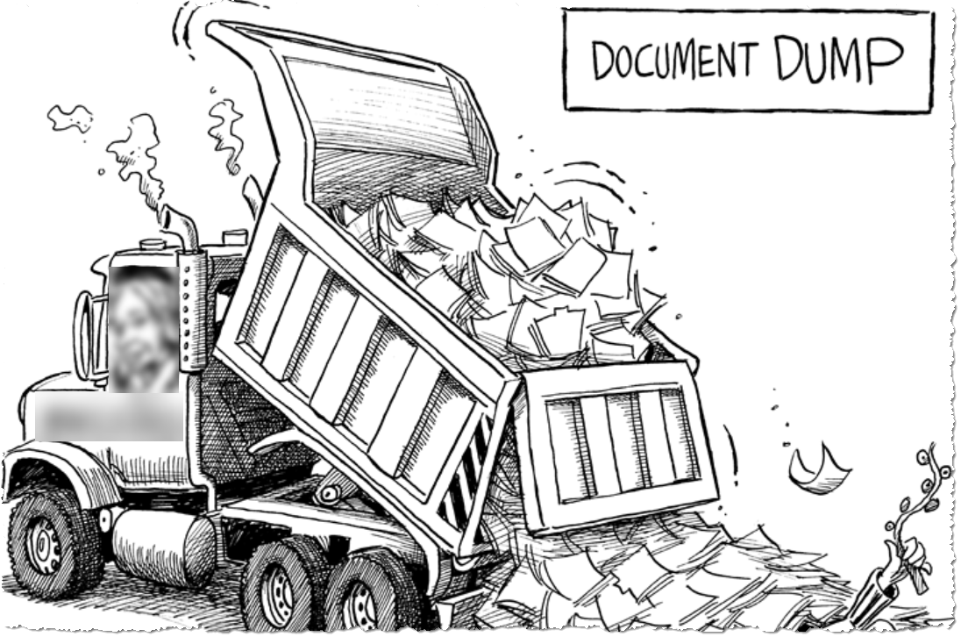
The Reality
Notes:
Reality: SharePoint is a dumping ground for documents. Nobody knows why there are hundreds of sites out there and who's using them. Microsoft is saying to go to the cloud. Executives don't want sensitive info in the cloud.

Slide 9
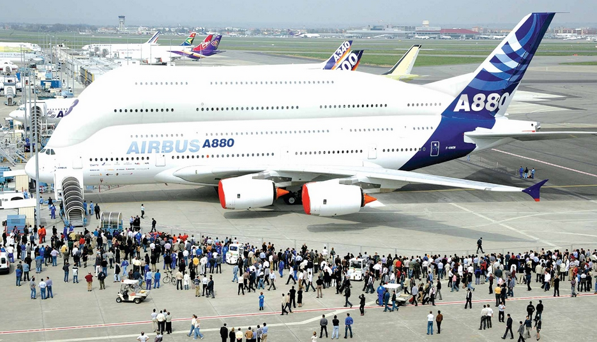
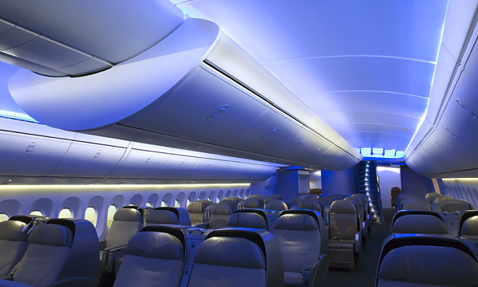
The Challenge
Where are the passengers…?
Notes:
Buying SharePoint and not getting the users onboard is like buying a Jumbo Jet, learning to fly it and then flying around in it without passengers. What's the point?
That’s what happens when end users are not provided the support they need when they need it!

Slide 10
Session Agenda
Understanding how people learn new behaviors
Various case studies of companies and how they tackled change
Lessons from my experiences

Slide 11
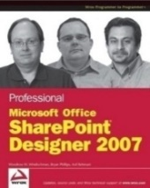
About me - Asif Rehmani
Conference Speaker
Ignite
ESPC
SPTechCon
SP Fest
SPC
Dev Intersection
And many more…
SharePoint MVP
Trainer & Consultant
Trainer
Founder and CEO
VisualSP
Chicago, USA
Since 2007
Contact:
@asifrehmani
asif@visualsp.com
www.VisualSP.com
Author

Slide 12
Always start with WIIFM
Notes:
Credit your account with the users before debiting it. Give before receiving. The same theory works for your marriage and for friendships.
Provide quick Solutions. Before the wow of the solutions wears off, ask for call to actions of what you want and then provide another quick solution after the first one is taken for granted.
Ability to visualize the change is very important for end users

Slide 13
Users cannot be made to do things they don’t want to do
Notes:
Users cannot be made to do things they don’t want to do… Unless you want to take extreme measures

Slide 14
Notes:
Change is hard. Solicitor comes to your door at dinner time to switch your WiFi, Electricity, Lawn Mowing, Pest Control provider and you say No! Not because it’s not a better deal, you just haven’t thought about it and are not ready to deal with it.

Slide 15
Types of changes
Minor change
Change in procurement, asset tracking, sales procedures. Ex: Record every pre-sales meeting and upload to Stream.
Major change
Moving offices, changing critical systems like email, collaboration tools.
Substantial
Completely changing your model of doing business like Kodak, IBM, Kmart, AOL did to survive.

Slide 16
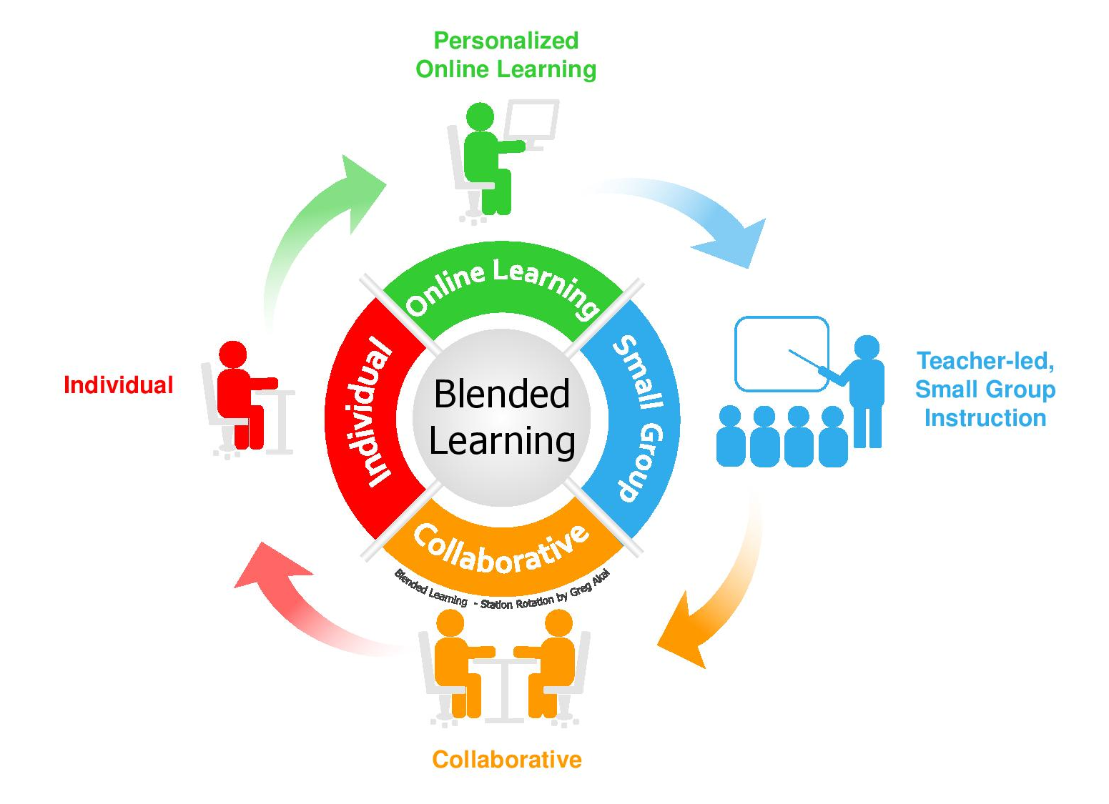
Types of training/learning
We all learn in different ways
Notes:
Different type of modalities used when training is necessary.
Learning
Teaching others
Supporting
Reinforcing
Poll: Which type of learner are you?

Slide 17
Immerse users in new ways of doing things
The way we learn…
Learning a new language
Learning to swim
Notes:
What do you do to learn a new language? Immerse yourself in culture with people and environment How do you learn to swim? in a swimming pool, Not from a textbook.

Slide 18
A stability plan
Be very specific about the things that are not changing
Provide an anchor
Notes:
A stability plan. Things that will not change and will remain the same. anchors to make them feel comfortable as they are going through other changes in their work environment.
Here’s what’s not changing…
Same content on the home page

Slide 19
Challenge at Sony
How do we ‘train’ users to go to our new intranet?

Slide 20
Using a pain point to their advantage
A mobile workforce who frequently needed to print documents
Hard to find and connect to the printer closest to them

Slide 21
Sony
Find the Nearest Printer
Notes:
Sony Using Spiderman to get people's attention Printing to the closest printer

Slide 22
JIT Concept
Just-In-Time
Notes:
Performance Support
Made popular by automotive manufacturing companies like Ford, Toyota, etc.
Henry Ford didn’t want warehouses.
Tesla doesn’t sell cars through dealerships – it has showrooms instead

Slide 23
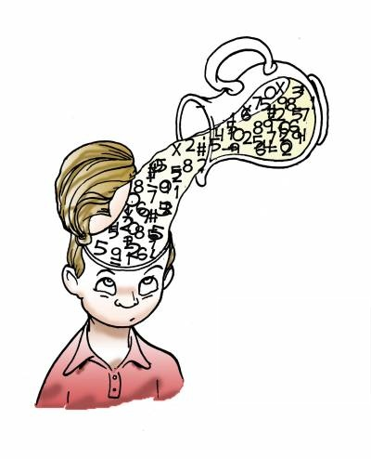
Just-In-Time Help
Notes:
Performance Support
Efficient delivery system needed
Very much like how I created this slide deck using “Design Ideas” feature in PowerPoint used to create this slide deck.

Slide 24
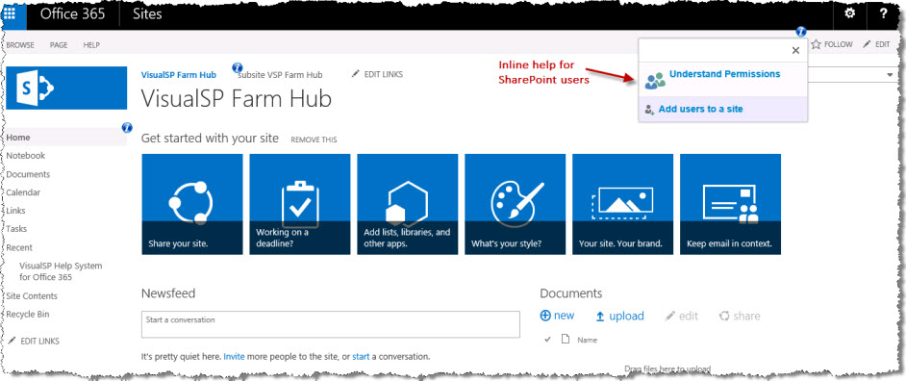
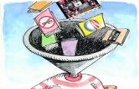
“Just-in-time” and “Just Enough” Help
Do you want users to follow blindly the advice they find on the internet?
End users are not motivated to look elsewhere - deliver help in-place.
Don’t overwhelm users with too much information.
Notes:
Thoroughly training SharePoint end users is a waste of time.
There are good as well as bad practices that exist in the SharePoint world. Ask yourself this:
Do you want users to follow blindly the advice they find on the internet?
End users as well as SharePoint admins can all make mistakes.
End users: creating subsites instead of pages
Admins: creating site collections underneath Central Admin
Just in time help: end users are not motivated to look elsewhere – so bring them help where they are
End users usually resort to calling support immediately or giving up rather than searching for Help
Provide SharePoint users the help they need when and where they need it – right within the SharePoint interface
The less clicks the better
Don’t overwhelm the users with too much info. Provide them with in-work performance support
We tried the long articles and the long videos… doesn’t work at all for end users!

Slide 25
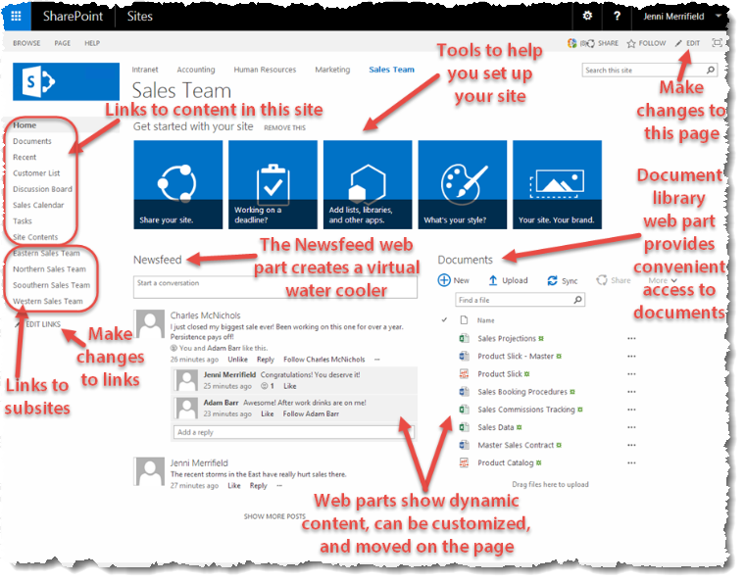
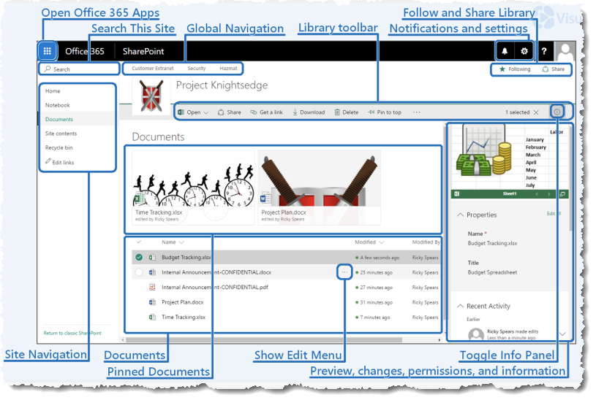
SharePoint Quick Reference Tip Sheets
http://bit.ly/SPQuickReference

Slide 26
Example of Just-in-Time/In Context Delivery
Link to governance about documents from th places where users upload documents
Add links in context to relevant pages
Notes:
Compliments of User Adoption expert Susan Hanley.
Document Library web part is modified and governance info is placed directly in context of the document library where users would be uploading the documents.

Slide 27
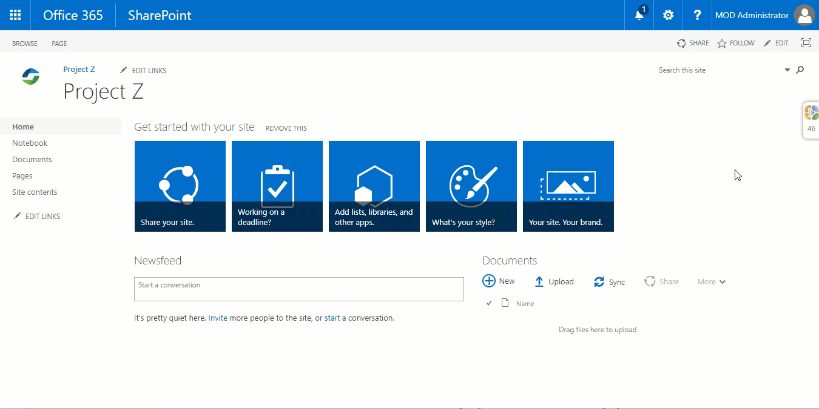
In-context Help/Training for end users
Notes:
User interactive guides providing contextual help to users.

Slide 28
Visa case study
http://bit.ly/VSPVisaCaseStudy

Slide 29
SharePoint at Visa in 2012
Two SharePoint on-prem farms
350 site collections
100 unique site owners
Low enthusiasm and low adoption for SharePoint

Slide 30
4 Tenets
simple governance policies
simple adoption metrics
simple solutions
user support that actually helps

Slide 31
Simple governance policies
Every imposed limitation should have a compelling reason
For every prohibited tool or process, an alternative should be provided
“We’ve always done it this way” should not justify a rule
Every rule should be clear enough to be fully understood by everyone

Slide 32
Simple adoption metrics
How many current site collections and unique site owners do we have?
How many new site requests are we getting per month?
How many custom objects do we have and the rate of their increase:
List forms
Form libraries
Custom workflows
Features activation
Customized pages
What type of support tickets are we getting? Complaints of broken things or looking for guidance

Slide 33
Simple solutions
Prioritized solutions to highest visible challenges
Example
Challenge
For requesting a site, users had to previously navigate the IT ticketing system to find the right form, and fill out many blanks that most of them didn’t understand.
Solution
Built a simple site request form in SharePoint. Added automation to streamline the site creation process and automatically track the site information in a master site list

Slide 34
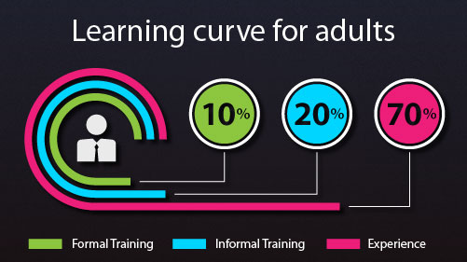
Provide help that actually helps
Users wanted hands-on assistance and not traditional training
Visa implemented a contextual help system to provide users help at moment-of-need in form of short videos and printable quick reference sheets
Provided struggling users an easy way to open support tickets – once again making it context sensitive to their environment

Slide 35
Case Study of a Large Enterprise Payment Processor
Migrating to a new system
Needed users to not feel disconnected

Slide 36
Informing and helping users at moment of need
Provided their users easy access to their site collection administrators when they had a question
Provided users the ability to get solutions to problems at the moment-of-need

Slide 37
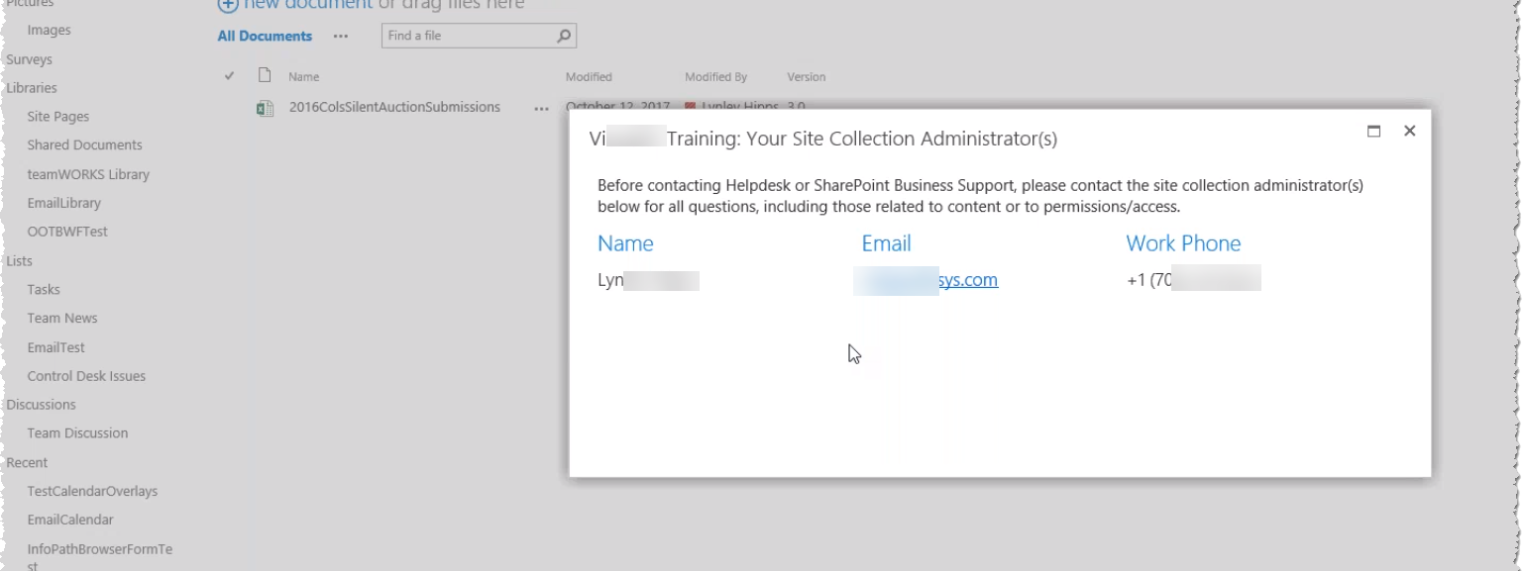
Got a question? – Contact the site collection admin

Slide 38
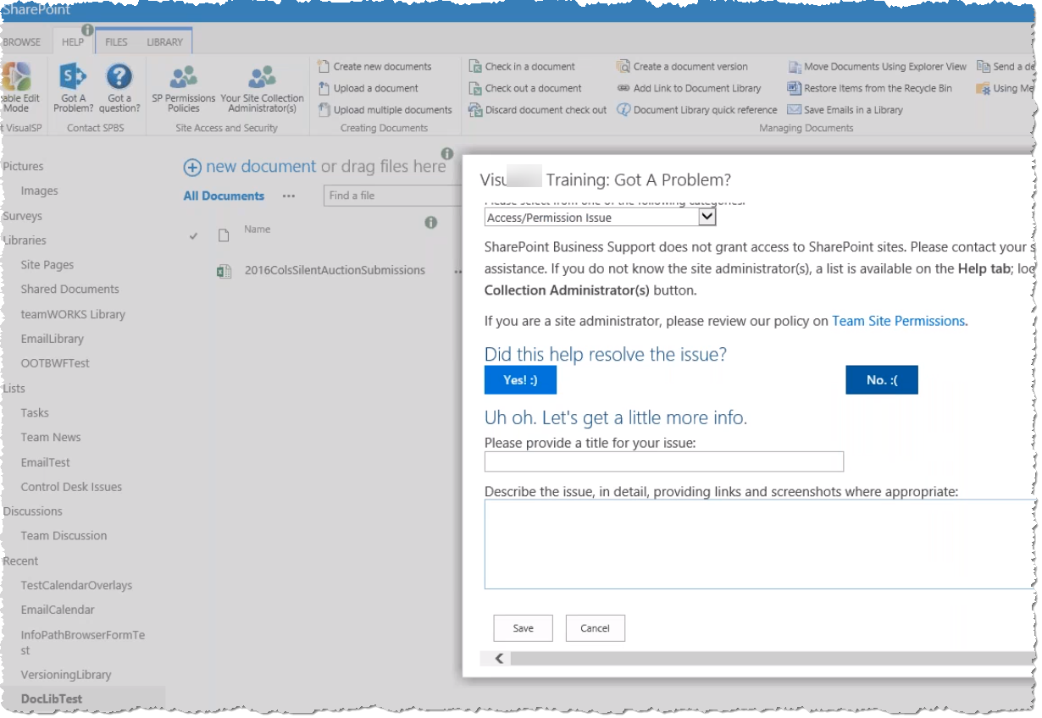
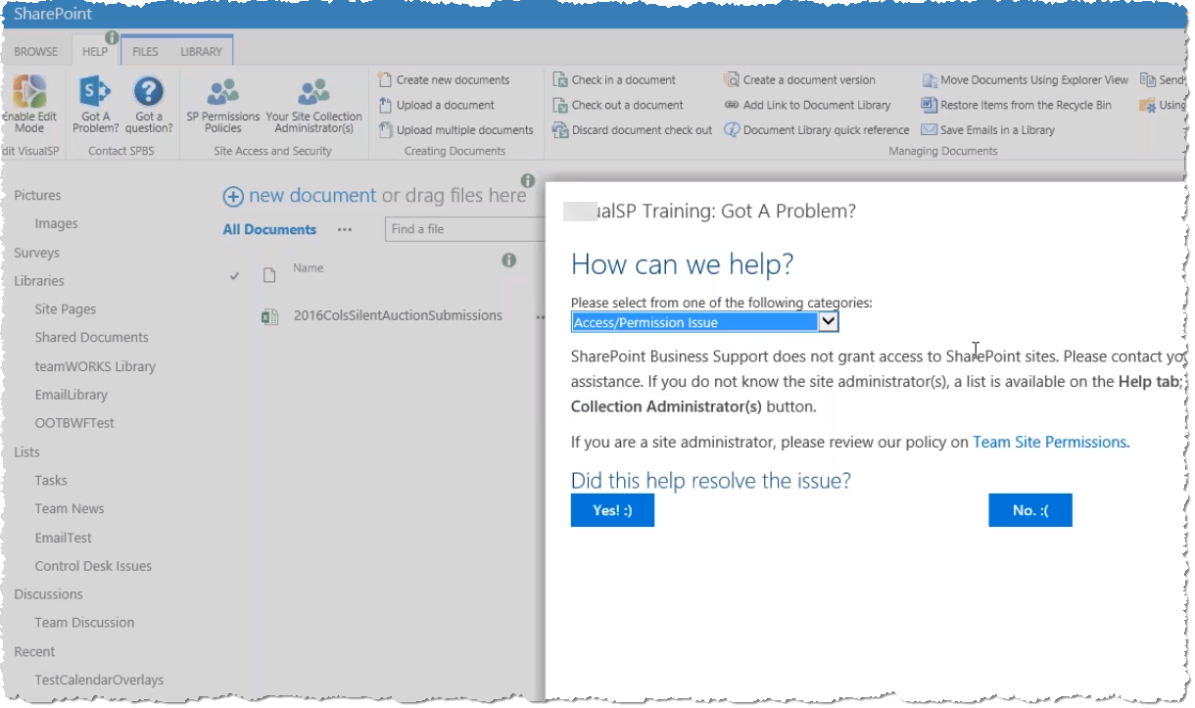
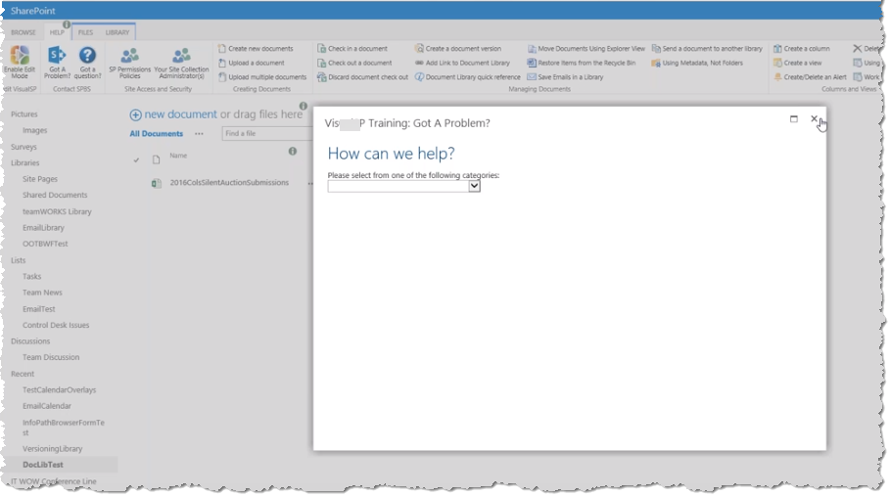
Got a problem? – solution provided in-context

Slide 39
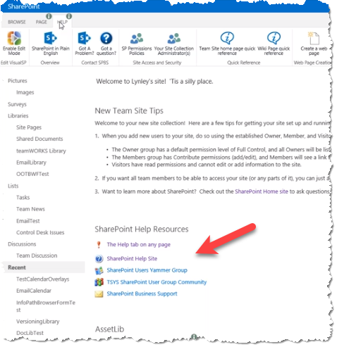
Help resources on the page

Slide 40
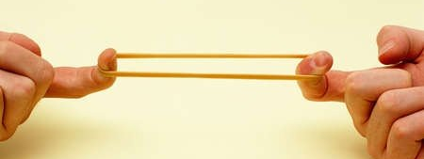
The elastic band effect
Notes:
Resistance is strong in the beginning.
Consistent effort has to be applied to make it go slack.
Then repeat the process with the next initiative.

Slide 41
User Adoption activities timeline
http://bit.ly/VSPUserAdoptionTimeline
Notes:
5 milestones for user adoption.
What activities to do when.
2 months before launch
1 week before
Day of launch
After launch – first 90 days

Slide 42
Call to Action
Download my presentations at:
http://bit.ly/asifconference
Come visit us at our booth
Thank You!
@asifrehmani
asif@visualsp.com
www.visualsp.com

