Slide 1
Download all my presentations and video recordings
http://bit.ly/AsifConference

Slide 2
Are you thinking about the following?
How do I make sense of all that’s included in Office 365?
Does our team even need all the Office 365 applications?
It would be great if I could learn from others’ experiences…
If Yes, Great! This session is for You!
Notes:
Not a deep dive in any particular application.
Learnings from my experiences.
This presentation helps you understand the pieces of Office 365 and how to best use it within your company.
Learn from others in the room as well.

Slide 3
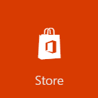
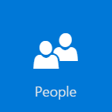
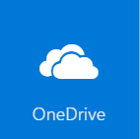
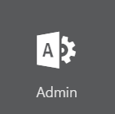

Slide 4
Office
Outlook
Collaboration
Video Portal
Workflows and Forms

Slide 5
Should we be using All Office 365 applications?
Asif Rehmani
Microsoft MVP
VisualSP
Download my presentations at:
http://bit.ly/AsifConference
@asifrehmani
Notes:
There's so much that Office 365 has to offer small to large organizations. However, the current reality is that most organizations are only using about 20% of the available capabilities. Why not understand the Entire value of the suite of Office 365 applications so your users can take full advantage of what you are already paying for!?
Also, keep in mind that there will Always be multiple ways of doing the same thing in the Microsoft sphere – document sharing, surveys, forms, workflows, site creation, etc. You just have to find the best way that it works for Your organization.
This session focuses on the ‘What’ and ‘Why’. Not the ‘How’.

Slide 6
About me - Asif Rehmani
Conference Speaker
Ignite
ESPC
SPTechCon
SP Fest
SPC
Dev Intersection
And many more…
SharePoint MVP
Trainer & Consultant
Trainer
Founder and CEO
VisualSP
Chicago, USA
Since 2007
Contact:
@asifrehmani
asif@visualsp.com
www.VisualSP.com
Author

Slide 7
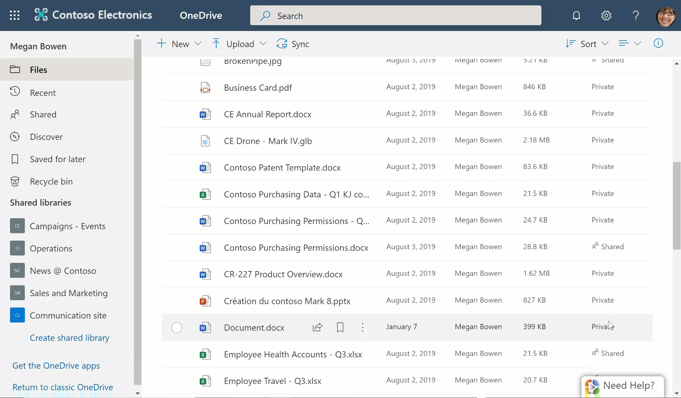
VisualSP – In-context training for Office 365 users

Slide 8
VisualSP for Microsoft Learning Pathways
http://bit.ly/VSP4LP

Slide 9
Should we be using All Office 365 applications?

Slide 10
Agenda
Story about a company and their Office 365 journey
Use cases for various Office 365 applications (much of it demonstrated in a Live environment!)
Lessons learned from other companies' successes and failures
Notes:
Learn which applications were adoption and which were rejected by our team and more importantly ‘why’ they were rejected.
Also stories of success and failures from other companies around Office 365 implementations.

Slide 11
Company Profile
Name:
Contoso corporation
Business:
Change Management Consulting
Employee count:
150

Slide 12
Requirements
Communications: Email & Chat
Document Types: Word processing, Spreadsheets
Document Management: Storage, Easy Access, Sharing
Internal company website for company wide communications
Consulting tracker application
Project tasks tracking application

Slide 13
Decided on Office 365
Office 365 E1 for $8/user/month
*no desktop MS Office apps
Notes:
They decided to not go for Office desktop applications since that would have been $20/user/month – a substantial difference

Slide 14
Deployment journey begins…

Slide 15
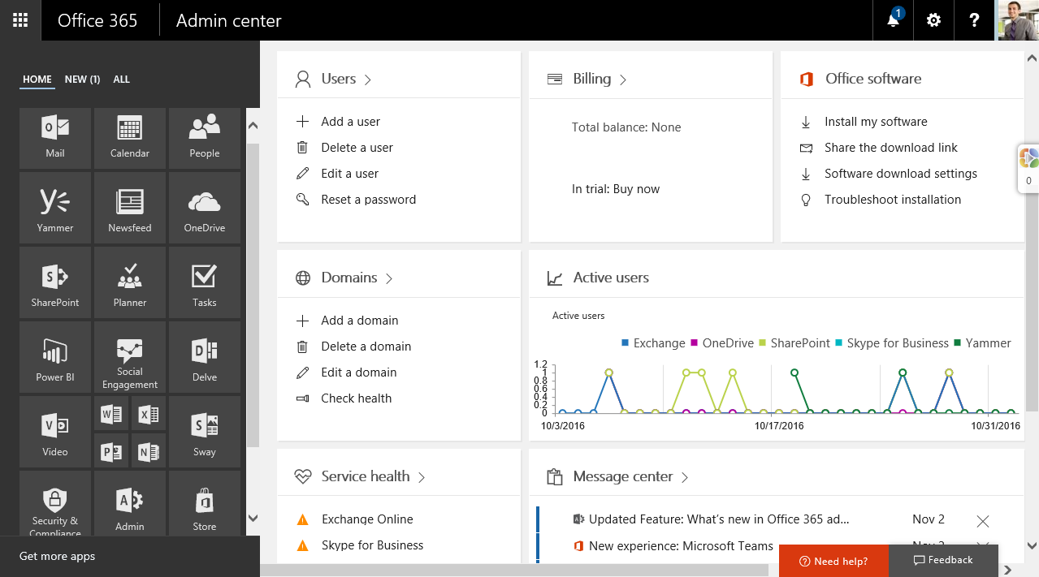
Admin Center used to manage the tenant
Manage billing
Setup users
Attach our domain
Track usage by our users
Activate/deactivate services like Analytics, Teams

Slide 16
Security and Compliance Center
Default protections already setup
Examples:
Auditing data being accessed by your users
Notification when someone gets added as a tenant admin
When sensitive information like credit card info leaves the organization domain, admin gets notified

Slide 17
Onwards to user focused apps…

Slide 18
To-Do replaced Outlook Tasks
As of Nov 2019, To-Do has replaced Outlook Tasks.

Slide 19
Personal Task Management with To-Do

Slide 20
What does the People app do anyway…?

Slide 21
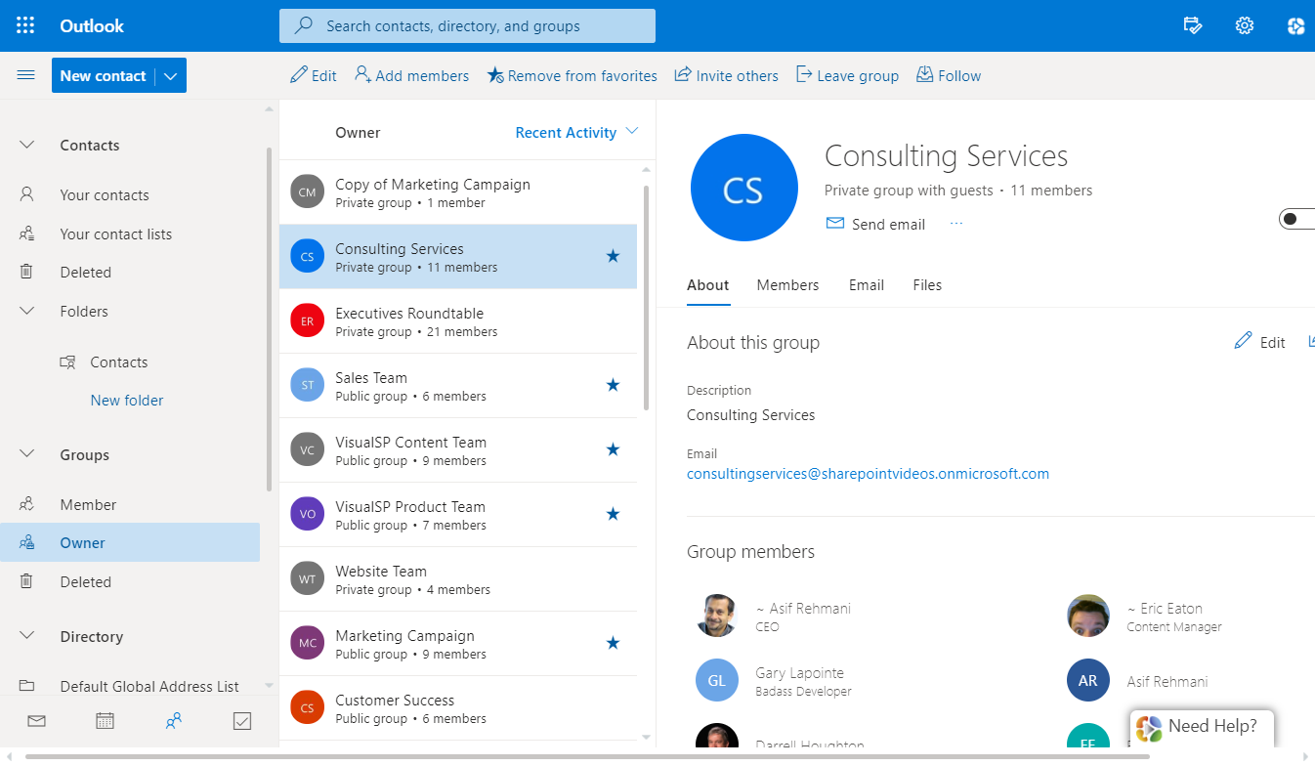
People
A people centric view
Manage group memberships
Discover and connect with co-workers
Notes:
Explore your contacts and contact lists and their info.
Manage Office 365 Group memberships that you own.
Get access to all users and all distribution lists.

Slide 22
Transitioning to Microsoft Office Online Apps
Notes:
Using these instead of desktop apps because of the difference in cost.
$8/user/month
As opposed to
$20/user/month

Slide 23
Should we be using Sway as a presentation tool?
PowerPoint or Sway?
Notes:
Is PowerPoint going away?
Is Sway the new PowerPoint?

Slide 24
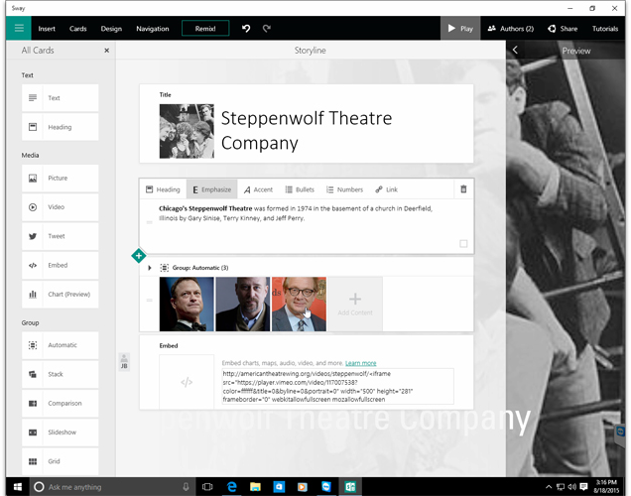
Sway
Pros:
Quick to create presentations
Easy to share with others
Like a quick web page
Cons:
Another application to learn
PowerPoint is still the industry standard and evolving as well
Notes:
Nothing broken with PowerPoint. No need to fix what’s not broken.
No need to use Sway unless there’s an actual business need.

Slide 25
Chose to not use Sway

Slide 26
Users need to manage their own business documents

Slide 27
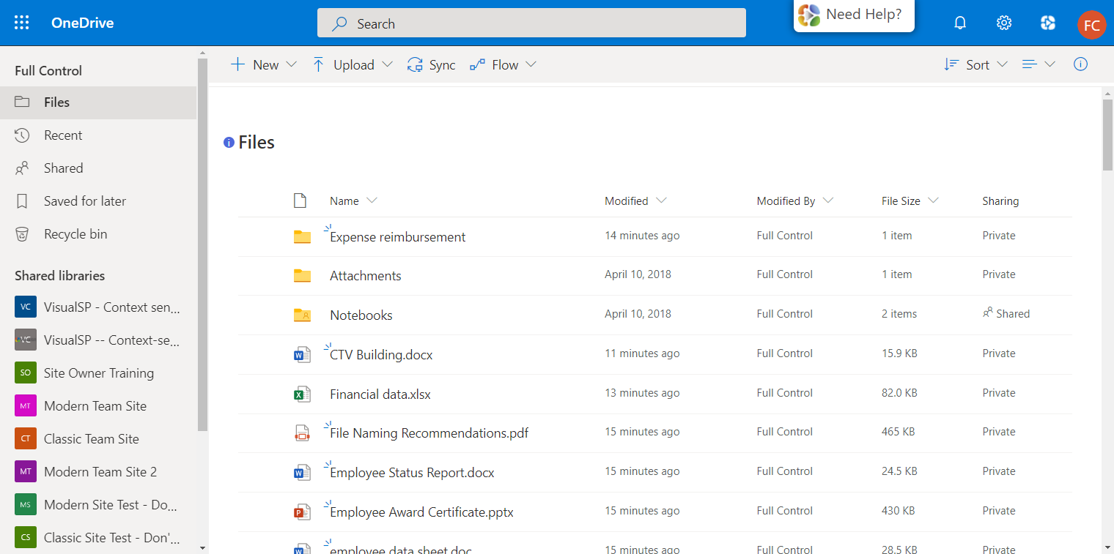
Personal file management using OneDrive
Notes:
This is where a document’s journey starts.
Simple shares can be done here with individuals.
For more complex collaboration on shared documents, promote them to a document library in SharePoint.

Slide 28
Employees are already pretty comfortable with Dropbox
What’s in it for them to move to OneDrive??

Slide 29
Challenge: how do you get users to switch to OneDrive?
Empathized with the users
Admin became a Dropbox user herself
Made a list of pros and cons of why employees should switch from Dropbox to OneDrive
Demonstrated the pros of switching in company town hall meeting
Examples:
Native support for automatically saving documents in OneDrive as you work on them
Easier to share documents with colleagues using OneDrive
Easily promote documents from OneDrive to SharePoint Document Library to share with others

Slide 30
Requirement: Workspace needed for teams to collaborate
Task management
Chat
Online meetings
Team calendars
Easy note taking

Slide 31
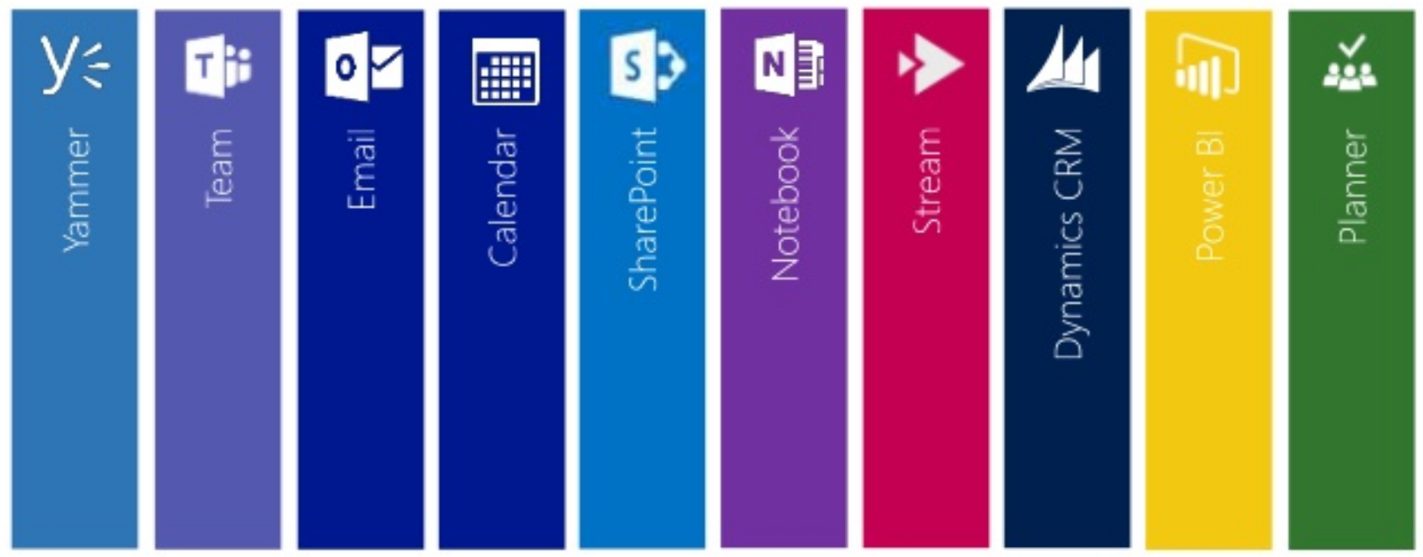
Office 365 Groups Underlying foundation for all work
Permanent and
Temporary
Groups
Notes:
Groups for Marketing, Sales, IT (long term)
Groups for Project X and Y (short term)

Slide 32
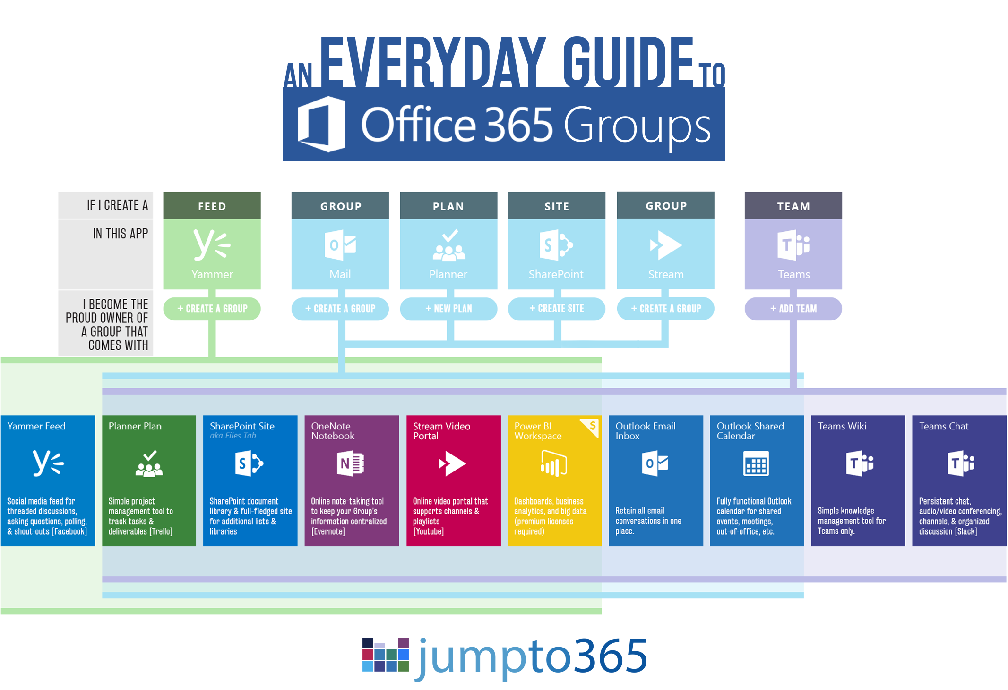
Notes:
If you are using Microsoft Teams, that’s the best way to create a new group so you get all of the other apps created at the same time (minus Yammer).

Slide 33
Chose to use Microsoft Teams to create Office 365 Groups as needed

Slide 34
Microsoft Teams
Chat based workspace
Organized by teams in the company
Channels exist within teams to discuss specific topics
Video chat capability
Connectors to connect to other services
Private chats and small group chats
Ability to send emails directly into Teams.
Attachments go into the associated SharePoint site document library

Slide 35
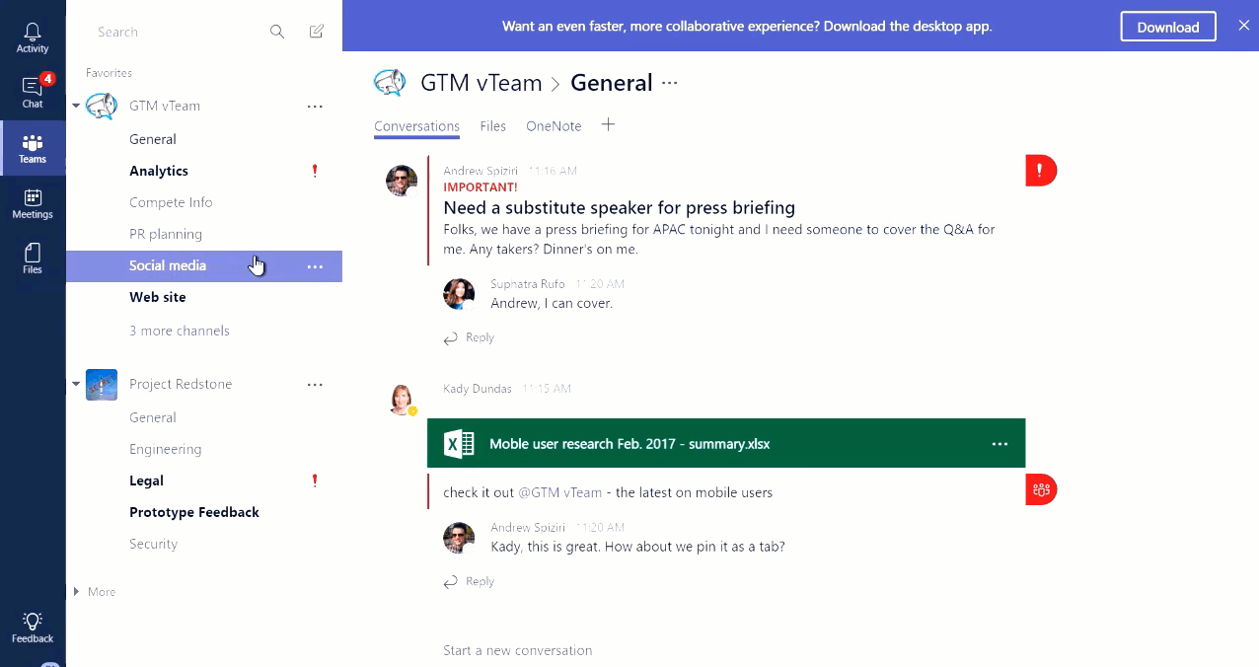
Microsoft Teams
Notes:
On by default
Public Teams - open to anyone in the company who wants to join it.

Slide 36
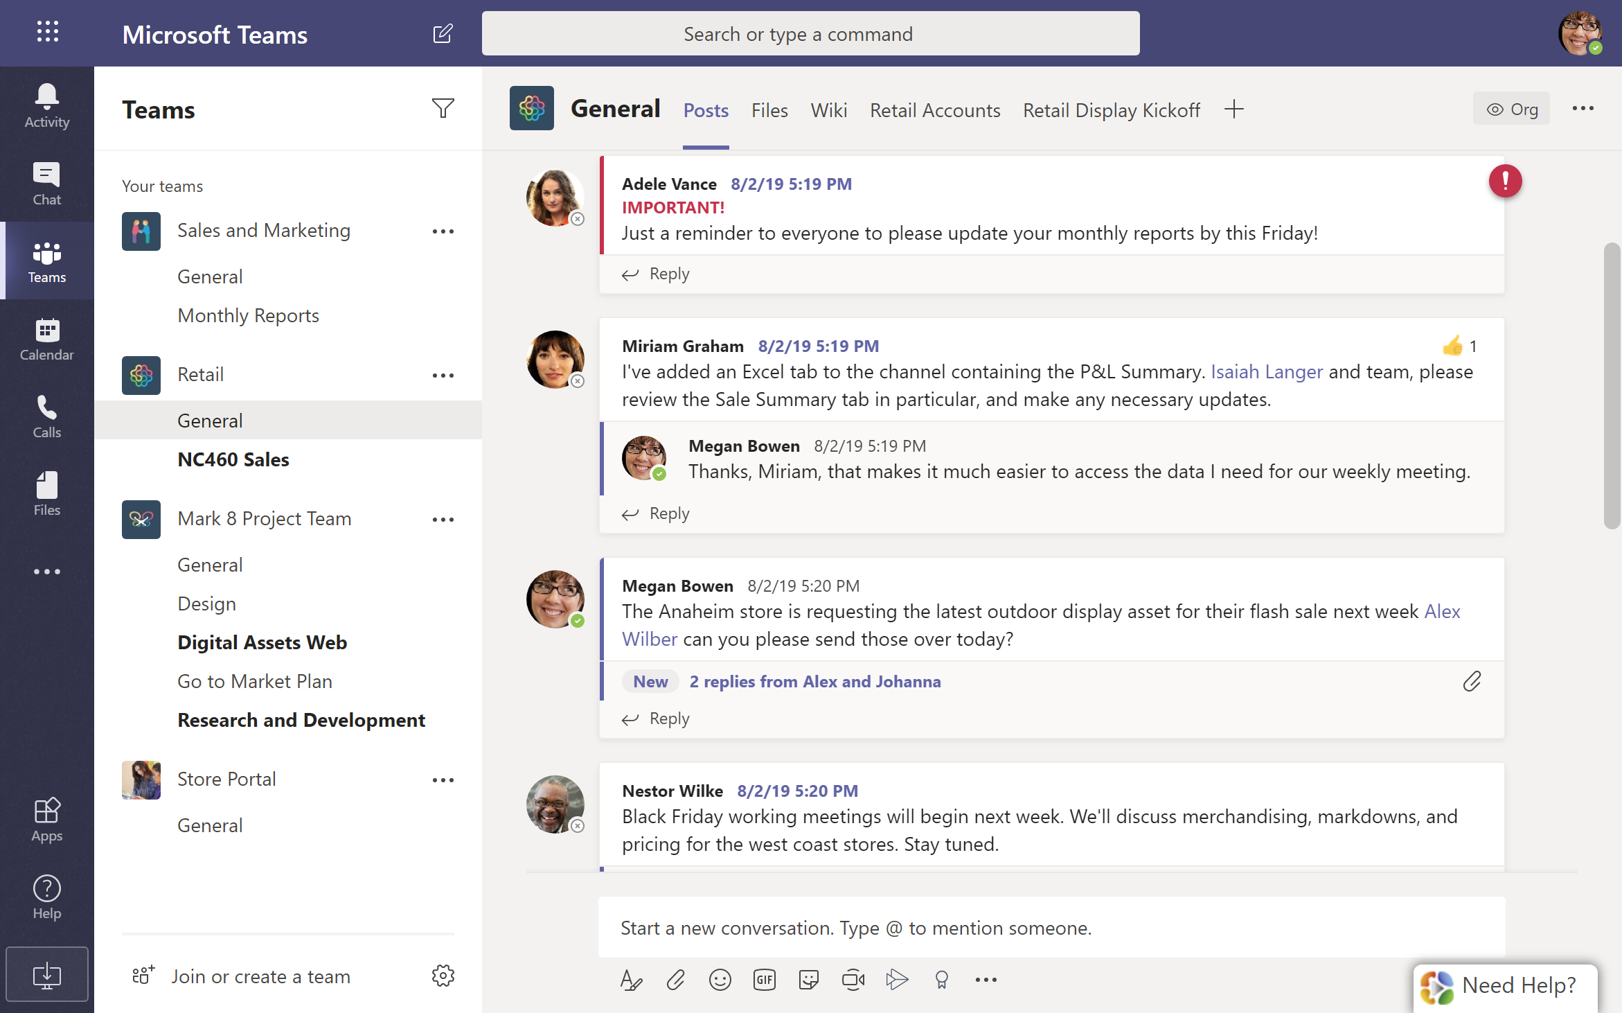
All collaboration and processes take place within Groups
Notes:
Sales and Marketing, Retail and Store Portal are permanent Teams.
Mark 8 Project Team is a temporary Team for the project.

Slide 37
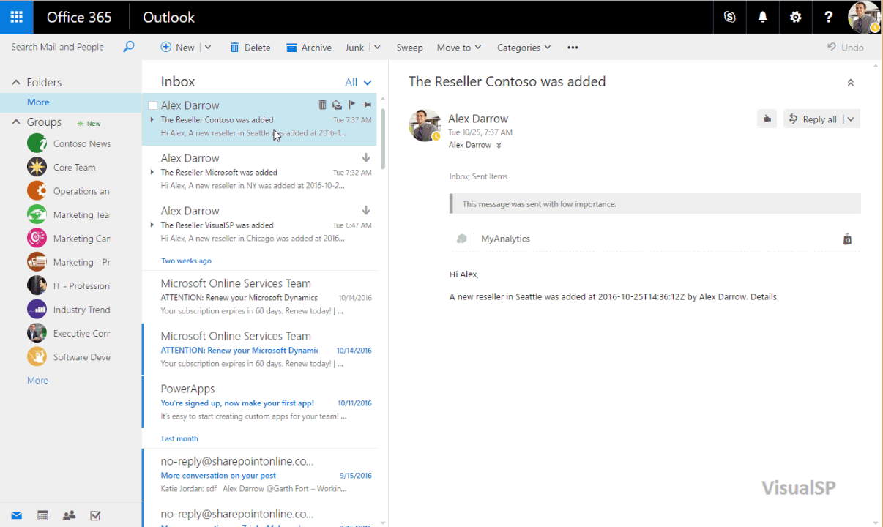
Easy access to Groups from Outlook
Notes:
Access to Groups conversations from Mail

Slide 38
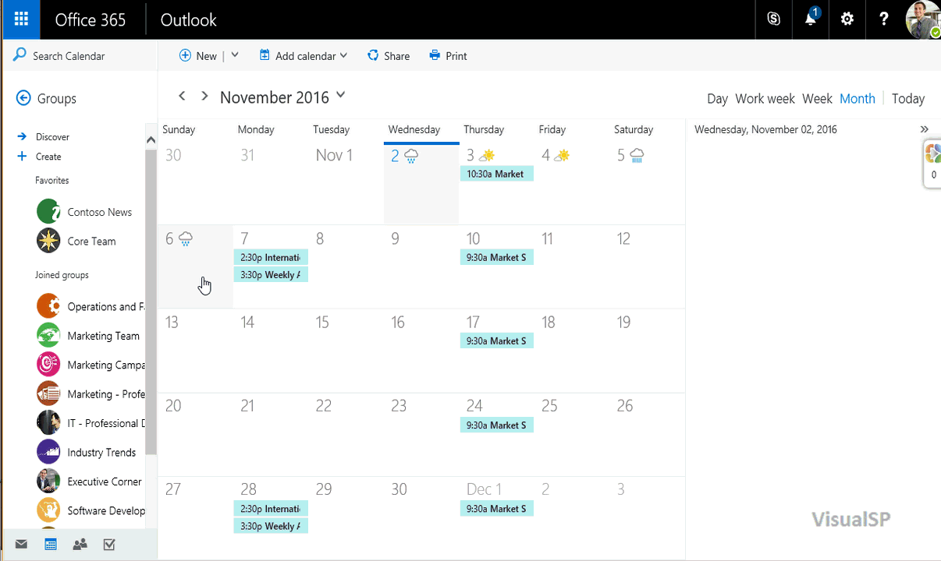
Group Calendars
Overlapping calendars to keep things in check
Notes:
Groups have Outlook based calendars.
Easily see your calendar overlapped with other Group calendars.

Slide 39
Requirement: Need to create quick anonymous forms for external surveys

Slide 40
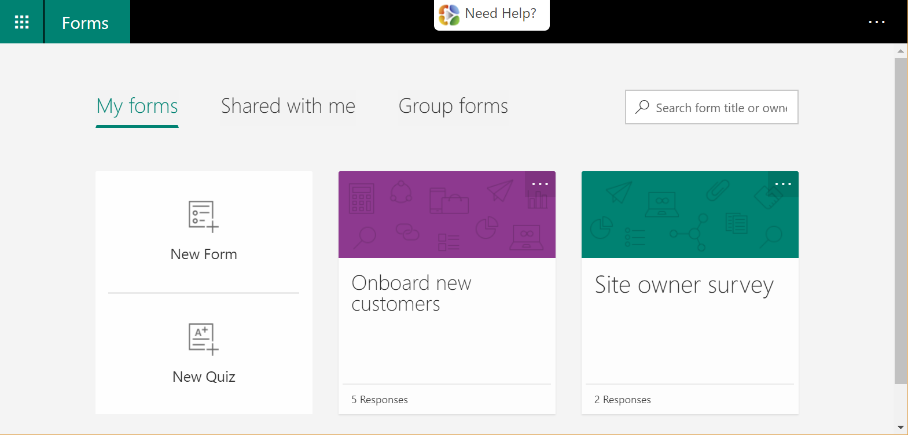
Microsoft Forms

Slide 41
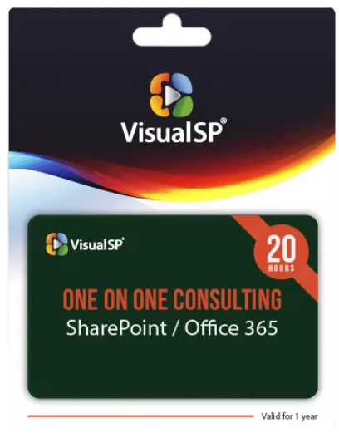
Requirement: Consulting team needs an easy way to track 1-on-1 consulting engagements

Slide 42
Chose to create application using SharePoint lists, PowerApps and PowerAutomate (formerly Flow)

Slide 43
Automated business processes
Notes:
Integrating various services you have access to as an individual.

Slide 44
Consulting services tracking
SharePoint list
Clients, Hours billed
PowerApps
Customized Forms and Views
Flow
Approval process

Slide 45
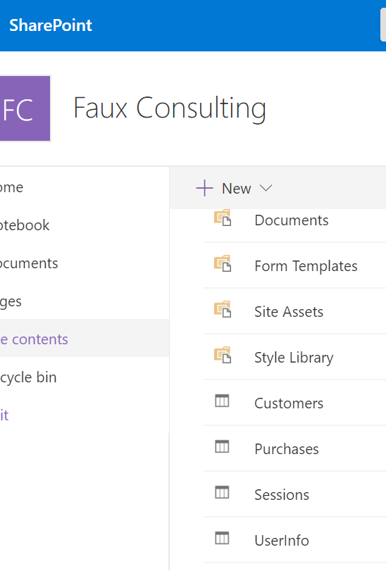
Consulting SharePoint lists

Slide 46
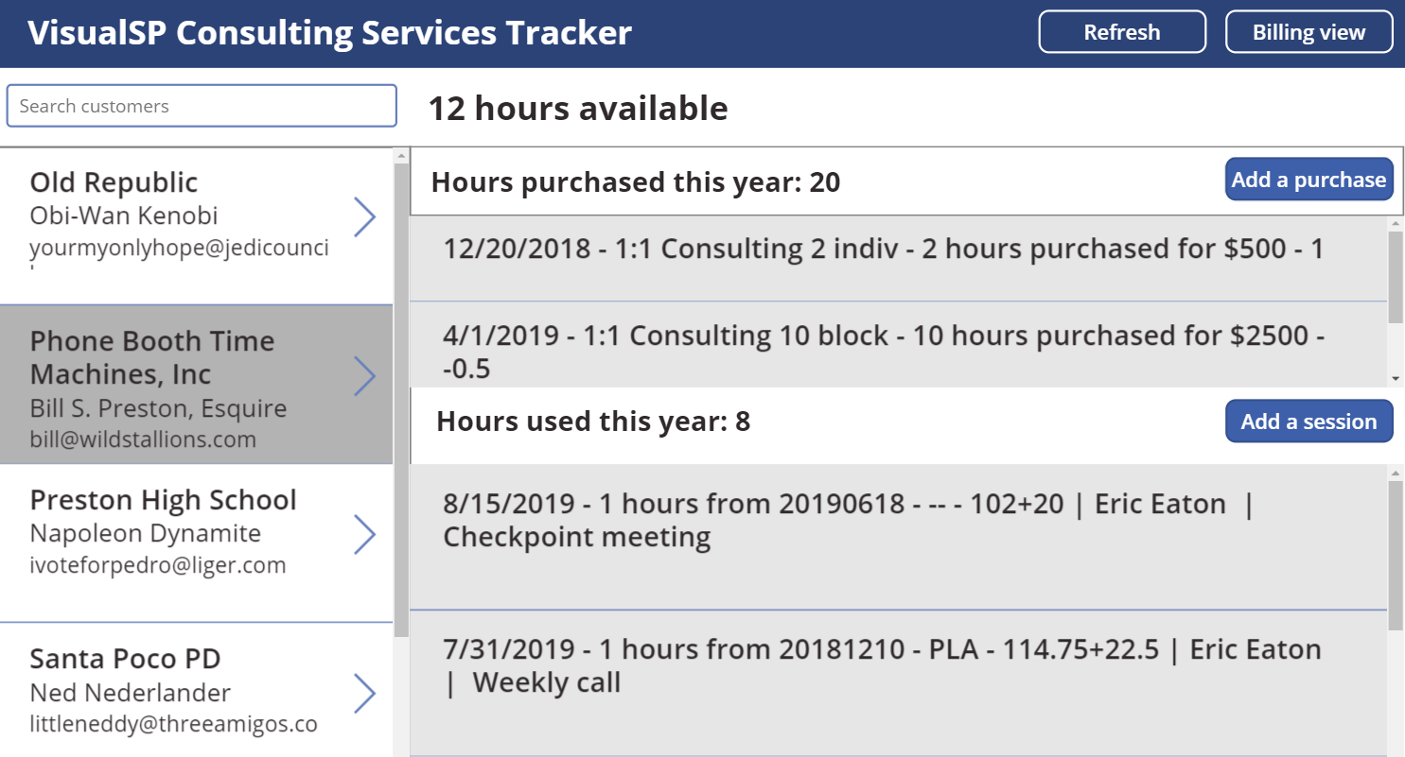
PowerApps

Slide 47
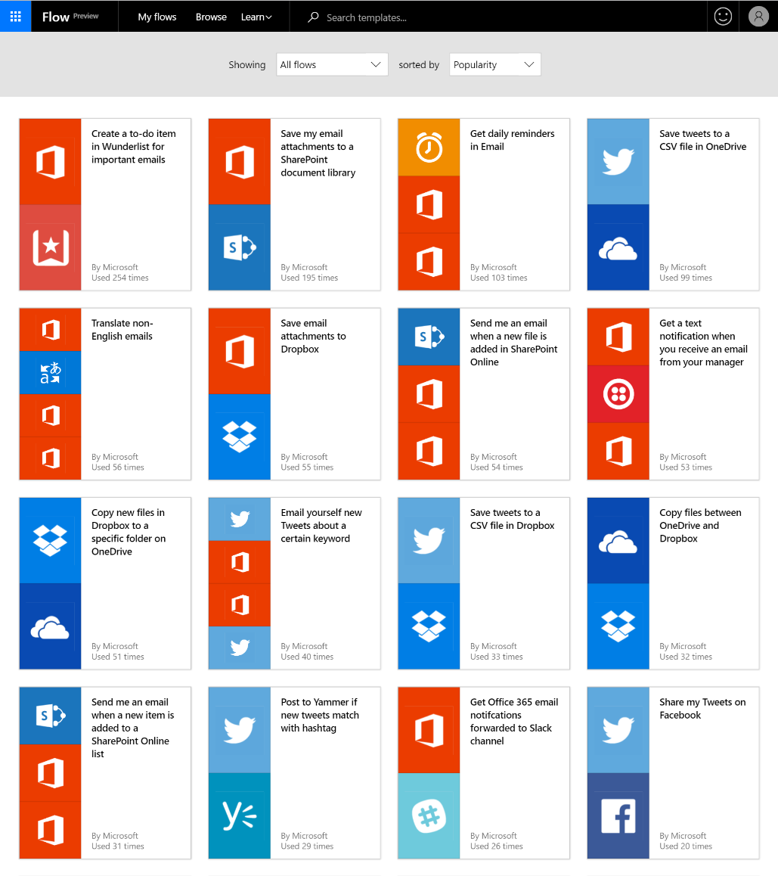
PowerAutomate (Flow)
Notes:
Lots of services supported.

Slide 48
What about Yammer?
Do we need it? Why…?

Slide 49
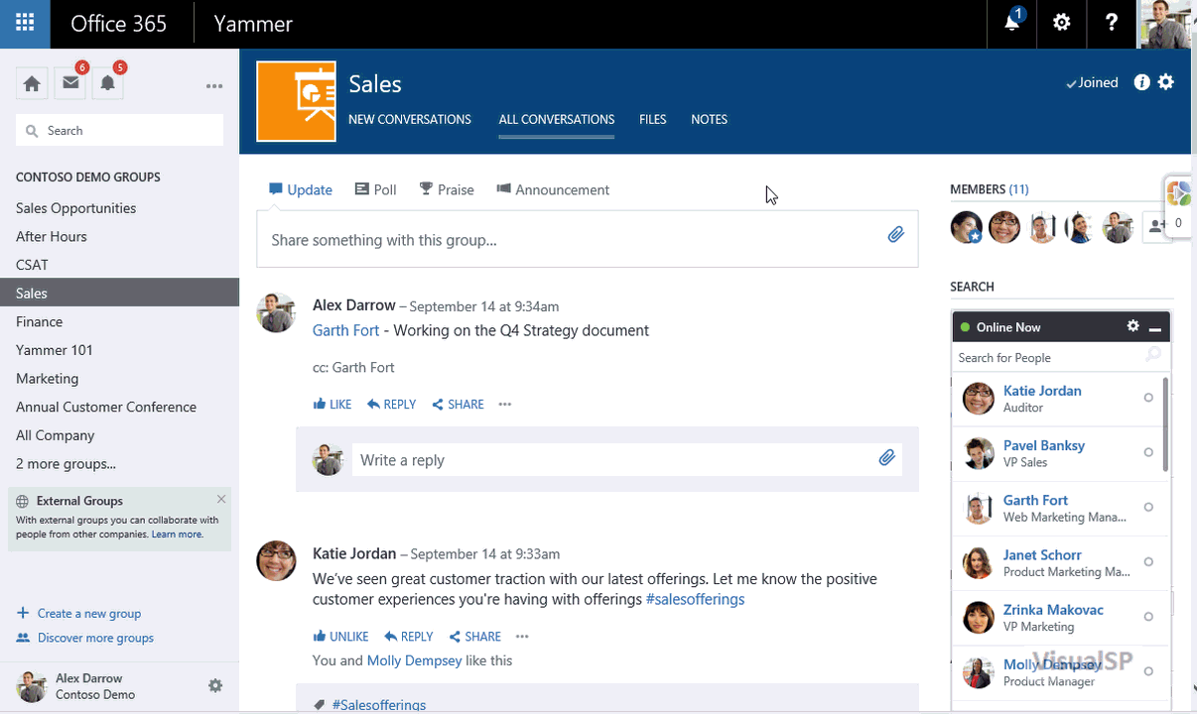
Yammer

Slide 50
Yammer
Enterprise Social. Works great for mid to large size companies – usually > 500 people
Discover connections and people you don’t know through the organization.
Yammer conversations are like forums
Many large companies are using Yammer successfully and loving it!
Definitely overlaps with Teams

Slide 51
Teams vs Yammer
What’s the difference…?
Notes:
Teams – interact with those you know
Yammer – Enterprise connections – those you don’t know

Slide 52
Teams or Yammer ??
Small teams (under 100 ppl)
Medium to Large teams
Teams only
Connecting with people you know
Teams and Yammer
Discovering people who you don’t necessarily know
Caution: avoid redundancy. Use both only if there is a good business use case for it

Slide 53
Requirement: Need simple task management tool for our team

Slide 54
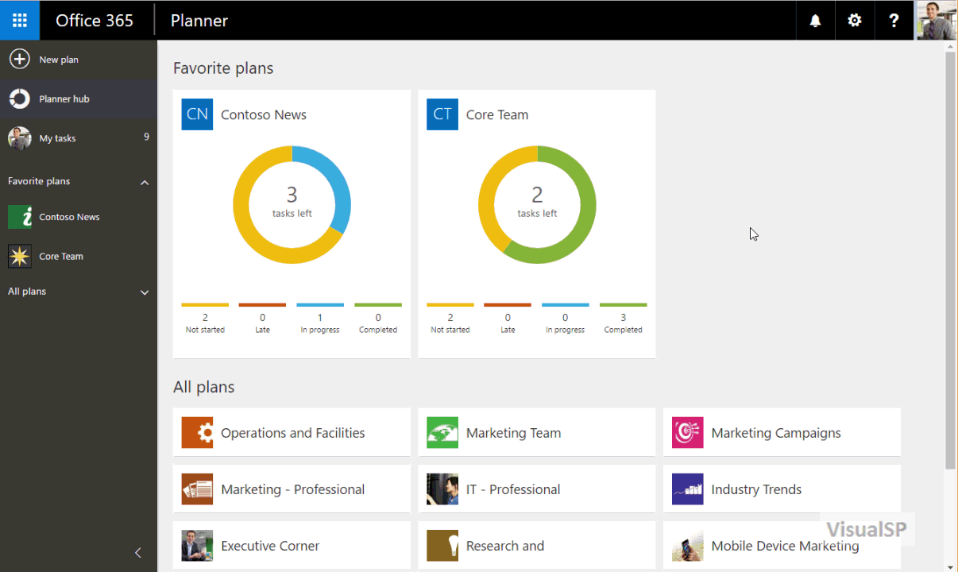
Team task management
Planner hub to see all your boards
Kanban approach to working on tasks
Notes:
Before Planner, we were using OneNote to keep track of our tasks

Slide 55
Requirement: Need a place to store our video demos, meetings, etc.

Slide 56
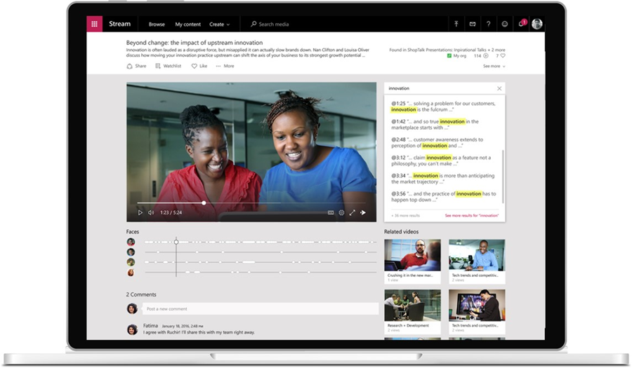
Stream – evolution of Video
Auto Transcription
Face detection
Search & Discovery
Notes:
If you’re starting from scratch, got with Stream instead of the Video portal (which might go away eventually)

Slide 57
The Challenge with info overload is Context not Content
Delve and Discovery view help with that

Slide 58
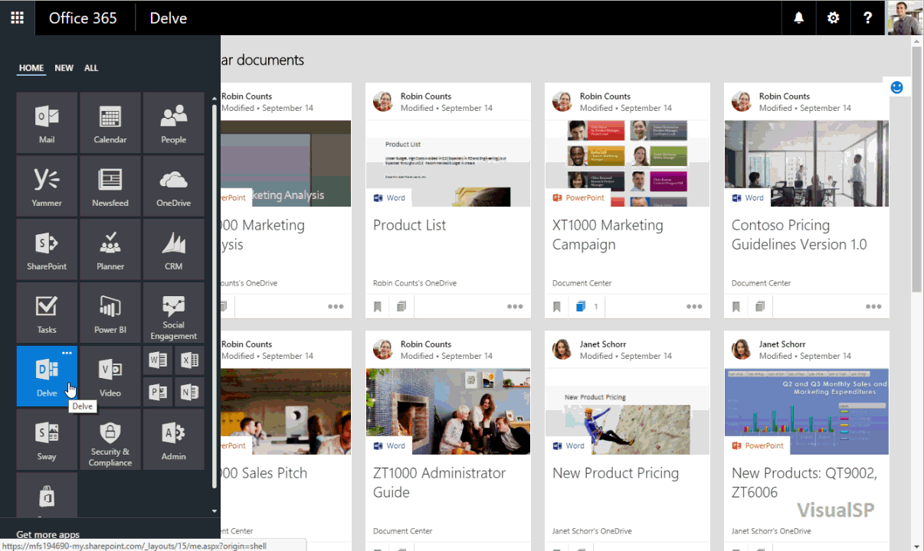
Delve
Notes:
Things that are important to You gets surfaced up to you.
However, be careful not to scare users when they see other people’s data and start wondering ‘why’ they can see it ☺

Slide 59
Employees needed to be educated as to why they were seeing other people’s content
Notes:
When people start seeing information and documents from others, they sometimes freak out and don’t know what’s happening or why they are seeing that info.
User education is needed when they first come to Delve to let people know that it’s ok for them to see what they are seeing.

Slide 60
Requirement: Needed dashboards to surface important data

Slide 61
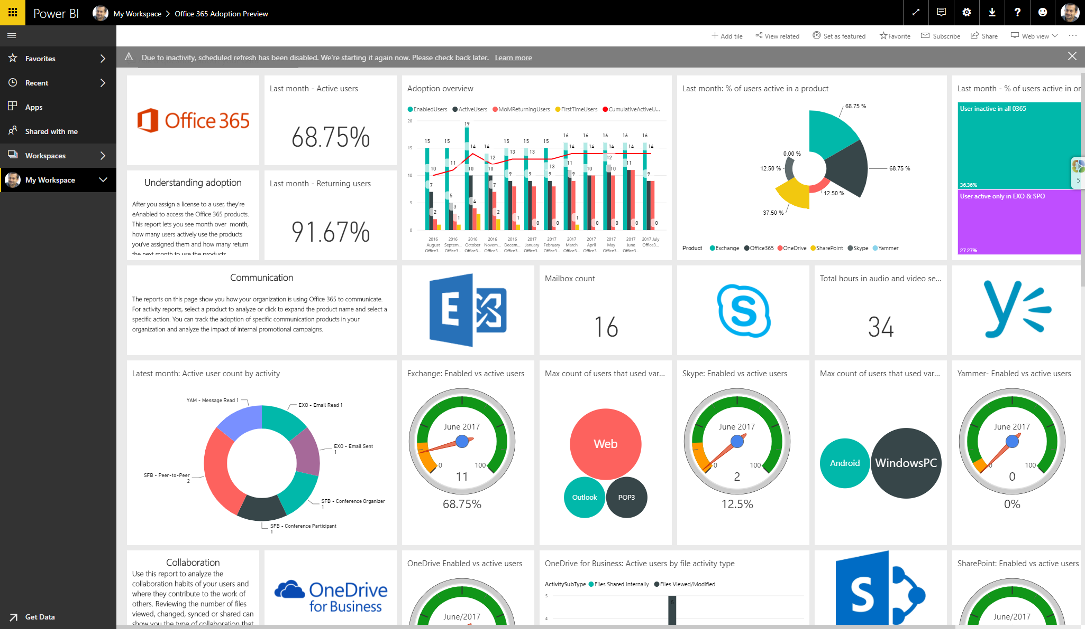
Power BI
Office 365
Adoption dashboard

Slide 62
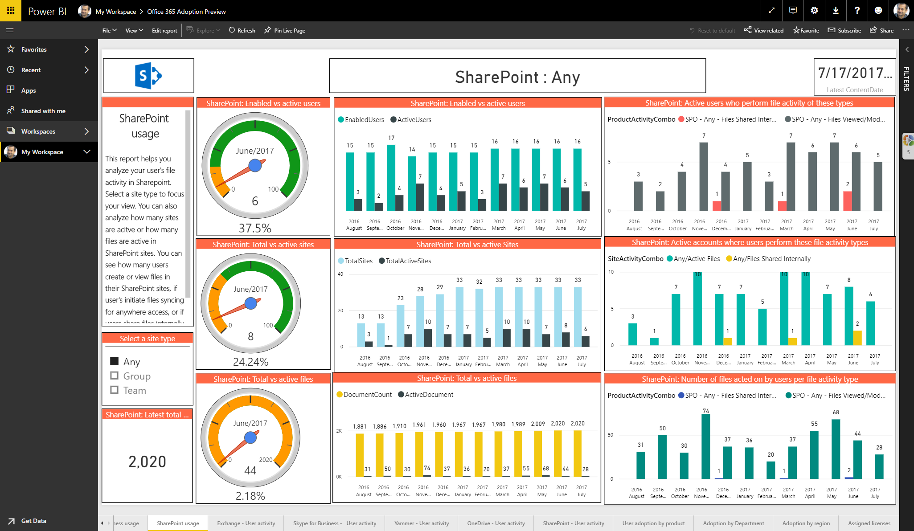
Power BI
Application
statistics
Notes:
Power BI transforms your company's data into rich visuals for you to collect and organize so you can focus on what matters to you.
Templates for various things available such as:
How is Office 365 adoption in my tenant?
What are the sales figures for each office?

Slide 63
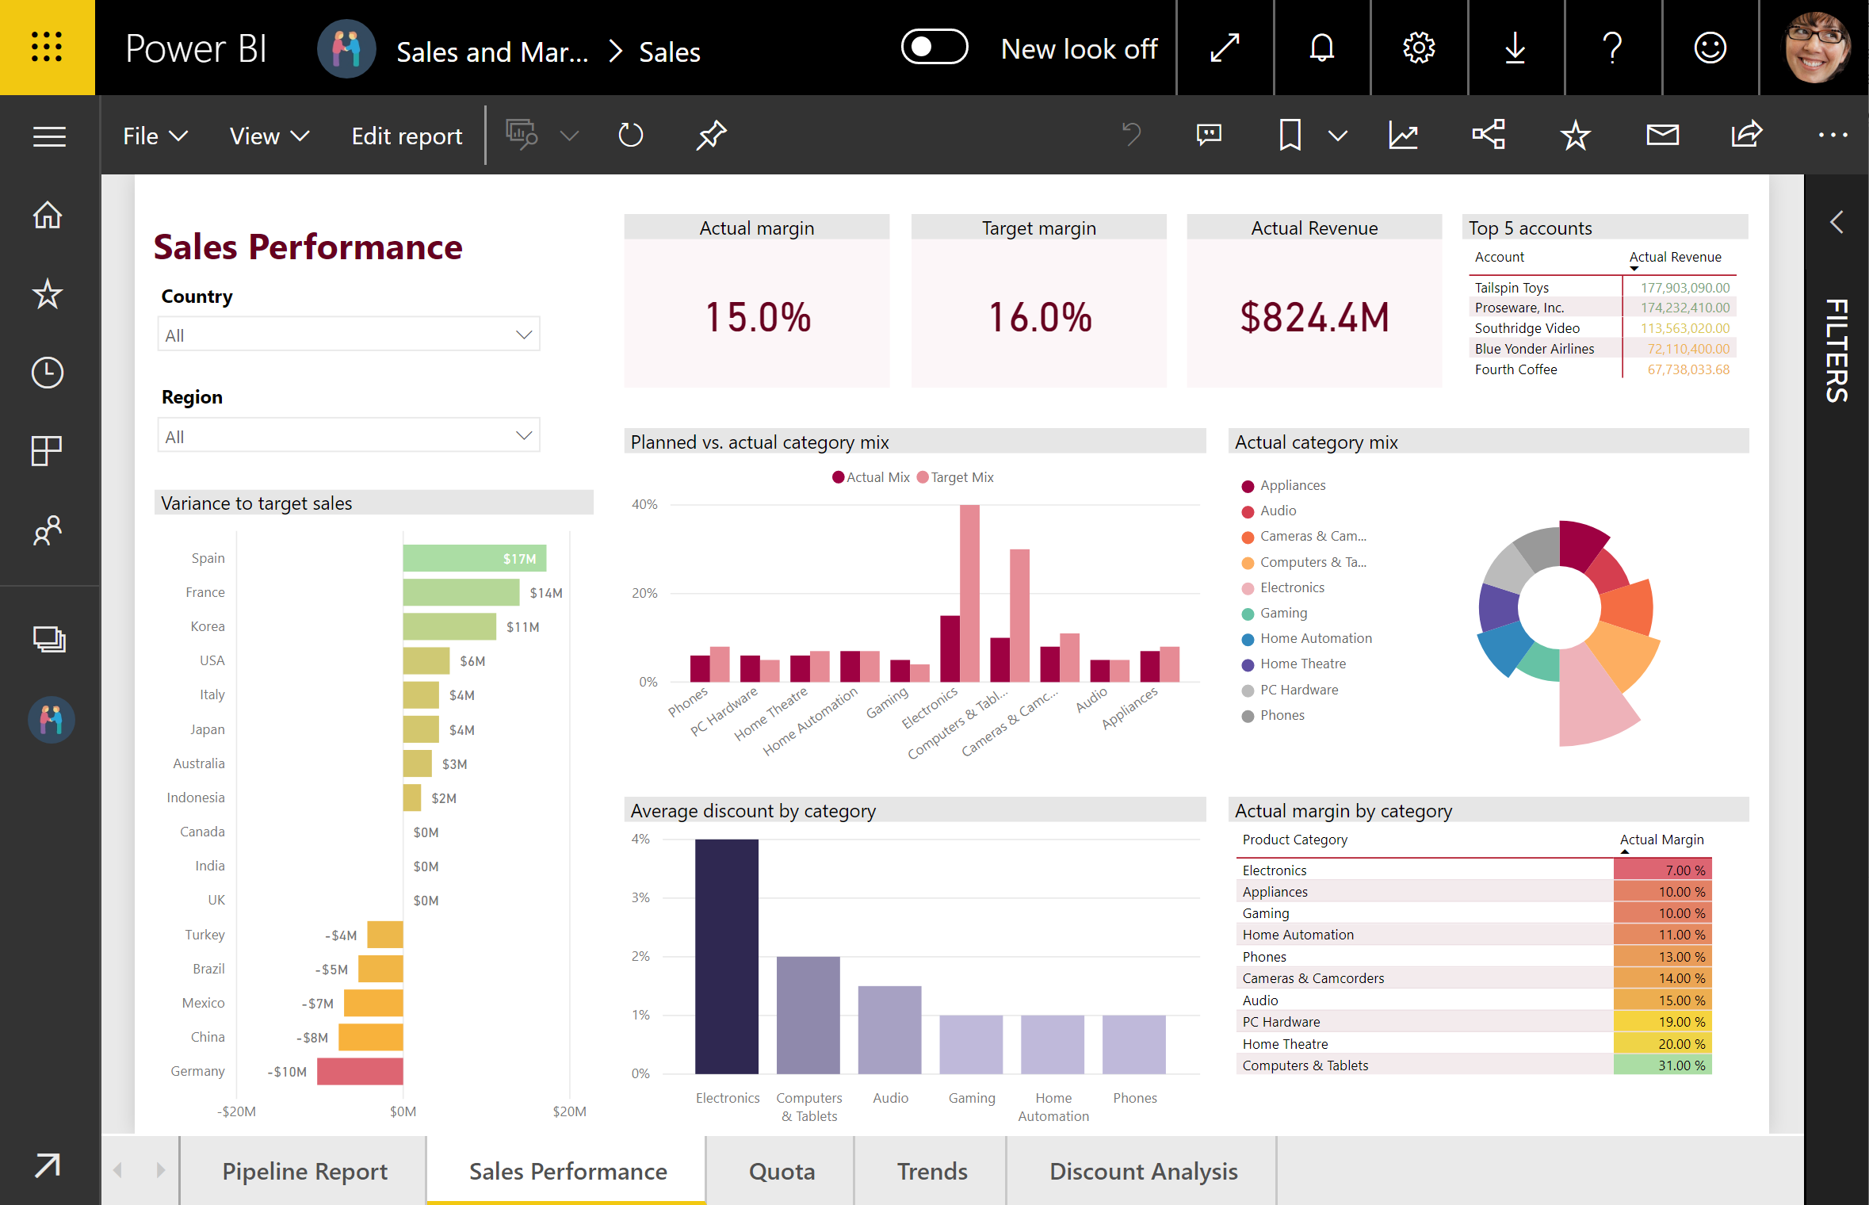
Sales dashboard

Slide 64
Summary
Use only what’s needed
Eliminate redundant systems
Make sure a need exists before using a new process/system

Slide 65
Are you the SharePoint Gal / Guy?
If yes, I have a gift for you!

Slide 66
Come collect your badge of honor
Notes:
You can pick these up from our booth

Slide 67
VisualSP – In-context training for Office 365 users

Slide 68
Next Steps
Download my presentations:
http://bit.ly/AsifConference
Get started free with VisualSP for Microsoft Learning Pathways training:
http://bit.ly/VSP4LP
Come pick up your SharePoint badge of honor and my business card
Reach out to me to talk about your scenarios:
asif@visualsp.com

