Slide 1


ELEVATE
Providers Only
Welcome to Scottsdale, AZ

Slide 2
The Best is Yet to Come
Jeff Bell, CEO
Welcome to Scottsdale, AZ

Slide 3

The State of our Industry and Business

Slide 4
Where We Are Today
After 4 years of membership decline (2010-13), we have had 4 years of growth with 268,000 net additions.
Payments to the LegalShield Provider Network have increased by $1,000,000 per month in the past 3 years.
We have 4 robust channels producing 550,000 memberships this year.

Slide 5



Competition

Slide 6


How Did We Get Here?
Investments for Growth
2014–2017

Slide 7
Retention
From 3.5% Churn to 2.0%
Dedicated Saves Team
Dedicated Outbound Pre-Cancel Calls
Software Investments for
Payments Processing

Slide 8
Software Development
Mobile Application
Snap – Speeding Tickets
Will Questionnaire
Free Legal Forms (Shake Law)
Ask Legal Questions (Erin AI)
Google Home/Amazon Echo

Slide 9
Enhance: Identity
Address Avvo and Become
Yelp! of Legal Services
All law firms are proudly displayed
on legalshield.com
All lawyer profiles are on legalshield.com
Expanding to all referral lawyers in 2018

Slide 10
Elevate Conference
Focus upon edifying the lawyers within the provider and referral network
Providing CLE credits to lawyers within the provider and referral network
Increase the approachability and appeal of joining the LegalShield referral network

Slide 11
Enhance: Insight
10 consecutive months of
improved scores
Expanded NPS Reporting to
individual lawyers and referral lawyers
Customized training based upon
individual lawyer feedback

Slide 12
Investments for Savings
WAN Retirement
Transition to Portal
Reduction in reporting requirements
Creation of Quality Services Department

Slide 13
Investments for Growth: 2014 to 2017
Retention | $7.2 million
Software Development | $1.5 million
NPS and Training | $125,000
Elevate Conference | $250,000
WAN Retirement | $228,000
Total Investment/Savings | $9,303,000

Slide 14
PerCapita vs. Request for Service (45 Mth trend)

Slide 15
PerCapita vs. Request for Service (45 Mth trend)

Slide 16

So Where Does This Leave Us?
  How do we continue to invest & grow to maintain higher payments to you?

Slide 17

2018 Legal Plan Price Increase
  Eliminate Individual Plan
  Drop the 15-day hold on speeding tickets; add power of attorney
  Maintain per capita payments at present level

Slide 18

Cultural Changes for Profitable Growth
Prideful promotion of Benefit 5 work in all marketing and sales presentations
Further opportunity for personal injury representation
Fixed fees for high demand services

Slide 19

Reduce Barriers & Workload
  SNAP will expand to include multi-page documents for submission and review
  QUESTIONNAIRES will expand to include pre-nuptial, divorce and personal bankruptcy
  AUTOMATIC ACTIVATION of legal plan membership
  ONE TOUCH enrollment and payment for retail and employee benefit members

Slide 20
A Simple But Powerful Truth

Slide 21
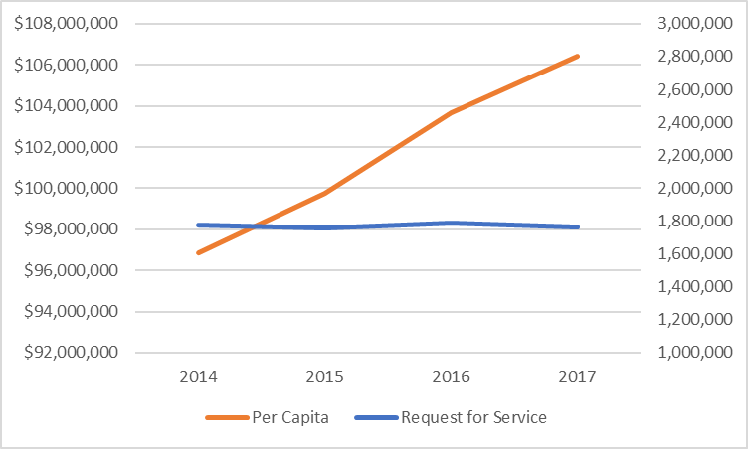
Provider Payments and
Requests for Service

Slide 22
Payment per Request has Grown 10%

Slide 23
Job 1 = Growth
Notes:
2010-2014 there were four consecutive years of declining membership sales. From 2014- 2017 we will have 4 consecutive years of increasing sales.

Slide 24
Trust is the glue of life. It’s the most essential ingredient in effective communication. It’s the foundational principle that holds all relationships.
– STEPHEN R. COVEY

Slide 26
Special Guests
&
New Provider Network Leaders

Slide 27
Enabling Provider Engagement via User Centered Design
Jerred Wilson - VP of Engineering
Notes:
Thank you Introducer (If not Jeff); Thank you for having me and a special shout out to Jack Goldenberg, our Chief Technology Officer, who trusted me to provide an update on our Technology efforts. I want to make sure I DON’T thank whoever scheduled me after Jeff!
I’ll formally introduce myself in a moment, but I’d like to ask a couple of questions. By a show of hands, how many of your firms perform manual conflict checks against members for intakes? And keeping your hands up, how many do the same for dependents? Please keep your hands up if you would you say you get great JOY from doing either? ☺ Promise to show how a user centered approach prevents these types of usability problems AND quantify the impact that not taking a UCD approach has on you!

Slide 28
Introduction – Who is this guy?
Started at LegalShield on 8/28/17
Relocated from DFW (16 years)
Over 20 years in IT, UX, Software and Product Development
Healthcare, Financial Services, Energy, Management & IT Consulting
Led 3 practices (including UX) for a Dallas Consulting Firm for 5 years
High Volume eCommerce - $1.5B jcpenney.com, healthcare staffing, field services
Why LegalShield?
Notes:
Why LS?; Belief in the Mission (teaching life transforming skills and delivering exceptional products and svcs that promote peace of mind), Vision (Equal access to Justice for all), and Values (belief in the good in all people, doing the right thing, clarity to purpose, empowering people’s passions)
LS’s dedication to Agile; best practice; run the company this way; not just IT and Product Development; Receptiveness to a user focused approach including using science to increase adoption of solutions.

Slide 29


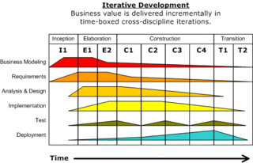
Software Delivery Best Practices
Deliver Iteratively
Manage Requirements
Component-based
Model Visually
Verify Quality
Control Change
User Involvement Early & Often
Notes:
Most modern software development lifecycles share 7 key best practices; whether you are talking about modern Agile processes (include LS’s adoption of Scaled Agile Framework for Enterprise/SAFe) or RUP, etc. Speak about each

Slide 30
Judging Solution Success via Adoption
Most product and software development organizations fail to realize who is judge of the ‘Verify Quality’ notion.
Users will, ultimately, judge the success (or failure) of your solution via adoption
  To be judged positively, you must place the user at the center of your entire process
  The users tasks, at both a business and system level, must be your focus
  You must quantifiably measure the user’s ability to perform these tasks throughout development
  True end users (not just ‘the business’) should evaluate each iteration

Slide 31
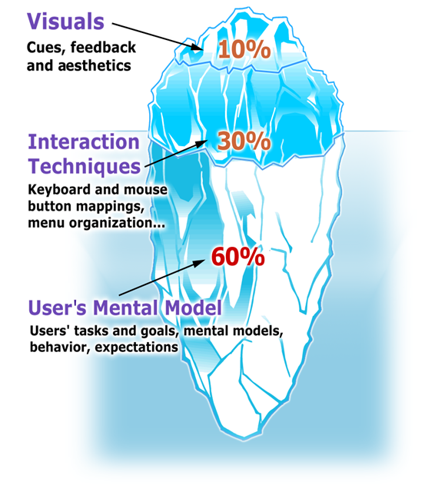
Using Science to Increase Adoption
Obtaining user adoption is much more than a eye-pleasing user interface and the latest interaction controls
Scientific Usability studies show successful user adoption is :
10% visual, including look and feel and other cues to the user
30% interactive, including user interface controls and their specific behavior
60% user (or user group) specific, including how the user organizes their tasks, their individual goals and how they expect the system to work (i.e., the baggage they bring to the table)
Successful software projects get the 60% right too!
Notes:
Transition: So what are some UCD activities we can do to get the 60% right? There are A LOT; focus is key; one of the most valuable and quickest to value is CI.

Slide 32
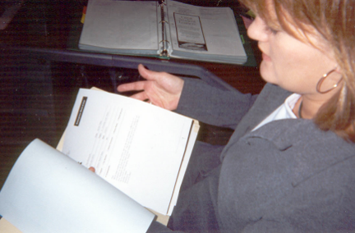
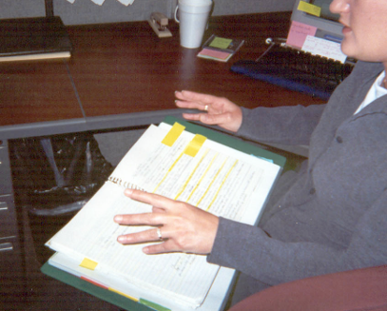
Contextual Inquiry
How It’s Done
An interpretive field research technique for examining users and their workplace, tasks, issues, and preferences. Facilitators use an apprenticeship model to gather detailed information about on-going work in context. Does not use traditional interviewing roles or format.
Deliverable
Task details, process analysis workflow
What is the Value?
Comparatively quick qualitative field research method
Yields a deep understanding of the user, his/her tasks, business logic, and of the users’ work environments and how they impact the way they perform tasks or complete their work
Notes:
Most or

Slide 33

Example 1: Conflict of Interest
Contextual Inquiry – 10/17/17
Riggs Abney – Tulsa, OK
2 UX Analysts (LS FTEs) for 2 hours
Notes:
As we discussed and observed incoming calls, we very quickly noticed the flow of work to the Conflict Clerk. Watch and voice over.

Slide 34
The Impact of a non-UCD Approach
Use Case | Duration
Member Conflict Check | 52 seconds
Dependent Conflict Check | 52 seconds
Total | 1 minute 44 seconds
Time Span | # of Intakes | Time Spent
Monthly | 128,350 (trailing 12 months @ 85%) | 3,708 hours
Yearly | 1,540,200 | 44,495 hours
44,495 hours, even at only $10/hour, costs providers $444,946 annually
Notes:
Approx. 85% of all intakes (>150k/month) involve a second party for which a Conflict Check is required. Over the years, this has become normal practice and hasn’t really been challenged or questions. Simple, isolated capture of the second party name (just not in the comments field) would enable complete automation of both the member and dependent conflict check, reducing these hours to essentially zero.
Stress Conflict ck still happens outside of system we deliver as well for non LS conflicts at the firm

Slide 35
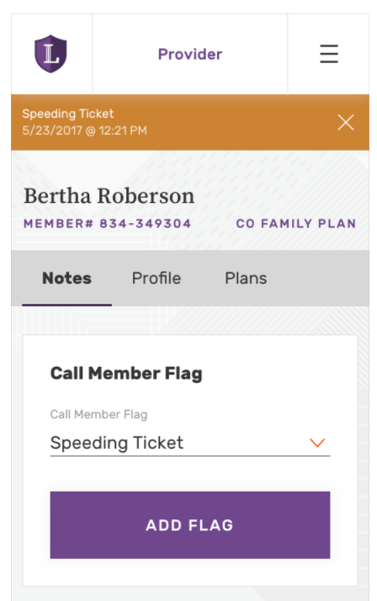
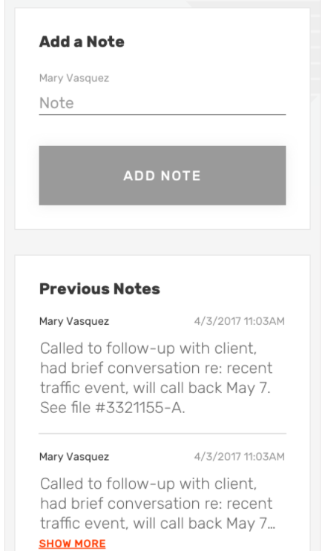
Example 1: Simpler Solution
Capture other party directly
Automatically run conflicts
Better Notifications
Notes:
Most or

Slide 36
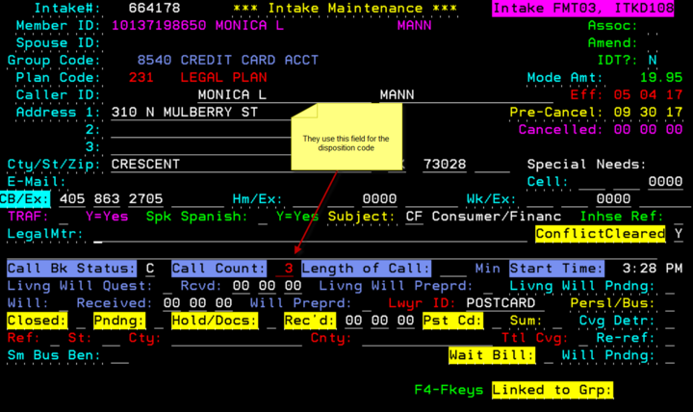
Example 2: Disposition & Call Count Codes
Static list of 50 Choices outside the system
Not context sensitive (error prone)
Notes:
Most or

Slide 37
The UCD Activity Menu
Inception
Map User and Site Goals to
Business and Brand Goals
Elaboration
Exploration of Alternative Models
Construction
Transition
Formative Usability Testing
Contextual Inquiry
Task Analysis
Task Flow Modeling
Card Sorting
Current Solution and Competitor Benchmarking
User Profiles and Personas
Instrumented Surveys
Pluralistic or Cognitive Walkthroughs
Creative Brief Development
Iterative 3x3 Prototype Design
Usability Heuristic Evaluation
Brand Heuristic Evaluation
Iterative 3x3 Prototype Design
Low, Mid and High-Fidelity Prototyping
Iterative Prototype Usability Testing
Brand Integration
Interface Design
Usability Heuristic Evaluation
Brand Heuristic Evaluation
Brand Communication Preference Testing
Iterative Prototype Usability Testing
Pluralistic or Cognitive Walkthroughs
Accessibility Audit and Site Review
with Assistive Technology
Usability Testing with Users with Disabilities
Visual Design
Dynamic and Static Template Development
Style Guides, CSS and Standards Development
Search Engine Optimization
Search Engine Marketing
Field Studies and User Journals
Summative Benchmark Usability Testing
Notes:
Most or

Slide 38
Call to Action
Co-Author Your Solution with us
Support Site Visits
Participate in Usability Testing
Share your concerns and ideas with the Tech Committee
Leverage our new Technology Operating Model driven by Persona
Member
Partner
Channel
People

Slide 40
Wikipedia Award

Slide 41
Ten Point Buck Award

Slide 42
15 Minute Break

Slide 43
Door Prize

Slide 44
Energizer Bunny Award

Slide 45
Enhancing the Provider Experience
Mariam Ballard – Product Director, Enhance

Slide 46
Enhanced Experience
We want Enhance to integrate with the ideal technology to create an easy to use user experience for both members and providers.
Identity (Profiles)
Insight
Elevate
Notes:
- As Jerred mentioned, our focus is to ensure user involvement as we develop new things. This also means considering not only the provider experience, but the member experience and interactions as well.

Slide 47
Identity – Lawyer Profiles

Slide 48
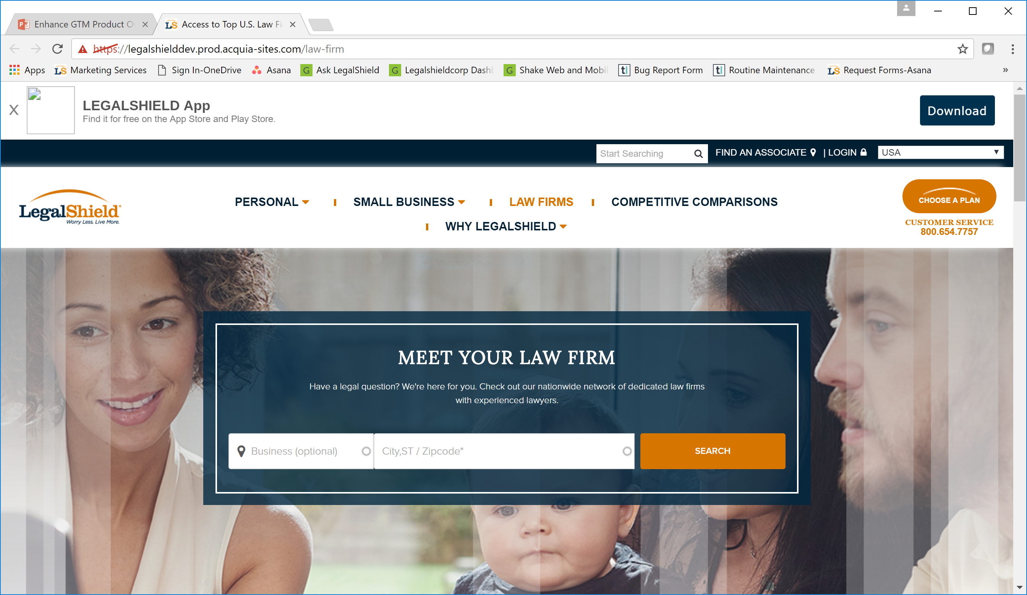
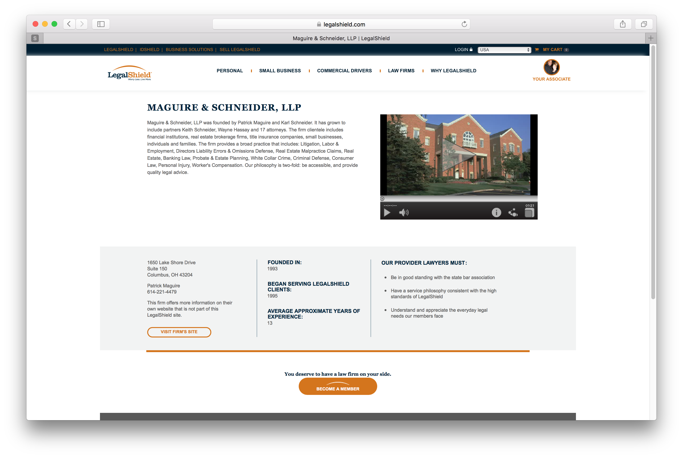
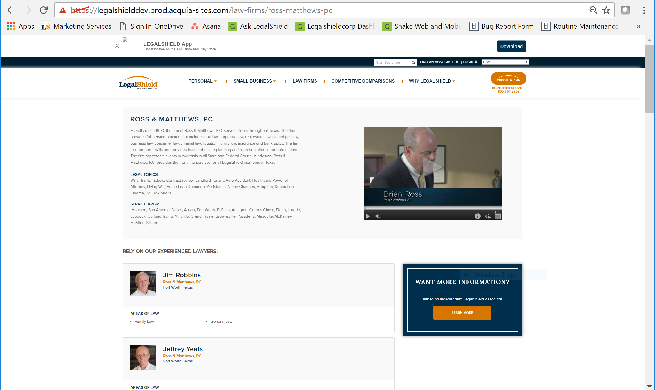
Then…
Notes:
- Our first dive into better connecting the members with our providers, was the launch of law firm and lawyer profile pages on legalshield.com

Slide 49
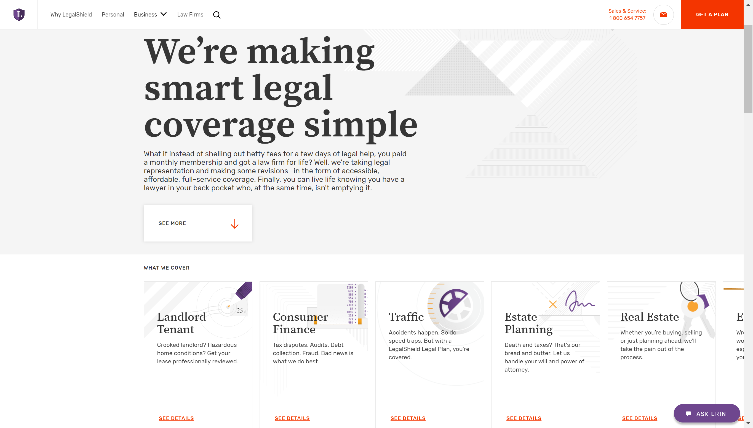
Now…
Notes:
- We learned a lot and we unveiled the new site design in September

Slide 50
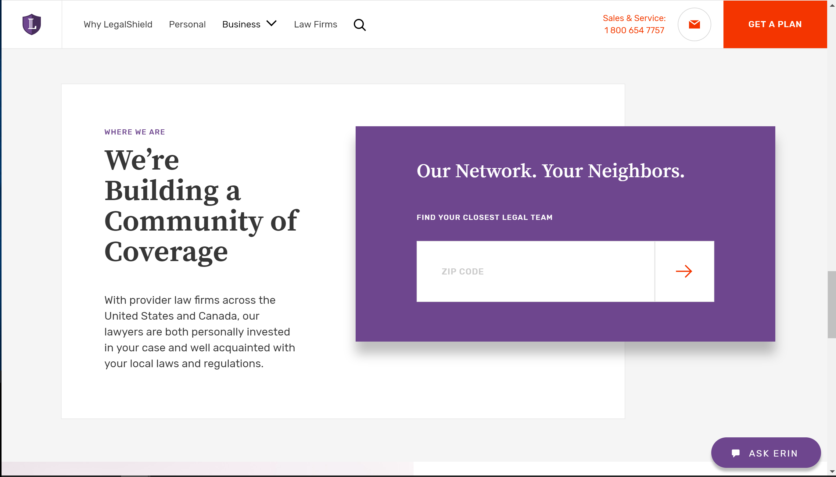
What’s Improved?
Simplified design
Easier navigation
New checkout design
Better mobile compatibility
Messaging is more about benefits

Slide 51
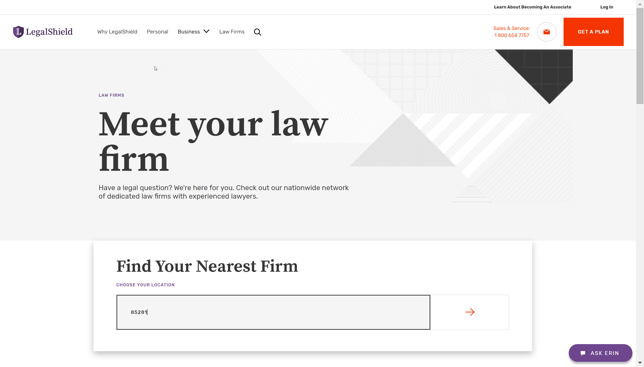
Notes:
- Here’s the overall experience

Slide 52
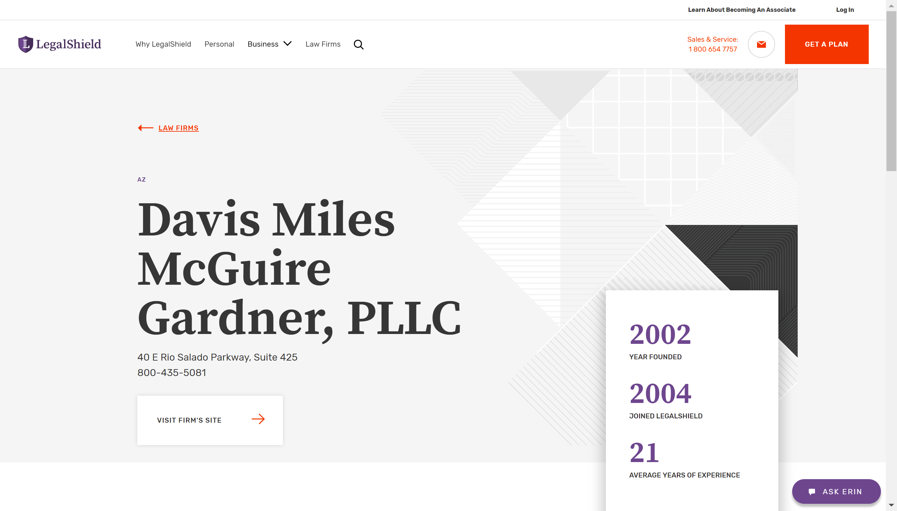

Slide 53
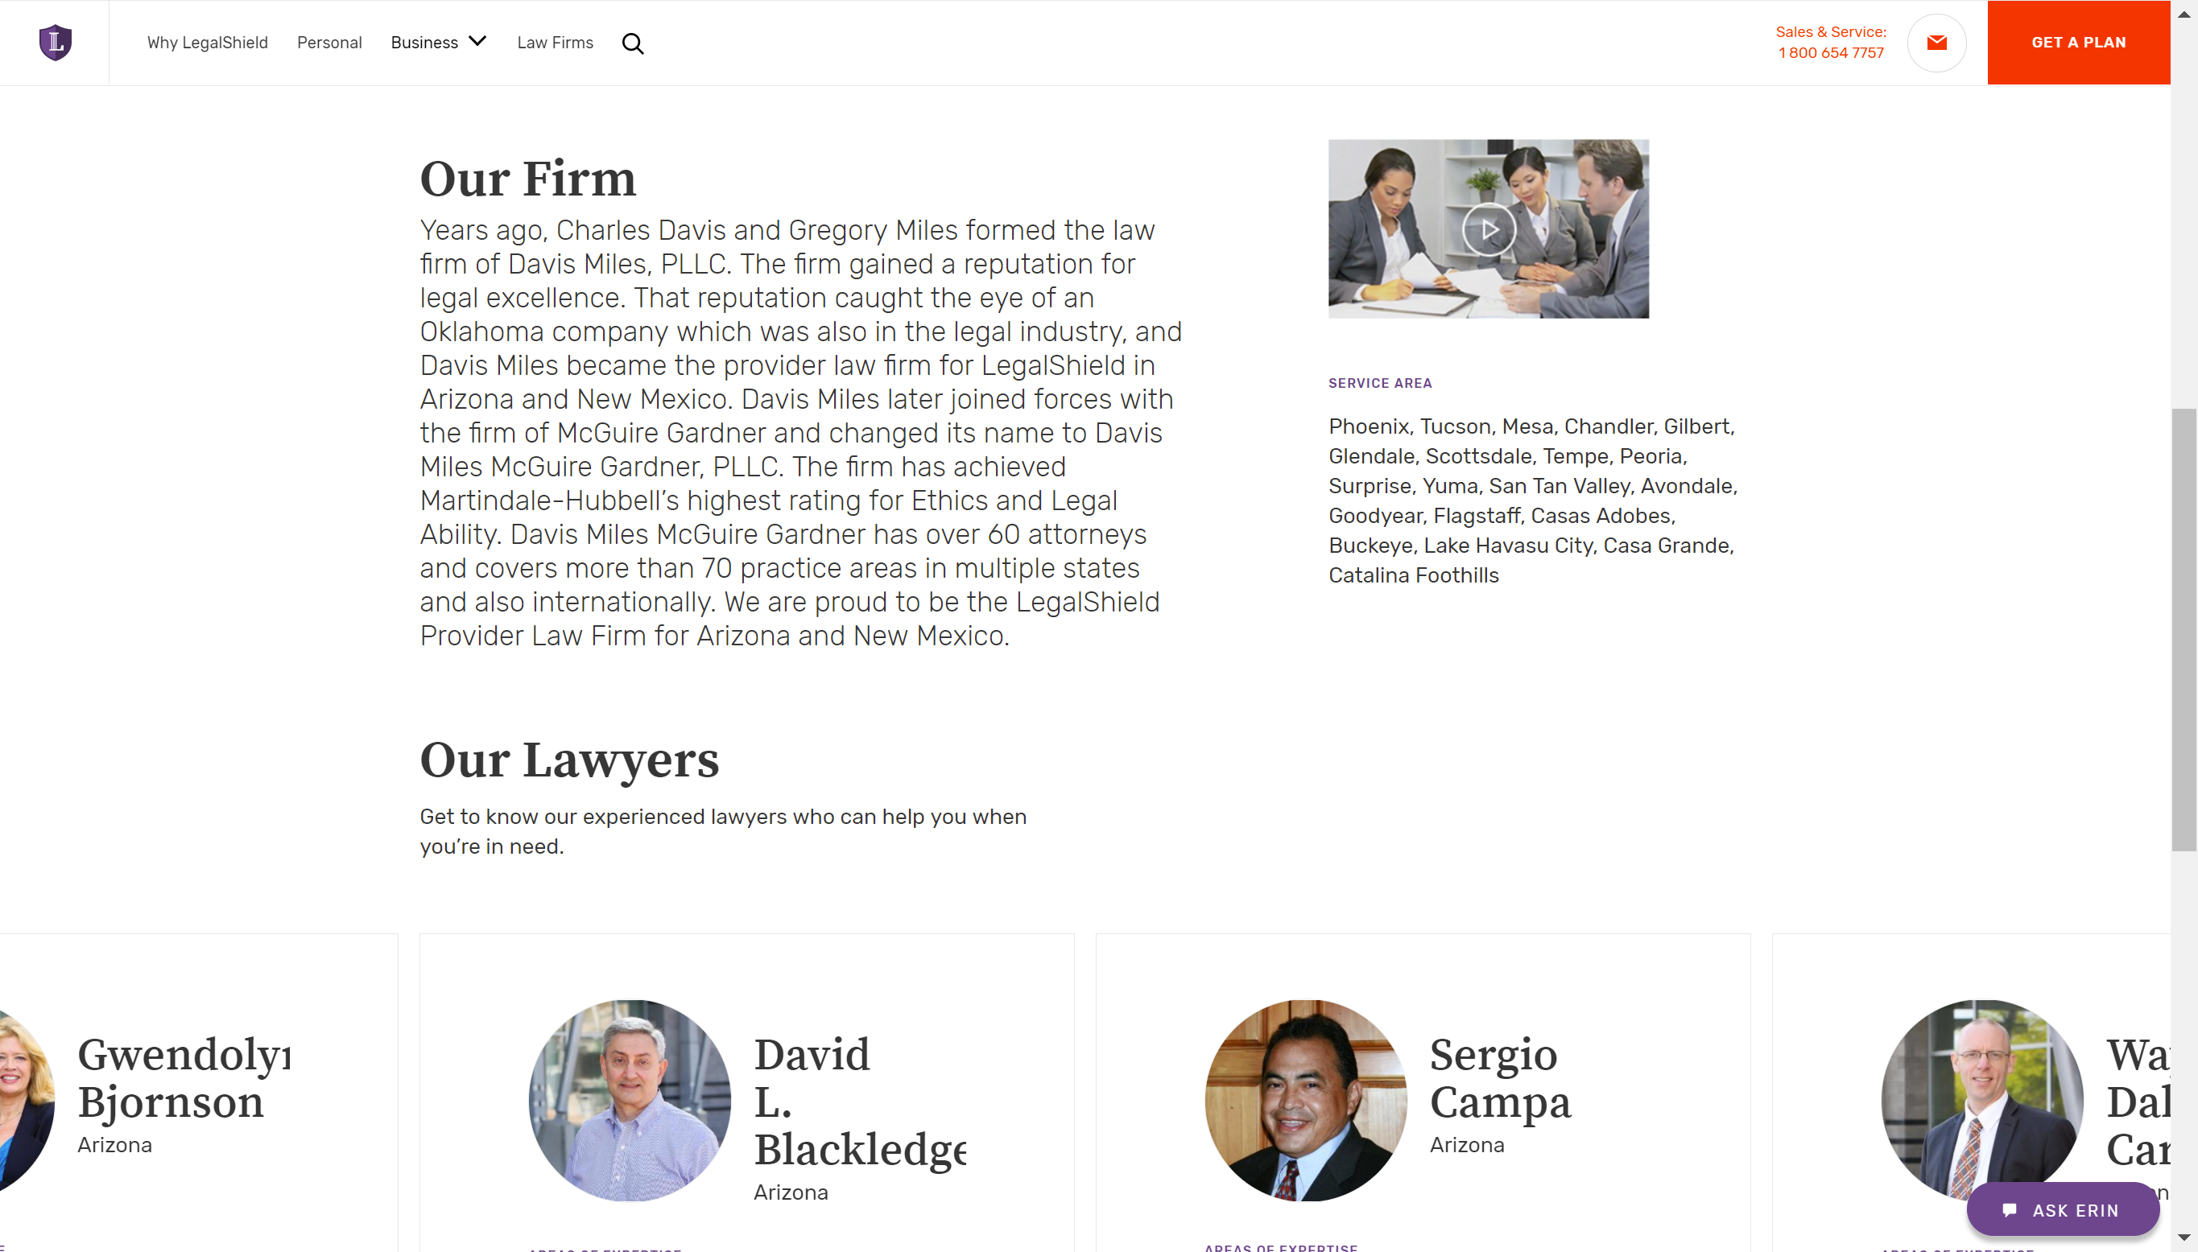

Slide 54
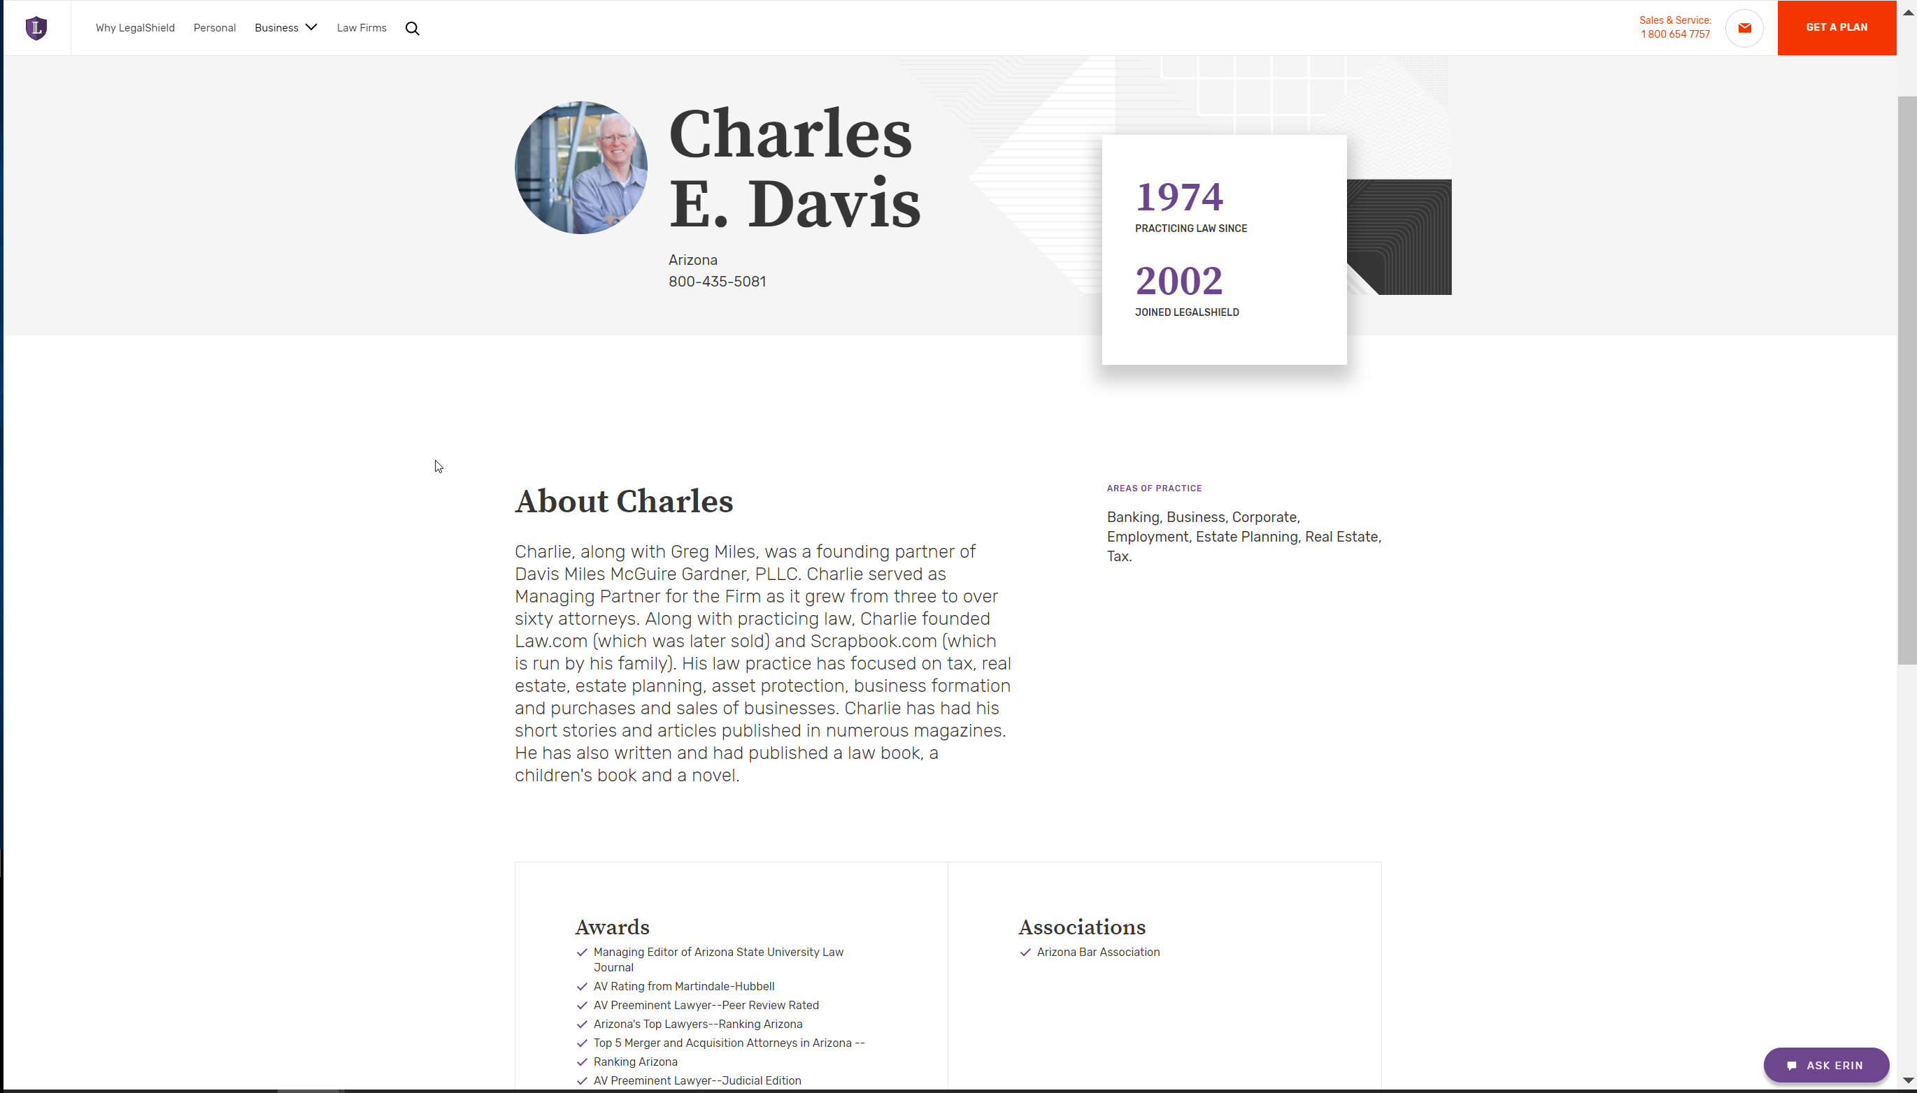

Slide 55
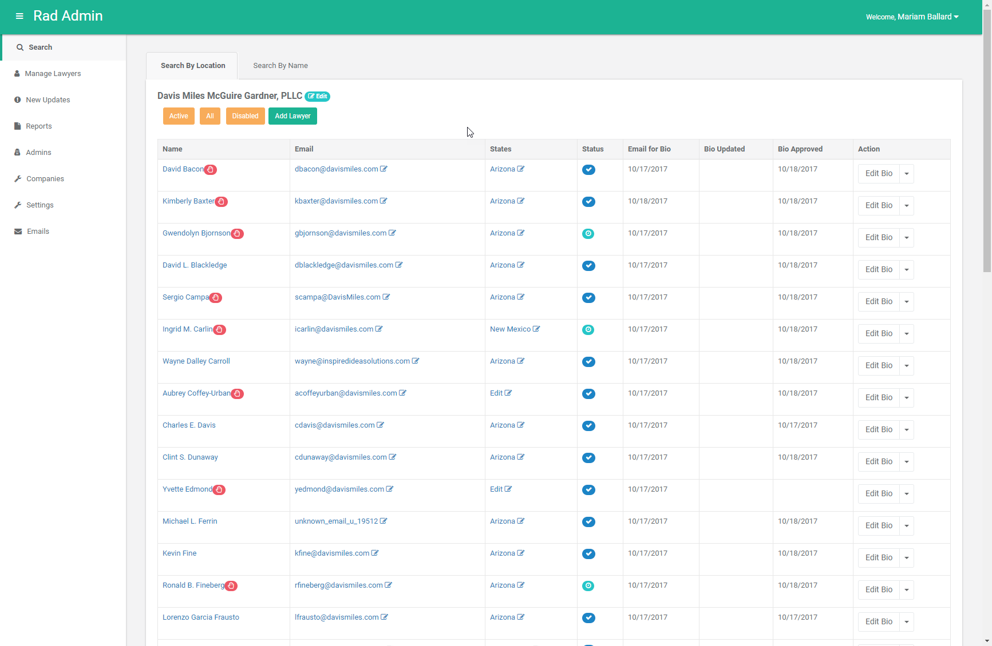
Keeping it Updated
Login: https://www.fairdocument.com/login
Profile edit functionality added to RAD
Notes:
Leveraged RAD, an existing platform = goal was to get user involvement early
And Reduce another system/ tool for providers to learn/ login to

Slide 56
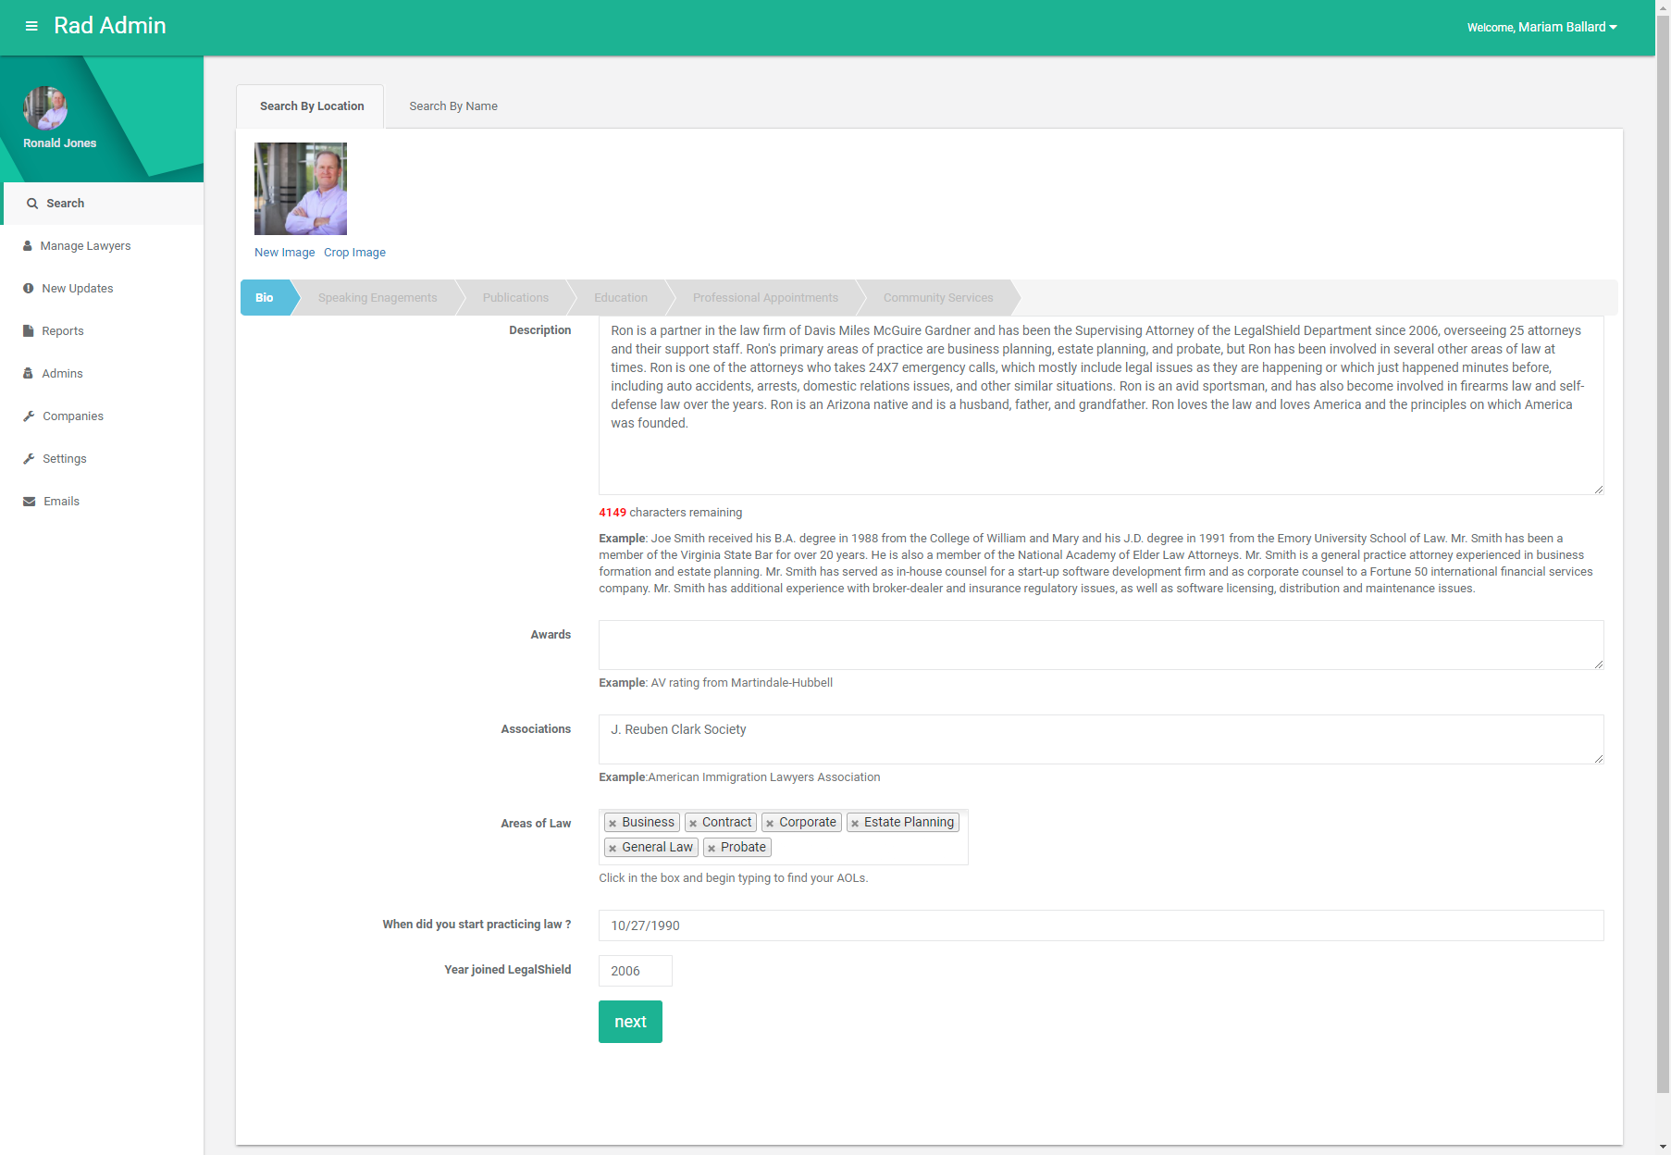
Keeping it Fresh
Monthly reminders
Requests will align with:
  Business Goals
  Changing Market Needs
Notes:
Communications will be streamlined and aligned with business goals and changing market needs
And to ensure content is maintained and current to provide the best SEO results to turn clicks into acquisitions

Slide 57
Identity - What’s Next?
Online App – Referral Lawyers
Lawyer Ratings
Referral Lawyer Profiles
Notes:
Add referral lawyers profiles to legalshield.com
Another way to increase transparency and explain the product benefits
Develop online application for referral lawyers
Adds digital app requirement – eliminating paper and manual processes
Information entered will automatically populate the digital profile in RAD
Goal is to increase lawyers in the network and improve their onboarding experience
Ratings
Will be based on NPS data
Are another way to provide transparency and educate members on the type of service they can expect

Slide 58
Insight

Slide 59
Calculating NPS
% of Promoters - % of Detractors = NPS
Example: 67% Promoters – 16% Detractors = 51
Passives are not calculated into the NPS
Promoters = 9-10 scores
Detractors = 6-0 scores
Notes:
Quick reminder on how NPS is calculated.

Slide 60
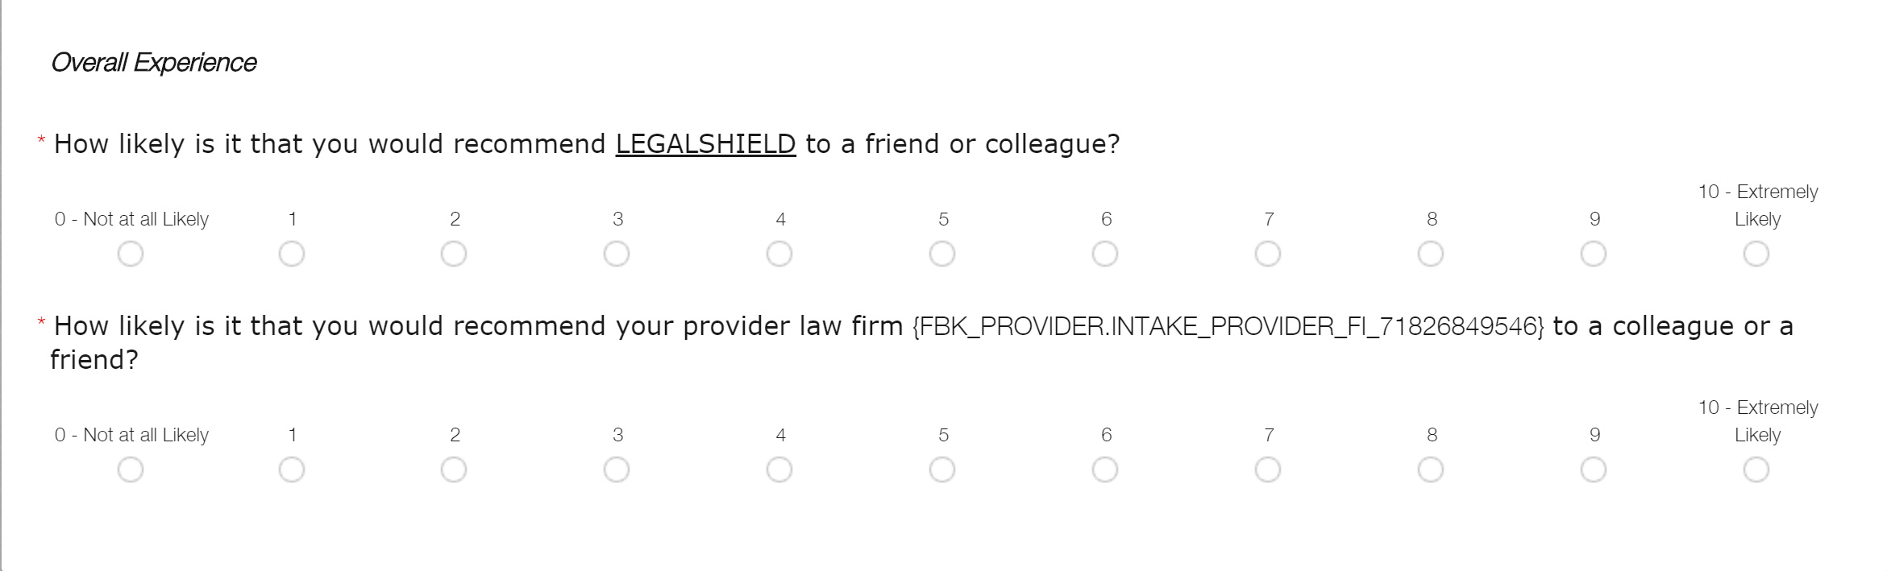
What Tracks LegalShield and Provider NPS?
Notes:
- Data responses to each question are tracked individually to calculate the NPS for LegalShield and Provider

Slide 61
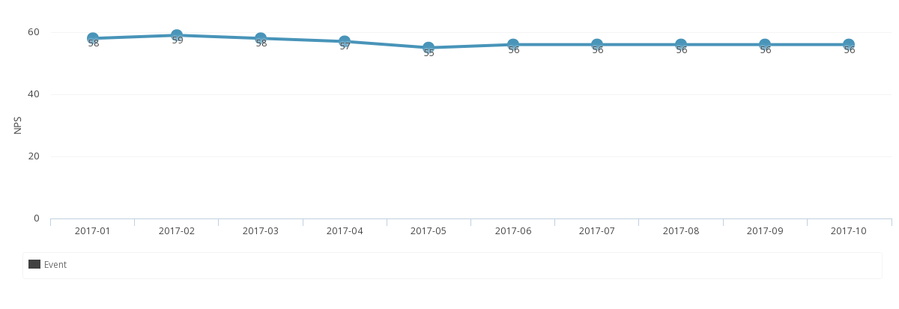
2017 LegalShield: NPS
Key takeaway
2017 NPS = 56
Sept is the 4th consecutive month, LS NPS has been equal to or greater than 2016 scores

Slide 62
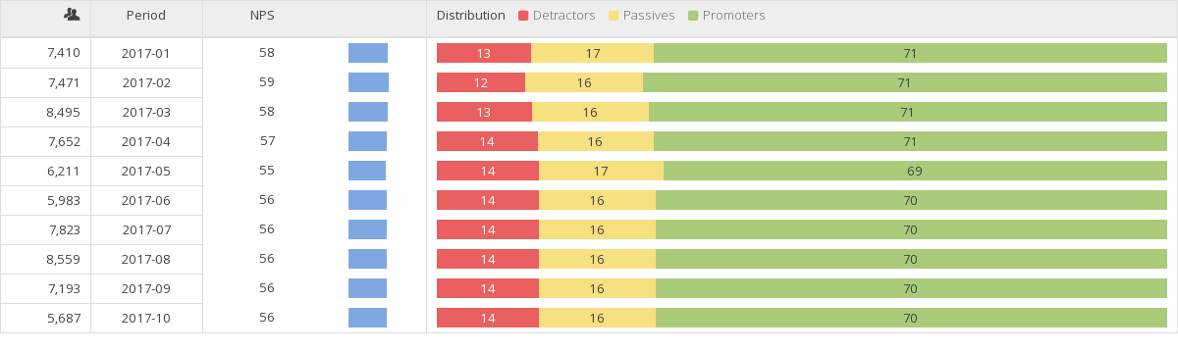
2017 LegalShield:
Score Distributions
Key takeaways
Promoters ≈ 70%
Passives ≈ 16%
Detractors ≈ 14%

Slide 63
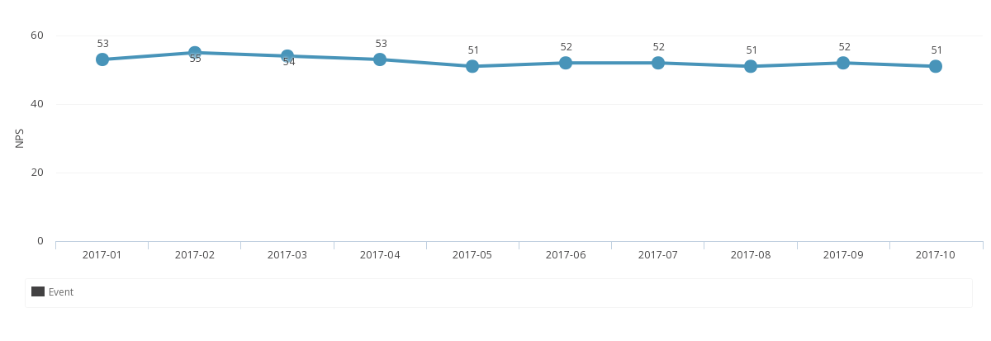
2017 Provider: NPS
Key takeaway
2017 NPS = 52
Sept is the 9th consecutive month, Provider NPS has been equal to or greater than 2016 scores

Slide 64
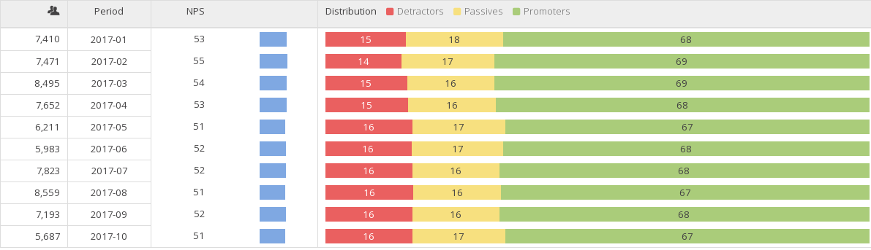
2017 Provider:
Score Distributions
Key takeaways
Promoters ≈ 68%
Passives ≈ 16%
Detractors ≈ 16%

Slide 65
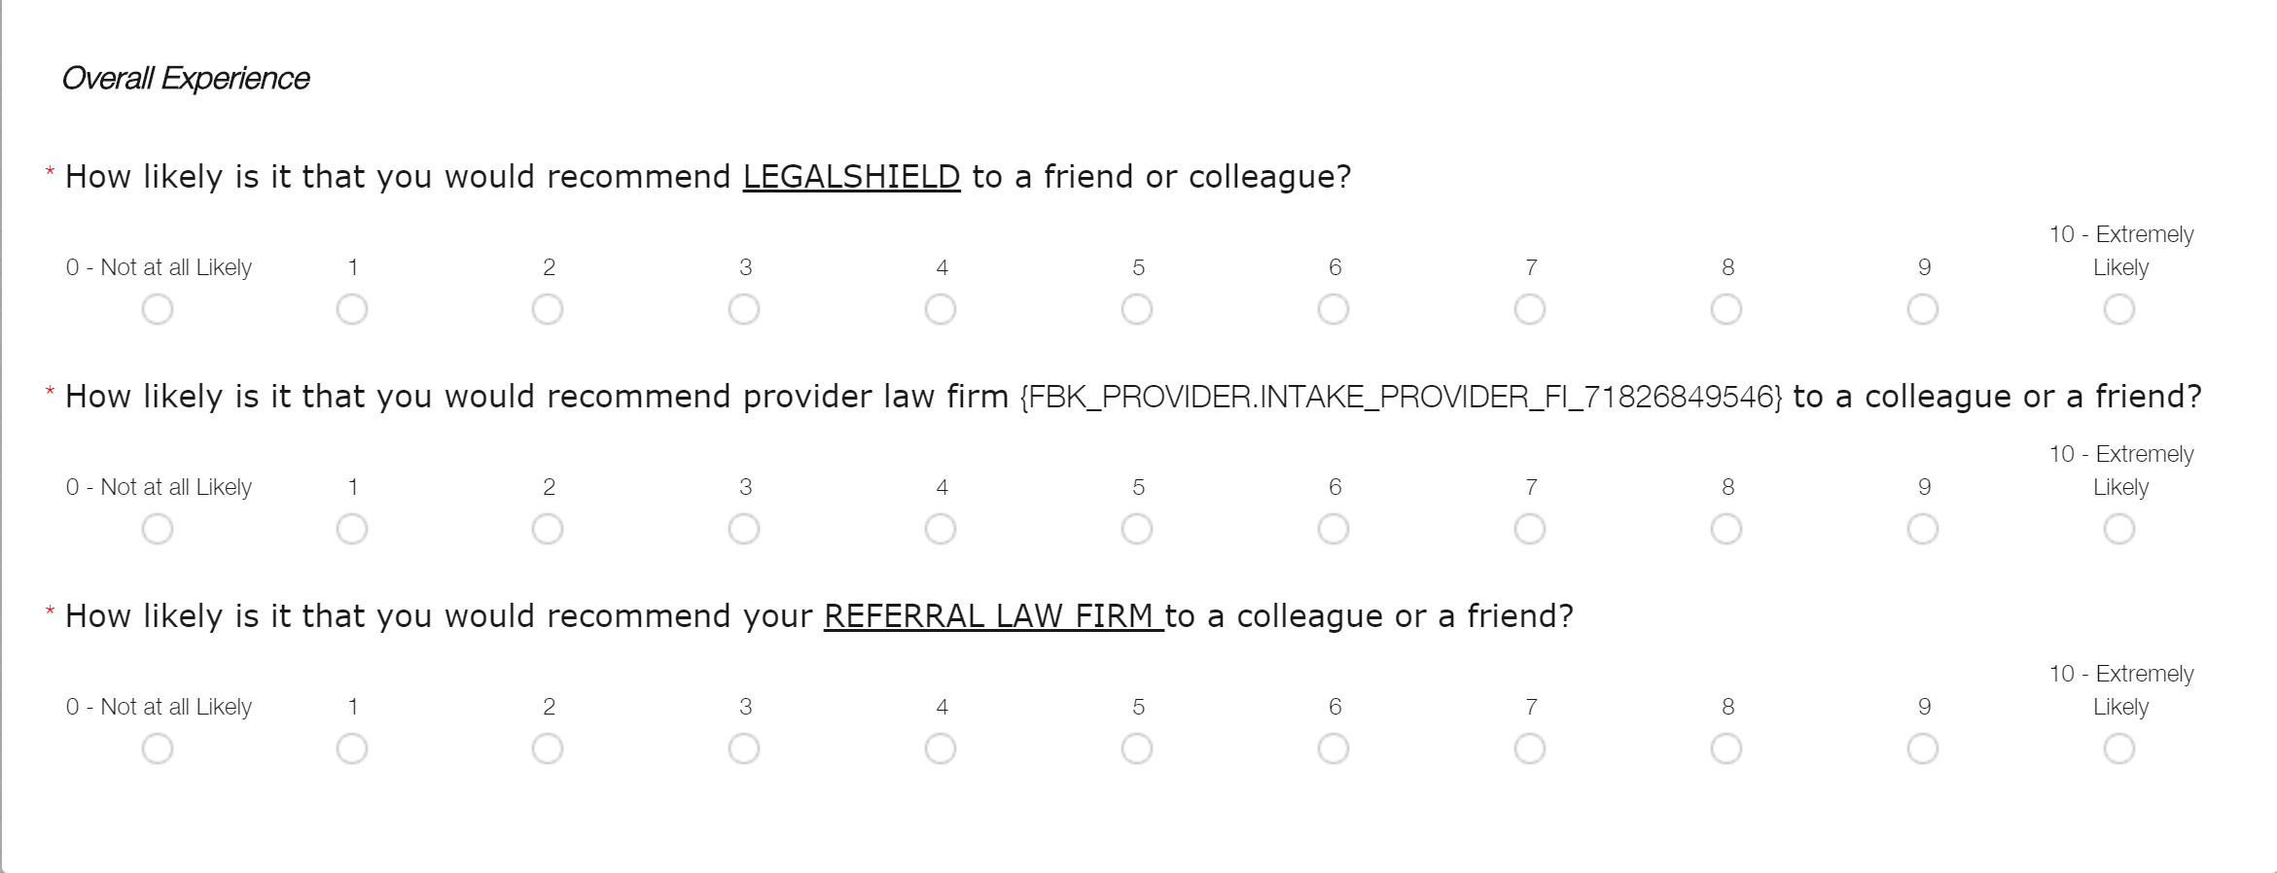
What Tracks Referral NPS?
Notes:
- Data responses to the referral law firm question is tracked individually to calculate the NPS for referral lawyers

Slide 66
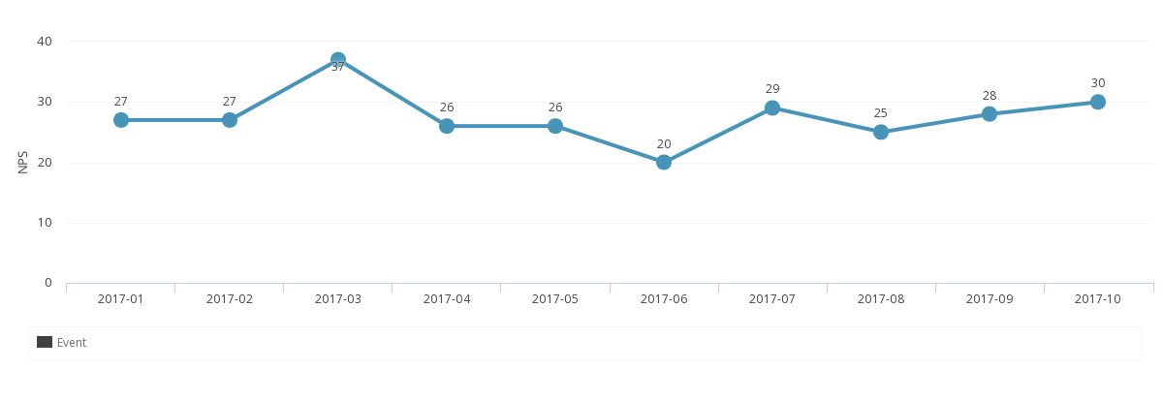
2017 Referral: NPS
Key takeaway
2017 NPS = 27
Sept is the 3rd consecutive month, Provider NPS has been equal to or greater than 2016 scores

Slide 67
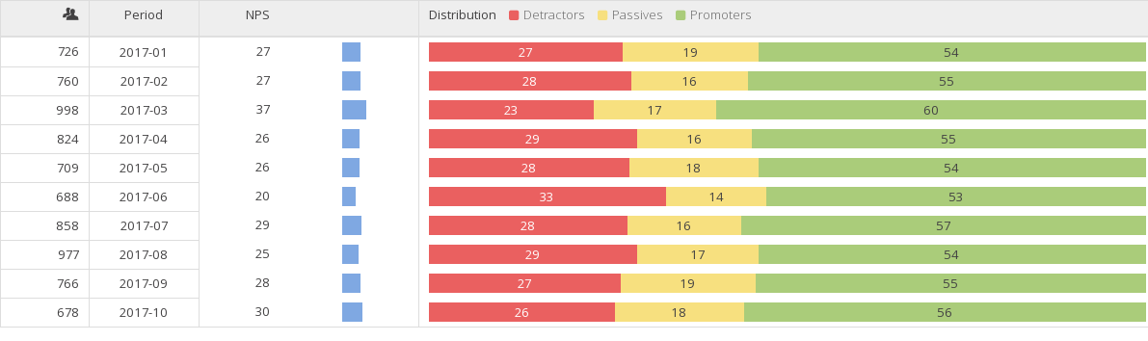
2017 Referral:
Score Distributions
Key takeaways
Promoters ≈ 55%
Passives ≈ 17%
Detractors ≈ 27%

Slide 68
Insight – Courses:
Areas of Emphasis
2016-2017 | Timeliness | Explanation | Update | Listening | Knowledge | Politeness
Total Attorneys | 1542 | 1496 | 751 | 650 | 552 | 292
Total Insight Courses Taken | 4807 | 5273 | 5273 | 5273 | 4807 | 5273
 | 32% | 28% | 14% | 12% | 11% | 6%
 | 60%
Notes:
- This list is a summary from 2016-2017
These are the course categories that are most commonly identified as an area of improvement from surveys
60% are related to timeliness and explanation

Slide 69
Insight – Courses:
Areas for Improvement
New Courses
  New design
  Different mediums
  Reduce length
Learning Management System (LMS) Platform
Notes:
Listening to all of your feedback to improve courses, get them shorter and get more into the LMS
New design is more interactive to provide more visuals and contextual examples
Will be integrating different mediums with not only slides, but also videos
All courses will be anywhere from 5-8 minutes long
We will be asking for you, our providers, to help create courses, film them and share them. You know best what works. And what doesn't.
Evaluating options for an LMS that will support our vision to grow and scale

Slide 70
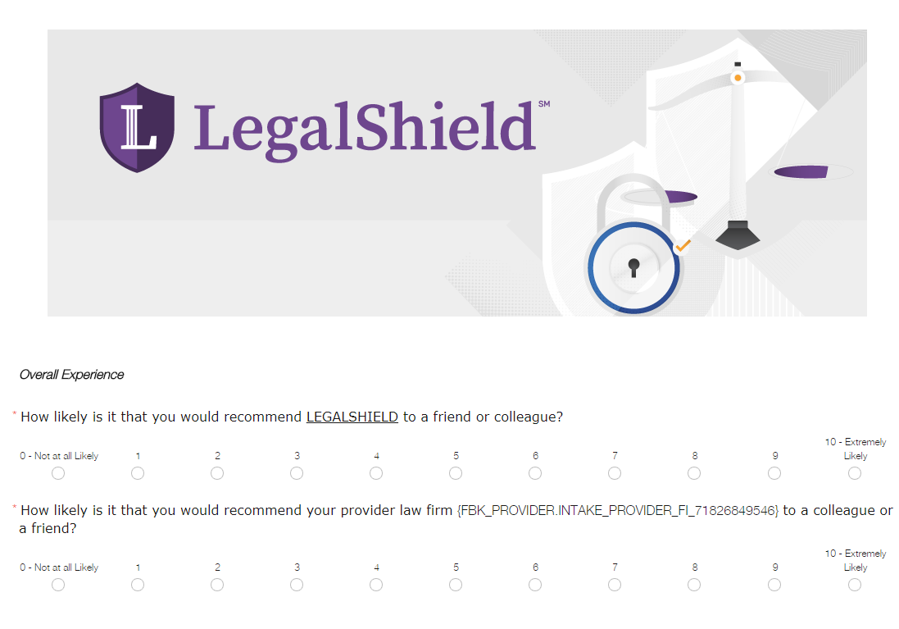
Insight – NPS Survey:
Improvements
Implement tests
Consistent survey audits
Notes:
Currently, working on plans to test different survey designs that will better engage members
Identify question biases to improve survey design/ copy
All efforts are to reduce barriers that prevent members from submitting a survey

Slide 71
Insight – Associates:
Areas for Improvement
Associate Retention Improvement Program (ARIP)
  Impact on Benefit Expectations & Benefits Consistency
  Monitor NPS and comments from members
Notes:
ARIP will go live in Q4
We monitored and saw that with new members - high cancellation is correlated with high levels of complaints in the first 6 months.
Upon investigation this is largely due to poor explanation of the membership or worse yet, misrepresentation of the membership.
The surveys also track the customer sentiment and comments related to this through the following questions:
Did your LegalShield benefits meet your expectations? (Benefits Expectations)
Are you satisfied that the explanation of your benefits was consistent with your recent experience? (Benefits Consistency)

Slide 72
Insight – Operations:
Areas for Improvement
Voice of the Customer
  Improve operational procedures
  Streamline processes
  Build Better Products
Notes:
Constantly listening to the voice of the customer comments
Identify ways to improve operational processes and procedures
Helps us build better products

Slide 73
Insight - What’s Next?
Expand to Referral Lawyers
LMS Platform
Improve Courses
Notes:
- LMS – investigating new platforms to improve the experience

Slide 74
Elevate

Slide 75
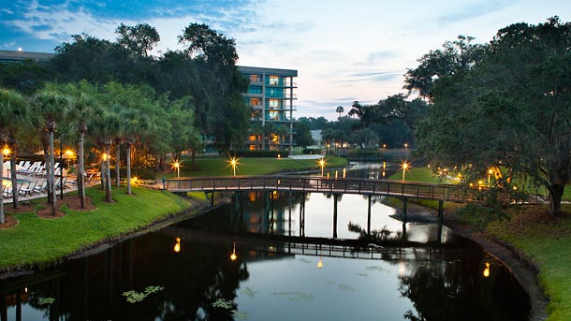
Elevate 2018
  June 28-30, 2018
  Sawgrass Marriott Golf Resort & Spa
  Ponte Vedra Beach, Florida

Slide 76

Elevate 2018
  Early Bird Rate = $99!
    Ends October 31st
  https://elevate2018.eventbrite.com

Slide 77
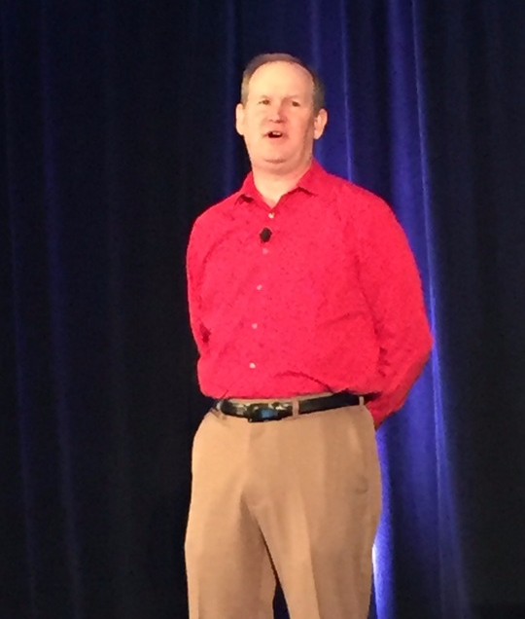
Elevate 2018
  CLE Speakers
    Entries due December 8th
    Speakers announced by December 20th
  https://elevate2018.eventbrite.com

Slide 78
Elevate 2018: Speaker Topics
Topics of Interest
  Increase focus on topics relevant for B1 attorneys
  Federal law surrounding consumer issues
Notes:
Trending topics in the legal industry
Technology in the legal industry today

Slide 79
Elevate 2018: Incentives
B1 Attorney Attendees
  Training/ development opportunity
  Reward for performance
Top Attendance
  Firm with the highest percentage of firm and referral lawyer attendance will be specially recognized
  Firm will receive a suite upgrade at no cost to them for the March International Convention

Slide 80
Enhance Features | Provider | Referral
IDENTITY
Lawyer “Back Office” (Replaces AS400) Client Intake Management Document Management Enhanced Referral Management Collaboration Platforms | a | a
Profile Management | a | a
Web presence/ SEO Management | a | a
Lawyer Profile Page | a | a
Law Firm Landing Page | a
INSIGHT
Customized Training Program | a | a
NPS Rating | a | a
Newsletters | a | a
Online Badge | a | a
Eventbrite Event Support | a
ELEVATE
Conference – focused on CLE and trending legal industry topics | a | a
BLACK – Existing | BLUE – In Progress | ORANGE – In Discovery
Notes:
So here’s a product feature overview for Enhance and what we envision

Slide 81

Man improves himself as he follows his path; if he stands still, waiting to improve before he makes a decision, he'll never move.
-- Paulo Coelho
Notes:
-

Slide 83
Carpe Diem Award

Slide 84
Duct Tape Award

Slide 85
Customer Service & Setting Expectations
Jeannie Forneris - Sr. Director Quality Services

Slide 86
Quality Customer Service
It’s the heart of what we do.
It’s necessary to maintain and improve retention rates.
It is what sets you and your practice apart from your competitors.

Slide 87
Good News
You are doing many things really well!
Ratio of complaints to requests for service across the network is just 0.83%.
Our NPS score is 56! That is above all industry averages other than department/specialty stores.

Slide 88
We Are Going Higher
Always room for improvement
To achieve Vision 20/20 we have to look at where we are, where we are going and how can we get there.
We are already the innovator in this space, how can we be even more innovative?

Slide 89
Explain the Process
example
A member calls in with a warranty issue of $700. During the consultation, express to the member what options are available. For example, you offer to send a letter on their behalf. Explain that process (draft & copy to be sent to them must be requested, etc.) and what happens after the letter is sent. What if the other party doesn’t comply? Will you negotiate on their behalf? How will you keep them updated?
Many of our members are not savvy on how the legal system works. They do not understand, are intimidated and emotional. When they are speaking about their legal issue, we need to make sure that we are actively listening and communicating to them in a way that they understand the process for dealing with their legal issue.
Notes:
After going through the example, go through the basic list of how this scenario works. $700 issue, would ultimately be a small claims court issue which does not allow for legal representation. So we need to tell the member a quick rundown of how this works, “This issue qualifies as a small claims issue. Our first step could be to send a letter to the opposing party on your behalf. We will send an authorization letter for the details and you will indicate on that letter if you want to see a draft of the letter before it is sent, if you want to receive a copy of that letter as well as notify the firm if you want to send that letter certified, which will result in a fee for the mailing. We will notify you if and when receive a response to the letter. If you would like an update regarding this situation, you will need to contact the law firm. If we receive a satisfactory response the issue is resolved. If not, your next option would be to file in small claims court. Small claims court does not allow representation at the hearing, but if you choose to receive assistance in preparing for court, you can do so at the 25% discounted rate.”

Slide 90
What Can We Do Better
Many member complaints originate from the member not understanding the process that relates to their legal situation.
During consultation, we need to be listening to the member and making sure we understand what resolution they are hoping to achieve.
Once we understand that, we need to take them through the steps that may be necessary to reach their desired outcome, even if it is likely that the only true resolution will occur at the 25% discounted rate.
Helping them see the entire picture from the beginning versus piece milling the services at each step will ease frustration and misunderstanding. In essence, teach the member how to use the membership.

Slide 91
“For anything not otherwise covered, you are entitled to a 25% discount.”
example
A member purchases a small business plan and a family legal plan. The member is named in a legal situation, related to their business, but as an individual resulting in no coverage per the contract. How do we help the member? We offer the member a 25% discount.
That’s how the product is presented and it is one of our competitive advantages. We need to make sure we are always offering the 25% discount.

Slide 92
What About Exclusions
We have members who have Smallbiz plans and personal/family plans yet still have situations where we offer them no benefits. They’ve bought everything from us that we offer and they understandably assume that their legal needs are covered.
For those legal plans that exclude business assistance - there is no requirement to offer a 25% discount in those situations outside of the example above.
The 25% discount was added to the plan to be sure we always had something to offer the member. We need to make sure our focus is offering service to whatever degree we can, not limiting service.
The “take rate” may not be high but to ensure we are doing all we can to provide service, we must at least make the offer.
The amendment must always be honored.

Slide 93
Uncontested Divorce
CSR Procedure Change
When a member calls in regarding uncontested divorce, regardless if named member or spouse, the CSR should explain the 90 day waiting period (and additional period if your state so requires), what uncontested means, caps on assets, the general process, etc. and advise that for benefits to apply, the named member must be the person to initiate the intake with the law firm.
There is a great deal of frustration around this benefit expressed by members. How can we handle this better?

Slide 94
Why Have the CSR Do This
If the spouse calls in and intake is created the provider is at risk of a conflict arising later, therefore most of you are not talking with that spouse.
However, the spouse should be able, as a member, to be given the details of what constitutes an uncontested divorce, the requirements for qualification and the process that must be followed for the service to be provided through the membership. Scripting for the CSR will ensure that all members receive the same information on this benefit.
If the uncontested divorce proceeds, the spouse and the named member will understand the process and follow the requirements of the plan to have the uncontested divorce processed.

Slide 95
Conflict of Interest
Basic Procedure
Once an intake is open, the firm checks for a conflict of interest. Someone contacts the member to advise them of the COI if one exists. Firm then offers a referral or connects member to Corporate.
Associates and members often ask questions about conflicts, how they arise and how are they resolved.

Slide 96
How Can We Do Better
At the time of the intake, the CSR should explain the conflict of interest check and why it is a required step before a provider attorney can begin working on the member’s issue.
Once a conflict is determined, contact the member to make the referral and explain that there is a conflict, what that means and make it clear that the other party is a client, or past client, to a member of the firm.
Include this as a topic to cover at your Open Houses with your associates so they better understand. Help them understand that conflict of interest does not exclusively apply to other LegalShield members. This is a common misunderstanding among associates. Also, explain how it works when the conflict is between LegalShield members. When do you refer both out, when do you provide assistance to the first member that creates an intake for the issue, etc.

Slide 97
Upfront Retainers
How it must work
Our members are promised by their contract consultation on their legal matters. We cannot ask a member to pay a retainer to a referral lawyer without having the opportunity to consult with that referral first. Would you be willing to hire an attorney without having first spoken with them?
The member has consulted with the Provider Firm and it is determined a referral is needed. Referral requires an upfront retainer before consultation.

Slide 98
Membership Lapse and Trial Defense Benefits
In the past, we have allowed members to pay their lapsed membership to current and allowed their trial defense hours to be bridged, for lapses of 12 months or less.
Lapse Policy Change
We will allow trial defense hours to be bridged for lapses of 90 days or less if the member pays the membership fee to current.

Slide 100

Area of Law
Reporting
Lori Owens

Slide 101
New Areas of Law coming soon
AF: Affidavit
BT: Boundary/Title Disputes
CC: Codicils
DE: Deeds
DV: Domestic Violence
GA: Garnishment
HL: Home Equity Loan
ID: Incompetency Defense
MD: Mortgage Document Services
  PY: Promissory Notes
  RF: Refinancing of Home
  RP: Repossession
  SL: Suspended Driver’s License
  TA: Property Tax Assessments
  TS: Timeshares
  VD: Motor Vehicle Property Damage

Slide 102
15 Top Key Areas of Law
  Consumer Finance
  Estate Planning
  Traffic
  Family Law
  Landlord/Tenant
  Real Estate
  Employment
General Law
Collection
Civil Litigation
Criminal
Business
Contracts
Personal Injury
Immigration

Slide 103
Door Prize

Slide 104
Pitbull Award

Slide 105
Back in the Day Award

Slide 106
Lunch
(Terraza Room)

Slide 107
Facebook Fanatic Award

Slide 108
Fourth and Long Award

Slide 109
Provider Committees
Lori Owens, Sr. Director, Provider Services

Slide 110
2016-2017 Current Sounding Board Committee
  Ben Farrow
  Charlie Davis
  Mike Fiffik
  Mike DuPont
  Kevin Almeroth
  Dave Watermeier

Slide 111
Special Honor
2016-2017 Provider Sounding Board

Slide 112
2018-2019 Sounding Board Committee
  Ben Farrow
  Joy Webb
  Sarah Kieny
  Steve Lisle
Ron Jones
Kevin Almeroth
Mike Fiffik
James Mathews

Slide 113
Insight by LegalShield Committee
  Robert Popp
  Sarah Kieny
  Alisha Waring
  Laura Redinger
  Matt Martin
Lori Owens
Mariam Ballard
Trisha Wainscott
Jeff Morris

Slide 114
Insight by LegalShield Committee
  Recognition Program
  Course Content Improvements
  Improve NPS Reporting to Firms
  Provider Employee Improvement Programs
  Meet once a Month

Slide 115
Provider Sub Committees
  Tech
  Referral Quality
  Legal Topics, Workshop & Webinars
  Sales Associate
  Marketing
Sign up sheets are in the back of the room.

Slide 116
How We Improve
Lori Owens, Sr. Director, Provider Services

Slide 117
Getting Better, Faster, Smarter
  Improve Efficiency
  Reduce Costs
  Increase Training
  Measure what matters
  WE WANT TO GIVE BACK TO YOU

Slide 118
Communication, Tools & Resources
  Provider Communications
    Bi-monthly Newsletters
    2 week sprints
    Fewer Email Requests
    Become more effecient
    Sufficient Notice and acceptable response time
  New Express Download

Slide 119
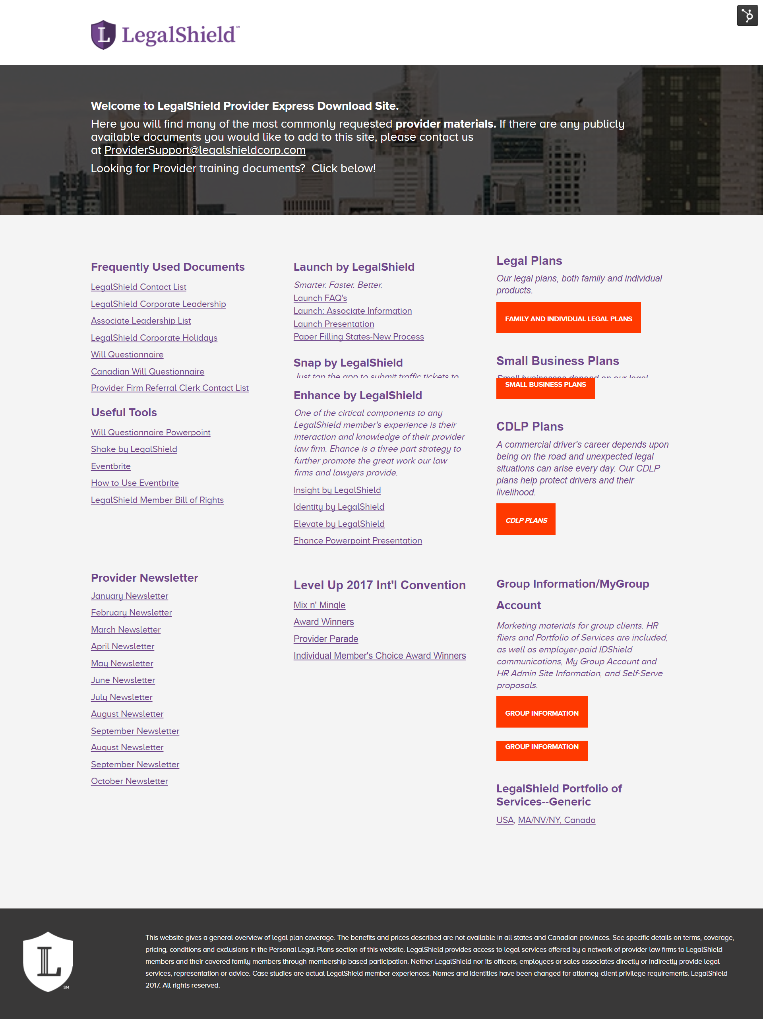
Provider Express Download Site
Examples of what you will find on the landing page.
Frequent Used Documents
LegalShield Contact List
Will Questionnaire
Useful Tools
Forms by LegalShield
Eventbrite
Enhance by LegalShield
Insight by LegalShield
Elevate by LegalShield
Contracts
Provider Newsletters
Training Decks
and much much more

Slide 120
Member Communications
End of Day Calls after 3:30 pm can be handled next business day
New script for calls to member after hours

Slide 121
Monthly Quality Control Changes
  No Monthly Report Card on SLA’s
  No more Mystery Shopping Calls
  Monthly PA Daily & Compliance will continue
  PAQC to monitor SLA’s daily will continue
  Complaints to Request for Service will be measured
  Focus will be on NPS and building relationships

Slide 122
End of Month Reports
No Longer Required
  Delete User Report
  Reporting of New Group Welcome Calls
  Report Log
  Webinar & Traditional Events

Slide 123
End of Month Reports
Required
  ACD Reports
  COI Referrals to Outside Counsel
  Praise Letters
  Referral Attorney Events Register should be sent to RAD as needed

Slide 124
Connectivity Efficiencies
iPortal savings
Monthly average approximately: $20,000
Yearly average approximately: 228,000
800 Phone line savings
Porting the 800 line reduces cost
Savings vary by phone carrier

Slide 125
Retention Improvements
Pre-Cancel Process
  Hold on membership for 45 days
  Email is first method, if no email then a letter is mailed
  How the member pays determines how many times we attempt to reach the member
Debit/Credit Cards Call up to 9 times
Bank Account/Direct Billing Call up to 7 times
Payroll Deduction Call up to 4 times
  All credit card members are sent to a Specialty Billing Service that successfully bill about 17% of the transactions we send.

Slide 126
Retention Improvements
Pre-Cancel Process Cont.
  Best retention strategy is contacting the member by phone
  We have a 35% connect rate in which 30% of those reached are SAVED
  Member Services makes:
    7500 dials per week
    2600 connects
    830 Saves
  Recently implemented an email strategy which has a 40% open rate

Slide 127
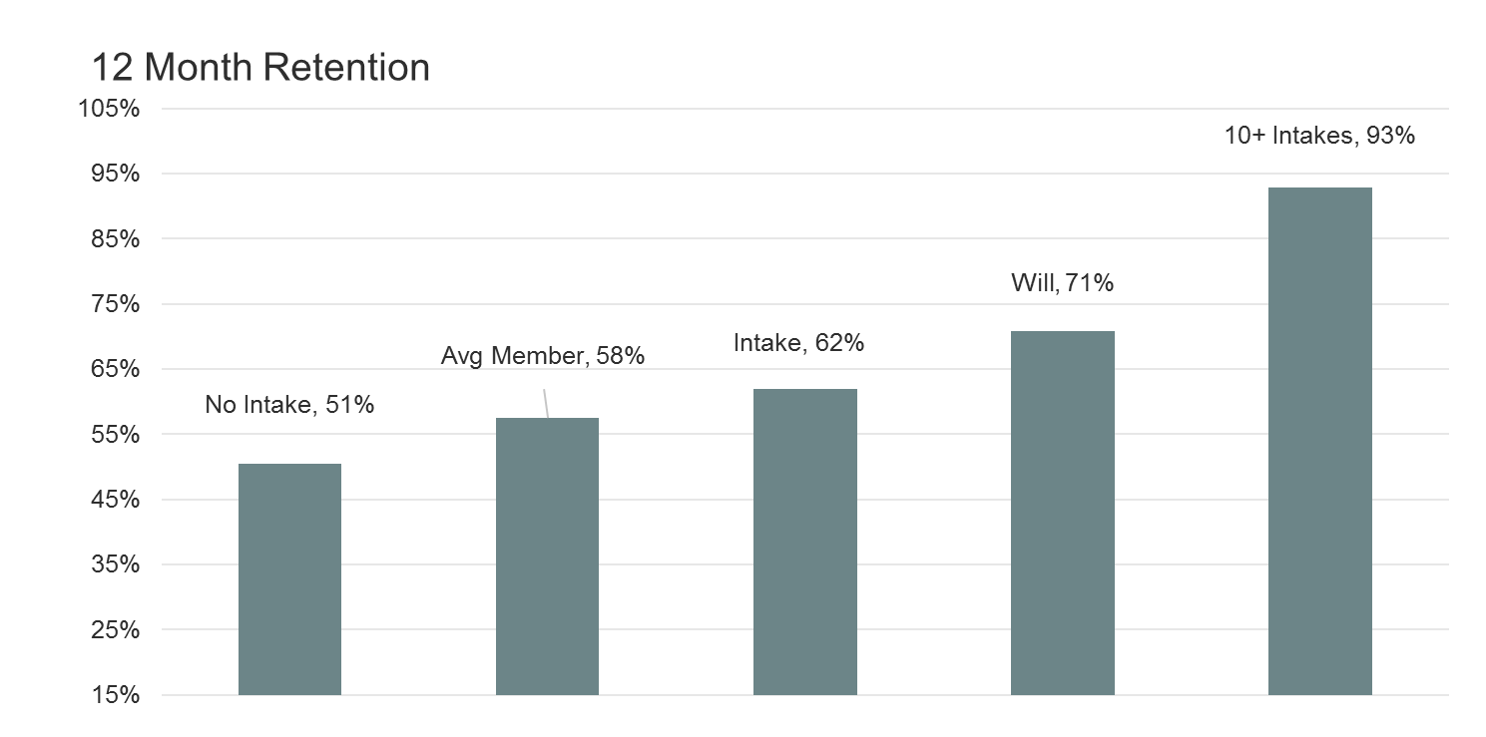
Retention Improvements

Slide 128
New Associate Retention Program
Goal: Analyze organizational retention rates & encourage associates to adopt better business practices.
How is ARP measured: Any associate’s organization retention that deviates 10 points from the Company retention rate
ARP Commission Advance Plan
Retention rate Action
66-70 Warning Coaching
61-65 9-Month Advance
56-60 6-Month Advance
51-55 3-Month Advance
50 and below As Earned
Steps of the ARP Process
Initial Warning Notice
30 Day Organization Review
After 30 days, if the retention rate is not at an acceptable level, a commission advance decrease can be implemented
Additional Coaching and Mentoring is Provided by LegalShield Corporate Office

Slide 129
Fixed Fees on Document Review
$35 for 16 – 20 pages
  Legal Zoom charges $39 for 11 – 15 (up to 5 additional pages)
$95 for 21 – 30 pages
    Legal Zoom charges $99 for 16 – 25 pages (up to 10 additional pages)
25% Discount for 31 + pages guaranteed
    Legal Zoom charges 25% Discount for 26+ pages

Slide 130
Discounted Rates
  No Discount on Flat Rates
  No Discount on Contingency Rates
  25% Discount on Hourly Rates

Slide 131
Forms by LegalShield
  First 5 State Specific Forms are Live
  Request for 5 Additional Forms Coming Soon
  15 Page limit will not apply, forms will be covered under consultation benefit

Slide 132
New Law Firm Pages
Area of Law Cards
Rates
Testimonials

Slide 133
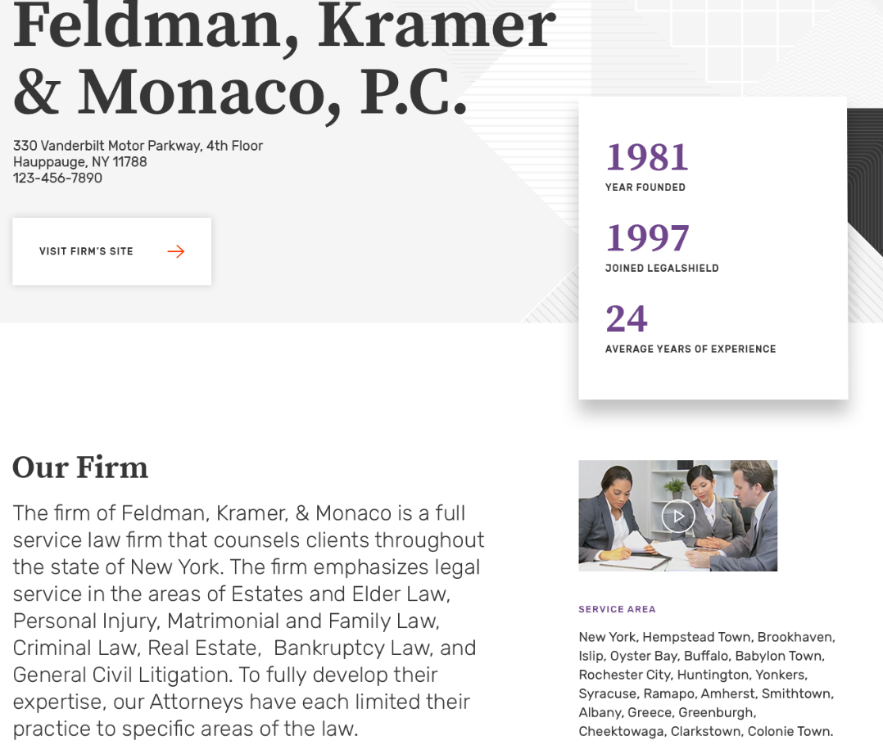
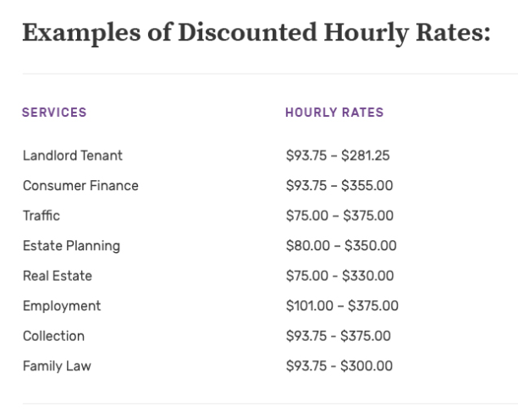
New Law Firm Pages

Slide 134
What We’ve Done to Improve
    Retention improvements
    Membership growth, more per capita
    New Quality Services Department
    EOM Reports/Report Card Changes
    Profiles = Free Marketing
    WAN Savings vs. Portal
    Fixed Fees on Document Reviews
    No Discounts on Flat Fees/Contingency Fees
    Elevate by LegalShield Conference (CLE)
    New Associate Training

Slide 135
Best Actor Award

Slide 136
Smooth Operator Award

Slide 137
Provider Law Firm Best Practices Panel
“Mixed Bag”
Tami Haley
David Shimanovsky
Kevin Almeroth
Scott Howard

Slide 138
Door Prize

Slide 139
Champagne Award

Slide 140
Best Practice Panels
Trisha Wainscott, PS Project Administrator

Slide 141
Provider Law Firm Best Practices Panel
“Coming out of the Trenches”
Joe Dempsey
Nina Martorana
Steve Meyers
Wayne Hassay
Paulette Geletko

Slide 142
Running with the Bulls Award

Slide 143
Morning Sunshine Award

Slide 144
15 Minute Break

Slide 145
National Plan/New Legal Plan Plus
Kathy Pinson & Lori Owens

Slide 146
Break Out Sessions
Jeannie Forneris, Mariam Ballard

Slide 147
ELEVATE
Providers Only
Welcome to Scottsdale, AZ

Slide 148
First Responder Award

Slide 149
Bubbles Award

Slide 150

Succession
Planning as a
LegalShield
Law Firm

Slide 151

“You Still Have Choices”
In your best interest
In the law firm’s best interest
In the clients’best interest
“
Failure to plan is planning to fail.”
J. Wooden

Slide 152

Roadmap
What are you going to do?
Succession planning options
  Solos/small firm owners
  What is a practice worth?
  Larger firms
“The best way to predict
your future is to create it.”
Abraham Lincoln

Slide 153
Future
For next 18 years, 10,000 people will turn 65 everyday
ABA predicts 400,000 boomer lawyers will retire in the next 10-15 years
65 – 20 year life expectancy
“The future ain’t what it used to be.”
Yogi Berra

Slide 154
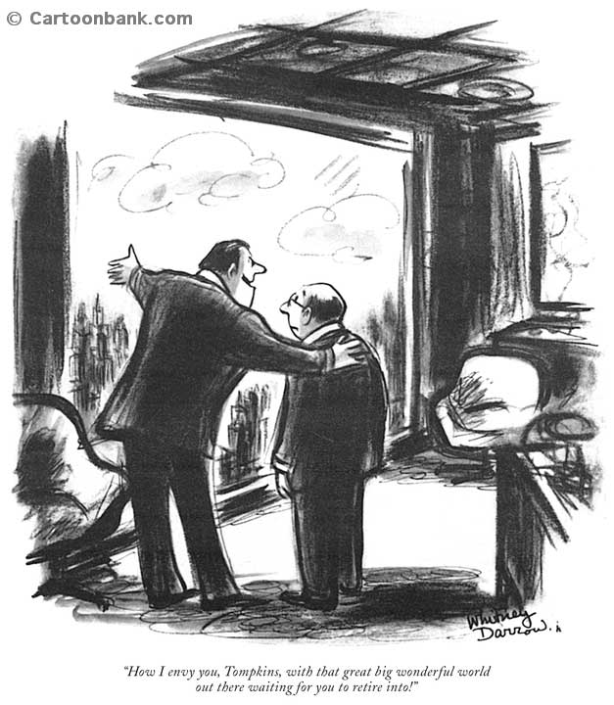
“How I envy you, Tomkins, with that great big wonderful world
out there waiting for you to retire into!”

Slide 155
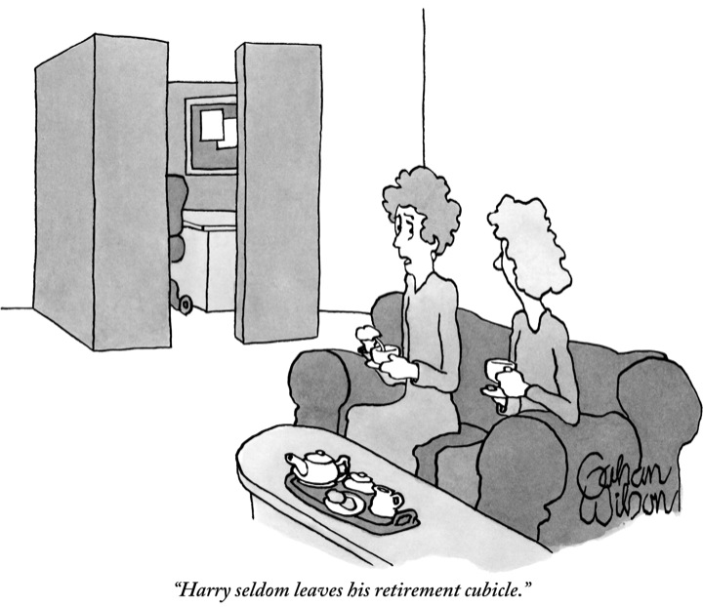

Slide 156
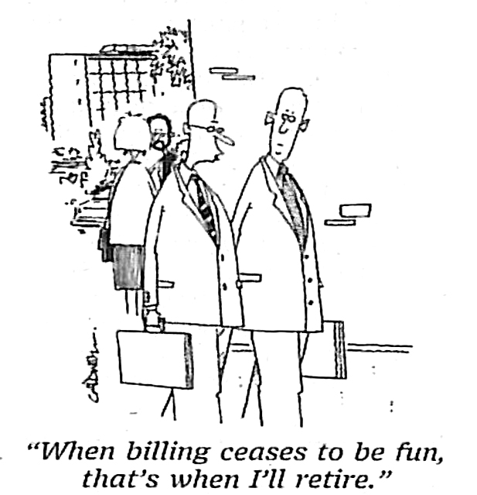
When to Hold ‘Em and
When to Fold ‘Em

Slide 157
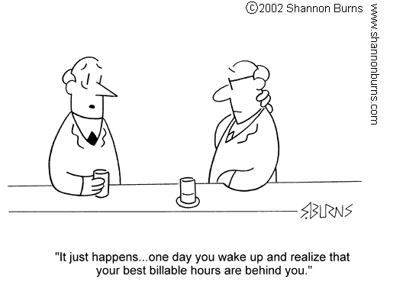

Slide 158
Is It Time?
Physical health
Mental health – edge and passion
Others’ health
Want to give back
Want more family time
Want more R & R

Slide 159
Is It Time?
Finances
What do you have?
What do you need?
Health insurance
Social Security
Estate planning

Slide 160


Slide 161
Why Lawyers
Flunk Retirement
Only thing planned - “how much do I need”
Think with enough money, all will be fine
Believe life of leisure will be fun
“For better or for worse, but not for lunch.”
62% disagree on timing; 33% disagree on lifestyle
Overwhelmed by family issues

Slide 162
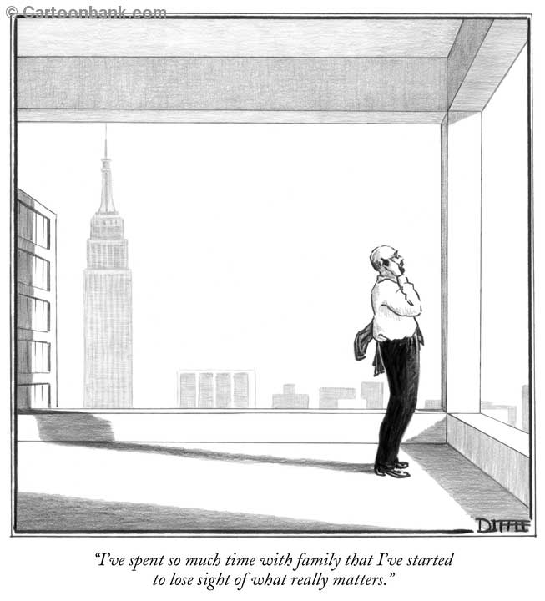

Slide 163
Lawyers Who Pass
Reflective
An identity above and beyond work
Enjoy helping others
Sociable
Financially stable
Flexible
Retire to something,
not from something

Slide 164
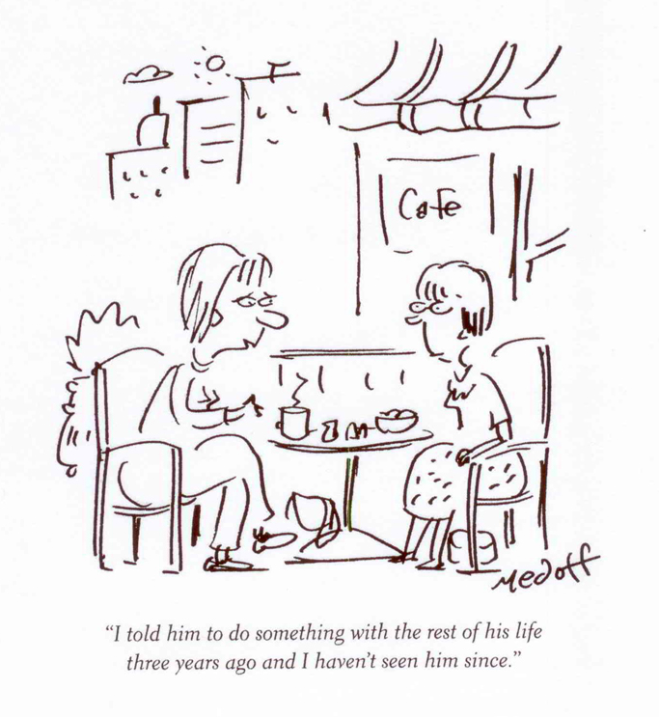

Slide 165
Replacing Work
Sense of identity
Sense of community
Sense of purpose
Mental stimulation
Status/perks
Routine/structure

Slide 166
Earn An Honest Living
ADR
Academia – adj. prof.
Politics
Become an entrepreneur
Write/blog

Slide 167
Volunteering
Bar associations
CLE’s
Religious orgs.
Social services
Hospitals
Civic orgs.
Education/youth services
Environmental
Cultural, sports, arts

Slide 168
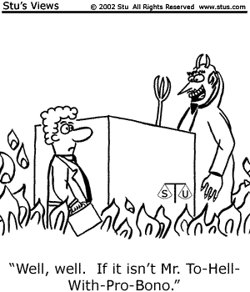
“Well, well. If it isn’t Mr. To-Hell-
With-Pro-Bono.”

Slide 169
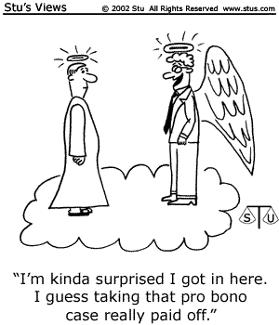
“I’m surprised I got in here.
I guess taking that pro bono
case really paid off.”

Slide 170
Relax!
Spend time with family/friends
Go back to school (Road Scholar)
Hobbies/arts/exercise/sports
Travel
Be a couch potato

Slide 171
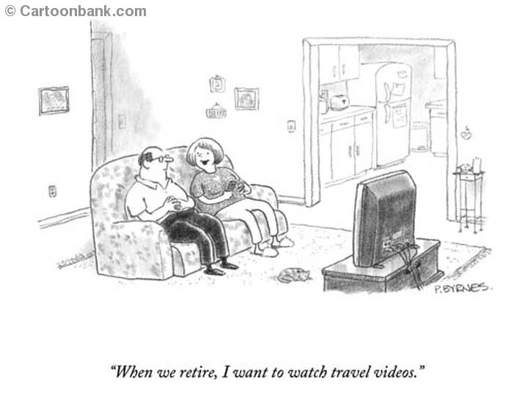

Slide 172
Practice Retirement
  Married to your smartphone?
  How do you spend weekends?
  Two-week vacations?

Slide 173
What’s on Your List?
“I haven’t been everywhere, but it’s on my list.”
Susan Sontag

Slide 174


Slide 175
Playing the Odds
65 or older
25% - memory loss
20% - serious illness
20% - depression

Slide 176


Slide 177


Slide 178
Why Can’t We Talk?
Fear Factor
Losing one’s identity
Reduced compensation
Loss clout
Political suicide
Death

Slide 179
Let’s Talk!
Third parties
Disguise within strategic planning
Focus on clients

Slide 180
Firm Leadership
Not just managing partners
Who are the candidates?
  Skills/personality
  Training needs
Transition phase
  Minimizes shocks to the system
  Takes time to groom

Slide 181
Client Transitions
Develop profiles
  Billing history
  Relationships
  Future legal needs
  Client’s own succession issues
Client input
Identify/assess successors

Slide 182
$$$$$$$$$$
What happens to origination?
Don’t penalize
Consider rewarding
Who pays?

Slide 183
Just Do It
Working Matters
Social
Takes time
  Expertise
  “Comfort and chemistry”
  Adjust as needed

Slide 184

Ownership Transition
Insiders
Competitors

Slide 185
Buy-in/Buy-out
Rewards loyalty
Cash
Uninterrupted client service

Slide 186
Myths
Compensation
Governance

Slide 187
“Right Stuff”
Business judgment
Marketing sense

Slide 188
Multi-phase/Multi-year
More time
Pay
Adjust roles
Separate, discrete deals

Slide 189
Phase One (Years 1-3)
Probation
Responsibilities shift – training
Time to back out
Cost – foregone raise or bonus
% - low

Slide 190
Phase Two (Years 4-6)
More payments
Closer to 50%

Slide 191
Phase Three (Years 7-9)
Tipping point
Significant payments

Slide 192
How Significant?
Few guidelines
What’s “fair?”
Marketplace defines “fair”
More affordable
Can extend beyond

Slide 193


Slide 194
So, What’s It Worth?
The “excess earnings” model is a calculation that reflects the amount by which the five-year average earnings of the practice, less the fair return on physical assets, exceeds the fair compensation figure of a comparable attorney, capitalized as a function of the risk of retaining the clientele versus the competitiveness of the practice. Essentially, this approach seeks to capitalize the net income stream expected by the buyer in the future.

Slide 195


Slide 196
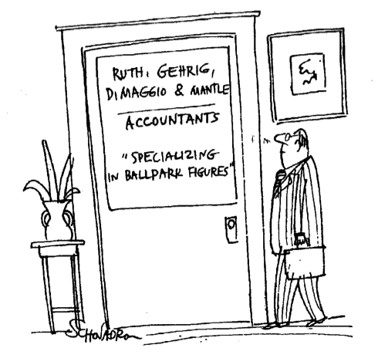

Slide 197
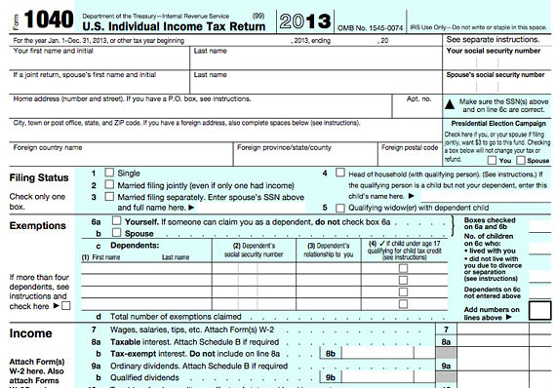

Slide 198
What’s in a Name?
Sooner rather than later
Benefits all

Slide 199
How Do You
Find Someone?
Consultants
Brokers
Networking
Advertising

Slide 200


Slide 201
The Deal is Your Compensation
Origination – for how long?
Billable time

Slide 202
Advantages
No more management headaches
Old files
Staff retained

Slide 203
Disadvantages
Fees
Culture
Not your own boss

Slide 204

Sooner Rather
Than Later
“The time to put on a new roof is when the sun is shining.”
John Kennedy

Slide 205
DOOR PRIZE

Slide 206
Swiss Army Knife Award

Slide 207
15 Minute Break

Slide 208
Extra Mile Award

Slide 209
Seinfeld Award

Slide 210

The On-Going Transformation of LegalShield
James Rosseau, Chief Commercial Officer

Slide 211
New Product Development Process & Team:
The Agile Approach

Slide 212
Organizational Chart
James Rosseau, CCO
PEOPLE
PRODUCT
Melissa Cornell, Sr. Director, HR
Patrick Hodges, SVP People & Org. Dev.
STRATEGIC AND BUSINESS PLANNING
Heather Swan, Business Analyst
Christie Reed, Workday ERP Administrator
Cory Craig, Adonis
Jarrod Legg, AI
Mariam Ballard, Enhance
Jenn Stueckler, IDShield
Angie Pettigrew, LegalShield
TBD, Forms
Oscar Garza, Mobile
Jake Varghese, VP Business Development

Slide 213
LegalShield Law Index

Slide 214
LegalShield Consumer Financial Stress Index
Headline: The LegalShield Consumer Financial Stress Index, a leading indicator of the Consumer Confidence Index, suggests that consumer confidence, though strong by historical standards, may soften. Recent weak consumer spending data support LegalShield’s stance that consumer confidence is overstated compared to wider economic conditions.
Trends in Context: The LegalShield Consumer Financial Stress Index edged up (worsened) from 90.4 to 90.8 in September, driven by modest increases in the Bankruptcy, Estate Planning, and Foreclosure components. The Conference Board’s Consumer Confidence Index decreased (worsened) in September, although there remains a notable divergence between the two series. September may well be the beginning of a downward correction in consumer confidence that LegalShield data have foreshadowed for months, as the University of Michigan’s Index of Consumer Sentiment also eased. If confidence moderates as expected, measures of consumer activity, including retail sales and real personal consumption, may also disappoint. Indeed, separate measures of retail sales released in August by the U.S. Department of Commerce and the National Retail Federation both declined, as did inflation-adjusted consumer spending. Time will tell if holiday spending also falls short of expectations.
HISTORICAL TREND OVER PAST 15 YEARS
MOVEMENT OVER PAST 12 MONTHS
Consumer Financial Stress Index
(Left Axis; Jan. 2002 =100)
Consumer Confidence, Inverted
(Right Axis; 1985 = 100)
Source: LegalShield; The Conference Board.
9

Slide 215
Agile
WHAT IS IT: A process that focuses on collaboration to deliver high value and high quality results as frequently as possible while relentlessly improving the delivery process.
CORE VALUES:
Built-In Quality
Program execution
Alignment
Transparency

Slide 216
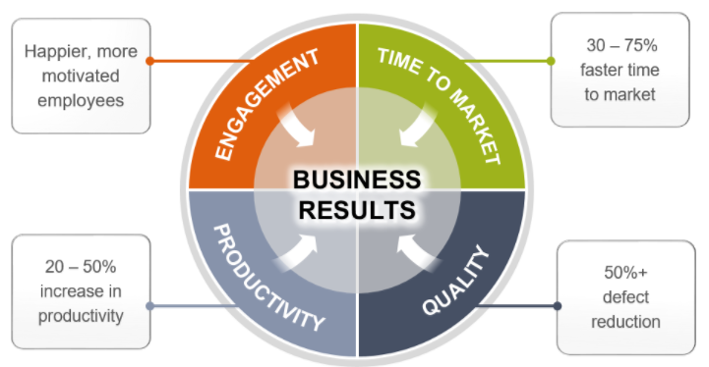
Business Results
Actual results
Time to Market
85% decrease
Cycle Time
28% decrease
Say/Do Ratio
Average is 104%
First Pass Yield
Currently at 90%
Releases YTD
5,043

Slide 217
Freemium and Premium Models

Slide 218
The Need
LEGAL: Over 100 million Americans are living with civil justice problems that the American Bar Association (ABA) has termed “basic human needs.” —THE FUTURE OF LEGAL SERVICES, ABA 2016
IDENTITY THEFT: Identity theft was among the top consumer complaints filed with the Federal Trade Commission for 16 consecutive years. —www.consumer.ftc.gov
SMALL BIZ: More than 13 million, or nearly 60%, of all small businesses have experienced significant legal events in the past two years. —DECISION ANALYST STUDY: THE LEGAL NEEDS OF SMALL BUSINESS

Slide 219
The Need
Subscription Based Legal
Services Market Penetration
7% use Subscription Based Legal Plans
Over 100 Million Americans living with civil justice problems that the ABA has termed “basic human needs.”

Slide 220
Why Freemium?
Upgrade to full membership
100 Million Americans living with civil justice problems that the ABA termed “basic human needs”
Download App
Use Freemium Services
Freemium services will create a higher visibility in the market
Clear paywalls will show the value of the membership and increase conversion rates
Ultimate sales tool for our field

Slide 221
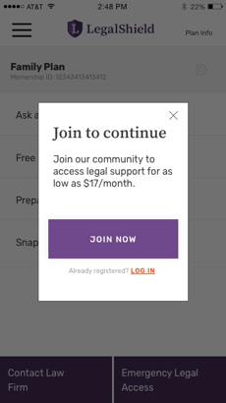
Freemium & Premium Features
Free Features:
Ask a legal question
Free legal forms
Beginning estate planning
Starting a speeding ticket upload
Researching law firm profiles

Slide 222
Freemium & Premium Features
Premium Features:
Saving a legal question conversation history
More and advanced legal questionnaires
Advanced Snap speeding tickets
Immediate access to law firms
Scheduling callbacks with lawyers

Slide 223
Forms by LegalShield
FORMS LIBRARY
Consumers are moving more and more towards the digital age – this is a fact
The search term “legal forms” and related queries average around 1M – 10M searches a month
Power of Attorney
Bill of Sale
Notice to Quit
Living Will
Promissory Note
Mutual Release
Non Compete
Settlement Agreement
NDA
and more...

Slide 224
Enhancing the Member Experience

Slide 225
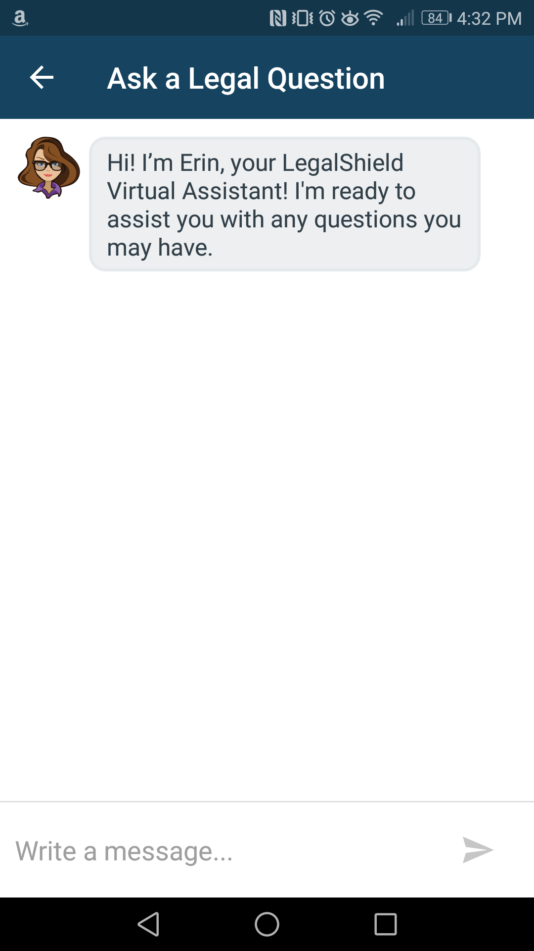
Mobile 2018
BOTS
What if a Member, Associate, Corporate Representative, Provider Law Firm, and Referral Attorney all had the same answer to a question?
Freemium
Callbacks
Snap
Bots
Alexa & Google Home
Member Auto Activation

Slide 226
Mobile 2018
ALEXA & GOOGLE HOME
What if a member is doing the dishes and has a question pop into their head?
Freemium
Callbacks
Snap
Bots
Alexa & Google Home
Member Auto Activation

Slide 227
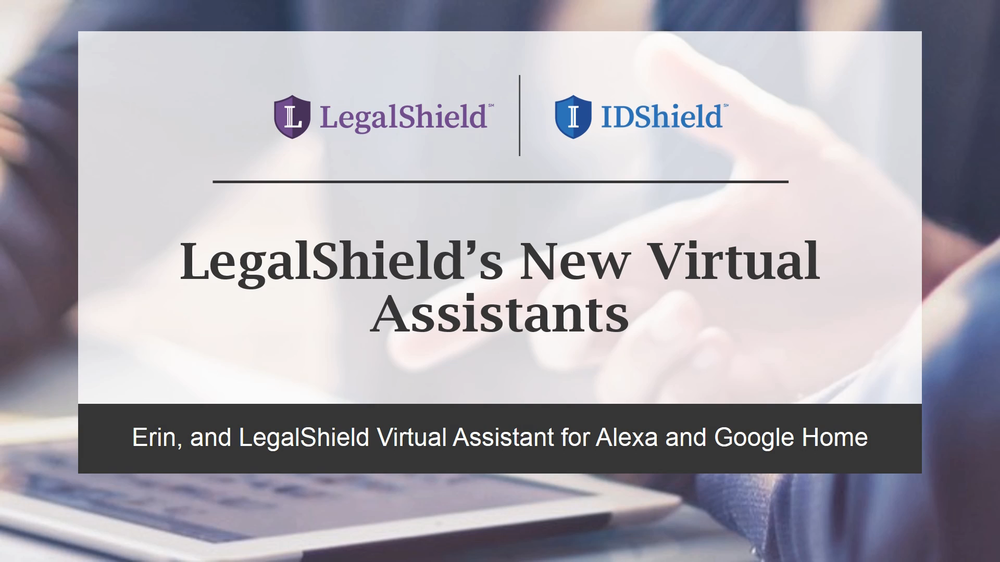

Slide 228
Mobile 2018
MEMBER AUTO ACTIVATION
What if a when a member signs up they can download the app and begin using the app immediately to start their Will Questionnaire?
Freemium
Callbacks
Snap
Bots
Alexa & Google Home
Member Auto Activation

Slide 229
Mobile 2018
FREEMIUM SERVICES
What if a member could try our Mobile App before deciding to buy a membership?
Freemium
Callbacks
Snap
Bots
Alexa & Google Home
Member Auto Activation

Slide 230
Mobile 2018
SCHEDULING CALLBACKS
What if the member could schedule a specific time for a callback?
Freemium
Callbacks
Snap
Bots
Alexa & Google Home
Member Auto Activation

Slide 231
Mobile 2018
ENHANCED SNAP FEATURE
What if the member has a contract that needs to be reviewed?
Freemium
Callbacks
Snap
Bots
Alexa & Google Home
Member Auto Activation

Slide 233
DOOR PRIZE

Slide 234
Point Guard Award

Slide 235
Preparing for Growth
Keri Norris

Slide 236
Q & A

