Slide 1
ISeries Training
Presenter Info Goes Here

Slide 2
How To Open an Intake

Slide 3
Most used Function Keys
F1 – from the intake using the f1 key will print the intake and notes.
F2 – takes you to the previous screen
F3 – backs you out of any screen – this is used all the time
F-5 – to read notes from an intake or to enter notes
F9 – to make multiple notes in an intake
F12 or F19 – to check lapses from the member inquiry screen
Shift F1 – to see if the member had filed any member resolution concerns
Shift F5 – to see all the intakes open from the member inquiry screen

Slide 4
Provider Attorney Intake Master Menu
On the Master Menu there are three option subtitles. Entry Options, Referral Attorney Options and Miscellaneous Options. The CSR’s will use Entry Options.
Entry Options
The CSR will mainly use 01 [Call Intake Entry] to open a new intake.
For an intake that has been opened but the attorney closed the intake after consulting, the CSR can use option 05 [Intake Maintenance] This is used when the member would like to revisit the issue and has the intake number to opened, the CSR can reopen the intake from this screen. If the member doesn’t remember the intake number, the CSR would have to go through Option 01.
Enter 01 in the ‘Enter Option Field’ and hit enter.

Slide 5
Member Look-up Screen
On this screen the CSR can find a member different ways.
By member number
By Name [last, first]
By phone number
By email
By birthdate
By Social Security Number
The easiest option is by member number or last, first name.

Slide 6
Member Inquiry
On this screen the CSR must verify all the information.
Ask for member’s name
If the name is different from the named member, check the f4 – Dependents
Verify the address, all phone numbers and email address
Next check the f6-Member’s comment screen for special request, like a secret code a member wanted listed or any conflicts and etc.
On this particular Inquiry screen, this membership is cancelled. Now let’s open a new intake by hitting the f9 function key.

Slide 7
Call Intake Entry
On this screen you will make the necessary changes so the attorney can contact the member.
Client: Use the caller's name in this field, if it is a dependent, use the dependent name.
Address
Email address
CB PH: number member would like to be called back on
Verify all the numbers listed
LegalMtr: brief description of legal issue. If you need more room to add information hit f5 and enter the rest of your notes.
Subject: to enter the area of law hit f7.

Slide 8
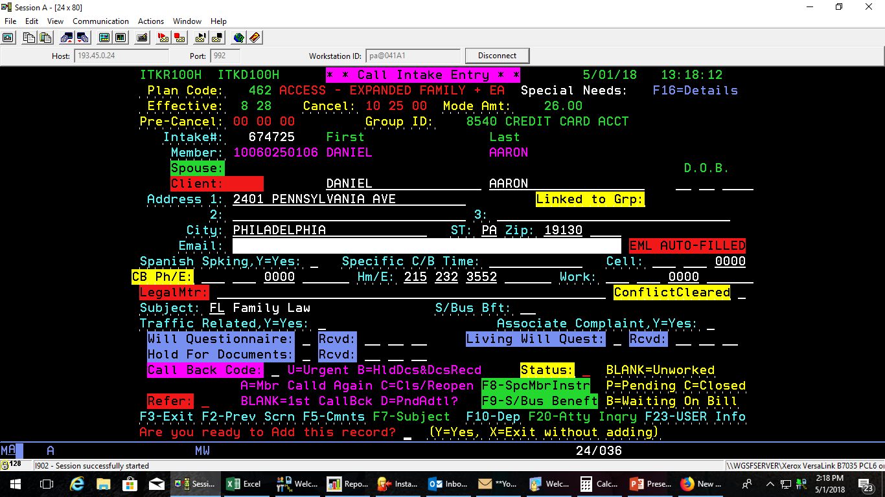
F-5 Comment Screen
Once you open the comment screen, hit f-9 to put multiple notes in the intake. Once you are done entering the notes, hit enter, hit f-3 which will take you to the front of the intake. Once everything is filled out hit enter, at the bottom it will ask you if you want to enter the intake. Put ‘Y’ in the field and hit enter.
You have just entered a new intake.

Slide 9
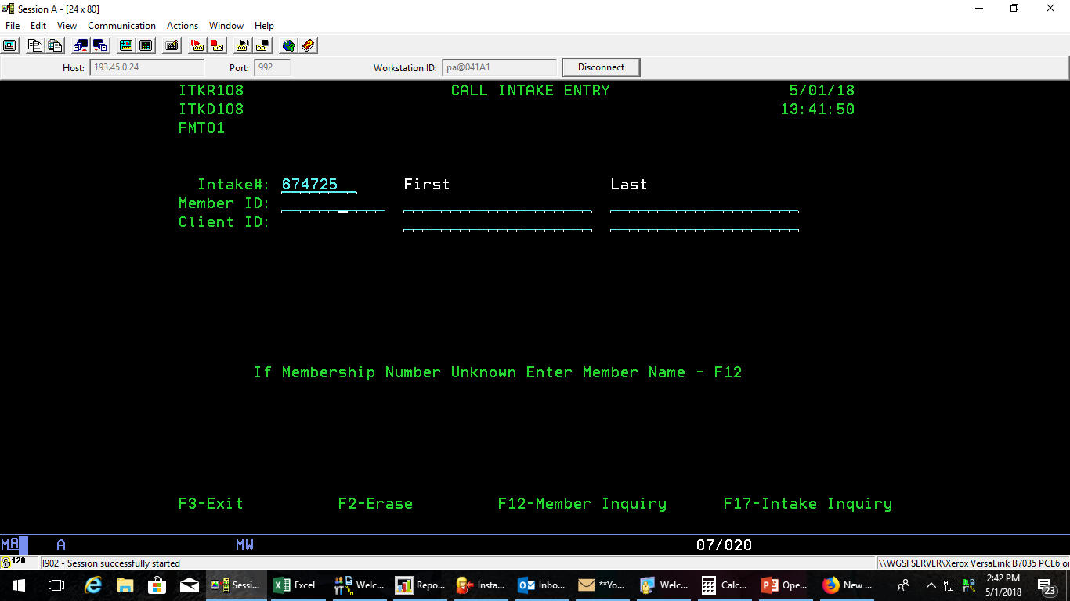
Opening an intake that the attorney closed is called a closed/reopen intake
From the master menu, in the enter option field type 05 Intake Maintenance for opening a closed/reopen screen.
Once you have opened this screen, type in the number of the closed intake and arrow down or hit TAB to the next field and hit enter.
You can also use the 01 screen, type in the membership number, hit enter, hit shift F5 to see all the intakes the member has opened.

Slide 10
Closed/Reopen Intake
Once you are in this screen go to the call bk status field highlighted in blue, place a ‘C’ and tab to Call Count field and use code 98 tab to Lwyr ID highlighted in red, put the attorney’s userid in this field and tab to the closed field highlighted in yellow and delete Y, and hit enter.
This intake is now on the closed/reopen screen.

Slide 11
Attorney’s Closed/ Reopen Screen
Once you enter a closed/reopen intake it goes on the 02 screen for closed/reopen intakes.

Slide 12
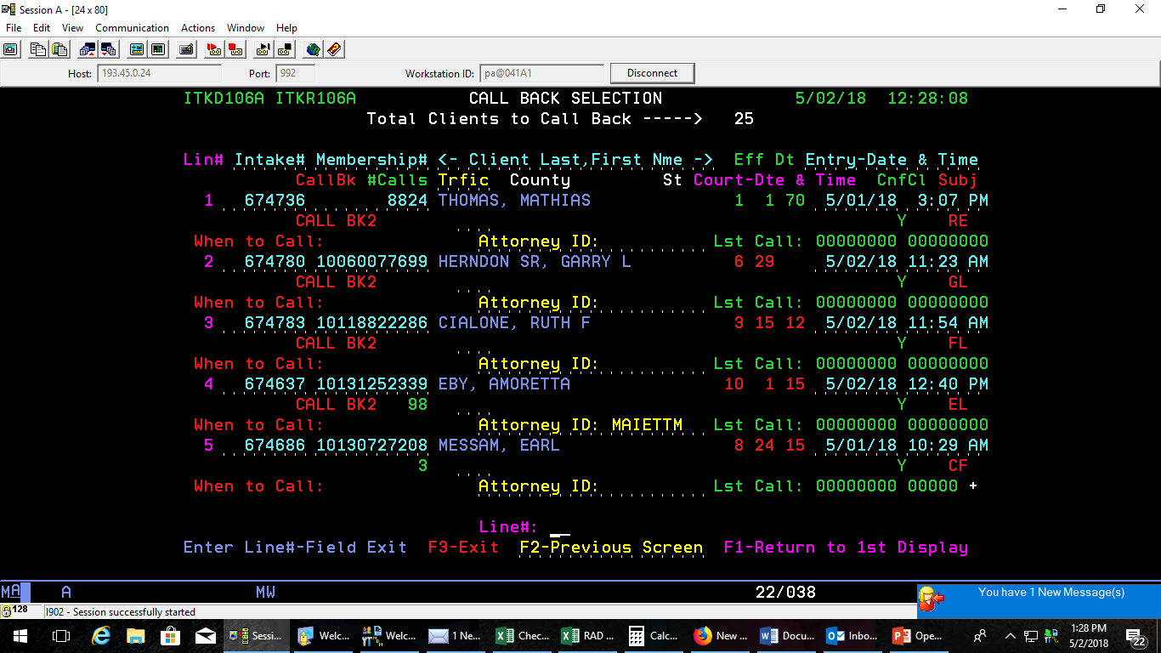
Attorney’s New Intake Screen
The attorney’s work off the 03 screen for new intakes. This screen shows the attorneys the member’s name, intake number, the date and time. This screen also shows that the member returned the attorneys call.

