Slide 1
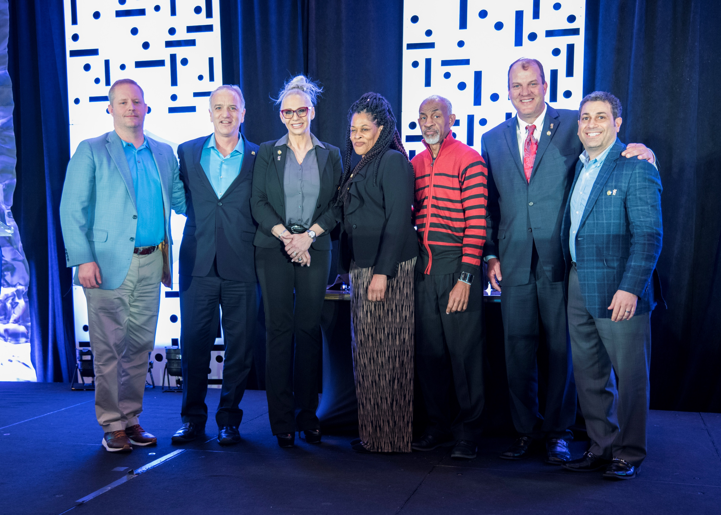
MCM - From left to right: Michael Savula (SC). Mark McDonald (CA); Melony Davis-Knab (LA); Rwanda & Lewis Wynder (GA); Todd Allen (MS); and Marty Gilano (NY)

Slide 2
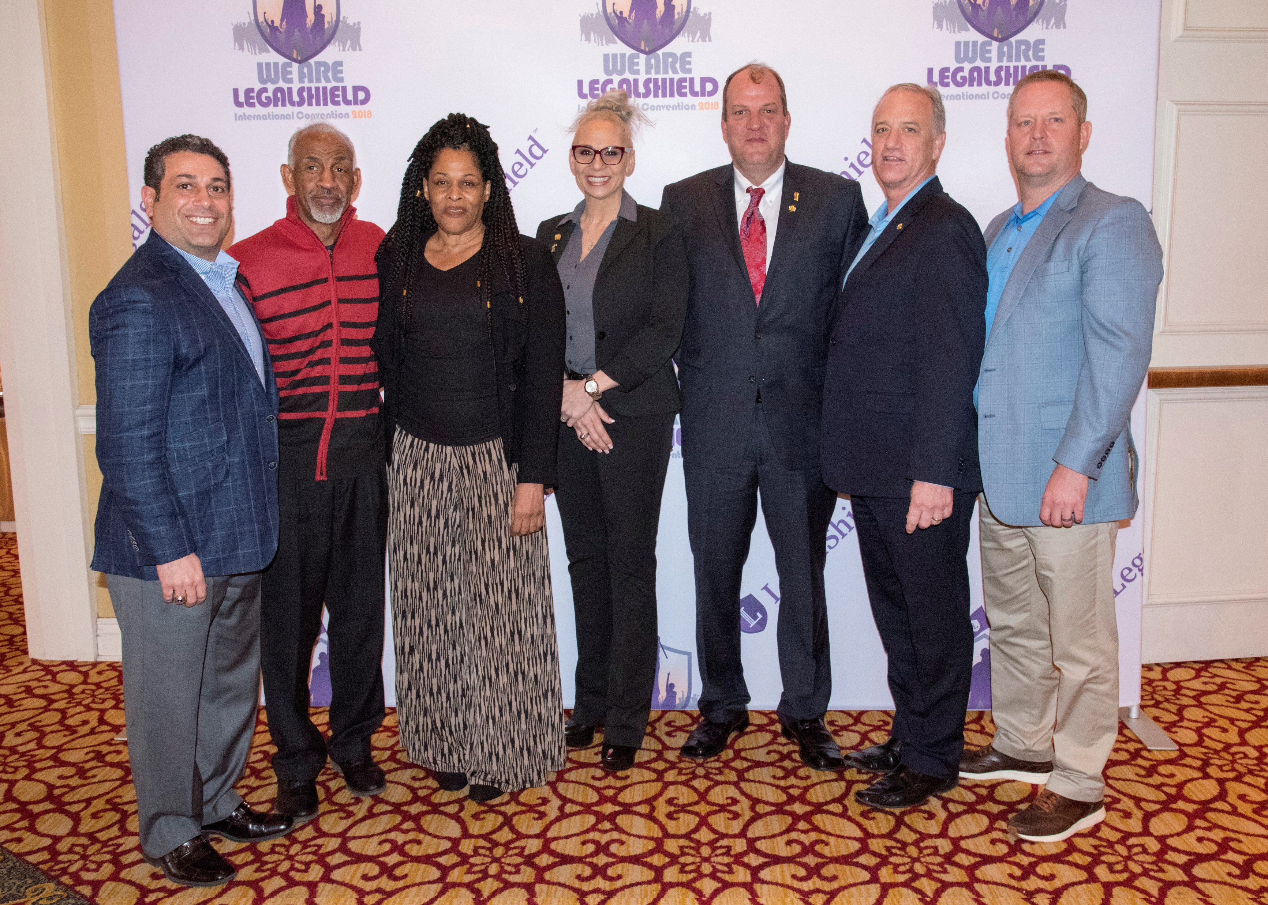
MCM - From left to right: Marty Gilano (NY); Lewis & Rwanda Wynder (GA); Melony Davis-Knab (LA); Todd Allen (MS); Mark McDonald (CA); and Michael Savula (SC).

Slide 3
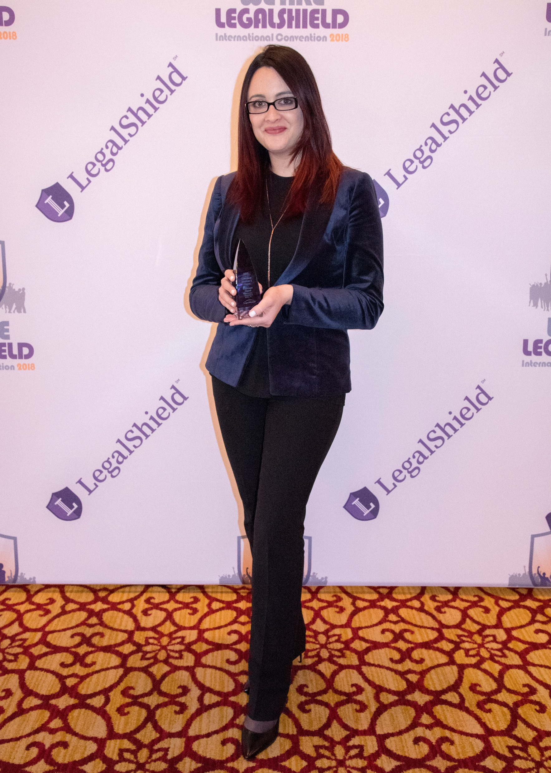
Individual Member Choice Award Dominique Church Mattleman, Weinroth & Miller, P.C. DE

Slide 4
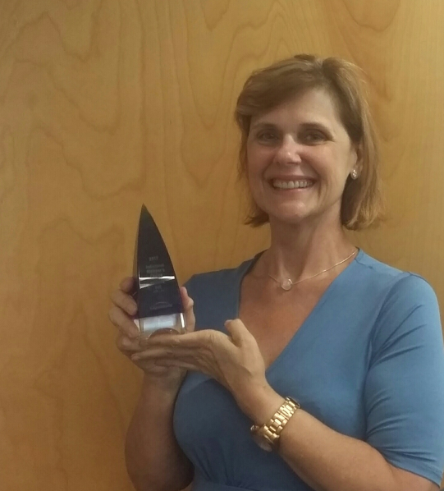
Individual Member Choice Award Michelle Bell
DSK Law
FLN

Slide 5
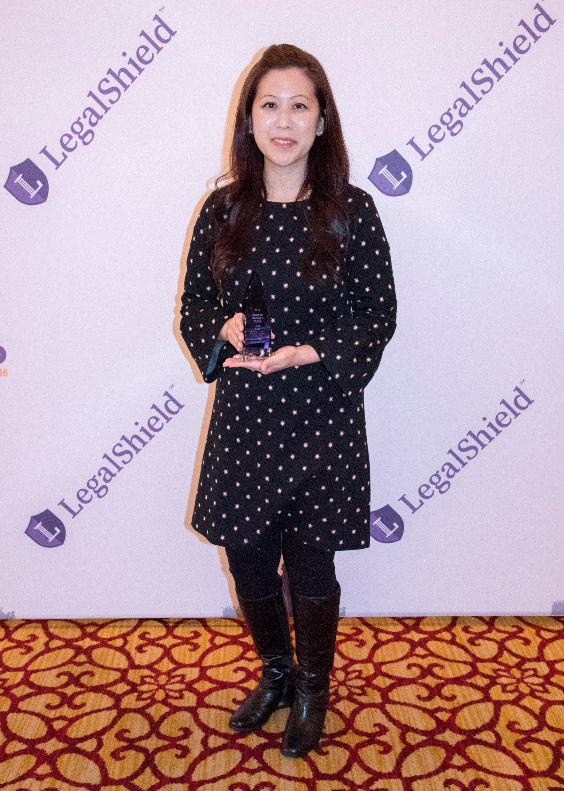
Individual Member Choice Award
Julie Kang
Deming, Parker, Hoffman, Campbell & Daly, LLC
GA

Slide 6
Individual Member Choice Award
Dana Katz
Mattleman, Weinroth & Miller, P.C.
NJ

Slide 7
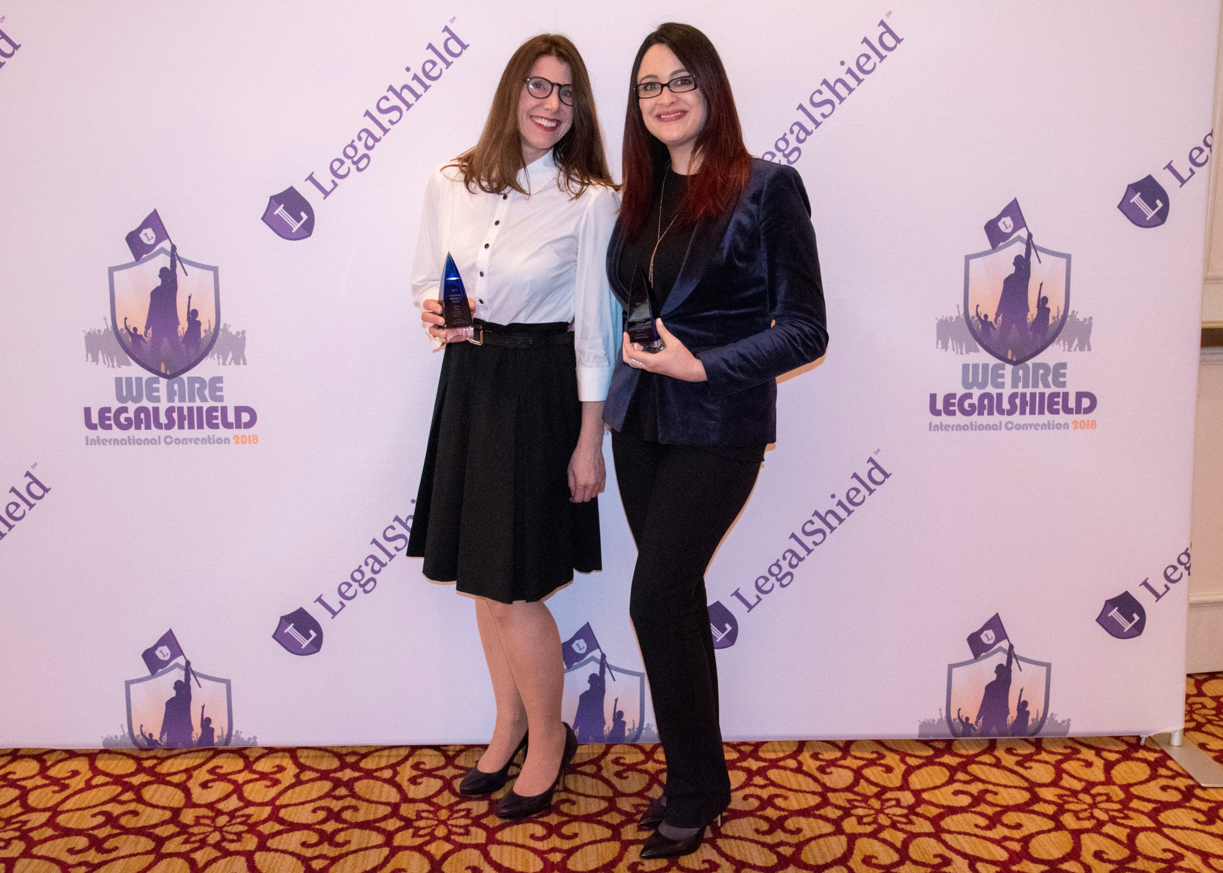
Individual Member Choice Award
Dana Katz & Dominique Church Mattleman, Weinroth & Miller, P.C. DE/NJ

Slide 8
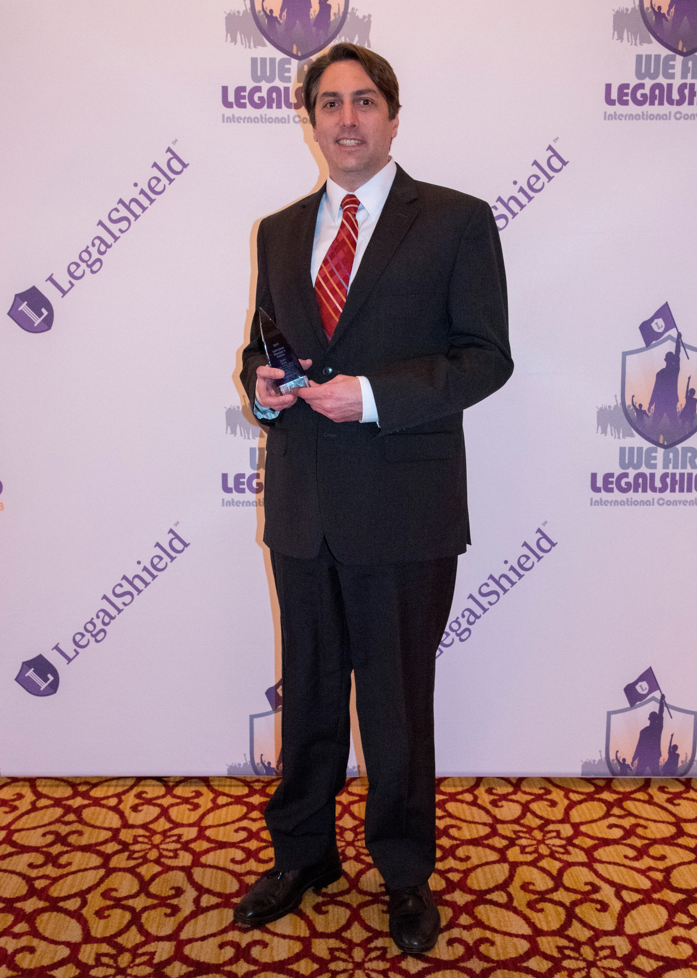
Individual Member Choice Award
Scott Byrd
Riggs, Abney, Neal, Turpen, Orbison & Lewis, P.C.
OK

Slide 9
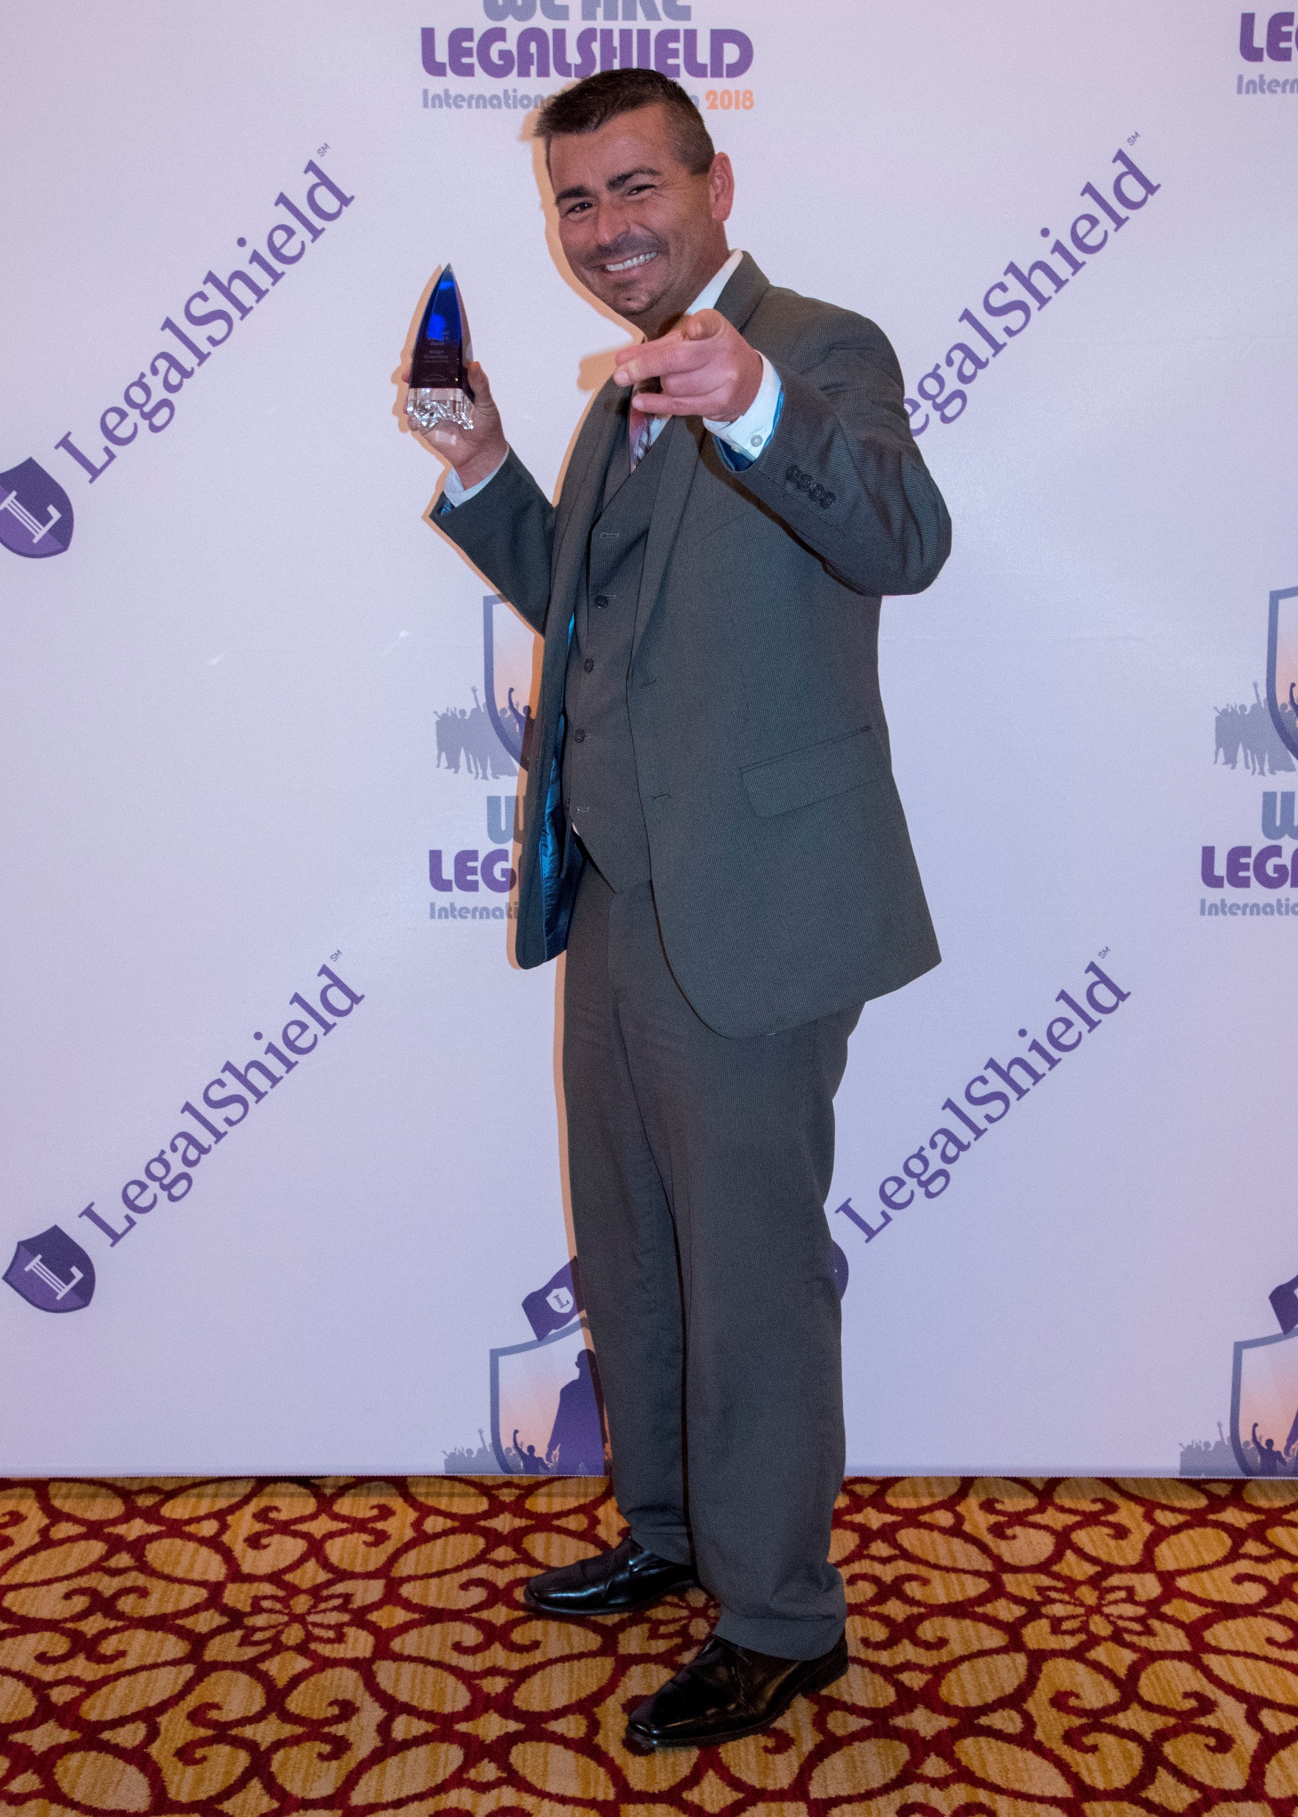
Individual Member Choice Award
William Shrewsberry
Caldwell & Riffee
WV

Slide 10
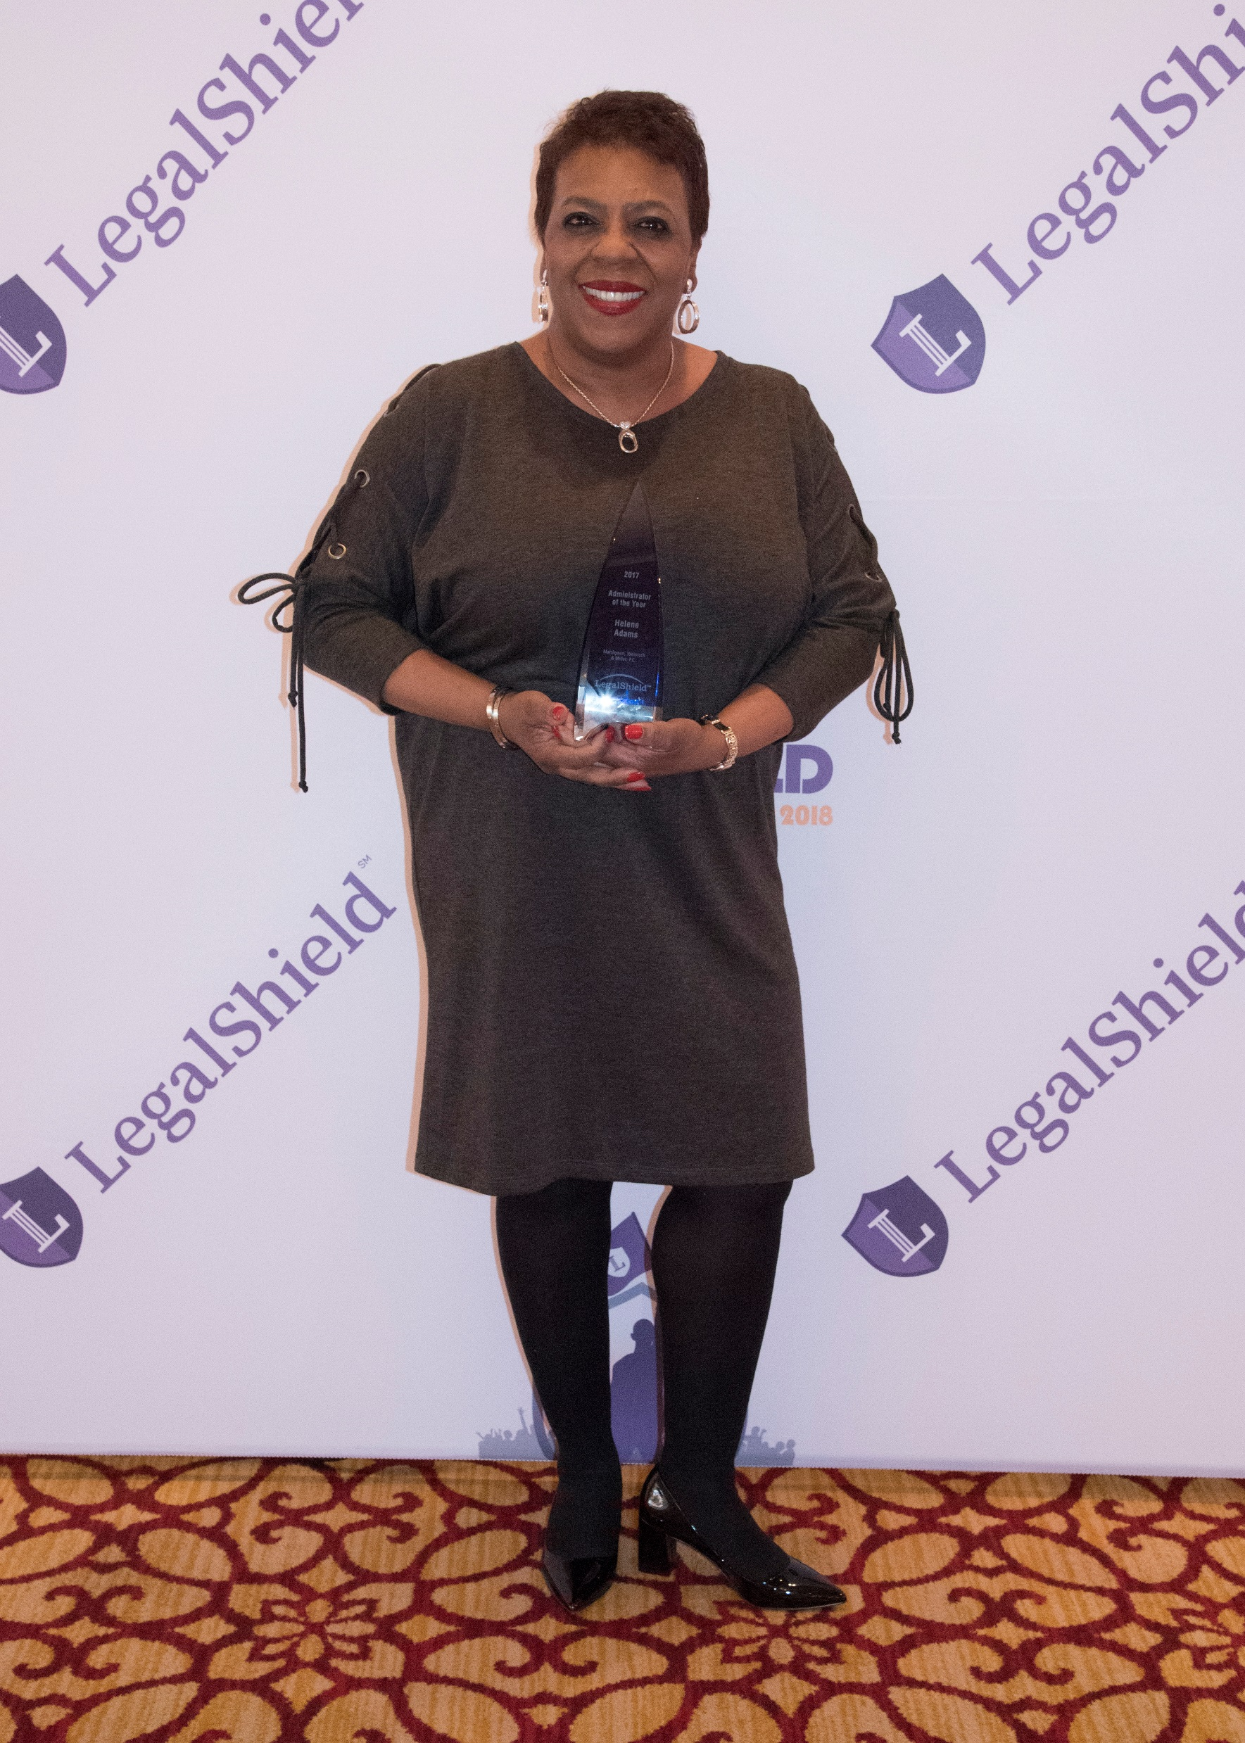
Administrator of the Year
Helene Adams
Mattleman, Weinroth & Miller, P.C.
DE/NJ

Slide 11
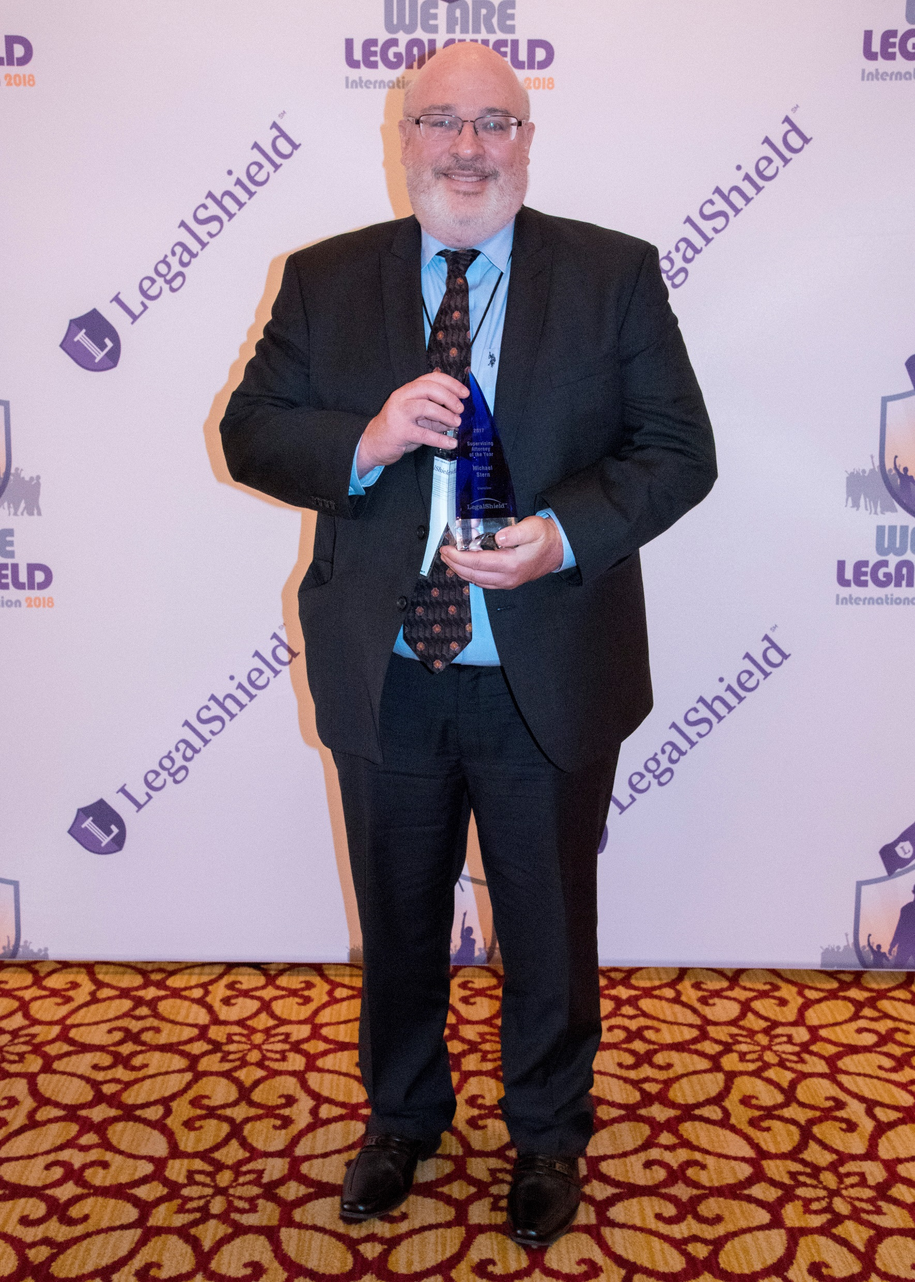
Supervising Attorney of the Year
Michael Stern
Glantzlaw
FLS

Slide 12
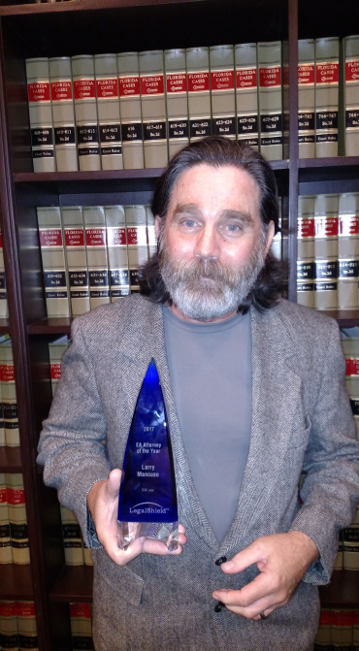
EA Attorney of the Year
Larry Mancuso
DSK Law
FLS

Slide 13
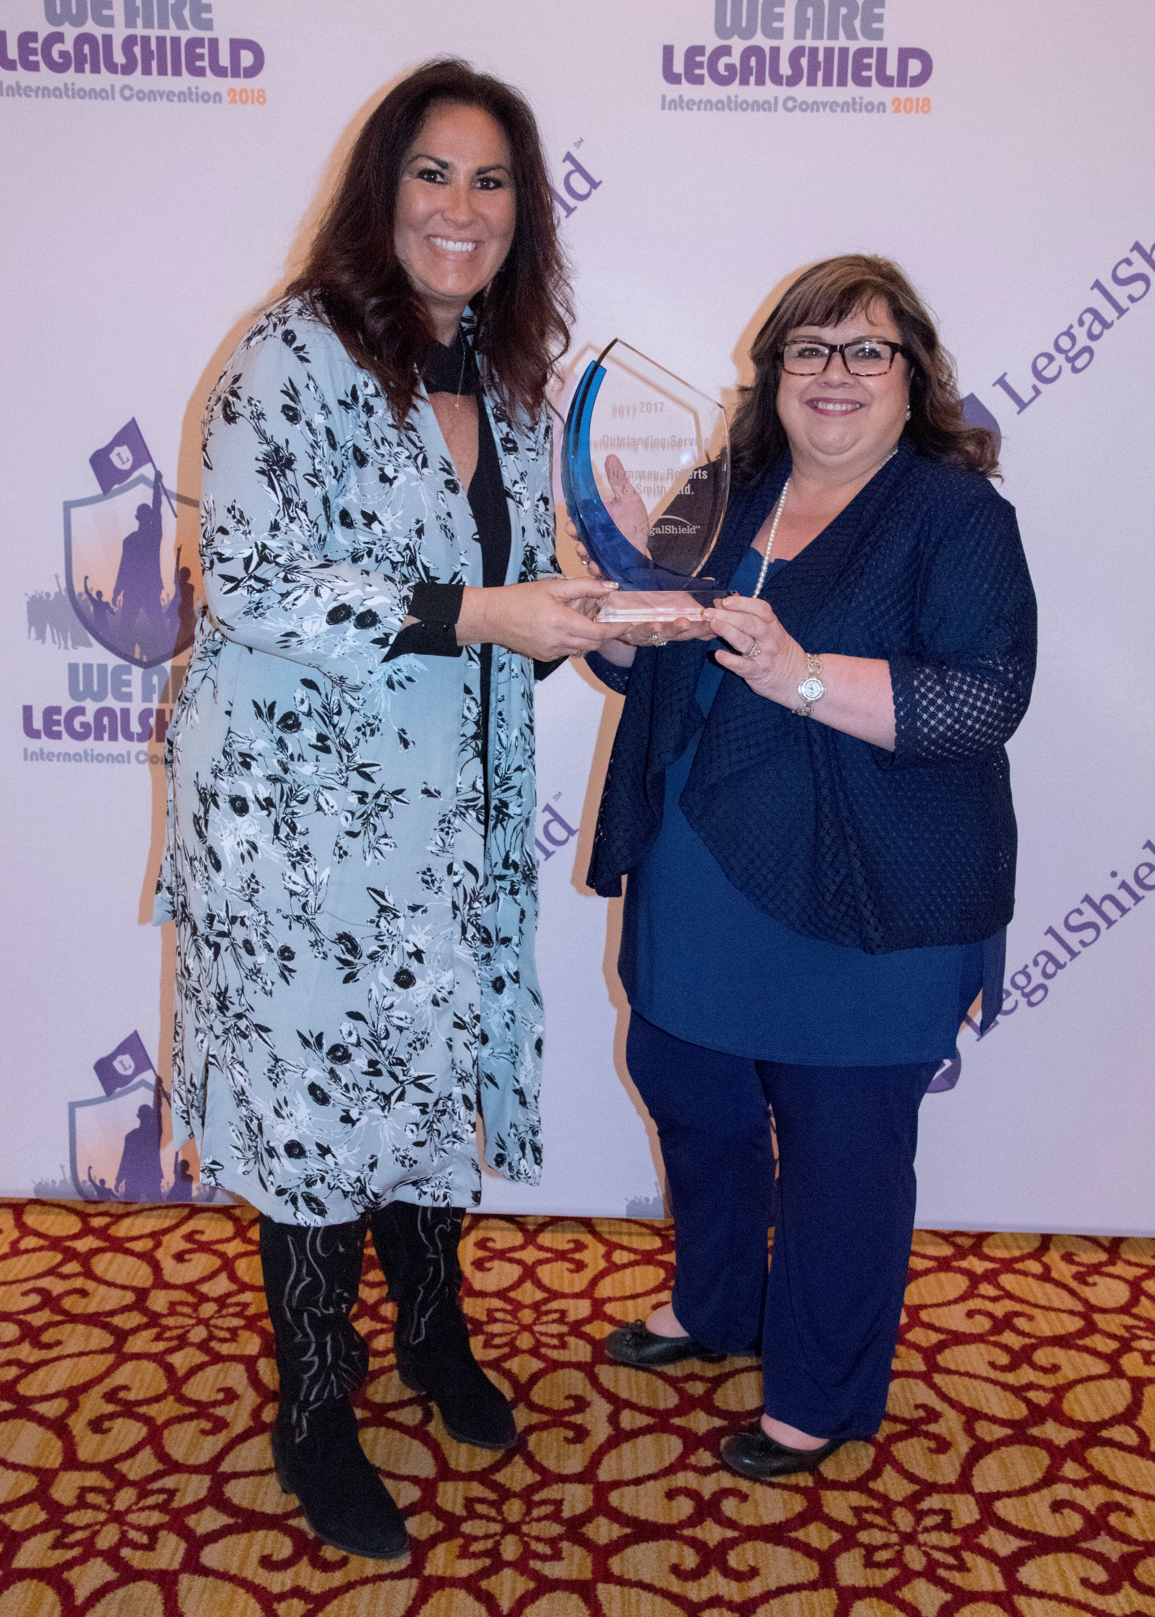
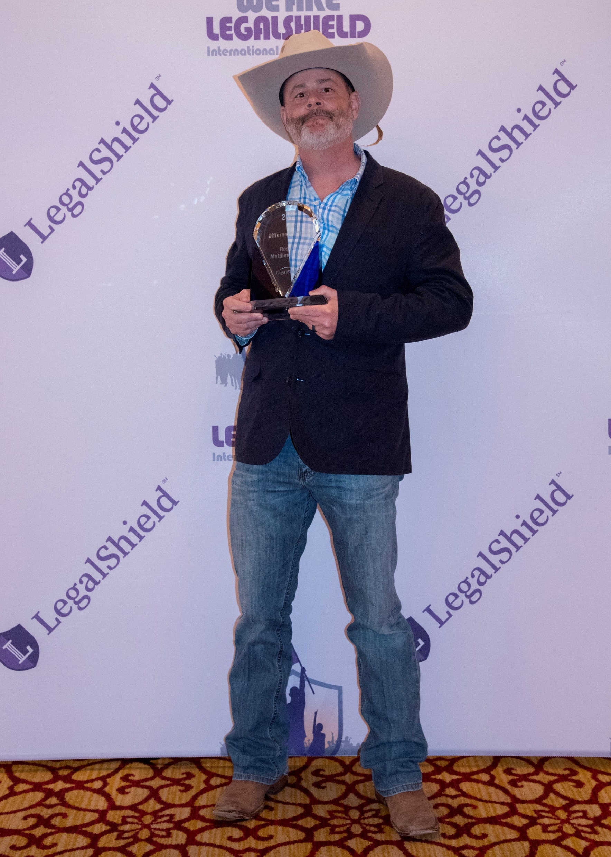
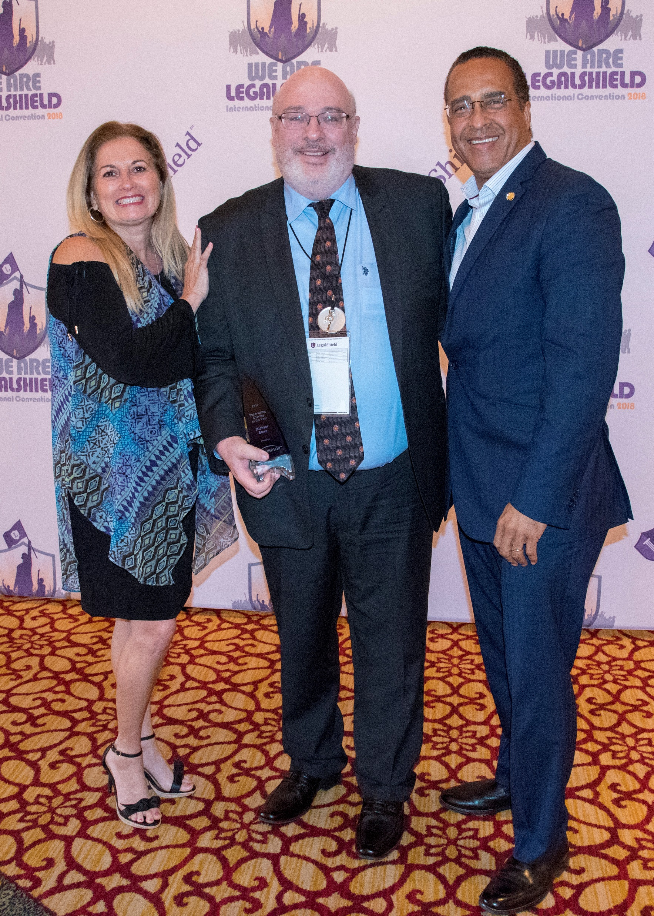
Supervising Attorney of the Year
Michael Stern
Glantzlaw
FLS

Slide 14
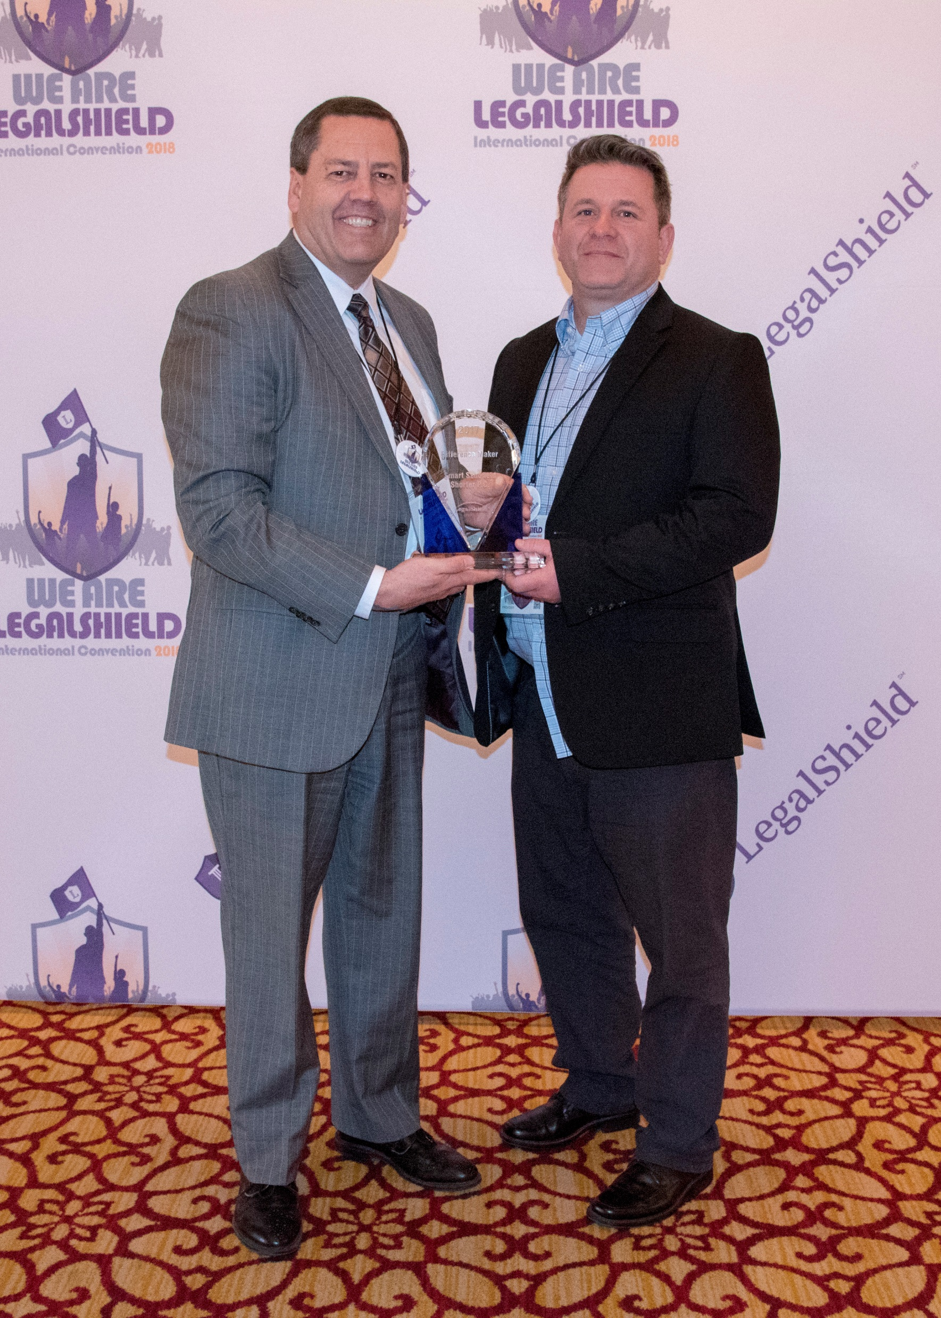
Difference Maker Award
Jeff Shorter and Ryan Smart
Smart Schofield Shorter P.C
Utah/Wyoming

Slide 15
Difference Maker Award
Brian Ross
Ross & Matthews, P.C.
Texas

Slide 16
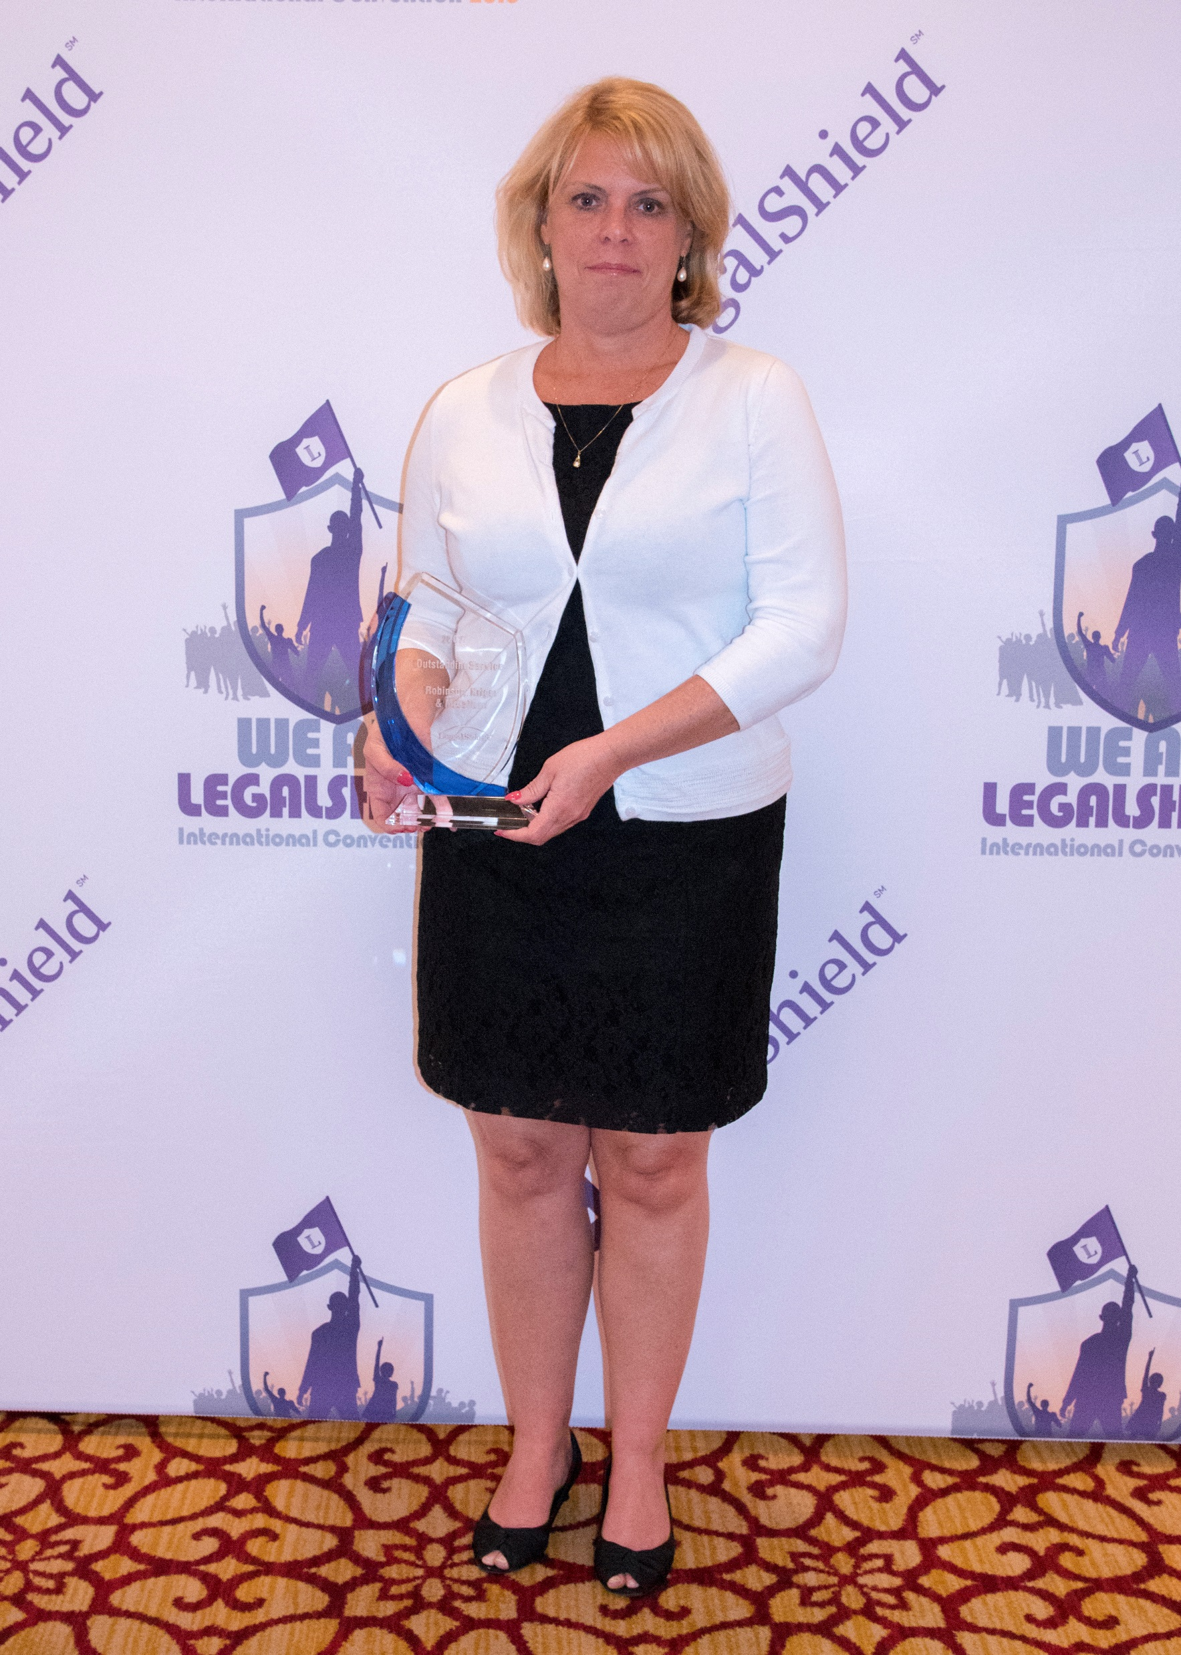
Outstanding Service Award
Marianna Fenton Hibbard
Robinson, Kriger & McCallum
ME

Slide 17
Outstanding Service Award
Kristy Travis & Vicki Staples
Dempsey Roberts & Smith Ltd.
Nevada

Slide 18
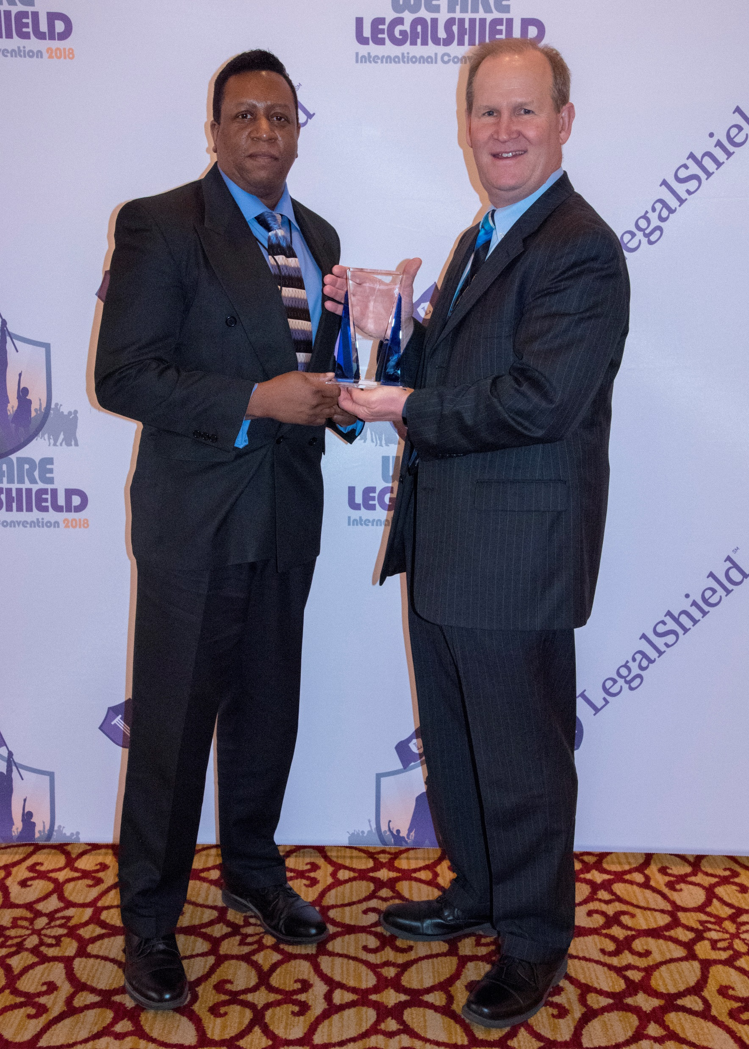
Member Choice Award
Kevin Studdard & Ron Jones
Davis Miles McGuire Gardner, PLLC
Arizona / New Mexico

Slide 19
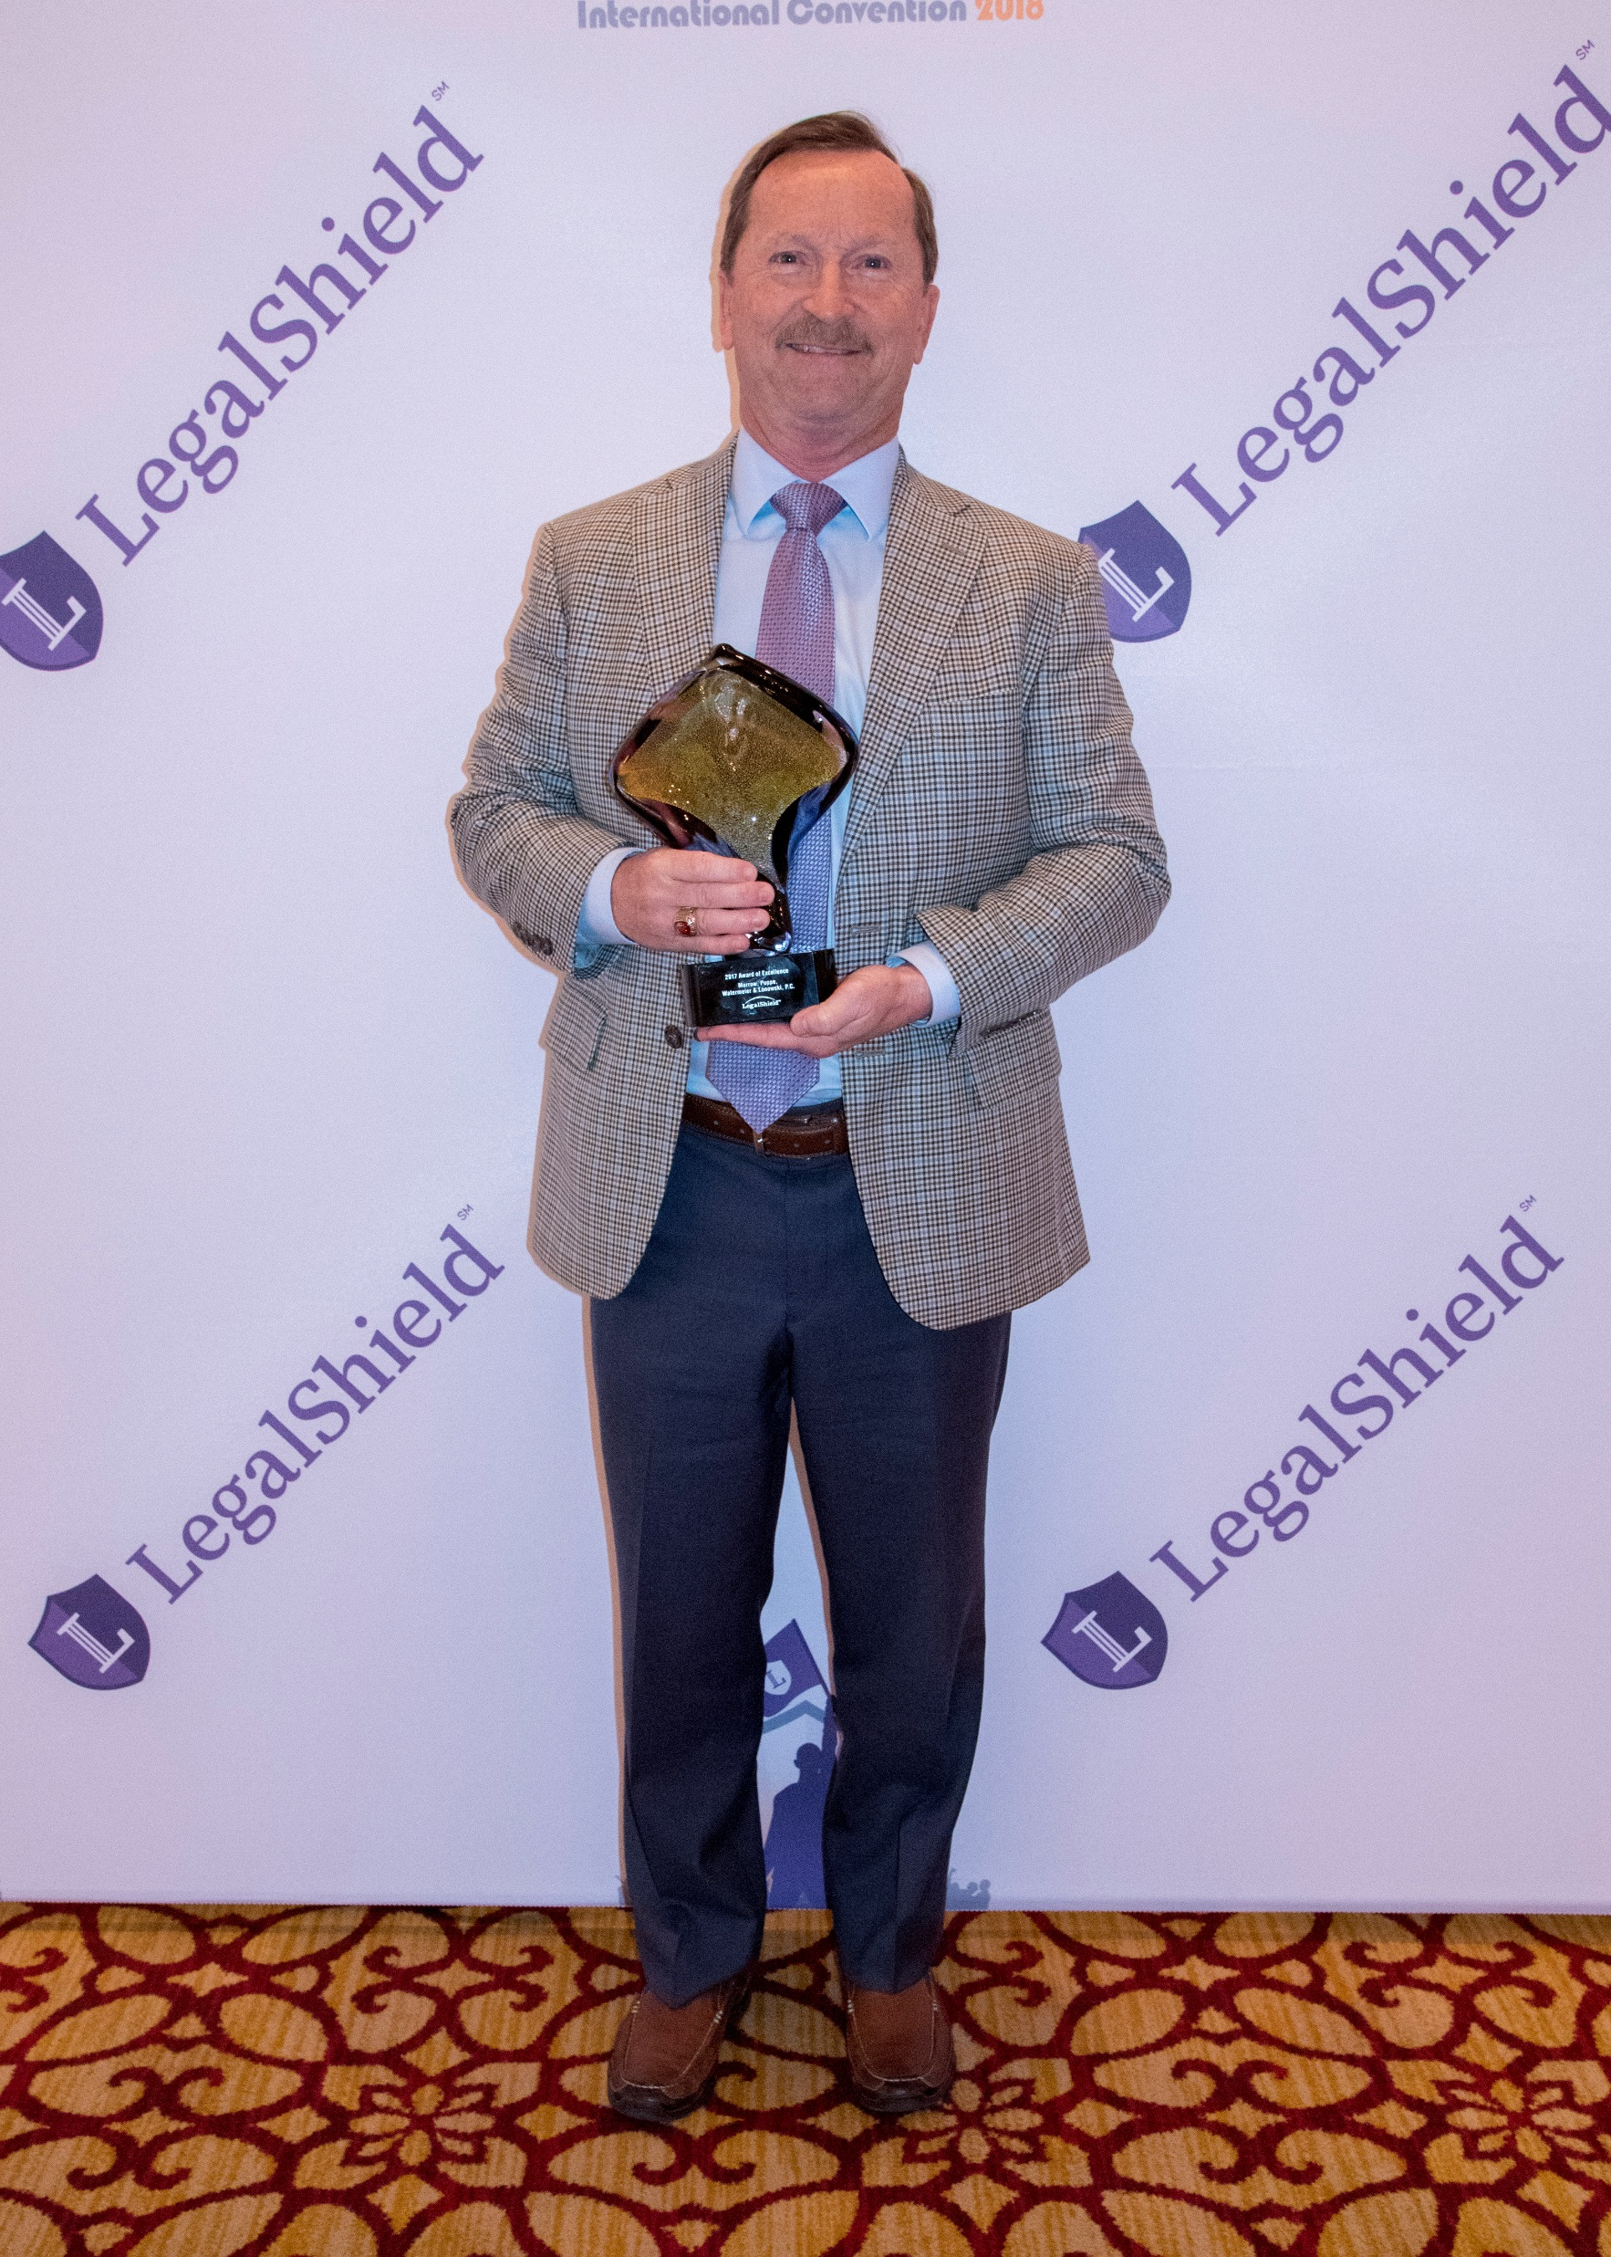
Award of Excellence
David Watermeier
Morrow, Poppe, Watermeier & Lonowski, P.C.
Nebraska

Slide 20
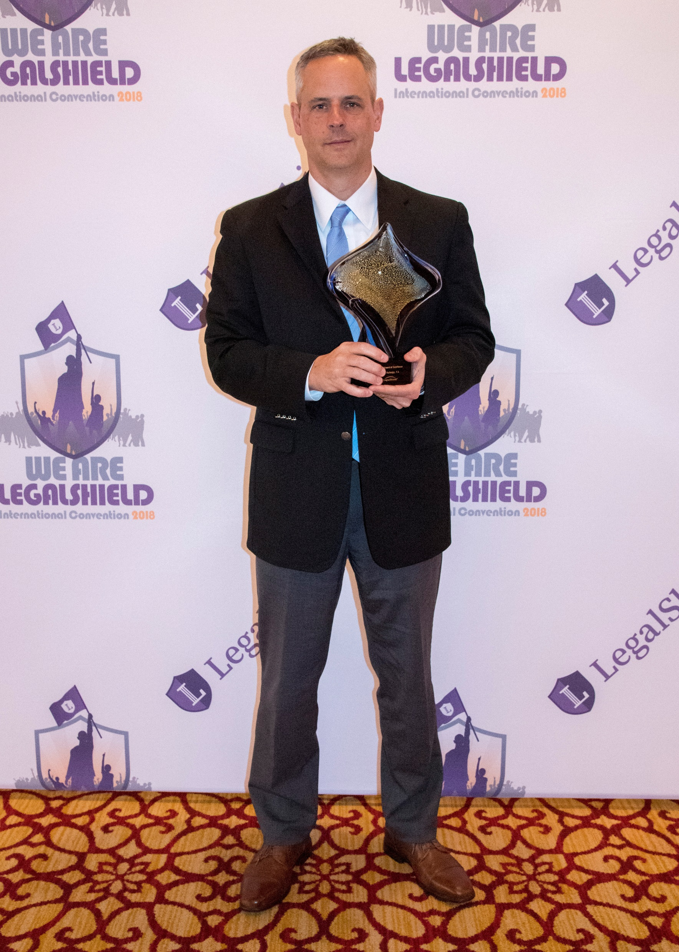
Award of Excellence
Steve Lisle
Lisle Rutledge, P.A.
WV

Slide 21
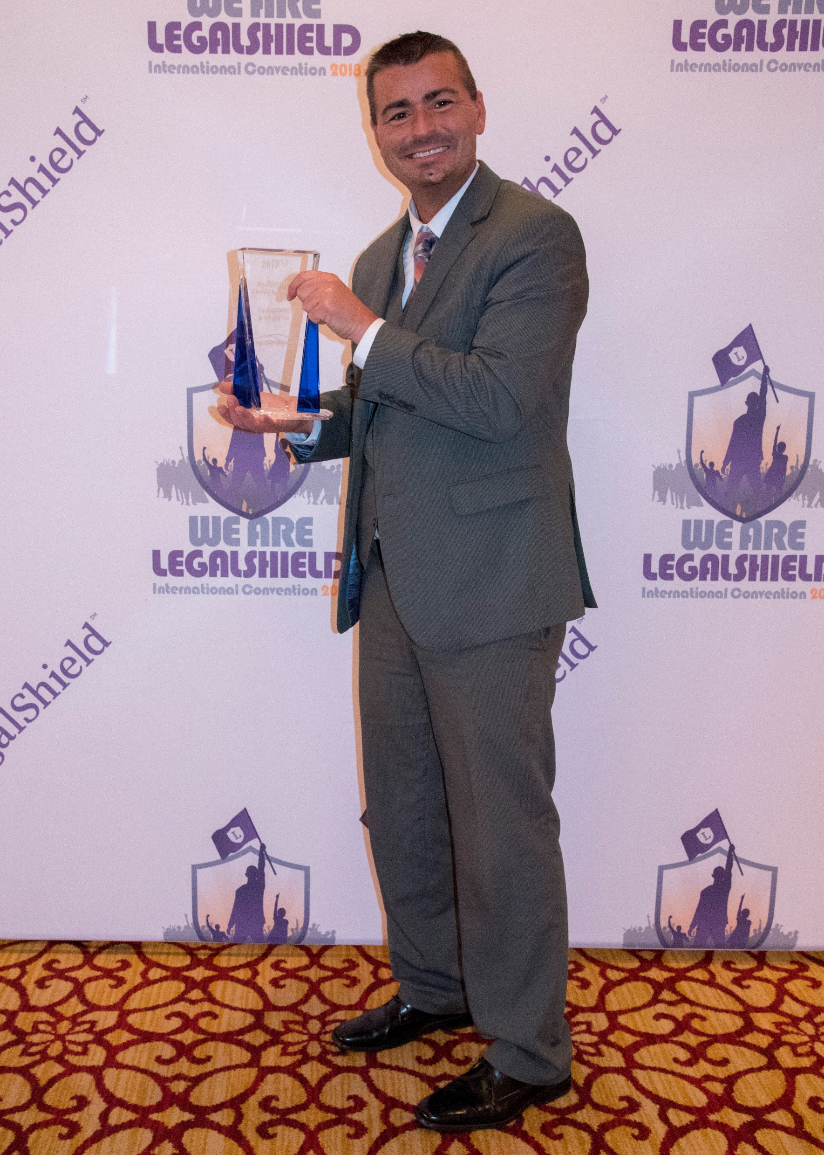
Member Choice Award
William Shrewsberry
Caldwell & Riffee
WV

