Slide 1


Provider
Lunch
& Learn

Slide 2


Welcome
Lori Owens – Sr. Director, Provider Services

Slide 3


Adonis
Provider Update
Jerred L. Wilson – VP of Engineering, Information Technology

Slide 4
Responding to Market Demands
Improve member engagement with a streamlined electronic intake process (service requests)
Service requests will drive up user adoption of our solutions (and, therefore, revenue)
Increase our focus on mobile support, driving members to mobile whenever possible (while still supporting phone and web)

Slide 5
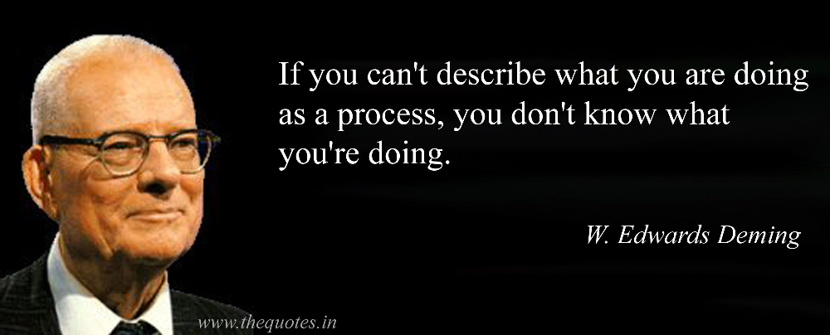
What Exactly Are We Doing?

Slide 6
LegalShield Adonis Business Process
Notes:
Add web interface fro members to responde with feedback/files; add what happens when a referral attorney is necessary (another swimlane that does the same thing); have Triage Clerk do this manually initially (MVP); long term, this should be automated completely (for later; not this conversation); focus of these flows should be only on Streamlined Intake/SR process incl electronic xchg with member

Slide 7
LS US MVP Functional Architecture

Slide 8
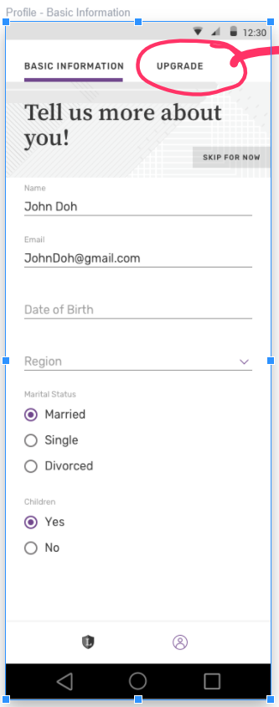
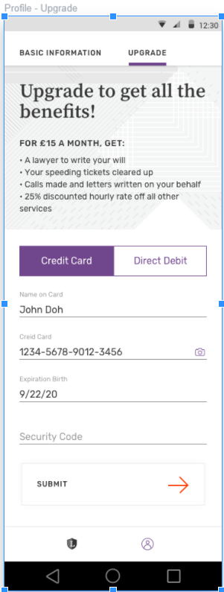
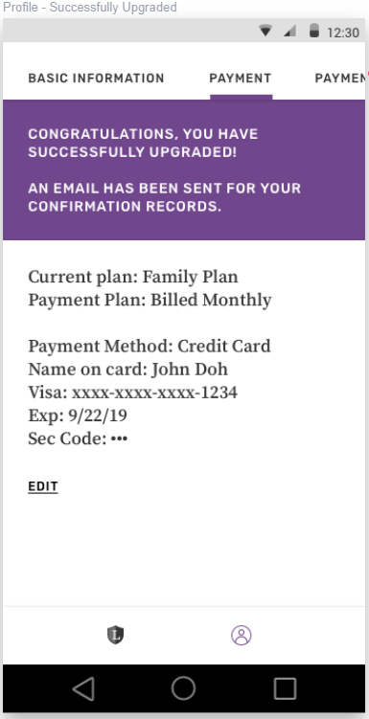
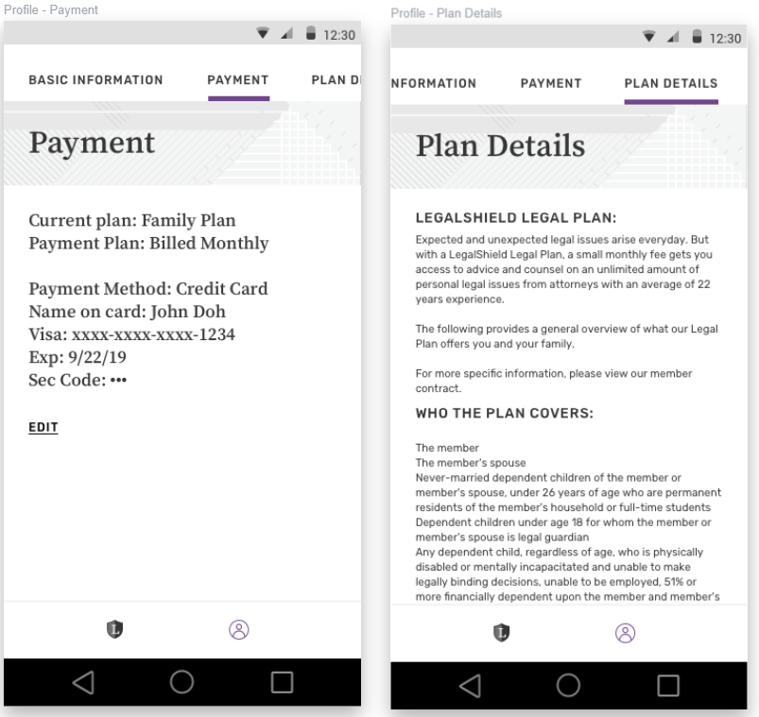
Member Designs (Paywall)

Slide 9
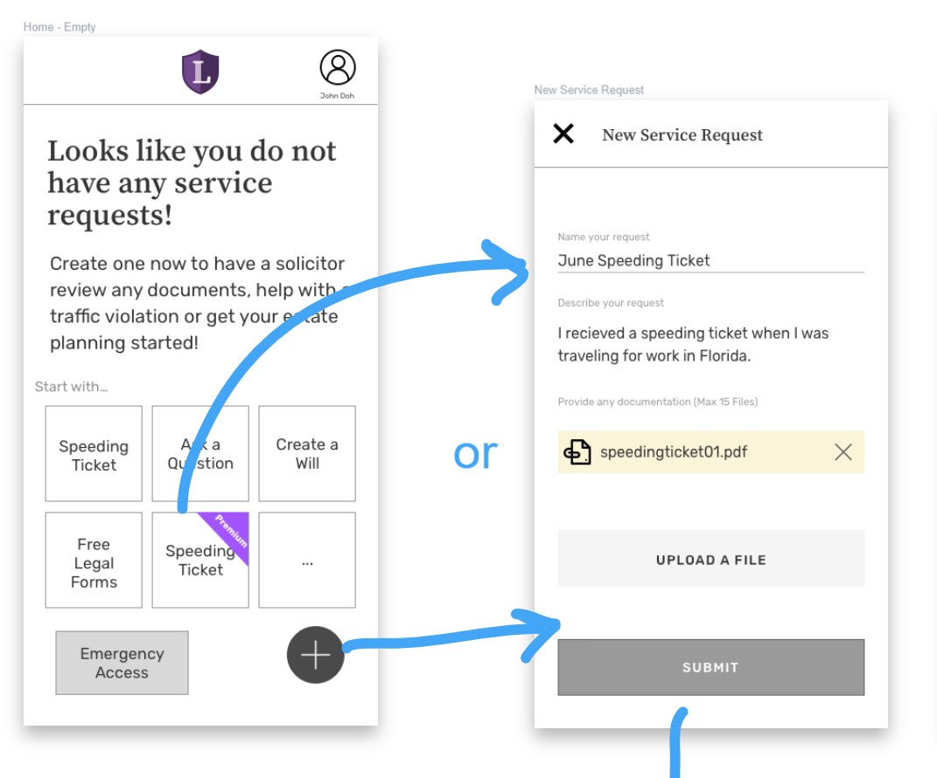
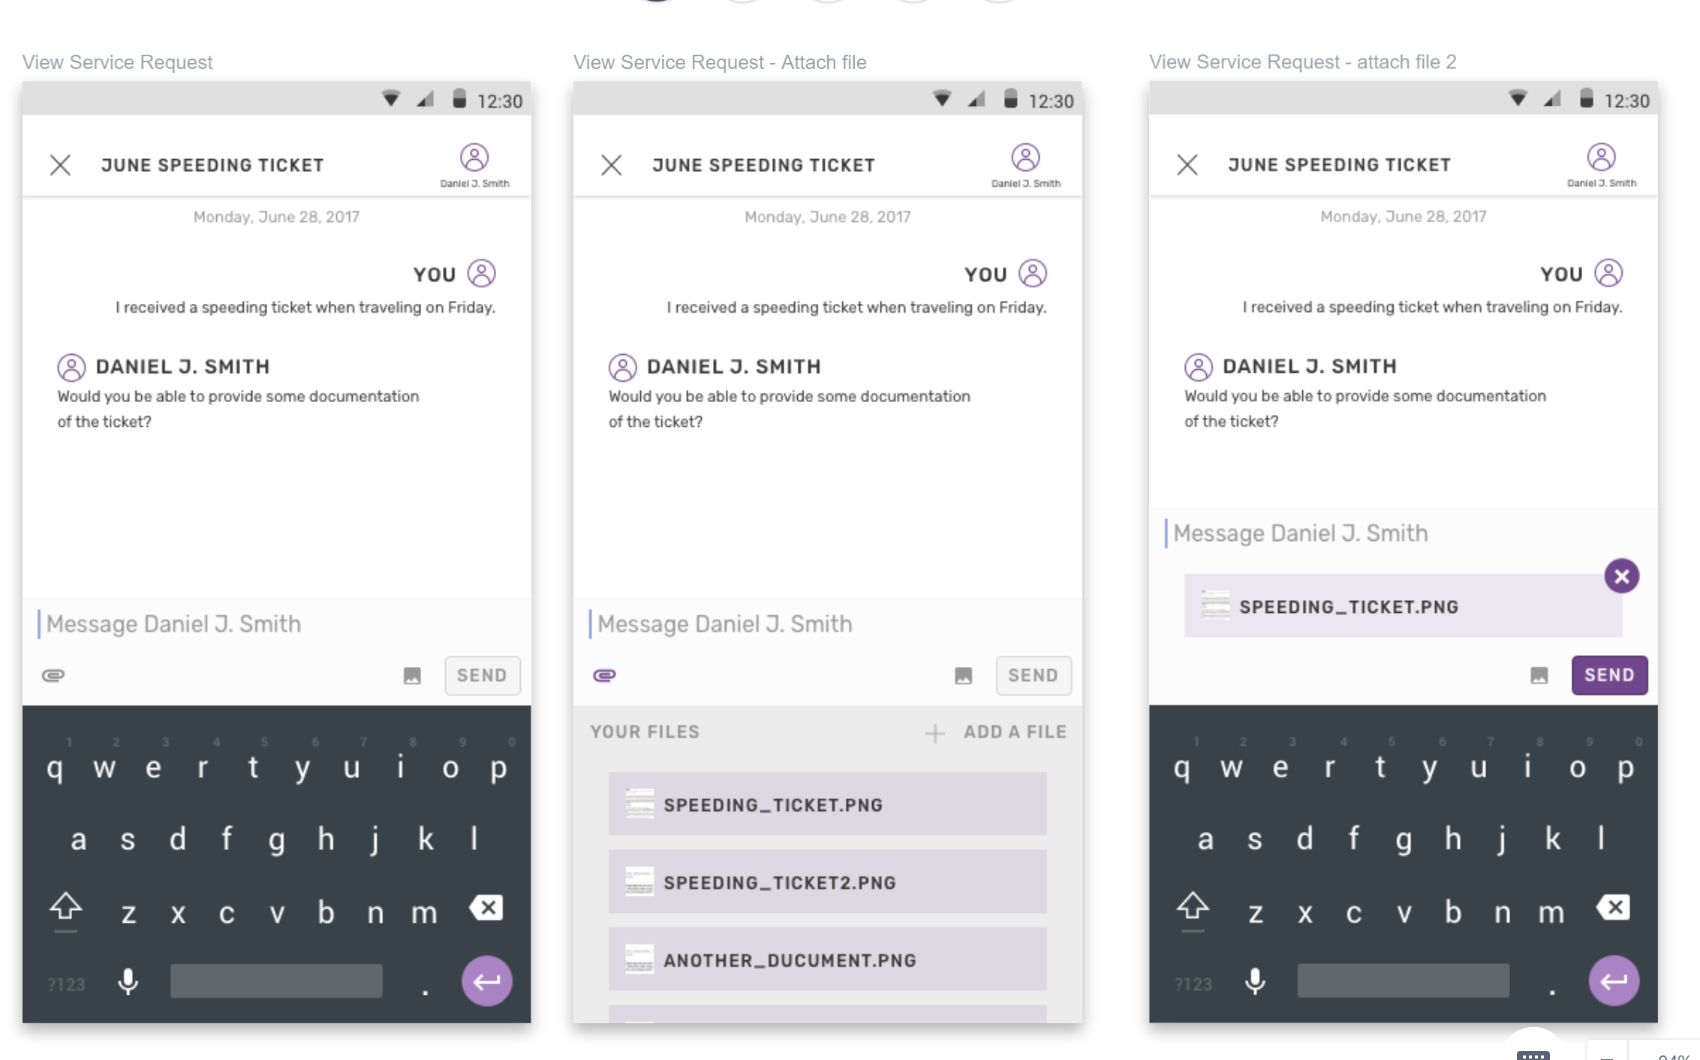
Member Designs (Service Request)

Slide 10
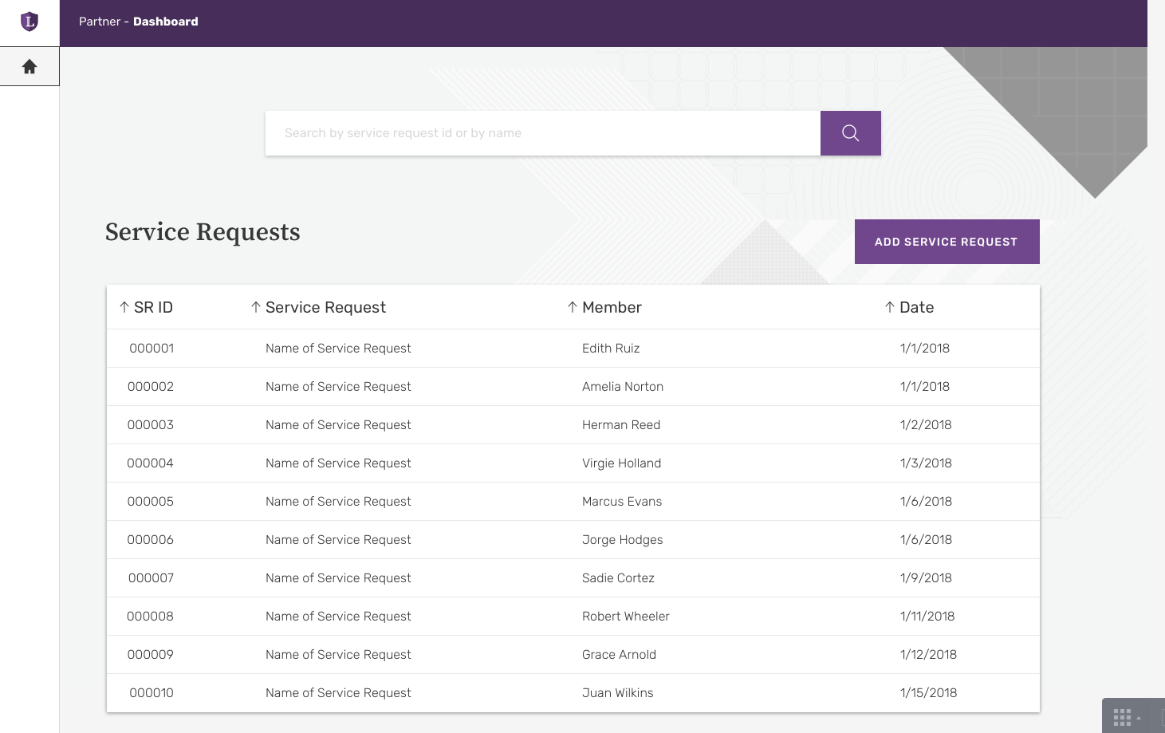
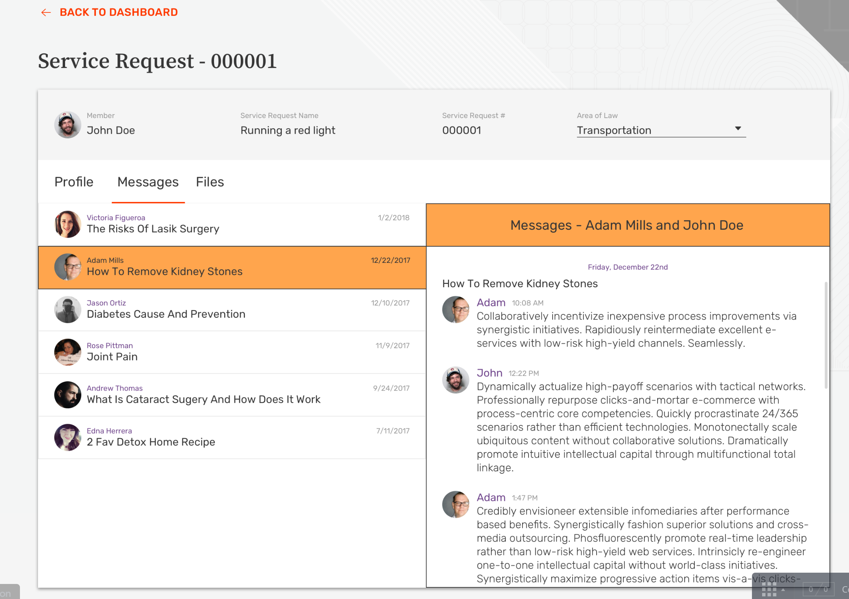
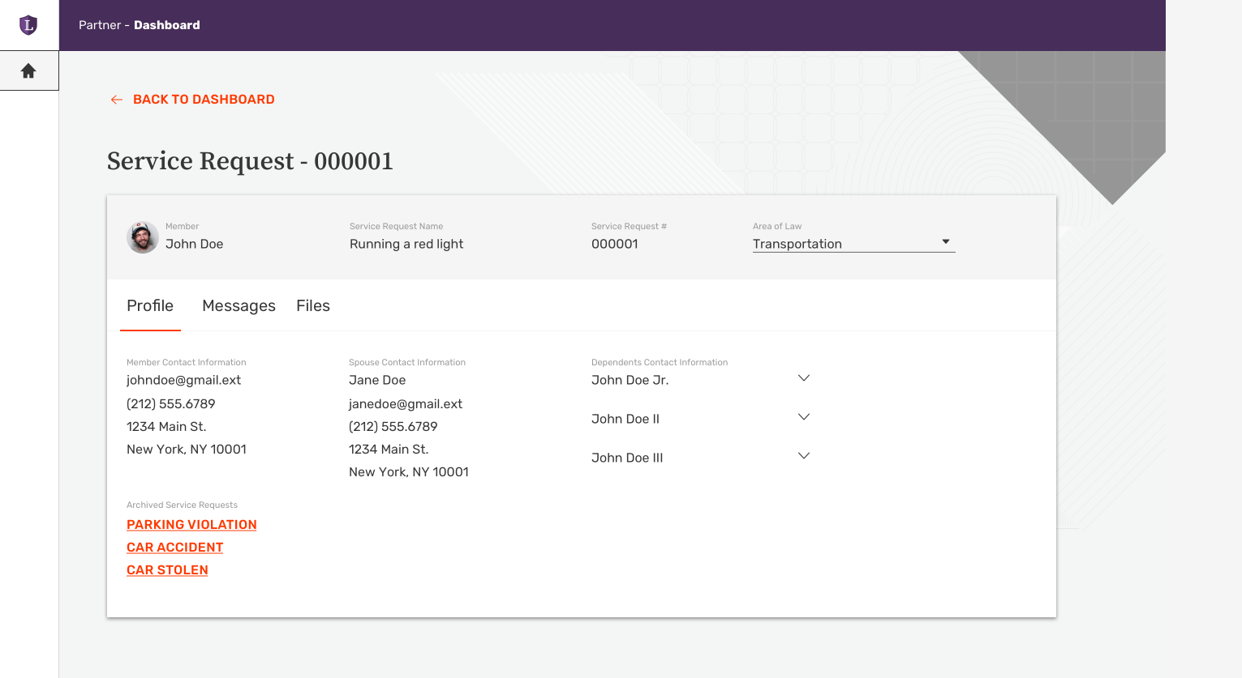
Partner Designs – Service Request

Slide 11


Slide 12
Security Planning
Jack Goldenberg
Chief Technology Officer

Slide 13
If you fail to plan, then plan to fail!

Slide 14
Industry Trends
Smaller firms (not just law firms) are targets because of low spend vs. high value of assets
http://www.abajournal.com/magazine/article/managing_cybersecurity_risk
Executive teams are targets because they have access to more assets
https://www.cio.com/article/3247428/security/safeguarding-your-biggest-cybersecurity-target-executives.html
Hackers are aggressively targeting law firms’ data
https://www.cio.com/article/3212829/cyber-attacks-espionage/hackers-are-aggressively-targeting-law-firms-data.html

Slide 15
Current State
Phishing
  For account credentials
  Ransomware
Impersonation for money

Slide 16
Multi Factor Authentication
Becoming a standard at many instituions
  Banking, medical, etc.
  Will ultimately be a requirement for members and associates
Requires 2nd device to complete login
  Will be required to access LegalShield Information Systems
  Will be required for authentication on provider owned systems

Slide 17
Email Filtering
Quarantines suspicious emails
    Scans the email for suspect content
    Leverages collective intelligence from the Ecosystem
LegalShield implementing Proofpoint
Email filtering will be required on your email systems
LegalShield can help negotiate or even manage your emails if desired
    What business model is preferred?

Slide 18
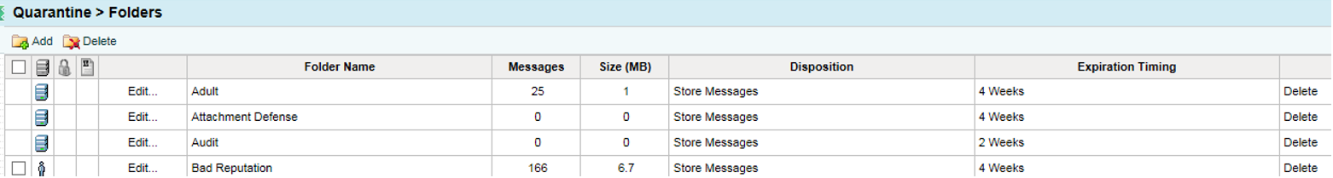
Quarantine Folders

Slide 19
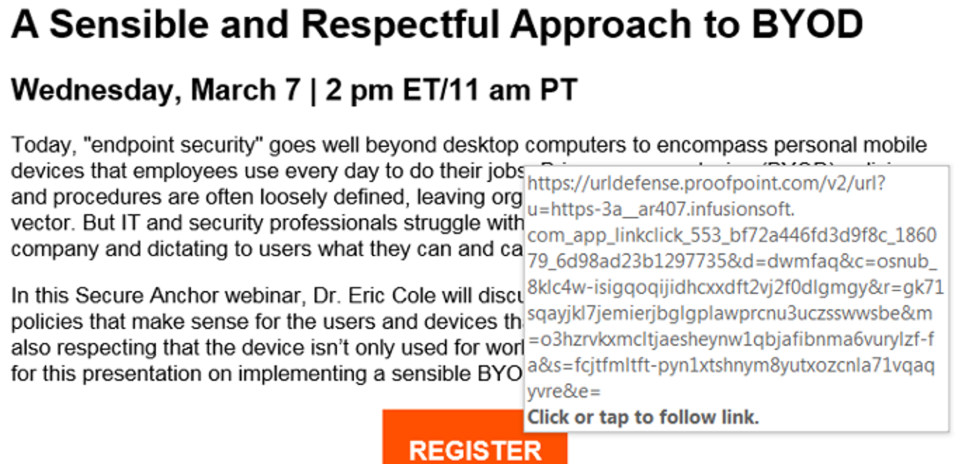
URL Defense

Slide 20
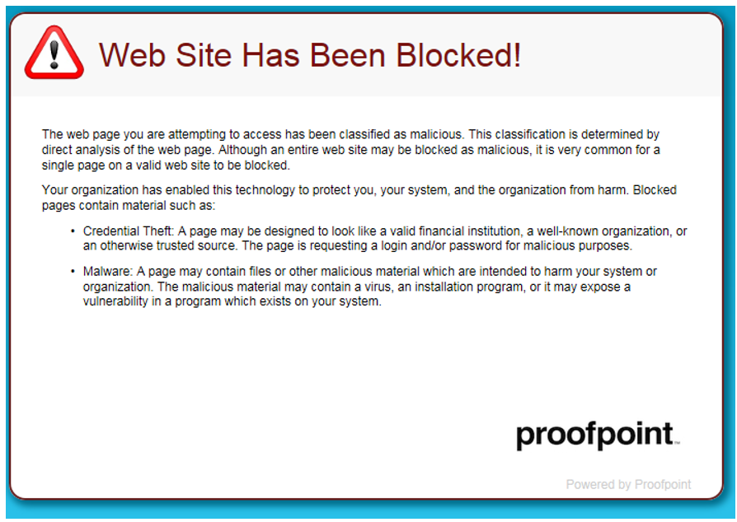
URL Blocked

Slide 21
Incident Response Plan
LegalShield has updated its incident reponse plan in the event of all security incidents
  Clear roles and responsibilities of key staff to manage the incident
  Technical recovery clearly defined
  Clear and consistent communication during the incident
    Will include local and federal law enforcement as part of the process
  You must have a plan like this

Slide 22
Security Assessment
Use of a 3rd party reviewer to assess your security risks
LegalShield utilizes Kroll and IBM for annual testing
  Produces a list of exposures and severity
This will be required of each firm with disclosure to LegalShield
    Technical
    Social

Slide 23
Engagement with Vendors
How can LegalShield help you?
  We can introduce you to vendors
  Manage on your behalf
  Mix of both
  Any suggestions

Slide 24
LegalShield/Provider Agreement
Will be modified to require by Sept. 1, 2018
  Multi Factor Authentication to access provider systems
  Email filtering (Phishing detection)
  Minimum of Annual Security Assessment
  Documentation of Incident Response Plan
  Disclosure to LegalShield of all security related incidents and any investigation results
    Designed to increase awareness for our whole network

Slide 26
Q&A
Jerred Wilson, Kathy Pinson, Jack Goldenberg & Keri Norris

Slide 27
Opportunities for Success LawPAK
Keri Norris – SVP, Legal & Regulatory Affairs, Chief Legal Officer
Michael Flanagan – Senior Executive at SafeLaw
Keri Norris – SVP, Legal & Regulatory Affairs, Chief Legal Officer
Michael Flanagan – Senior Executive at SafeLaw

Slide 29
New Retention Program
Steve Williamson
CFO

Slide 30
Retention Improvements
THE BIG PICTURE
  Historically
    Focused on Operational Improvements
      More credit card resubmits at better times
      Increased saves calls made at better times
      Processing payments on “better days”
      Reduced commissions for pre-paid credit cards
  The Future
    Focused on Early Intervention and Education
      Associate Retention Improvement Program (ARIP)
      Early warning indicators

Slide 31
Membership Churn

Slide 32
Associate Retention Improvement Program
ANALYSIS, IDENTIFY, COACHING/TRAINING
  When: Program began November 2017.
  What: A monthly analysis of organizational retention for every sales associate.
  Who: Associates with 50+ LTM organizational counters who have retention below acceptable level.
  How: Managed by Jeannie Forneris, Quality Department and supported by Kristi Hudson, Analytics.
  Goal: To work with and encourage associates to adopt better business practices to improve their organizational retention.

Slide 33
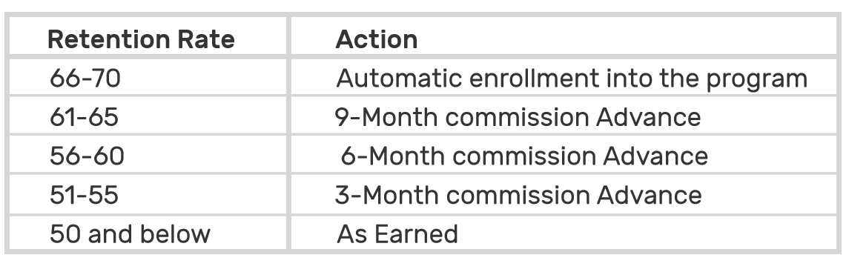
Associate Retention Improvement Program
COMMUNICATION
All email communication to associates include copies to their ED and Platinum
First 30 days: Must improve retention or could have advances lowered
Next 90 days: Review again to determine if retention improved equal to, or greater than, advances

Slide 34
Associate Retention Improvement Program
STATS
There are 1,022 associate enrolled, less than 1% of associates
Retention Rate | November Enrollment - % of Total Enrollees
66-70% | 50%
61-65% | 7%
56-60% | 12%
51-55% | 16%
50% and below | 15%

Slide 35
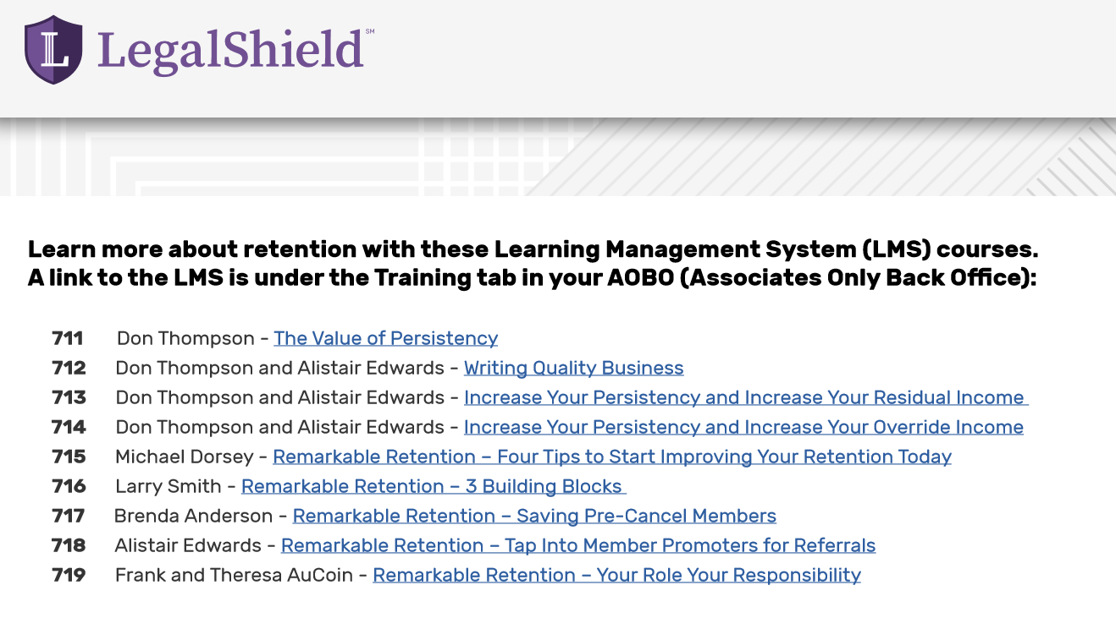
Associate Retention Improvement Program
TRAINING
New Retention Training (added Feb):
LMS Course 720: How to Contact Pre-Cancel Members

Slide 36
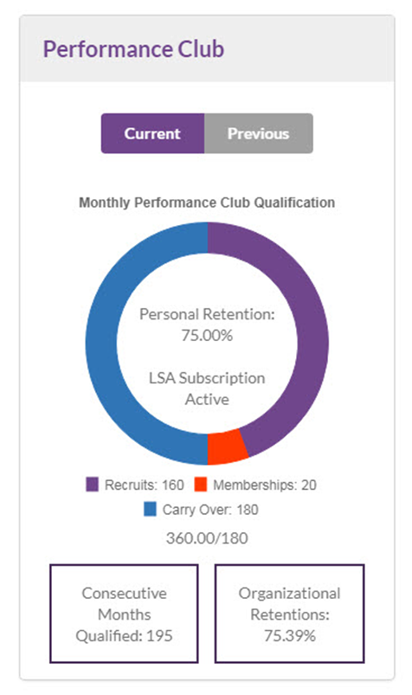
Associate Retention Improvement Program
LS ENGAGE REPORTING
LS Engage Reports – Performance Club:
Current and previous month
Quarterly personal and organizational retention data

Slide 37
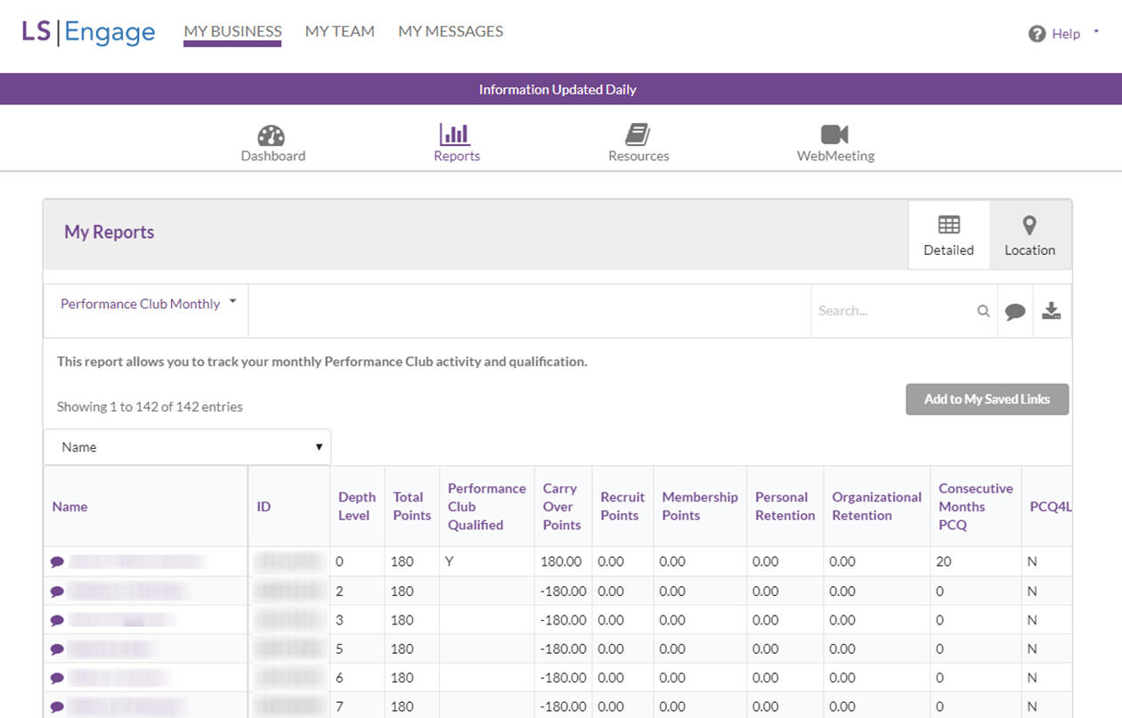
Associate Retention Improvement Program
LS ENGAGE REPORTING
LS Engage Reports:
Detail of Associate Downline with Search, Email and Export

Slide 38
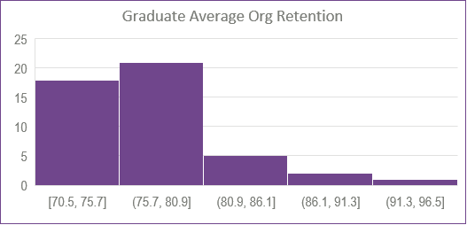
Associate Retention Improvement Program
RESULTS
47 Associates are ARIP Graduates
Organizational retention of the 47 associates who were eligible to move out of the program.

Slide 39
Retention Training Results
Retention Improvement 30 Days Post Training

Slide 40
Early Warning System
IDENTIFY LOW & HIGH RETENTION ASSOCIATES SOONER
  When: Program began January 2018.
  What: A monthly analysis of all member data by associates with six identified metrics that are predictive of low/high retention.
  Who: Associates with five organizational counters in the last three months with several elevated metrics.
  Goal: To identify new associates with potential low/high retention in their first few months and engage with them to correct the negative metrics or promote those with high levels.

Slide 41
Early Warning System
IDENTIFY LOW RETENTION ASSOCIATES SOONER
  The Factors
    1. High pre-cancel percent
    2. High percent of pre-paid credit cards
    3. High complaint ratio
    4. High non-taken ratio
    5. High percent of reinstatements
    6. Associate’s membership cancelled
  First Month: In January 2018, we identified the 10 associates that needed the most help. Engaged to advise/correct practices.

Slide 42
Conclusion
  We have come a long way
    Churn Rate improved from 3.2% to 2.1%
  We are excited about our future
    ARIP is already making an impact
    Early Warning System has great possibilities

Slide 44
Launch by LegalShield
Blake Turney
Manager of Operations
Launch

Slide 45
Launch Process Today
There are several issues that exist with the Launch process today.
UPL concerns
Less than ideal customer experience
Several opportunities for error
Not scalable

Slide 46
Launch Version 3 (coming soon)
Customers will answer less than 10 questions on the website, pay and submit.
Attorney provider receives notification and will contact the new customer within 4 business hours and discuss their business formation needs.
Provider will do the rest.

Slide 47
What Does This Mean for You?
UPL concerns go away
Issues with incorrect plans will be dramatically lessened or eliminated (members will be assigned a SmallBiz 10 plan in cases where it is needed)
You’ll have the opportunity to serve as the Registered Agent for the business and will collect and keep the fees
You’ll have happier and better served members

Slide 49
Biz Box by Office Depot
Niclas Carlsson
Sr. Director/Assistant Controller

Slide 50
Exciting News with the New LegalShield/Office Depot Partnership and the New Biz Box Concept
FY18

Slide 51
Office Depot at a Glance
Annual sales of approximately $14 billion.
Employs about 66,000 associates.
206 million visitors in stores annually.
OfficeDepot.com has 250MM visitors annually.
They operate 2,200 retail outlets under various brand names (roughly 1,700 are branded Office Depot).

Slide 52
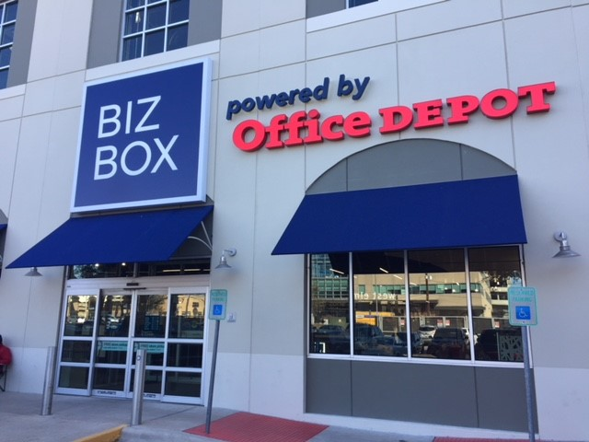
Biz Box New Concept
  Rebranding started in January FY18
  Our Launch product will be sold at all Biz Box locations.
  14 stores in Austin currently being rebranded, then nationwide. Our products will be sold in 1,700 stores.
  $250MM Marketing Plan for FY18.
  We will have access to 25,000 sales reps.
  We will also be featured on their website.

Slide 53
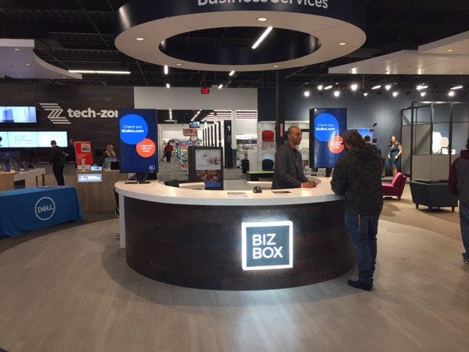
Biz Box Store Layout
  One stop shop for anything business
  Modern design
  Customer focus

Slide 54
This New LegalShield/Office Depot Partnership Will Increase Sales of Launch
Sales are estimated to grow quickly in FY18-19.
A collaborative marketing plan between LegalShield/Office Depot is underway.
More clients will be introduced to provider firms, which in turn will lead to increased business.

Slide 56
Member Resolution
Process Changes
Jeannie Forneris – Sr. Director, Quality Services, Quality – Member Resolution

Slide 58
Questionnaires & Forms / Enhance by LegalShield
Mariam Ballard – Product Manager, Enhance, Provider Services

Slide 59
Questionnaires & Forms

Slide 60

Mobile App: Questionnaires

Slide 61
Questionnaires: Roadmap
Will
March 14
Prenup
March 23
Bankruptcy
April 13
Divorce
April 13

Slide 62
Improved Will Questionnaire
What’s Changing?
Member | Provider
Brand new design | New formatting for the questionnaire report
Provide more information | Timestamps per question and response
Save as you go

Slide 63
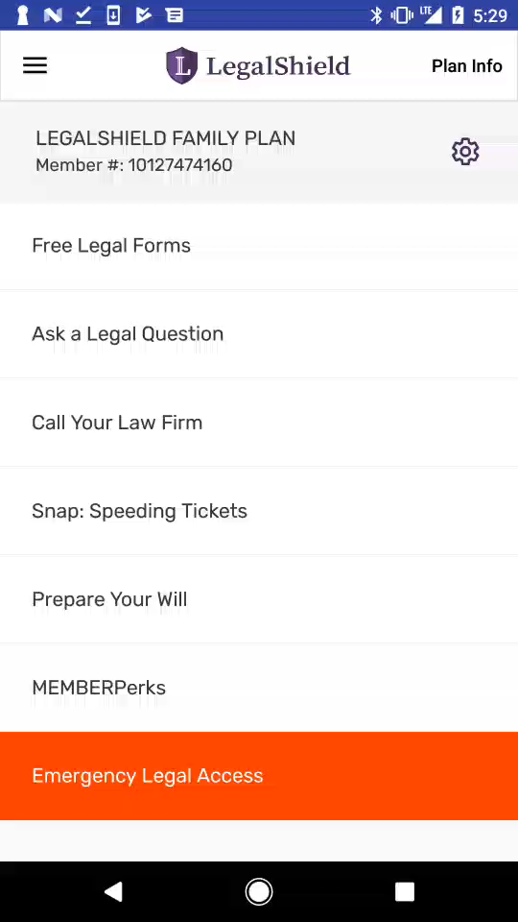
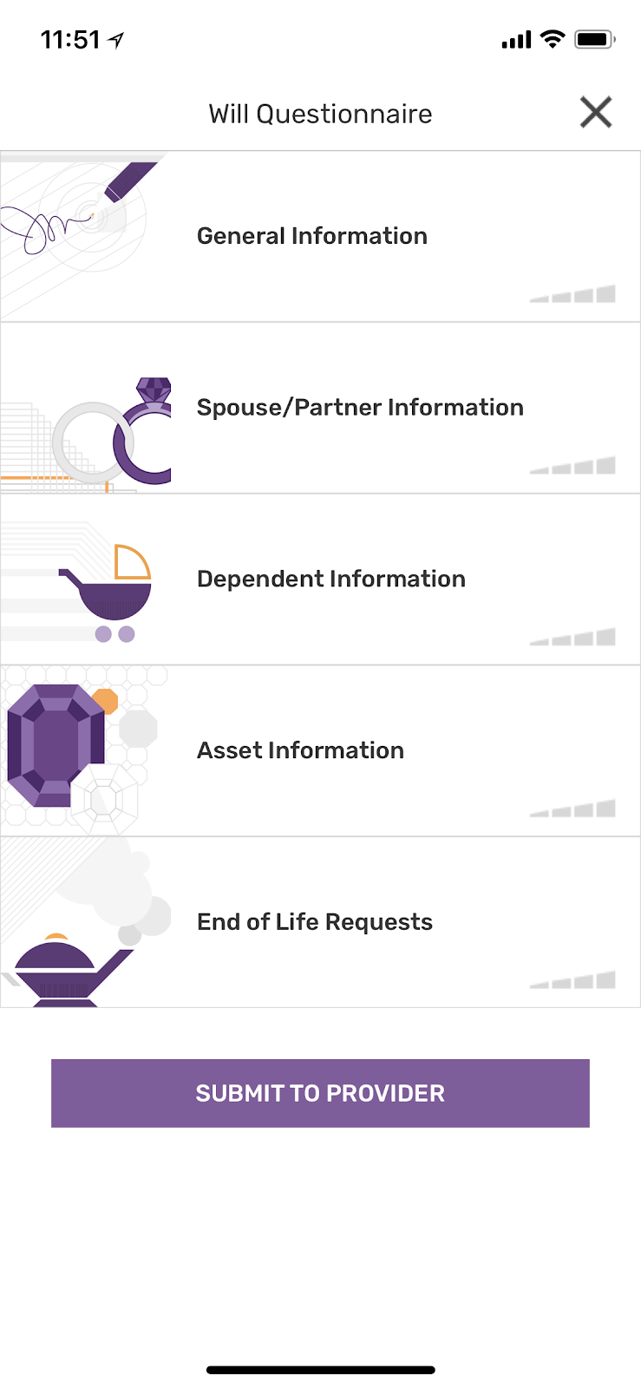
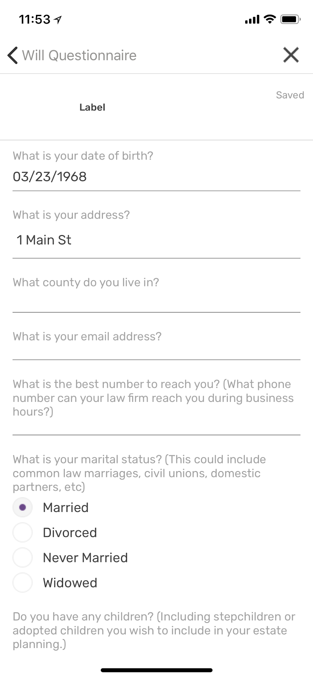
Member Experience: Will
Notes:
- Continuous improvements will be made. The member’s info will be populated in a future iteration.

Slide 64
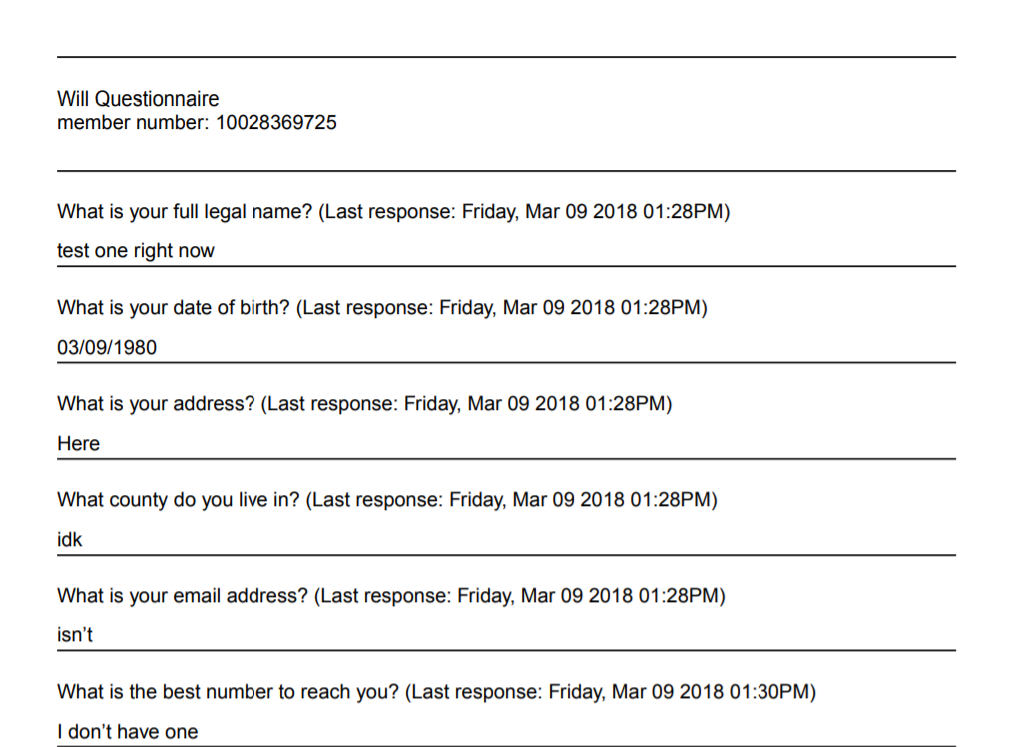
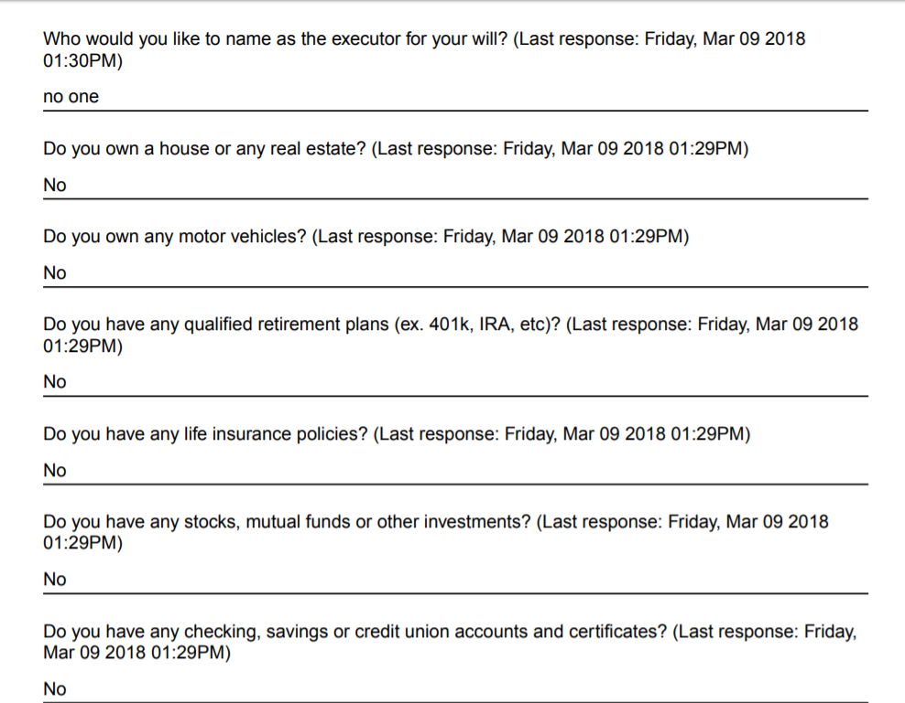
Provider Experience: Will

Slide 65
Mobile App: Forms

Slide 66
Forms: Roadmap
Forms by LegalShield (All States/ Provinces)
Live in App (Batch 1) | In Development (Batch 2)
Health Care Power of Attorney Bill of Sale Living Will/ Advance Directive Notice to Quit Non-disclosure Agreement/ Confidentiality Agreement | Promissory Note Warranty Deed Quit Claim Deed Residential Lease Agreement Affidavit of Surviving Joint Team POA for Minors (Delegation of Parental Powers, Medical Treatment for Minors)

Slide 67
Forms: Roadmap
Forms by LegalShield (All States/ Provinces)
Need to Collect (Batch 3)
Lease modification Notice to Terminate Tenancy/ Eviction Notice Roommate Agreement Tenant Move In/ Out Agreement Termination of Lease
Notes:
New forms will be released in batches that fulfill a holistic need. Example – landlord/ tenant

Slide 68
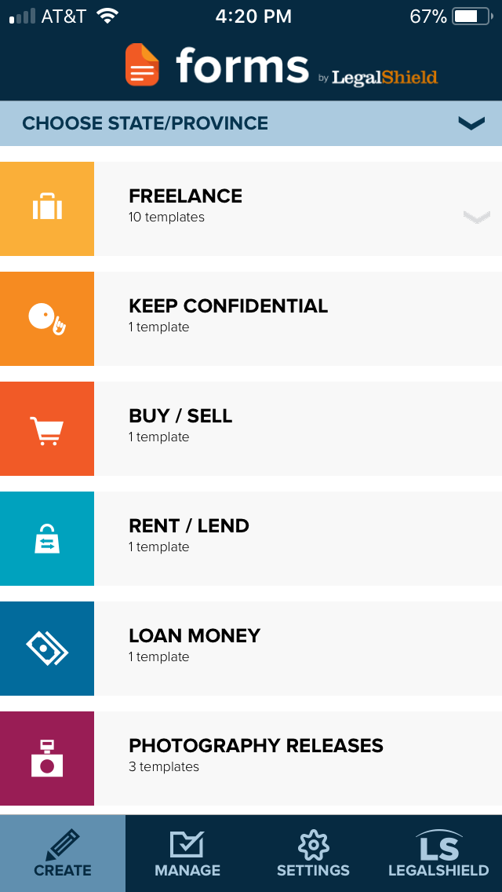
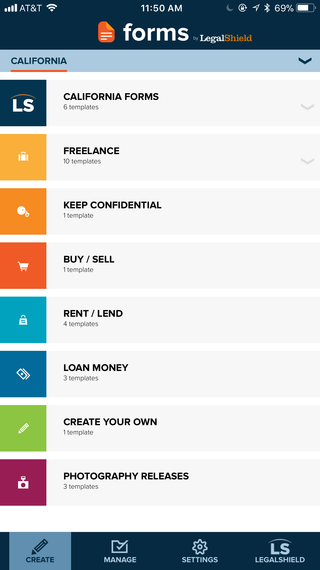
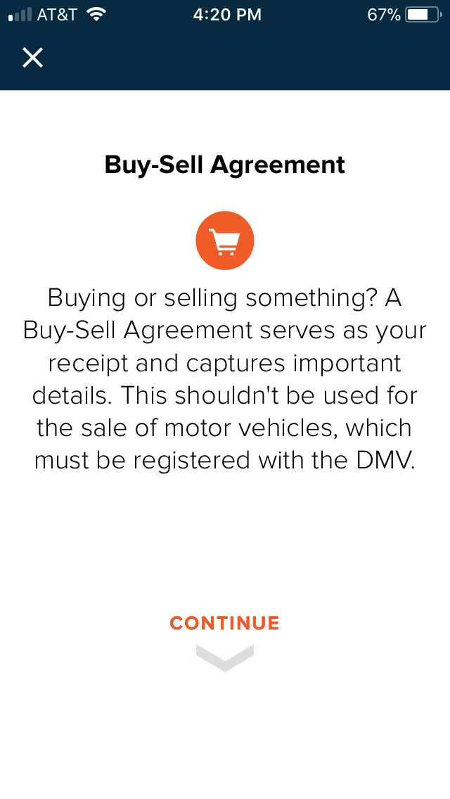
Freemium Experience: Forms

Slide 69
Forms: What’s Next
Mobile
Web
Q2: Forms by LegalShield marketing pages added to www.LegalShield.com
April: Release Batch 2 Forms
May: Release Batch 3 Forms

Slide 70
Enhance: Identity
Lawyer and AOL Directory

Slide 71
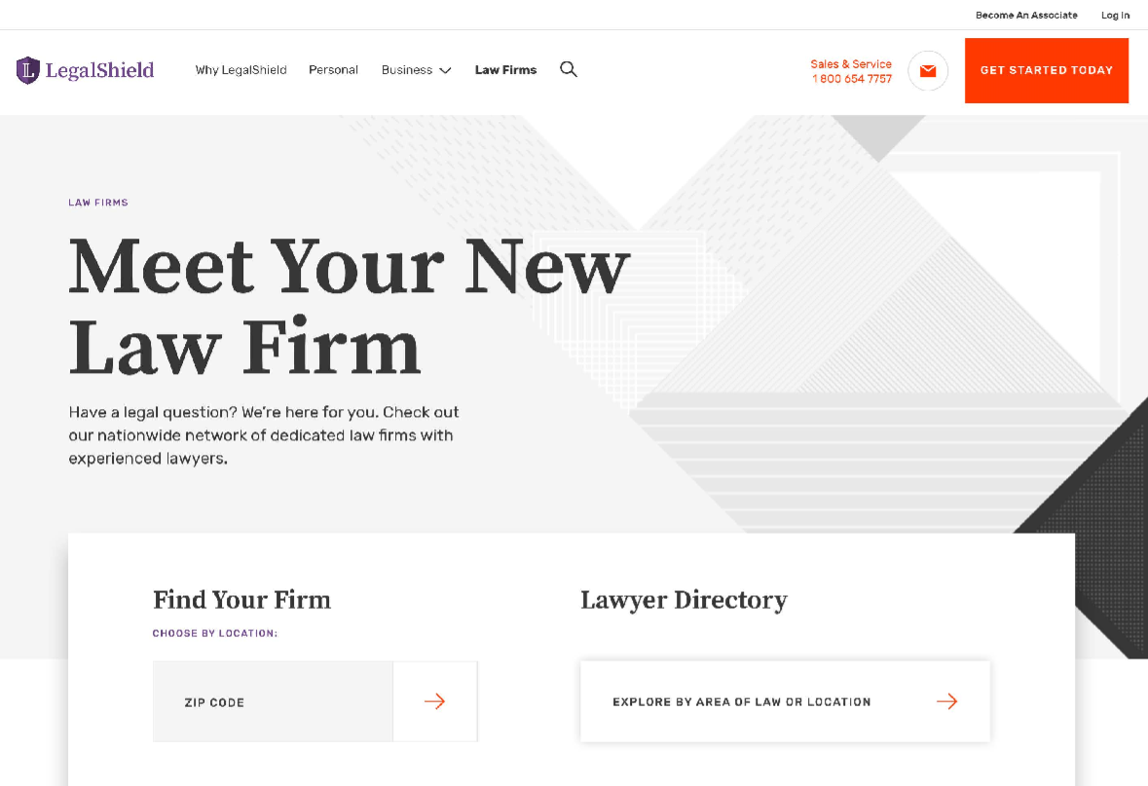
Identity: Directory

Slide 72
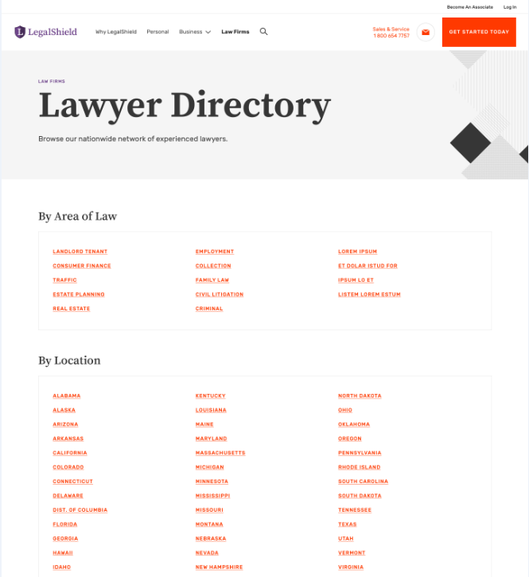
Identity: Directory – AOL/ Location

Slide 73
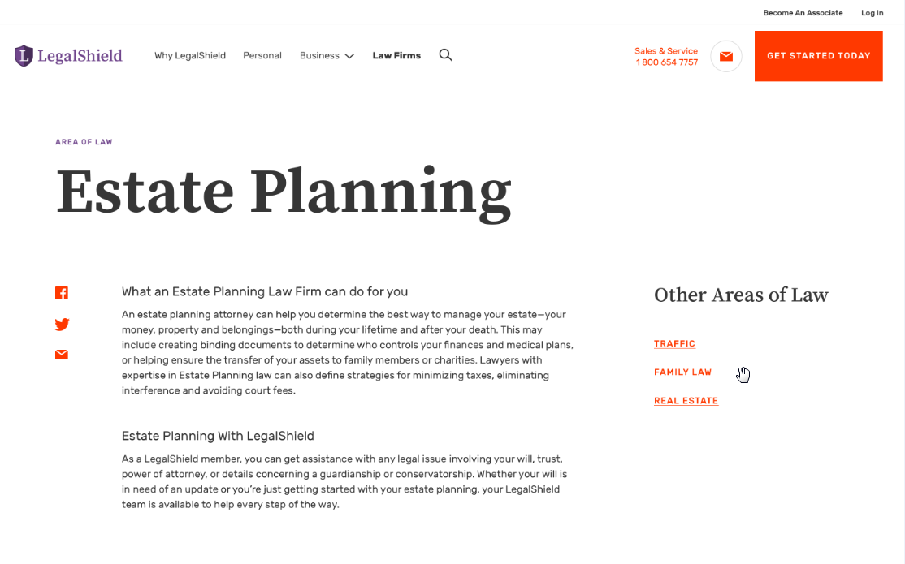
Identity: Area of Law Pages

Slide 74
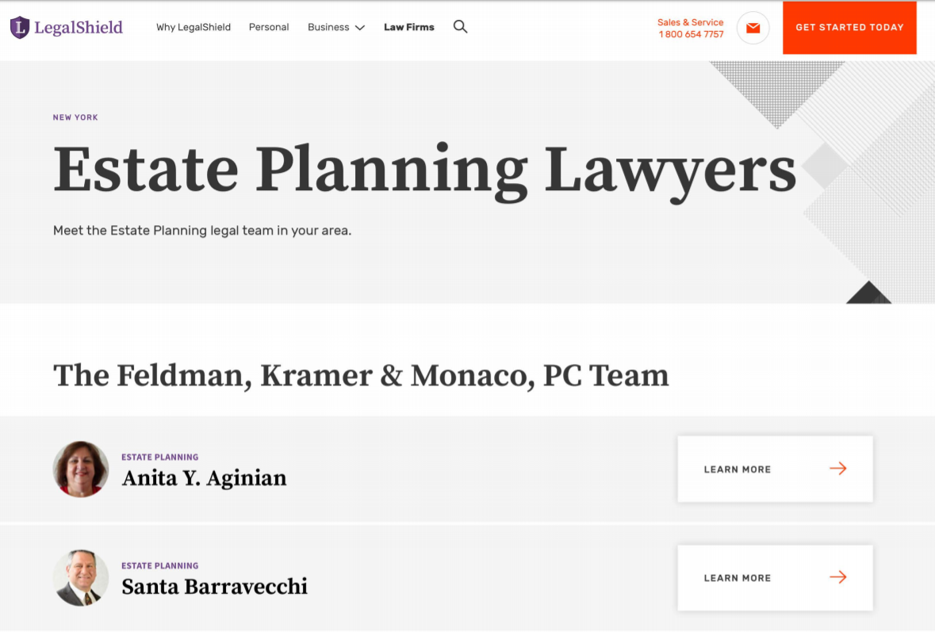
Identity: Lawyers by Location & AOL

Slide 75
Enhance: Discounted Hourly Rates
www.legalshield.com

Slide 76
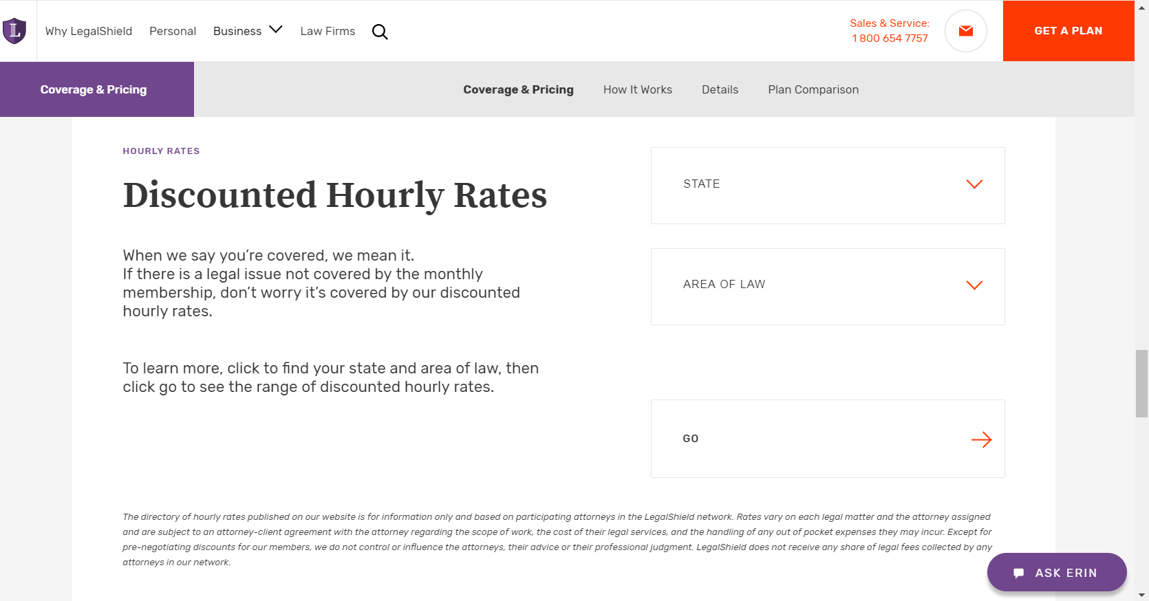
Notes:
The top 15 areas of law are the options listed in the drop down
Business, Civil Litigation, Collection, Consumer/ Finance, Contract, Criminal, Employment, Estate Planning, Family Law, General Law, Immigration, Landlord Tenant, Personal Injury, Real Estate, Traffic

Slide 77
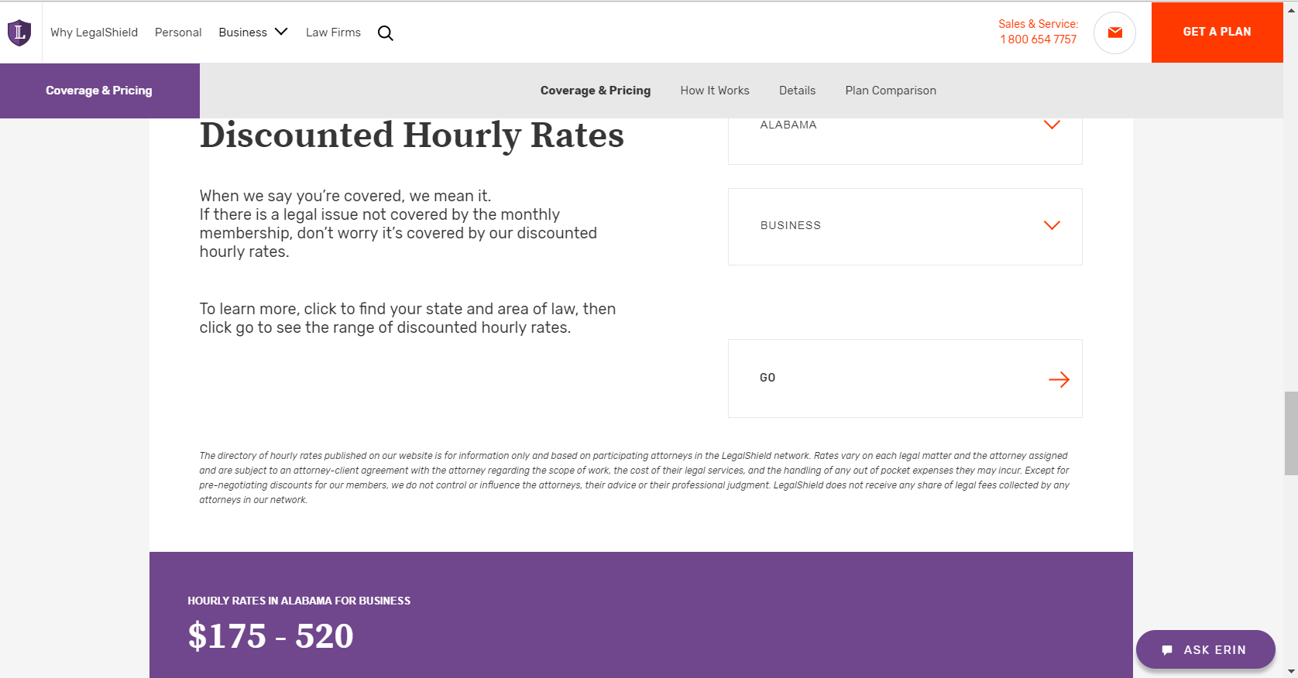
Notes:
- Rates used are the rates in RAD for the provider lawyers

Slide 78
Hourly Rates: What’s Next
Pricing Page
Firm Pages
Add hourly rates
Add generalist and specialist descriptions
Lawyer Pages
Add hourly rates
Notes:
Generalist and specialist descriptions will better inform the member as to why there is a range
Adding hourly rates to more pages of the site will continue to improve the members experience and awareness about benefit 5

Slide 79
Enhance: Referral Lawyers
Referral Attorney – Digital Application

Slide 80
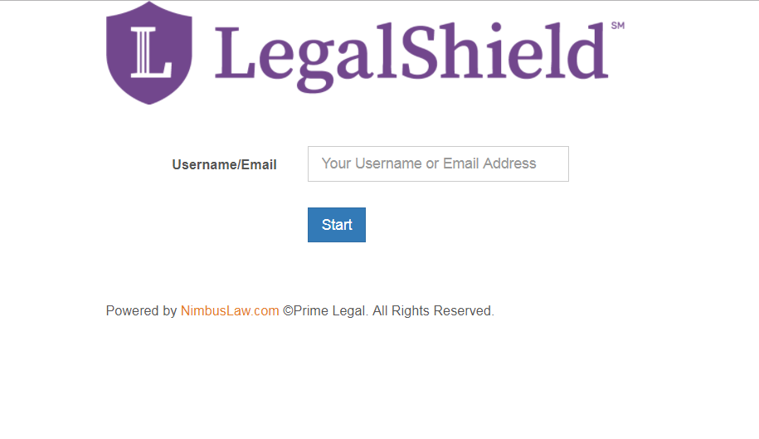
Referral Lawyer: Online Application (Beta Testing)
https://www.legalshield.com/for-lawyers/apply
Notes:
Can easily share this link with referral lawyers you are looking to add to the network.

Slide 81
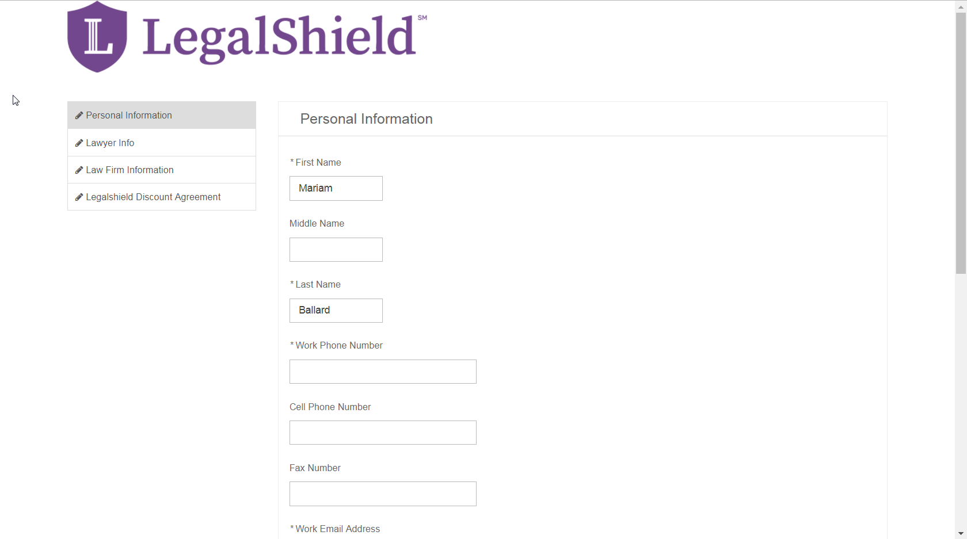
It Takes About 5 Minutes
Notes:
Less paperwork
Processing is an initial screening
- 24 hours to review and provide approval by PLF

Slide 82
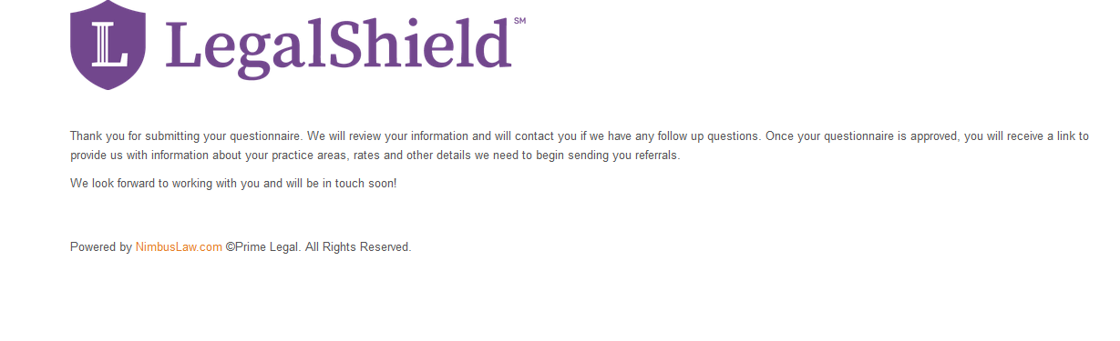
Lawyer: Follow Up Email

Slide 83
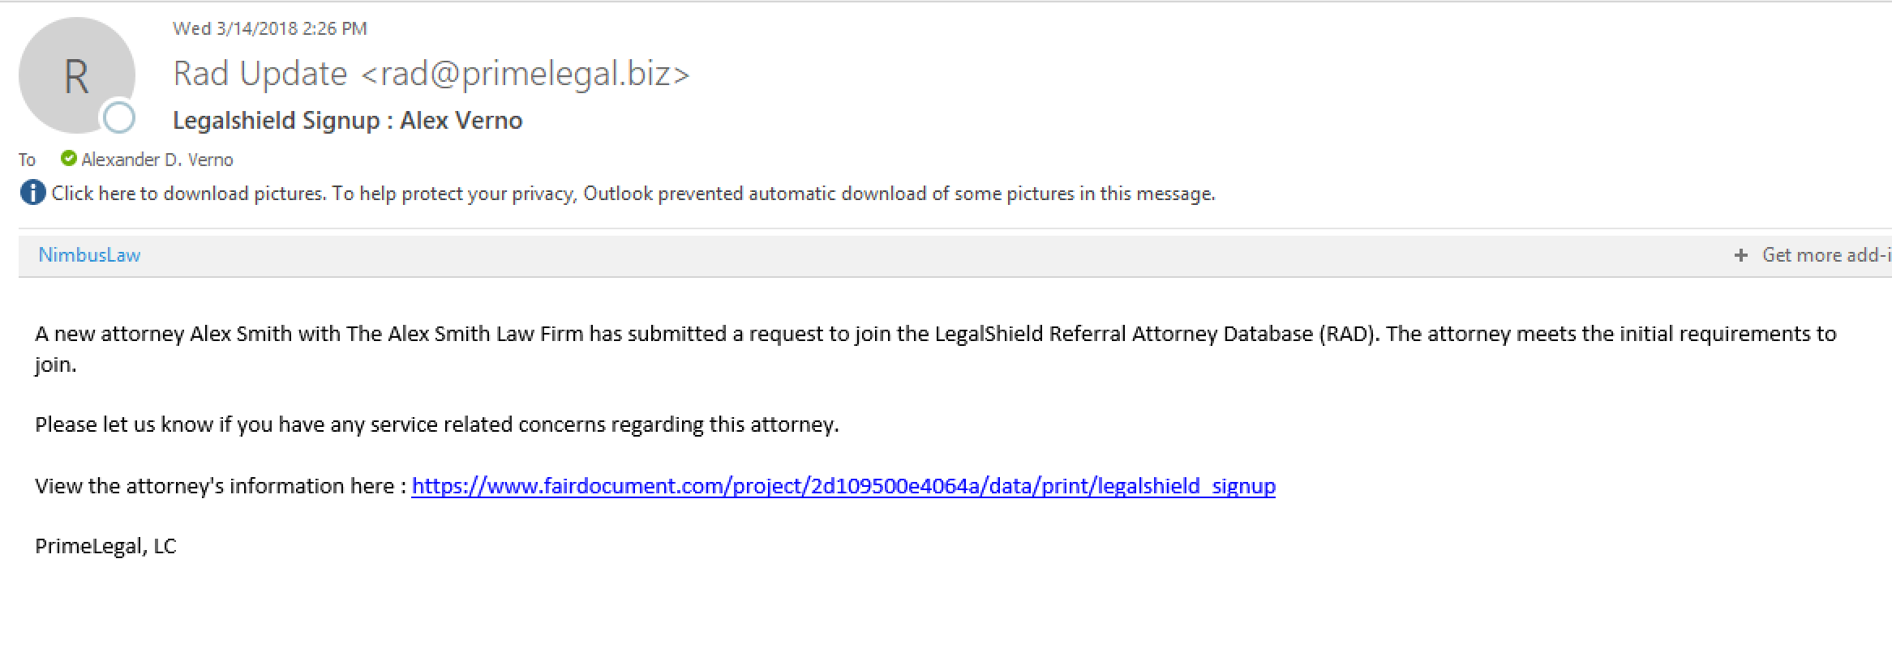
PLF: Applicant Notification Email
Notes:
Raise a concern if previous service issues exist
We ask that review happen within 24 hours upon receiving the email

Slide 84
Process Flow
Submits Application
Reviews:
- Licensed in State
- Bar Complaints
Lawyer
PLF
Provider Services
PrimeLegal
Sends: Notification email to PLF
Review & insight on lawyer history (if any)
Service concerns: Review & contact lawyer
Sends: Follow up email to lawyer
Notes:
- Follow up email to lawyer to collect AOL, insurance and localities and complete their profile: AOL, bio, headshot, etc

Slide 85
Why We’re Doing This
Bolster the network of referral lawyers
Provide better member experience
Marketing and promotion
Notes:
As we grow, so do the needs of our members and we need to match these needs
As we grow, there is a potential for more conflicts of interest. Having a robust referral network can support us in these times.
To maintain our competitive edge, it’s important that we continuously build our referral network and have the numbers needed for marketing efforts

Slide 87
Plans & Products
Lori Owens
Sr. Director, Provider Services

Slide 88
Gun Owners Supplement
Gun Owners Supplement
Must be 18 years of age or older to purchase
Supplement is for member and member’s spouse
Services include:
  Advice
  24/7 Emergency Access after the use of a firearm where legally permitted to carry
  Trial Defense
  NFA Gun Trust Services at a flat fee of $250
  25% Discount
Available on
March 17, 2018
in all states
(except MA, NC, NV, NY
and Canada)

Slide 89
2018 Roadmap
New Plans - Supplements
2 Axle (Uber) Sept. 2017
Arbitration/Administrative Jan. 1, 2019
Non profit Jan. 1, 2019

Slide 90
National Plan
200+ Employee Marketplace
A must to compete with the competition
Top 80 brokers assistance is required
No changes to plan or benefits
Per capita based on 500 group price rates

Slide 91
Emergency Access Improvement
Anytime in the presence of a law enforcement officer that may place you under arrest or take away your rights, freedoms or liberties.
Anytime in the presence of an executive branch official who is attempting to take away your children.
If you were injured and are being asked to sign a document that would forfeit or waive your rights, freedoms or liberties. This benefit is not to be used for matters when you wish to take legal action against another party.
Emergency Access
If your rights, freedoms or liberties are being denied or threatened, you have the right to speak to an emergency access lawyer. We do everything we can to have a lawyer on the phone in 15 minutes
or less.
Notes:
The purpose of our improvements is to put more members in contact with a lawyer in their time of need and eliminate the determination of detainment by focusing on the purpose Emergency Access was created…protecting your rights, freedoms and liberties.

Slide 92
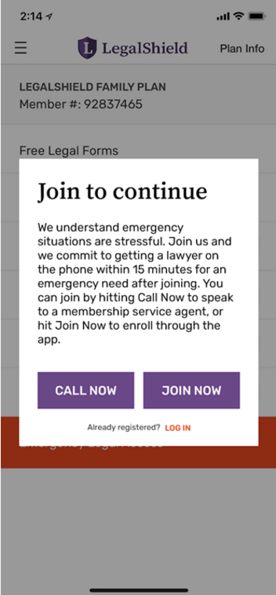
Emergency Access
Gun Owners Supplement
Available on March 17, 2018
in all states except
MA, NC, NV, NY, MA
and Canada
Prospects can access the EA button from the mobile app.
Prospects get a message to sign up.
Prospect signs up, the EA button is active to connect the new member to the EA line.
Prospects who call to sign up are directed to the Inside Sales Team to be signed up over the phone.

Slide 93
Member Immediate Activation
Summary | Current Processing Time | Immediate Activation Processing Time
Membership Account Created | 24-48 Hours | 15 Minutes
Welcome Email Received | 24-48 Hours | 15 Minutes
Contact Provider Attorney | 24-48 Hours | 15 Minutes
Setup Online User Accounts | 24-48 Hours | 15 Minutes
Notes:
No more courtesy consults.

Slide 94
What is Immediately Activated?
Only New Enrollments Are Immediately Activated (all new processable business).
What Is Not Immediately Activated?
Reinstatements
Future Effective Dates (for group business)
Plan Changes
Any Other Non-processable Business

Slide 95
Who Gets What?
All enrollments processed will receive the new welcome email
Immediate Activation covers all plan types:
  Legal
  IDS
  CDL
  Business
Immediate Activation includes all channels
  Network
  Broker
  Group

Slide 96
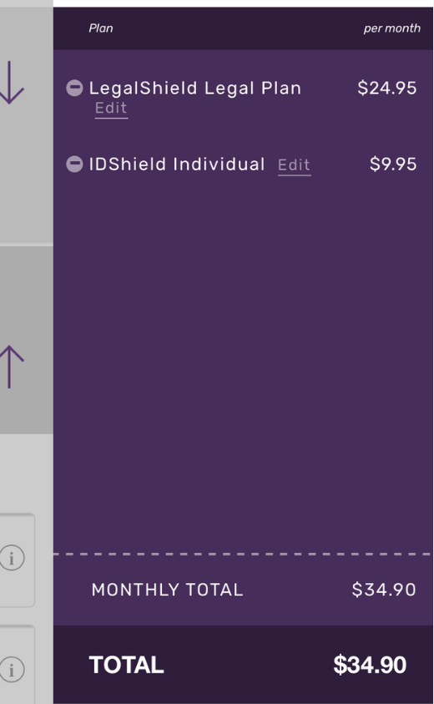
Mobile App Enrollment
Select Plans
Notes:
From your mobile phone, go through the sign-up like you normally would by selecting a plan

Slide 97
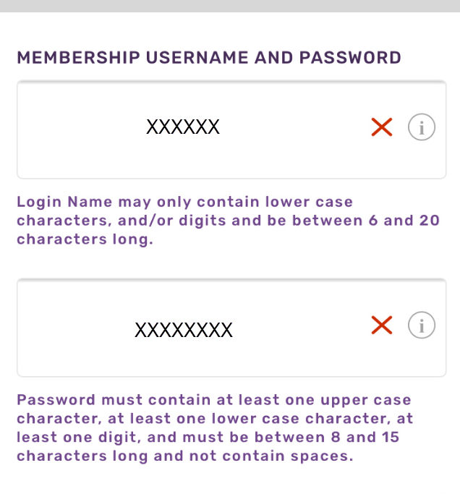
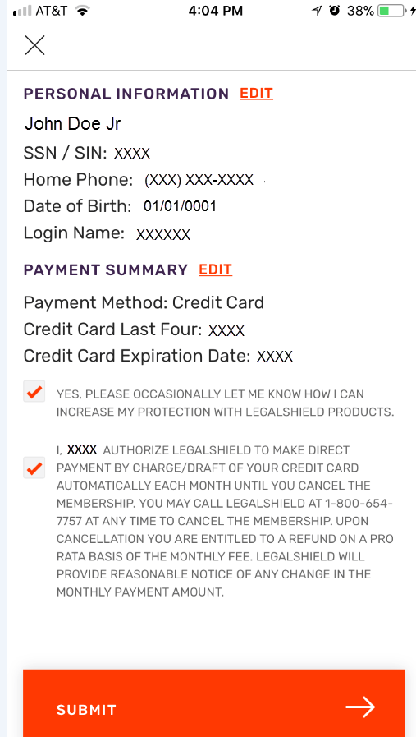
Mobile App Enrollment
Enter Personal Information
Create Username and Password
Notes:
Now this is where we’ve made the change. Members will create their username and password in checkout!

Slide 98
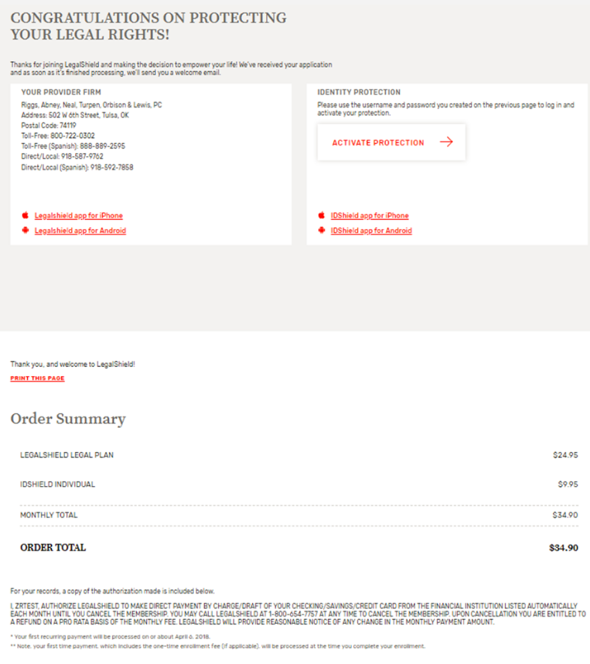
New Checkout Confirmation Message
Provider Info
IDS Activate
Mobile App
Download
Order Summary
Notes:
This is the confirmation page, but it looks the same. How is this any different? We no longer provide the member number in the confirmation message but instead provide the member number in the email we send within 15 minutes of processing! This is important because members will no longer receive one member number in checkout and then run the risk of a different number being assigned after the membership is processed.

Slide 99
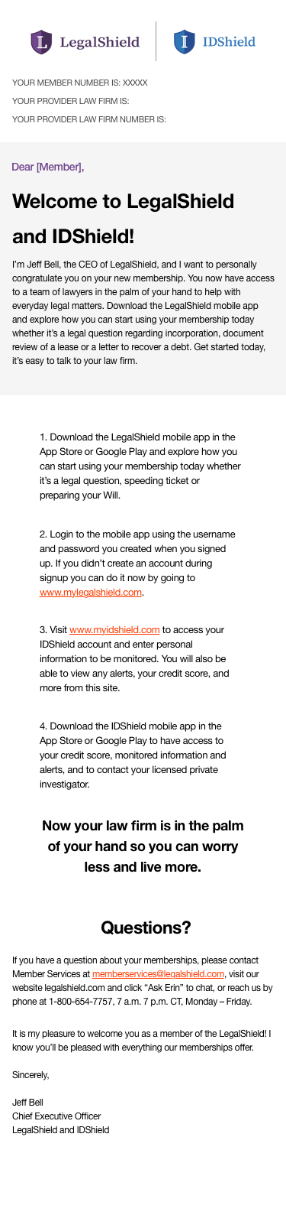
Notes:
This is the new Welcome email (mobile app version)

Slide 101
Imhoff & Associates, pc joins LegalShield
Presented by Vince Imhoff
Introduction by Ron Miller

Slide 102
We offer Quality Criminal
Defense Representation for LegalShield Clients
Presented by Vince Imhoff
Introduction by Ron Miller

Slide 103
Heroes Helping Heroes
We are honored to join the LegalShield family
LegalShield provides complete legal care
to their clients across the nation
LegalShield attorneys provide accessible, affordable, full-service legal representation to LegalShield clients over a wide area while maintaining the highest levels of client satisfaction
Imhoff & Associates is a nationwide Criminal Defense Law Firm. We fill the gaps in your criminal defense network while maintaining the highest levels of satisfaction
that LegalShield clients expect
Our caring, competent staff will work hard to satisfy the expectations
of LegalShield clients who have criminal defense needs

Slide 104

Our firm was founded to meet Client Needs
Ron noted the level of customer service provided by independent criminal
defense attorneys was often not up to the quality expected by clients
and their families
Independent attorneys are often busy, hard to be in close contact with
and may not possess the soft skills or staff necessary for outstanding customer support
Our firm instead utilizes a team of case analysts, case managers and attorney supervisors working with state licensed attorneys that meets with both customer expectations and state bar ethics
The Case Manager system helps organize the attorneys’ time and meets the emotional and informational needs of the client and their family while they are going through a difficult time
Our firm has developed and utilizes standard and unique defense strategies such as pre-file representation, in-depth case investigation, jail visits, and we make ourselves accessible to our clients.
⋆ Ron Miller founded the firm in 1993

Slide 105
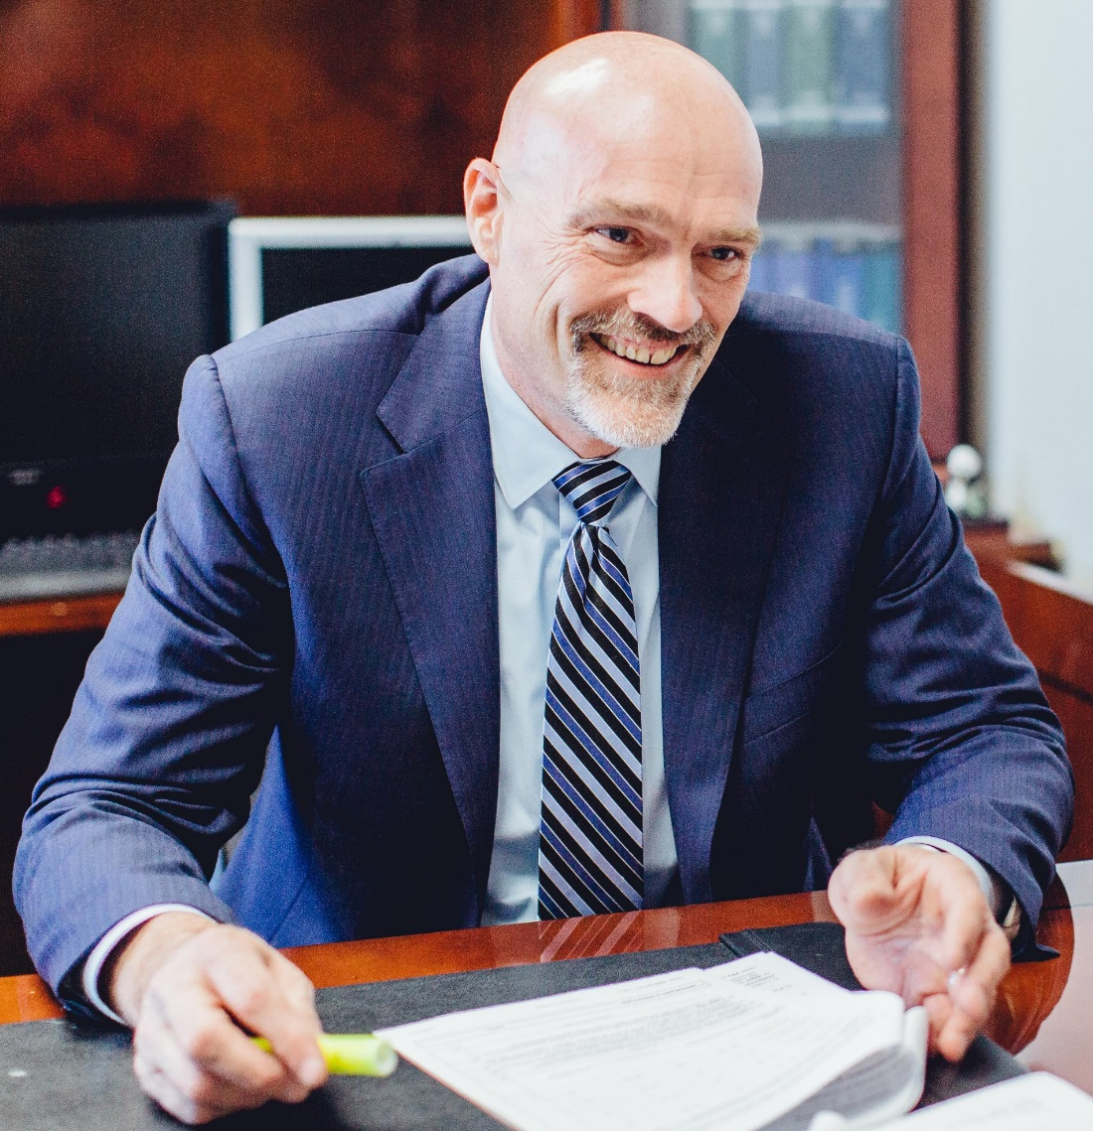

Introducing Vince Imhoff
About Vince Imhoff
Vince’s Background
1989: Graduated from Chicago Kent College of Law and passed the Illinois State Bar
1990-1997: Public Defender Cook County, IL (Chicago)
1997: Vince passed the California State Bar
1998: Ron hired Vince Imhoff as a northern California trial attorney
2002: Vince Imhoff is promoted to National Director of Attorneys at Miller & Associates
2003: Vince purchases Miller & Associates, allowing Ron to pursue other entrepreneurial passions; Miller & Associates becomes Imhoff & Associates
2004: Mr. Imhoff partners with Johnny Cochran, and the firm is renamed
“The Cochran Firm, Criminal Defense Section”
2006: After Mr. Cochran’s unfortunate passing, the firm reverted to Imhoff & Associates
Notes:
2006: After Mr. Cochran’s unfortunate passing, the firm reverted back to Imhoff & Associates
(speaker notes: This is where Ron can give some comments on Vince.)

Slide 106

People Accused of Crimes Need a hero
Our Mission at Imhoff & Associates is to enthusiastically represent everyday people who have been accused of a crime in order to give them the best possible outcome in an ethical, caring, and proficient manner

Slide 107



Our Mission is to Help People Accused of Crimes
Being accused of a crime can be a frightening experience for the accused and their family and we want to help remove their fear and reassure them that they are getting quality defense and attentive support
We help people:
family members, sons, daughters, husbands or wives, co-workers, friends,
and people in your community; Everyday people whose jobs are important to them and who are often
on a tight schedule
We help those who have been accused of crimes, and their families, achieve the best possible outcome for their case so they can get their lives back on track – to these people we are heroes

Slide 108

Heroes Have Good Ethics
To our clients, who have been accused of a crime
We are their defenders and heroes
We defend their lives and livelihoods and help them on their way
We help them and their families at a difficult time when they are in need of professional counsel and legal support
As heroes, we are expected to behave with the highest ethics and integrity and always with the best interests of our clients and communities in our hearts and on our minds

Slide 109

LegalShield Is A Hero To Their Members
Our Role at LegalShield
We reduce the obligation of LegalShield local provider firms to cover criminal defense matters outside of their covered territories
We maintain the highest quality legal representation that
LegalShield clients expect
We create an ease of transfer of your criminal clients
to Imhoff & Associates
We improve call center efficiency at your firm by reducing the time
and resources devoted to criminal defense cases
We value client satisfaction and provide complete customer service to your LegalShield clients who need criminal defense counsel

Slide 110
Heroes Providing Quality Defense
In 49 States and Puerto Rico
Who We Represent
We represent all types of clients and cases including but not limited to:
DUI
Drug Crimes
Homicide
Nationwide criminal defense
and professional license defense
White
Collar Crimes
Professional
Licenses Defense

Slide 111
Heroes are available anywhere, anytime
We Have Attorneys Throughout the Nation
* Our client may live in one state and be arrested in another state. We cover that!
Attorney assignment based on location and unique case circumstances
Client and attorney compatibility
is important
We make attorney reassignments
when necessary
Client satisfaction with their attorney
is our #1 priority

Slide 112




We Are a National Criminal Defense Law Firm
I&A is a Leading National Law Firm. We Are Not a Referral Service.
National leading criminal defense law firm with a network of 659 attorneys and growing
We fully comply with all state bar rules as we understand the value of regulations in protecting customers
Our teams always include attorneys licensed in the states where we do business, and we have attorney partners in
49 states and Puerto Rico
Our attorneys use our business cards, welcome letters, letter head, and closing letters, maintaining the law firm’s national image in local communities

Slide 113

We Know How to Satisfy Employers And Clients
We Have a Proven Track Record Servicing Large Providers Including Employee Assistance Programs (EAP’s):
Attorney Search Network
CLC
Lawpoint
Legal Access Plans
Legal Club of America
Workplace Solutions

Slide 114

Staffing – Training – Quality Assurance
Practice Makes Perfect
Recruiting
Training
Call monitoring
Quality Service Points (QSP) protocols
Follow-up
training and quality
improvement feedback
We work with provider
to quantify and increase customer satisfaction

Slide 115

25% Discount for LegalShield Clients
What We Offer Our LegalShield Clients
Free consultations (as many as the client wants)
24 hour emergency service
We facilitate ease of communication between attorney and client
A commitment to excellence and quality service
We address their anxiety as well as their actual police and
incarceration problems
Team approach including local state-licensed attorneys and
attorney supervisors in our corporate office
Highly accessible staff – We address our clients needs immediately so that they do not need to call anywhere else, including the referring source

Slide 116
The First Point of Contact With a Client
Call Flow
LegalShield client calls LegalShield
Client is transferred to provider firm in appropriate state
Client’s case
is identified
as criminal
in nature
Client is transferred to Imhoff & Associates
Imhoff & Associates Case Analyst answers
the phone
Client is transferred
to an Imhoff
& Associates Case Manager
Imhoff & Associates facilitates attorney consultation with appropriately licensed attorney
Client retained or given direct I&A contact information should they decide to retain us in
the future

Slide 117

First Point of Contact at Imhoff & Associates
Imhoff & Associates Case Analysts
Answer the phones and general emails
at Imhoff & Associates
Incorporate compassion and
empathy with all callers
Analyze the call for routing
Answer and return all calls promptly
Quality Service Points:
Our internal training and evaluation system for Case Analysts
Decide which Case Manager should get the call based on unique case attributes
After-hours answering
service available for emergencies
Trained to minimize the need for client to repeat details of case
Bilingual agents always available

Slide 118
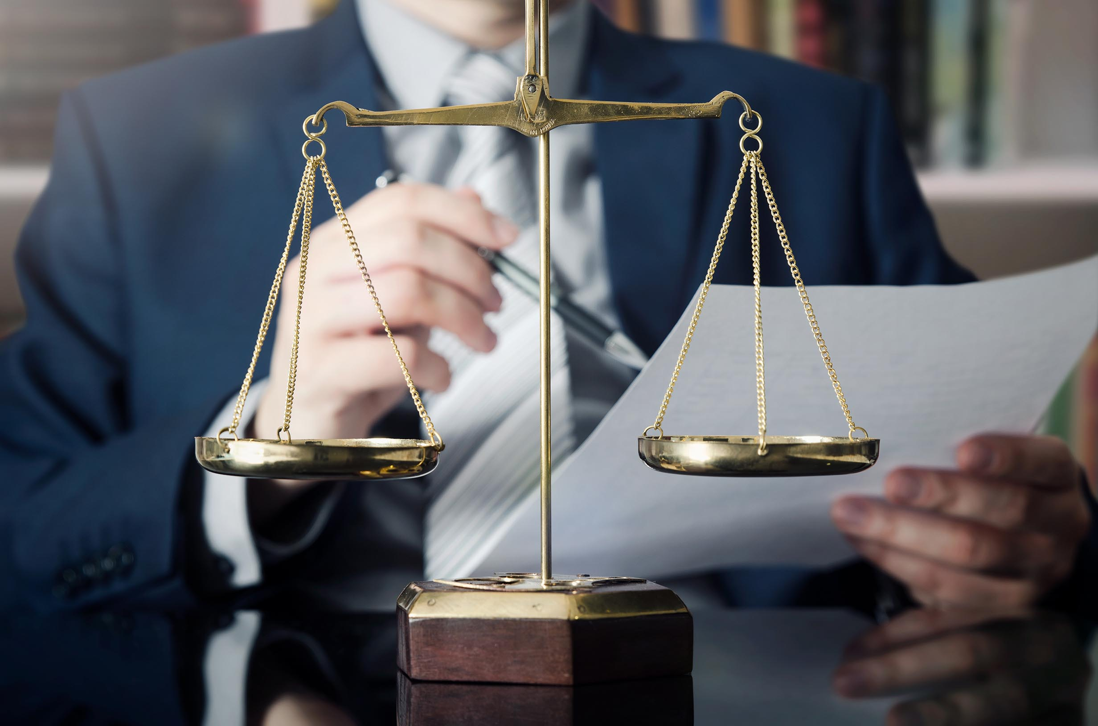

Case Managers
Trained to meet the emotional needs of clients
Attorneys
Case Managers
VS.
Busy, frequently in court, strategy-oriented,
less verbal, less emotional
Facilitators of communication between attorneys and clients
Available after hours to
care for clients’ needs
At their desk, available, communicative, empathetic,
more emotionally oriented, more verbal, “people persons”
May be attorneys, paralegals, former law enforcements officers or specially trained client service professionals

Slide 119

I&A Case Managers
By Your Side Through the Entire Case
Case Managers
Act as a liaison between the client and assigned attorney
Incorporate tactful compassion and empathy in all client interactions
Are trained and evaluated on their client interaction skills
Remain on cases of clients throughout representation
Become familiar point of contact for client
Always available to client via phone, text or email

Slide 120
Attorney Management Team
Ensures Ethical Compliance In All States
All attorneys are appropriately licensed
All attorneys conduct themselves with the highest values and ethics
All attorneys are
vetted for demeanor,
experience and results
Most have a minimum
of 5 years experience
Out Nationwide Network of Attorneys is Managed by Our Attorney Management Team

Slide 121
Attorney Management Team
Ensures Ethical Compliance In All States
I&A Attorneys Managed by Our Attorney Management Team
Our attorneys and cases are monitored
by in-house supervising attorneys and staff
We incentivize our attorneys to insure provision
of value-added customer services that may sometimes be overlooked by other attorneys such as filing complex motions, providing jail visits or after-hours office visits, retaining private investigators and taking other measures
to provide the client with a team approach that gives them the best outcome for their case.
Case updates
submitted regularly
Attorneys are monitored
and reviewed annually
We conduct onsite meetings and trainings at our attorneys’ offices
We constantly strive for improved quality in servicing clients

Slide 122

Heroes don’t have hidden fees
One Time, Flat Rate Fee – No Hidden Charges
25% discount for LegalShield members (unique case factors
considered in quote)
Flat fee covers the entire case, including jury trial
No additional fee for a jury trial if necessary
Removes financial pressure on client to plead guilty
Flat fee retainer provides client’s family’s peace of mind

Slide 123

Our goal
Our attorneys and team are always available to our clients
When You Need to Reach Us – We Are Accessible to You
Imhoff & Associates office hours: 6:00 am – 6:00 pm PST
We return client calls within 4 hours at a minimum.
After-hours call service can transfer clients and
reach attorneys or Case Managers
Being accessible to our clients is important to us and one of the reasons clients retain us over independent attorneys
If call center can’t reach Case Manager on call,
they have 2 back-up numbers for a Senior Case Manager
and National Director of Client Services
National Director of Client Services and Senior Case Manager monitor after-hours calls and emails sent to the firm

Slide 124



We Care About Your Clients
With 14 years of service, and over 15,000 cases, our integrity and commitment to our clients has been put to the test
Our providers value their clients and want to feel secure in sending their clients to other law firms
That’s why when we have client complaints or issues we always work towards an outcome that is client-centric and values the referral source

Slide 125
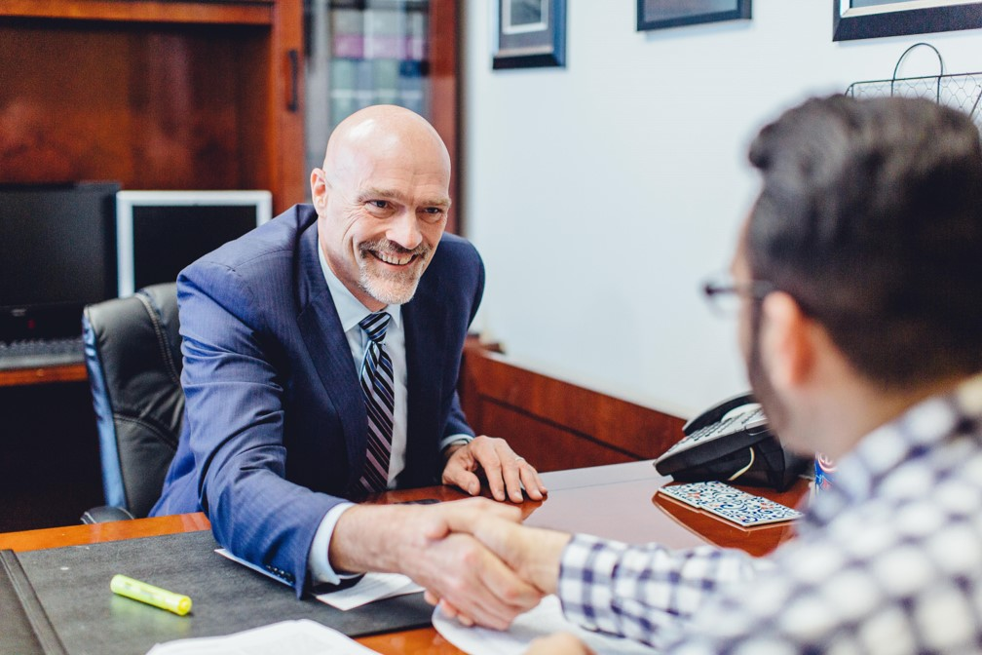
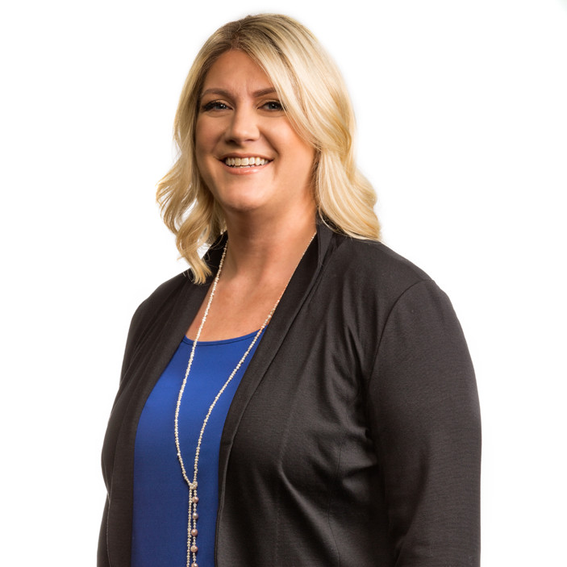
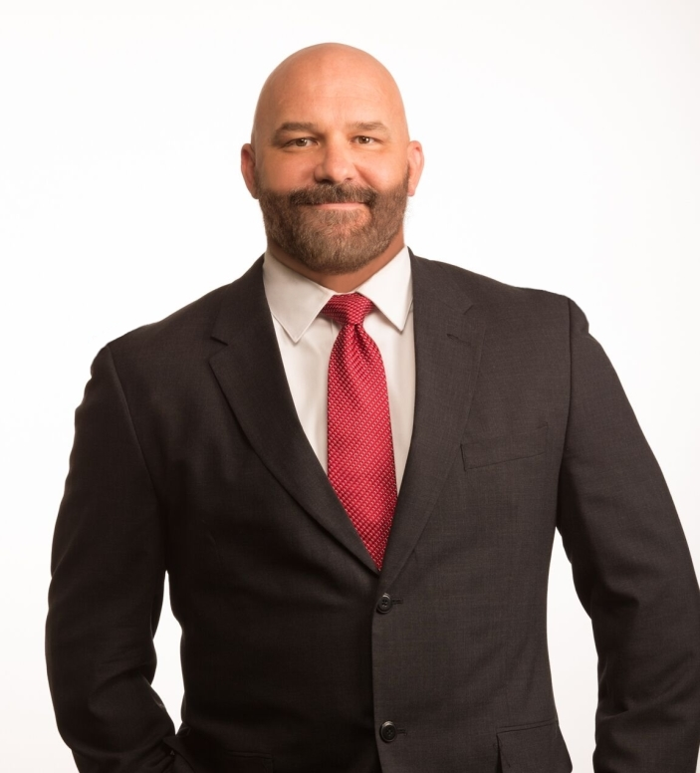
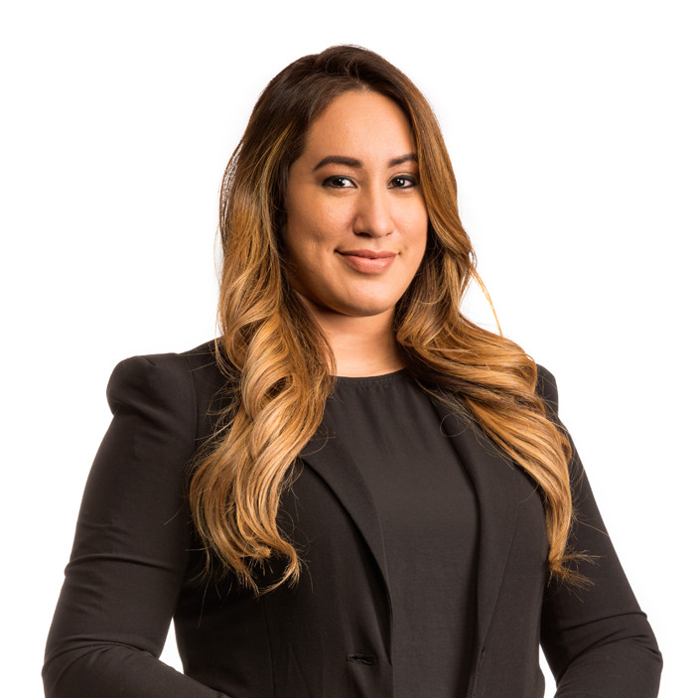


Our doors are open
Introducing Our Management Team
Vince Imhoff
Sarah Small
Tom Lawson
Jesy Martinez
Shawnna King
Managing Director
National Director
of Attorneys
Director of
Client Services
Case Analysts
Manager
Director of HR
Legal Shield is always welcome to communicate with our team: Call (800) 887-0000

Slide 126


We are here for you
Our Managing Director – Vincent Imhoff
Contact Info
800-887-0000 x 123
vinceimhoff@criminalattorney.com

Slide 127

Imhoff And Associates:

Slide 128
Q&A
Blake Turney, Nic Carlsson, Mariam Ballard, Jeannie Forneris, Lori Owens & Keri Norris

