Slide 1
Enhancing the Provider Experience
Mariam Ballard – Product Director, Enhance

Slide 2
Enhanced Experience
We want Enhance to integrate with the ideal technology to create an easy to use user experience for both members and providers.
Identity (Profiles)
Insight
Elevate
Notes:
- As Jerred mentioned, our focus is to ensure user involvement as we develop new things. This also means considering not only the provider experience, but the member experience and interactions as well.

Slide 3
Identity – Lawyer Profiles

Slide 4
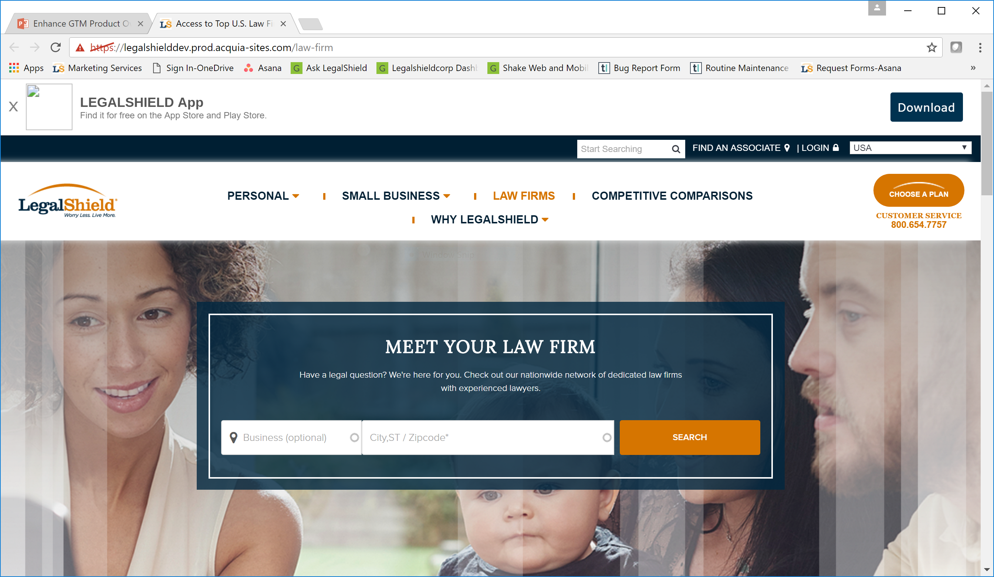
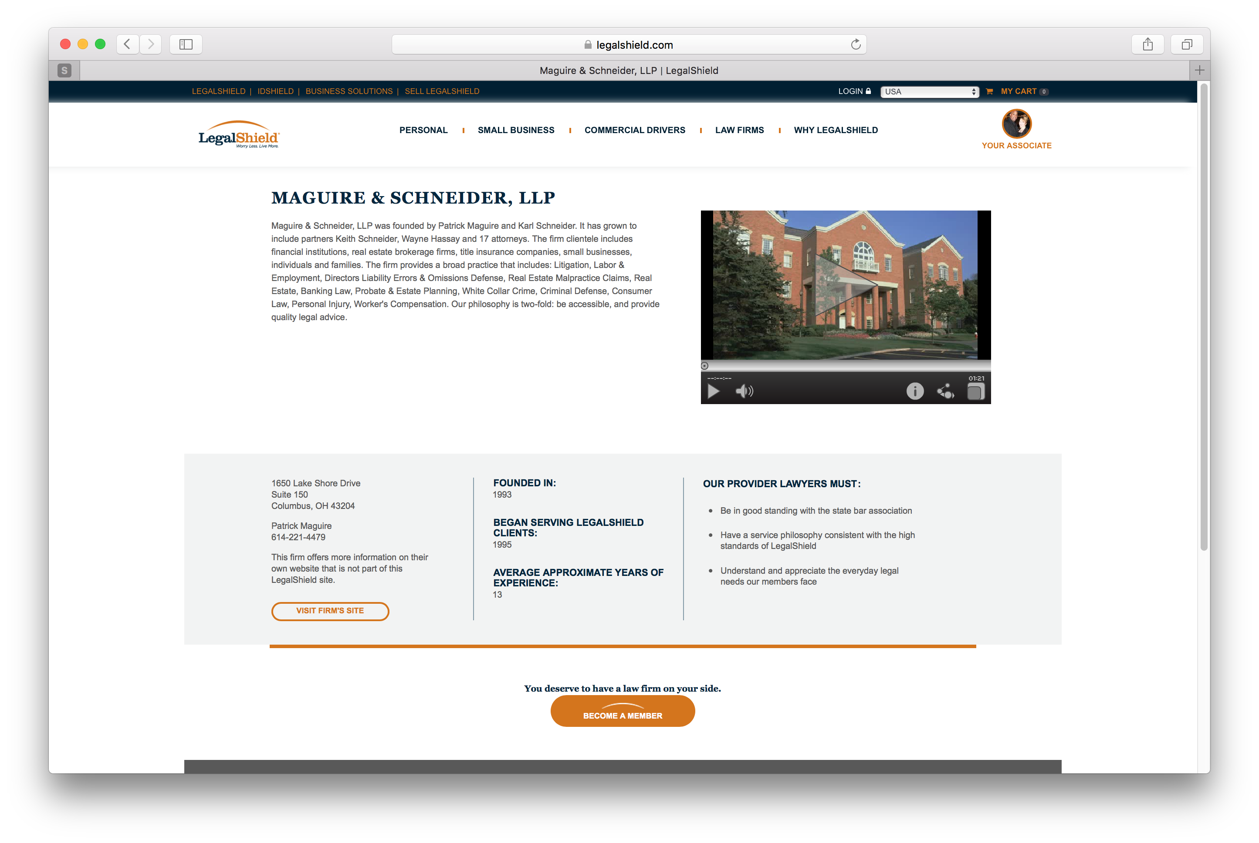
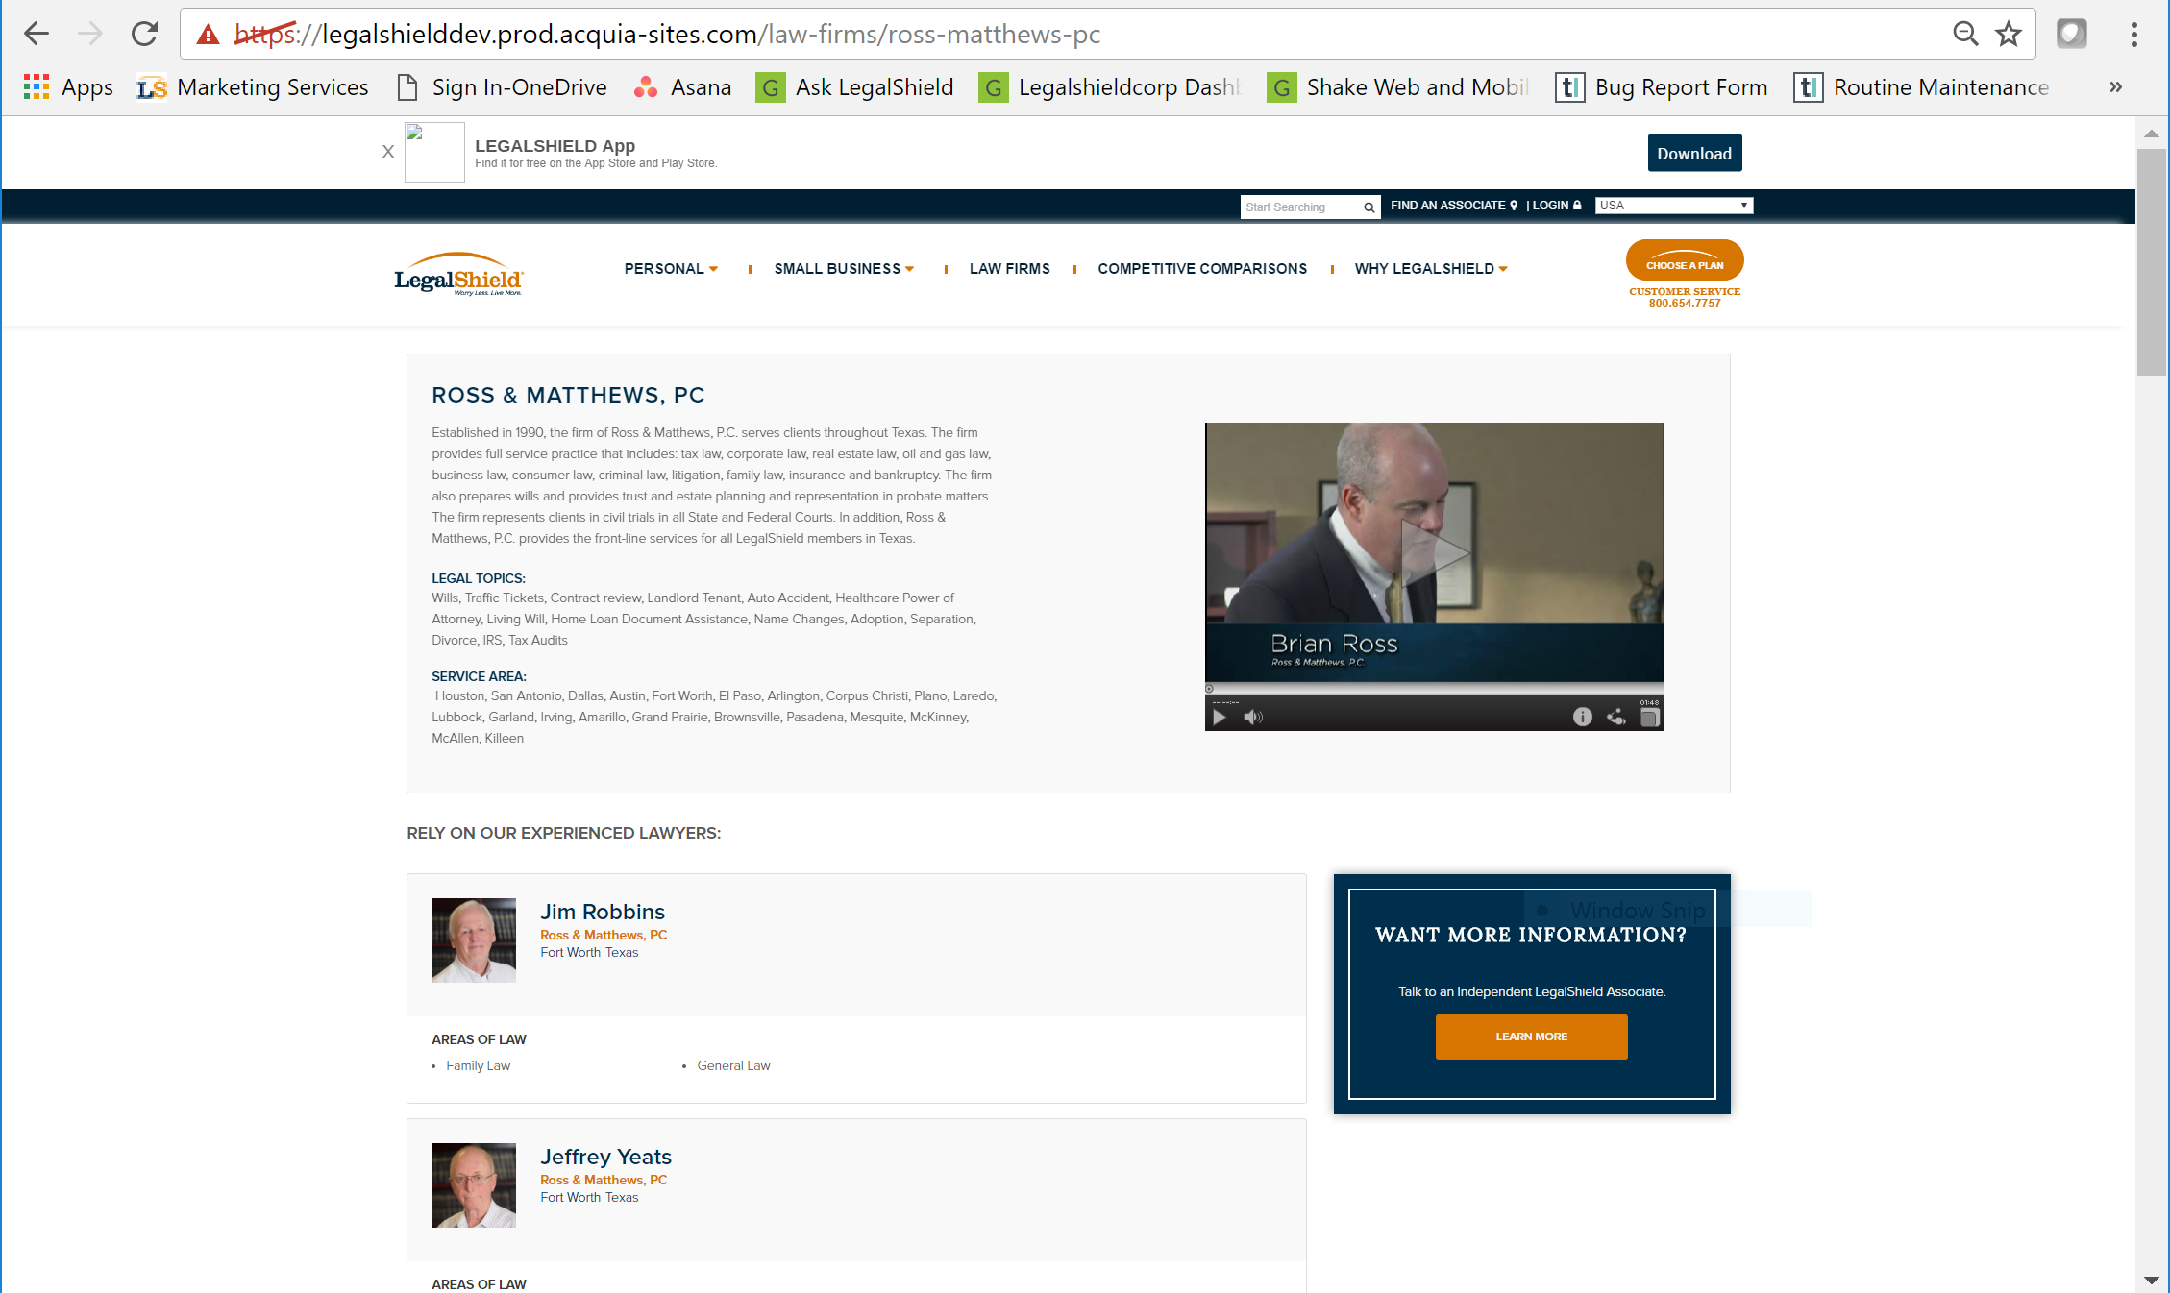
Then…
Notes:
- Our first dive into better connecting the members with our providers, was the launch of law firm and lawyer profile pages on legalshield.com

Slide 5
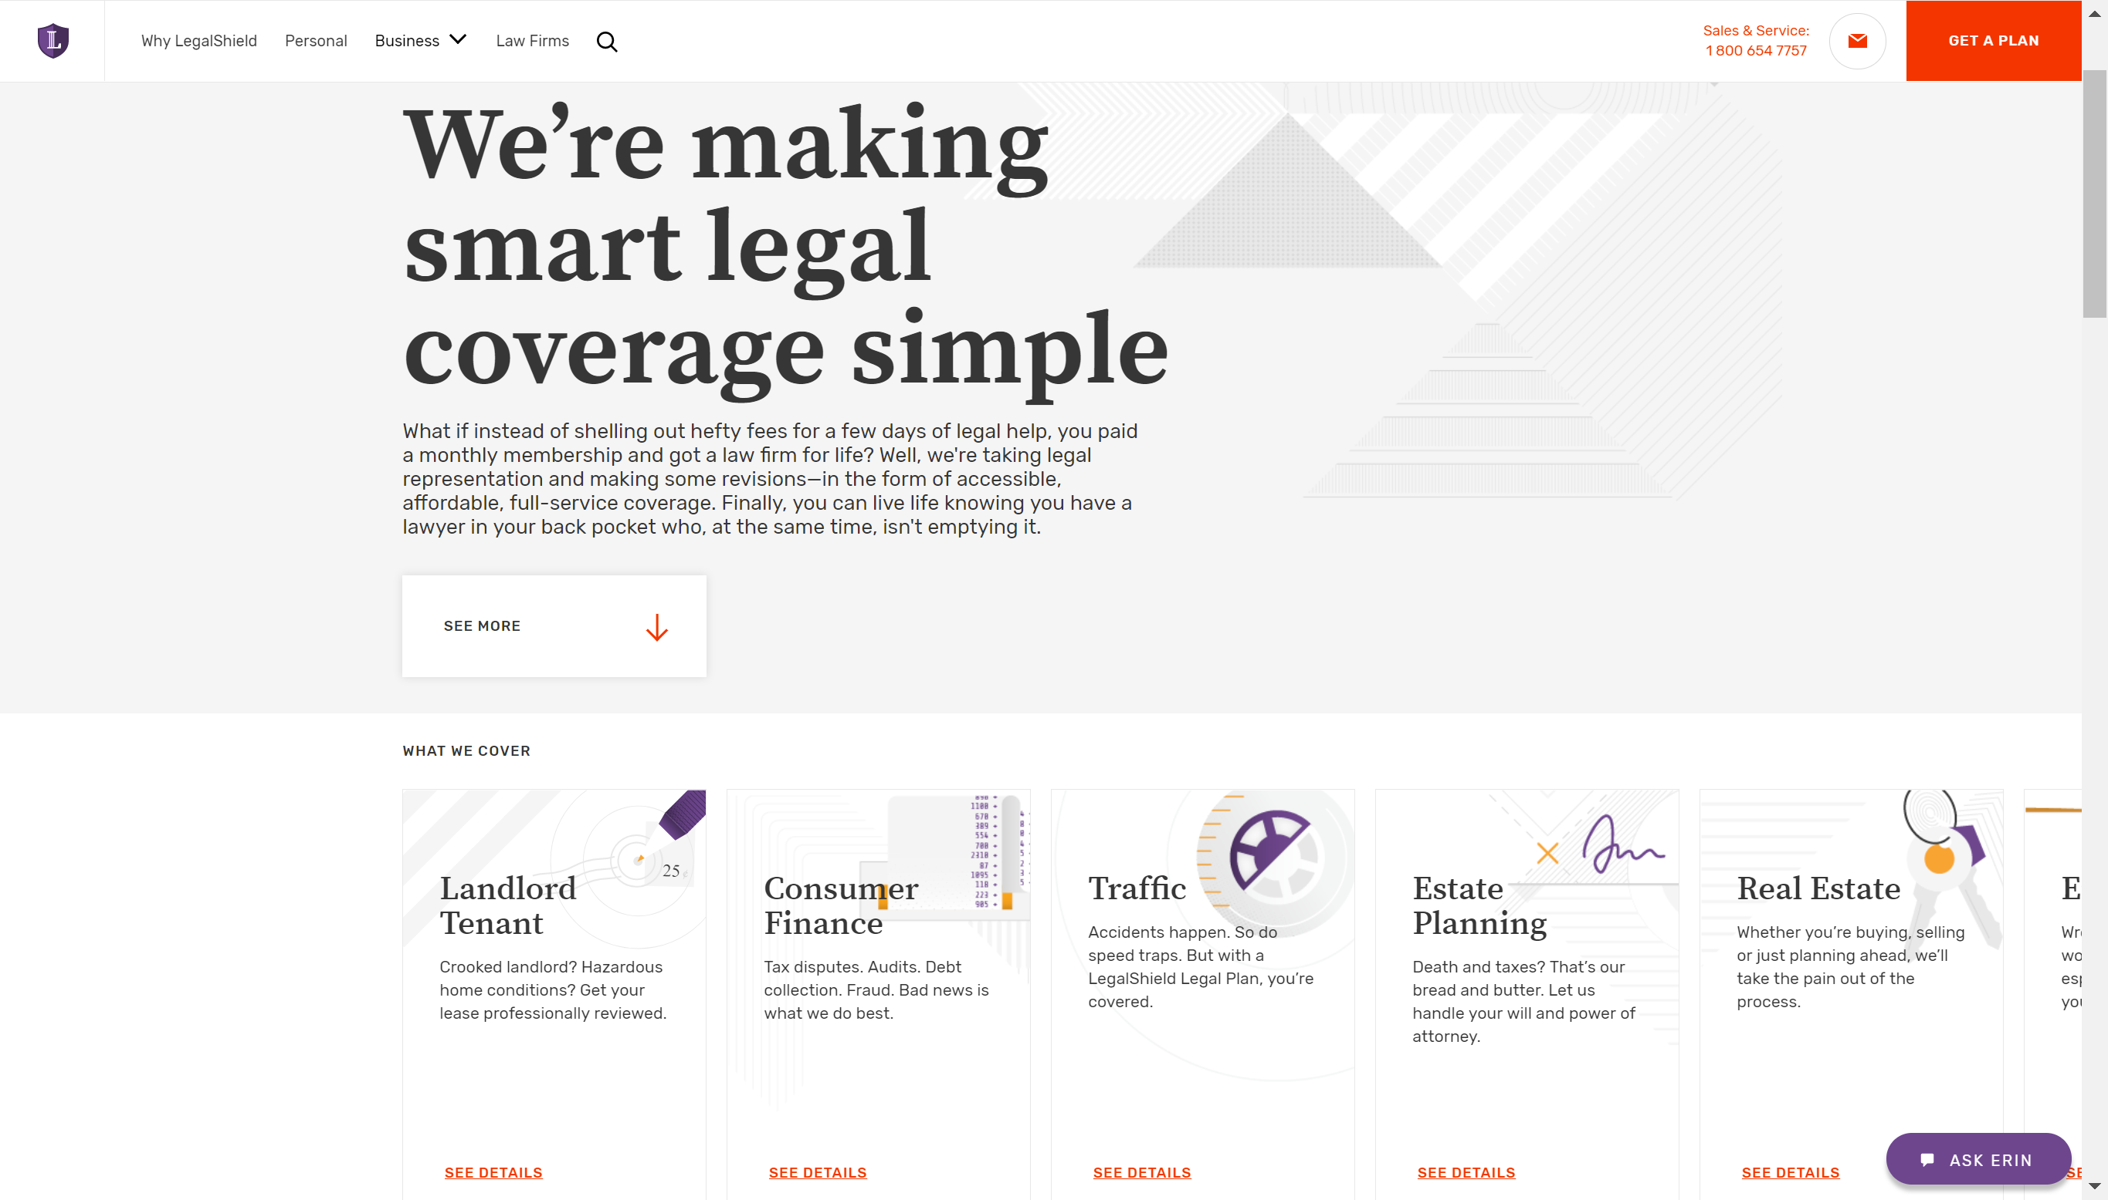
Now…
Notes:
- We learned a lot and we unveiled the new site design in September

Slide 6
What’s Improved?
Simplified design
Easier navigation
New checkout design
Better mobile compatibility
Messaging is more about benefits

Slide 7
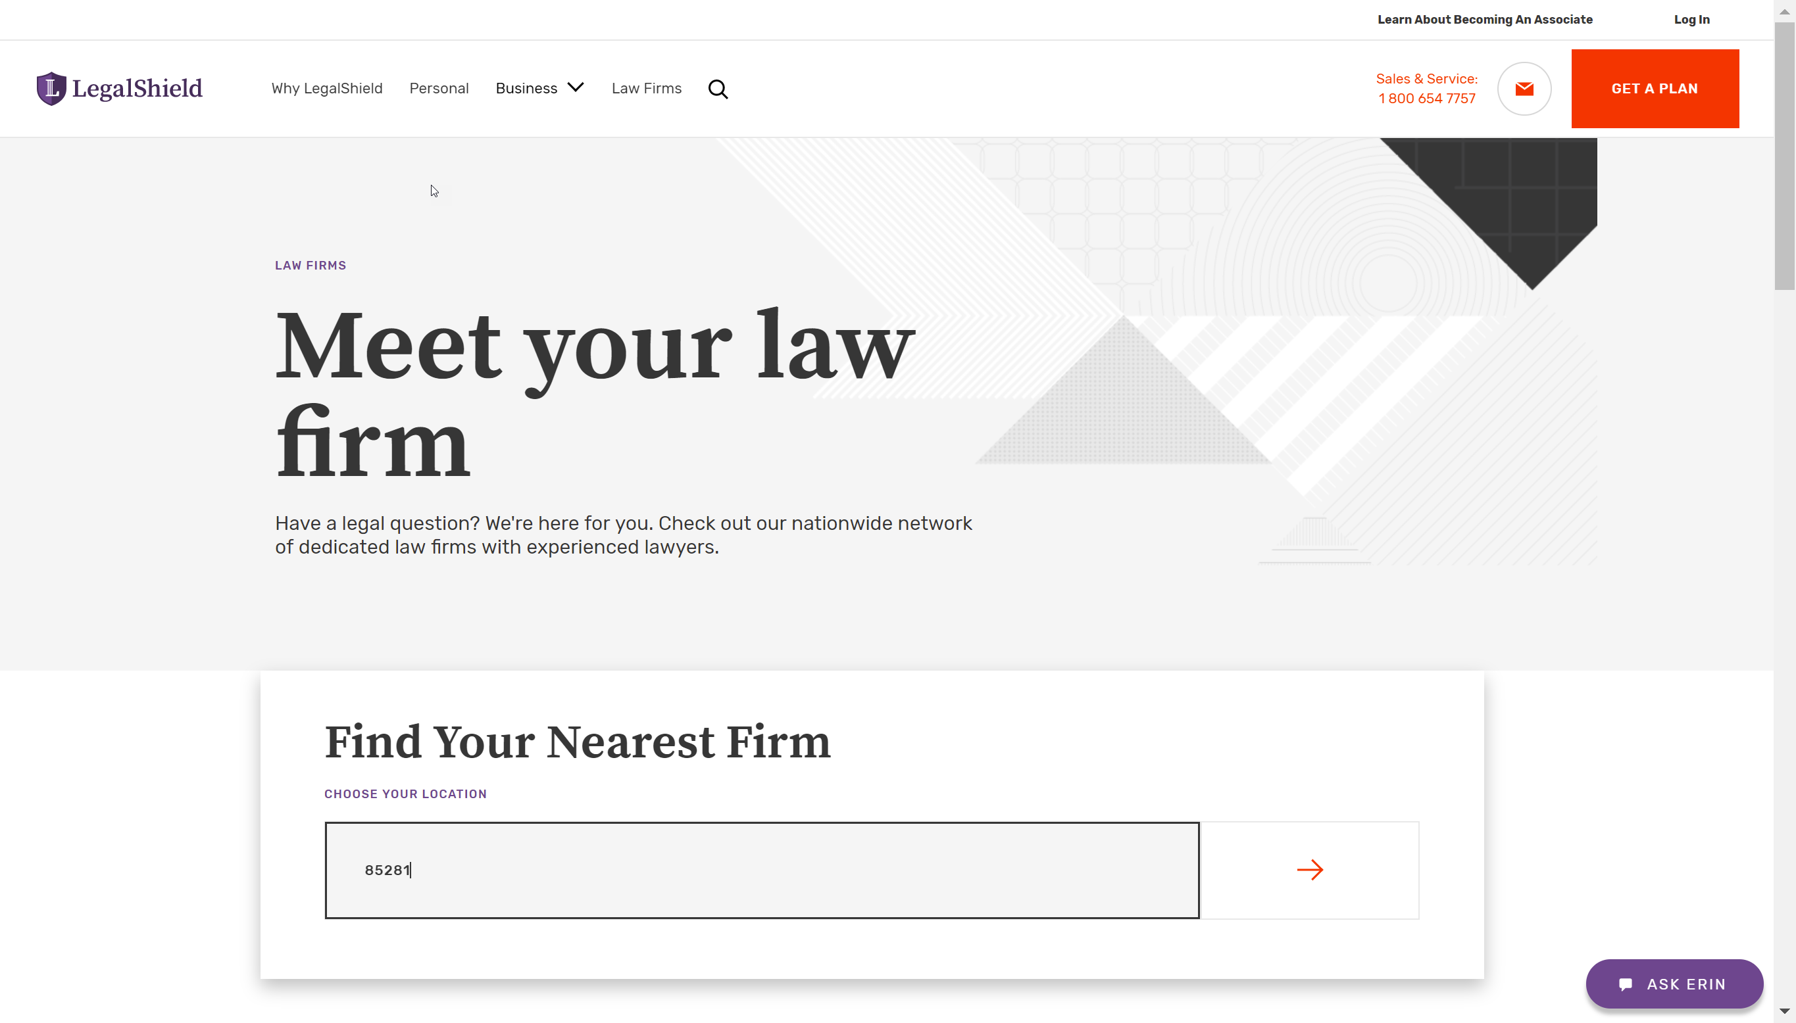
Notes:
- Here’s the overall experience

Slide 8
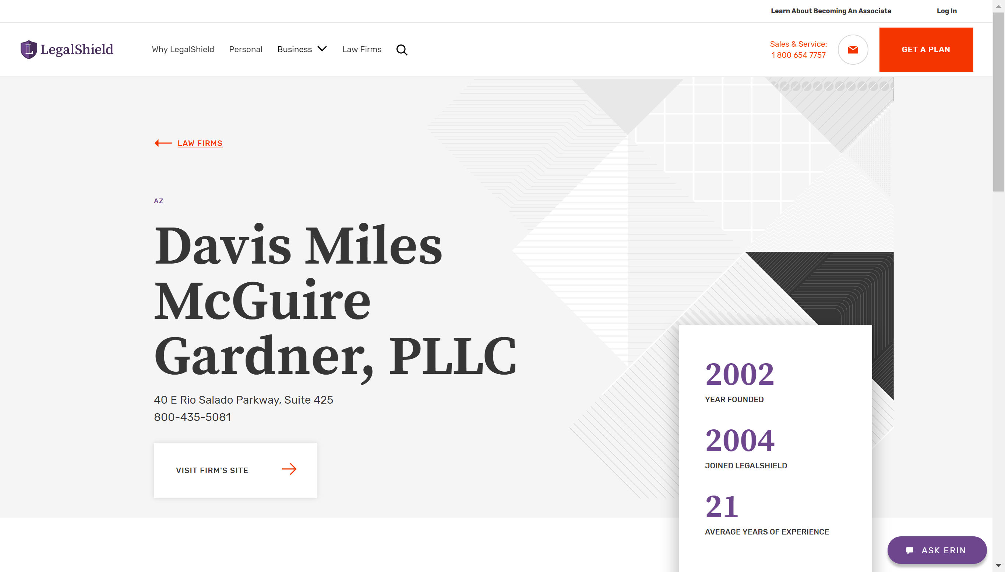

Slide 9
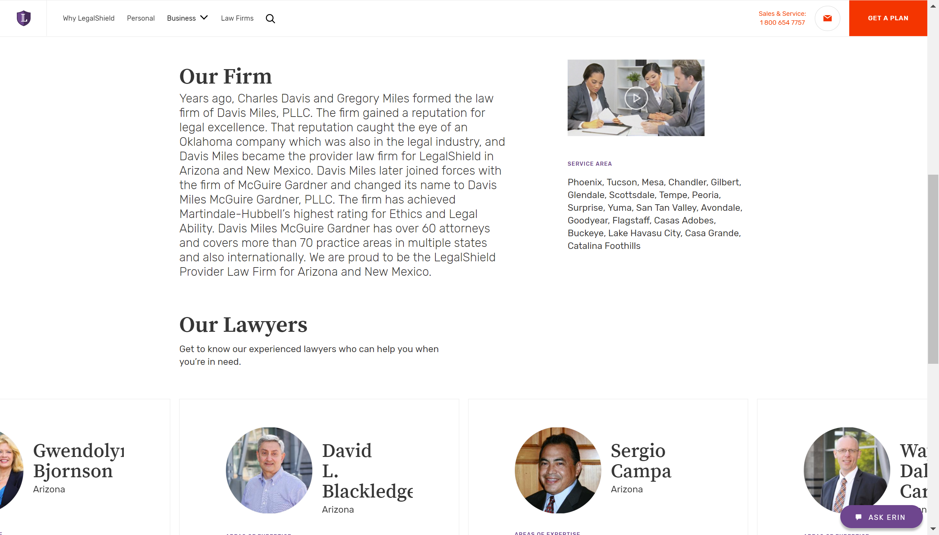

Slide 11
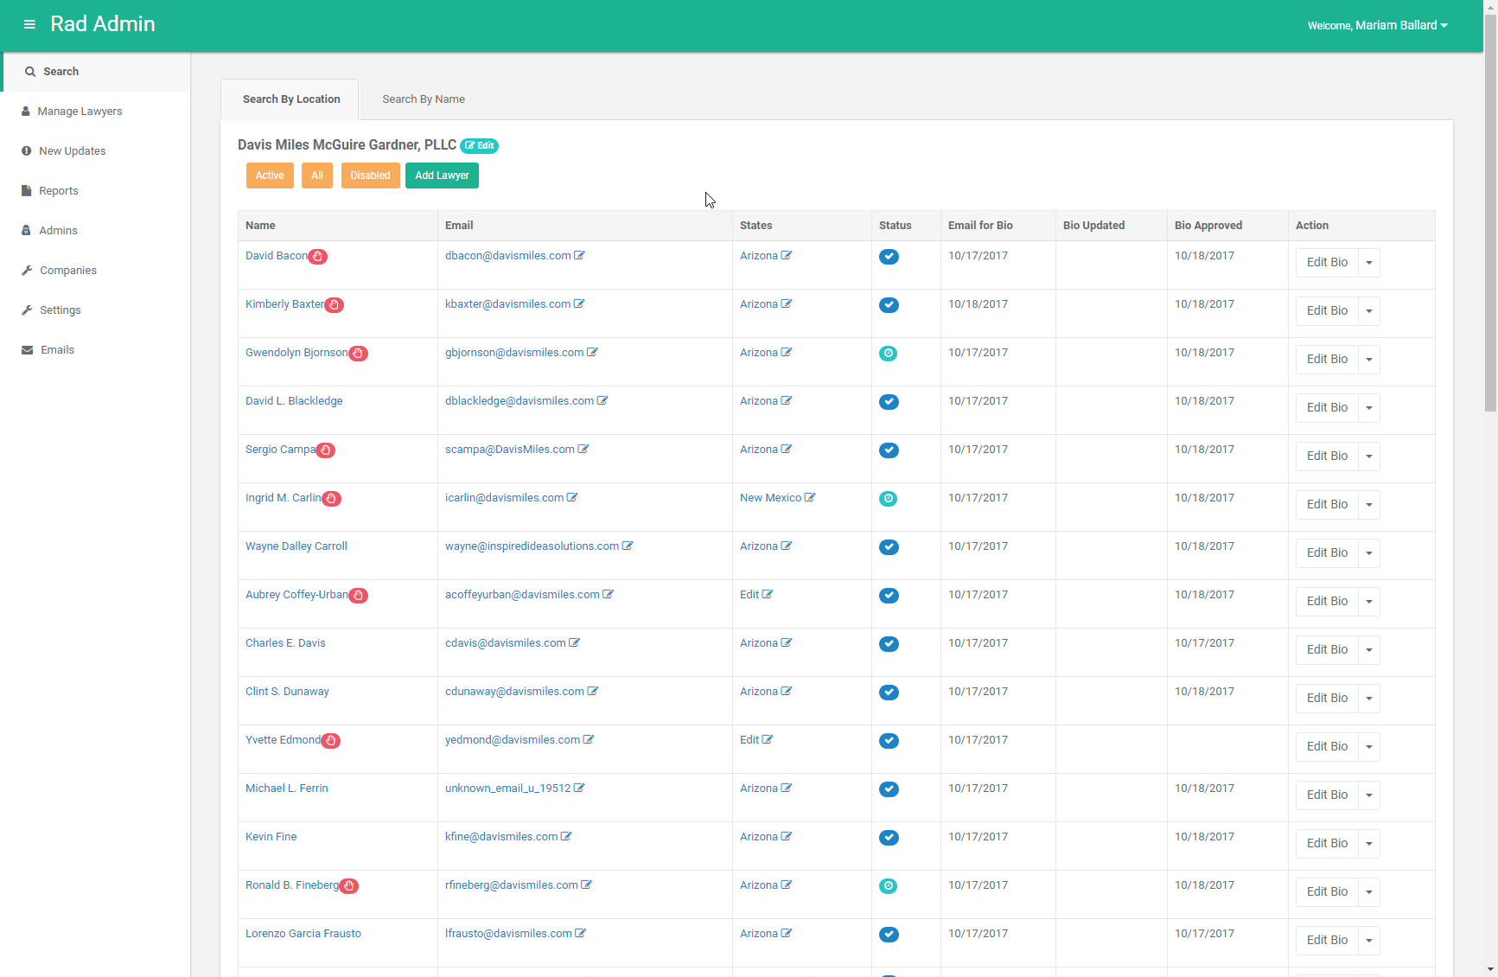
Keeping it Updated
Login: https://www.fairdocument.com/login
Profile edit functionality added to RAD
Notes:
Leveraged RAD, an existing platform = goal was to get user involvement early
And Reduce another system/ tool for providers to learn/ login to

Slide 12
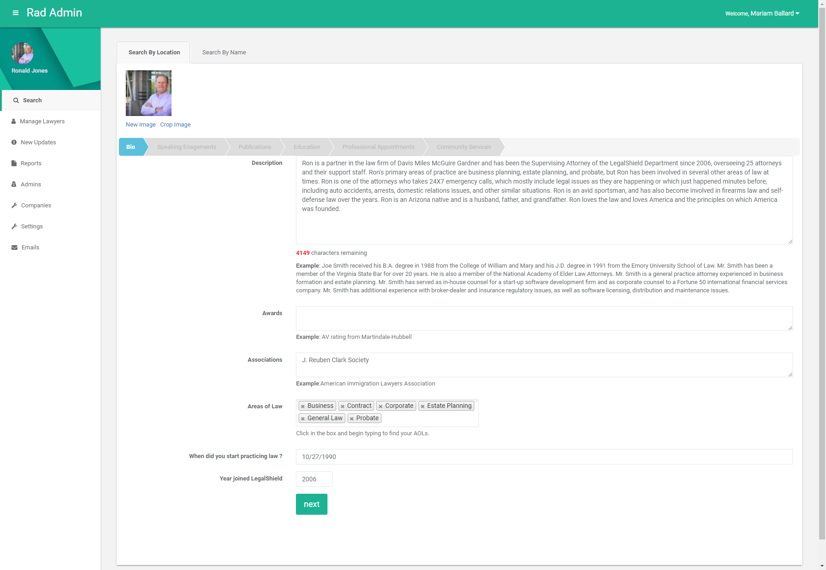
Keeping it Fresh
Monthly reminders
Requests will align with:
Business Goals
Changing Market Needs
Notes:
Communications will be streamlined and aligned with business goals and changing market needs
And to ensure content is maintained and current to provide the best SEO results to turn clicks into acquisitions

Slide 13
Identity - What’s Next?
Online App – Referral Lawyers
Lawyer Ratings
Referral Lawyer Profiles
Notes:
Add referral lawyers profiles to legalshield.com
Another way to increase transparency and explain the product benefits
Develop online application for referral lawyers
Adds digital app requirement – eliminating paper and manual processes
Information entered will automatically populate the digital profile in RAD
Goal is to increase lawyers in the network and improve their onboarding experience
Ratings
Will be based on NPS data
Are another way to provide transparency and educate members on the type of service they can expect

Slide 14
Insight

Slide 15
Calculating NPS
% of Promoters - % of Detractors = NPS
Example: 67% Promoters – 16% Detractors = 51
Passives are not calculated into the NPS
Promoters = 9-10 scores
Detractors = 6-0 scores
Notes:
Quick reminder on how NPS is calculated.

Slide 16
What Tracks LegalShield and Provider NPS?
Notes:
- Data responses to each question are tracked individually to calculate the NPS for LegalShield and Provider

Slide 17
2017 LegalShield: NPS
Key takeaway
2017 NPS = 56
Sept is the 4th consecutive month, LS NPS has been equal to or greater than 2016 scores

Slide 18
2017 LegalShield: Score Distributions
Key takeaways
Promoters ≈ 70%
Passives ≈ 16%
Detractors ≈ 14%

Slide 19
2017 Provider: NPS
Key takeaway
2017 NPS = 52
Sept is the 9th consecutive month, Provider NPS has been equal to or greater than 2016 scores

Slide 20
2017 Provider: Score Distributions
Key takeaways
Promoters ≈ 68%
Passives ≈ 16%
Detractors ≈ 16%

Slide 21
What Tracks Referral NPS?
Notes:
- Data responses to the referral law firm question is tracked individually to calculate the NPS for referral lawyers

Slide 22
2017 Referral: NPS
Key takeaway
2017 NPS = 27
Sept is the 3rd consecutive month, Provider NPS has been equal to or greater than 2016 scores

Slide 23
2017 Referral: Score Distributions
Key takeaways
Promoters ≈ 55%
Passives ≈ 17%
Detractors ≈ 27%

Slide 24
Insight – Courses: Areas of Emphasis
2016-2017 | Timeliness | Explanation | Update | Listening | Knowledge | Politeness
Total Attorneys | 1542 | 1496 | 751 | 650 | 552 | 292
Total Insight Courses Taken | 4807 | 5273 | 5273 | 5273 | 4807 | 5273
 | 32% | 28% | 14% | 12% | 11% | 6%
 | 60%
Notes:
- This list is a summary from 2016-2017
These are the course categories that are most commonly identified as an area of improvement from surveys
60% are related to timeliness and explanation

Slide 25
Insight – Courses: Areas for Improvement
New Courses
New design
Different mediums
Reduce length
Learning Management System (LMS) Platform
Notes:
Listening to all of your feedback to improve courses, get them shorter and get more into the LMS
New design is more interactive to provide more visuals and contextual examples
Will be integrating different mediums with not only slides, but also videos
All courses will be anywhere from 5-8 minutes long
We will be asking for you, our providers, to help create courses, film them and share them. You know best what works. And what doesn't.
Evaluating options for an LMS that will support our vision to grow and scale

Slide 26
Insight – NPS Survey: Improvements
Implement tests
Consistent survey audits
Notes:
Currently, working on plans to test different survey designs that will better engage members
Identify question biases to improve survey design/ copy
All efforts are to reduce barriers that prevent members from submitting a survey

Slide 27
Insight – Associates: Areas for Improvement
Associate Retention Improvement Program (ARIP)
Impact on Benefit Expectations & Benefits Consistency
Monitor NPS and comments from members
Notes:
ARIP will go live in Q4
We monitored and saw that with new members - high cancellation is correlated with high levels of complaints in the first 6 months.
Upon investigation this is largely due to poor explanation of the membership or worse yet, misrepresentation of the membership.
The surveys also track the customer sentiment and comments related to this through the following questions:
Did your LegalShield benefits meet your expectations? (Benefits Expectations)
Are you satisfied that the explanation of your benefits was consistent with your recent experience? (Benefits Consistency)

Slide 28
Insight – Operations: Areas for Improvement
Voice of the Customer
Improve operational procedures
Streamline processes
Build Better Products
Notes:
Constantly listening to the voice of the customer comments
Identify ways to improve operational processes and procedures
Helps us build better products

Slide 29
Insight - What’s Next?
Expand to Referral Lawyers
LMS Platform
Improve Courses
Notes:
- LMS – investigating new platforms to improve the experience

Slide 30
Elevate

Slide 31
Elevate 2018
June 28-30, 2018
Sawgrass Marriott Golf Resort & Spa
Ponte Vedra Beach, Florida

Slide 32
Elevate 2018
Early Bird Rate = $99!
Ends October 31st
https://elevate2018.eventbrite.com

Slide 33
Elevate 2018
CLE Speakers
Entries due December 8th
Speakers announced by December 20th
https://elevate2018.eventbrite.com

Slide 34
Elevate 2018: Speaker Topics
Topics of Interest
Increase focus on topics relevant for B1 attorneys
Federal law surrounding consumer issues
Notes:
Trending topics in the legal industry
Technology in the legal industry today

Slide 35
Elevate 2018: Incentives
B1 Attorney Attendees
Training/ development opportunity
Reward for performance
Top Attendance
Firm with the highest percentage of firm and referral lawyer attendance will be specially recognized
Firm will receive a suite upgrade at no cost to them for the March International Convention

Slide 36
Enhance Features | Provider | Referral
IDENTITY
Lawyer “Back Office” (Replaces AS400) Client Intake Management Document Management Enhanced Referral Management Collaboration Platforms | a | a
Profile Management | a | a
Web presence/ SEO Management | a | a
Lawyer Profile Page | a | a
Law Firm Landing Page | a
INSIGHT
Customized Training Program | a | a
NPS Rating | a | a
Newsletters | a | a
Online Badge | a | a
Eventbrite Event Support | a
ELEVATE
Conference – focused on CLE and trending legal industry topics | a | a
BLACK – Existing | BLUE – In Progress | ORANGE – In Discovery
Notes:
So here’s a product feature overview for Enhance and what we envision

Slide 37
Man improves himself as he follows his path; if he stands still, waiting to improve before he makes a decision, he'll never move.
-- Paulo Coelho
Notes:
-

