Slide 1
Situation Analysis – COVID 19 concerns and assistance programs
START ANALYSIS
Source: Raymond Chabot Grant Thornton; April 9, 2020
The Tool

Slide 2
This tool was created to help explain the assistance programs that have been announced by the different levels of government. The information in this tool comes from various sources and represents an overview of the information available to date. Therefore, we are providing this tool for information purposes, and it does constitute legal advice, tax advice or other. As much as possible, we will endeavour to update the information within this tool as the situation evolves.
START
Source: Raymond Chabot Grant Thornton; April 9, 2020
The Tool

Slide 3
←
Have you stopped working due to COVID-19?
YES
NO

Slide 4
←
Are you afraid that you may lose your job in the near future?
YES
NO

Slide 5
←
Do you know about the assistance programs the government has put in place?
YES
NO

Slide 6
←
Per eligible person
Canada Emergency Response Benefit
CERB
$2,000/month
If you are receiving this assistance and you’re worried about your finances, making a detailed budget is crucial. I can help you with that.
CERB - Complete information
MORE INFORMATION
NEXT MEASURE
As of April 5, 2020

Slide 7
←
Per eligible person
Canada Emergency Response Benefit
CERB
$2,000/month
The Benefit is available to workers:
Residing in Canada, who are at least 15 years old;
Who have stopped working because of reasons related to COVID-19 or are eligible for Employment Insurance regular or sickness benefits or have exhausted their Employment Insurance regular benefits between December 29, 2019 and October 3, 2020;
Who had employment and/or self-employment income of at least $5,000 in 2019 or in the 12 months prior to the date of their application; and,
Who have not quit their job voluntarily.
When submitting your first claim, you cannot have earned more than $1,000 in employment and/or self-employment income for 14 or more consecutive days within the four-week benefit period of your claim.
When submitting subsequent claims, you cannot have earned more than $1,000 in employment and/or self-employment income for the entire four-week benefit period of your new claim.
If you are receiving this assistance and you’re worried about your finances, making a detailed budget is crucial. I can help you with that.
CERB - Complete information
MORE INFORMATION
NEXT MEASURE
As of April 5, 2020

Slide 8
The New Canada Emergency Response Benefit (CERB)
The federal government introduced this benefit of $2,000 per month (4 weeks) for a maximum of 16 weeks, for the period from March 15, 2020 to October 3, 2020. This flat-benefit payment is designed to provide support to eligible workers who:
Are age 15 or over
Received working income or pregnancy or parental employment insurance benefits or an equivalent provincial plan (e.g. QPIP) of at least $5,000 in 2019 or in the 12 months preceding the request
Have stopped receiving said income and any another employment insurance benefits for a period of at least 14 consecutive days included in the 4-week period for which the request is made, for reasons related to COVID-19
This benefit cannot be requested for a period during which the beneficiary was receiving working income or employment insurance benefits, or pregnancy or parental benefits under a provincial plan (e.g. QPIP).
The benefit will be paid within 10 days following the request, which can be made online starting on April 6, 2020, through a portal which will be made available for this purpose. No requests can be made after December 2, 2020.
CERB - Complete information
Why some people who applied for federal aid received more money than expected
BACK
HOW TO APPLY
NEXT MEASURE
As of April 5, 2020

Slide 9
The New Canada Emergency Response Benefit (CERB)
1 - There are 2 ways to apply:
Online through your CRA My Account
Over the phone using an automated phone service - 1-800-959-2019
2 – The system will be available for you to apply on certain days of the week based on your birthdate
If you were born in: | Apply for CERB on a: | The best day to apply:
January, February or March | Monday | April 6
April, May or June | Tuesday | April 7
July, August or September | Wednesday | April 8
October, November or December | Thursday | April 9
All months | Friday, Saturday or Sunday
How to apply - Click here
BACK
NEXT MEASURE
As of April 5, 2020

Slide 10
←
Do you work in an “essential” sector and earn gross wages less $550 per week?
YES
NO

Slide 11
←
Incentive Program to Retain Essential Workers (IPREW)
Additional benefit of $100 for low-income employees working in essential services
IPREW: WEBSITE - Click here
NEXT MEASURE
As of April 8, 2020

Slide 12
←
Incentive Program to Retain Essential Workers (IPREW)
Benefit of $100 per week for low-income employees working full-time or part-time in essential services.
Paid retroactively from March 15, for a maximum of sixteen (16) weeks.
The benefit is taxable.
Eligibility:
Work in one of the essential service sectors during the program period
Receive gross wages of $550 or less per week
Have an annual employment income of at least $5,000 and a total annual income of no more than $28,600, calculated before the benefit
Apply: You can apply using the Revenu Québec online form available starting May 19 and the benefit will be paid by direct deposit starting May 27
IPREW: WEBSITE - Click here
NEXT MEASURE
As of April 5, 2020

Slide 13
←
Extension of the Tax Filing Deadlines
To learn more, click here.
Individuals
Filing extended to June 1, 2020 (April 30 before this measure)
Payment date extended to September 1, 2020 without interest (April 30 before this measure)
Self-employed
Filing extended to June 15, 2020
Payment date extended to September 1, 2020 without interest (April 30 before this measure)
1- If you think you’re going to get a refund, file your taxes quickly.
2- If you have a balance to pay, don’t rush to send your payment before the September 1 deadline.
MORE INFORMATION
NEXT MEASURE
As of April 5, 2020

Slide 14
←
Tax Filing
Canada Revenue Agency: increasing flexibility for citizens (filing tax returns)
The deadline to file tax returns for 2019 has been extended to June 1, 2020.
The deadline for payment of any balances due for your income tax and benefit return for 2019 has been postponed from April 30, 2020 to September 1, 2020. This means that you will not incur any penalties or interest if your balance owing is paid before September 1, 2020.
To learn more, click here.
BACK
NEXT MEASURE
As of April 8, 2020

Slide 15
←
Are you currently making withdrawals from a RRIF (retirement savings)?
YES
NO

Slide 16
←
Support for Seniors (RRIF)
Required minimum withdrawals from Registered Retirement Income Funds (RRIFs) are reduced by 25% for 2020, given the volatile market conditions and their impact on many seniors’ retirement savings. This will provide flexibility for seniors who are concerned that they may be required to liquidate their RRIF assets to meet minimum withdrawal requirements.
Similar rules would apply to individuals receiving variable benefit payments under a defined contribution Registered Pension Plan.
To learn more, click here.
If you don't need the minimum, reducing your withdrawals could save you a lot of money on your taxes.
NEXT MEASURE
As of April 8, 2020

Slide 17
←
Do you have children and currently receive the Canada Child Benefit?
YES
NO

Slide 18
←
Increased Canada Child Benefit
Canada Child Benefit (CCB)
Up to $300 more per child
To learn more, click here.
You could use this benefit to maximize your children’s RESPs or for an emergency fund with a guaranteed return
WHAT’S THE CCB
NEXT MEASURE
As of April 8, 2020

Slide 19
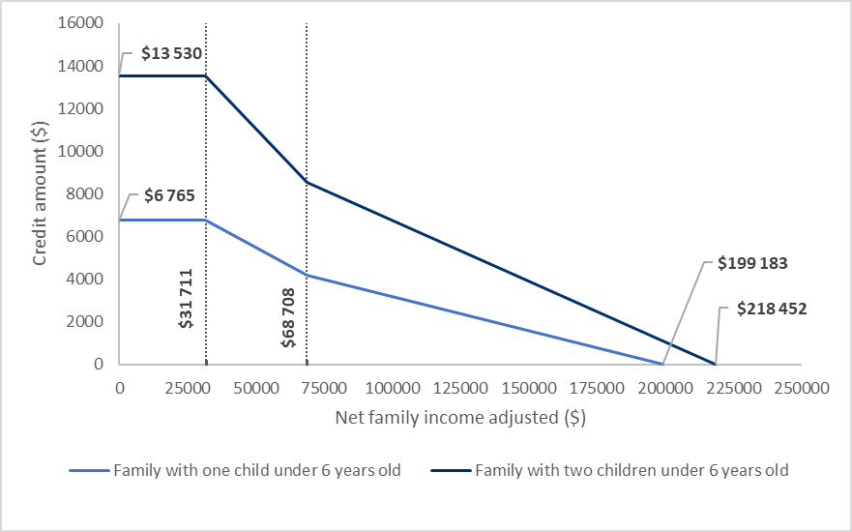
Canada Child Benefit (before increase)
Annual Canada Child Benefit paid to families with one or two children under 6 years old, 2020-2021 benefit year
Source: CFFP
BACK
NEXT MEASURE
As of April 8, 2020

Slide 20
←
Are you eligible for the GST credit?
YES
NO

Slide 21
←
Increased GST Credit
GST Credit
DOUBLED
To learn more, click here.
Average increase of $400 for single individuals and $600 for couples
GST CREDIT?
NEXT MEASURE
As of April 5, 2020

Slide 22
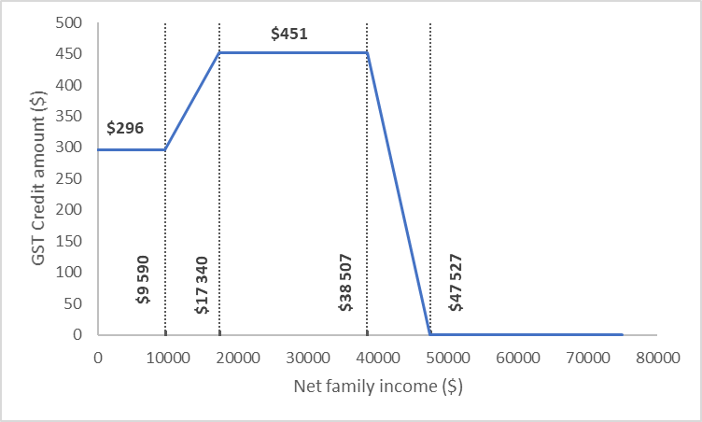
GST Credit (before increase)
GST/HST credit based on net family income for a single individual, 2020-2021 benefit year
SINGLE
COUPLE WITHOUT CHILDREN
COUPLE WITH CHILDREN
Source: CFFP
BACK
NEXT MEASURE
As of April 5, 2020

Slide 23
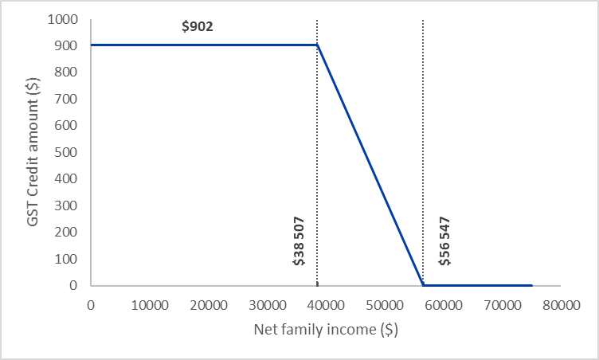
GST Credit (before increase)
GST/HST credit based on net family income for a couple with 2 children, 2020-2021 benefit year
SINGLE
COUPLE WITHOUT CHILDREN
COUPLE WITH CHILDREN
Source: CFFP
BACK
NEXT MEASURE
As of April 5, 2020

Slide 24
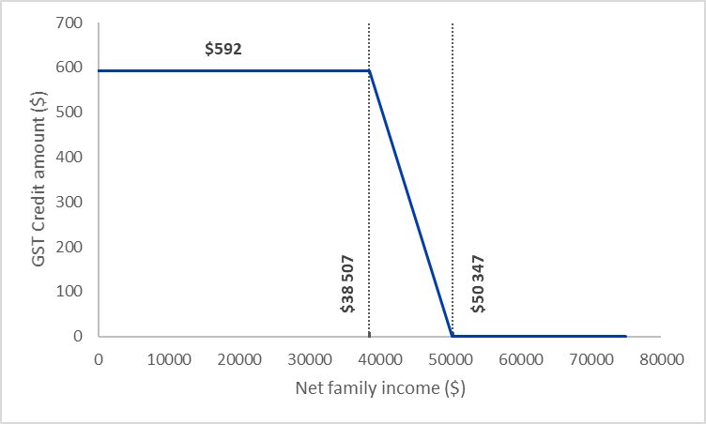
GST Credit (before increase)
GST/HST credit based on net family income for a couple with no children, 2020-2021 benefit year
SINGLE
COUPLE WITHOUT CHILDREN
COUPLE WITH CHILDREN
Source: CFFP
BACK
NEXT MEASURE
As of April 5, 2020

Slide 25
←
Do you have a student loan?
YES
NO

Slide 26
←
Student Loans
To help support those who have to pay off student loans and who are affected by the challenging situation caused by COVID-19, the government of Quebec has postponed repayment for the Aide financière aux études student loan program. This measure, for which the financing is estimated to be close to $48M, is being implemented, and will be in effect before April 1.
To learn more, click here.
The government is giving you 6 months with no interest (which applies automatically). Opt to make an automatic payment in the same amount during this period.
SEE AN ILLUSTRATION
NEXT MEASURE
As of April 5, 2020

Slide 27
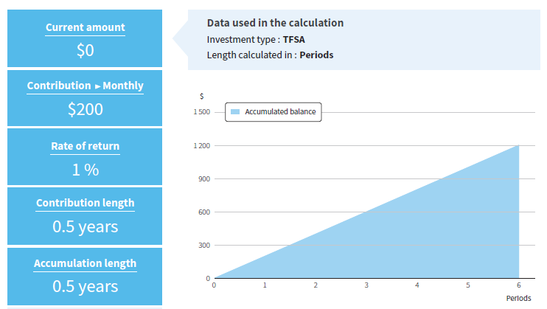
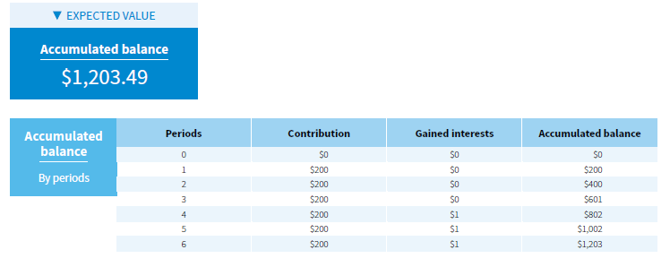
Student Loans
If you choose an automatic withdrawal of $200 per month, after the 6-month postponement, you’ll have accumulated a balance of $1,203.49, with no penalties.
Financial Calculator - Equisoft
BACK
NEXT MEASURE

Slide 28
←
Do you have a mortgage or another type of loan? (Mortgage, credit card, line of credit, etc.)
YES
NO

Slide 29
←
Mortgage Support
Canada’s six biggest banks have taken decisive action to help customers impacted by COVID-19.
Effective immediately, Bank of Montreal, CIBC, National Bank of Canada, RBC Royal Bank, Scotiabank and TD Bank have made a commitment to work with personal and small business banking customers on a case-by-case basis to provide flexible solutions to help them manage through challenges such as pay disruption due to COVID-19; childcare disruption due to school closures; or those facing illness from COVID-19.
This support will include up to a six-month payment deferral for mortgages, and the opportunity for relief on other credit products.
The role of financial institutions
WHO TO CONTACT
Though these options may seem attractive, don’t forget that they are mostly only deferrals. Be careful, because these will still have to be paid back. It would be better to start by taking a look at your budget and how best to manage liquidity.
CREDIT CARDS
MORE INFORMATION
NEXT QUESTION
As of April 5, 2020

Slide 30
←
The big banks are temporarily lowering their credit card interest rates
Financial Institution
Scotiabank | 10.99%
National Bank | 10.90%
RBC | RBC will reimburse 50% of the interest on credit cards for its clients facing financial hardship due to COVID-19
BMO | 1-844-837-9228
TD Bank | TD is offering a 50% rebate on credit card interest rates for its clients facing financial hardship .
Desjardins | 10.90%
CIBC | 10.99%
BACK
NEXT QUESTION
As of April 8, 2020

Slide 31
Mortgage Support
What is mortgage payment deferral?
Mortgage payment deferrals can help you during times of financial hardship — like unemployment or reduced employment due to the coronavirus (COVID-19) outbreak.
The deferral is an agreement between you and your lender. Typically, the agreement indicates that you and your lender have agreed to pause or suspend your mortgage payments for a certain amount of time. It’s also known as a mortgage payment deferral agreement or mortgage forbearance agreement and it’s a temporary measure.
After the agreement ends, your mortgage payments return to normal and the missed payments — including principal and accumulated interest - repaid.
How mortgage payment deferrals can help you?
A mortgage deferral helps you when you’re struggling to make your payments by allowing you to skip your mortgage payment for a specified amount of time.
Are the deferred payments erased or cancelled?
The mortgage deferral agreement does not cancel, erase or eliminate the amount owed on your mortgage. At the end of the agreement, you will have to resume payment according to your regular payment schedule.
NOTE: The interest that hasn’t been paid during the deferral period continues to be added to the outstanding principal of your mortgage. This can affect the total amount you owe in accordance with the original payment schedule.
Do I need to repay the deferred amounts?
Yes, you’ll need to repay the amounts of the skipped payments including both principal and interest.
How do I repay the deferred amounts??
Details of the repayment will vary according to the specific lender and situation.
The interest on your mortgage that hasn’t been paid during the deferral period continues to be added to the outstanding principal of your mortgage. When your payments start again, your mortgage payment might be based on the total amount you then owe to pay off your mortgage in accordance with the original payment schedule.
IMPORTANT: Mortgage payment deferrals focus solely on your mortgage. It won’t affect other payments regularly withdrawn, like property taxes and life/disability insurance.
BACK
NEXT QUESTION

Slide 32
Mortgage Support
Financial Institution
Scotiabank | 1-800-790-7979
National Bank | 1-888-835-6281
RBC | 1-800-769-2511
Bank of Montréal | 1-844-837-9228
TD Bank | 1-800-563-3995
Desjardins | 1-800-224-7737
CIBC | 1-877-454-9039
iA Financial Group | 1-800-463-4396
BACK
NEXT QUESTION
As of April 8, 2020

Slide 33
←
While we’re on the subject
Do you have insurance coverage for your mortgage in case of death or disability?
YES
NO

Slide 34
←
While we’re on the subject
Why, or why not?
NEXT

Slide 35
←
While we’re on the subject
Do you know about the advantages of using a private insurer instead of a mortgage lender?
YES
NO

Slide 36
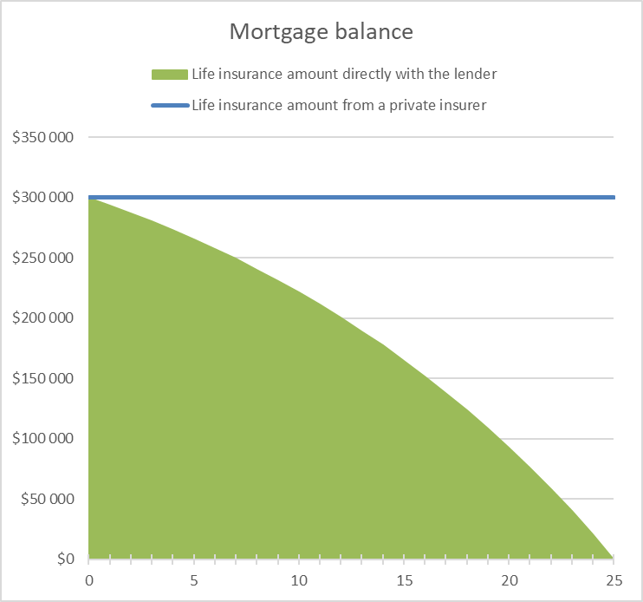
←
Advantages of a Private Insurer
30-year-old man,
non-smoker;
$300,000 loan over 25 years at 3% interest
Source: Advanced Financial Planning
NEXT

Slide 37
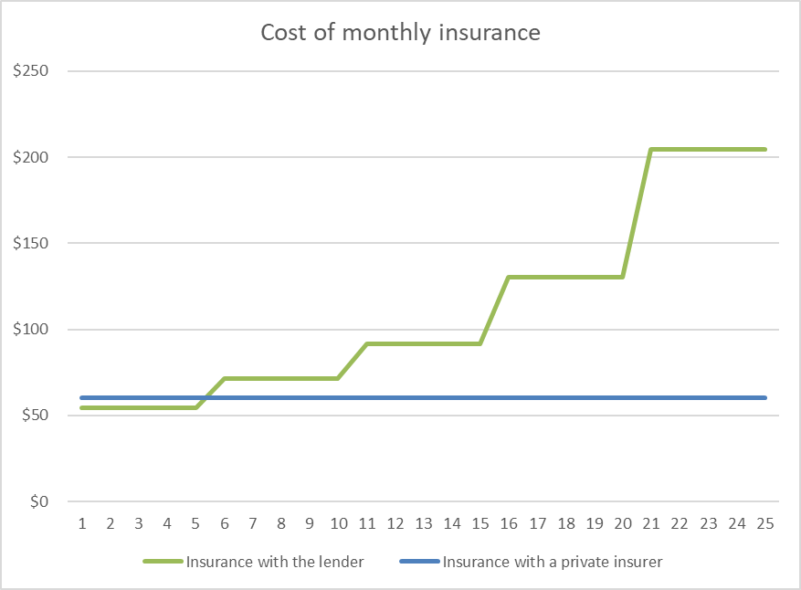
←
Advantages of a Private Insurer
30-year-old man,
non-smoker;
$300,000 loan over 25 years at 3% interest
Source: Advanced Financial Planning
NEXT MEASURE

Slide 38
←
Deferral for Tax Payment
Measures announced by several municipalities, including:
Quebec City: May 4 payment has been deferred to August 4, July 3 payment has been deferred to September 4, and final payment has been deferred to November 3
Montreal: Tax payment deadline pushed by one month, to July 2
For more information about paying your taxes, consult the website for your municipality.
It is worth taking advantage of this measure as you can increase your cash flow without incurring penalties and interest during the prescribed period.
PARTICIPATING CITIES
NEXT MEASURE

Slide 39
←
Deferral for Tax Payment
Participating cities: (as of April 3, 2020)
Quebec City
Montreal
Saguenay
Drummondville
St-Denis-de-Brompton
Lévis
Laval
Granby
Sherbrooke
Trois-Rivières
Longueuil
St-Lambert
Coaticook
Varennes
St-Bruno
Gatineau
Lac-Mégantic
Rivière-du-Loup
Ancienne
Lorette
Montarville
Victoriaville
BACK
NEXT MEASURE
As of April 3, 2020

Slide 40
←
Do you have life, disability or critical illness insurance coverage from an insurance company?
YES
NO

Slide 41
←
Some insurance companies are allowing clients affected by COVID-19 to defer payment for their insurance premiums up to 90 days
Ask your insurance company
Though this is an attractive offer, it should be used as a last resort. We should re-evaluate your budget so that we can make sure you get through this crisis, but also through the “post-crisis”.
NEXT QUESTION
As of April 5, 2020

Slide 42
←
Do you, or you and your spouse, have a will?
YES
NO

Slide 43
←
When was the last time it was updated?
NEXT

Slide 44
←
Currently, there are 3 ways to make a will
Holograph wills
Wills made in the presence of witnesses
Notarial wills
For more information, click here
NEXT

Slide 45
←
In the event of an unexpected death, people usually consider 3 options:
Some people only want to make sure final expenses are covered
Some also want to make sure their family (or spouse) receives some additional money to help with expenses for 2 to 3 years
Some want to make sure their family (or spouse) can maintain the same lifestyle (worry-free) in the long term (e.g.: until their youngest child is no longer a dependant)
When you think about how you feel about this, for an unfortunate event like this, which of these three approaches sounds right for you?

Slide 46
←
Are you 100% certain that your current coverage and your estate is enough to provide what you would want to for your family (or spouse)?
YES
NO

Slide 47
←
While we’re on the subject
How have you evaluated your situation? And when was the last time you did?
NEXT

Slide 48
←
Before this crisis, did you have an emergency fund?
YES
NO

Slide 49
←
Using this emergency fund, how long would you be able to cover your living expenses?
According to the IQPF (Quebec institute of financial planners), your emergency fund should be the equivalent of 3 to 6 months of living expenses. These funds should be in risk-free investments.
NEXT

Slide 50
←
According to the IQPF (Quebec institute of financial planners), your emergency fund should be the equivalent of 3 to 6 months of living expenses. These funds should be in risk-free investments.
NEXT

Slide 51
←
Do you have investments for retirement?
YES
NO

Slide 52
←
If you could add a guarantee but keep your return potential, would you take advantage of that option?
YES
NO
I DON’T KNOW

Slide 53
←
Investment guarantees
Guarantees available
75/75
75/100
100/100
THE MEASURES
As of April 5, 2020

Slide 54
←
Investment guarantees
Guarantees available
75/75
75/100
100/100
Guarantee at death: 75% of the value of all premiums invested
Guarantee at maturity: 75% of premiums invested
THE MEASURES
As of April 5, 2020

Slide 55
←
Investment guarantees
Guarantees available
75/75
75/100
100/100
Guarantee at death: 75% of the value of all premiums invested
Guarantee at maturity: 100% of premiums invested
THE MEASURES
As of April 5, 2020

Slide 56
←
Investment guarantees
Guarantees available
75/75
75/100
100/100
Guarantee at death: 100% of the value of all premiums invested
Guarantee at maturity: 100% of premiums invested
THE MEASURES
As of April 5, 2020

Slide 57
Summary
The Measures | Applies to me?
Canada Emergency Response Benefit
Incentive Program to Retain Essential Workers
Extension of the Tax Filing Deadlines
Protection for Seniors (RRIF withdrawal reduction)
Increased Canada Child Benefit
Increased GST Credit
Student Loans (six-month interest-free moratorium)
Mortgage Support
Deferral for Tax Payment
Deferral of Life Insurance Premiums
SEE THE MEASURES AGAIN
MY ROLE AS A FINANCIAL SECURITY ADVISOR

Slide 58
Did you know that, to date, there are over twenty measures? Here are the major ones:
CANADA EMERGENCY RESPONSE BENEFIT
INCENTIVE PROGRAM TO RETAIN ESSENTIAL WORKERS
EXTRA TIME TO FILE INCOME TAX RETURNS
SUPPORT FOR SENIORS
INCREASED CANADA CHILD BENEFIT
STUDENT LOANS
MORTGAGE SUPPORT
INCREASED GST CREDIT
EXTRA TIME TO PAY TAXES
INSURANCE COMPANIES
BACK TO QUESTIONS
MY ROLE AS A FINANCIAL SECURITY ADVISOR

Slide 59
My Role: Help you get through this crisis
Analyse the support measures available to you
Find opportunities to optimize your financial situation and taxes
Ensure the sound management of your liquid assets
Ensure that you have a portfolio in alignment with your investor profile
Evaluate the possibility of consolidating your insurance
Make sure you’re paying the right prices for your auto and home insurance
Evaluate whether you could benefit from other financial opportunities based on your situation
Make a virtual appointment
Get your information ready
Starting at the beginning of this crisis, our clients save $347 per year on their auto and home insurance.
AUTO AND HOME INSURANCE QUOTE
NEXT

Slide 60
←
Get an auto and home insurance quote
Priority phone line for you:
(418) 650-4641
Get a discount of up to 10%*
*When you have another iA Financial Group product
Promo code for the quote: _______
NEXT

Slide 61
←
Has this helped to clear things up a bit?
Are there other people you know who could benefit from the same information?
Family
Friends
Co-workers
Neighbours

Slide 62
Support Measures
CANADA EMERGENCY RESPONSE BENEFIT
INCENTIVE PROGRAM TO RETAIN ESSENTIAL WORKERS
EXTRA TIME TO FILE INCOME TAX RETURNS
SUPPORT FOR SENIORS
INCREASED CANADA CHILD BENEFIT
STUDENT LOANS
MORTGAGE SUPPORT
INCREASED GST CREDIT
EXTRA TIME TO PAY TAXES
INSURANCE COMPANIES
START ANALYSIS

