Slide 1
Business Tracker The ideal tool to manage your in-force contracts
April 2020

Slide 2
Business Tracker is:
An electronic and secure tool to exchange information, including for:
Insurance
Claims
Transactions
Documents sent to your client
Sales opportunities (Life contract events)
Savings
Confirmation of transactions or Reset confirmation
New issue or Contribution
ACTIONS
INFORMATION
CENTRALIZED
PRIVILEGED ACCESS
OPPORTUNITIES
CLEAR MESSAGES
SECURE
Business Tracker
A MUST-HAVE
* New business not available at this time

Slide 3
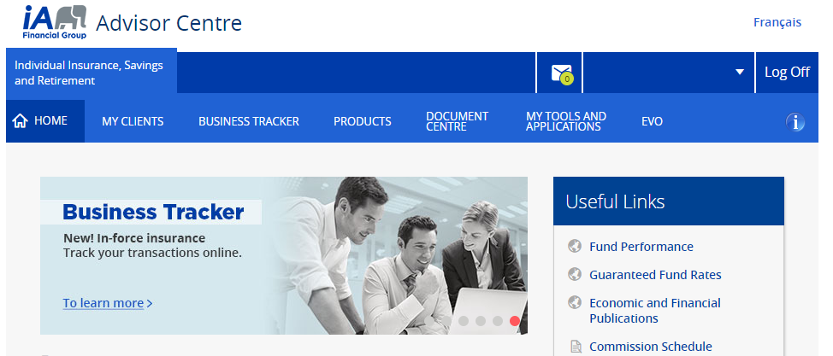
How to access the Business Tracker
1- Visit ia.ca/advisorcentre, then log in.
2- You simply have to click on Business Tracker in your Advisor Centre!
To know how to sign up to the Advisor Centre Consult the annex on page 19.

Slide 4
Door opener to sales opportunities
See sales opportunities at a glance.
Examples

Slide 5
Some documents sent to your client
Examples Events that may have an impact on the client
One-click access to document sent to your client
Droit d’exercice – Garantie d’assurabilité

Slide 6
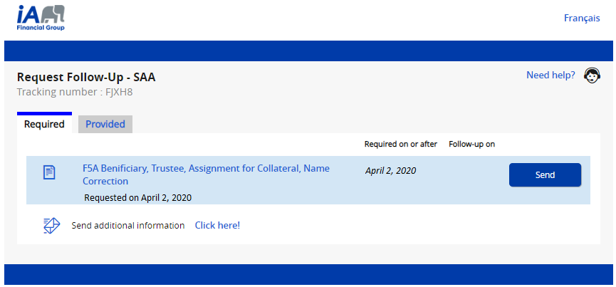
Tracking insurance transactions
THE channel to use to send missing information
See the completed steps, from receipt to the processing of the transaction
No searching required! Click to download
Missing or incomplete forms Questions / Answers
Starting April 26th, 2020
Click on Request Follow-Up to see and send the missing information

Slide 7
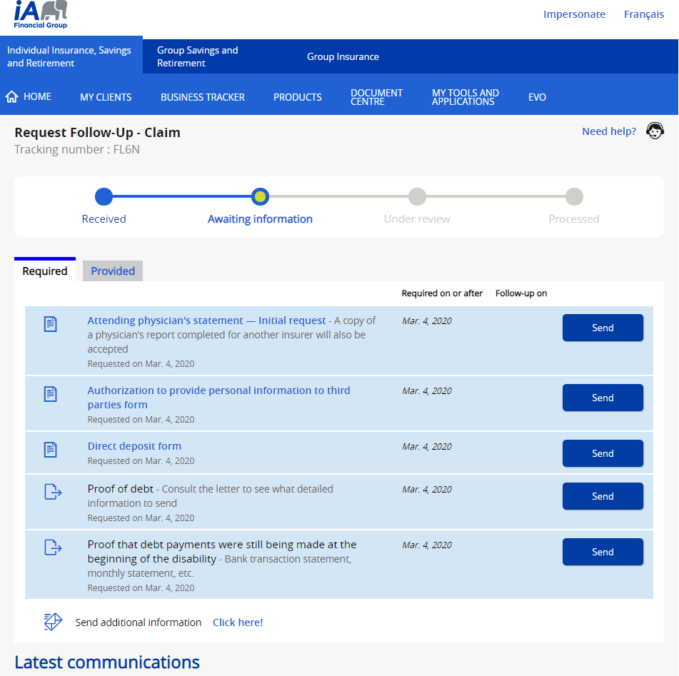
Tracking claims
One-click access to detailed information regarding claims.

Slide 8
Features

Slide 9
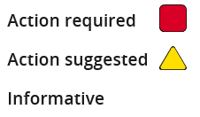
Importance
Clear instructions regarding
actions required or
suggested on your part.

Slide 10
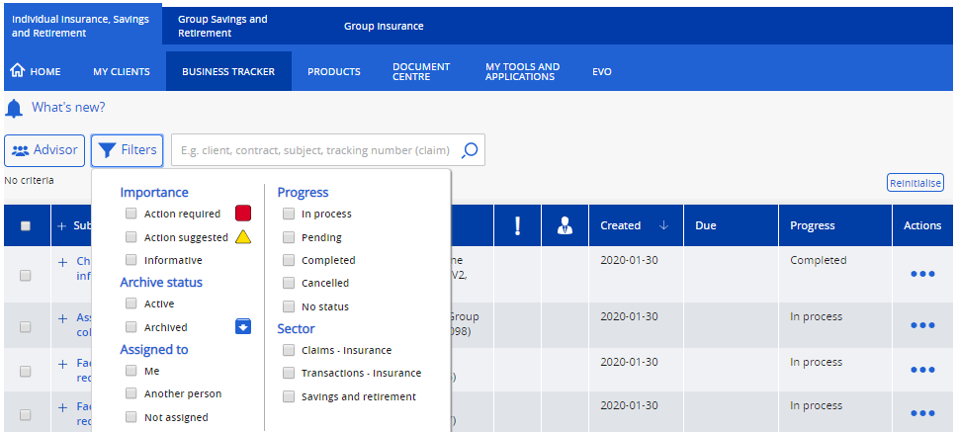
Filters and search
Powerful filter, sort and search functions.

Slide 11
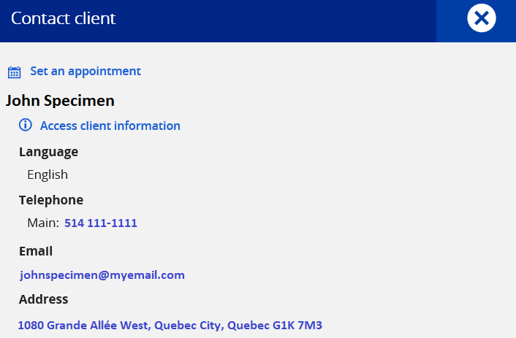
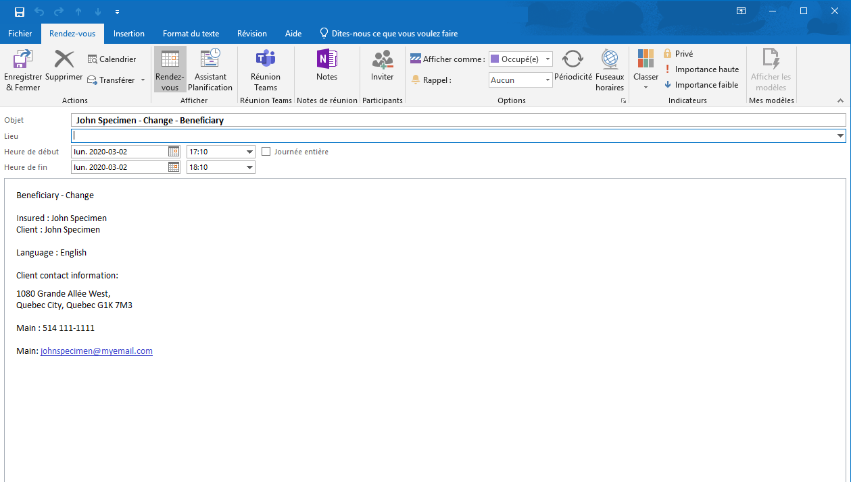
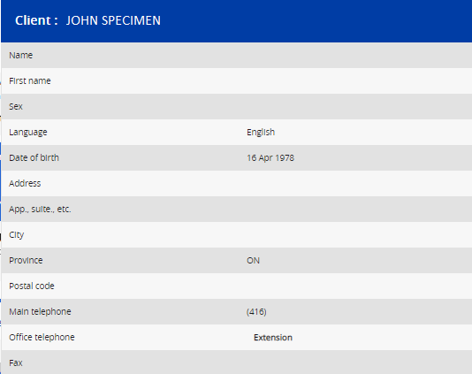
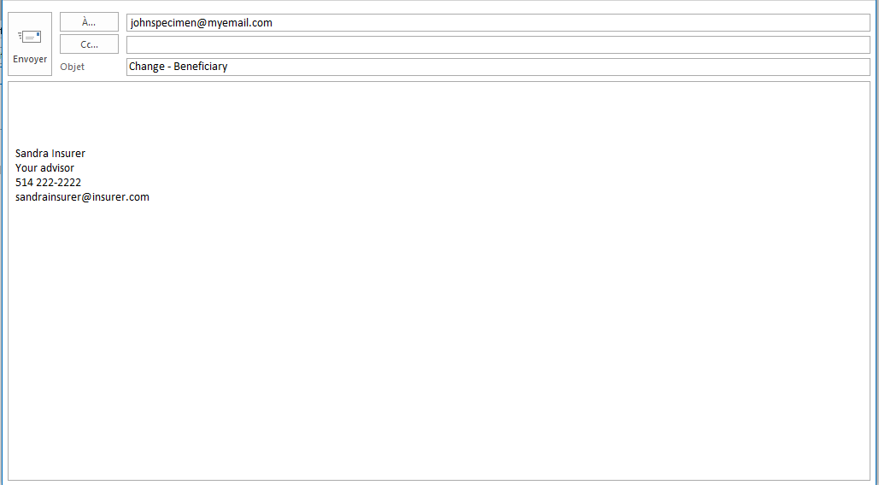
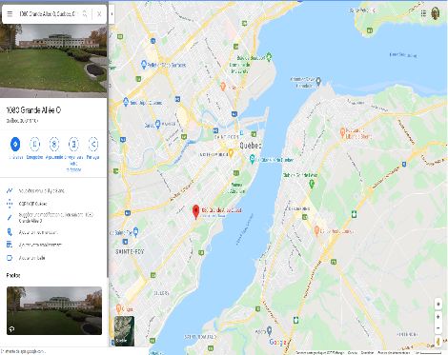
Client information

Slide 12
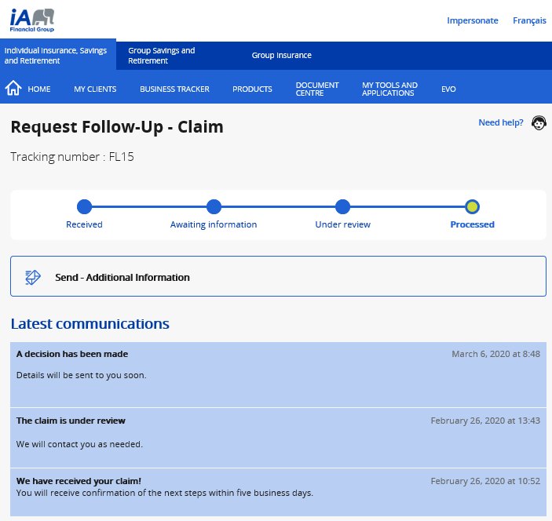
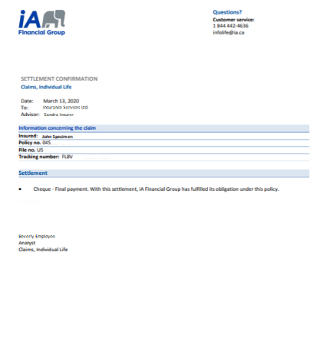
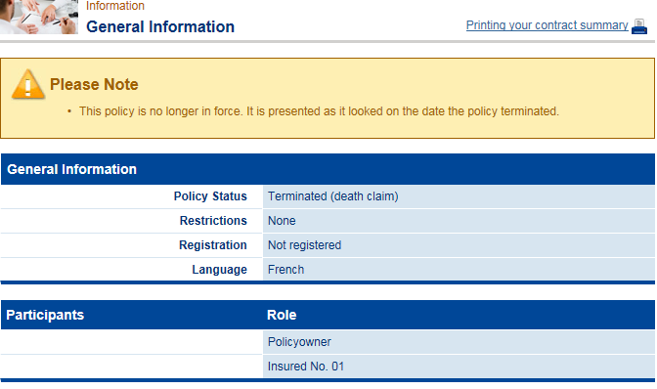
Clickable links – Detailed information

Slide 13
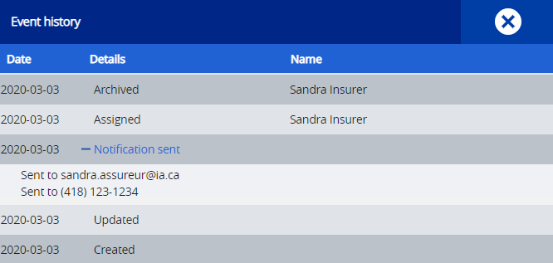
Archive – Assignment – History
SI

Slide 14
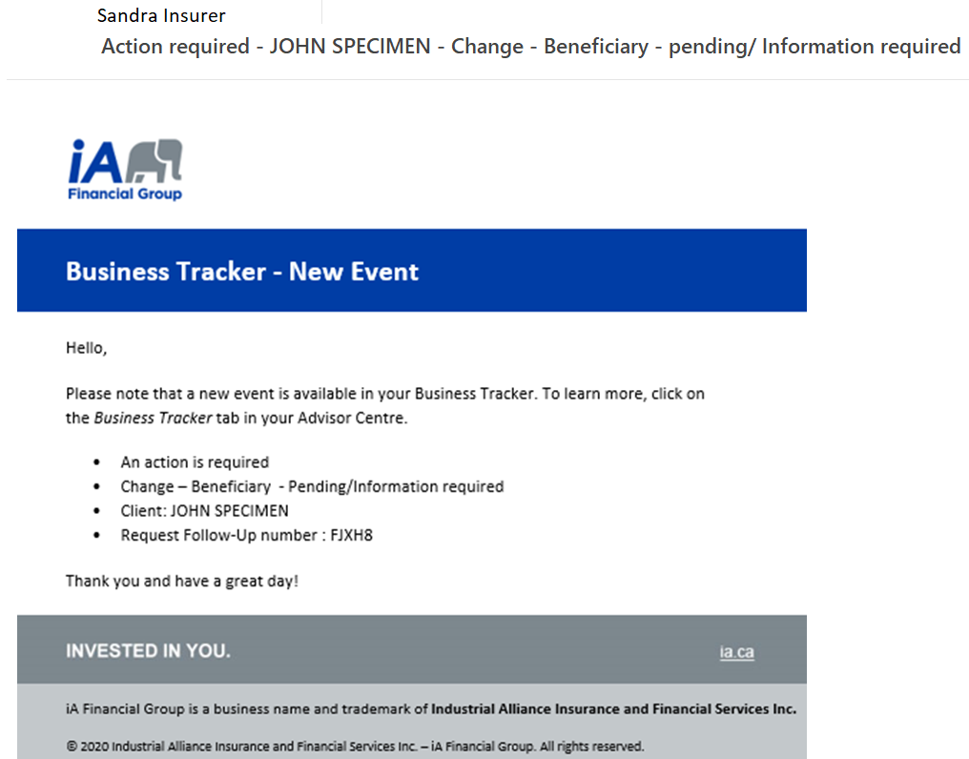
Default notifications by email
What? Email notification sent by default when an action is suggested or required following an event to an in-force contract.
Who? The advisor and any other person to which the access to their clientele has been delegated.
To know how to personalize your notification preferences, see the next pages.

Slide 15
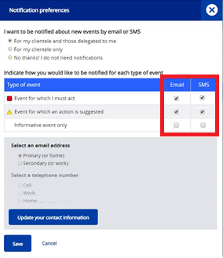
Desktop How to personalize – Notification preferences*
1- Click here!
2- Set or change Notification preferences
* Available only to the advisor and any other person with delegated access to their clientele.

Slide 16
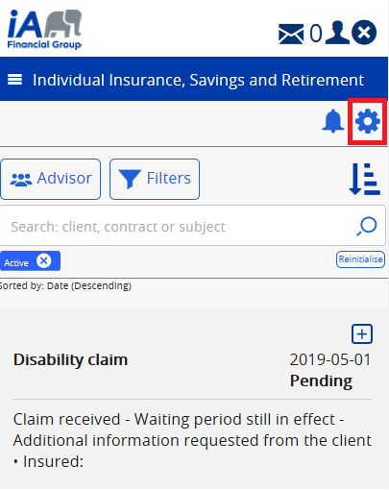
Mobile How to personalize – Notification preferences*
1- Click here!
2- Set or change Notification preferences
* Available only to the advisor and any other person with delegated access to their clientele.

Slide 17
Need help?
As always, go through the: IT service desk for technical support 1-888-610-5101 / interface@ia.ca Client and partner contact centre for all other questions 1-844-4iA-INFO / infolife@ia.ca / savings@ia.ca

Slide 18
Annex

Slide 19
How to register to the Advisor Centre

