Slide 1
Requirement Management – Insurance Transactions
April 2020

Slide 2
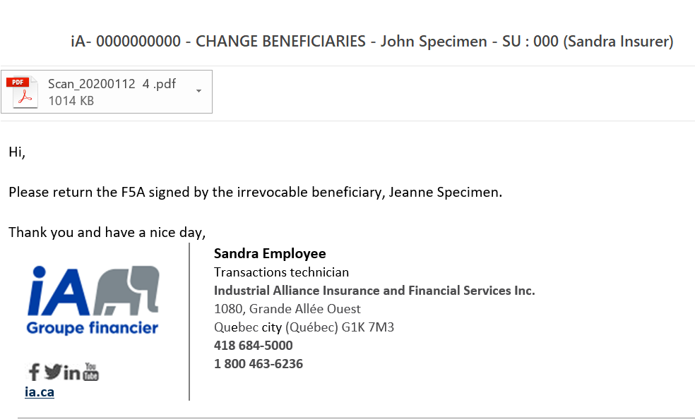
Requirement Management – Insurance Transactions
Before April 26th – Communication process
Agency informed by email of the missing information still needed to process the insurance transaction.

Slide 3
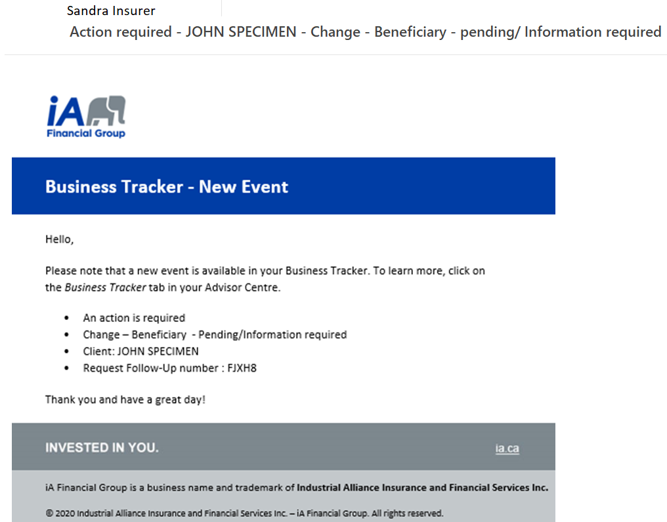
Requirement Management – Insurance Transactions
Starting April 26, 2020
New communication process
Advisor informed by the Business Tracker of the missing information still needed to process the insurance transaction. Notification sent to the advisor based on their notification preferences. This notification replaces the email to the agency.

Slide 4
New Communication Process
Efficiency
No more manual email forwarding
No more forms lookup in the document center
Facilitated processing and shortened processing delay
Complete overview in Business Tracker
Everything in one place: No need to search through mutiple emails.
Easy status filtering (Ex.: In process, Pending, Completed, etc. )
See the “Required” and “Provided” information at a glance
Confidentiality
Secure way to transmit information

Slide 5
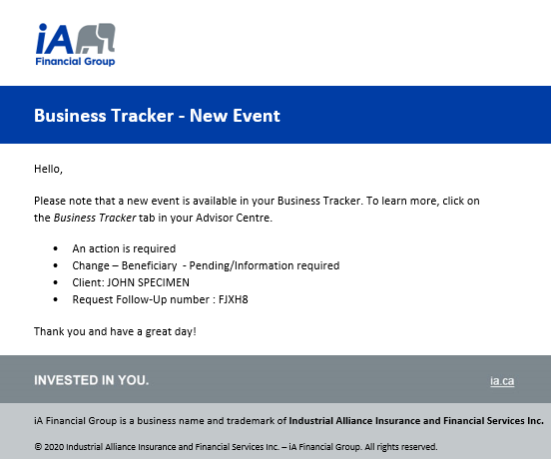
Requirement Management – Insurance Transactions
Notification sent to the advisor based on his/her notification preferences.
Subject: Action required – Client name – Transaction type and status
Consult the Business Tracker to see and send the missing information

Slide 6
In Business Tracker
Requirement Management – Insurance Transactions
See the completed steps, from receipt to the processing of the transaction
Click on Request Follow-Up to see and send the missing information

Slide 7
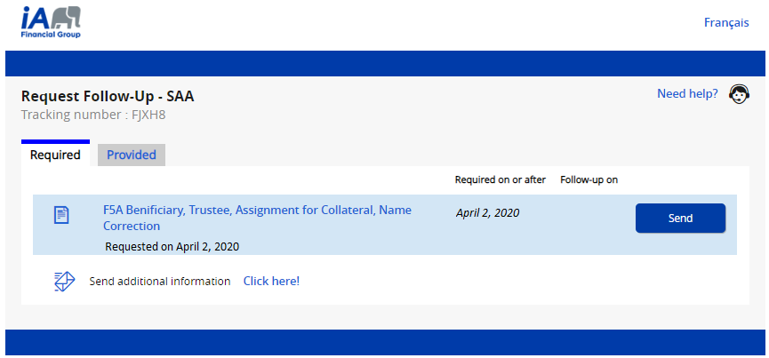
In Request–Follow-Up
Requirement Management – Insurance Transactions
THE channel to use to send the missing information

Slide 8
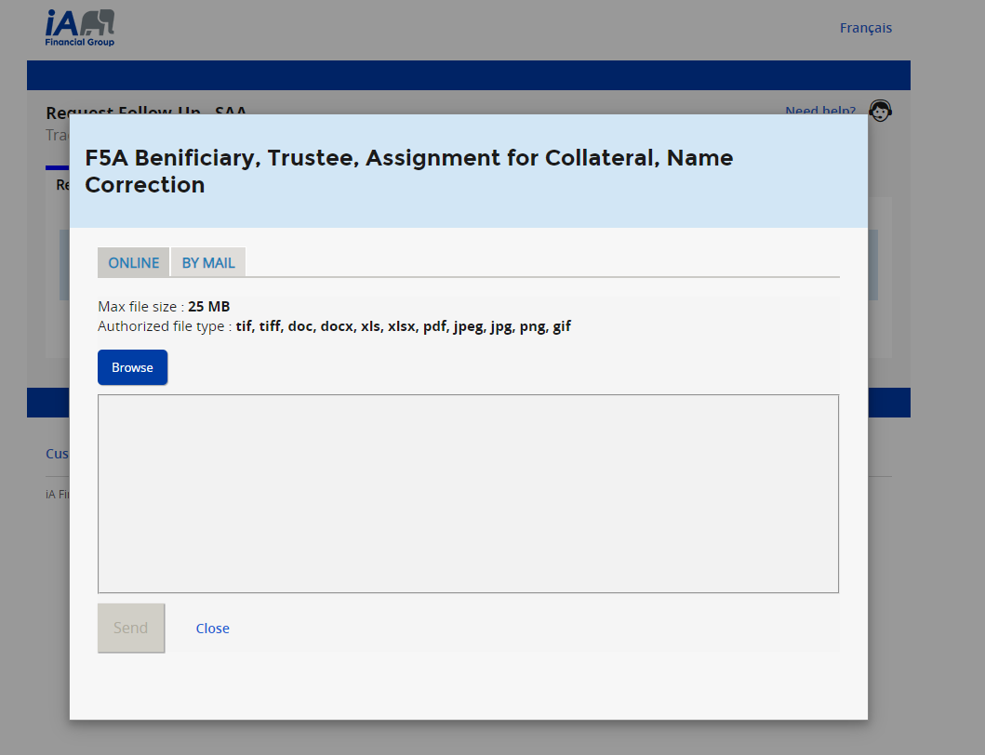
Requirement Management – Insurance Transactions
In Request Follow-Up
Attach the document

Slide 9
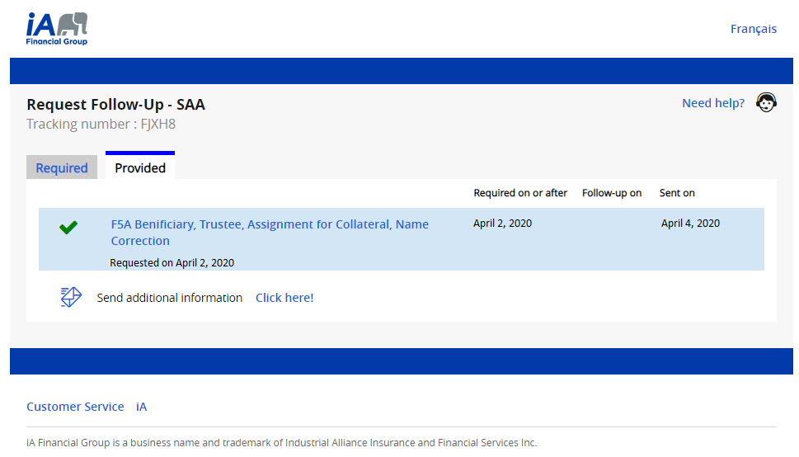
In Request Follow-Up
Requirement Management – Insurance Transactions
Provided section
As soon as the information is sent – Automatically updated

Slide 10
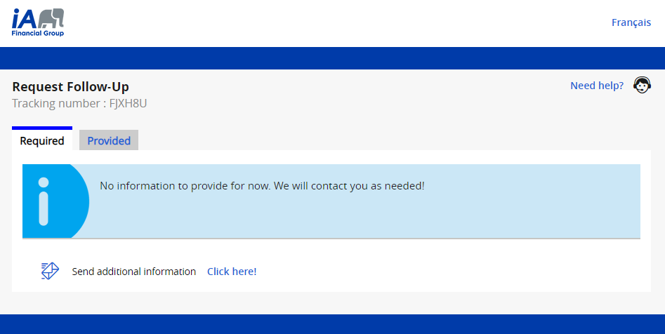
Requirement Management – Insurance Transactions
In Request Follow-Up
Required section
Automatically updated – Based on the information sent and the information still required (as needed)

Slide 11
Requirements management – Insurance Transactions
Requirement Management – Insurance Transactions
In Business Tracker– Insurance Transactions
Automatically updated – When all the
missing information is sent

Slide 12
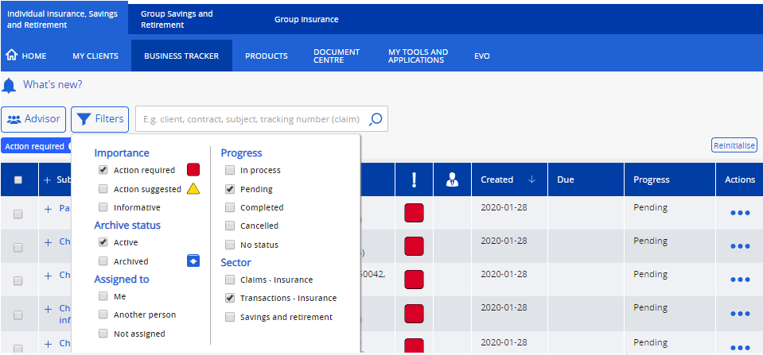
Tip!
Display the transactions requiring the sending of missing information
Business Tracker Select these filters

