Slide 1



| Welcome
Notes:
NOTE: This PowerPoint presentation was created to help you introduce the YouScience experience to your students. However, you should feel free to make this your own. Edit, rearrange, cut, add, do whatever is comfortable for you.

Slide 2
Q&A| But why am I taking YouScience?
To help you answer these questions:
  What are my natural strengths?
  What pathways are
  good fits for high school?
  What career clusters are a good fit for me based on my natural abilities?
  How can I describe myself and who I am with confidence?

Slide 3



Q&A| So how does YouScience work?
The Core Assessment is broken up into 6 short 8 – 10 minute exercises. You can take a break after any exercise, but not during the middle!
Many students refer to them as “brain games”.
You might not think the exercises are measuring anything valuable that can help you with your future. Well, believe it or not, it really does measure how your brain is wired and important aspects of what makes you, uniquely you!

Slide 4

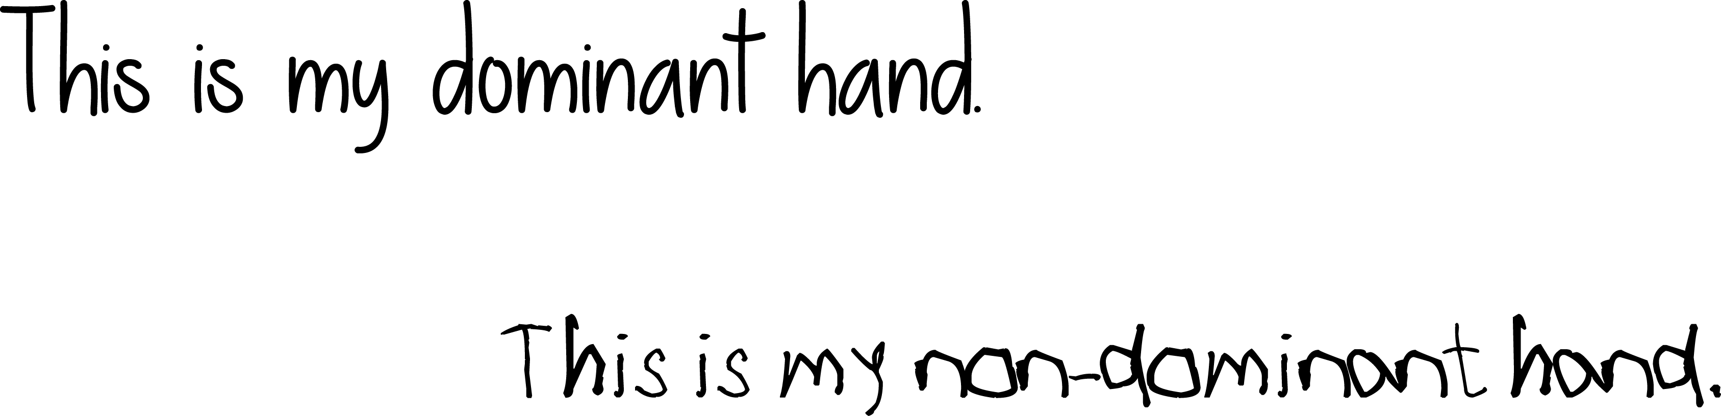
YOUR NATURAL ABILITIES| What is your dominant hand?
Notes:
Interactive & Fun Activity
GOAL: Have students experience what ‘poor aptitude fit’ feels like, and how important it is
SPEAKER TEXT:
To get a sense of how YouScience can help you, I want you all to take out a piece of paper, and write “I am excited to learn about my aptitudes”, with your NON-Dominant hand. So, if you’re a righty, write with your left hand.
[-----ACTIVITY-----] [-----SOLICIT STUDENT RESPONSES-----]
How did that feel? (hard, frustrating)
Would you want to write like this everyday?
How would you feel if you had to?
[Take a few student responses and/or have them discuss the experience with their neighbor briefly]
This is exactly what it feels like to work at a job that is a poor aptitude fit for you. That means it requires you to do things that do not come easily or naturally to you. Just writing that one phrase with your non-dominant hand was frustrating; imagine if you had to do that all the time! If that was your job, you wouldn't’t even want to go to work eventually! We don’t want this to happen to you in real life. This is where YouScience comes in.

Slide 5

SMILE!
THIS IS NOT A TEST
- or -
An intelligence or personality test
A test you can study for
A test that compares you to others
Notes:
GOAL: This slide is meant to get them out of ‘test mode’ and instill in them that this is not about intelligence, the students will not be compared to others, and this is not a test you need to ‘score high on’.
SPEAKER TEXT:
Let’s be clear about what YouScience is NOT:
This is not an intelligence test – you will not be given a score
This is not a personality test or skills test
This is not a “test” you can study for
This is not an assessment that compares you to others. There are no grades and no percentile ranks.
This is about YOU! This is about the natural abilities you were born with and how your brain is innately wired.
[STRONGLY EXPRESS THE IMPORTANCE OF NOT CHEATING & NOT DISTRACTING OTHERS]
YouScience aims to identify what your aptitudes are, so that you can find a path that allows you to do your best work in a way that feels natural and enjoyable for you. Wouldn’t you want your everyday to feel like you’ve done great work without stress or frustration? The name of the game is what is the best fit for you.
While you are doing the exercises, keep in mind that knowing what’s challenging for you is just as important as knowing what’s easy.
If you were to cheat and fold a real piece of paper while you were taking the Spatial Visualization exercise – sure, your results would probably show that you have a knack for this aptitude – but would you want it? You’d then be recommended careers that fit with that level of Spatial Visualization. If those careers are not actually a good fit for you, working in them would be stressful – and you’d probably not be very happy. So, definitely try you best, but remember – this is about what you naturally do well, and about how you fit with potential majors and careers. Let the natural you shine through. Your future self will thank you for it.
Do not cheat. This is not for a grade and you will not be compared to others. This is only for you. You’d only be cheating yourself of an opportunity to learn about you.
Paper and pencil are ONLY permitted during the Numerical Reasoning & Numerical Computation Exercises. Do not use any other aide while you are taking the assessment. When breaking these rules you are only cheating yourself and your future.
Do not distract your neighbors. It’s ok if you are frustrated or need a break, but these exercises take a lot of concentration and focus. Even a momentary distraction can pull someone out of their focus and cause them to fumble an exercise. It is unfair to those around you to make them lose an opportunity to get the most accurate information about themselves.

Slide 6


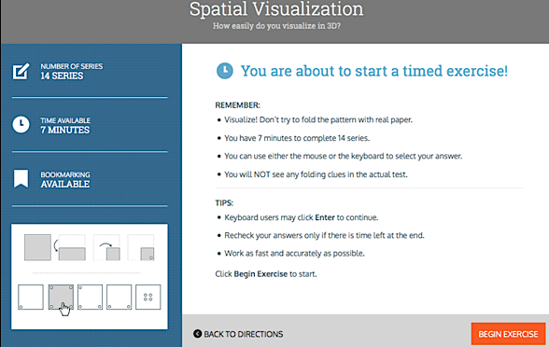
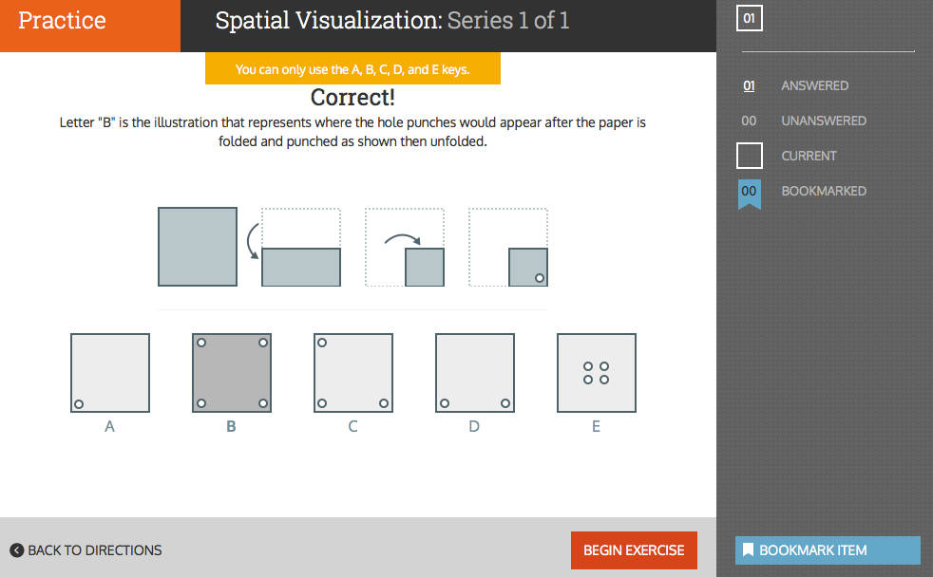
WHAT TO EXPECT| Sample exercises
Notes:
[IMPORTANT] Your goal is for students to get the most true and accurate information about themselves. This means putting forth your best, most honest effort (no cheating!)
SPEAKER TEXT:
Here is an example of the exercise for the Spatial Visualization Aptitude. This is one of the many exercises you’re about to work through. Some of these will feel more like games that exercises. Some will be fun, some will be frustrating, and some will seem totally random. You’ll wonder what they could possibly reveal about you. But believe it or not, they are measuring core and important aspects of what makes you, you. That’s part of the science. Don’t give up, give it your all!
Some exercises will be fun and easy, and others may be difficult or even frustrating. Keep in mind that knowing what is hard for you is just as important as knowing what is easy. You will be challenged, and you will get frustrated. These exercises are purposefully designed to be hard at times. Even when you are feeling really challenged, don’t give up! That’s when you’re getting the BEST information about yourself! Good stuff happens when you’re working at your limit. Stress is ok. This is measuring the real you.
The exercises are timed, and take between 4-15 minutes to complete. To help you pace yourself there is a built in 10-minute break. Take the break- you’ve earned it! You can also take breaks as often as you need to, so you can keep doing your best. Just make sure you take breaks between exercises, and not in the middle of them. When you finish an exercise, take a minute to catch your breath and regain your focus before starting the next one. Take the time you need- it’s ok. Make sure you do not close your browser during an active exercise.
[OPTIONAL: Depending on your school’s Implementation Plan]
It is even okay if you need to come back and finish the next day. If you need to step away and come back to finish the exercises later, stop at the end of an exercise and log-off. It is perfectly fine to log off after an assessment, your work will not be lost.

Slide 7
THE YOUSCIENCE EXPERIENCE | Know your strengths
Make a short list: What are your greatest strengths?
They can relate to school, another activity or club outside of school, or even qualities relating to your personality.
For example:
I have an awesome singing voice.
I’m kind.
In Algebra, I always do well on my tests and quizzes because numbers and formulas make sense to me.
*Keep these descriptions, because we will revisit them after you see your Snapshot results!
Discover what career fields are most closely linked to your natural gifts & abilities.
Notes:
Final Activity
GOAL: Have students attempt to verbalize their unique strengths, then after taking Snapshot, open them up to new, eloquent words and phrases to describe themselves and their gifts
SPEAKER TEXT:
Before you take Snapshot, I want you to create a short list of words or statements to describe yourself and the things you’re good at. These descriptions can relate to anything in your life, from school and sports, to playing musical instruments, or even what kind of friend you are.
[-----ACTIVITY-----] [-----SOLICIT STUDENT RESPONSES-----]
Would anyone like to share one or two of their words or statements?
How do you know you’re good at these things?
[Take a few student responses and/or have them discuss the experience with their neighbor briefly]
It’s important to know what your strengths are and how to use them in your life- you want to focus on the things you’re good at and be proud of them! They are what make you uniquely you. After you finish YouScience Snapshot and see your results, we are going to revisit these descriptions and see if we can rewrite them or add some new ones based on what your results say about you.

Slide 8



GETTING STARTED| Do you have?
1)
2)
3)
Notes:
Make sure each student has a piece of paper & pen/pencil – they will need it for the Numerical Reasoning Aptitude Assessment.

Slide 9



GETTING STARTED| Reminders
Do not cheat! ONLY permitted Do not distract your neighbors! Log off when finished!
during Numerical Reasoning
You need to finish an exercise to log off and take a break.
Click & sign off!
Notes:
[STRONGLY EXPRESS THE IMPORTANCE OF NOT CHEATING & NOT DISTRACTING OTHERS]
SPEAKER TEXT:
While you are doing the exercises, keep in mind that knowing what’s challenging for you is just as important as knowing what’s easy.
If you were to cheat and fold a real piece of paper while you were taking the Spatial Visualization exercise – sure, your results would probably show that you have a knack for this aptitude – but would you want it? You’d then be recommended careers that fit with that level of Spatial Visualization. If those careers are not actually a good fit for you, working in them would be stressful – and you’d probably not be very happy. So, definitely try you best, but remember – this is about what you naturally do well, and about how you fit with potential majors and careers. Let the natural you shine through. Your future self will thank you for it.
Do not cheat. This is not for a grade and you will not be compared to others. This is only for you. You’d only be cheating yourself of an opportunity to learn about you.
Paper and pencil are ONLY permitted during the Numerical Reasoning & Numerical Computation Exercises. Do not use any other aide while you are taking the assessment. When breaking these rules you are only cheating yourself and your future.
Do not distract your neighbors. It’s ok if you are frustrated or need a break, but these exercises take a lot of concentration and focus. Even a momentary distraction can pull someone out of their focus and cause them to fumble an exercise. It is unfair to those around you to make them lose an opportunity to get the most accurate information about themselves.
If you need to step away and come back to finish the exercises later, stop at the end of an exercise and log-off. It is perfectly fine to log off after an assessment, your work will not be lost.

Slide 10

GETTING STARTED| Questions?
The chat tool is available to you in the bottom right-hand corner of the screen as soon as you log in. Use it any time if you have questions about the test.
Inappropriate chats and those not related to YouScience
will be reported to your school.

Slide 11
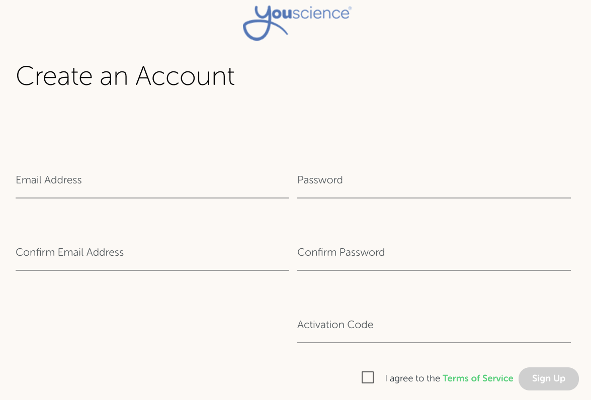
GETTING STARTED| Log on!
Click the green activate button in your email to get started
email format:
password format:
Notes:
Students need to check their email inbox, find their invitation from The YouScience Team, and click on the green ”Activate” button to get to the account creation page. On that page, each student will type in their email address and create a password for the account. If you are using email invites, your students will NOT need activation codes (that will be pre-filled for them).
Please fill out this slide to make sure students know which email to use for their YouScience username (for example, if there is a specific school email they need to use). You can also require students to use a certain password, like their student ID number or your school mascot.

Slide 12
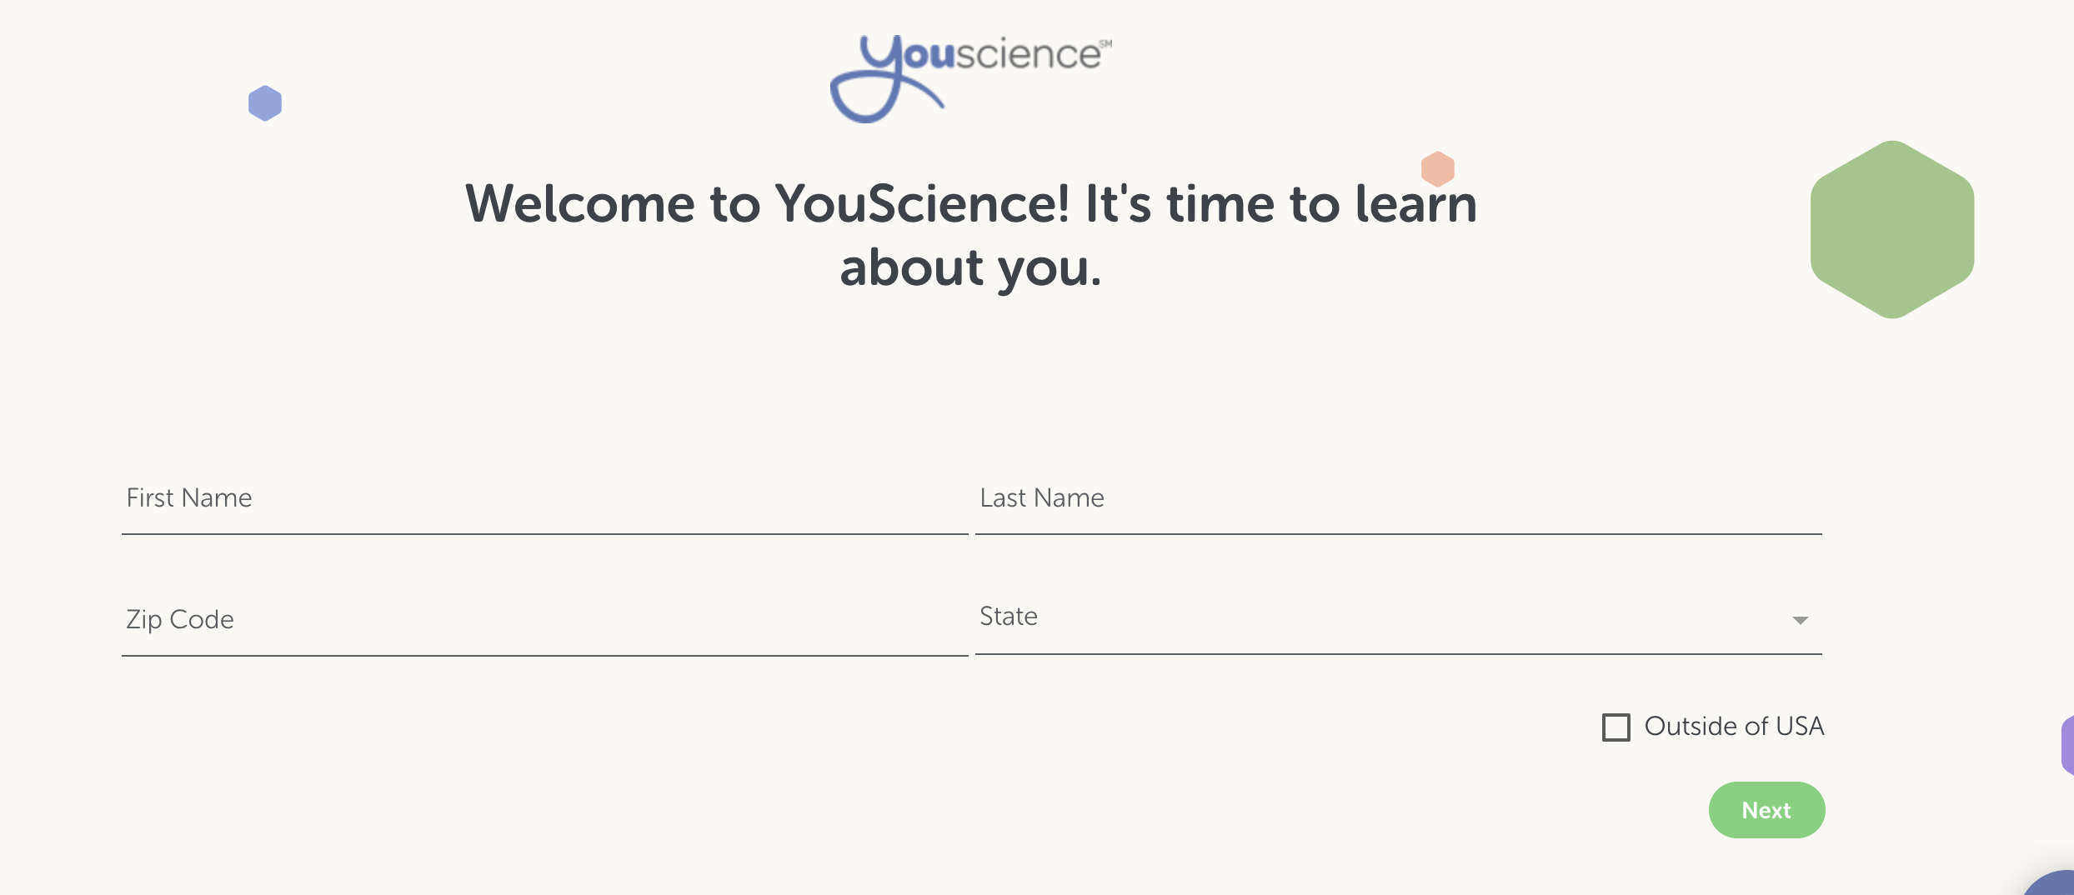
GETTING STARTED| Completing the bio
Notes:
Students must complete the “bio” portion of YouScience before they get started on the first brain game. The bio collects information about the student for password reset purposes and to ensure YouScience validity for all users.

Slide 13
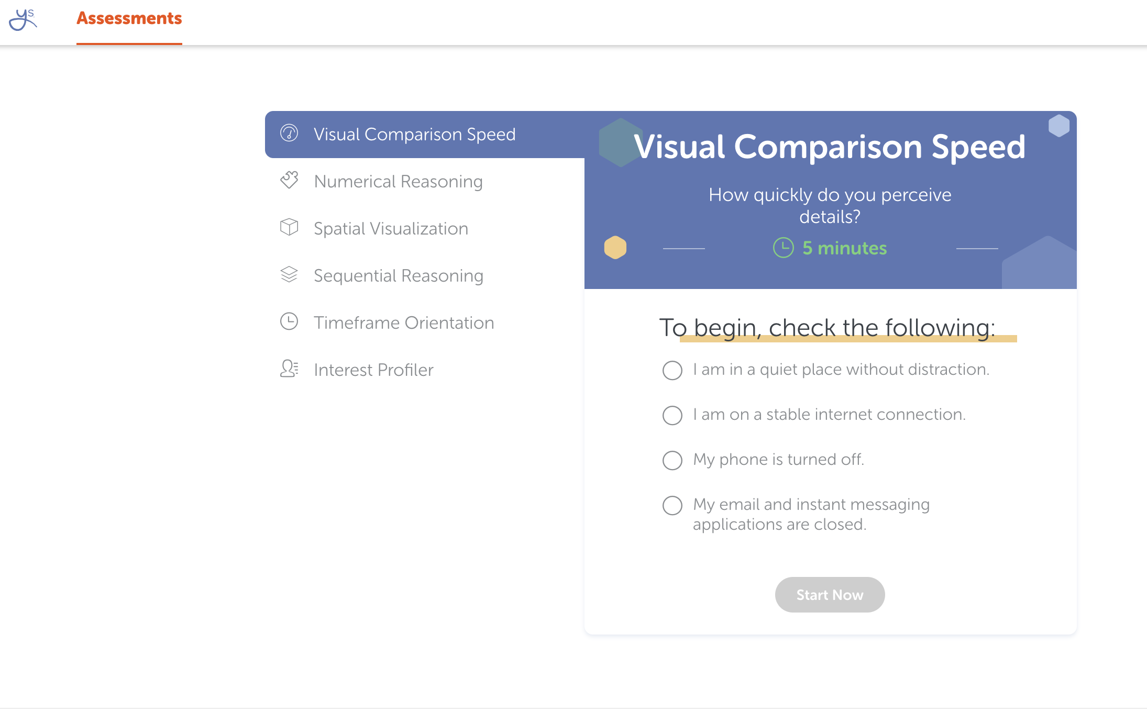
Ready, set, go…
Notes:
During the Assessment, provide 10- and 5-minute warnings before class time is up.
Do not have students be in the middle of an exercise when the bell rings. Give 10- and 5- minute warnings, and tell your students not to begin a new exercise if it will take longer than the amount of time they have left.
If a student was interrupted in the middle of an exercise and could not complete it, please contact YouScience through chat. We will reset that student’s interrupted exercise so they can complete it in one sitting when they return.
Make sure the students LOG OUT of their account prior to shutting down their computer or closing the browser.
If they do not, the computer will remember them as the user and the next student will immediately be in that student’s account. You do not want students completing each others’ assessment.

Slide 14
