Slide 1
FIND YOUR
WAY FASTER
Notes:
NOTE: This PowerPoint presentation was created to help you introduce the YouScience experience to your students. However, you should feel free to make this your own. Edit, rearrange, cut, add, do whatever is comfortable for you.
SPEAKER TEXT:
You are about to embark on an amazing journey of self-discovery. You’ll learn about how you think, how you process information and where you naturally excel. This is the first step on your path to answering these questions and more. Based on the science behind the YouScience Profile we believe this will help you make more informed decisions when it comes to future education and career-related choices. This could translate into a more time-efficient, cost-effective and enjoyable journey through your post-high school years, as well as help you make better initial career choices.
One of the key components of a successful and impactful YouScience implementation is taking the time, prior to taking YouScience, to help students understand why they are taking YouScience, some insight into the “test-taking” experience and most importantly how the results will benefit them.

Slide 2
| Welcome

Slide 3
Q&A| But why am I taking YouScience?
To help you answer these questions:
What careers are the
right fit for me based on my natural strengths?
What am I going to do
after I graduate?
Where do I fit in the world of work and careers?
How can I describe myself and who I am with confidence?

Slide 4
Q&A| So how does YouScience work?
The Core Assessment is broken up into 11 short 8 – 10 minute exercises. You can take a break after any exercise, but not during the middle!
Many students refer to them as “brain games”.
You might not think the exercises are measuring anything valuable that can help you with your future. Well, believe it or not it really does measure how your brain is wired and important aspects of what makes you, uniquely you!

Slide 5
Notes:
Feel free to use this as your Introduction video to inspire the students prior to starting YouScience. You have this as an option or the next cartoonish type of video as options.

Slide 6
YOUR NATURAL ABILITIES| What is your dominant hand?
Notes:
Interactive & Fun Activity
GOAL: Have students experience what ‘poor aptitude fit’ feels like, and how important it is
SPEAKER TEXT:
To get a sense of how YouScience can help you, I want you all to take out a piece of paper, and write “I am excited to learn about my aptitudes”, with your NON-Dominant hand. So, if you’re a righty, write with your left hand.
[-----ACTIVITY-----] [-----SOLICIT STUDENT RESPONSES-----]
How did that feel? (hard, frustrating)
Would you want to write like this everyday?
How would you feel if you had to?
[Take a few student responses and/or have them discuss the experience with their neighbor briefly]
This is exactly what it feels like to work at a job that is a poor aptitude fit for you. That means it requires you to do things that do not come easily or naturally to you. Just writing that one phrase with your non-dominant hand was frustrating; imagine if you had to do that all the time! If that was your job, you wouldn't’t even want to go to work eventually! We don’t want this to happen to you in real life. This is where YouScience comes in.

Slide 7
SMILE!
THIS IS NOT A TEST
- or -
The ACT or SAT
An intelligence or personality test
A test you can study for
A test that compares you to others
Notes:
GOAL: This slide is meant to get them out of ‘test mode’ and instill in them that this is not about intelligence, the students will not be compared to others, and this is not a test you need to ‘score high on’.
SPEAKER TEXT:
Let’s be clear about what YouScience is NOT:
It is not the SAT or ACT which measures verbal & mathematical reasoning and is an indicator of how you will do in your first year of college
This is not an intelligence test – you will not be given a score
This is not a personality test or skills test
This is not a “test” you can study for
This is not an assessment that compares you to others. There are no grades and no percentile ranks.
This is about YOU! This is about the natural abilities you were born with and how your brain is innately wired.
[STRONGLY EXPRESS THE IMPORTANCE OF NOT CHEATING & NOT DISTRACTING OTHERS]
YouScience aims to identify what your aptitudes are, so that you can find a path that allows you to do your best work in a way that feels natural and enjoyable for you. Wouldn’t you want your everyday to feel like you’ve done great work without stress or frustration? The name of the game is what is the best fit for you.
While you are doing the exercises, keep in mind that knowing what’s challenging for you is just as important as knowing what’s easy.
If you were to cheat and fold a real piece of paper while you were taking the Spatial Visualization exercise – sure, your results would probably show that you have a knack for this aptitude – but would you want it? You’d then be recommended careers that fit with that level of Spatial Visualization. If those careers are not actually a good fit for you, working in them would be stressful – and you’d probably not be very happy. So, definitely try you best, but remember – this is about what you naturally do well, and about how you fit with potential majors and careers. Let the natural you shine through. Your future self will thank you for it.
Do not cheat. This is not for a grade and you will not be compared to others. This is only for you. You’d only be cheating yourself of an opportunity to learn about you.
Paper and pencil are ONLY permitted during the Numerical Reasoning & Numerical Computation Exercises. Do not use any other aide while you are taking the assessment. When breaking these rules you are only cheating yourself and your future.
Do not distract your neighbors. It’s ok if you are frustrated or need a break, but these exercises take a lot of concentration and focus. Even a momentary distraction can pull someone out of their focus and cause them to fumble an exercise. It is unfair to those around you to make them lose an opportunity to get the most accurate information about themselves.

Slide 8
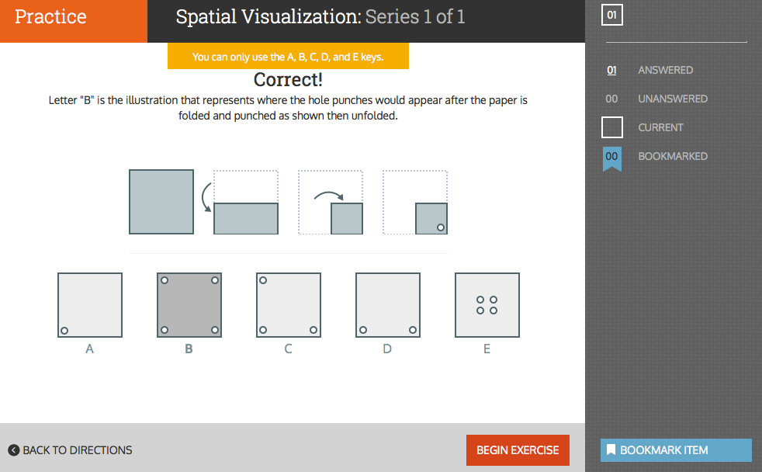
WHAT TO EXPECT| Sample exercises
Notes:
[IMPORTANT] Your goal is for students to get the most true and accurate information about themselves. This means putting forth your best, most honest effort (no cheating!)
SPEAKER TEXT:
Here is an example of the exercise for the Spatial Visualization Aptitude. This is one of the many exercises you’re about to work through. Some of these will feel more like games that exercises. Some will be fun, some will be frustrating, and some will seem totally random. You’ll wonder what they could possibly reveal about you. But believe it or not, they are measuring core and important aspects of what makes you, you. That’s part of the science. Don’t give up, give it your all!
Some exercises will be fun and easy, and others may be difficult or even frustrating. Keep in mind that knowing what is hard for you is just as important as knowing what is easy. You will be challenged, and you will get frustrated. These exercises are purposefully designed to be hard at times. Even when you are feeling really challenged, don’t give up! That’s when you’re getting the BEST information about yourself! Good stuff happens when you’re working at your limit. Stress is ok. This is measuring the real you.
The exercises are timed, and take between 4-15 minutes to complete. To help you pace yourself there is a built in 10-minute break. Take the break- you’ve earned it! You can also take breaks as often as you need to, so you can keep doing your best. Just make sure you take breaks between exercises, and not in the middle of them. When you finish an exercise, take a minute to catch your breath and regain your focus before starting the next one. Take the time you need- it’s ok. Make sure you do not close your browser during an active exercise.
[OPTIONAL: Depending on your school’s Implementation Plan]
It is even okay if you need to come back and finish the next day. If you need to step away and come back to finish the exercises later, stop at the end of an exercise and log-off. It is perfectly fine to log off after an assessment, your work will not be lost.

Slide 9
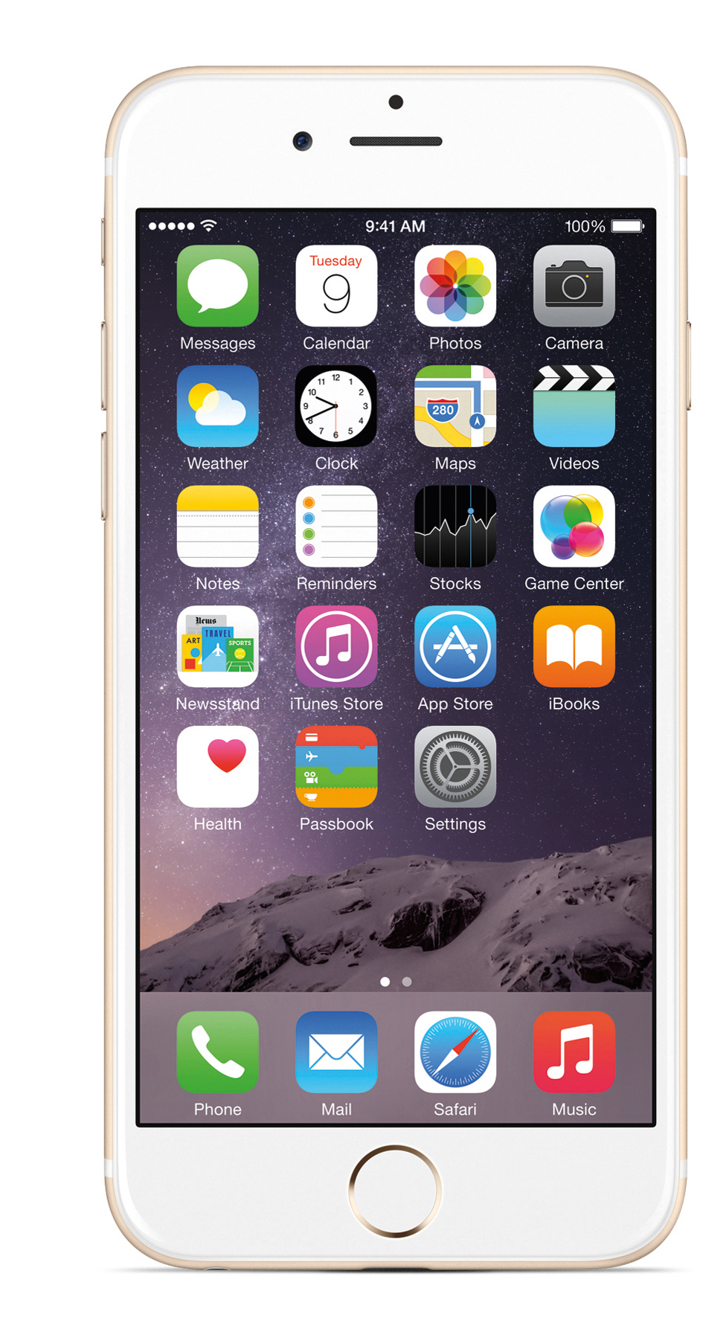
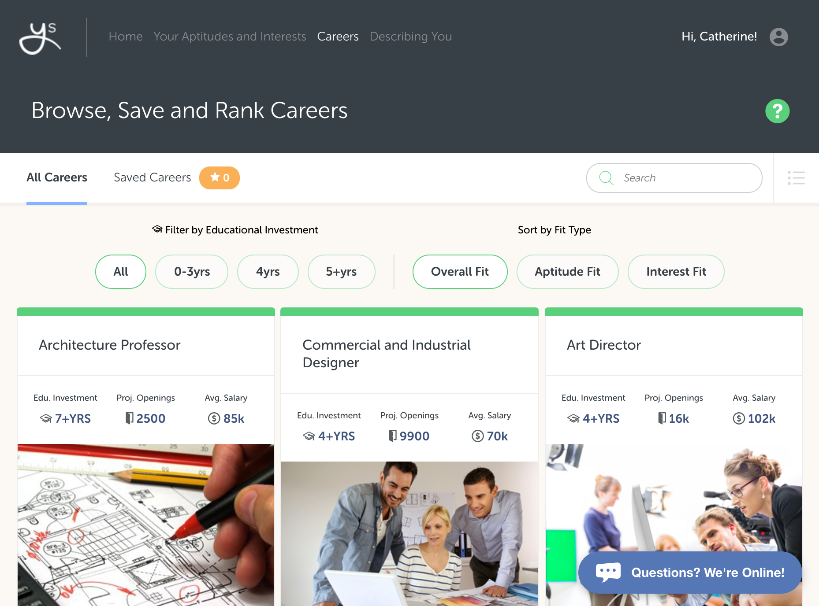
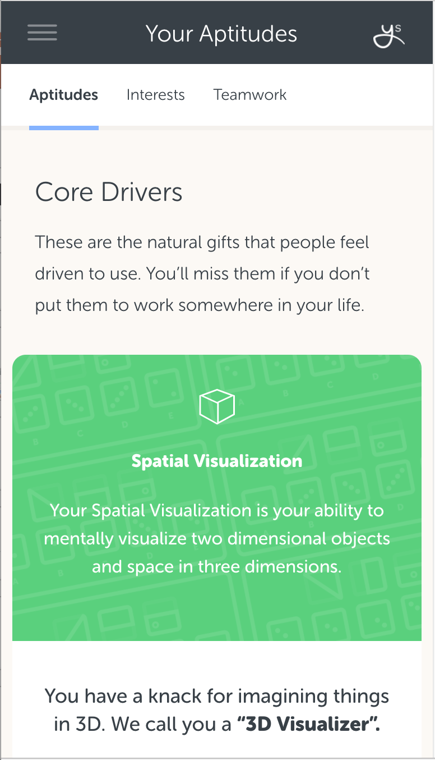
THE YOUSCIENCE EXPERIENCE| Expand your vision of career possibilities
Discover what careers are most closely linked to your natural gifts & abilities.
Get exposed to careers you might have never thought of for yourself.
Notes:
SPEAKER TEXT:
If you already have a career in mind, you will learn about how that career fits with your natural strengths.
You will be able to approach the college planning experience with more confidence about the direction you are going.

Slide 10
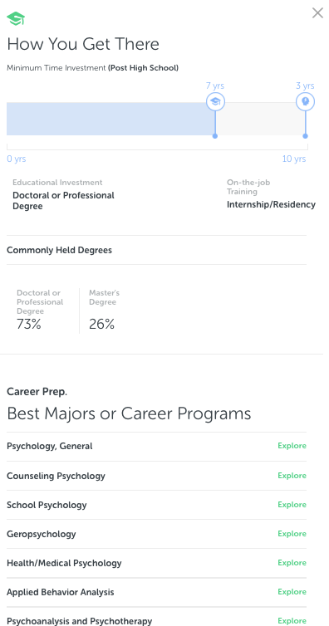
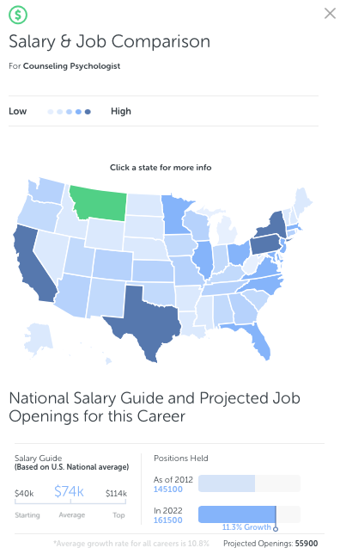
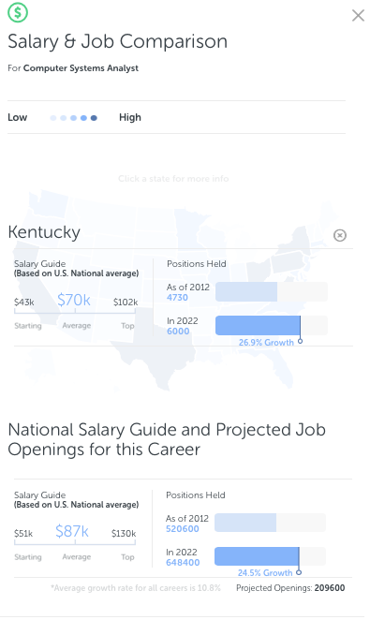
THE YOUSCIENCE EXPERIENCE| Expand your vision of career possibilities
Educational Requirements & Suggested Majors
National Salary Guide
& Job Openings
Job Openings
Nationally & By State
Notes:
SPEAKER TEXT:
Your results will show you best majors or career programs for specific careers, projected job openings by state, and compare salaries based on location.

Slide 11
Notes:
Another video option to use for Introduction or at another time.

