Slide 1
HR INSIGHTS
shifting from reporting to analytics

Slide 2
Reporting in HR Service Center
Added Workforce Analyst
?
our journey…
Notes:
We started with doing reporting through our HR Service Center
Highly manual
Excel-based
Ad hoc queries in SAP
In 2013, added a Workforce Analyst within our Recruiting (Talent Acquisition/Management) team
Started doing more with data
Re-occurring HR metrics
Created HR Scorecard
Go-to person for CHRO to answer data questions
Still faced problems….

Slide 3
reactionary
HIGHLY MANUAL
inconsistent definitions
inefficient
DUPLICATION OF EFFORTS
various methods used
lack statistical/analytical skills
Data Quality
Notes:
How many of you can relate to one or more of things either now or in the past?
Although we had reporting pretty much centralized within our service center we still had various departments (Payroll, Recruiting, Talent Management, Training) doing various reports and analystics.
This lead to inconsistency in definitions, inefficient duplication of efforts, conclusions drawn from bad analysis
Not to mention that these pockets of pseudo-analytical expert varied widely in statistical and analytical skills.

Slide 4
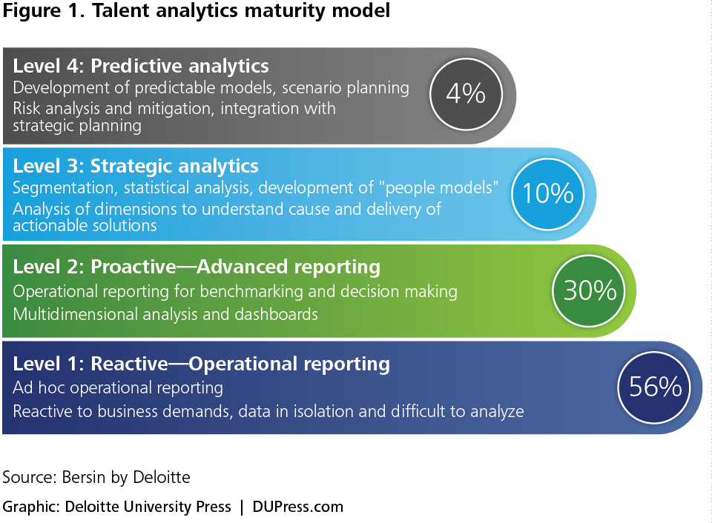
Notes:
When you look at the various maturity models out there…..
This one is from Bersin by Deloitte which explains how most organizations are currently just Operationally reporting talent data but the goal is to get to more Predictive analytics.

Slide 5
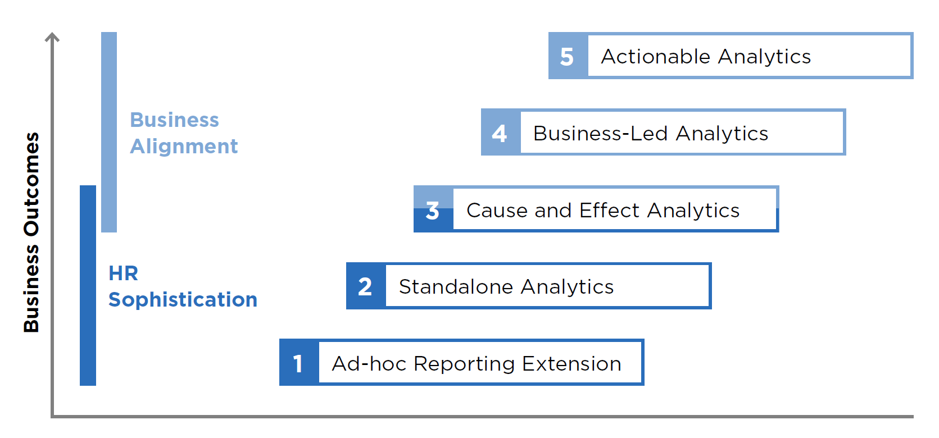
Notes:
I also like this one

Slide 6
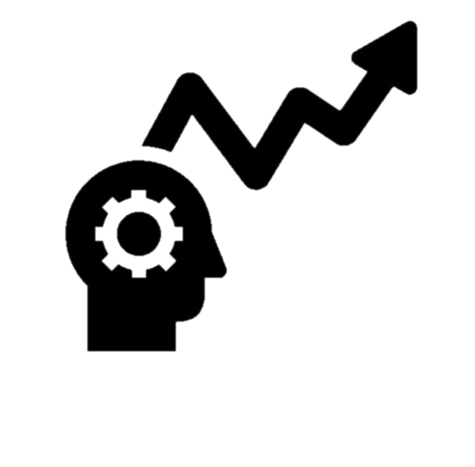
reporting
analytics
Notes:
Primary goal in all of these models is moving from reporting to analytics…
Pulling out a number, list, table, percentage to making business decisions utilizing your talent data.
Reports are great and will continue to be necessary for auditing, tracking, benchmarking, etc. but you really want to get to a more analytical environment where you are making business decisions utilizing your talent data.

Slide 7
Notes:
One common trap to fall into and is one I fell into at first as thinking these are all inclusive steps. You must master one before you can move onto the next.
If you do that you will never get anywhere and make any progress.
You don’t have to master one to move on to the next. If you focus on cleaning up your data and mastering operationally reporting you will never get anywhere.
Need to shift your mindset to an analytical mindset. We are no where near operating at the highest level of maturity but we are dabbling in all of these buckets moving to a world where we are operating on all cylinders.
So how did we at Graybar decide to do this…I’m going to a run through a simple 3 step process.

Slide 8
reoccurring reporting & analytics
strategic analytics
insights leader
Notes:
First we (Beverly) created a team of myself and two analysts (pulled reporting personnel out of HRSC and Workforce Analyst out of talent management).
With the thought that one would focus more on regular/reoccurring Reporting/analytics & the other would work on special projects and requests.
The lines on this are a little blurry but really I have one that is newer to the organization with less experience who is currently developing professionally and one more senior analyst who things very strategically, asks the right question and serves as a real go in our department and outside of the department.
My role is more of the “consultant” the bridge between our senior leaders, HR directors, the field leaders which brings me to my next step…

Slide 9
what we do…
consult | with senior leadership to create strategic business priorities based on human capital analytics
partner | with HR and other departments to improve analytics capabilities and provide guidance on data and analytics
leverage | data and analytics to lead enterprise-wide workforce solutions in the field
Notes:
Step 2: Determine what you do and who your customer are
Our HR Insights team’s purpose is 3-pronged…
Support our business leaders. Creating reports that the senior leaders want/need to see, answer questions they have that inform business strategy
HC trends, payroll spend, how ratings are related to sales performance, how to predict business performance.
Understand what they are trying to accomplish, what question they are asking and dig into the data.
Next we partner with our HR Centers of Excellence. As I mentioned before everyone was doing analytics sporadically within their own departments. Now we are pulling that out.
Running analytics prior to project to better understand need/scope
Calculating ROI of programs/initiatives
Setting up reoccurring metrics/dashboards to measure departments effectiveness
Support our field in making better decisions utilizing talent data.
Assist our HR leaders in each District with reporting, giving them trend data information, running smaller ad hoc analysis on their workforce.

Slide 10
If you want to go fast, go alone. If you want to go far, go with others. -African Proverb
Notes:
Step 3…build relationships and collaborate
This turned out to be one of the most critical and difficult step especially at Graybar.
I was at the CEB Reimagine HR conference last month and their research found the #1 thing to focus on in your talent analytics efforts is “BUILDING RELATIONSHIPS”

Slide 11
why?
Notes:
Part of focusing more on analytics is asking “Why?”
Because of our service mindset groups across the company (functional leaders, district leaders, etc) would ask for reports, lists which were not adding a lot of value but taking a lot of time. We started asking “Why?” to see if we could help them with the real question they were trying to answer. At first people didn’t respond well to this. But once we managed the relationship started delivering something with greater value the initial reaction went away.

Slide 12
finance
field HR
IT
senior leaders
centers of excellence
sales & marketing
operations
Notes:
Who for you would be the most difficult relationships to master?
For us it was Finance because they also do a great deal of analysis and reporting so ownership and defining plays a big role. One of saving graces was our FP&A group was formed around the same time we were so I’ve been working very closely with our Director FP&A
IT is also critical as we do not have data scientists on our team. We need a close partner with IT to understand our data, understand automation, dashboards, analytics tools.

Slide 13
Some Examples:
Level4 | predictive analytics | Business Performance Study
Level 3 | advanced analytics | Critical Talent Strategy
Level 2 | advanced reporting | Automated Dashboards
Level 1 | operational reporting | Centralization & Process Efficiency
Notes:
Let me give you some examples of how we are tackling all levels.

Slide 14
Level4 | predictive analytics | Business Performance Study
Level 3 | advanced analytics | Critical Talent Strategy
Level 2 | advanced reporting | Automated Dashboards
Level 1 | operational reporting | Centralization & Process Efficiency
Notes:
For operational reporting centralization, standardization and continuous improvement (process efficiency, eliminate redundancy) really helped us.

Slide 15
Notes:
Just by coming together under one umbrella, we were able to look at our processes with a questioning lens:
Why are we doing this?
Does X still need it?
Can we add this to replace these 4?
Can we use better tools (Alteryx, SAP report vs. query?
Can it be self-service?

Slide 16
Monthly Reporting
Quarterly Reporting
Annual
Reporting
2 weeks
2 days
3
weeks
1 week
months
3 weeks
Notes:
We did this with our…
Monthly reporting (2 weeks to 2 days) 768 hours/year
Quarterly reporting (3 weeks to 1 week) 320 hours/year
Annual reporting (months to 3 weeks) 360 hours

Slide 17
~1,500 hours/year
Notes:
When you add that all up
That’s almost 1500 hours saved/year (that’s 1 person’s entire year back)

Slide 18
Level4 | predictive analytics | Business Performance Study
Level 3 | advanced analytics | Critical Talent Strategy
Level 2 | advanced reporting | Automated Dashboards
Level 1 | operational reporting | Continuous Improvement & Process Efficiency
Notes:
Now that is only the start…our goal is full automation.
Creating interactive, searchable dashboards with data and analysis right at users fingertips.

Slide 19
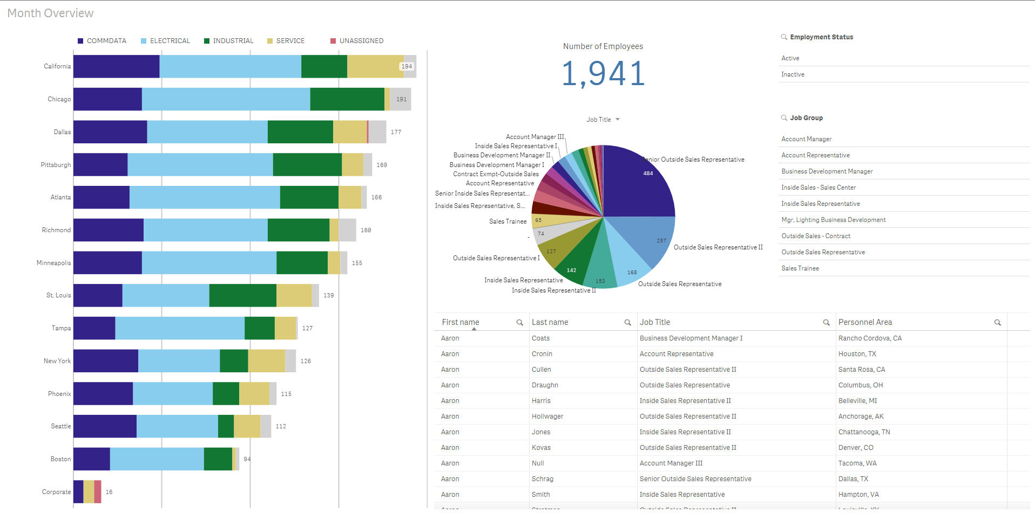
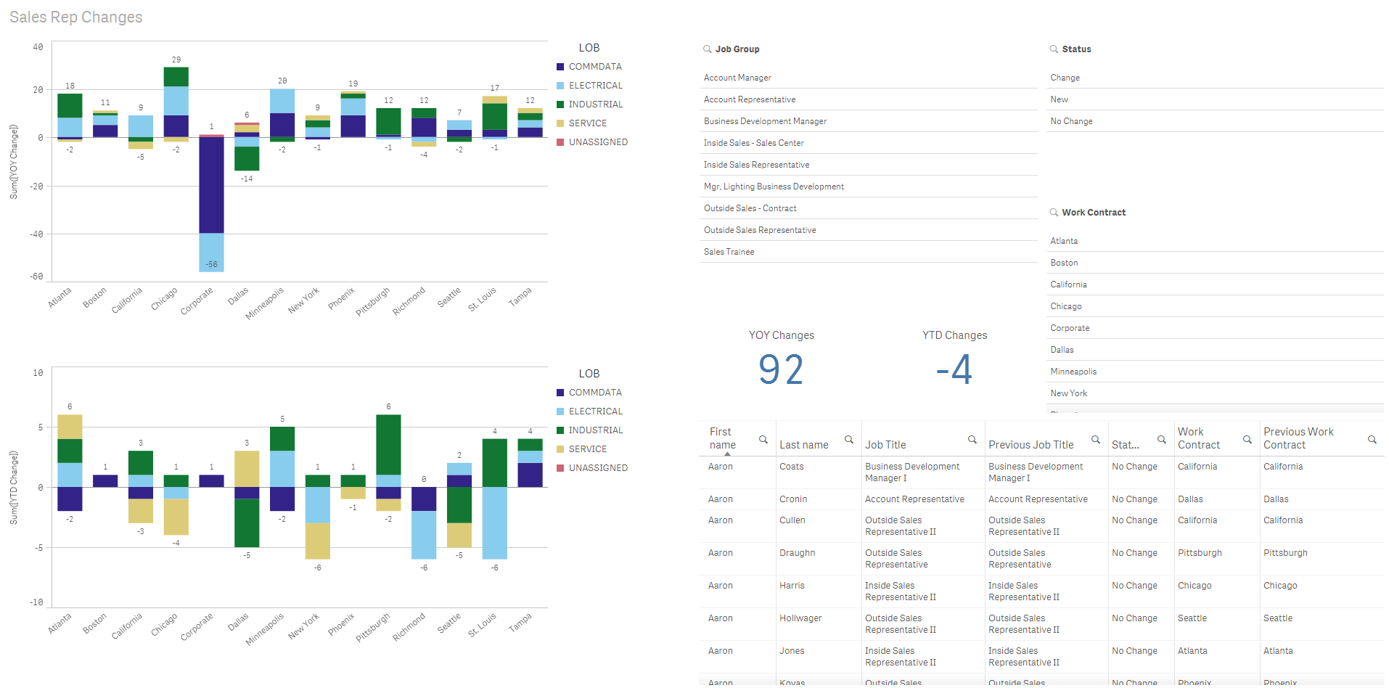
Notes:
This is an example of our SR HC dashboard we created in click.
The end goal would to replace all reoccurring reporting needs with dashboards or fully automated/generated reports.
We would serve as interpreters of these dashboards….answer the so what? What is happening?

Slide 20
Level4 | predictive analytics | Business Performance Study
Level 3 | advanced analytics | Critical Talent Strategy
Level 2 | advanced reporting | Automated Dashboards
Level 1 | operational reporting | Continuous Improvement & Process Efficiency
Notes:
Advanced Analytics
One issue we had in HR was treating all employees the same…spending training dollars, recruiting efforts, compensation philosophy

Slide 21
Specialists Skills/Knowledge = Highly Specialized Impact on Profitability = Less Direct Investment = $$ (Higher initial) Strategy Type = Individualized (Recruiting Firms, Above Market Compensation, Retention Efforts) | Critical Roles Skills/Knowledge = Developed over time in house Impact on Profitability = Large & Direct Investment = $$$ (Higher) Strategy Type = Customized (Specialized Training Programs, Individualized Coaching, Rotational Assignments, Assessment)
Doers Skills/Knowledge = Widely available and/or trainable Impact on Profitability = Low and/or Less Direct Investment = $ (Low) Strategy Type = Broad (High Volume Recruitment, General Training/Onboarding, General Engagement Efforts) | Key Players Skills/Knowledge = Widely available and/or trainable Impact on Profitability = Direct Investment = $$ (Lower) Strategy Type = Targeted (Training Programs, Retention Efforts, Mass Recruitment)
Skill Uniqueness
Low High
Low High
Impact on Business
Notes:
Through a process of interviews at all levels, digging into trend data and evaluating roles, we segmented our talent in an effort to prioritize our HR projects and strategies.

Slide 22
Low ------ Difficulty of acquiring skills in the market ----- High
Low ------------------------------------------------------- Impact on the Business ---------------------------------------------------- High
Notes:
This is the end result
Size of bubble indicates HC in role.
A lot of confirming some of the things we already knew like our field management positions (already have focused talent planning, internal development programs both individualized and group) but some things.
Large group of folks with high impact on business but available skills on market. We already have a pretty extensive training program for this group.

Slide 23
Level4 | predictive analytics | Business Profitability Study
Level 3 | advanced analytics | Critical Talent Strategy
Level 2 | advanced reporting | Automated Dashboards
Level 1 | operational reporting | Continuous Improvement & Process Efficiency
Notes:
Predictive Analytics
First question we asked in our journey was…
What predicts profitability (net)?
Put in various HC metrics to try and answer what are the biggest human capital levers driving profitability?

Slide 24
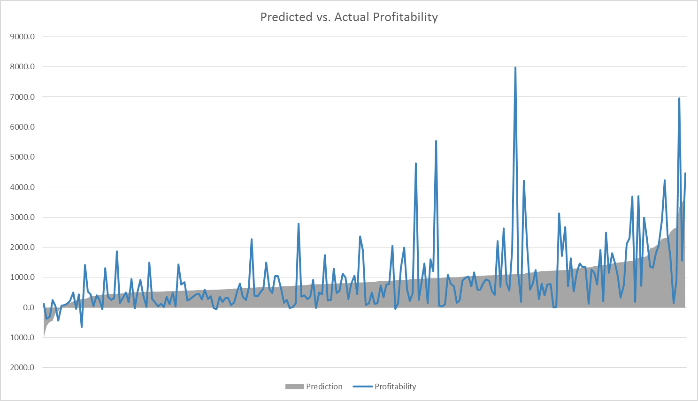
staffing level
proximity to leaders
turnover
racial diversity
Notes:
We were able to predict 25% of the variance with these 4 levers (which is pretty statistically speaking good for a predictive model):
Staffing Level
Proximity to Leaders
Turnover
Racial Diversity
Some of these may not seem shocking but from an HR prioritization, strategic planning this effort was very beneficial and powerful.
2018 studies include:
-Attrition of SRs
-Prediction of HiPo’s

Slide 25
form your team
determine your scope
build relationships
focus on all levels
1
2
3
4
Notes:
As a recap….
Form your team and their corresponding responsibilities…this could just be one person for you or half of 1 person’s role or a team of 10 but you need to decide ownership.
Determine your scope…full centralization is not for everyone. Who are your customers? How do you plan to service them?
Build relationships…as I mentioned this is key: with customers, other analysts, subject matter experts. You can’t go this alone.
Focus on all levels. If you wait until your data is perfect and operational reporting is fully automated you will never progress on your journey. Get started dabbling in everything. Ask questions. How can your data inform business decisions? What questions should senior leadership be asking that they are not?

Slide 26
questions?

