Slide 1
“Why do salespeople make so much money?”
On a day-to-day basis, a salesperson interrupts complete strangers and within seconds convinces the strangers to listen to them. Within minutes of an encounter like this, the salesperson disarms the stranger and earns their trust. From this point further, the salesperson takes every action to move the relationship further with the stranger – sometimes going months without a return phone call or any signal of respect.
At a certain point in the relationship, the salesperson will have the opportunity to offer a solution to the stranger in exchange for the stranger’s money. To do so, the salesperson must ask uncomfortable, personal questions to understand the stranger’s problems. Once they understand the problems, the salesperson designs a solution and leads a presentation in front of the stranger and their bosses. It’s at this point in the relationship that the salesperson asks for the money.
Most of the time, the stranger will choose not to work with the salesperson – maybe they like another solution better or they do nothing. Either way, the salesperson loses most of the time. When this happens, the salesperson starts over with incessant actions to secure more time with the stranger and get another chance.
Once the stranger decides to trade their money for the salesperson’s solution, then the salesperson has finally won. It’s the stranger’s money that provides life to the salesperson’s company – rent, materials, bills, trucks, and of course … payroll.
All of the companies in our Academy exist today because salespeople interrupted strangers years ago … and they continue to interrupt hundreds of strangers, facing rejection, working tirelessly, and advocating internally for those very strangers that ignored them, showed them little respect, and turned them down multiple times.
So … what was the question, again?

Slide 2
Five Stay-At-Home Ideas Salespeople Can Implement Immediately
Session 032.5
March 27th, 2020

Slide 3
1. Use Video

Slide 4
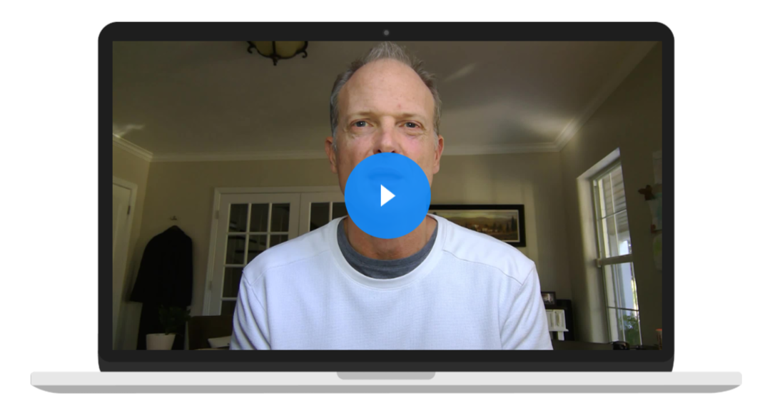
1. Use Video
Sincerely,

Slide 5
Using Video on Web Conference Calls
Let them know ahead of time that you’ll be on video.
Buy the right lighting (lighting for webinars).
Turn off phone and email on computer.
Look at your audience, not yourself☺.
Never forget … they can see you.

Slide 6
Video Emails
Use good lighting (same as last slide).
Natural setting but not messy or weird.
Post an outline (not a script) next to the computer but don’t look at it.
Use a thumbnail, not a link.
Covideo, BombBomb, Dubb

Slide 7
2. Send Unsolicited Ideas

Slide 10
Five Step Process to Delivering Unsolicited Ideas
Brainstorm to develop three to five common ideas that are needed by your customers right now.
Call them. Say this: “I know you’re slammed during this time. Is there anything I can take off your plate?”
Email ideas of how you might be able to help.
Develop budgetary scope idea.
Email it to them and follow-up with a phone call / voicemail.

Slide 11
Hi Jennifer.
I’ve attached an idea of how we can help you secure your fence line now that your facility isn’t busy with people.
This is a draft with budgetary pricing, but I think it’s pretty close. No expectations – I just wanted to get this into your hands because I know you’re slammed during this time.

Slide 12
Five Step Process to Delivering Unsolicited Ideas
Brainstorm to develop three to five common ideas that are needed by your customers right now.
Call them. Say this: “I know you’re slammed during this time. Is there anything I can take off your plate?”
Email ideas of how you might be able to help.
Develop Budgetary Scope Idea.
Email it to them and follow-up with a phone call / voicemail.

Slide 13
Brainstorm to develop three to five common ideas that are needed by your customers right now.
Call them. Say this: “I know you’re slammed during this time. Is there anything I can take off your plate?”
Email ideas of how you might be able to help.
Develop Budgetary Scope Idea.
Email it to them and follow-up with a phone call / voicemail.

Slide 14
3. Post One Piece of Educational Content on LinkedIn Everyday.

Slide 15
Yes, Every Day!

Slide 16
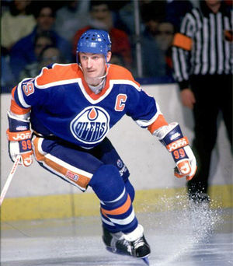
Good hockey players skate to where the puck is. Great hockey players skate to where the puck is going to be. Wayne Gretzky

Slide 17
Where is your puck going to be?

Slide 18
90 Days to Become Known as an Expert
Daily content must be educational and helpful to your marketplace.
Find information in periodicals, blogs, and other LinkedIn posts.
Post at 7:45 am every day.
Post other things – comment, share, like.

Slide 19
4. Produce Webinars with Your Partners

Slide 20
Manufacturers
 | Customer Type 1 | Customer Type 2 | Customer Type 3 | Customer Type 4
Region 1 | Topic 11 | Topic 12 | Topic 13 | Topic 14
Region 2 | Topic 21 | Topic 22 | Topic 23 | Topic 24
Region 3 | Topic 31 | Topic 32 | Topic 33 | Topic 34
Region 4 | Topic 41 | Topic 42 | Topic 43 | Topic 44

Slide 21
Integrators …
 | Customer Type 1 | Customer Type 2 | Customer Type 3 | Customer Type 4
Manufacturer 1 | Topic 11 | Topic 12 | Topic 13 | Topic 14
Manufacturer 2 | Topic 21 | Topic 22 | Topic 23 | Topic 24
Manufacturer 3 | Topic 31 | Topic 32 | Topic 33 | Topic 34
Manufacturer 4 | Topic 41 | Topic 42 | Topic 43 | Topic 44

Slide 22
Best Practices
Content must be educational.
Topics should be narrow and relevant.
Work with other partners – consultants, technology partners, contractors, etc.
Use manufacturers tools and resources and integrators contacts.
Dance with the one that brought you.

Slide 23
Before moving to #5 …

Slide 24
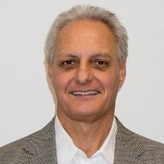
Next Week: Discussion with Industry Leaders…
Steve Wagner
Acting CEO, Open Options
Former President, Mercury
Former COO, HID
Gannon Switzer
Executive VP, D/A Central
Dave Sweeney
CEO, Advantech

Slide 25
Poll Question

Slide 26
Yes.
No.
Do you think you’ll listen to this discussion of industry leaders sharing how they’re handling this situation?

Slide 27
5. Facilitate Peer Group Discussions

Slide 29
How to Facilitate Peer Discussions
Before anything else, recruit your first member.
Next, recruit your second member. Now it’s a group, not just an idea.
Keep the group role-specific – security managers, IT managers, etc.
You coordinate the details – web link, calendar invite, questions.
Send everyone coffee and snacks like it was an in-person meeting… maybe.
Don’t limit to customers – technology partners, contractors, etc.

Slide 30
Use Video.
Send unsolicited ideas.
Post educational content on LinkedIn every day.
Conduct webinars with your partners.
Facilitate peer group discussions.

Slide 31
Let’s go back to our opening slide…

Slide 32
On a day-to-day basis, a salesperson interrupts complete strangers and within seconds convinces the strangers to listen to them. Within minutes of an encounter like this, the salesperson disarms the stranger and earns their trust. From this point further, the salesperson takes every action to move the relationship further with the stranger – sometimes going months without a return phone call or any signal of respect.
At a certain point in the relationship, the salesperson will have the opportunity to offer a solution to the stranger in exchange for the stranger’s money. To do so, the salesperson must ask uncomfortable, personal questions to understand the stranger’s problems. Once they understand the problems, the salesperson designs a solution and leads a presentation in front of the stranger and their bosses. It’s at this point in the relationship that the salesperson asks for the money.
Most of the time, the stranger will choose not to work with the salesperson – maybe they like another solution better or they do nothing. Either way, the salesperson loses most of the time. When this happens, the salesperson starts over with incessant actions to secure more time with the stranger and get another chance.
Once the stranger decides to trade their money for the salesperson’s solution, then the salesperson has finally won. It’s the stranger’s money that provides life to the salesperson’s company – rent, materials, bills, trucks, and of course … payroll.

Slide 33
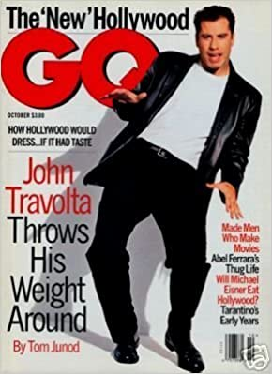
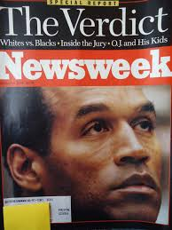
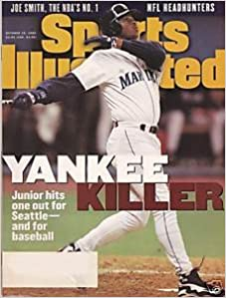

Slide 34
On a day-to-day basis, a salesperson interrupts complete strangers and within seconds convinces the strangers to listen to them. Within minutes of an encounter like this, the salesperson disarms the stranger and earns their trust. From this point further, the salesperson takes every action to move the relationship further with the stranger – sometimes going months without a return phone call or any signal of respect.
At a certain point in the relationship, the salesperson will have the opportunity to offer a solution to the stranger in exchange for the stranger’s money. To do so, the salesperson must ask uncomfortable, personal questions to understand the stranger’s problems. Once they understand the problems, the salesperson designs a solution and leads a presentation in front of the stranger and their bosses. It’s at this point in the relationship that the salesperson asks for the money.
Most of the time, the stranger will choose not to work with the salesperson – maybe they like another solution better or they do nothing. Either way, the salesperson loses most of the time. When this happens, the salesperson starts over with incessant actions to secure more time with the stranger and get another chance.
Once the stranger decides to trade their money for the salesperson’s solution, then the salesperson has finally won. It’s the stranger’s money that provides life to the salesperson’s company – rent, materials, bills, trucks, and of course … payroll.

Slide 36
Sales Process
1. Target and Biz Dev.
2. Prospect
3. Impress
4. Win
5. Client Success
Vertical
Region
Descriptors
Networking
Disarm
Flawless Follow-up
Timely Content
Tone and Confidence
Proactive Client Success Plan
Ongoing Value
Vision Meetings
Social Selling
Outbound Calls
BD Strategy
Understand
Gain Credibility
Present / Demo
Effectively Propose
Weekly Plan

Slide 37
On a day-to-day basis, a salesperson interrupts complete strangers and within seconds convinces the strangers to listen to them. Within minutes of an encounter like this, the salesperson disarms the stranger and earns their trust. From this point further, the salesperson takes every action to move the relationship further with the stranger – sometimes going months without a return phone call or any signal of respect.
At a certain point in the relationship, the salesperson will have the opportunity to offer a solution to the stranger in exchange for the stranger’s money. To do so, the salesperson must ask uncomfortable, personal questions to understand the stranger’s problems. Once they understand the problems, the salesperson designs a solution and leads a presentation in front of the stranger and their bosses. It’s at this point in the relationship that the salesperson asks for the money.
Most of the time, the stranger will choose not to work with the salesperson – maybe they like another solution better or they do nothing. Either way, the salesperson loses most of the time. When this happens, the salesperson starts over with incessant actions to secure more time with the stranger and get another chance.
Once the stranger decides to trade their money for the salesperson’s solution, then the salesperson has finally won. It’s the stranger’s money that provides life to the salesperson’s company – rent, materials, bills, trucks, and of course … payroll.

Slide 38
On a day-to-day basis, a salesperson interrupts complete strangers and within seconds convinces the strangers to listen to them. Within minutes of an encounter like this, the salesperson disarms the stranger and earns their trust. From this point further, the salesperson takes every action to move the relationship further with the stranger – sometimes going months without a return phone call or any signal of respect.
At a certain point in the relationship, the salesperson will have the opportunity to offer a solution to the stranger in exchange for the stranger’s money. To do so, the salesperson must ask uncomfortable, personal questions to understand the stranger’s problems. Once they understand the problems, the salesperson designs a solution and leads a presentation in front of the stranger and their bosses. It’s at this point in the relationship that the salesperson asks for the money.
Most of the time, the stranger will choose not to work with the salesperson – maybe they like another solution better or they do nothing. Either way, the salesperson loses most of the time. When this happens, the salesperson starts over with incessant actions to secure more time with the stranger and get another chance.
Once the stranger decides to trade their money for the salesperson’s solution, then the salesperson has finally won. It’s the stranger’s money that provides life to the salesperson’s company – rent, materials, bills, trucks, and of course … payroll.

Slide 39
Action Plan

Slide 40
April’s Session: How to Lead a Virtual Sales Meeting

Slide 41
Questions and Discussion

