Slide 1
How to Lead a Virtual Sales Call
Session 033
April 17th, 2020
Welcome – we’ll be starting soon.

Slide 2
www.slido.com
Event Code: #91281

Slide 3
How to Lead a Virtual Sales Call
Session 033
April 17th, 2020

Slide 4


Live vs. Virtual Sales Calls

Slide 5
1. Use Video.

Slide 6
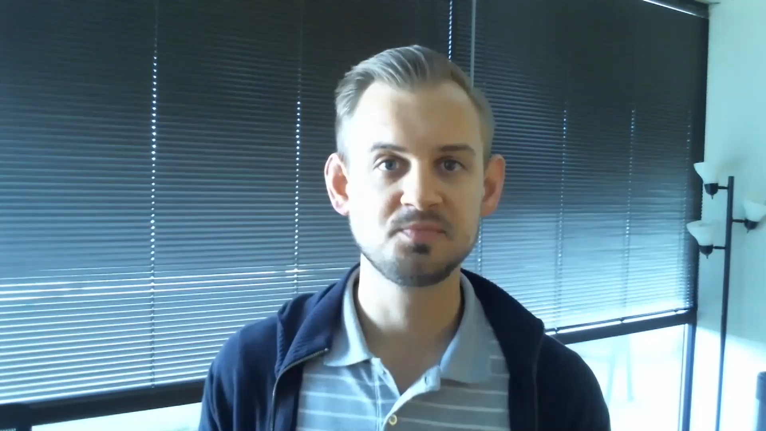
1. Use Video.

Slide 7
2. Cover all the bases when scheduling.

Slide 8
2. Cover all the bases when scheduling.
Don’t assume that your audience is used to or comfortable with virtual calls.

Slide 9
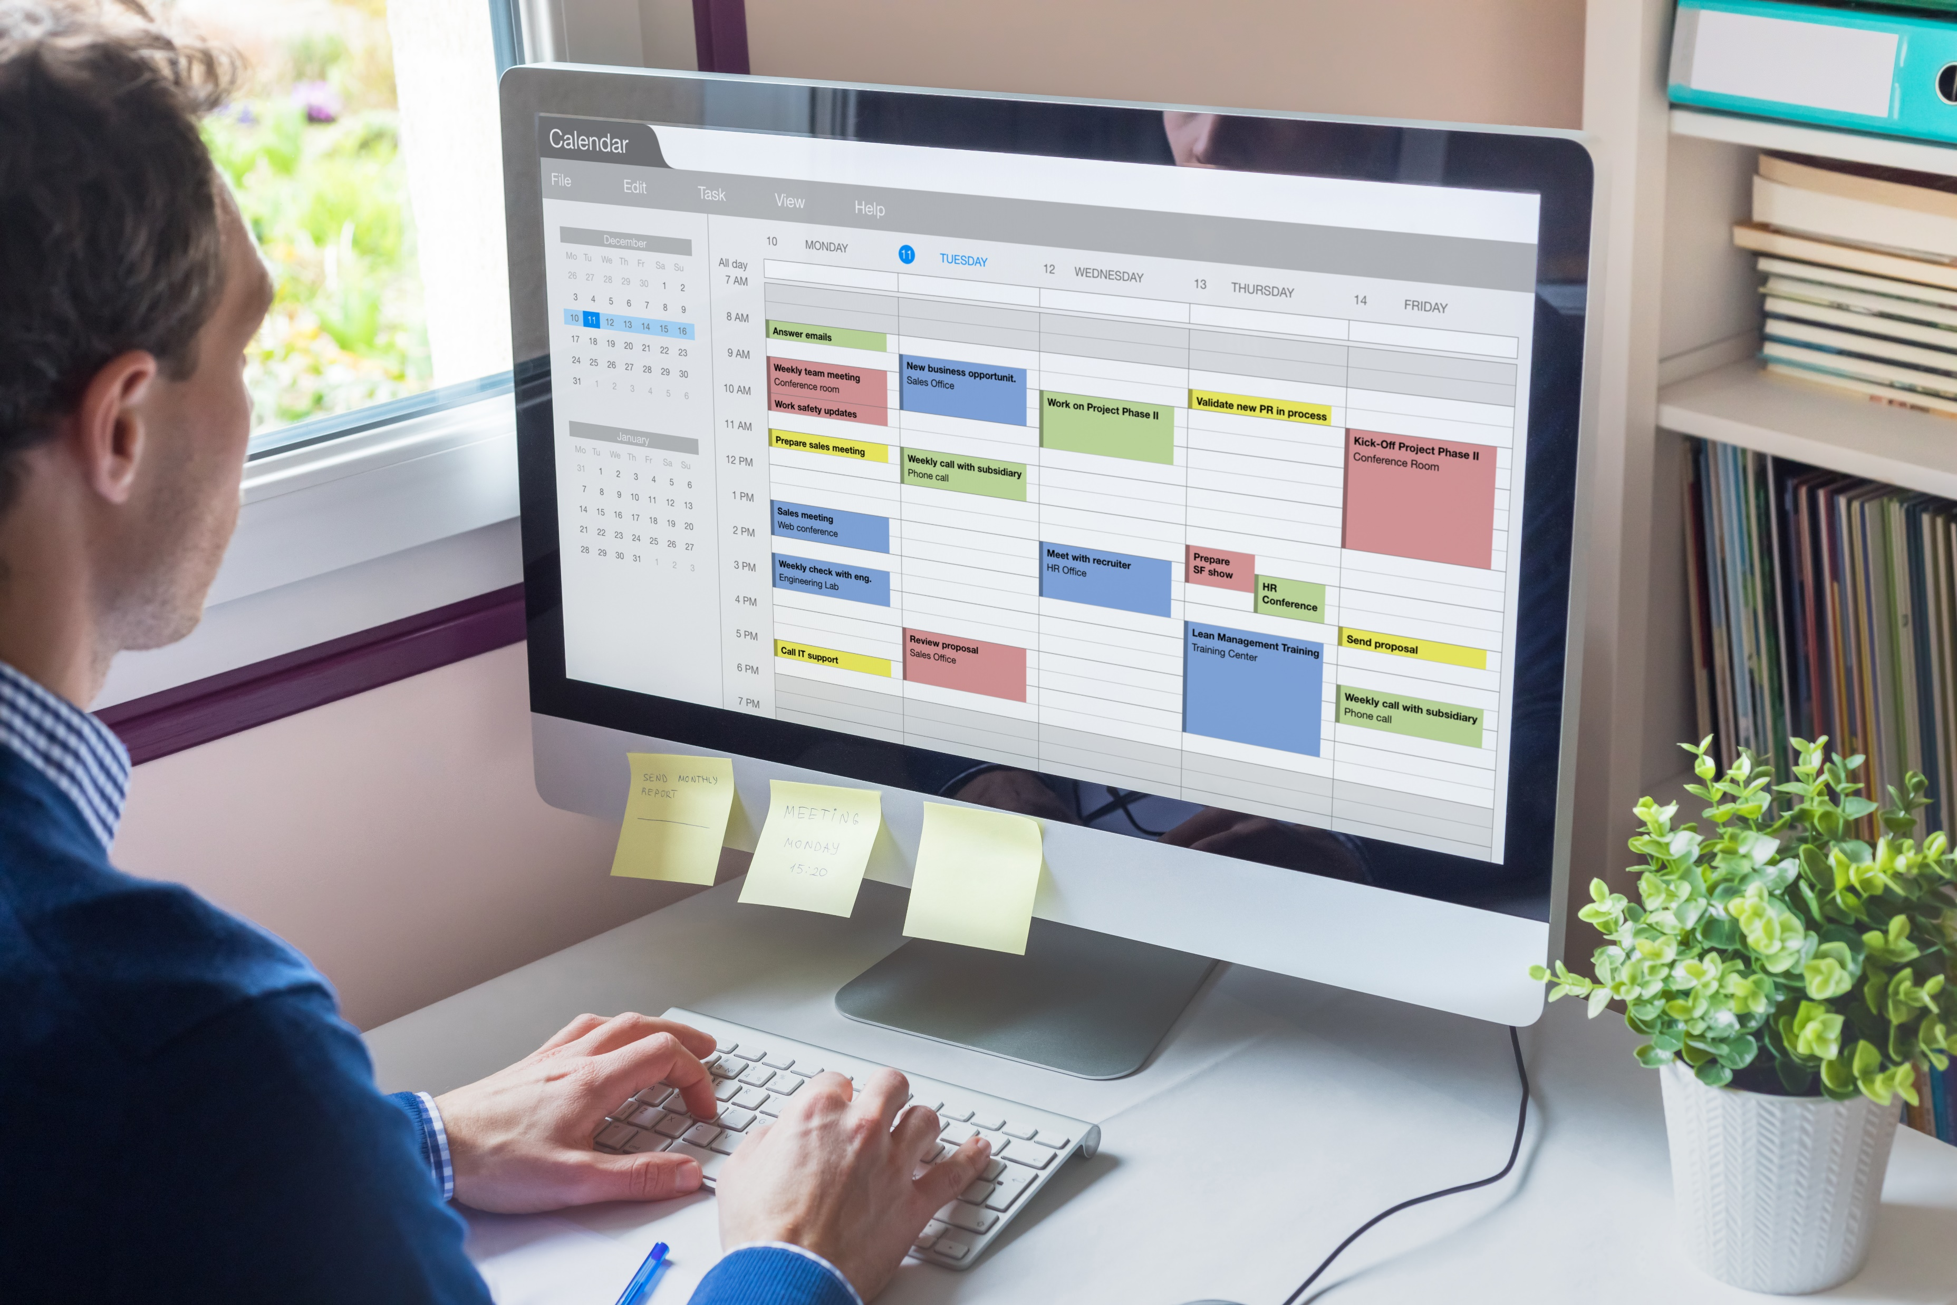
Send a calendar invitation, and …

Slide 10
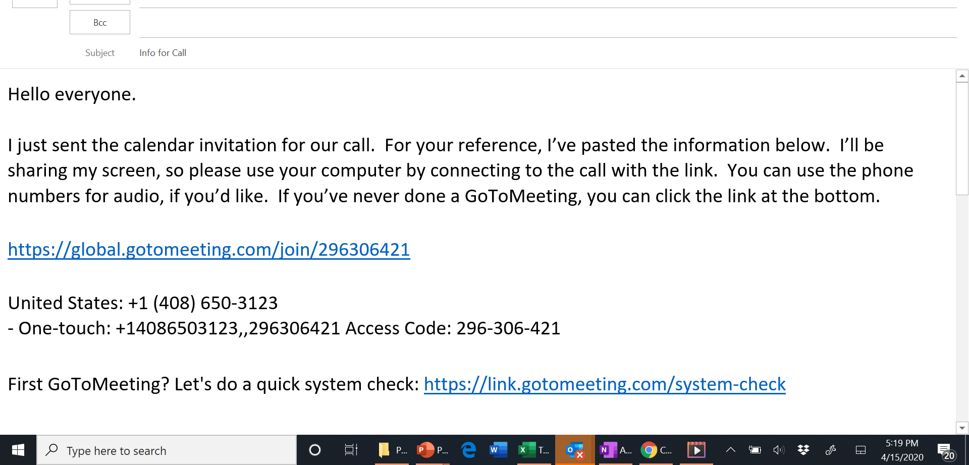

Slide 11

Let them know you’ll be using video …

Slide 12
3. Recruit a moderator.

Slide 13
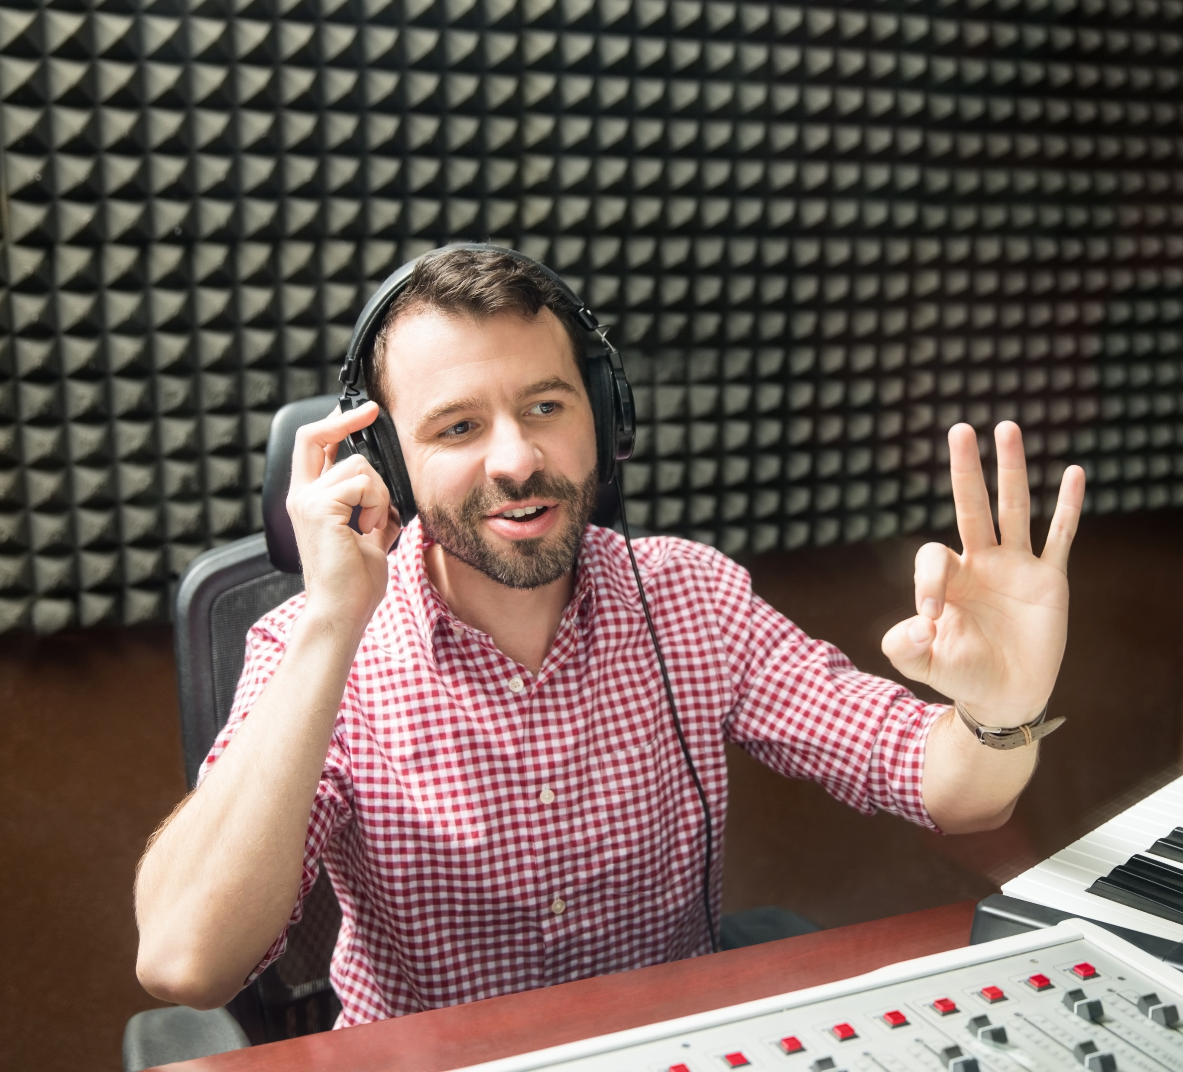
3. Recruit a moderator.
Manage the questions / comments.
Serve as another voice and provide commentary.
If it makes sense (e.g. greater than 10 people), then also recruit a guest host – a manufacturer / integrator partner, end-user customer, other partner, sales engineer, etc.

Slide 14
4. Plan for muting and interaction.

Slide 15


4. Plan for muting and interaction.
< 5 people: don’t mute and ask them to self-mute unless they have a question.
10 > n > 5 people: mute everyone and unmute to take questions (“3-2-1-unmute”).
< 10 people: mute everyone and take chat questions. Unmute by request.
Clearly communicate this plan at the opening.

Slide 16
5. Send material ahead of time.

Slide 17



5. Send material ahead of time.

Slide 18
6. Use appropriate lighting and audio.

Slide 19
7. Welcome screen.
Let’s them know that they’re in the right spot.
Free commercial for you.

Slide 20


Slide 21
8. Use an external webcam.

Slide 22
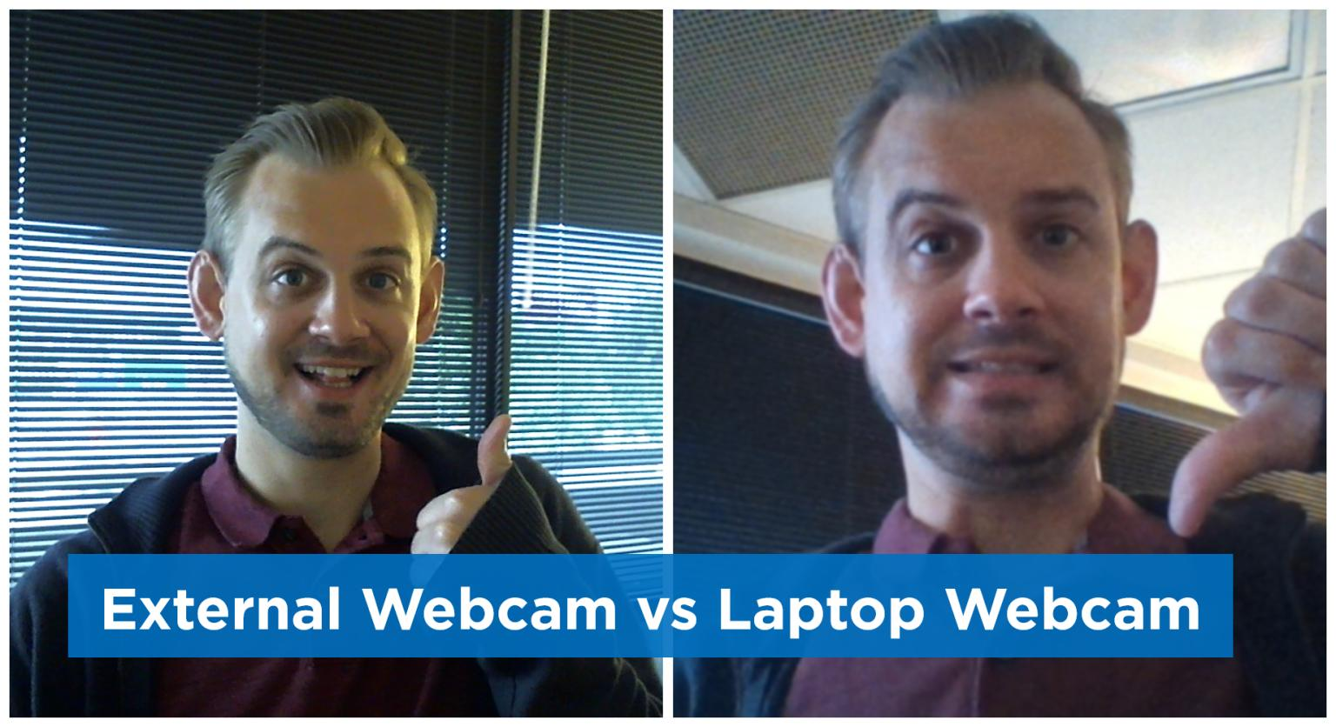

Slide 23
9. Stand up.

Slide 24
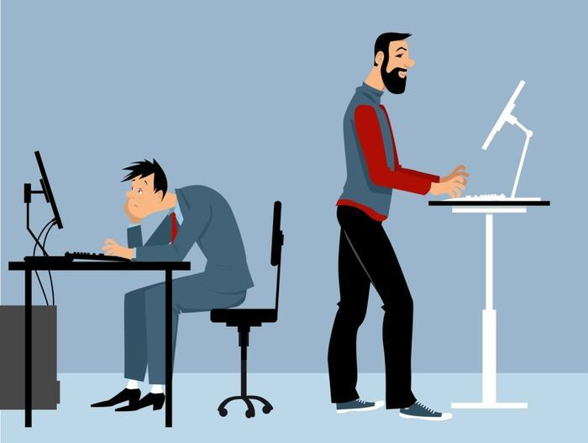

Slide 25
10. Use poll questions.

Slide 26

10. Ask Poll Questions
Every 15 – 20 minutes.
Mixture of fun and meaningful material.
If you can’t ask with your virtual tool, use Slido.com.

Slide 27
www.slido.com
Event Code: #91281

Slide 28
11. Use hyperlinks to shift order of topics.

Slide 29
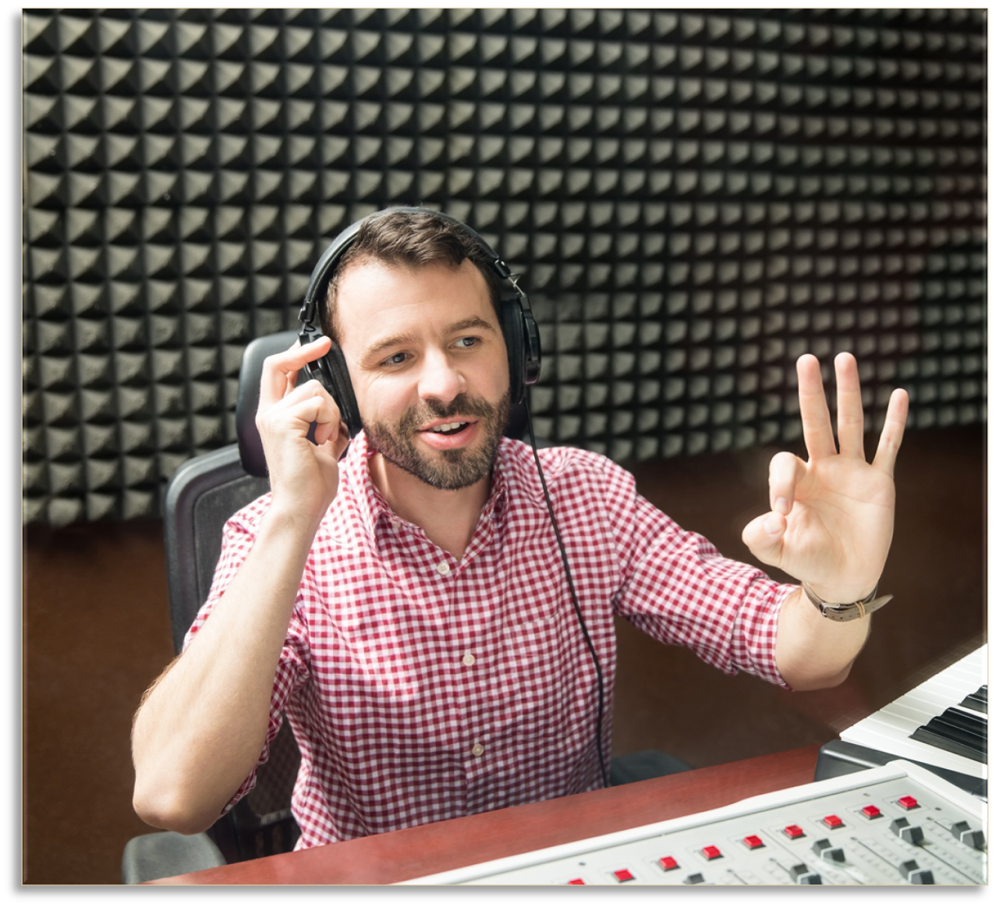



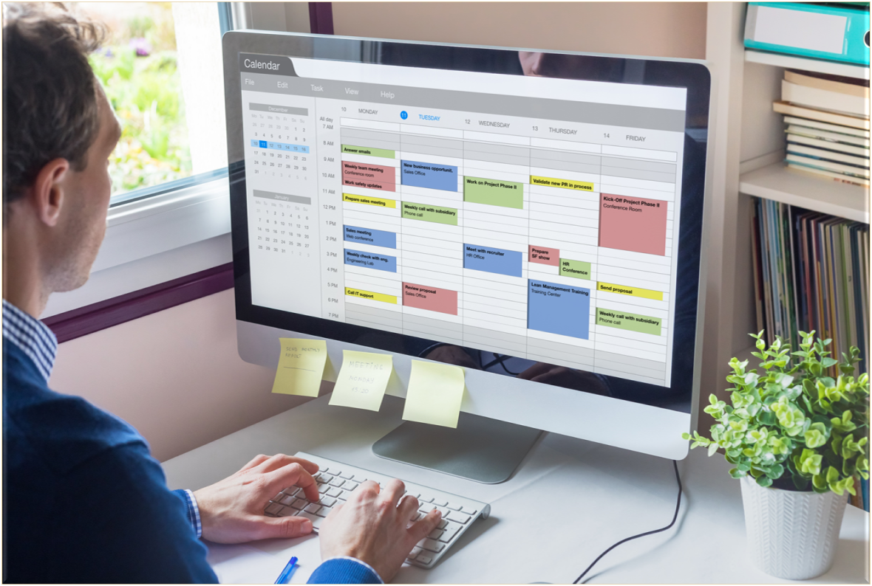
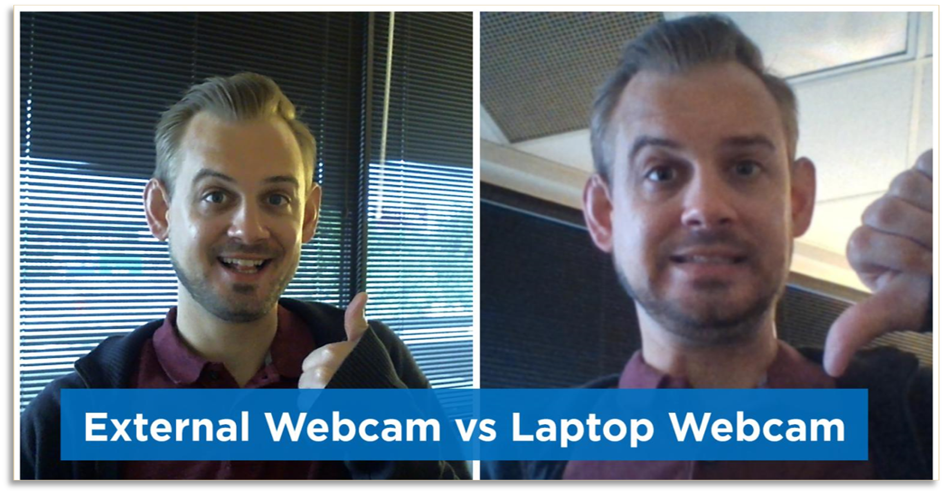

Slide 30
www.slido.com
Event Code: #91281

Slide 32
12. Move.

Slide 33

You’ve gotta keep moving …

Slide 34
You’ve gotta keep moving …
Documents
Polls
Websites
Social Media
Videos
Live Searches
Anything Live
Use hyperlinks (staged), and your virtual call tool.

Slide 35
13. Schedule emails during call.

Slide 36
14. Schedule the next call.

Slide 37

14. Schedule the next call.
“While we’re all together, let’s schedule our next call.”
Open your calendar.
If you have more than four people, use Doodle...
https://doodle.com/poll/xswvrftsha4ubrkx

Slide 38
15. Record the call and send follow-up.

Slide 39

15. Record the call and send follow-up.
Get their permission to record and reminder them.
Listen to the entire recording before sending it.
Don’t send if it’s not appropriate.
Send to the boss/POC and let them forward.

Slide 40
Action Plan

Slide 41

Lesson Plan
May’s Session: Creating an Unsolicited Proposal

Slide 42


Slide 44
Questions and Discussion

