Slide 1
Sprint 002 Creating a Great LinkedIn Profile

Slide 2
Creating a Strong LinkedIn Profile
Why Your LinkedIn Profile?
Five Requirements of a Great LinkedIn Profile.

Slide 3
Why Your LinkedIn Profile?

Slide 4
If following the right strategy, hundreds of people, including LinkedIn geeks, will view your profile.
LinkedIn is the most prevalent business social media platform.
It’s hard. Nail this and the others are easy.

Slide 5
Five Requirements of a Great LinkedIn Profile

Slide 6
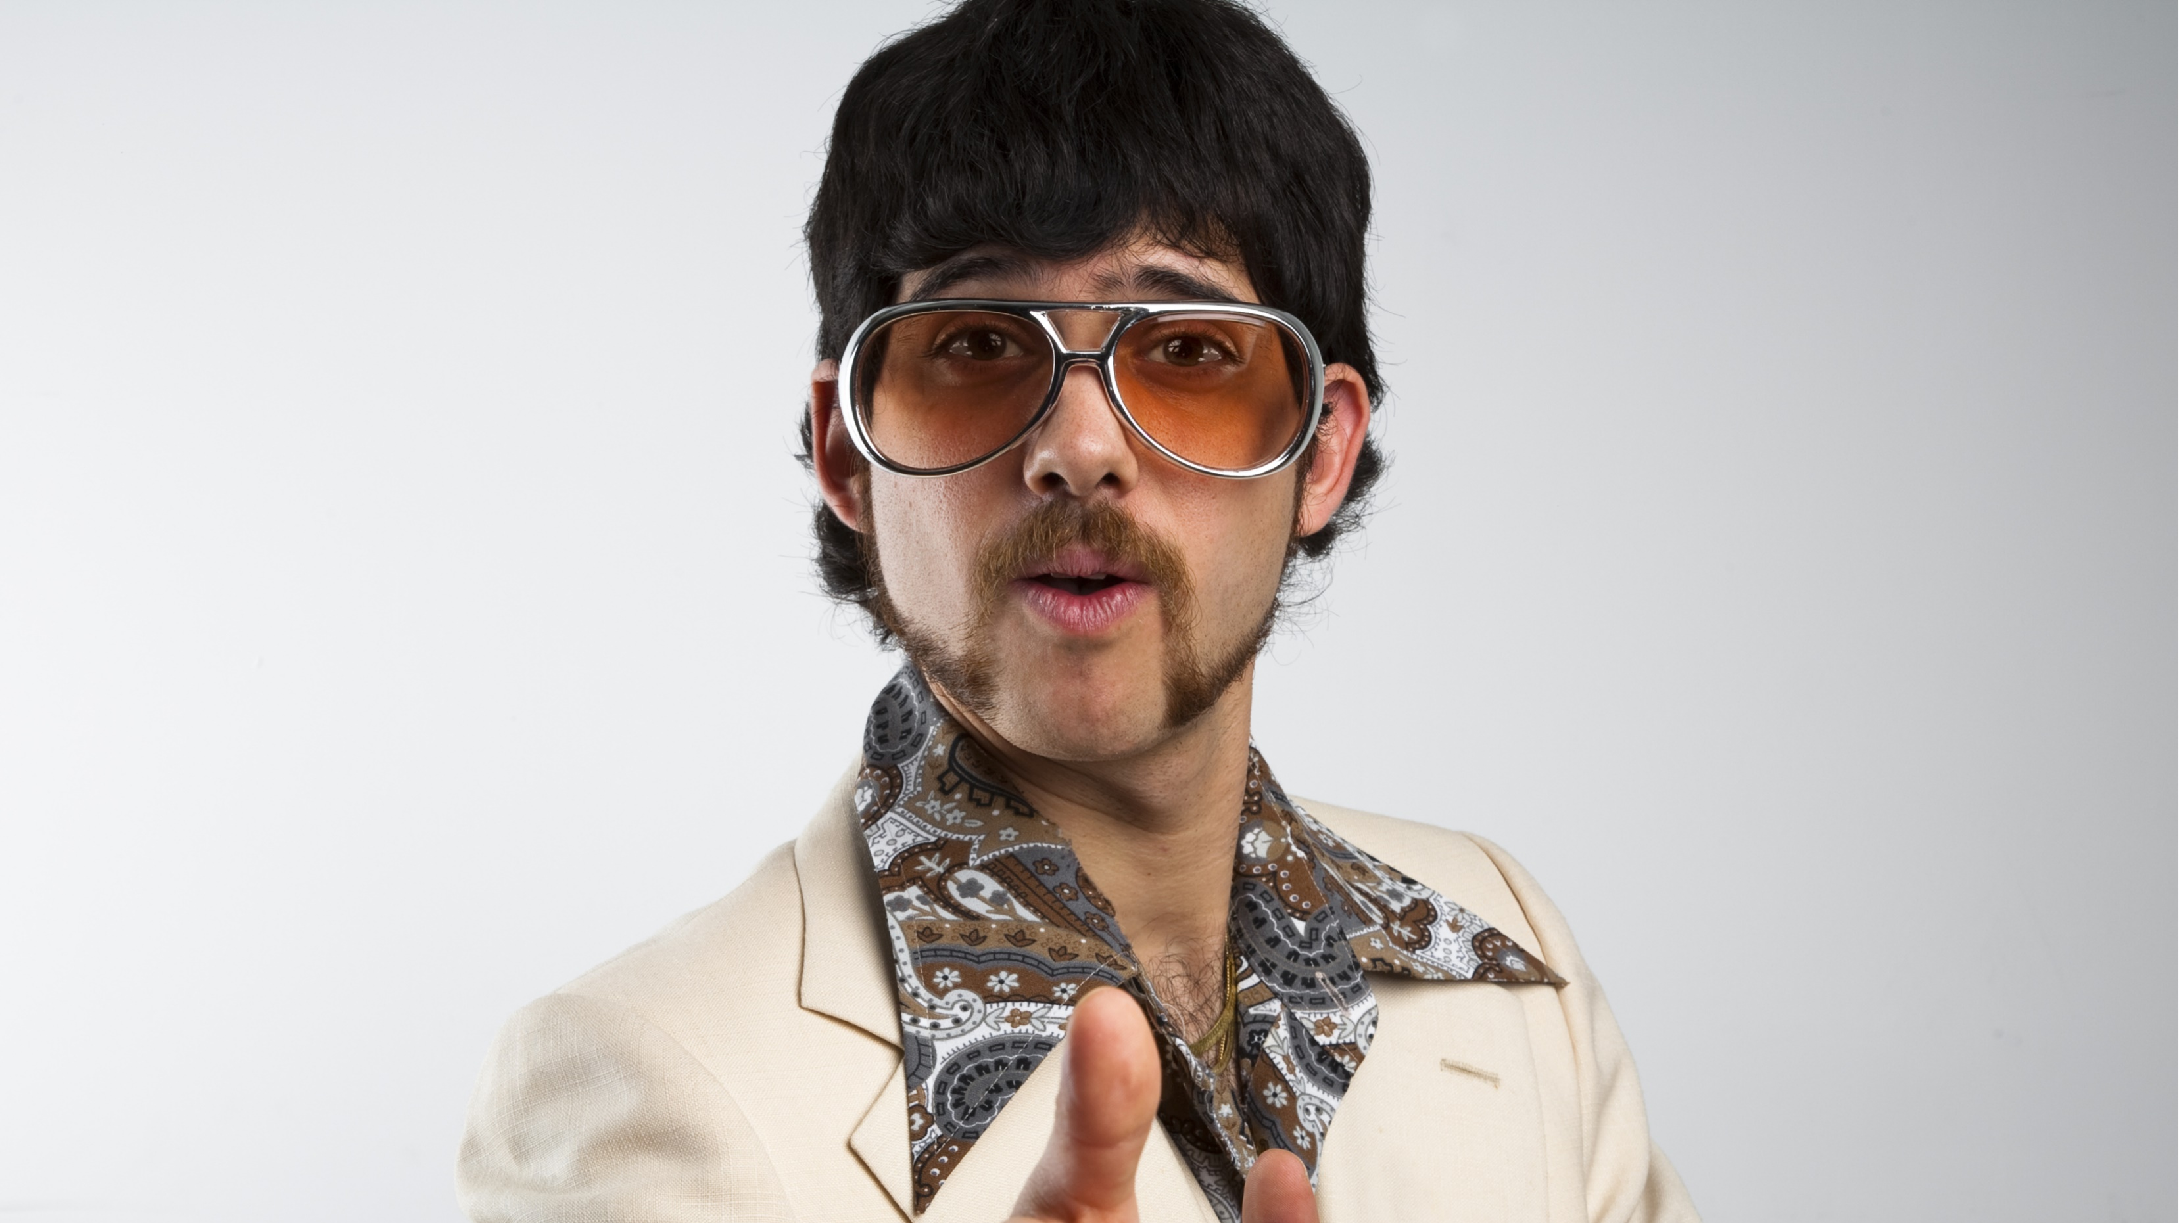

Slide 7
Five Requirements of a Great LinkedIn Profile
Professional Photo
Story-Telling Background Image
Customer-Centric Headline
Conversational and Real Summary
Updated Information

Slide 8
Time to take action…

